Slide 1

Xerxes
6. Salamis

Slide 2
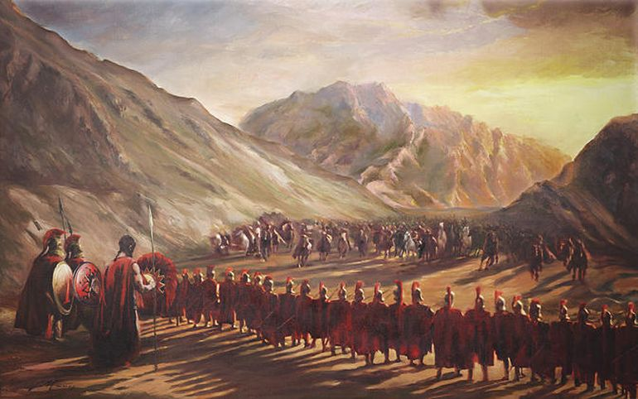
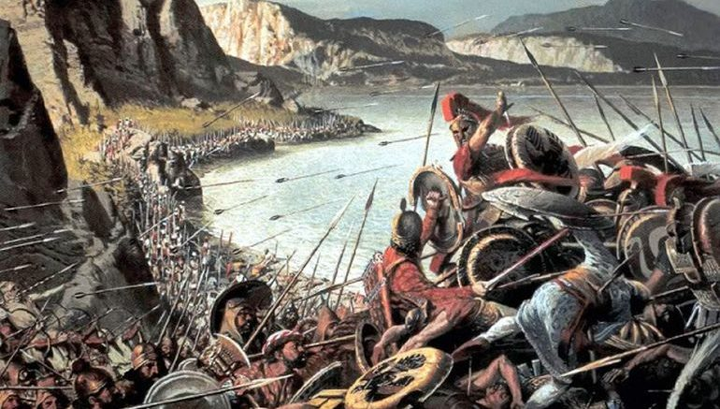
Outline the key features of why the Spartans lost the Battle of Thermopylae.

Slide 3
Copy and Complete the paragraph
The first battle of the Persian wars, that included King Xerxes, was the Battle of Thermopylae, which took place in 480. Xerxes had decided to march against Greece to avenge the loss of his father Darius at the Battle of Marathon in 490.
The Greeks forces at the battle were lead by King Leonidas of Sparta. He had not been joined by other forces from Greece, or Sparta, the Spartan forces had been held back because of a religious festival that was taking place at the time of Xerxes’ invasion. Leonidas and his troops, of which there were 300 men, held a small strip of land known as the Hot Gates. The Greeks managed to hold Xerxes off for 3 days, however they were ultimately betrayed by a local Greek called Ephialtes, who told the Persian of a secret path that would allow them to surround the Greeks.
The Persians usually respected the bodies of the dead, however Xerxes was so angry that on this occasion he ordered the body of Leonidas to be beheaded and the head to be placed on a pike for all others to see. With that, Xerxes continued on into Greece, and towards Athens…
Leonidas path Thermopylae Marathon 480 Darius surrounded Sparta 490 beheaded festival Ephialtes
Hot Gates 300 pike 3

Slide 4
Copy and Complete the paragraph
The first battle of the Persian wars, that included King Xerxes, was the Battle of Thermopylae, which took place in 480. Xerxes had decided to march against Greece to avenge the loss of his father Darius at the Battle of Marathon in 490.
The Greeks forces at the battle were lead by King Leonidas of Sparta. He had not been joined by other forces from Greece, or Sparta, the Spartan forces had been held back because of a religious festival that was taking place at the time of Xerxes’ invasion. Leonidas and his troops, of which there were 300 men, held a small strip of land known as the Hot Gates. The Greeks managed to hold Xerxes off for 3 days, however they were ultimately betrayed by a local Greek called Ephialtes, who told the Persian of a secret path that would allow them to surround the Greeks.
The Persians usually respected the bodies of the dead, however Xerxes was so angry that on this occasion he ordered the body of Leonidas to be beheaded and the head to be placed on a pike for all others to see. With that, Xerxes continued on into Greece, and towards Athens…

Slide 5
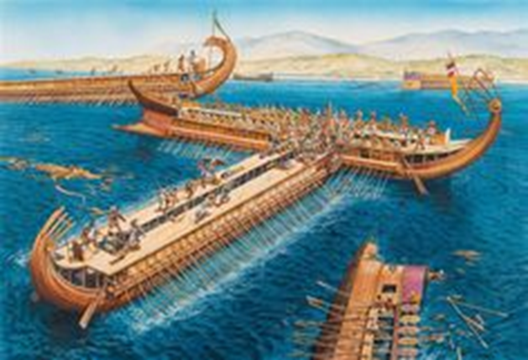
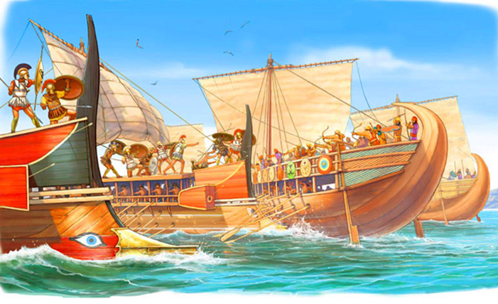
February 27, 2020
The Battle of Salamis
Lesson Objectives:
L.O. to understand and explain the key points of the Battle of Salamis
L.O to practise and perfect 6marker exam questions ‘outline key features’.
RRR: Key events of the Battle of Salamis

Slide 6
Persian actions after Thermopylae and the sack of Athens
At the same time that the battle of Thermopylae was being fought, Persian and Greek navies had been engaging in skirmishes off the coast of Cape Artemisium. After the Persians had won at Thermopylae, the Greeks ships fled back south, and the Persian lazily followed them. Marching on land, was the Persian army, who brutally sacked every city they encountered who had NOT supported them when they asked for earth and water. However, they happily spared those who had already submitted to them.
Thanks to the work of Athenian politician Themistocles, the city of Athens was already mostly empty of people, as Themistocles had managed to convince the people that a prophecy from the oracle at Delphi meant there only hope of survival was to leave Athens and head for the island of Salamis.
The last few people left had holed up in the Acropolis, and the Persian burnt and sacked the city as they had threatened they would...
TASK: read the section from Herodotus that covers the Persians sacking Athens.
How are the Persians portrayed (shown) in this passage?
Why might Herodotus have wanted to portray them like that?
What does this tell us of the tolerance and predictability of Xerxes as a king?
CHALLENGE: does Xerxes’ lack of respect for a religious site in Athens mirror the actions of other Kings we have studied previously?

Slide 7
When the Persians arrived at Athens it was deserted, but in the sacred Acropolis they found a few Athenians, stewards of the Acroplis, who defended themselves against the assault by fencing the acropolis with doors and logs. They had not withdrawn to Salamis not only because of poverty but also because they thought they had discovered the meaning of the oracle, namely that the wooden wall would be impregnable. They believed that according to the oracle this, not the ships, was the refuge.
The Persians took up a position on the hill opposite the acropolis, and besieged them in this way: they wrapped arrows in tar and set them on fire, and then shot them at the barricade. Still the besieged Athenians defended themselves, although they had come to the utmost danger and their barricade had failed them.
However, the Persians struggled to successfully take the Acropolis. They had to discover that in front of the Acropolis, and behind the gates and the cliff edge, was a place where no one was on guard, since no one thought any man could go up that way as it was too step. Here some men climbed up, near the sacred precinct, although the place was a sheer cliff. When the Athenians saw that they had ascended to the acropolis, some threw themselves off the wall and were killed, and others fled into the chamber.
The Persians who had come up first turned to the gates, opened them, and murdered the servants. When they had levelled everything, they plundered the sacred precinct and set fire to the entire acropolis.
Levelled = destroyed/ flattened Acropolis = scared building in the centre of Athens impregnable = no one can get in

Slide 8
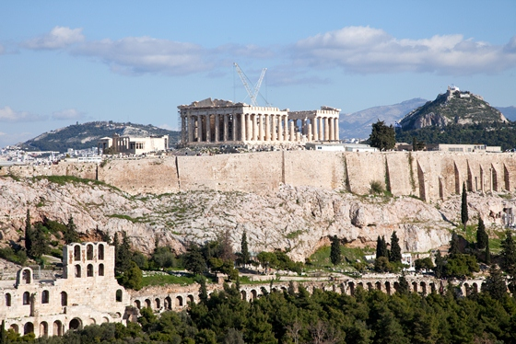
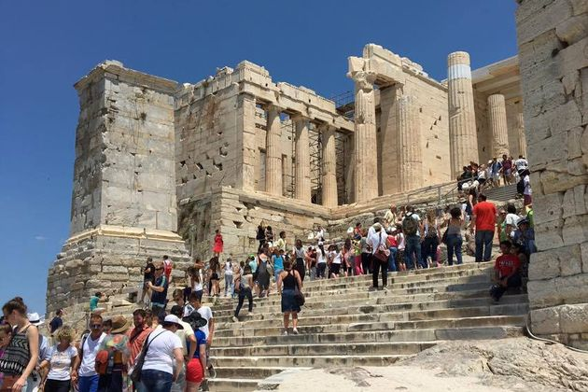

Slide 9
The Battle of Salamis - overview
TASK: watch the recap video and use what you learn the complete the following spider diagram below.
CHALLENGE: to what extent was Themistocles pivotal in the success of the Greeks at Salamis?
Why were the Greeks able to win?
Which were the main forces in Greece opposing the Persians?
What mistakes did Xerxes make while trying to lead the battle
The Battle of Salamis
What successes had the Persian empire had before the battle of Salamis?
Why was Themistocles important to the Greeks and their fight against Persia?
Notes:
https://www.youtube.com/watch?v=7uhoDZtA9PQ – watch till 9:33

Slide 10
Why were the Greeks able to win?
Which were the main forces in Greece opposing the Persians?
What mistakes did Xerxes make while trying to lead the battle
The Battle of Salamis
What successes had the Persian empire had before the battle of Salamis?
Why was Themistocles important to the Greeks and their fight against Persia?

Slide 11
Themistocles organises the Greeks, Xerxes discusses tactics with his generals
In the led up to the battle of Salamis, Xerxes had requested that his generals and tyrants gather and give their advice on whether he should engage in the sae battle or not. All of them agree to the battle, apart from Artemisia, who Herodotus presents as a voice of reason in a sea of ‘yes-men’.
Your first paragraph must give 1 of the things you can learn or infer from the source. It must use details from the source like quotes to support the point made. It must also use some detailed own knowledge (relevant detail that is not from the source) to explain further the point made. | One thing I can learn from the passage about…………… is … This is evidenced from the passage when it says … We know that…
TASK: read the extract covering Artemisia’s conversation with Xerxes, and practise writing one point from a 10marker question, using the section from the question strip
Using the passage and your own knowledge, what can we learn about Xerxes as a leader?
CHALLENGE: expand your practise answer by making another point.
Is there evidence (from previous lessons) to challenge any assertion you've made about Xerxes from this passage?

Slide 12
Artemisia responds to Xerxes’ request for advice on whether he should engage in a sea battle with the Greeks or not. Xerxes respects her opinin, but ultimately goes against her advice.
Xerxes came and sat on his throne, and present at his summons were the tyrants of all the peoples and the company leaders from the fleet. They sat according to the honour which the king had granted each of them. When they sat in order one after another, Xerxes sent Mardonius to test each by asking if they should fight at sea.
Mardonius went about questioning them, and all the others were unanimous, advising to fight at sea, but Artemisia said, “Tell the king, Mardonius, that I say this: ‘Master, it is just for me to declare my real opinion, what I consider to be best for your cause. And I say to you this: spare your ships, and do not fight at sea. Their men are as much stronger than your men by sea as men are stronger than women. Why is it so necessary for you to risk everything by fighting at sea? Do you not possess Athens, for which you set out on this march, and do you not have the rest of Hellas? No one stands in your way. Those who opposed you have received what they deserved”.

