Slide 1

Xerxes
7. Eurymedon

Slide 2
Starter:
Who led the Greek forces at Thermopylae?
Which Persian soldiers were sent in first by Xerxes at Thermopylae?
How did the Persians find out about the secret path at Thermopylae?
Name an adviser who gave Xerxes good advice.
How many bridges did Xerxes build over the Hellespont?
Who was the leader of the Greek fleet at Salamis?
What did Xerxes do to Athens once he captured it.
Which queen advised Xerxes not to fight at Salamis?
Apart from Herodotus, who is the other source of information about Salamis?
How did Themistocles trick Xerxes at Salamis?

Slide 3
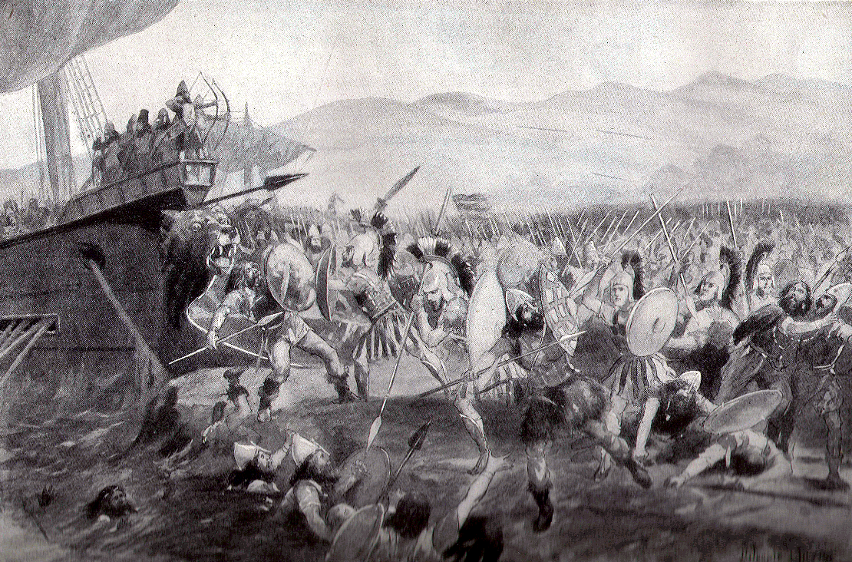
The Battle of Eurymedon
Lesson Objectives:
To know the details and outcome of the Battle of Eurymedon in the 460s.
To analyse the reasons why Xerxes invasion of Greece failed.

Slide 4
In 480BC the Persian fleet was decisively defeated at Salamis by the Greek fleet led by Themistocles and the Athenian navy.
The Persian fleet withdrew back to Asia Minor and Xerxes returned to Persia. His commander Mardonius was left behind with a Persian army to try and complete the conquest of Greece.
In 479BC the final battle of the 2nd Greco-Persian war took place between Mardonius’ Persian force and the Greeks at Plataea. The Persians were crushed and Mardonius was killed.
After their victory the Greeks formed the Delian League. This was an alliance to protect against another Persian invasion led by the Athenians.
In fact the Delian League took the fight to the Persian Empire and won some victories against them at places like the Hellespont, Thrace and Cyprus.

Slide 5
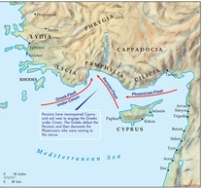
Battle of Eurymedon c.466
The Athenian admiral Cimon defeated the Persians in c.468 in a double battle. During the day, he defeated the Persian navy at the estuary of the Eurymedon (near Aspendus) and during the night, he unexpectedly attacked the camp of his enemies.
At the Persian court, the news of the defeat created great unrest, and if we are to believe the Greek historian Diodorus, king Xerxes was murdered as a consequence of his army's defeat.
However, this is impossible (he died three years later), but it was an important event nonetheless.
THE GREEKS
The Delian League
Led by Cimon
200 triremes
THE PERSIANS
Led by generals and satraps
Xerxes was not present
Up to 350 triremes

Slide 6
Task 2 - Eurymedon
Use the OCR textbook p62-63. Answer the following questions;
Who does the historian credit with the Greek victory at Eurymedon?
What are the problems with the other 2 sources about the Battle of Eurymedon?
Why does Plutarch claim the battle was an important one?
Why do you think the Persians never threatened Greece or its islands after the battle?
When did Xerxes die and what did his successor decide to do?
CHALLENGE: Salamis was a more significant battle than Eurymedon, in terms of deciding the failures of the Persians in their war against Greece. How far do you agree with this statement?

Slide 7
Task 3 – Xerxes in Greece
Xerxes’ attempts to take Greece have included a number of key events; bridging the Hellespont, battle of Thermopylae, Sacking of Athens, battle of Salamis, his fleeing back to Persia and battle of Eurymedon.
TASK: create a 5-stage board accounting the Xerxes’s actions in Greece.
CHALLENGE: EXPLAIN why had Xerxes failed to conquer Greece?
THINK ABOUT:
Problems with Xerxes’ leadership
Issues within the Persian military
The role of Greek leaders like Leonidas and Themistocles
Any other factors you think were important

Slide 8
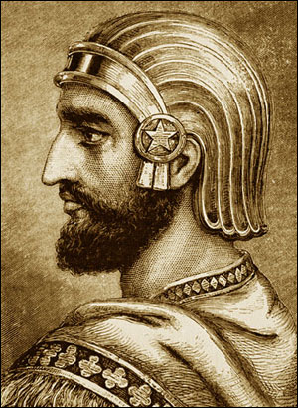
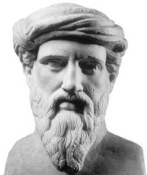
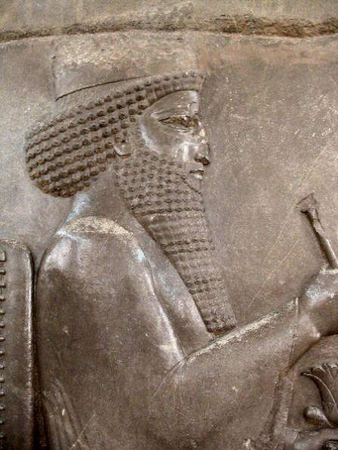
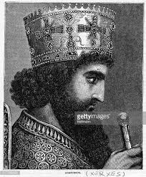
Plenary
Who was the greatest Persian king militarily?
Who was the greatest Persian king in terms of ruling his empire effectively?
Who was the greatest Persian king in terms of keeping his subjects happy?
CYRUS
CAMBYSES
DARIUS
XERXES

