Slide 1
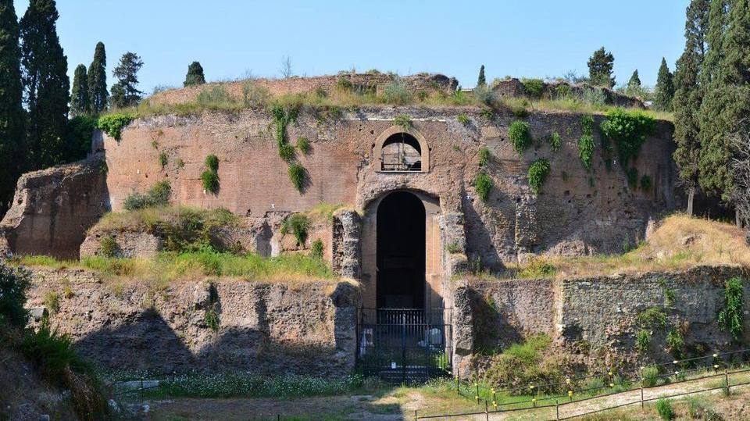


Death In The Ancient World

Slide 2
What can burials and tombs tell us about the dead?
Who is buried (i.e. their status)
Religious beliefs
Age (may be shown on a tombstone)
Who is honouring the dead
Personality

Slide 3
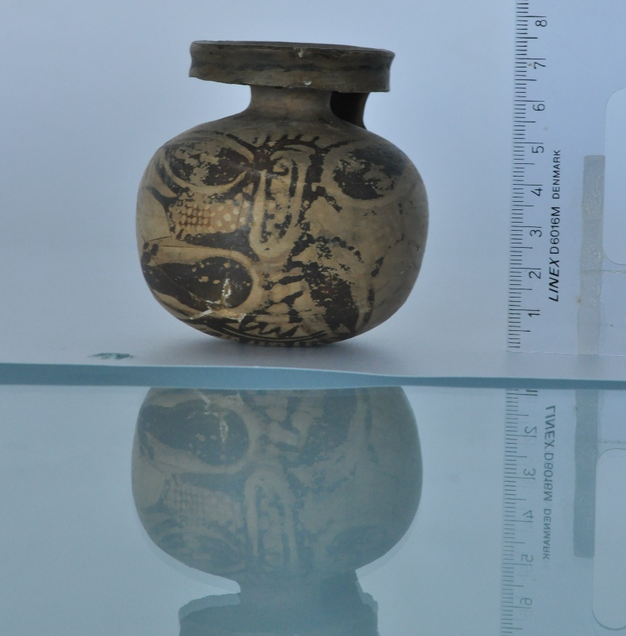
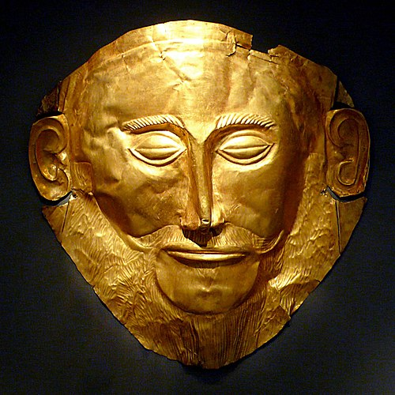
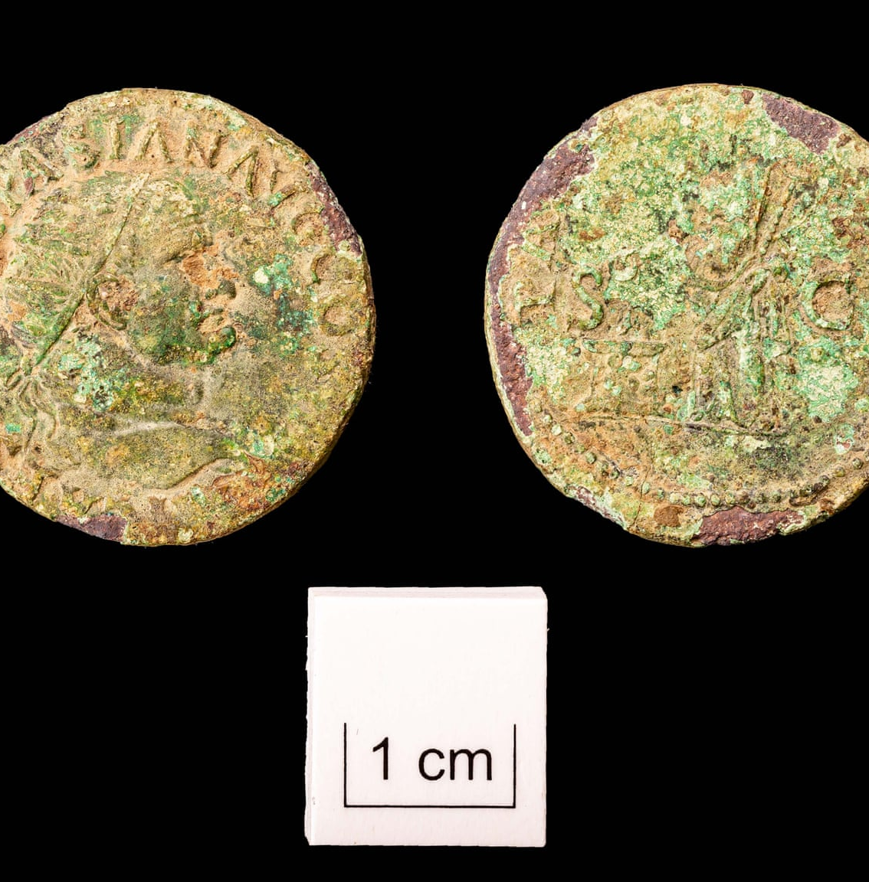
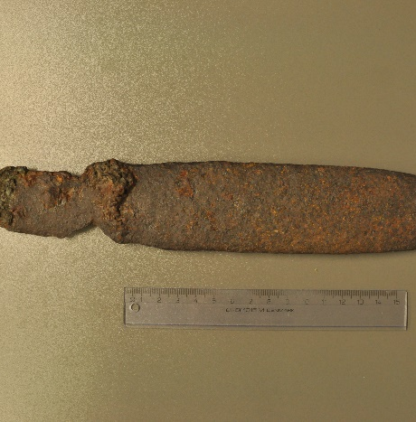
What would you find in an ancient grave?

Slide 4
Where did the Romans and Greeks bury their dead?
Greece
Mass burial (Marathon Tumuli)
Group burials, such as Grave Circle A
- outside of main settlement, often multiple burials within one grave
Individual burials in cemetery outside city walls
- Athenian burial grounds found in outer Kerameikos
Rome
Columbarium
- the funerary urn could be placed in a columbarium (public storage facility for urns)
Catacombs
-underground gallery of tombs

Slide 5
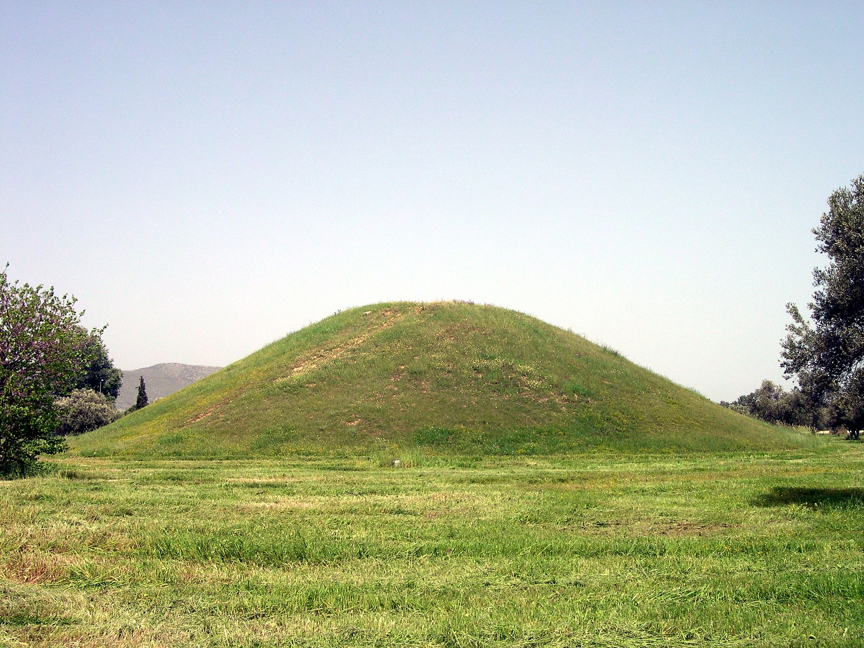
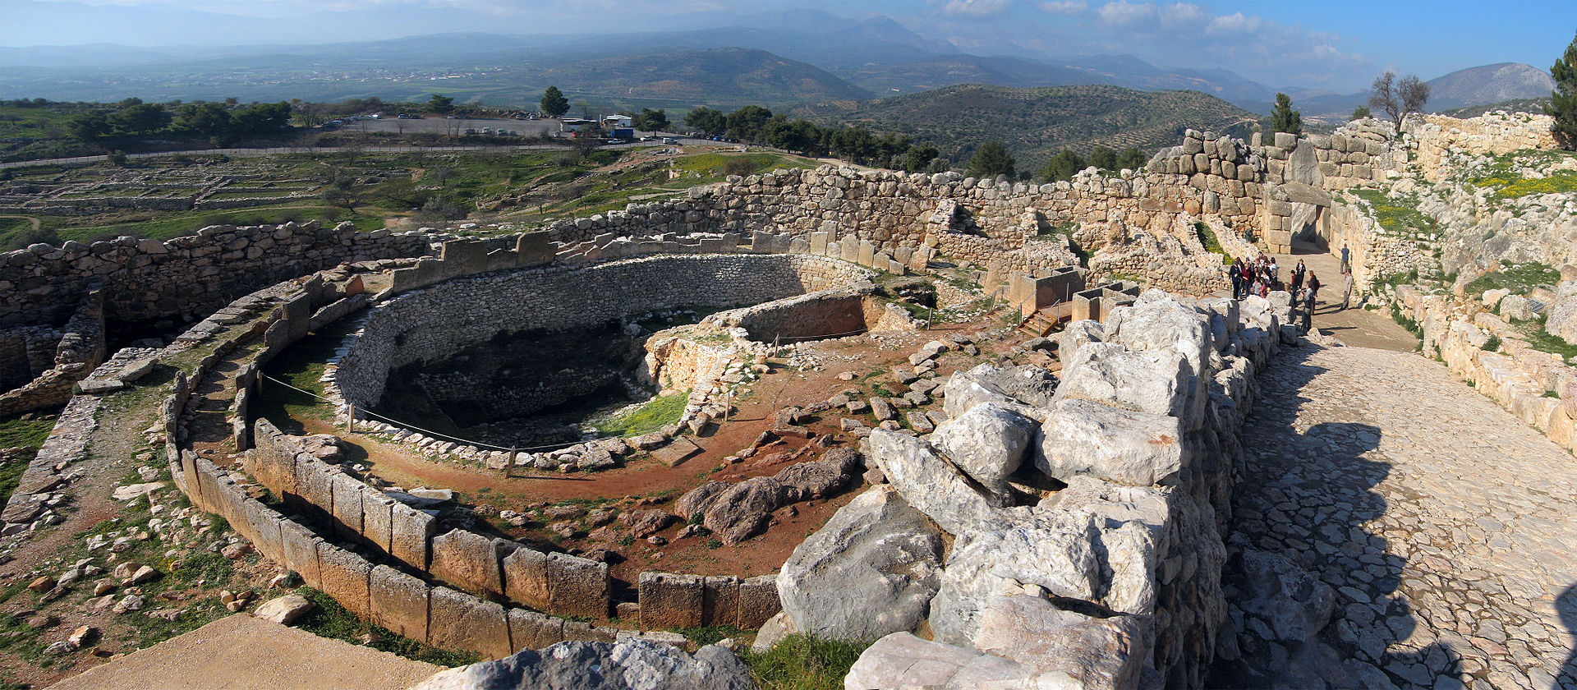
FAMOUS Greek Graves
(Left)Tumulus (burial mound) of the Athenians at Marathon. At Marathon in 490BC the Greeks defeated the invading Persians.
(Below) Grave Circle A at Mycenae from 16th century BC where the so-called Mask of Agamemnon was discovered.

Slide 6
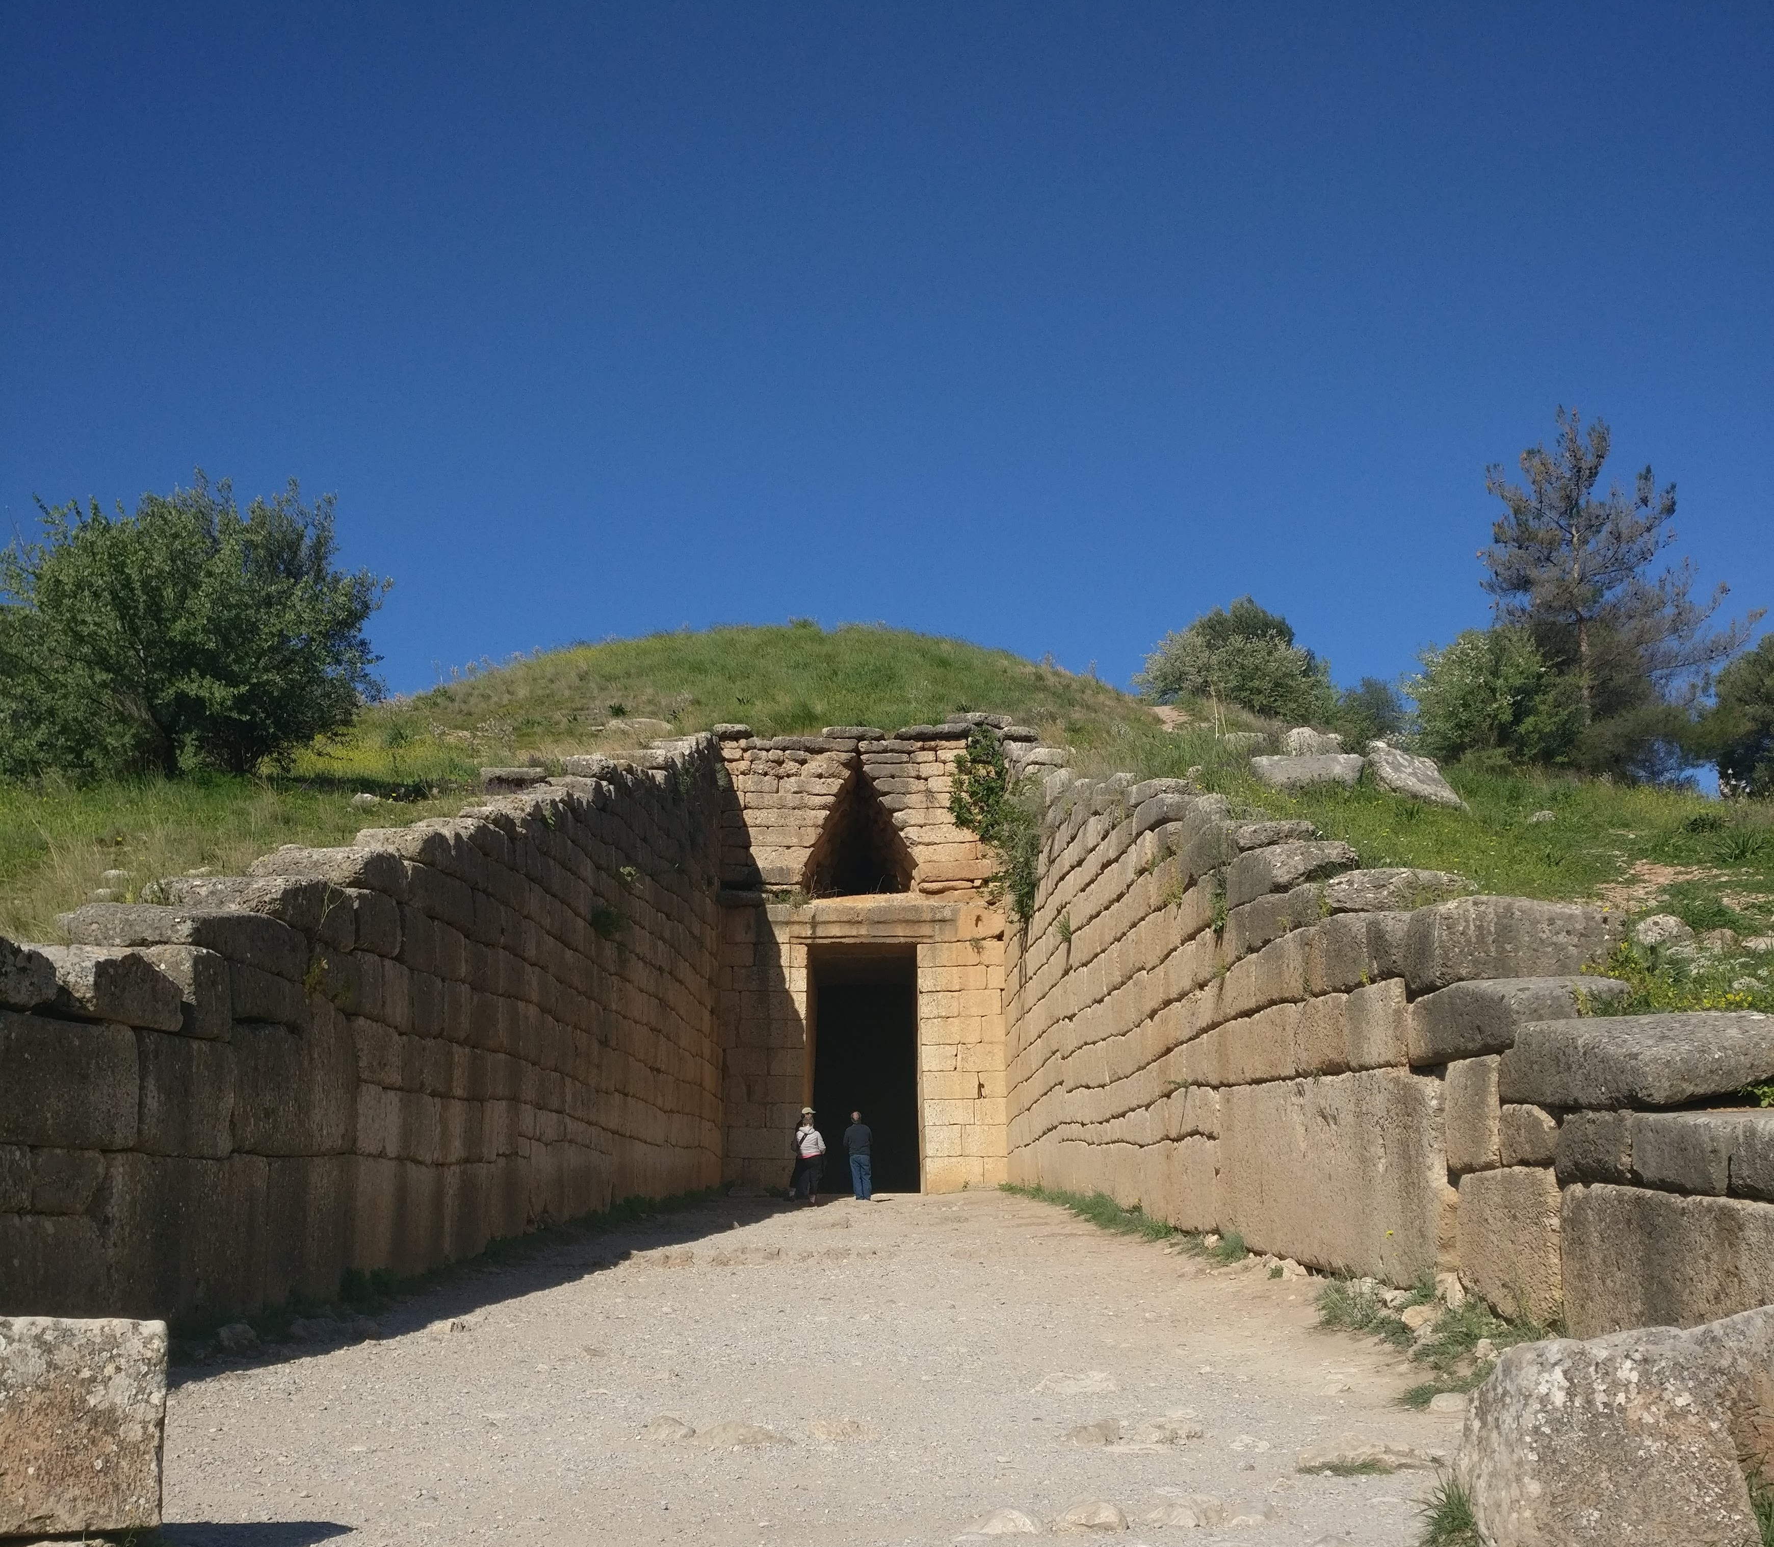
Different types of Greek graves
Early Greek Graves: Cist graves
- a simple dug-out pit
Shaft graves
Tumuli (mounds)
Chamber tombs
Tholoi (vaulted chamber)
Treasury of Atreus, c. 1250 BC, Mycenae (Greece)

Slide 7
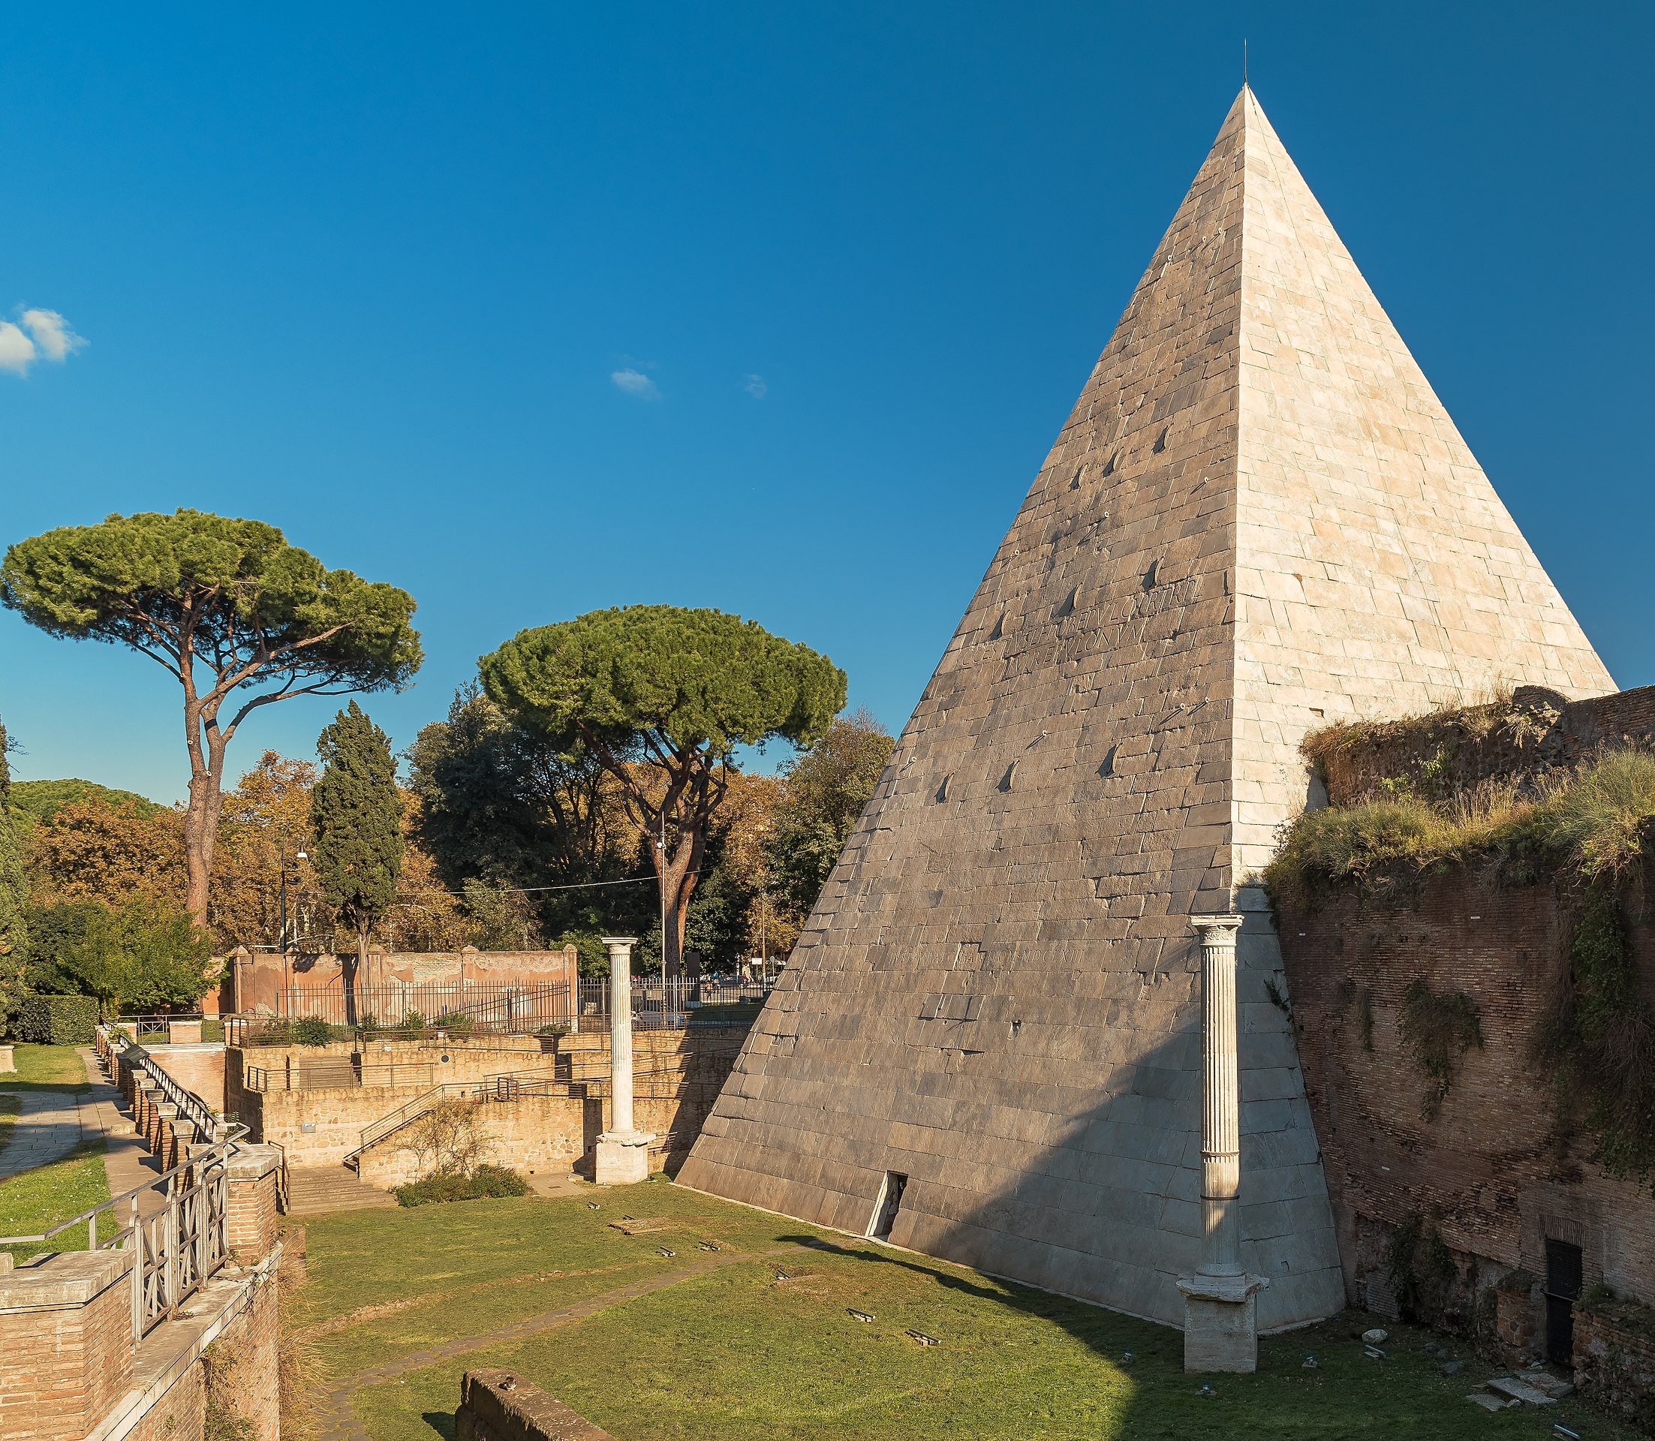
Different types of Roman burials
Mausoleum
Catacombs
Columbaria (where cremations were stored)
Pyramid
Sarcophagi
Pyramid of Cestius, 1st Century BC, Rome

Slide 8
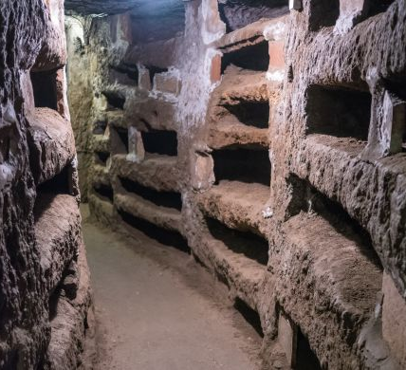
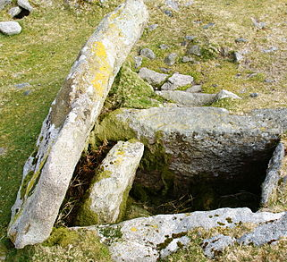
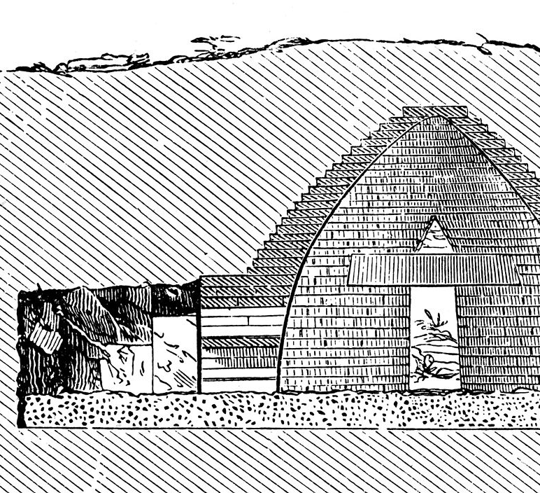
Guess the tomb!

Slide 9
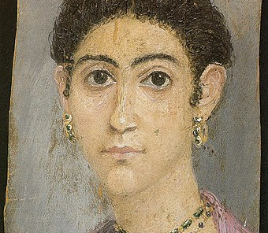
As well as Egyptian- inspired burials, funerary portraits were often Egyptian style
(e.g. Fayum portraits)
Portrait of a woman on limewood, c. 100-120 BC, Fayum, Hawara (middle Egypt)

Slide 10
"For it’s all wrong for a man to deck out his house when he’s alive, and then have no pains taken with the one he must stay in for a longer time”
Petronius, Satyricon

Slide 11
Roman Tombstone
Inscriptions
Calling upon the spirits of the dead: the Manes
Names of the dead (Lucius Caecilius Iucundus)
Job title
If the deceased was female, they often had character-based complements
Age
Who set up the monument
Heirs

Slide 12
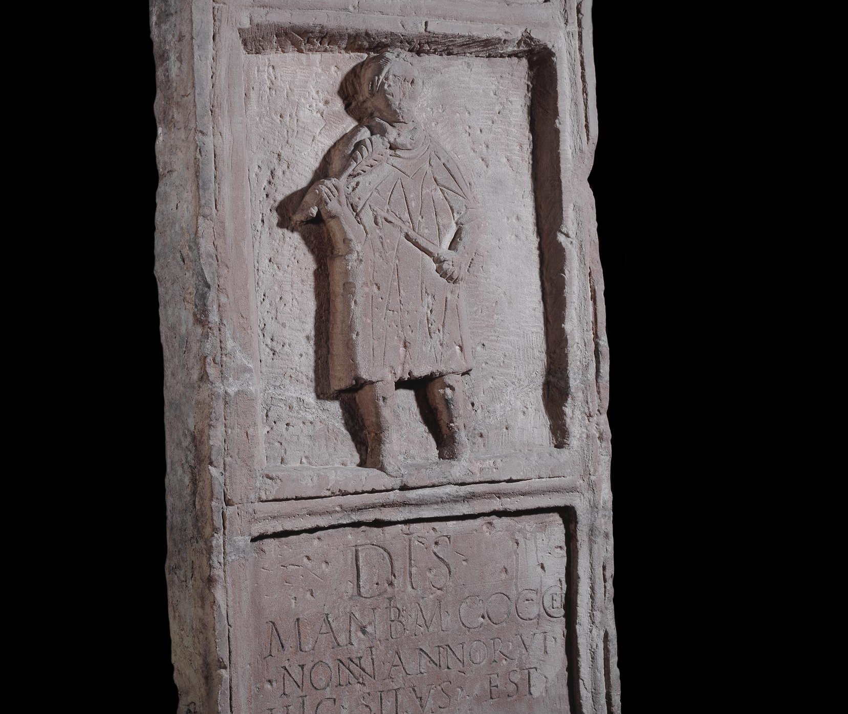
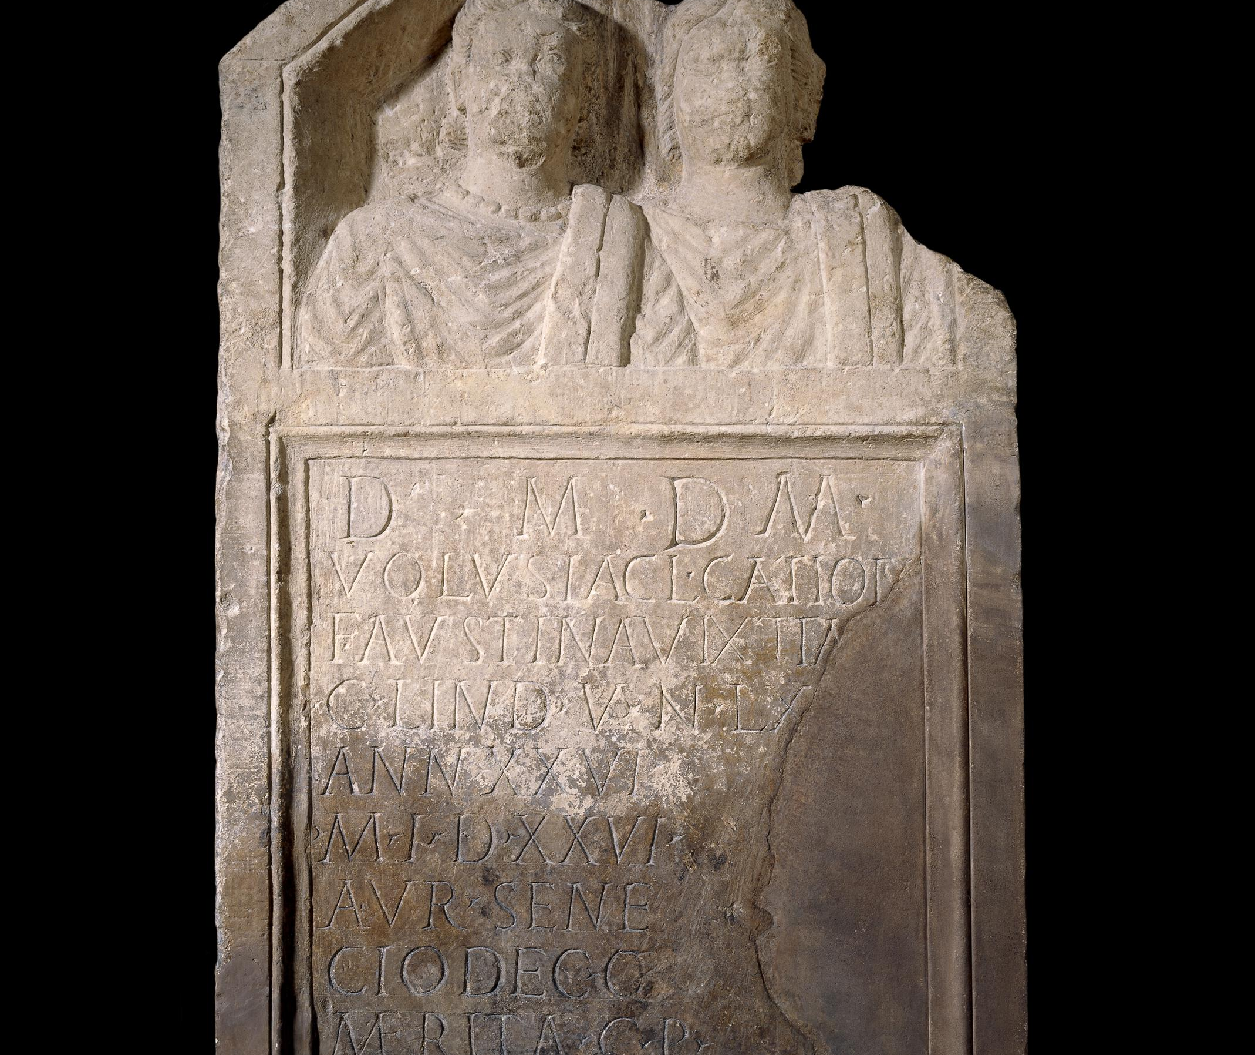
Roman Tombstones

Slide 13
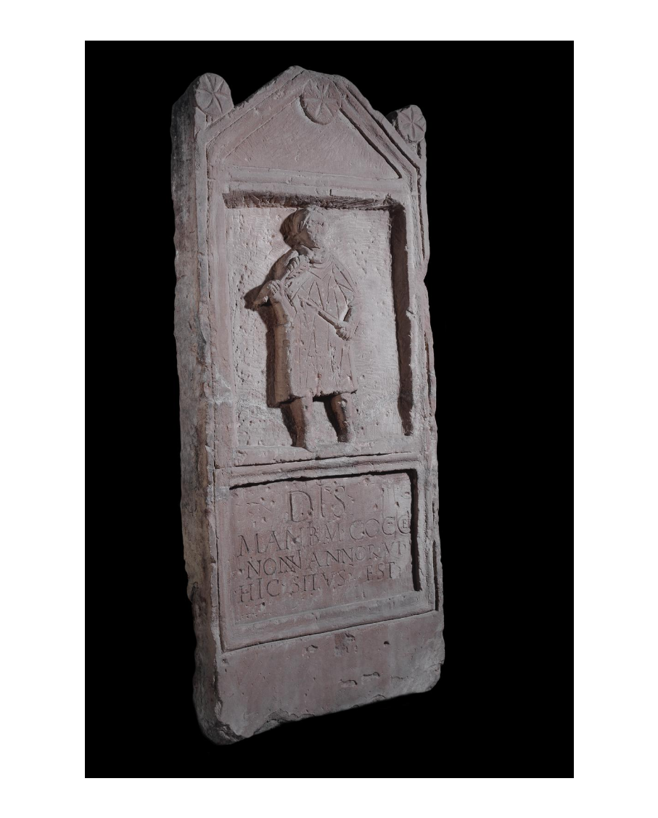
  Tombstone of six year old boy, Marcus Cocceius Nonnus.
  At the top, in the pediment, it was carved with three rosettes. The figure of the deceased boy holds a palm-branch in his right hand, and a whip in his left, as if victorious in a chariot race (this hints at what he could have become).
  Late C1st to early C2nd AD Inscription: To the Spirits of the dead of Marcus Cocceius Nonnus, 6 years of age. He lies here.
  Image shows that there were multiple misspellings on the tombstone that were carved over

Slide 14
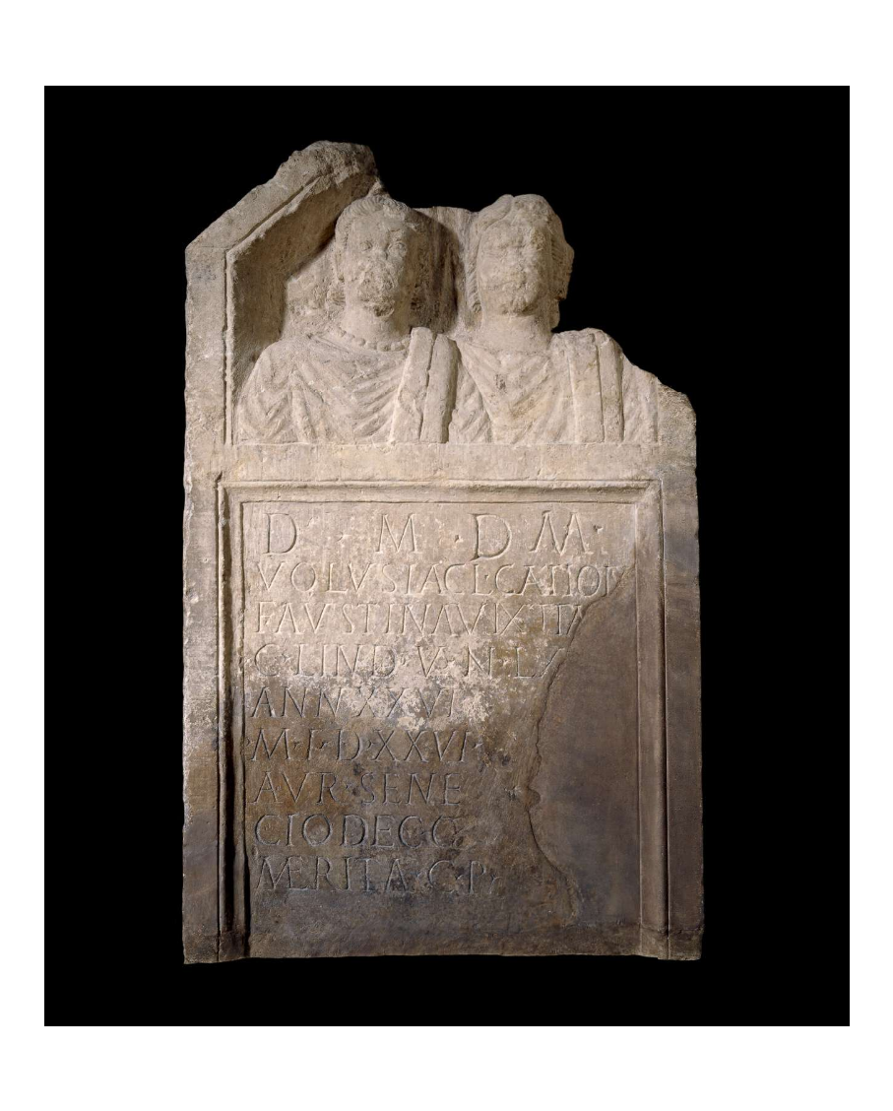
Roman Tombstone from Lincolnshire
Dates from 3rd century AD
This is the stone tombstone of Volusia Faustina and Claudia Catiotu[a].
The tombstone comprises a rectangular inscription panel surmounted by the portrait busts of the two women set side by side
If you were a Roman Briton, what would you want on your tombstone?

Slide 15
Funerals
Rome
inhumation (burial)
cremation
eulogy (speech about the dead person)
sacrifice
libations (pouring wine on the gave in honour of the dead)
greece
Prothesis (preparing the body)
Ekphora (funeral procession)
Inhumation (burial)

Slide 16
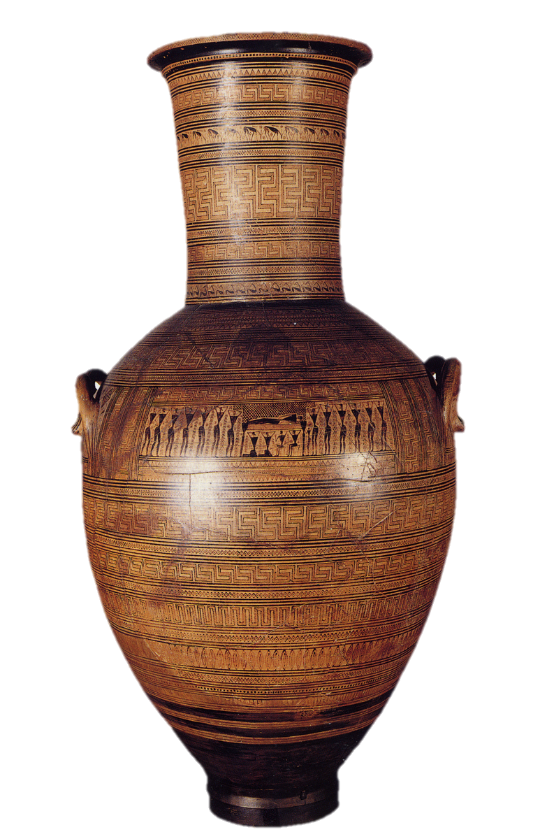
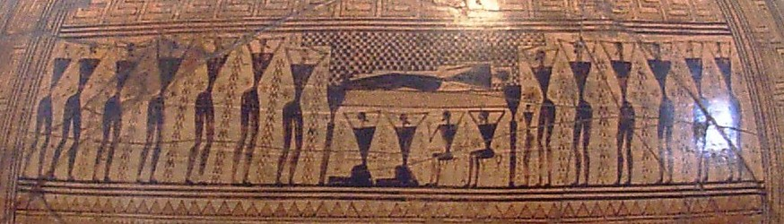
GREEK
FUNERALS
Prothesis
The Dipylon Amphora, ca. 750BC, National Archaeological Museum, Athens – shows the prothesis (laying out) of the body during an ancient Greek funeral (detail of scene, above)
The scene shows many mourners

Slide 17
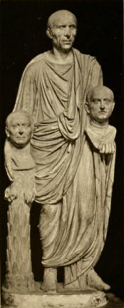
Commemoration
Roman
Imagines
- statues of ancestors displayed within the atrium of the household
Parentalia
- A 9 day festival where gifts were given to the dead ancestors
Greek
Stele (gravestones)
- famous example e.g. the grave Stele of Hegeso
Libations
- pouring drinks for the dead
Togatus Barberini, 1st Century AD, Rome

Slide 18
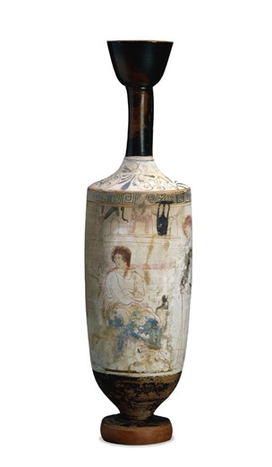
Lekythoi
Commonly used as a perfume bottles, storing scented oils
No spout= not intended for pouring
Often used white ground technique
Found at burial sites containing the ashes of the dead - oil from such vessels could also be used to anoint the bodies
White-ground Lekythos, c. 420-400 BC, Greece

Slide 19
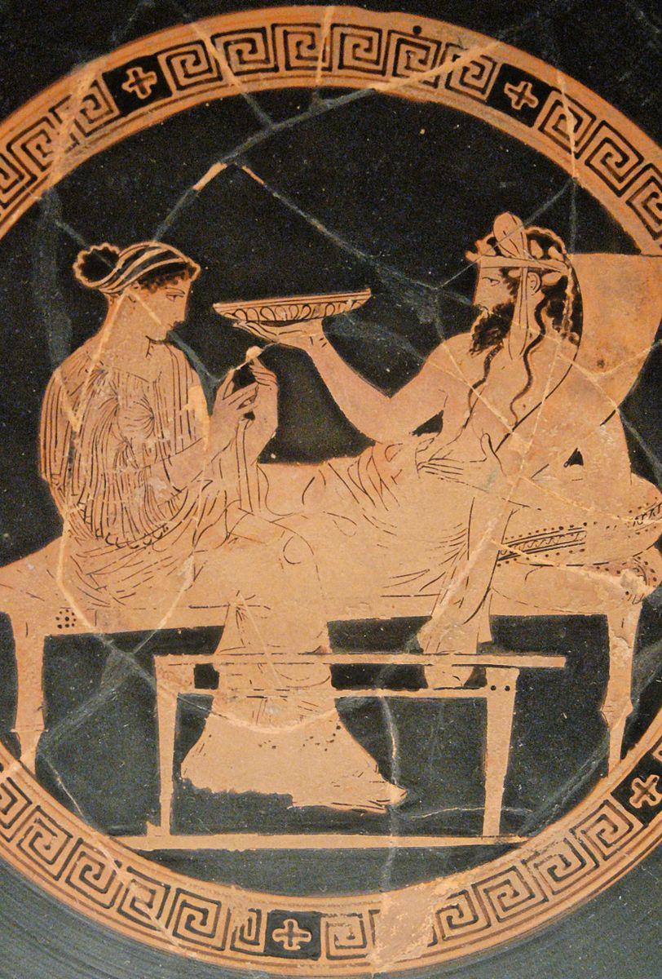
The Underworld- what do you know?
Hades/Pluto (god of the underworld)
Persephone /Proserpina (queen of the underworld/spring and rebirth)
Afterlife
Different areas of the underworld (e.g.Tartarus)
https://youtu.be/RhaepLsP5eg : Orpheus and Eurydice
Persephone and hades red-figure kylix, c. 430BC, Greece

Slide 20
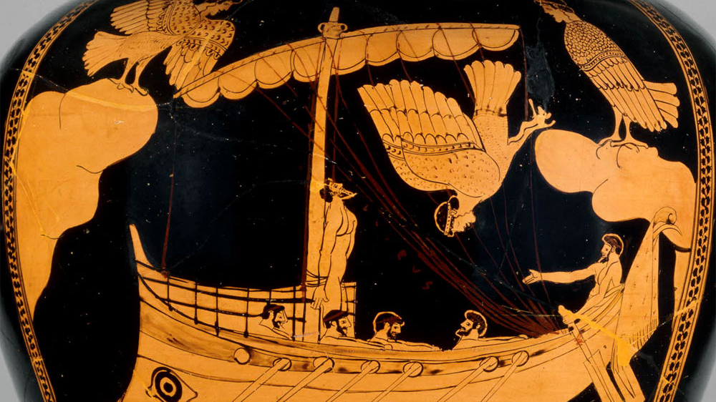
Finding tales of the underworld in literature
Homer, Iliad, Book 23. 71-76
“Bury me as quickly as can be, so that I can pass through the gates of Hades. The ghosts…are keeping me away, they will not let me cross the river to join their number, but I am left wandering in vain along the broad-gated house of Hades”
Virgil, Aeneid, Book 6
- “These are the rivers and waters guarded by the terrible Charon in his filthy rags. On his chin there grows a thick beard, never trimmed. His glaring eyes are lit with fire…”
- “They entered the land of joy, the lovely glades of the fortunate woods and the home of the blest… Some take exercise on the grassy wrestling grounds… Others pound the earth with dancing feet and sing their songs…”
Red figure stamnos of Ogysseus and the Sirens, c. 480 BC, Greece

Slide 21
MUSEUMS TO VISIT
Fitzgerald museum (Cambridge)
British Museum
Museum of London
Museum of London
Ashmolean Museum (Oxford)

Slide 22
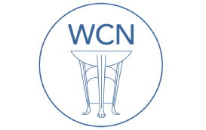
Bibliography
https://warwick.ac.uk/fac/arts/classics/warwickclassicsnetwork/stoa/classciv/gcse/myth - for more information on myth and religion
J. March, Dictionary of Classical Mythology
https://www.theguardian.com/uk-news/2020/jan/07/archaeologists-discover-graves-high-status-romans-somerton-somerset - for an example of Roman Britain burials
https://www.britishmuseum.org/collection/object/H_1969-0701-4 - for a catalogue of tombstones and ancient artefacts

