Slide 1

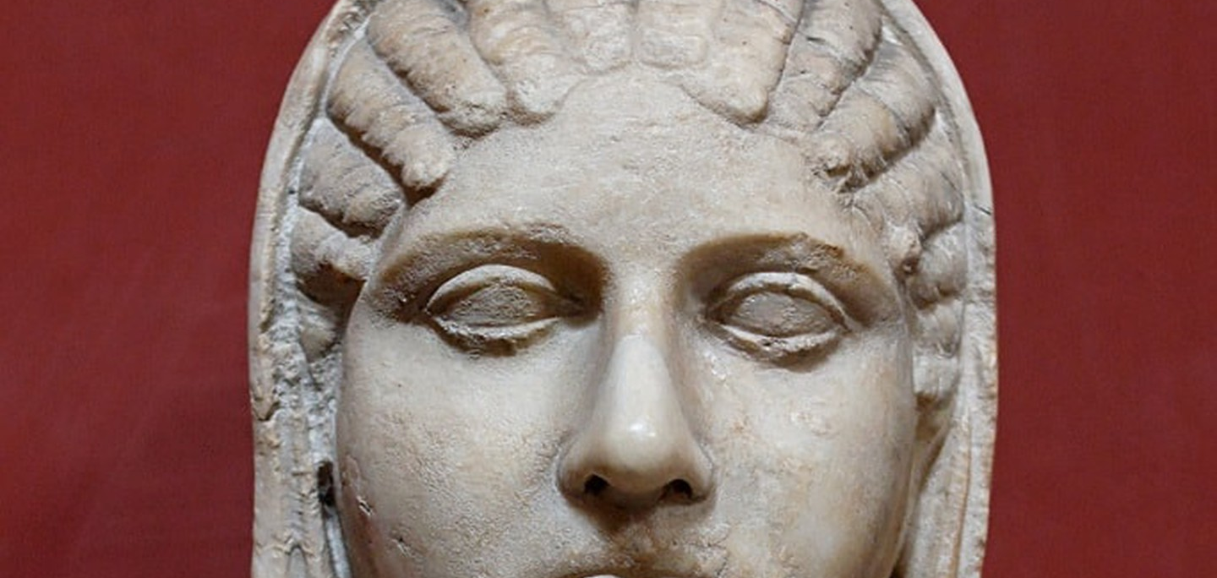


Women in Antiquity
Travelling Museum Project

Slide 2
Outline of the Session
Context
Outlining the role of the Women in antiquity
Activities
1) Design your own vessel (Aryballos)
2) Engagement Quiz
Object Handling
Guided object handling with discussion.

Slide 3
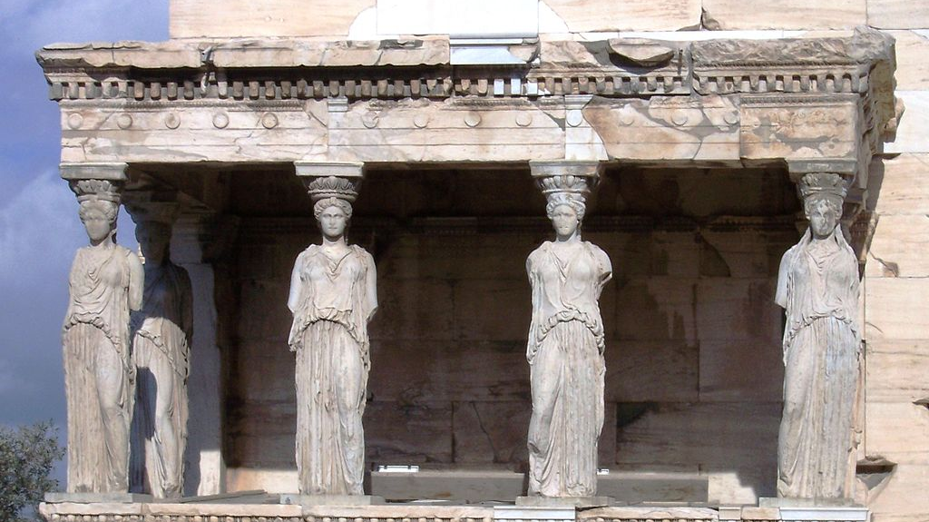
Aims of this session:
To understand the role of women in ancient civilisations focussing on Classical Greece.
To compare the lives of women in Athens to women in other communities (e.g. Sparta)
To think about what activities a woman may partake in dependant on her wealth.
Look at a variety of primary sources and discuss them.
Porch of the caryatids on the Erechtheum, Acropolis, Athens, Greece

Slide 4

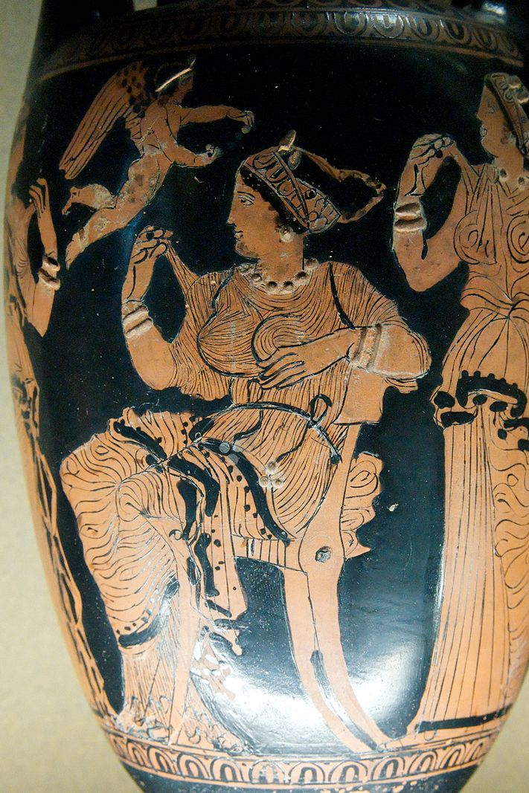
The Ideal Athenian Woman – Separation
Wealthy women were for the most part isolated from the rest of society. The ideal woman was expected to be out of the public eye and instead live inside their houses or estates. Even within the house women had their own quarters called the Gynaeceum, which further separated them.
An Attic red-figured loutrophoros depicting women in a Gynaeceum, ca 400 BC

Slide 5
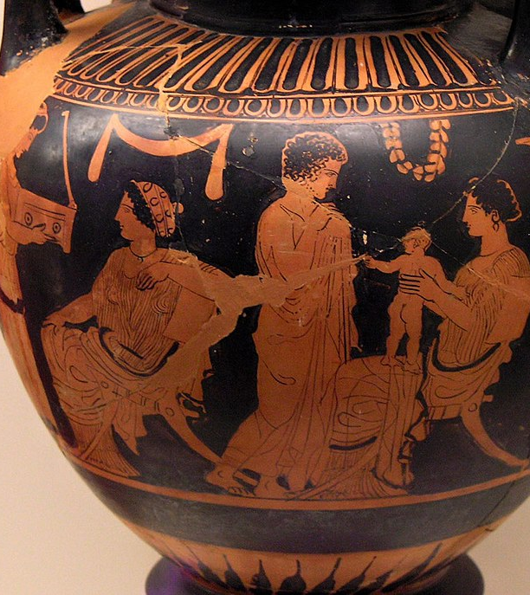
The Ideal Athenian Woman – Child-Bearing
The main purpose of marriage in Classical Athens was procreation. Sons were especially desirable. A woman who survived multiple pregnancies and reared her children to adulthood was very valuable as infant mortality was high.
Because of the infant mortality rates older women with experience commonly acted as nurses.
Familial scene in the gynaeceum. Attic red-figure lebes gamikos, c.430 BC.

Slide 6
Primary Source Discussion
  Aristotle, Politics (1254b2)
  Again, as between male and female the former is by nature superior and ruler, the latter is inferior and subject. And this must hold good of mankind in general.
  Xenophon, Oeconomicus 7, 35-37
  Your duty will be to stay indoors and dispatch those slaves whose work is outside, and superintend those who are to work indoors, and to receive what comes in and dispense as much of it as must be spent, and watch over as much as is to be kept in reserve, and take care that the amount stored up for a year is not spent in a month.
  Lysias, Against Simon, 6
  Hearing that the boy was at my house, he came there at night in a drunken state, broke down the doors, and entered the women’s rooms: within were my sister and my nieces, whose lives have been so well-ordered that they are ashamed to be seen even by their kinsmen.”

Slide 7
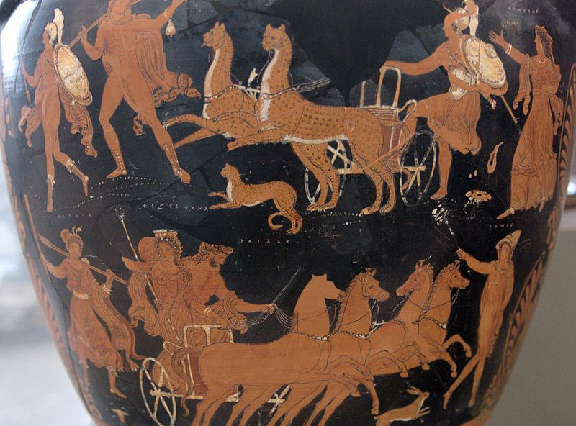
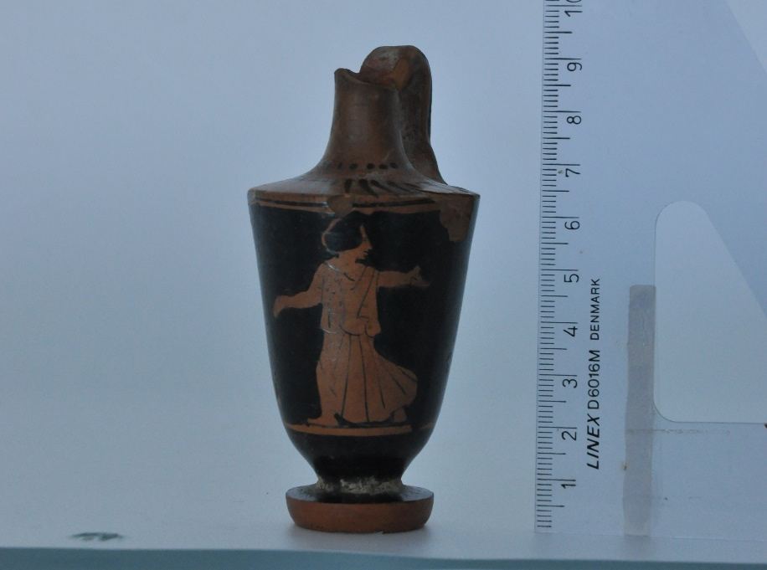
The Importance of Fertility
As childbearing was so central to women's life. Fertility festivals were popular. The most well attended being the Thesmophoria which was held in the honour of Demeter and Persephone. It was celebrated by only women.
  Does anyone know the myth of Persephone?
Side A of the “Persephone krater”, an Apulian red-figure volute-krater, ca. 340 BC.
Attic red figure Lekythos depicting a young woman, Lekythoi were often associated with funeral rites and marriage. (5th -4th Cent BC)

Slide 8

Queen Gorgo from the film 300 (2006)

Slide 9
Comparison
Athenian Women (Wealthy)
Spartan Women
Expected to stay indoors.
Main role in society is to produce children (preferably males)
Women were largely uneducated.
Women expected to dress modestly.
Girls brought up so as not to speak. Aristotle thought it natural for women to be Silent (Pol.126oa28-31)
Could inherit property and wealth.
Main role is still to produce children.
They could go outside for leisure and exercise however this was to ensure strong offspring.
Women were prescribed an educated centred on being a good mother, in order to raise strong offspring.

Slide 10
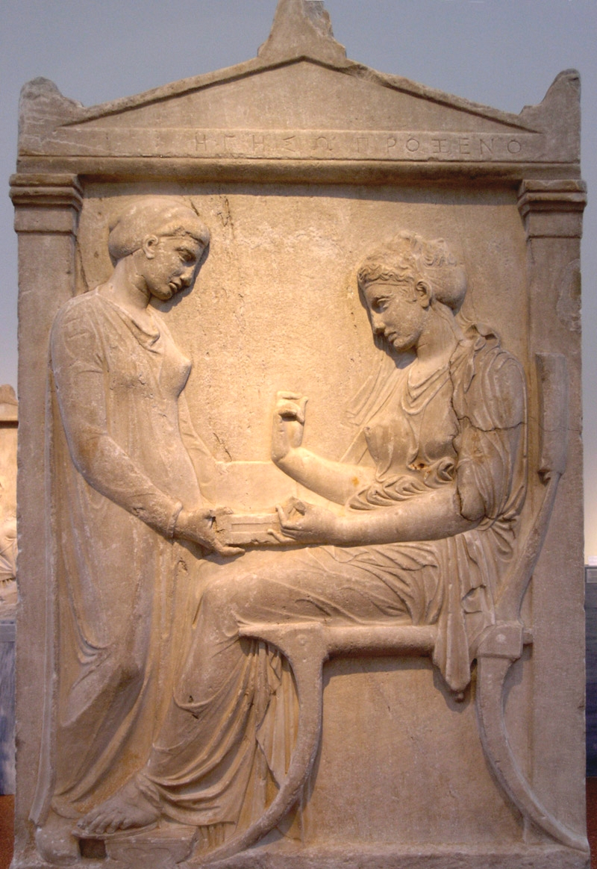
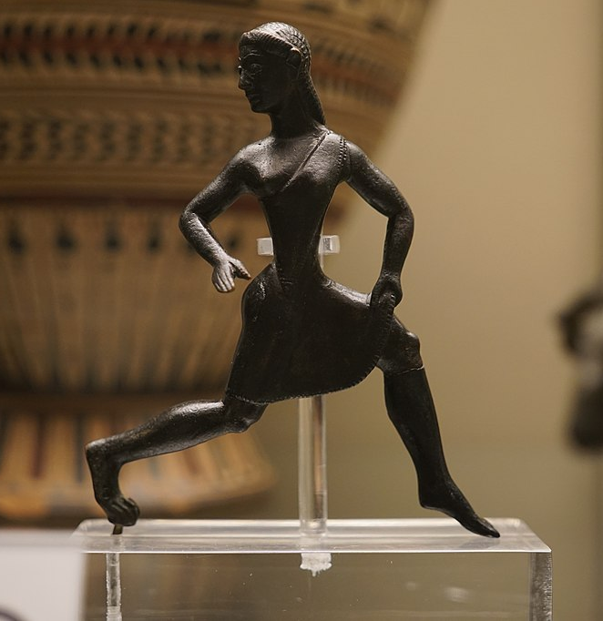
Comparison & Discussion
‘…he insisted on physical training for the female no less than for the male sex: moreover, he instituted races and trials of strength for women competitors as for men, believing that if both parents are strong they produce more vigorous offspring.’
[Xenophon, Constitution of the Lacedaemonians I.6]
The Grave Stele of Hegeso (c.410–400 BC)
Bronze figure of a running girl, (520-500 BC.)

Slide 11
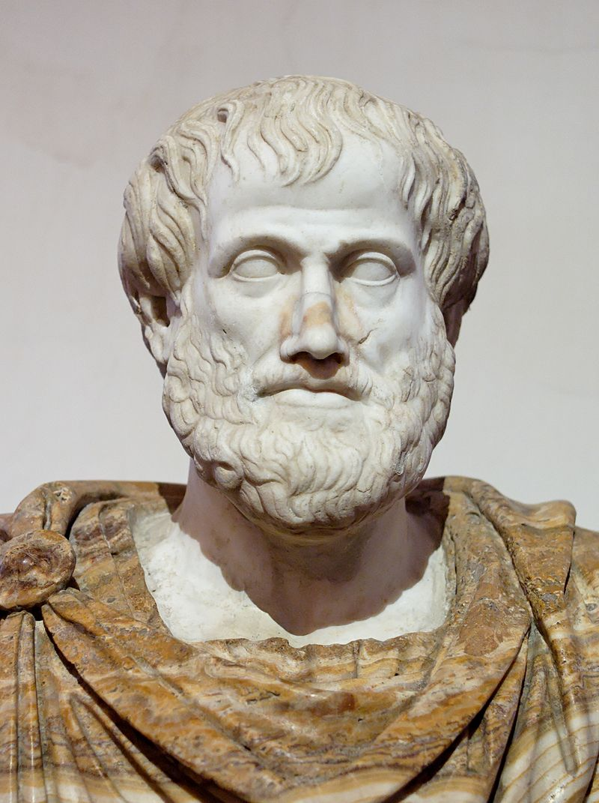
Aristotle on Spartan Women
‘the lack of control over Spartan women is detrimental both to the attainment of the aims of the constitution and to the happiness of the state’
‘…at Sparta women live in temperately, enjoying every licence and indulging in every luxury.’
‘…where in the days of their [Sparta’s] supremacy a great deal was managed by women.’
‘Boldness is not a quality useful in any of the affairs of daily life…’
Aristotle, Politics 1269b12-23
Roman copy of a bronze original by Lysippos, bust of Aristotle.

Slide 12
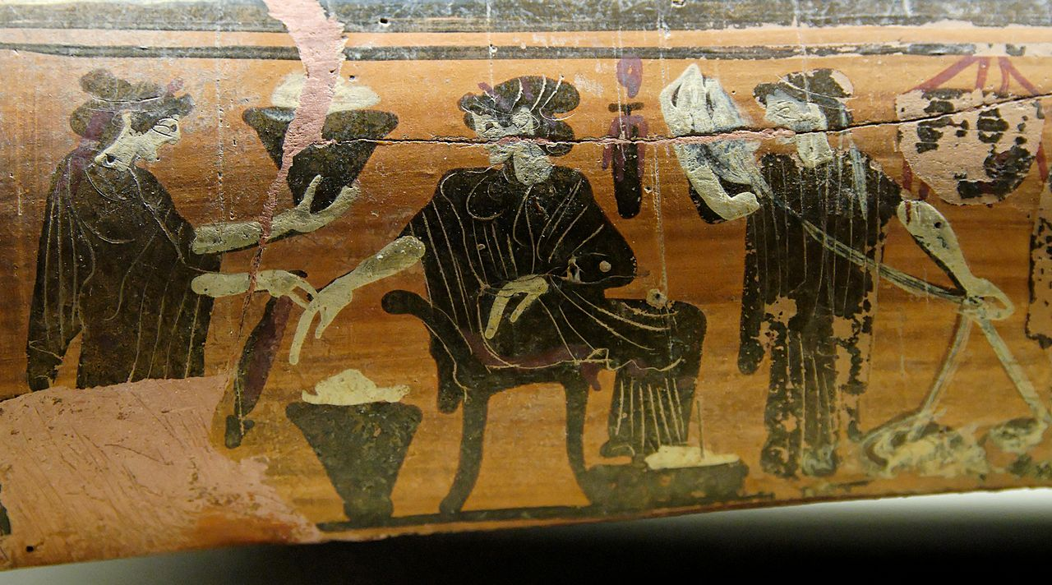
Class Activities?
Upper Class Women
Lower Class Women
Making clothes, selling their wares in addition to making them for their families.
Women also participated in agricultural work.
Some women worked as wet-nurses (breastfeeding and looking after wealthier families children) and others as midwives. This is attested by the commemoration of these on grave stones.
Weaving
Look after slaves
Visit the burial sites of their family and perform rites
Wealthier women became ‘managers’ of the home overseeing the production of clothes and in some cases economic assets.
Become priestesses
Most of the time working women were freed slaves or the wives of Metics (foreign men with some citizen rights)
Painting of women preparing wool for weaving, this painting was found on an epinetron (thigh guard) which would protect the women’s legs whilst weaving. Ca.500 BC

Slide 13
True or False: Athenian Law Edition
3. Women could not defend themselves in court.
TRUE
1.It was illegal for a woman who had committed adultery to attend a public sacrifice as they would corrupt the other women present.
TRUE
4. Women were not officially considered citizens of Athens.
FALSE
2. Men caught in the act of having sex with someone's wife were allowed to be killed.
TRUE
5. A Slave’s testimony wouldn’t be considered unless they were tortured.
TRUE

Slide 14
Solon’s Law Code (Early 6th Century BC)
Solon (640-550 BC) was an Athenian lawgiver who made reforms to Athenian law to combat against the political, moral and economic decline in Athens.
‘But in general, Solon’s laws concerning women seem very absurd. For instance, he permitted an adulterer caught in the act to be killed; but if a man committed rape upon a free woman, he was merely to be fined a hundred drachmas; and if he gained his end by persuasion, twenty drachmas, unless it were with one of those who sell themselves openly, meaning of course the courtesans. For these go openly to those who offer them their price. Still further, no man is allowed to sell a daughter or a sister, unless he find that she is no longer a virgin.’
  [Plutarch, Solon 23]

Slide 15
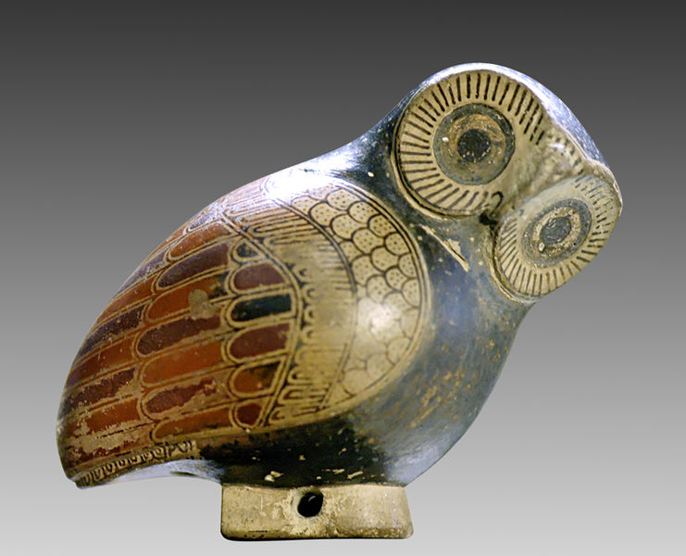
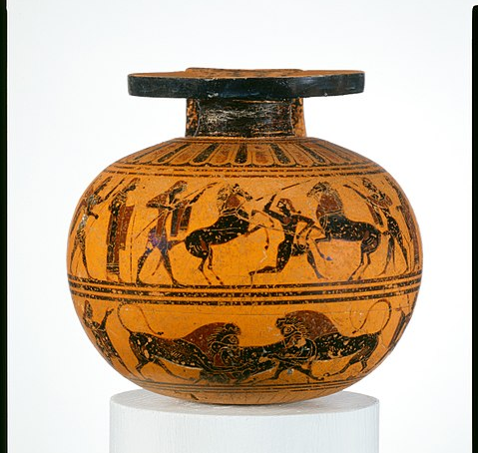
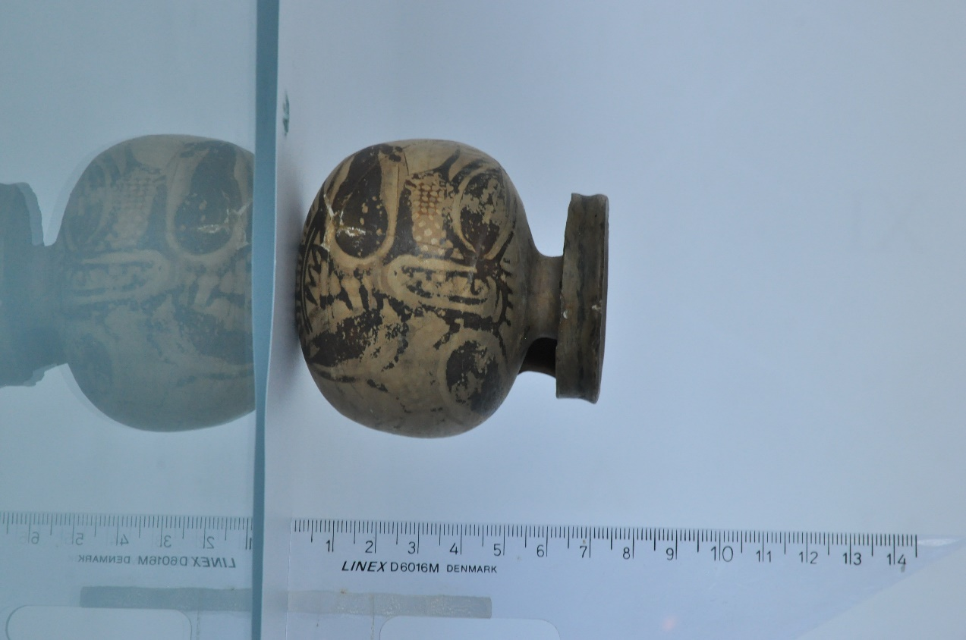
Examples of Aryballoi
Left 1, proto-Corinthian owl aryballos, owls are linked to the virgin goddess Athena (c.640 BC)
Middle 2, terracotta aryballos associated with the gymnasium. Upper Frieze: features a horse tamer and wrestlers. Lower Frieze: an animal fight between on lookers (c.550 BC)
Right 3, Corinthian aryballos, possibly depicting a harpy or a floral motif (7th Century BC)

Slide 16
Bibliography
Demosthenes. Orations, Volume VI: Orations 50-59: Private Cases. In Neaeram. Translated by A. T. Murray. Loeb Classical Library 351. Cambridge, MA: Harvard University Press, 1939.
Lysias. Against Simon. Translated by W. R. M. Lamb. Loeb Classical Library 244. Cambridge, MA: Harvard University Press, 1930
Demosthenes. Orations, Volume VI: Orations 50-59: Private Cases. In Neaeram. Translated by A. T. Murray. Loeb Classical Library 351. Cambridge: Harvard University Press, 1939
Xenophon. Hiero. Agesilaus. Constitution of the Lacedaemonians. Ways and Means. Cavalry Commander. Art of Horsemanship. On Hunting. Constitution of the Athenians. Translated by E. C. Marchant, G. W. Bowersock. Loeb Classical Library 183. Cambridge: Harvard University Press, 1925.
Xenophon. Memorabilia. Oeconomicus. Symposium. Apology. Translated by E. C. Marchant, O. J. Todd. Revised by Jeffrey Henderson. Loeb Classical Library 168. Cambridge: Harvard University Press, 2013.
Plutarch. Lives, Volume I: Theseus and Romulus. Lycurgus and Numa. Solon and Publicola. Translated by Bernadotte Perrin. Loeb Classical Library 46. Cambridge: Harvard University Press, 1914.
Aeschines. Speeches. Translated by C. D. Adams. Loeb Classical Library 106. Cambridge: Harvard University Press, 1919.
Aristotle. The Politics. Translated by T. Sinclair, London: Penguin, 1962.
MacLachlan, B. (2012) Women in Ancient Greece: A Sourcebook (New York: Continuum)
Brock, R. (1994). The Labour of Women in Classical Athens. The Classical Quarterly, 44(2), 336-346. Retrieved June 24, 2020, from www.jstor.org/stable/639638
Kosmopoulou, A. (2001). 'Working Women': Female Professionals on Classical Attic Gravestones. The Annual of the British School at Athens, 96, 281-319. Retrieved June 25, 2020, from www.jstor.org/stable/30073281

Slide 17
Image Credits
Slide 3 , Caryatids, CC BY-SA 3.0, https://commons.wikimedia.org/w/index.php?curid=538962
Slide 4, Gynaeceum Scene, By Painter of Louvre MN 558 - Marie-Lan Nguyen, Own work, 2008-03-15, CC BY 3.0, https://commons.wikimedia.org/w/index.php?curid=3723453
Slide 5, Familial Gynaeceum Scene, By Marsyas - Own work, CC BY-SA 2.5, https://commons.wikimedia.org/w/index.php?curid=487373
Slide 7, (Top), Side A of the “Persephone krater”, an Apulian red-figure volute-krater, c.340 BC, By Circle of the Darius Painter - User:Bibi Saint-Pol, own work, 2008, Public Domain, https://commons.wikimedia.org/w/index.php?curid=3702013
Slide7, (Bottom), Red-figure lekythos with girl running dated to the classical period, Courtesy of the Department of Classics and Ancient History (2020)
Slide 10, (Right), Spartan Bronze Figure, By Caeciliusinhorto – Own work, CC BY-SA4.0, https://commons.wikimedia.org/w/index.php?curid=83369855
Slide 10, (Left), The Grave Stele of Hegeso (c.410–400 BC), By Kallimachos - Marsyas (2006), CC BY 2.5, https://commons.wikimedia.org/w/index.php?curid=501119
Slide 11, Bust of Aristotle, By Copy of original by Lysippos - Jastrow (2006), Public Domain, https://commons.wikimedia.org/w/index.php?curid=1359807
Slide 12, Women weaving in a gynaeceum, By Diosphos Painter - Marie-Lan Nguyen (2007), CC BY 2.5, https://commons.wikimedia.org/w/index.php?curid=2793972
Slide 16 (fig 1), Proto Corinthian owl Aryballos, By Jastrow (2006), Public Domain, https://commons.wikimedia.org/w/index.php?curid=1272335
Slide 16 (fig 2), Terracotta gymnasium Aryballos (c. 550 BC), By Amasis Painter - This file was donated to Wikimedia Commons as part of a project by the Metropolitan Museum of Art. See the Image and Data Resources Open Access Policy, CC0, https://commons.wikimedia. org/w/index.php?curid=60420827
Slide 16 (fig 3), Corinthian Aryballos (7th Century BC), Courtesy of the Department of Classics and Ancient History (2020)

