Slide 1
OCR Greek Theatre
Prescribed visual materials

Slide 2


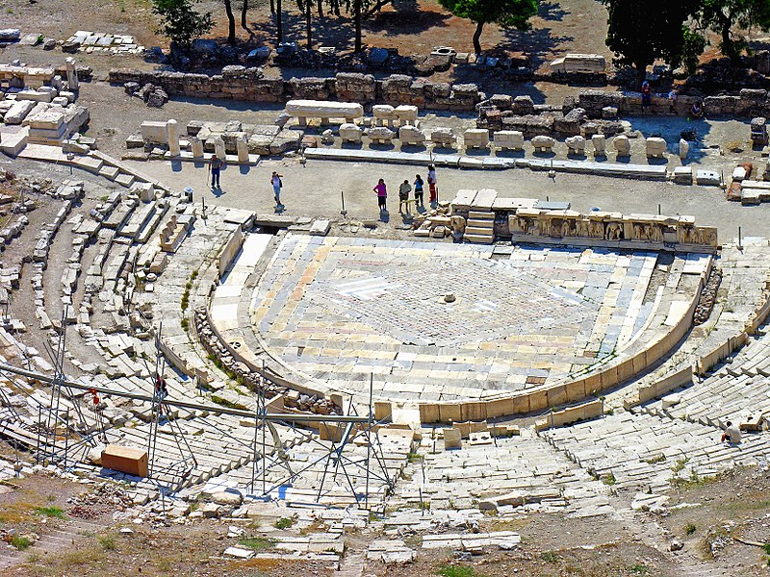



Theatre of Dionysus at Athens

Slide 3
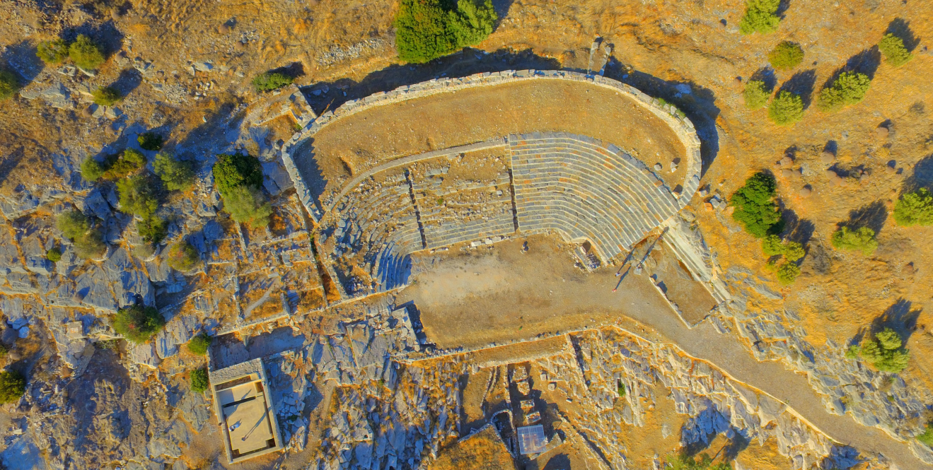
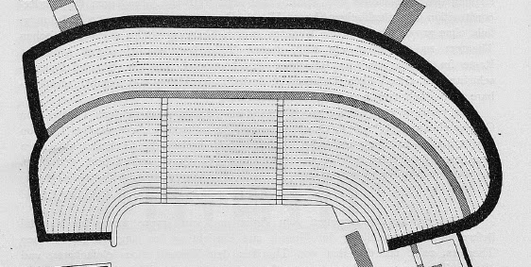
Thorikos Theatre

Slide 4
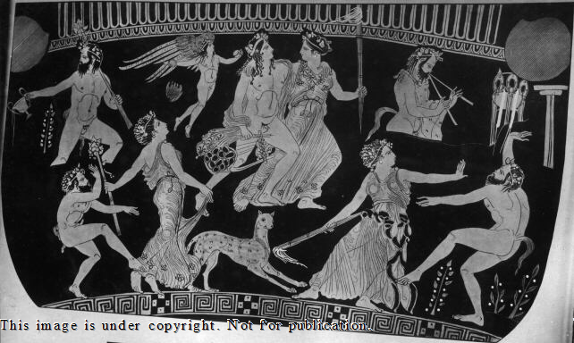
Volute krater by the “Pronomos” painter, depicting team of actors celebrating, with costumes, masks, aulos-player, playwright, Dionysus, c.410 BC, in the Naples Museo Nazionale

Slide 5
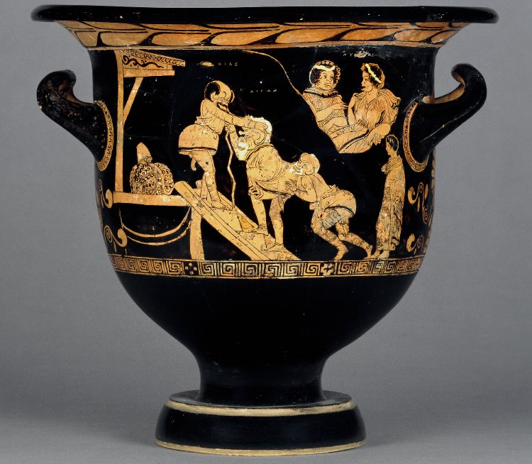
Bell krater by McDaniel Painter, “Cheiron Vase”, Cheiron and Xanthias slave – comic scene, steps & low stage, c.380–370 BC, in British Museum (1849,0620.13)

Slide 6
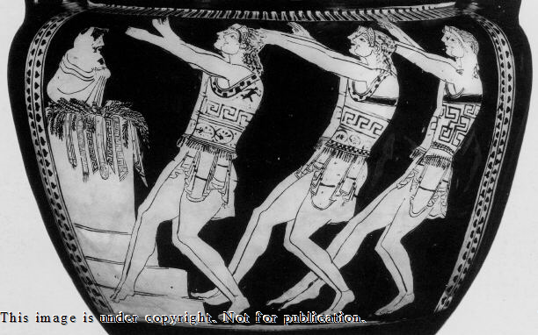
Red-figure column krater in mannerist style, “Basel Dancers”, tragic chorus in action, in front of stepped altar, c.500–490 BC, in Antikenmuseum, Basel (BS 415)

Slide 7
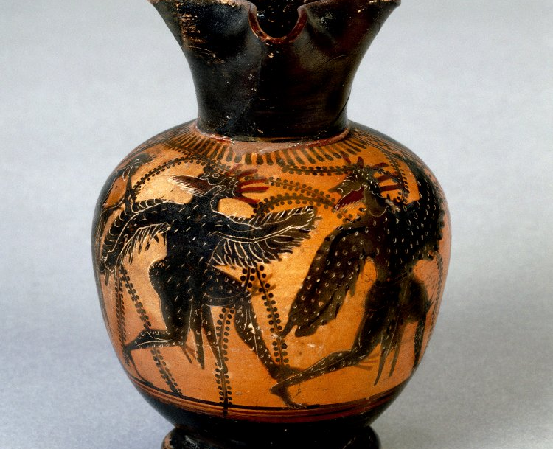
Black-figure oinochoe depicting two chorus-members dressed as birds, c.480 BC in British Museum (B509)

Slide 8
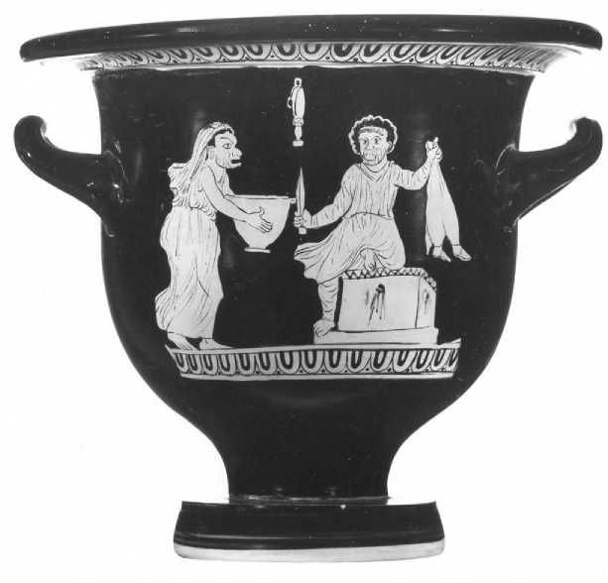
Red-figure bell krater by Schiller Painter, depicting scene with wine-skin & boots from Women at the Thesmophoria (Thesmophoriazusae), c.380–370 BC, in Martin von Wagner Museum, Wurzburg (H5697)

Slide 9
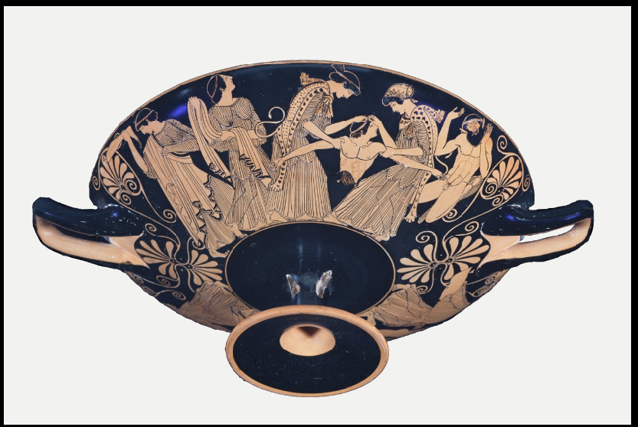
The death of Pentheus, red-figure kylix attributed to Douris, c.480 BC, in Kimball Art Museum, Fort Worth, Texas, USA

Slide 10
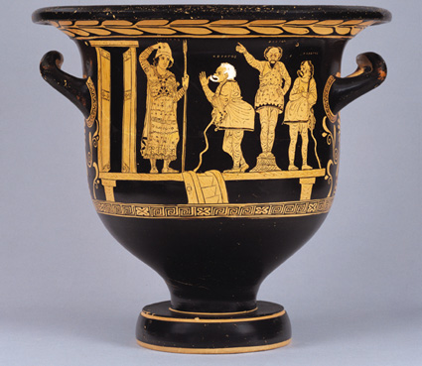
Red-figure Volute Krater, “Choregos Vase” or “Comic Angels”, choregoi with Aegisthus and Pyrrhias, c.400–390 BC in Paul Getty Museum, California (No. 96.AE.29. J)

Slide 11
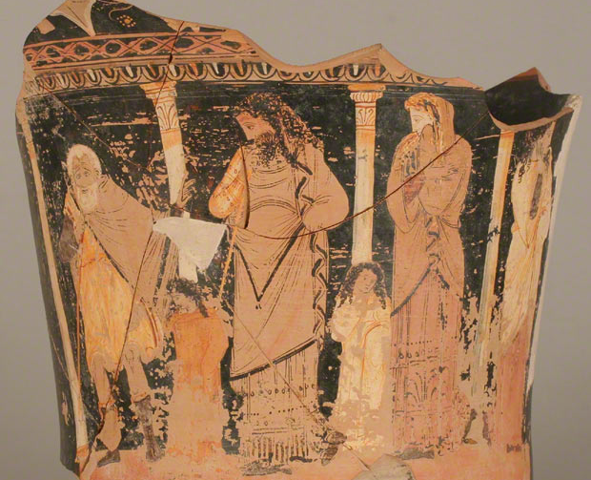
Red-figure calyx krater fragment by Capodarso painter, depicting Jocasta and Oedipus the King, c.330 BC in Museo Archeologico Regionale, Syracuse (“P. Orsi” 66557)

Slide 12
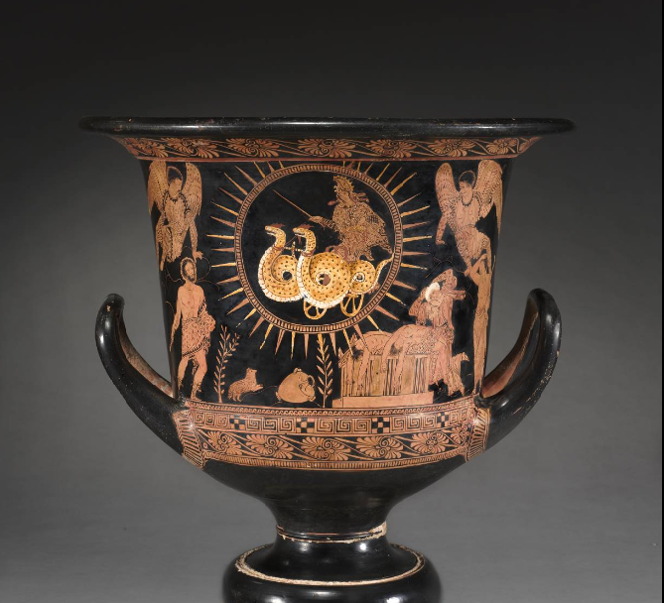
Red-figure Calyx Krater depicting Medea’s escape, c.400–380 BC, in Cleveland Museum of Art (91.1)

Slide 13
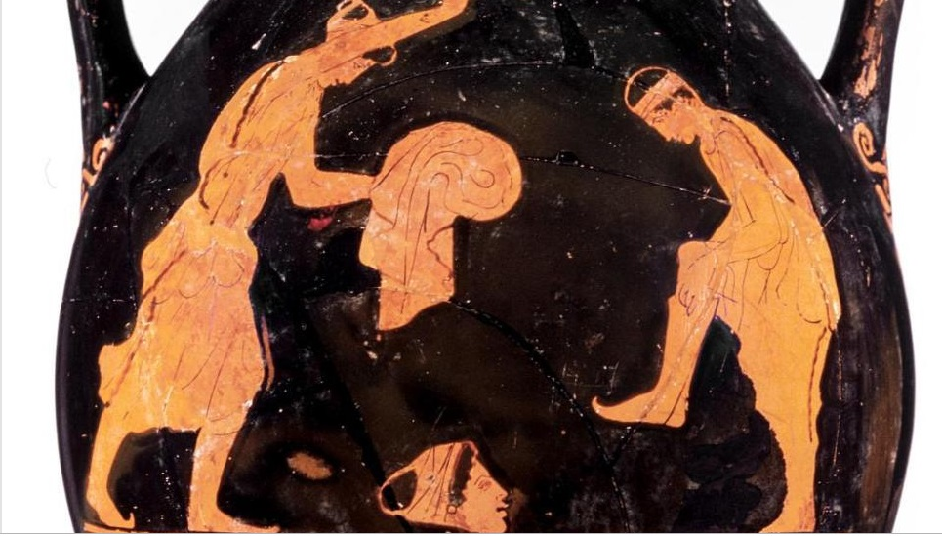
Red-figure pelike by Phiale painter depicting tragic actors dressing, c.450 BC, in Museum of Fine Arts, Boston (98.883-11)

Slide 14
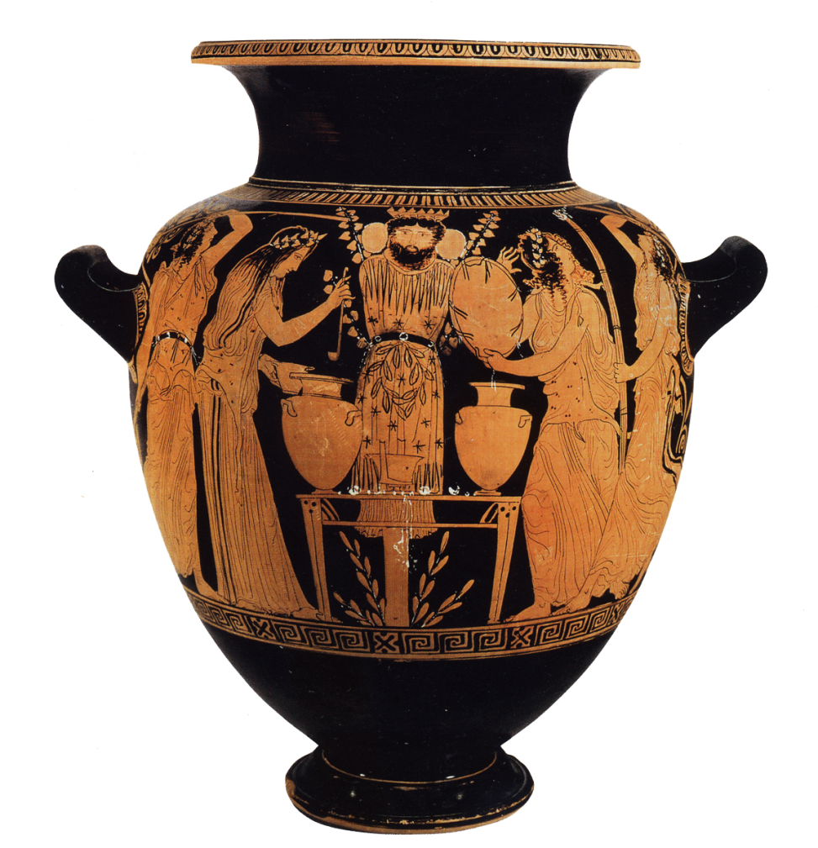
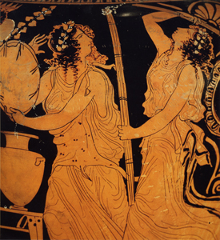
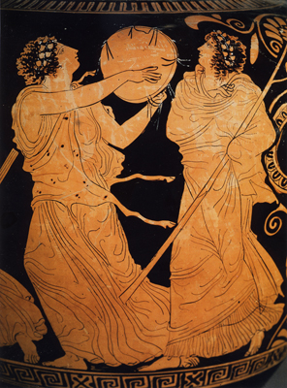
Red-figure ‘maenad’ stamnos by Dinos Painter, late 5th century, in Naples, Museo Nazionale Archeologico

Slide 15
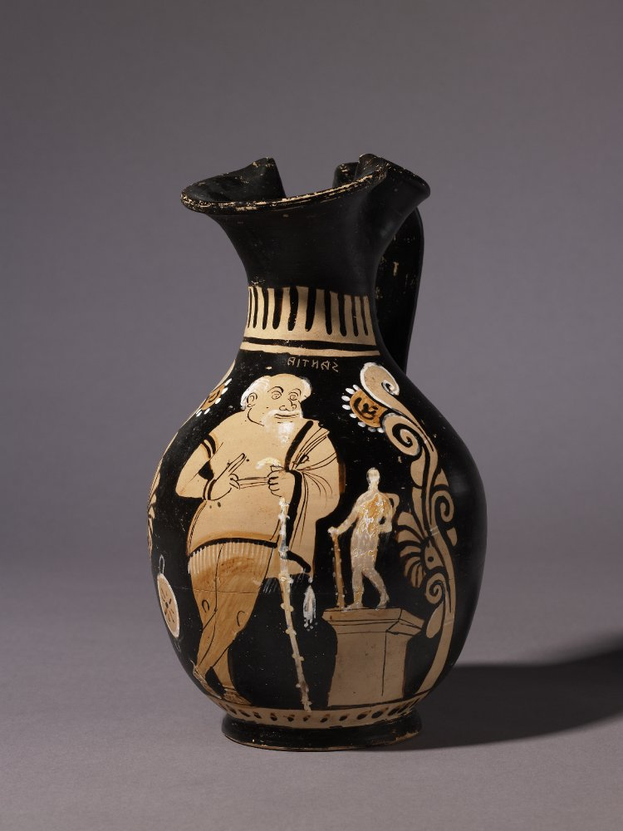

Slide 16
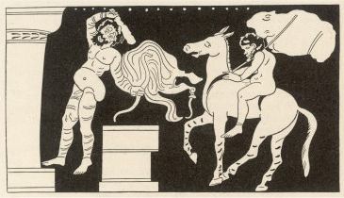
a vase-painting from 375-350 BC, once Berlin Staatliche Museen F3046 but now lost (probably a war casualty), apparently depicting the opening scene of Aristophanes’ Frogs.

