Slide 1
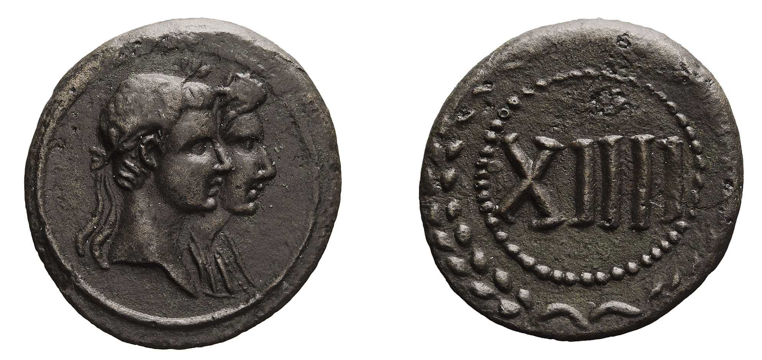
A token showing Augustus and Livia

