Slide 1
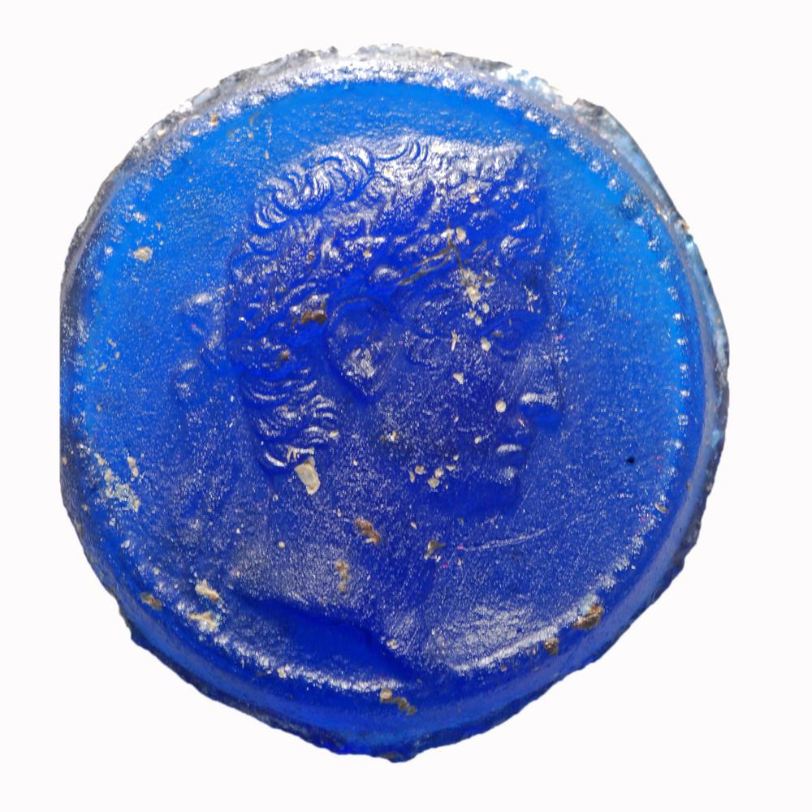
Diversifying the Imperial Image
Some additional
sources
Clare Rowan

Slide 2
Cameos, gems (incl. seals) and glass pastes
Intaglios (precious gems, gold glass pastes) used as seals and signet rings
Gems and gold elite objects
glass pastes were non-elite objects, mostly made from moulds of clay or other materials. Particularly frequent in late Republic and early imperial period.
Pliny reveals elite anxieties about these ‘imitations’ (Natural History 37.22), a prejudice that has persisted in scholarship to the present day.
Yarrow, L., (2018). ‘Markers of identity for non-elite Romans: A prolegomenon to the study of glass paste intaglios’, Journal of Ancient History and Archaeology 5.3, pp. 35-54, available online at https://brooklynsabbatical.files.wordpress.com/2019/06/yarrow-2018-glasspastes.pdf

Slide 3
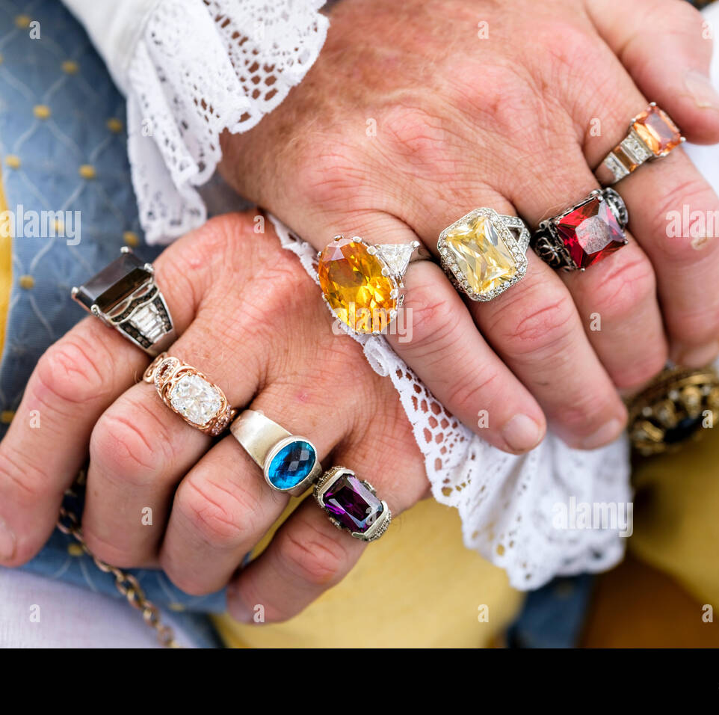
This fashion like everything else luxury has diversified in numerous ways, by adding to rings gems of exquisite brilliance, and by loading the fingers with a wealthy revenue (as we shall mention in our book on gems) and then by engraving on them a variety of devices, so that in one case the craftsmanship and in another the material constitutes the value….
Pliny, Natural History 33.6

Slide 4
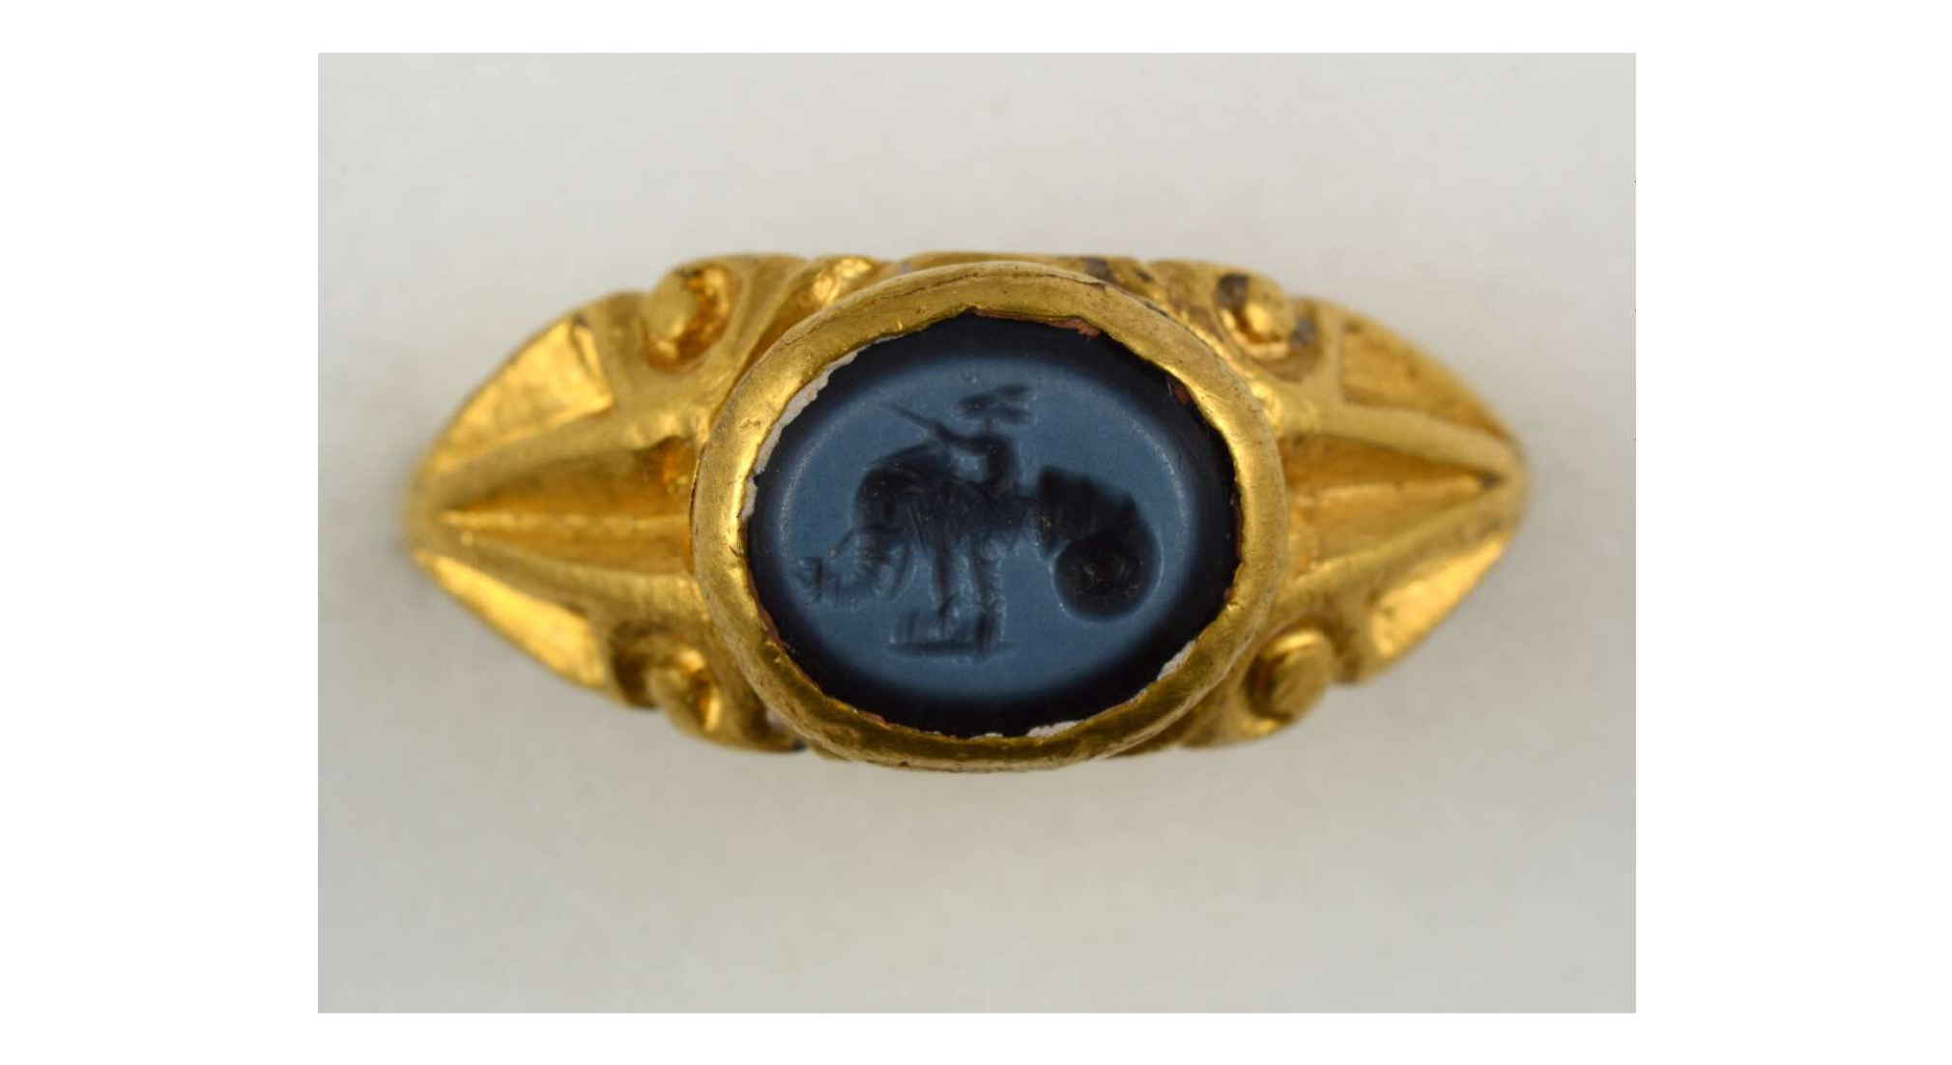
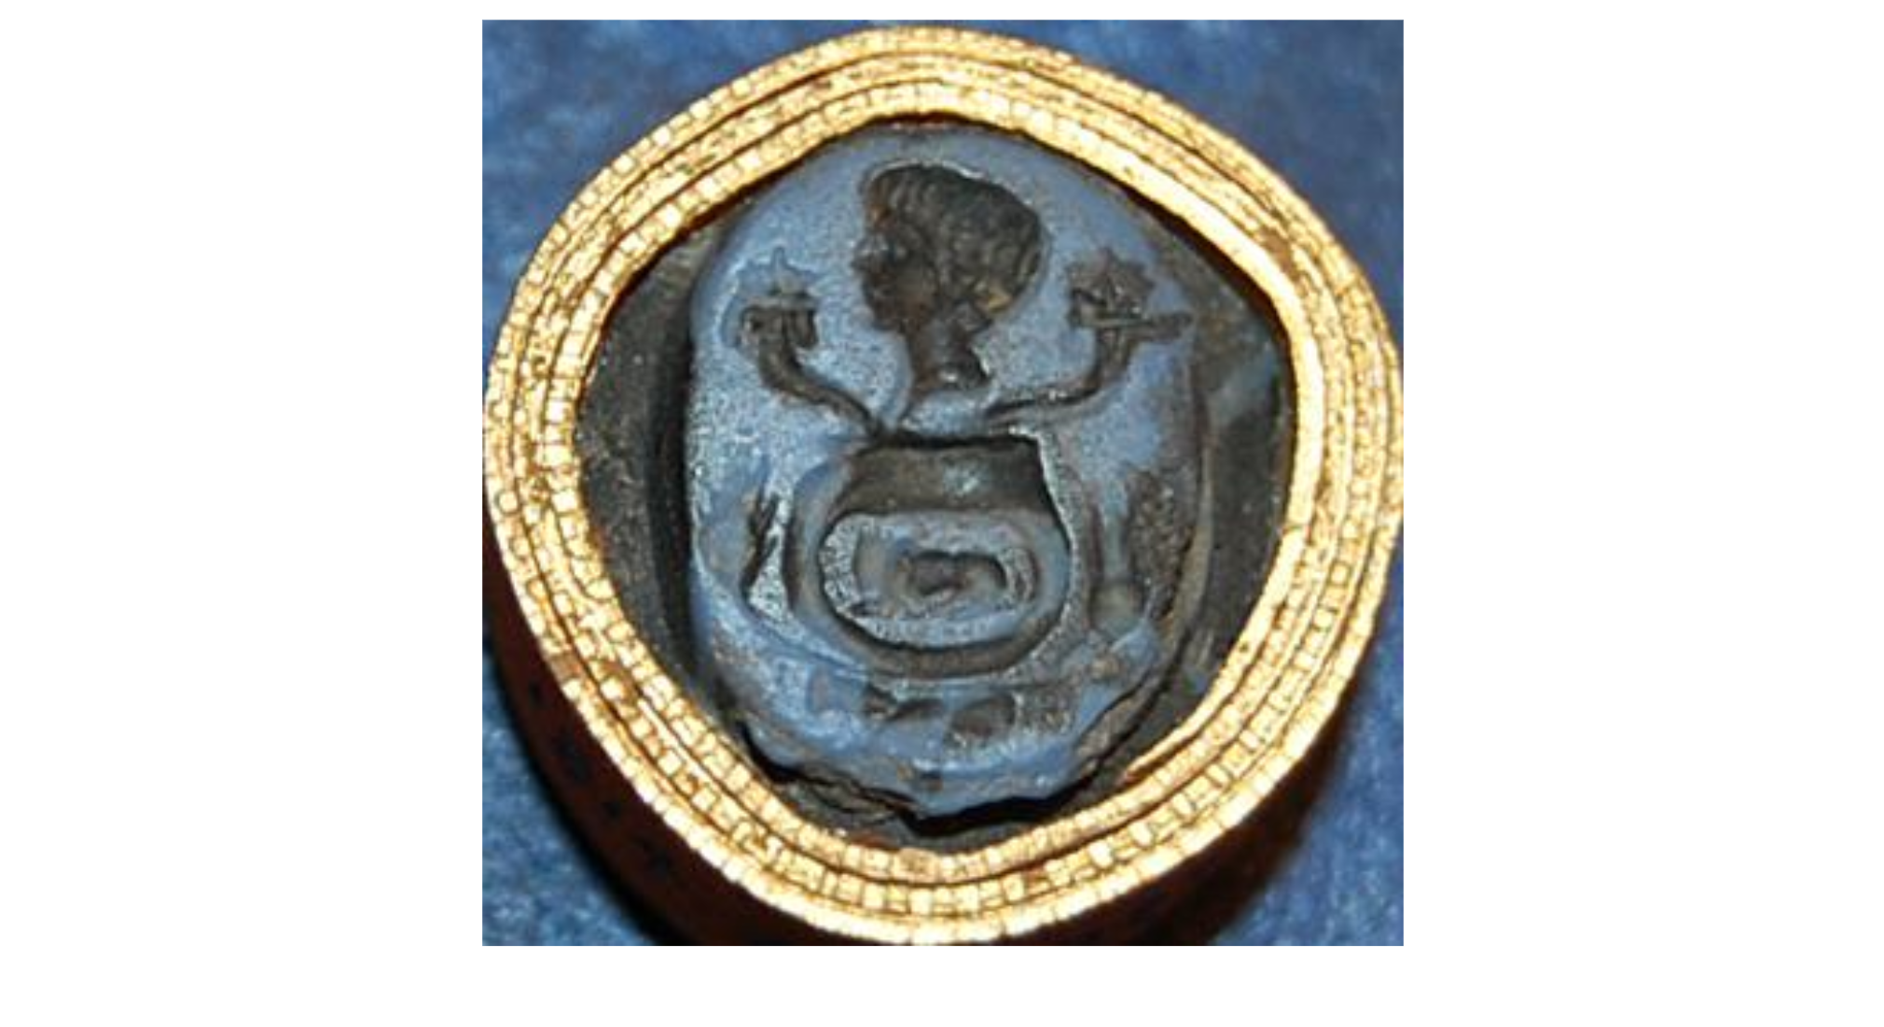
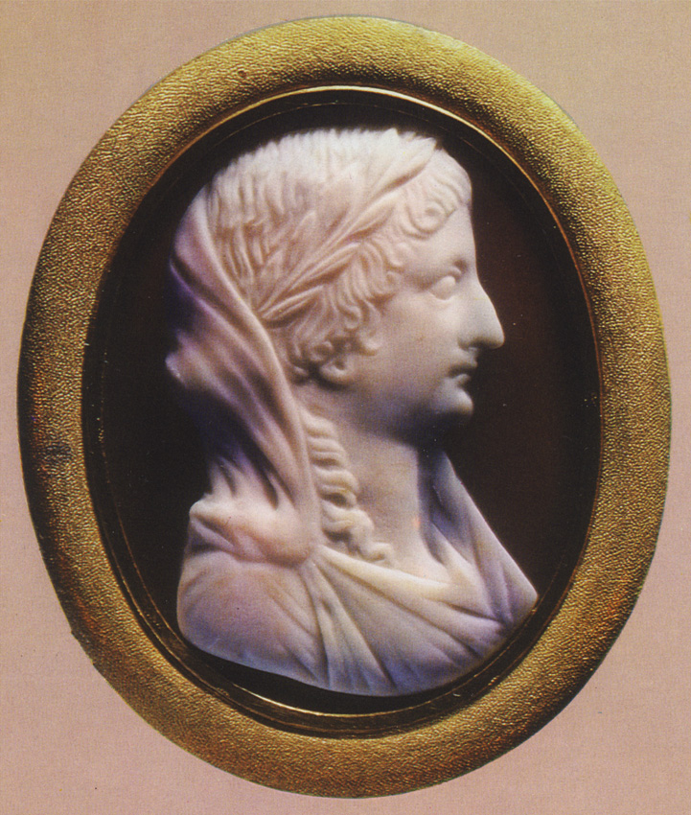
Oval blue glass paste intaglio: head between cornucopiae above a ring, with ears of corn and clasped hands below. BM 1814,0704.2494
nicolo intaglio with a mouse riding an elephant emerging from a shell, BM 1917,0501.535
Pliny, Natural History 15.137 (29 BC): ‘And later, when the emperor celebrated a triumph he carried laurel from this grove in his hand and wore a wreath of it on his head’.
Livia with laurel wreath on a cameo in St. Petersburg, post AD 14.
Suetonius Galba 1: omen created a laurel grove at Livia’s estate at Prima Porta, from which her male family members took laurel for their triumphal processions.
Notes:
Years before, as Livia was returning to her estate near Veii, immediately after her marriage with Augustus, an eagle which flew by dropped into her lap a white hen, holding in its beak a sprig of laurel, just as the eagle had carried it off. Livia resolved to rear the fowl and plant the sprig, whereupon such a great brood of chickens was hatched that to this day the villa is called Ad Gallinas,​² and such a grove of laurel sprang up, that the Caesars gathered their laurels from it when they were going to celebrate triumphs. Moreover it was the habit of those who triumphed to plant other branches​³ at once in that same place, and it was observed that just before the death of each of them the tree which he had planted withered
Cameo portraits likely after Augustus’ death.

Slide 5
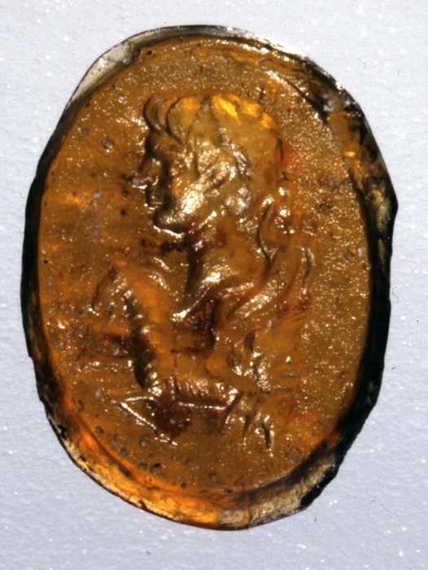
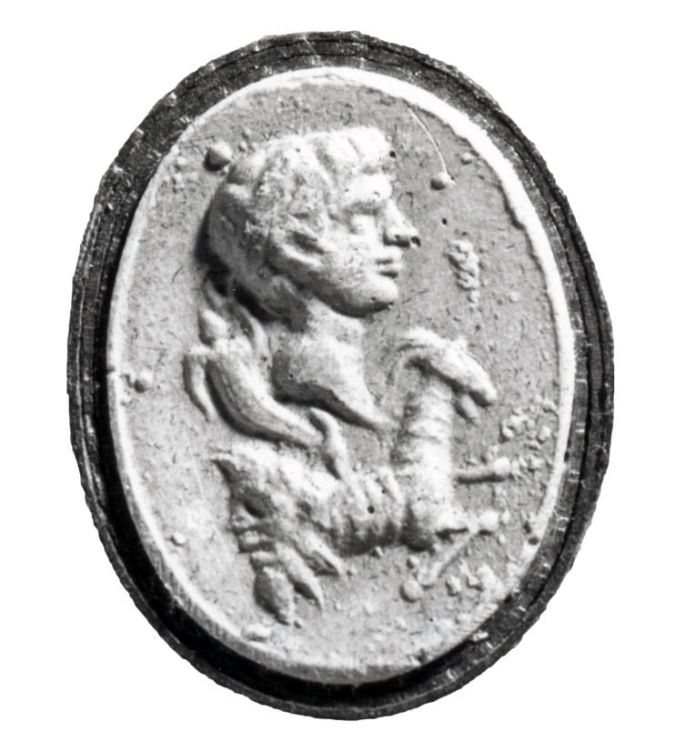
Portraiture as a statement of loyalty
Seal of glass paste imitating sard: with a bust of Octavian in intaglio: the head, in profile to the left, shows abundant hair falling on the brow in the style of Hellenistic royal portraits. Behind the fringe is a fillet tied at the nape of the neck.
Immediately below the bust is a Capricorn; balanced on its back is a theatrical mask and above that a cornucopia.
30s-20s BC, 1.4x1.1cm
https://www.britishmuseum.org/collection/object/G_1923-0401-928?selectedImageId=1613358766
Notes:
Capricorn – star sign of Augustus, put on coinage.
Cornucopia – abundance
Theatre mask a bit of a weird addition – making it significant for the person or people?
Worn on the body of someone – combining facets of Augustan ideology
Also becomes the seal or sign of an individual.

Slide 6
Cameo of deep blue glass paste, engraved with a laureate head of Augustus in profile; the rim is milled like that of a coin.
British Museum Asset No. 1865,1214.90
First century AD
In sealing letters-patent, rescripts, or epistles, he at first used the figure of a sphinx, afterwards the head of Alexander the Great and at last his own, engraved by the hand of Dioscorides; which practice was retained by the succeeding emperors.
Suetonius, Augustus 50

Slide 7
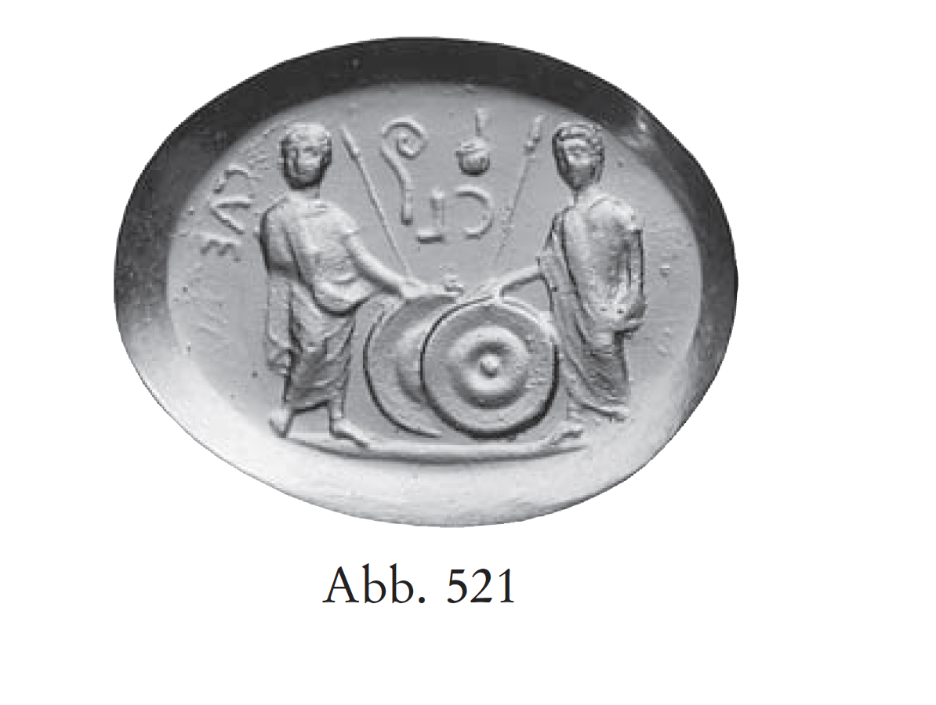
Carnelian intaglio 2 BC – AD 4
1.2cm
Gaius and Lucius Caesar (CL CAE) with shields, spears, lituus and simpulum.
Now in Florence, Museo Archeologico Nazionale
Portraits of Gaius and Lucius also appear in other forms on glyptics
Zweierlein-Diehl, E. (2007). Antike Gemmen und ihr Nachleben. Berlin, Walter de Gruyter.

Slide 8
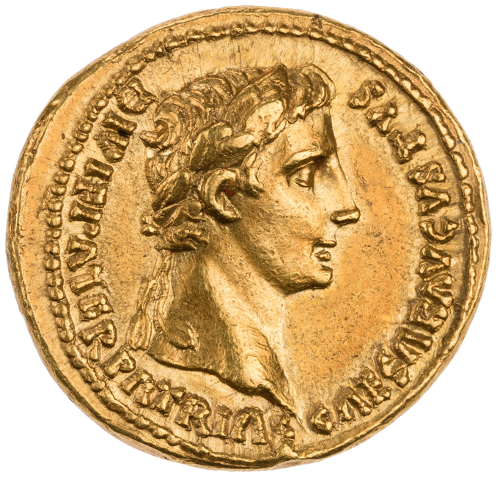
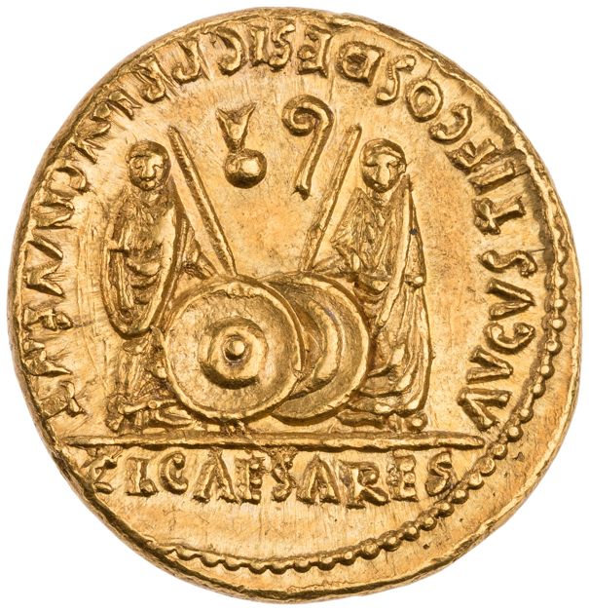
RIC 1² 206
Res Gestae Divi Augustus 14.1
the Roman equestrians hailed Gaius and Lucius “as leader of the youth, and honoured them with silver shields and spears”
Simpulum – Gaius’ position as pontifex
Lituus – Lucius’ position as augur
8 BC – AD 13 – ONLY aurei and denarii produced were of this type.
Aureus, mint of Rome, 2 BC – AD 4. Laureate head of Augustus, CAESAR AVGVSTVS DIVI F PATER PATRIAE / Gaius and Lucius Caesar standing, each, togate, resting hand on shield and spear, simpulum (=pontifex), right, and lituus (= augur), left, flanking, left and right respectively, C L CAESARES AVGVSTI F COS DESIG PRINC IVVENT.
Notes:
RGDA – the Roman equestrians hailed Gaius and Lucius “as leader of the youth, and honoured them with silver shields and spears”
Simpulum – Gaius’ position as pontifex
Lituus – Lucius’ position as augur

Slide 9
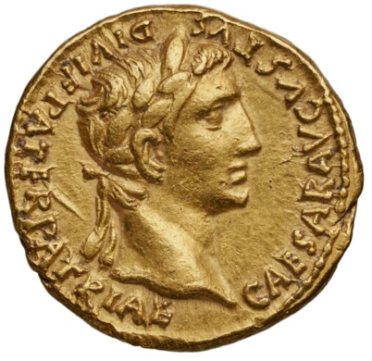
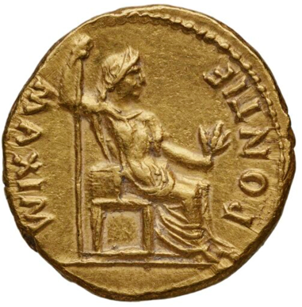
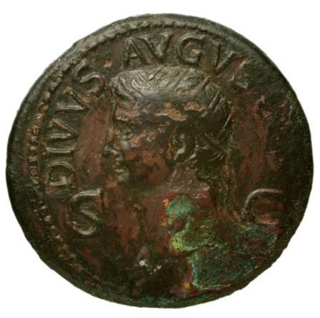
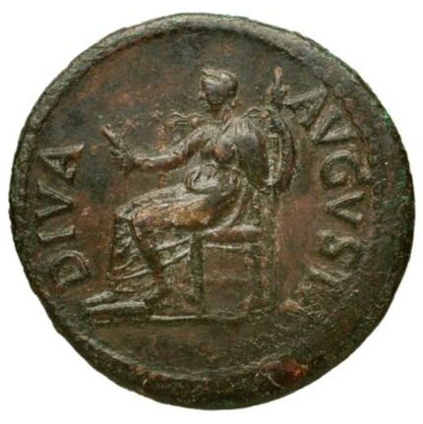
Where is Livia on Roman imperial coinage under Augustus?
Gold Aureus, RIC 1² Augustus 219, AD 13-14
Laureate head of Augustus, CAESAR AVGVSTVS DIVI F PATER PATRIAE
Female figure,, draped, seated right, holding branch in left hand and leaning right on sceptre, PONTIF MAXIM
Image courtesy of the BnF
https://numismatics.org/ocre/id/ric.1(2).aug.219
Bronze dupondius, RIC 1² Claudius 101, AD 41-50
Radiate head of Augustus, DIVVS AVGVSTVS S C
Livia, draped, wearing a wreath of corn-ears, seated left on an ornamented throne, holding corn-ears in right hand and long torch in left, DIVA AVGVSTA
Image courtesy of the BnF
https://numismatics.org/ocre/id/ric.1(2).cl.101
Notes:
Very surprising absence given that there is a large emphasis on Gaius and Lucius as the successors on coins.
Also Tiberius appears at the end.

Slide 10
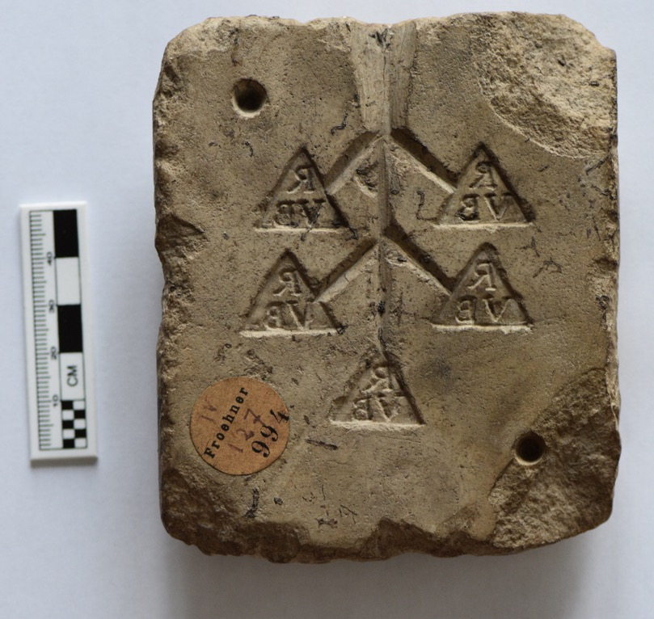
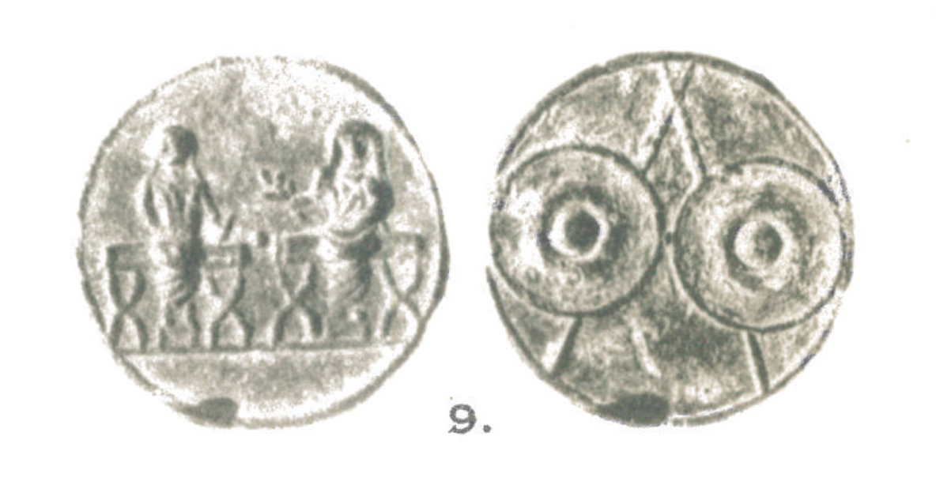
Lead Tokens
TURS 3
https://coins.warwick.ac.uk/token-types/id/TURS3
Lead token.
Gaius and Lucius Caesar (?) seated front on curule chairs with their heads covered by their togas. The figure on the right holds a laurel branch, the figure on the left holds an uncertain object /
Two shields and two spears.

Slide 11
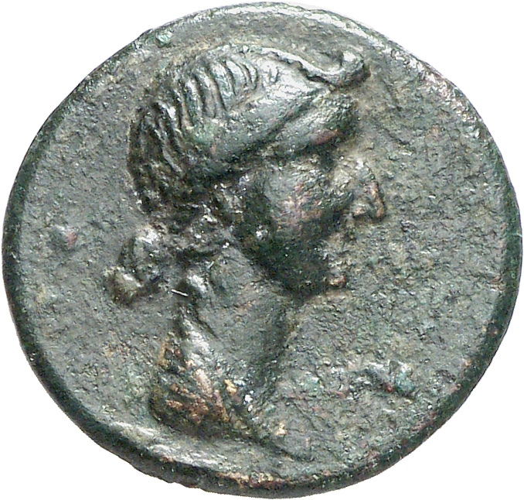
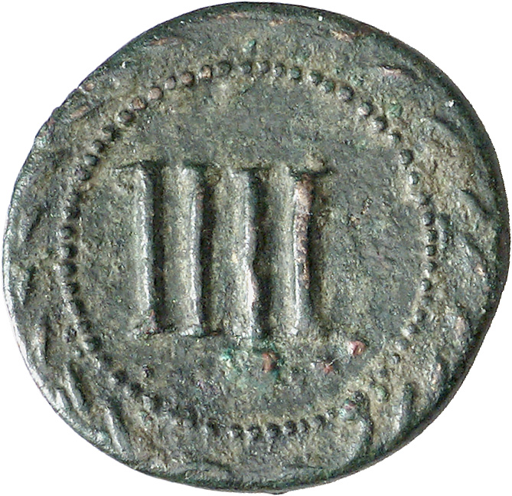
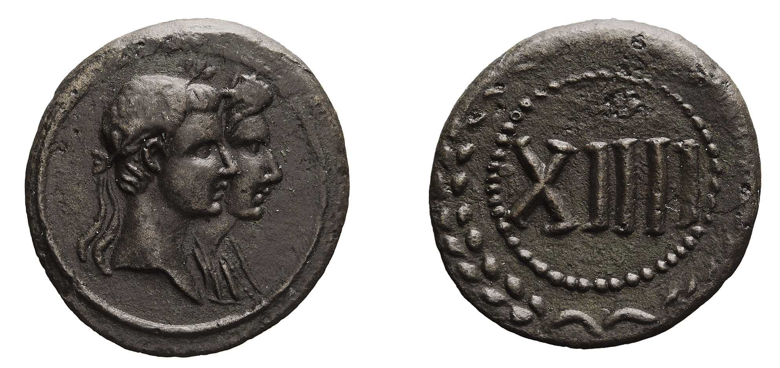
Bronze token, 20mm.
Portrait of Livia (?) right / IIII within dotted border and wreath.
Image courtesy of Berlin, Münzkabinett der Staatlichen Museen, 18203139. Photographs by Lutz-Jürgen Lübke (Lübke und Wiedemann). https://ikmk.smb.museum/object?id=18203139
Notes:
Again perhaps later than the rule of Augustus – might be Tiberius, although Livia had a different hairstyle by then and the nodus was no longer there.
Tokens show a broader array of imperial family members than the Roman imperial currency issued by the government generally.

Slide 12
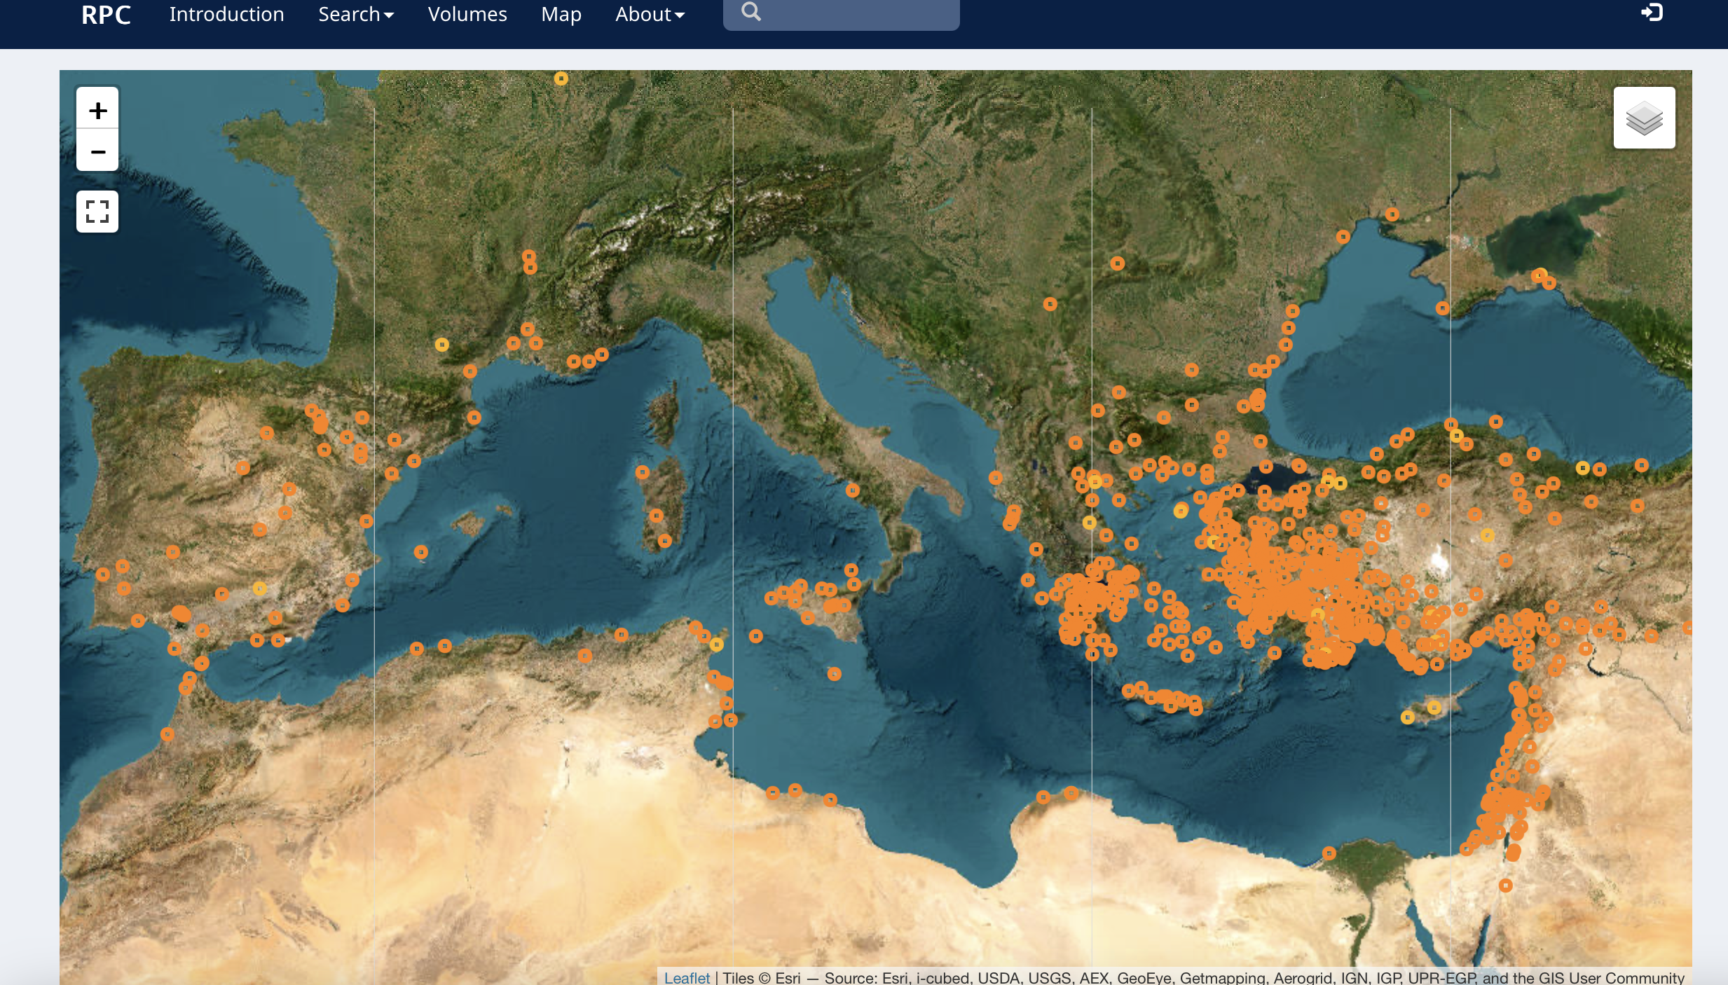
Provincial Coinage
Provincial mints striking coinage during the rule of Augustus.

Slide 13
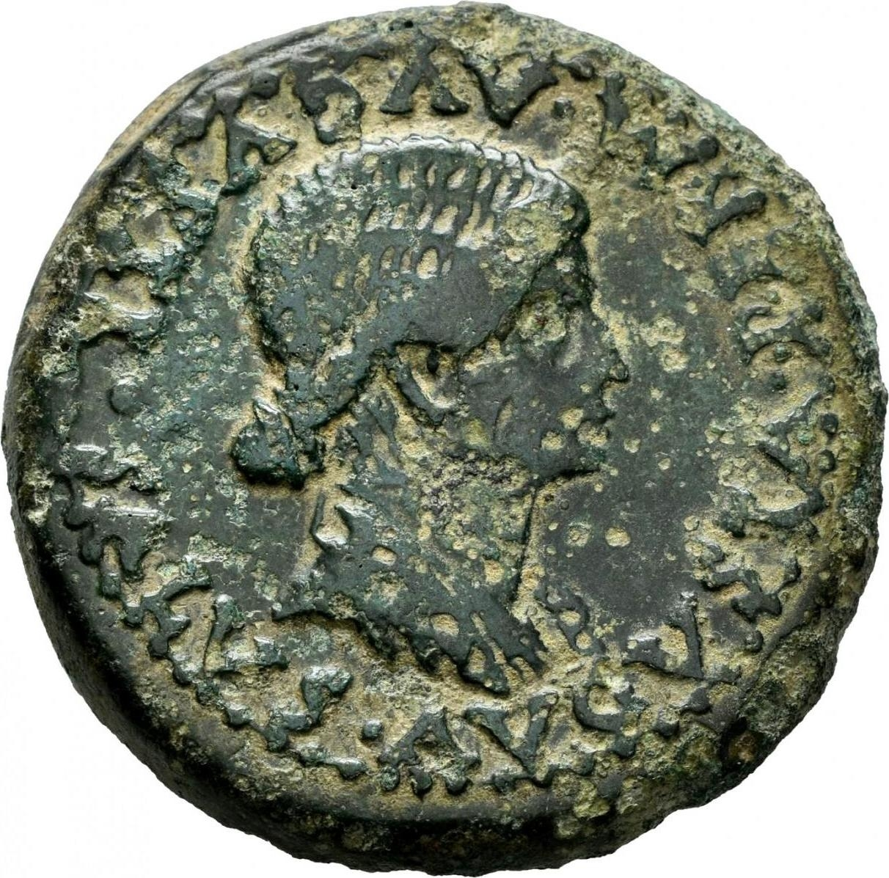
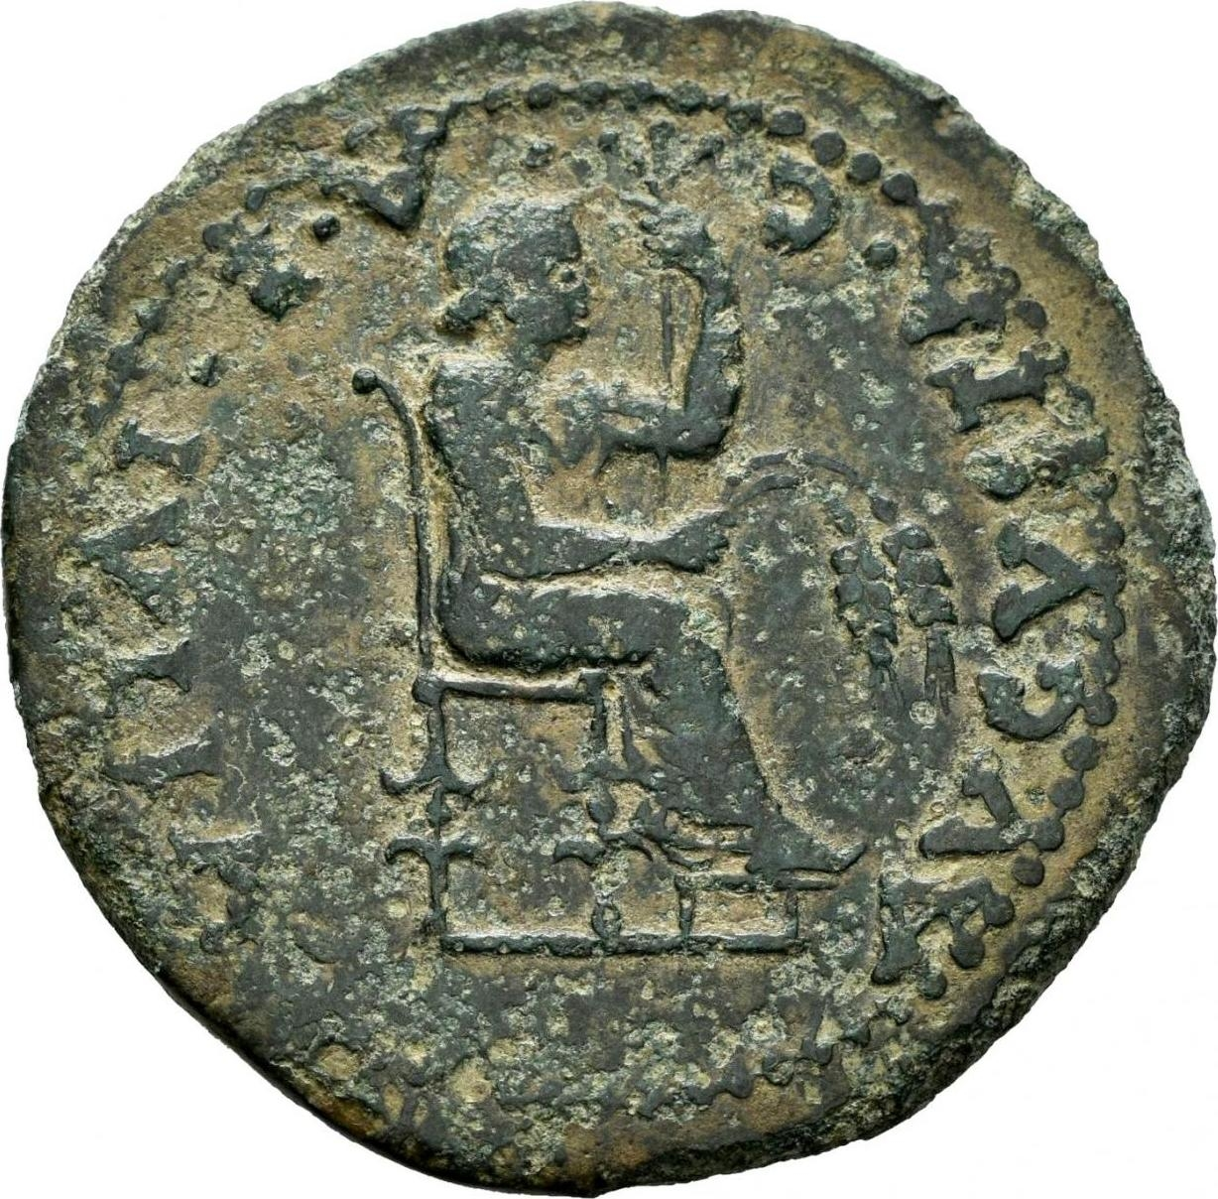
Roman Provincial Coinage
As well as imperial Roman mints (run by the Roman government on behalf of the emperor), cities throughout the empire might also strike their own coinage
This was normally bronze ‘small change’. We imagine permission was sought from the imperial government for this honour (see the permission mentioned on the coin on the right).
Provincial coins was the responsibility of different local magistrates, who are often named on the coins
This solved some of the issues in terms of producing and supplying small change for a large empire.
These ‘Roman provincial coins’ carried local imagery, and language (e.g. Greek). An insight into different local cultures.
These coins are catalogued at https://rpc.ashmus.ox.ac.uk
RPC I, 39, mint of Emerita (Hispania), Reign of Tiberius.
Obverse shows bust of Livia, along with an inscription that says by permission of Augustus, Augustan health.
Reverse shows Livia seated on a throne with the legend CAE IVLIA AVGVSTA = Colony Augusta Emerita, Julia Augusta

Slide 14
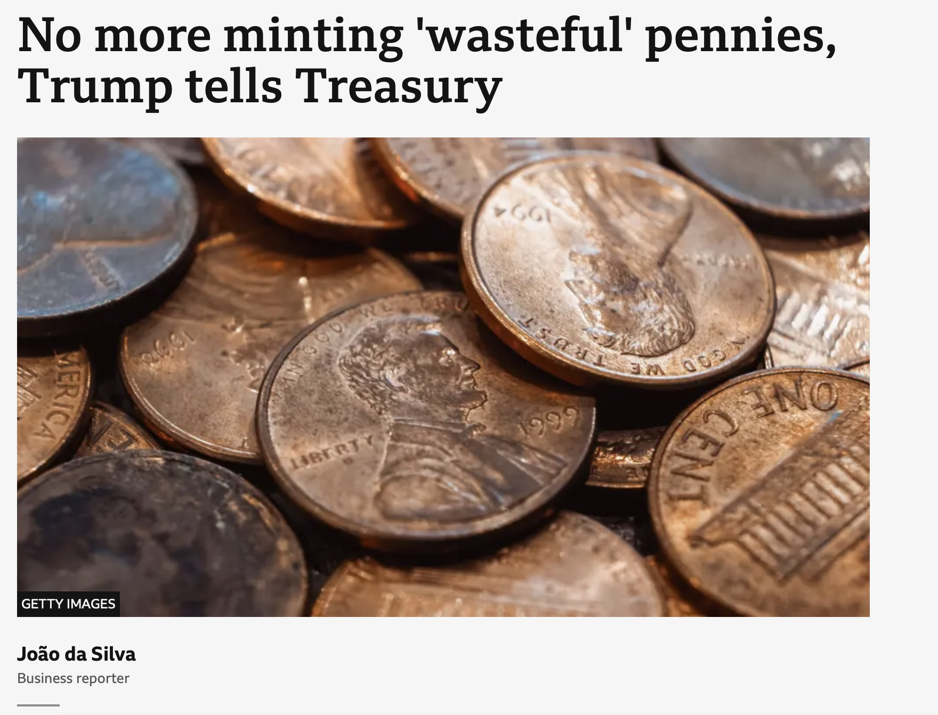
The Big Problem of Small Change
‘According the US Mint's 2024 annual report, making and distributing a one cent coin costs 3.69 cents.’

Slide 15
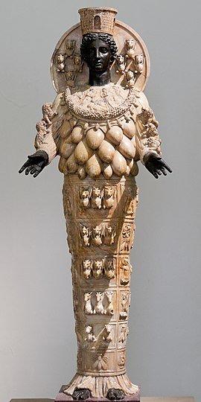
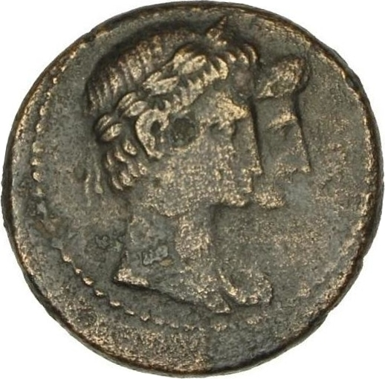
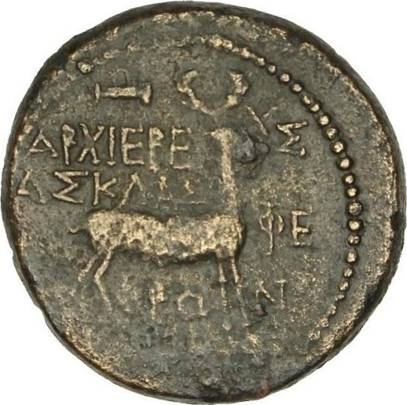
Local Culture in Ephesus
RPC I, 2591, reign of Augustus, bronze coin of 19mm
Jugate busts of Augustus (laureate) and Livia, right /
Stag standing, right; above, quiver; Greek legend reading high priest Asklas, of the Ephesians, Eyphron
Artemis of Ephesus
Notes:
Stag animal associated with Artemis, also a goddess of the hunt so the quiver also relevant to her.

Slide 16
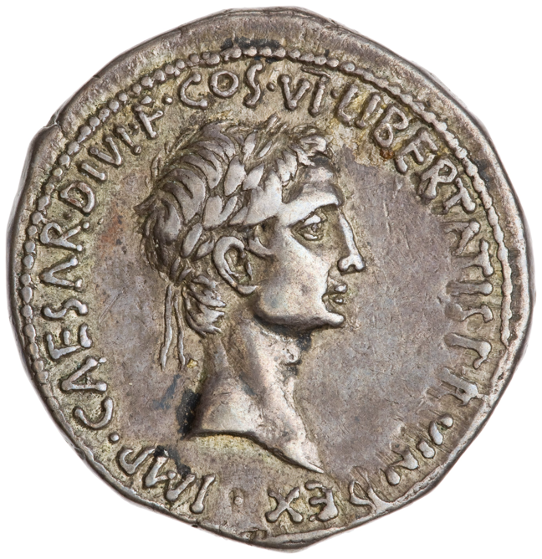
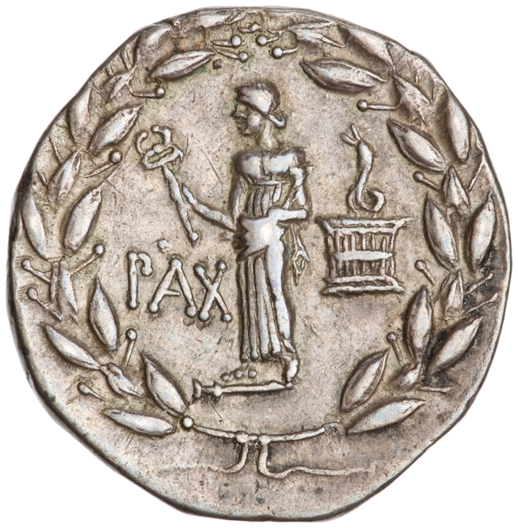
RIC 1² 476
Imperator Caesar, son of the god, consul for the 6th time, champion of the liberty of the Roman people
Cistophorus = basket carriers
Silver cistophorus from the mint of Ephesus, c. 28 BC.
Laureate head of Octavian, IMP CAESAR DIVI F COS VI LIBERTATIS P(opuli) R(omani) V(index) / Pax standing on parazonium (?) holding caduceus; snake emerging from cista mystica on the right, PAX, all within laurel wreath.
Notes:
Champion of the liberty of the Roman people, responsible for the peace shown on the other side.
With Augustan provincial coin

Slide 17
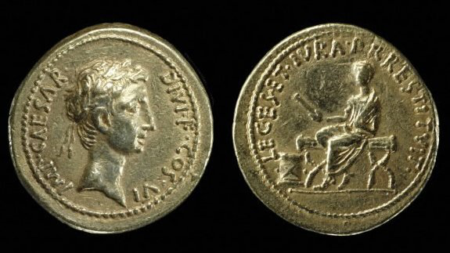
British Museum 1995,0401.1
He has restored to the people of Rome their laws and rights.
Aureus, Mint of Ephesus (?), c. 28 BC. Laureate head of Octavian, IMP CAESAR DIVI F COS VI / Togate Octavian seated on curule chair holding scroll, scroll case (scrinium) before, LEGES ET IVRA P(opulo) R(omano) RESTITVIT.
Notes:
He has restored to the people of Rome their laws and rights. Political settlement that began in 28 BC. Augustus transferred the res publica from his power back to the senate and people of Rome – language probably derived from an official decree in his honour.
With Nero aureus.
Who would use this? Volume? Mint?

Slide 18
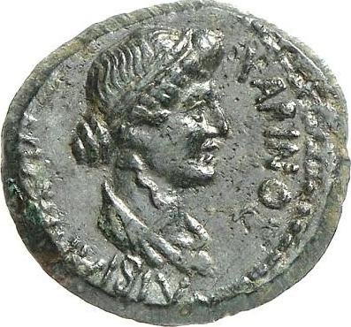
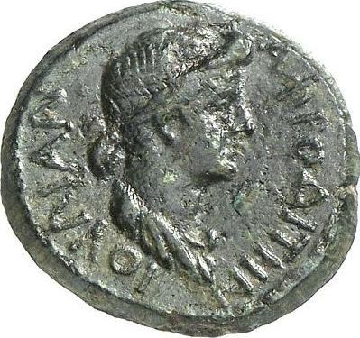
Livia and Julia aligned with local goddesses
RPC 1, 2359, mint of Pergamum, c. 10-2 BC
Draped bust of Livia, right, Greek legend for Livia Hera, Charinos /
Draped bust of Julia, right, Greek legend for Julia Aphrodite
Notes:
Empresses were often aligned with local deities – the image of the imperial women was more flexible and lent itself more to this type of local affiliation than that of the emperor.

Slide 19
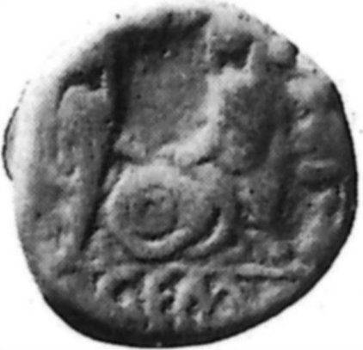
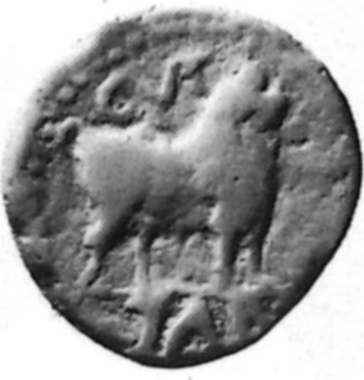
Tarracco, Hispania: Gaius and Lucius Caesar
RPC I, 211, from the mint of Tarracco, Hispania, after 2 BC, bronze 19mm
Standing figures of Gaius and Lucius, holding shields between them, CAESAR(ES) GEM(INI) = ‘the twin Caesars’ /
Bull right, c(olonia) u(rbs) T(riumphalis) Tarr(aco) = The triumphal colonial city of Tarraco
Notes:
Bull = local symbol of Tarracco
Both Caesars are now dead and hence they can be described as gemini – aligning them with the Dioscuri probably.

Slide 20
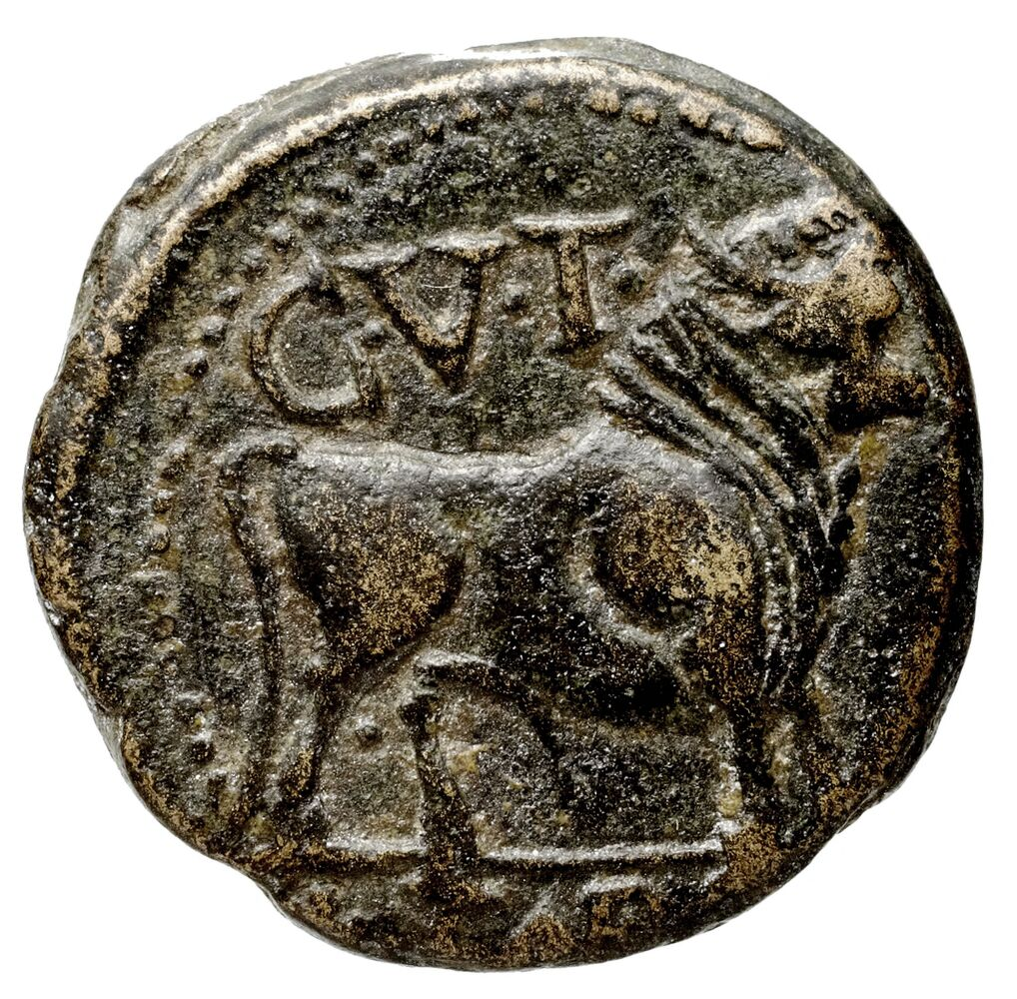
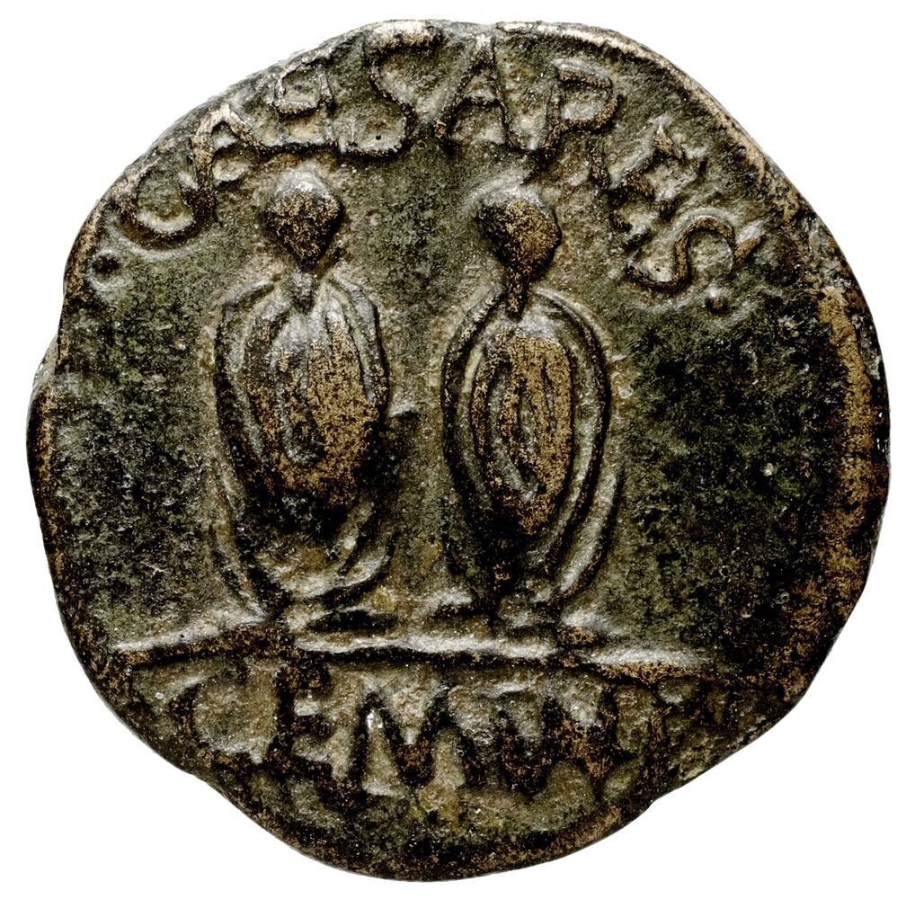
Tarracco, Hispania
RPC I, 212, from the mint of Tarracco, Hispania, after 2 BC, bronze 19mm
Bull right, c(olonia) u(rbs) T(riumphalis) Tarr(aco) = The triumphal colonial city of Tarraco /
Standing figures of Gaius and Lucius, CAESARES GEMINI = ‘the twin Caesars’
Notes:
Bull = local symbol of Tarracco
Both Caesars are now dead and hence they can be described as gemini – aligning them with the Dioscuri probably.

Slide 21
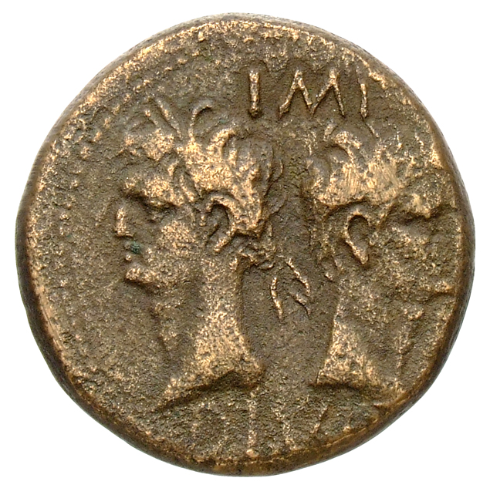
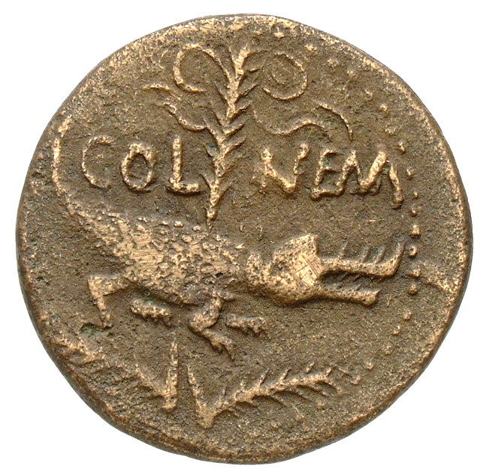
Bronze as of Nemausus (Nîmes)
NB difference in representation between Agrippa and Augustus
Crocodile references the capture of Egypt
Nemausus probably served as a colony to settle veterans from this campaign – the capture of Egypt was their achievement as well
Both ‘provincial’ and ‘imperial’
Coins of this type struck in large quantities: found throughout Gaul and in military camps along the Rhine frontier = probably given to soldiers
RPC I, 523, c. 16/15-10 BC, 26mm
IMP DIVI F (imperator son of the god) above and below heads of Agrippa to left and Augustus to right back to back; Agrippa wears a rostral crown combined with a laurel wreath; Augustus is bare-headed /
COL NEM (colonia Nemausus) on either side of a palm to which a crocodile is chained; above palm, wreath with long tie

Slide 22
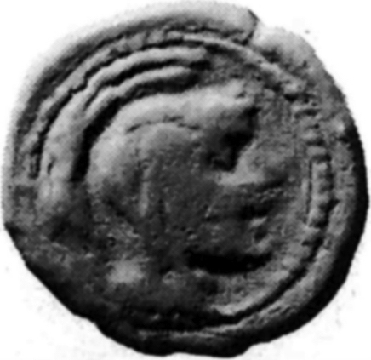
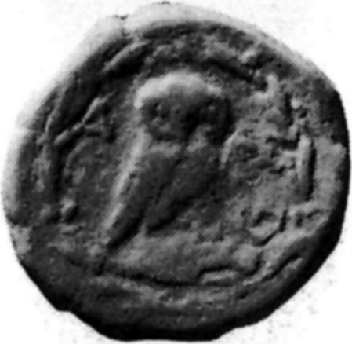
Athens.... pretending the Empire does not exist?
RPC I, 1312A, Athens, leaded bronze coin, c. 10s BC
Helmeted head of Athena Parthenos, right /
Owl standing on amphora; to right, coiled serpent, ΑΘΕ (of the Athenians)
Notes:
Coin of the Athenians
Looking at the coins of Athens you would never know they were living in a Roman Empire, never put the emperor on their coins.

Slide 23
What other additional sources or resources are useful in teaching the imperial image?

Slide 24
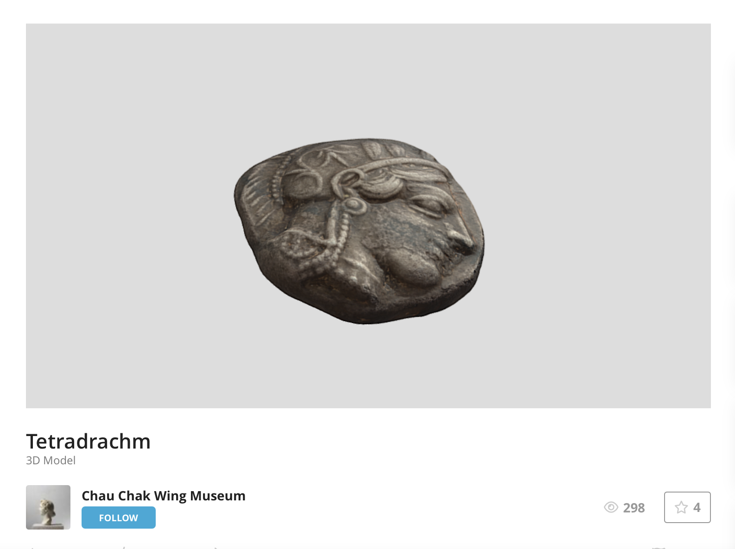
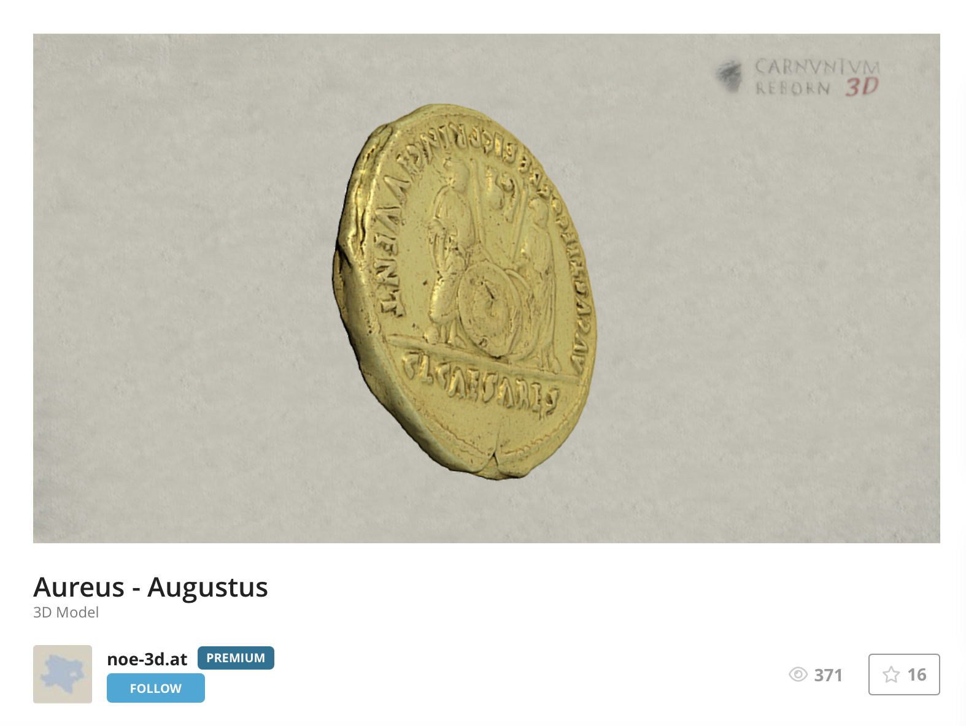
https://sketchfab.com/3d-models/aureus-augustus-cf246df8251b442c8eae5657eebd31f2
https://sketchfab.com/3d-models/tetradrachm-14916dc4d83f46bebddae6e96f998ffe
Notes:
https://sketchfab.com/3d-models/tetradrachm-14916dc4d83f46bebddae6e96f998ffe

Slide 25
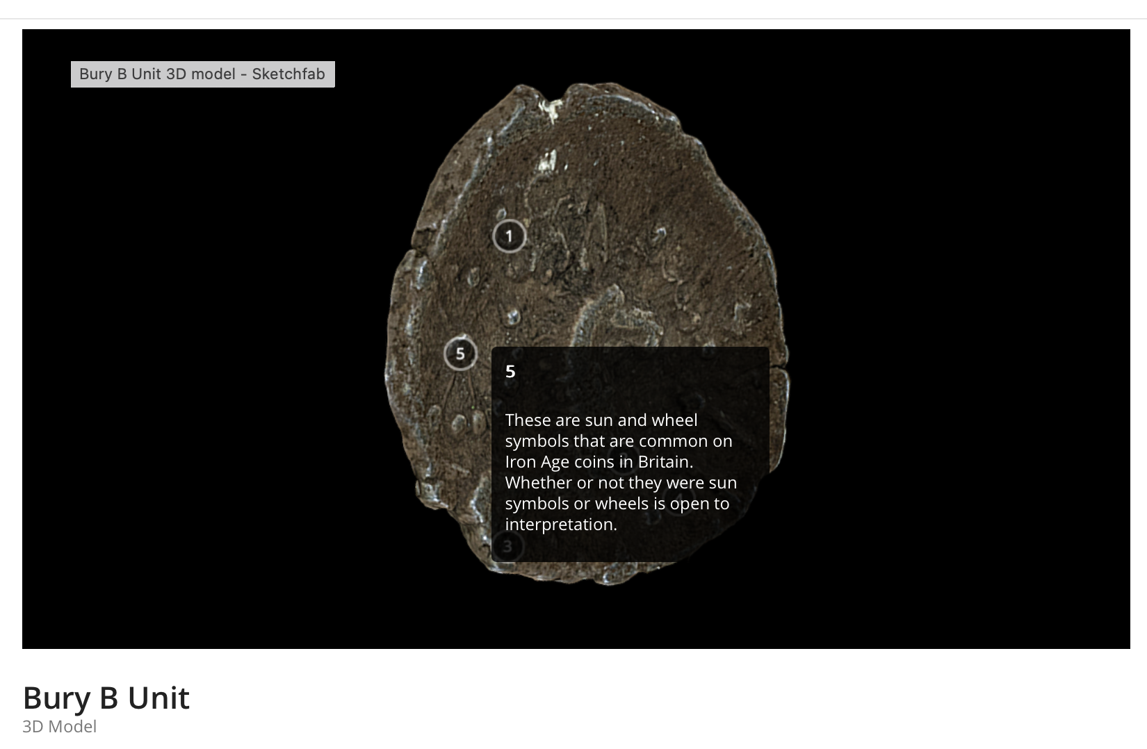
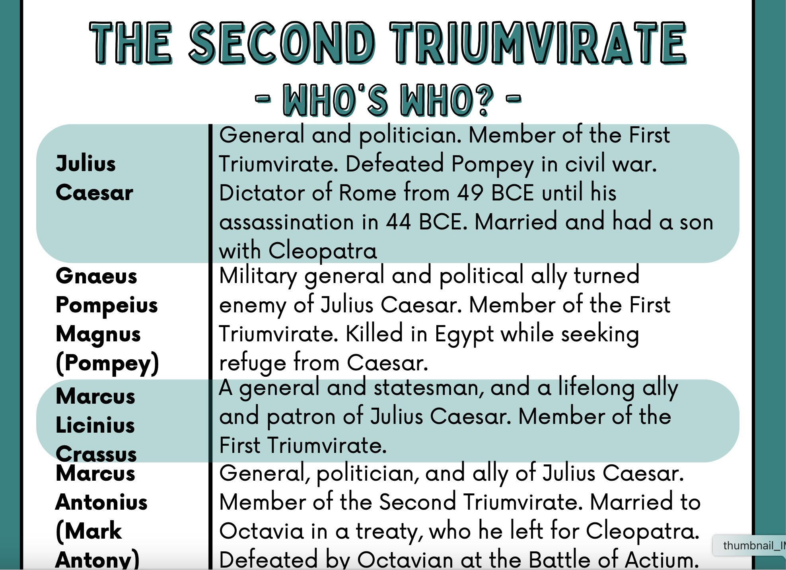
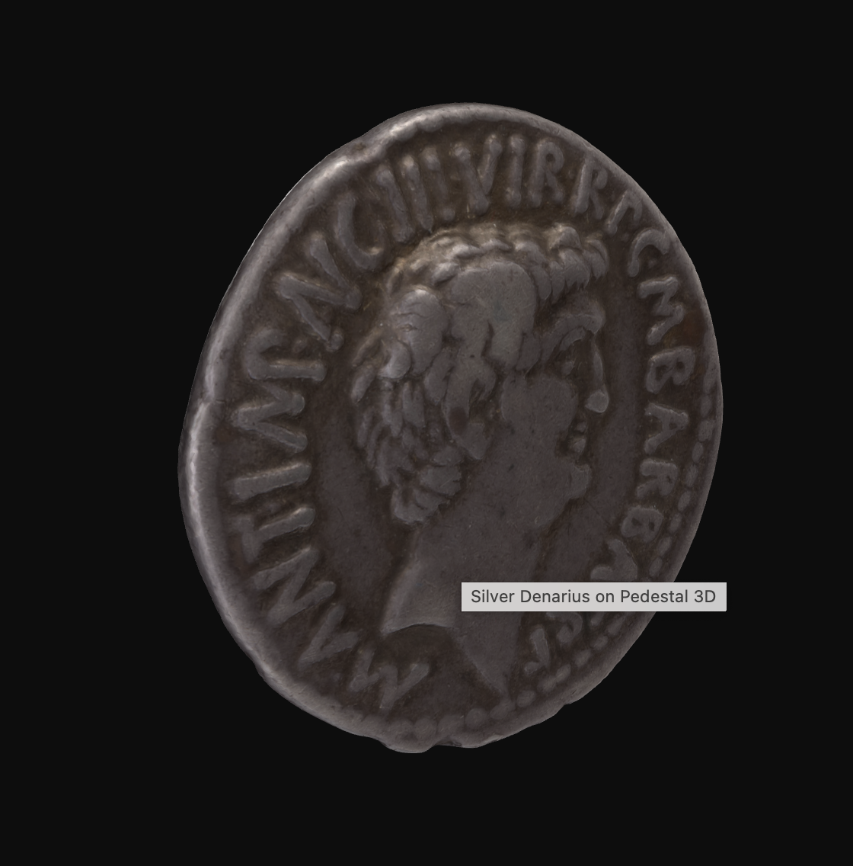
https://mq.pedestal3d.com/r/uC5fqA_f8c
ACANS (2024). Silver Denarius, 07GR517_2. //objectbasedlearning.com/artefacts/07gr517_2/ (accessed on: Mon Feb 17 2025).
Notes:
https://sketchfab.com/3d-models/bury-b-unit-caabb259b1d8433d9e4944db108f4c92

Slide 26
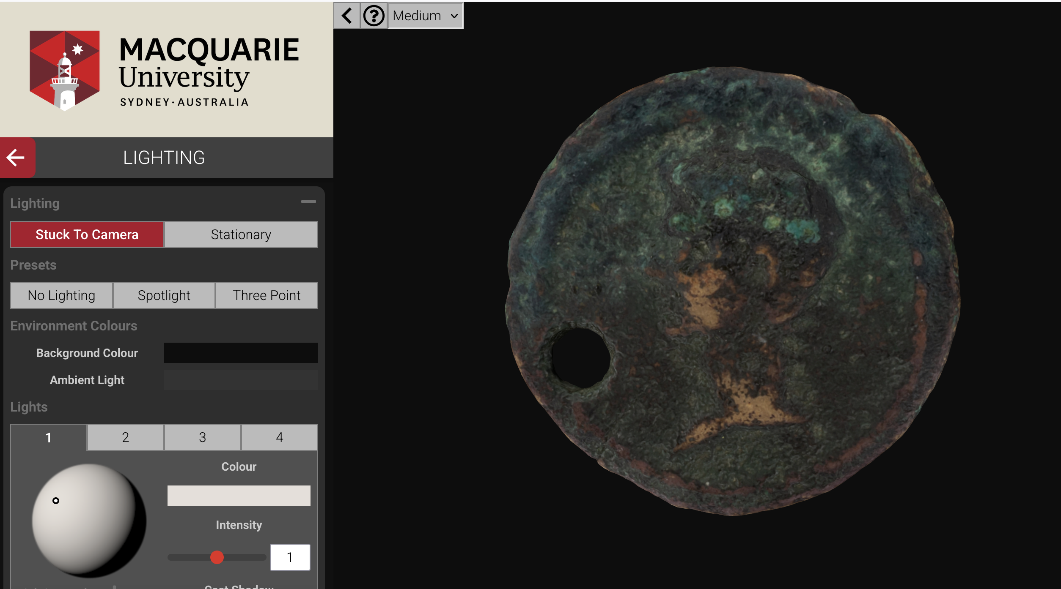
https://mq.pedestal3d.com/r/uC5fqA_f8c

Slide 27
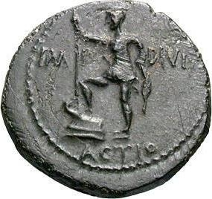
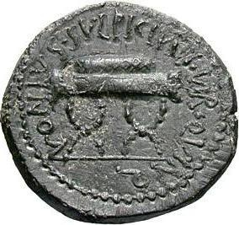
Pella in Macedonia
RPC I, 1548, c. 26 BC (?), Copper 25mm coin
Augustus in military dress, right foot on prow, holding spear, left, IMP DIVI F ACTIO, emperor, son of a god, from Actium /
Wreath on sella curulis, NONIVS SVLPICIVS IIVIR QVINQ, Nonius (and) Sulpicius, quinquennial duovirs

