Slide 1
The Homeric World: Mycenaean Greece
Dr Ellen Adams
ellen.adams@kcl.ac.uk

Slide 2
Contents and challenges
Key Sites
Life in the Mycenaean Age
Decorative Arts
Tombs, Graves and Burials
Prescribed Sources: artworks, architectural features, plans and Linear B
Prehistory/protohistory: creating a narrative
Interpreting visual/material culture - reading plans and images

Slide 3
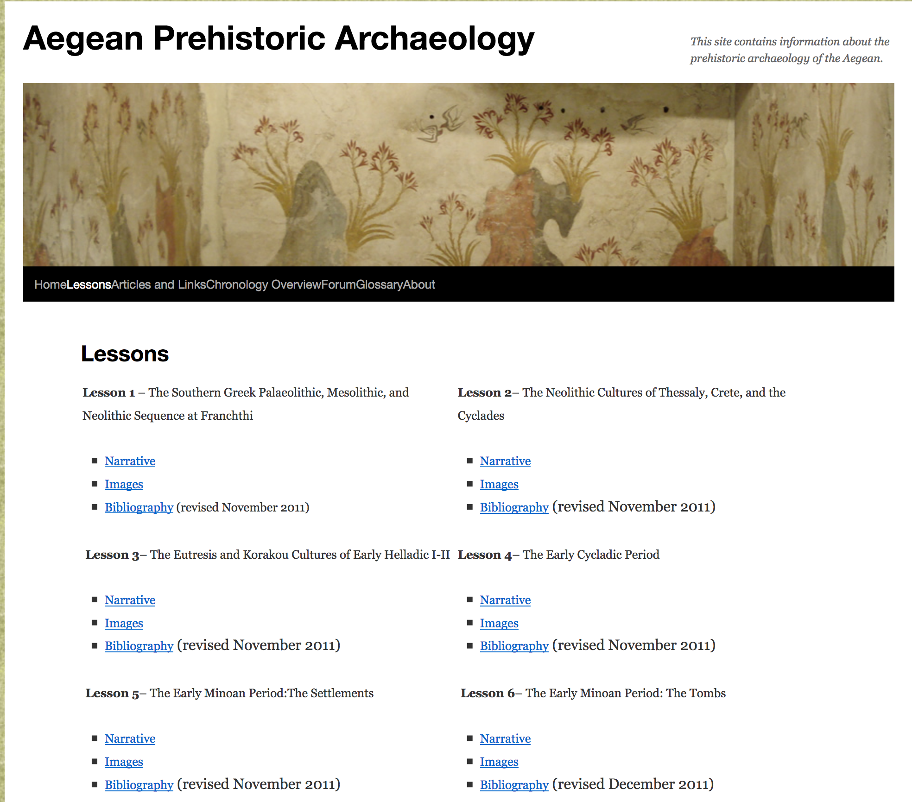

Slide 4
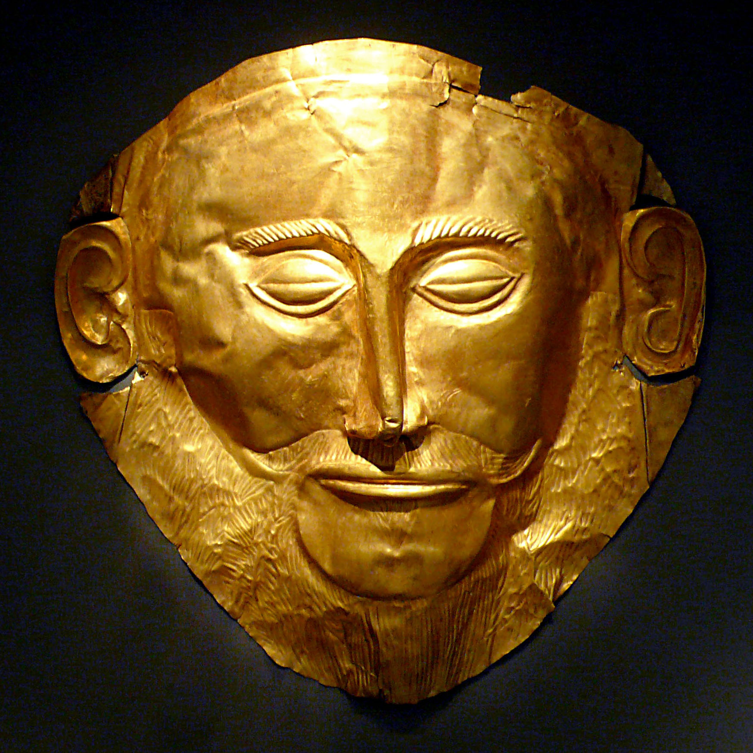

Slide 5
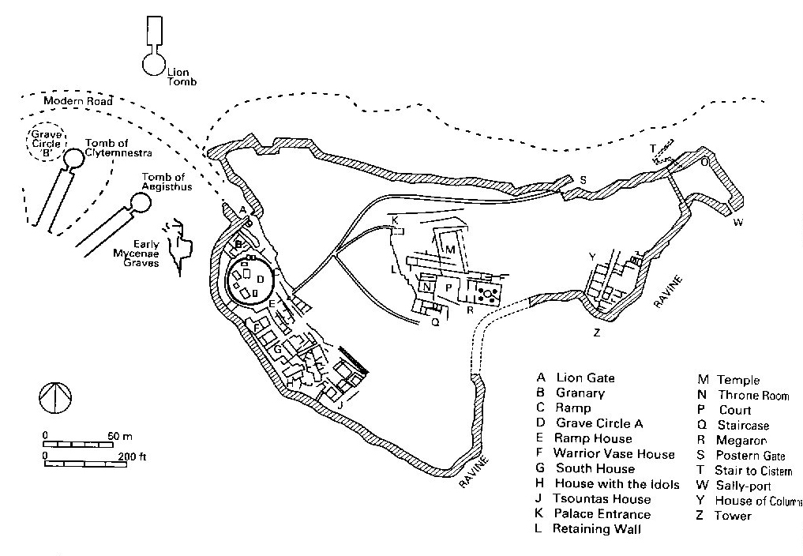

Slide 6
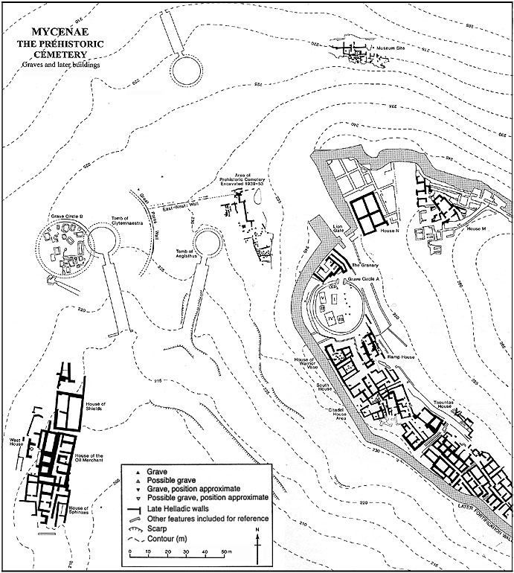
Mycenae — ‘Grave Circles’
B
Mylonas
(1952 - 4)
Earlier, poorer,
more burials
A
Schliemann
(1876)
Later, richer,
fewer burials

Slide 7
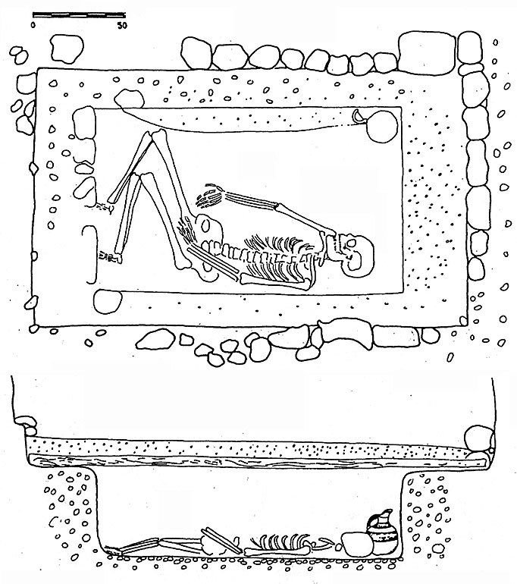
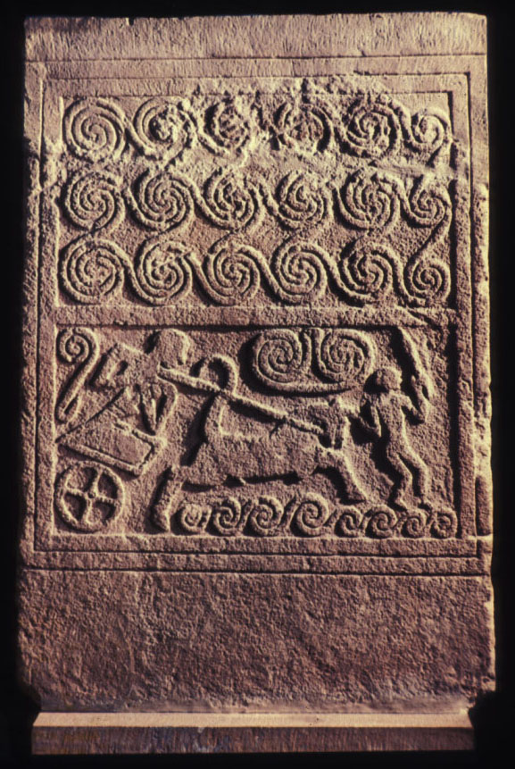
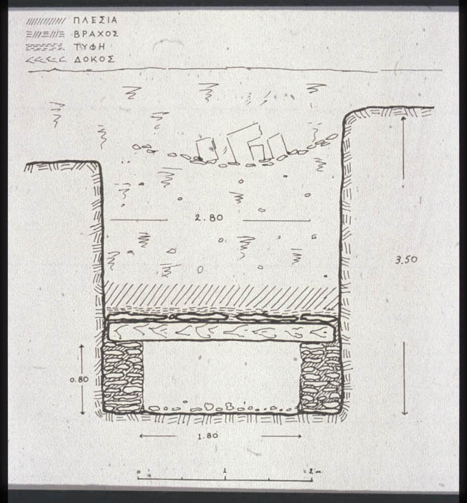
Shaft Grave form and layout

Slide 8
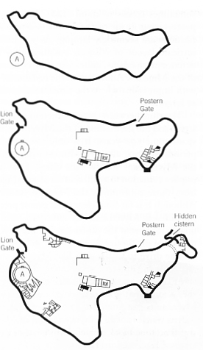
Mycenae wall
c. 1340 BC
c. 1250 BC
c. 1200 BC

Slide 9
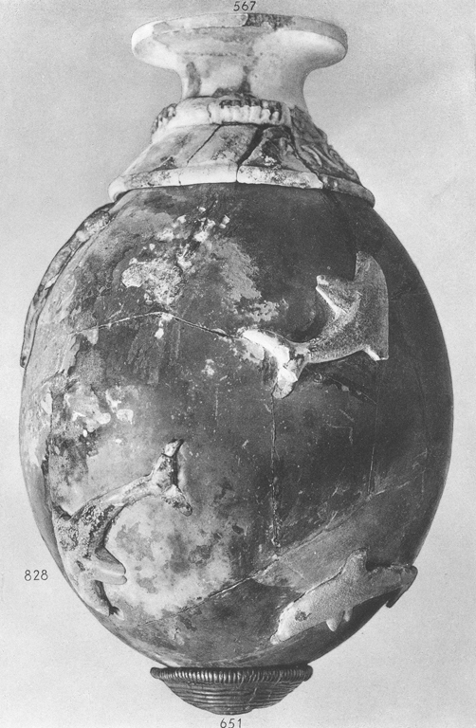
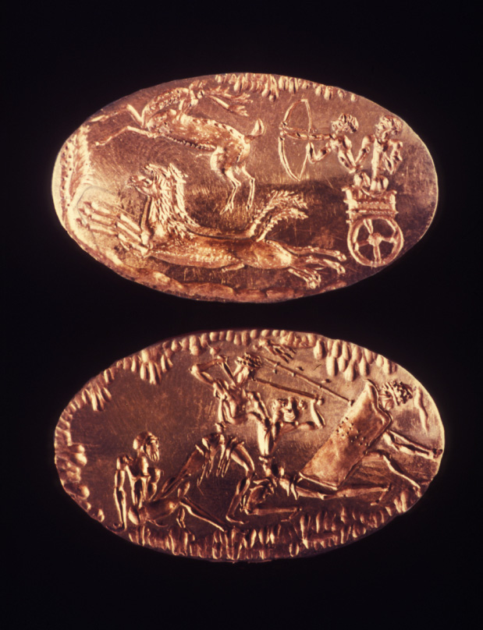
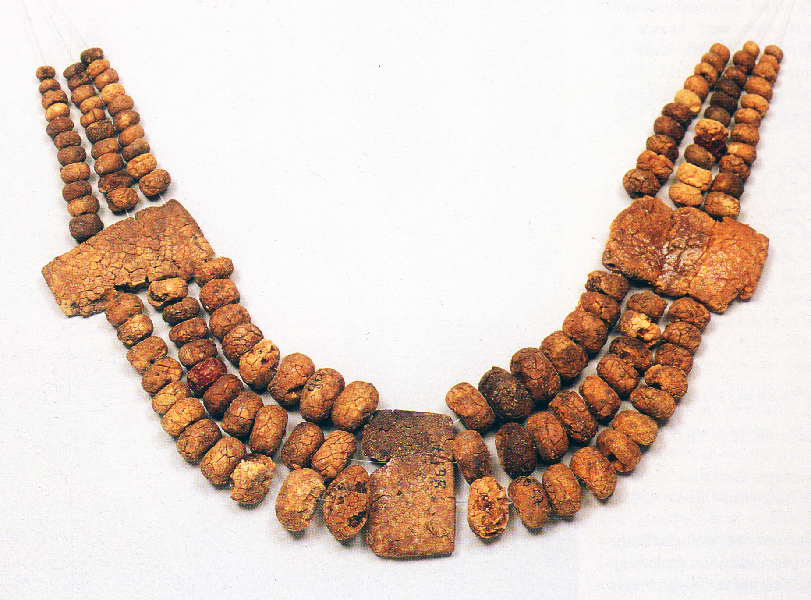
Shaft grave material qualities
Martial
Elaboration of body
Biographical
Exotic
‘East’ (Crete; eastern Med; Anatolia)’
‘North’ (Baltic; filtered through C Europe?)

Slide 11
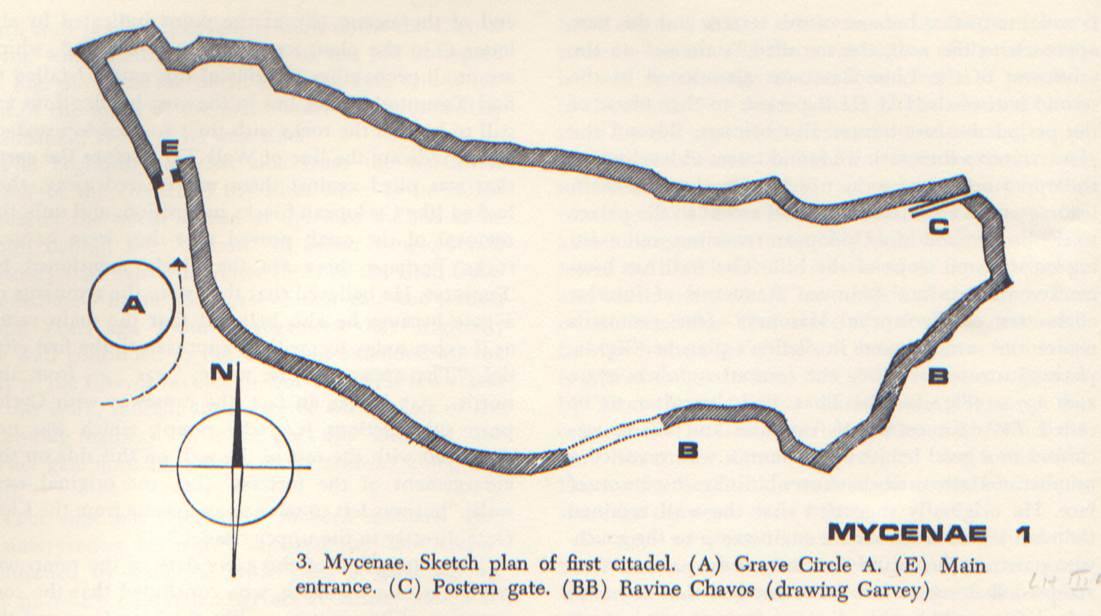
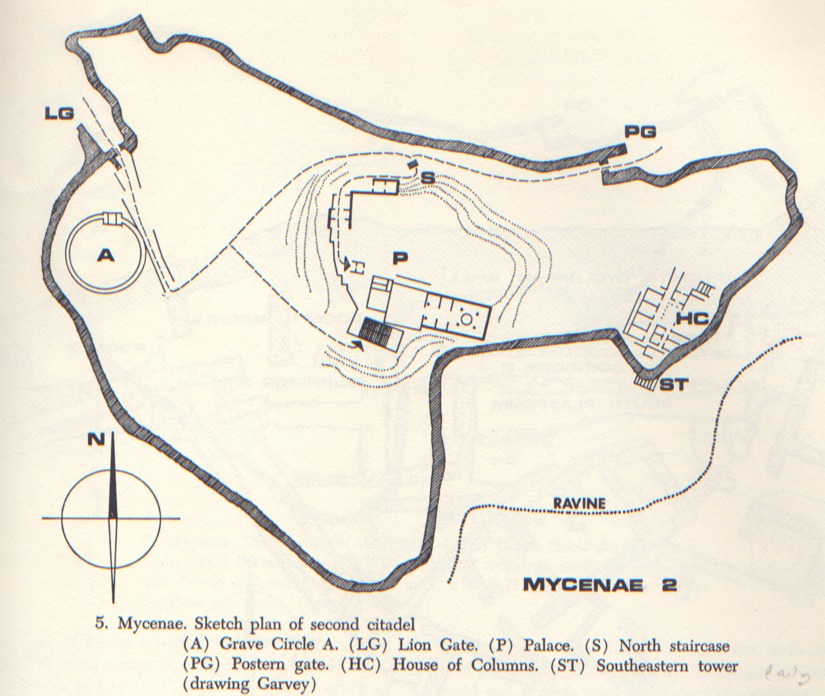
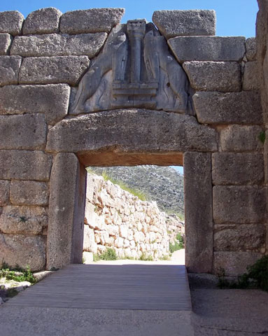
MYCENAE
LH IIIA , c.1340 BC
LH IIIB1, c.1250 BC

Slide 12
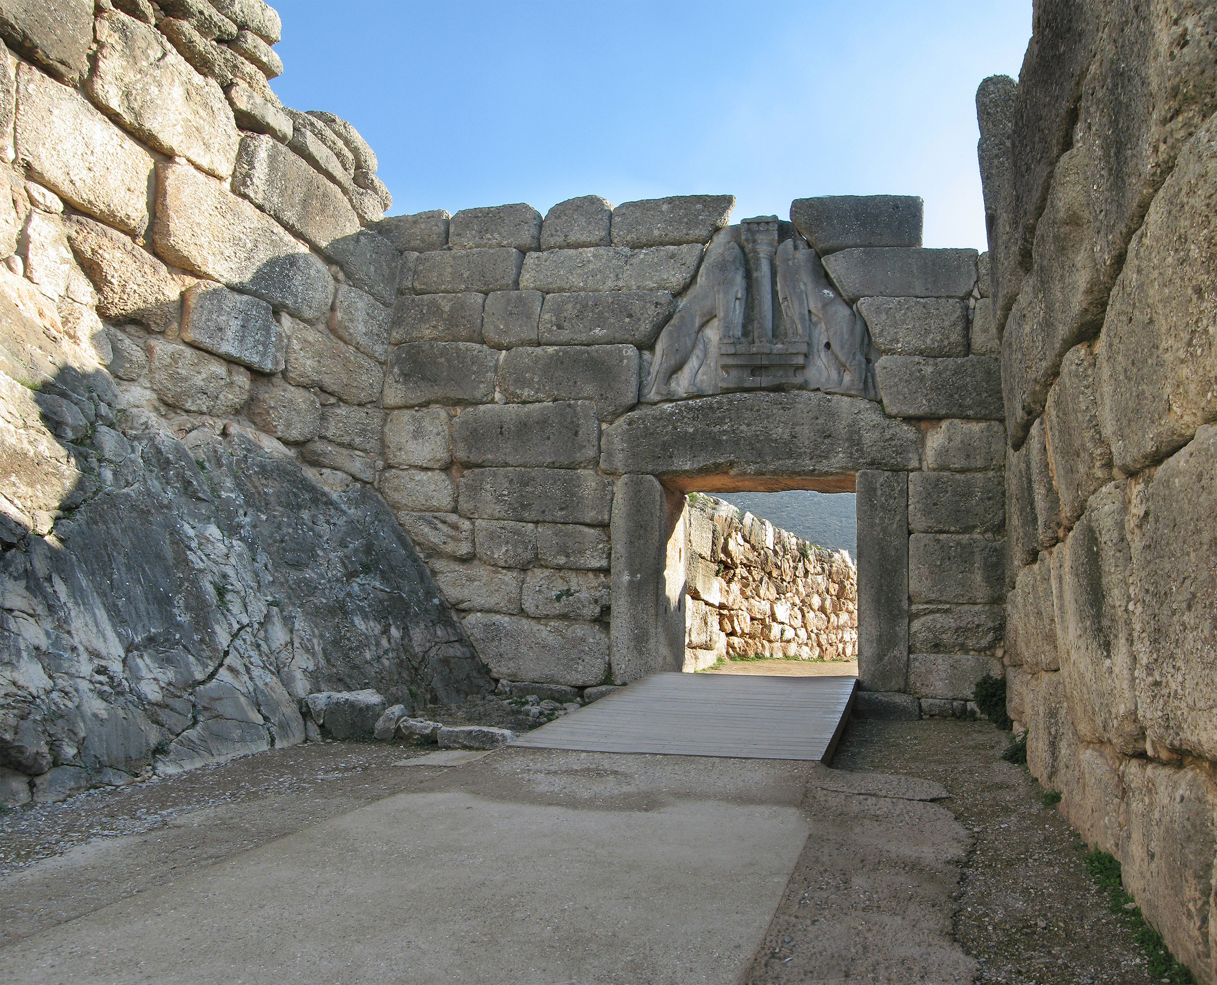
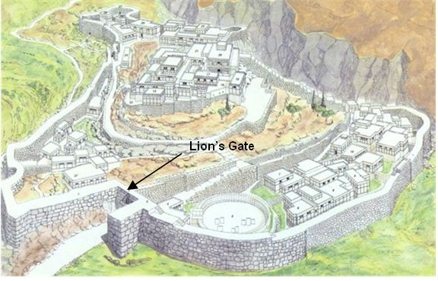
Mycenae
Lion Gate

Slide 13
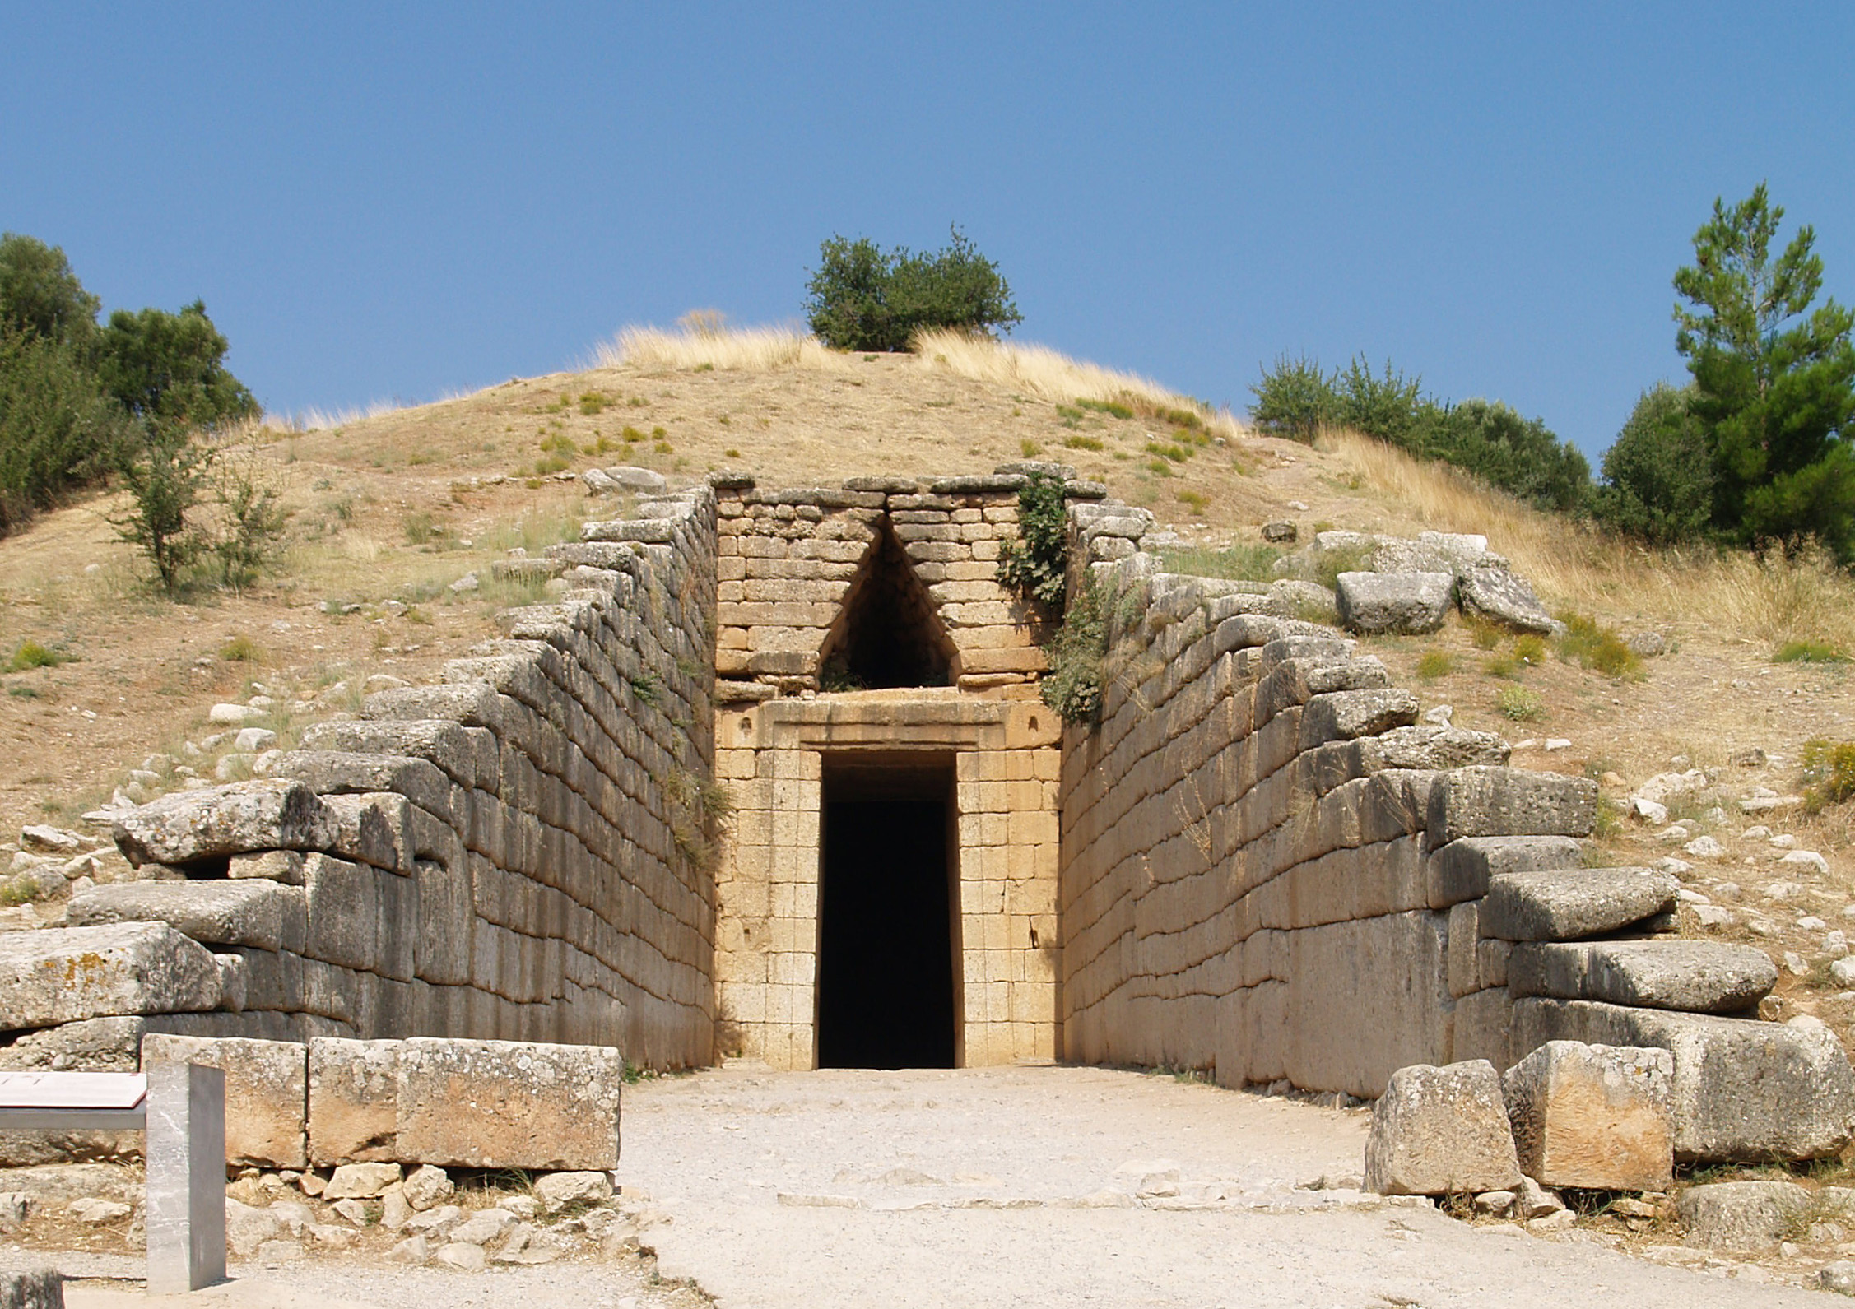
Mycenaean tholos (Atreus)

Slide 14
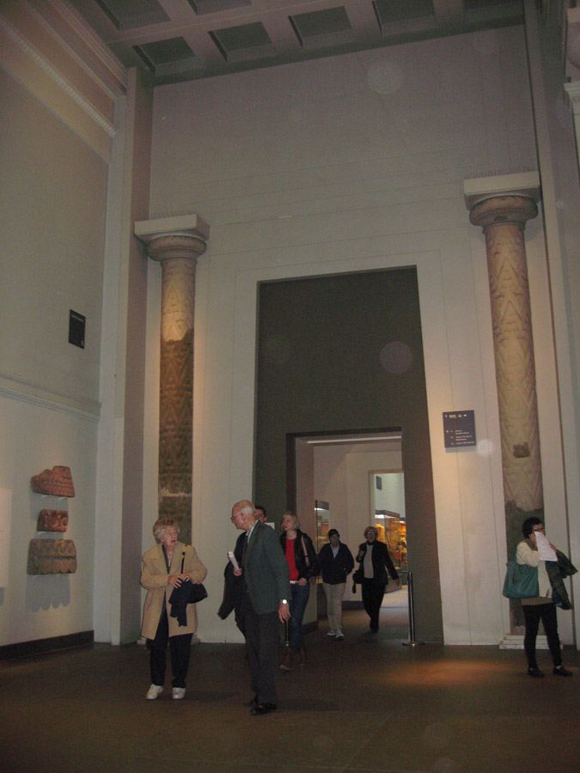
Mycenaean tholos (Atreus)

Slide 15
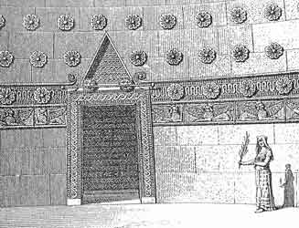
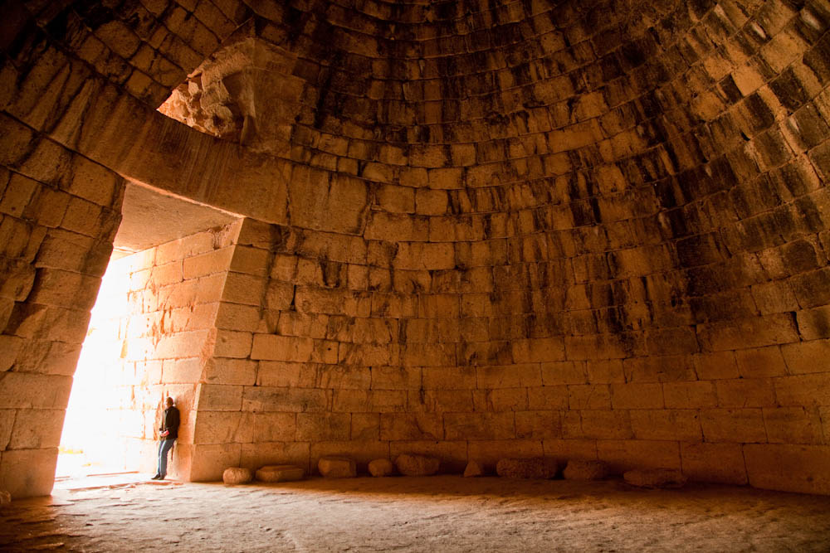
Treasury of Atreus

Slide 16
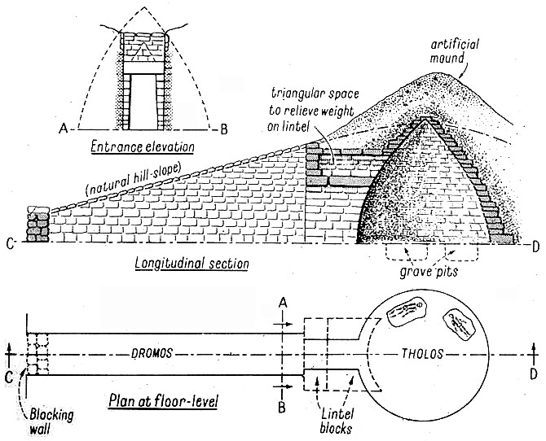
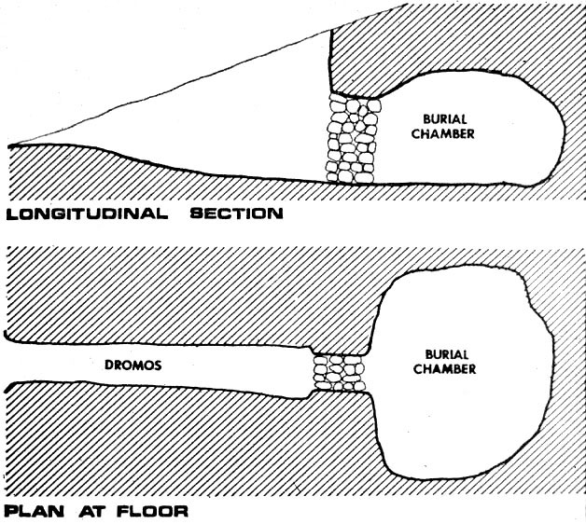
‘Tholos’ versus ‘chamber’ tombs

Slide 17
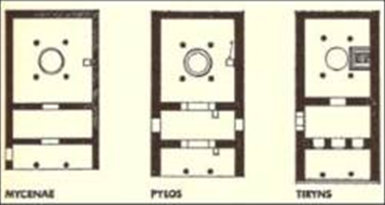
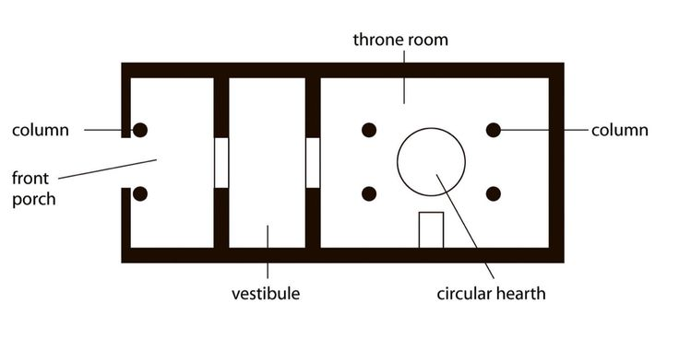
Megaron

Slide 18
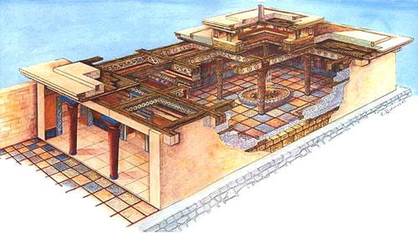

Slide 19
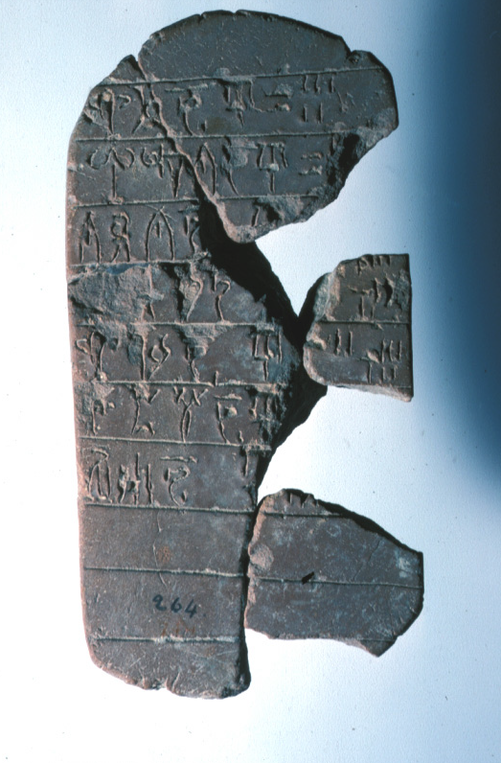
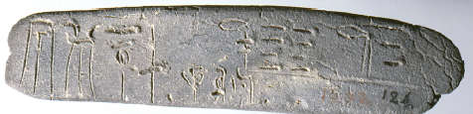
Elongated / ‘palm-leaf tablet’
Linear B
Clay documents
Page-shaped tablet

Slide 20
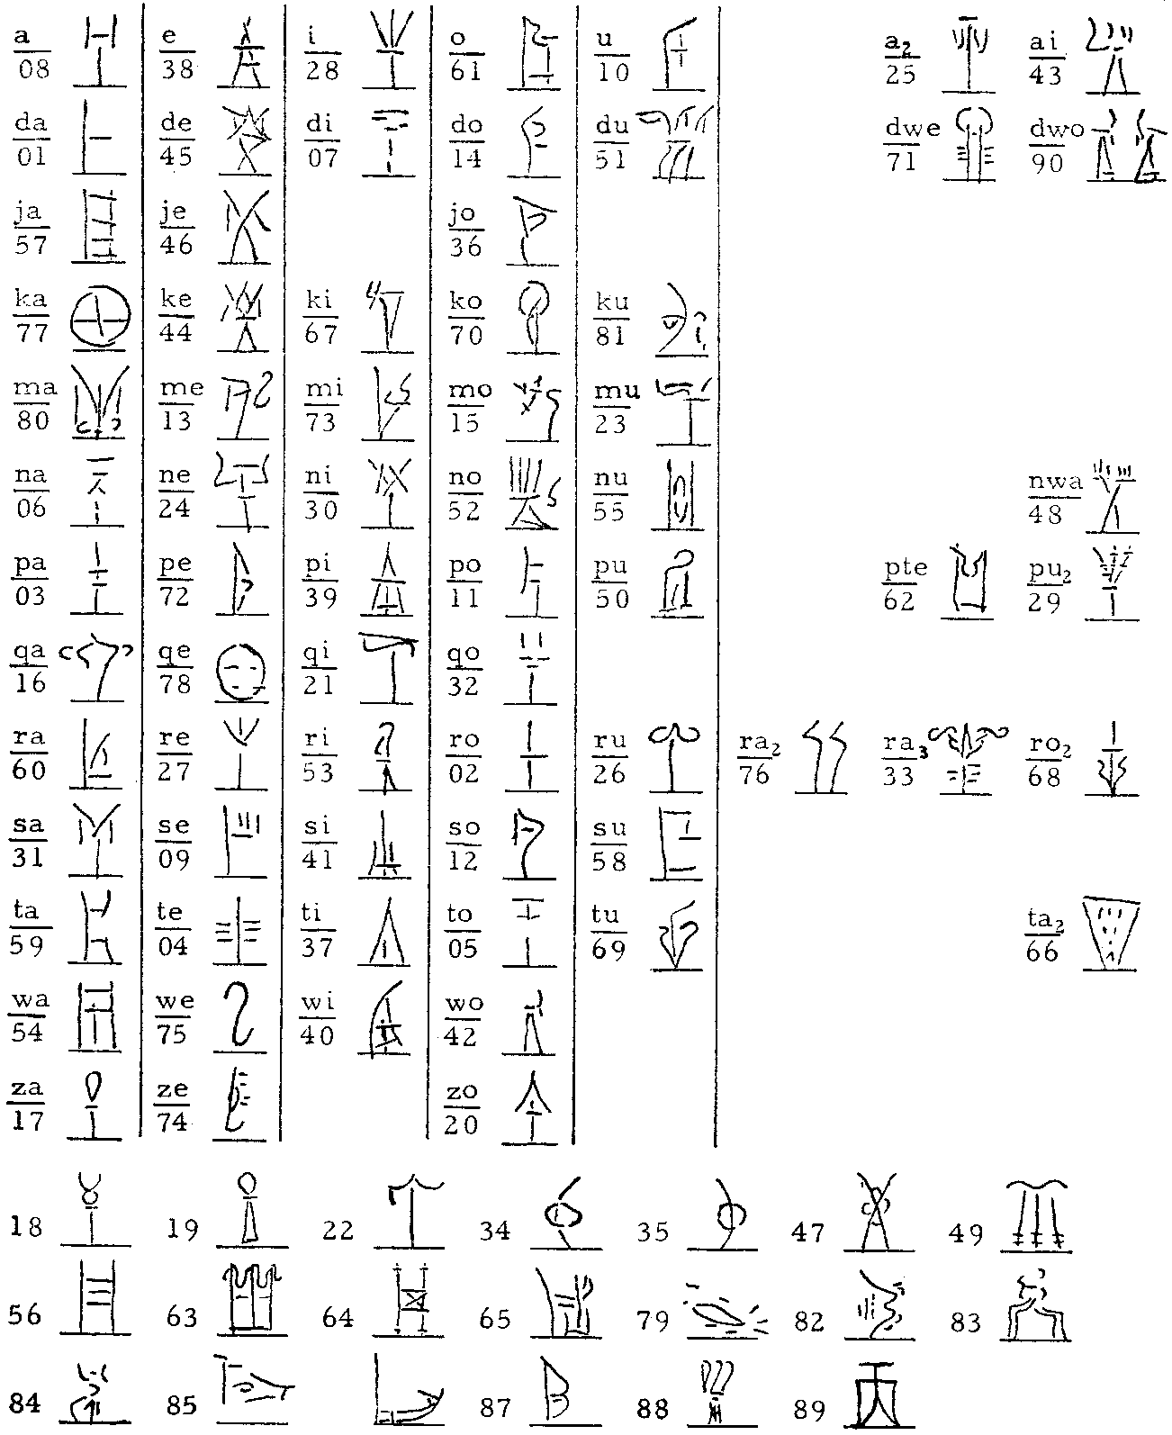
Linear B
The syllabary,
after Pylos scribe
of Class I

Slide 21
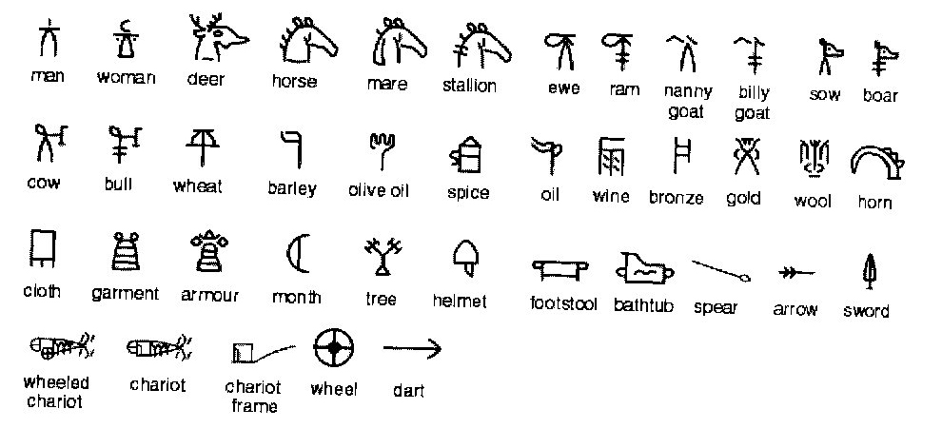
Linear B
Logograms, ‘ideograms’ or commodity signs

Slide 22
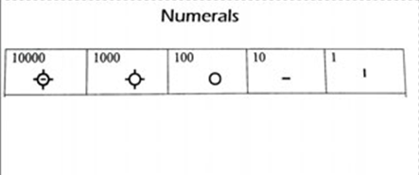
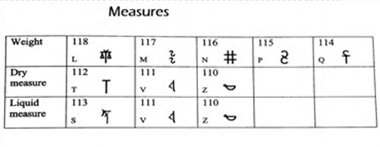
Measures and numerals

Slide 23
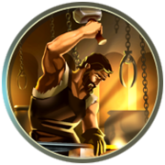
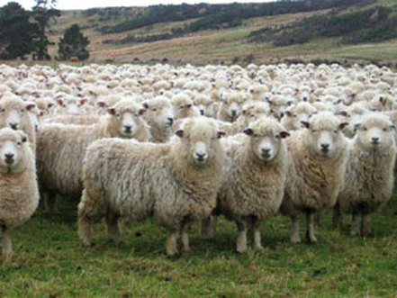
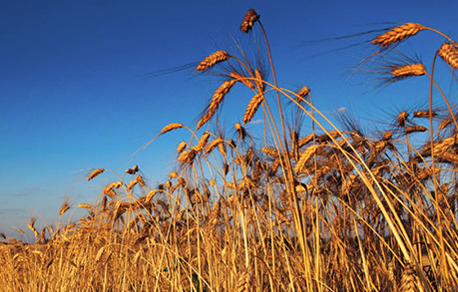
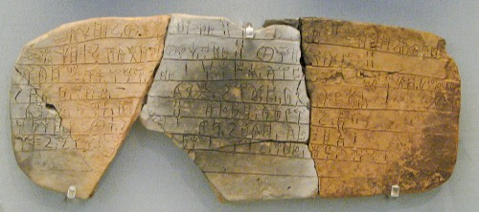
Large scale Animal husbandry Manufacture
agriculture
Records of taxation
Land-holdings
Religious offerings
Contributions to festivals & banquets
Inventories

Slide 24
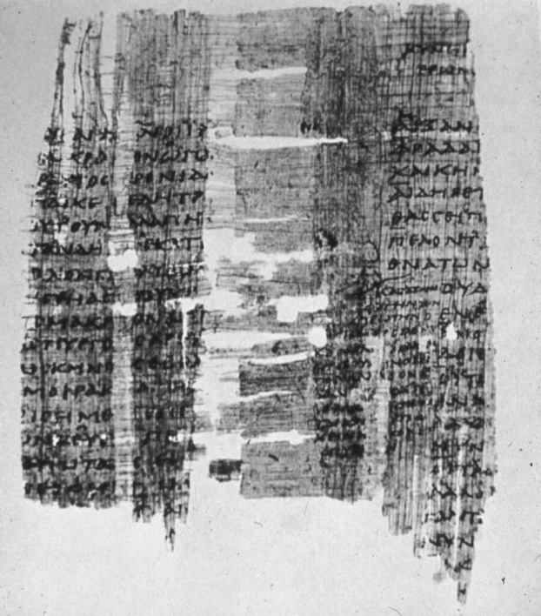
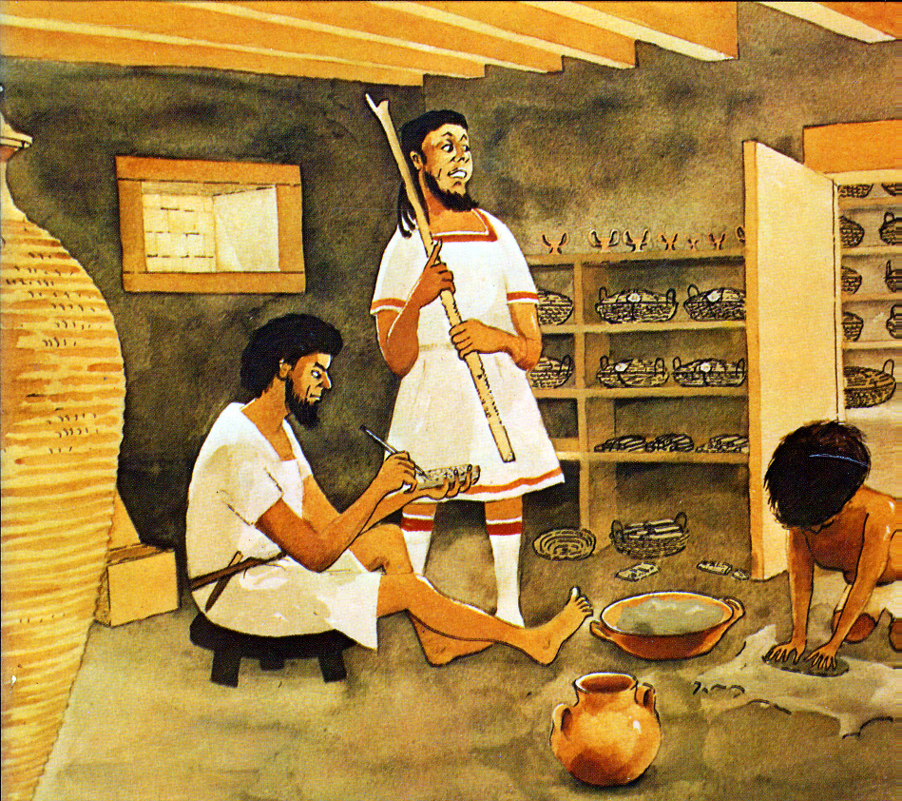
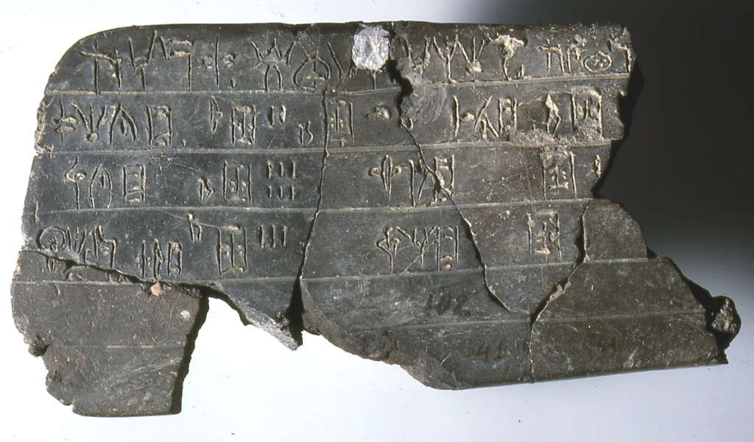
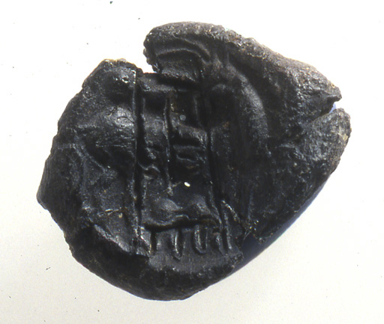
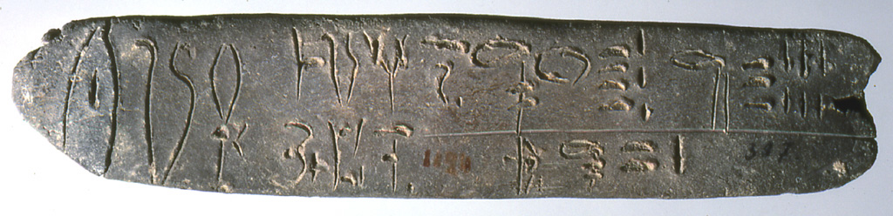
Administrative bureaucracy
?
‘central’ / ‘archival’
‘peripheral’

Slide 25
Potentials & Limitations
texts can offer:
specific types of information re. individual actions
qualitative / quantitative information re. commodities not preserved (e.g., textiles; oil)
(Linear B) texts cannot offer:
diachronic perspective — needs to be linked to archaeological data
total, panoptic view — selective and written from particular point of view

Slide 26
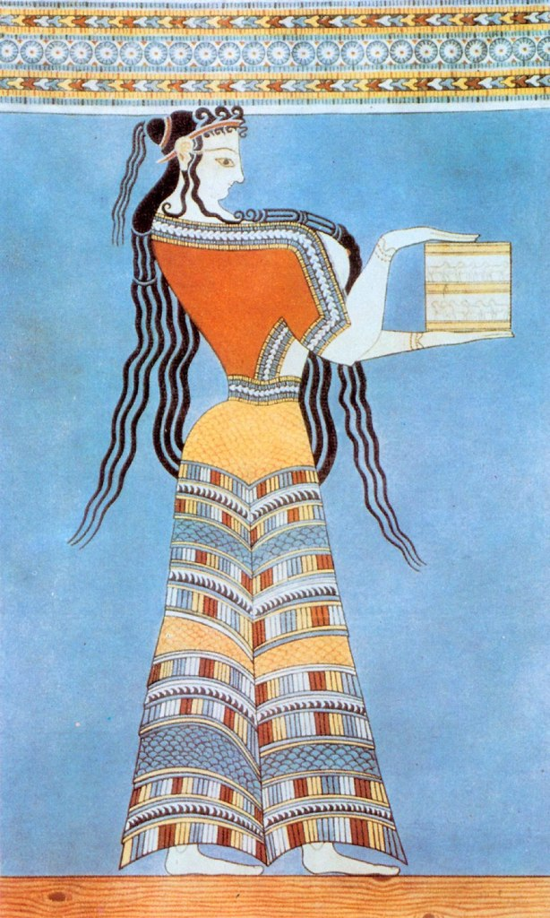
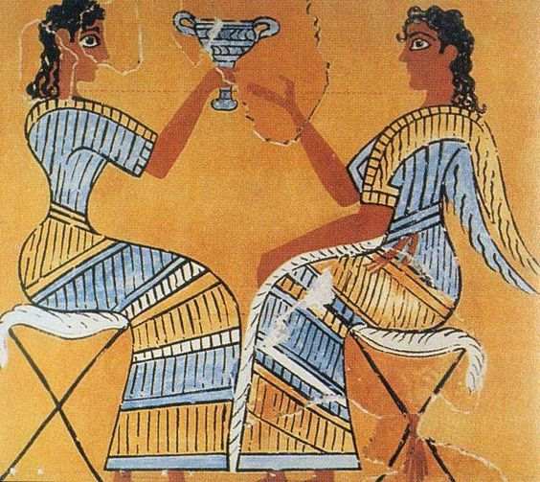
Mycenaean textiles
Detail of woman in Tiryns “Procession
Fresco”
Detail of "Campstool" Fresco Knossos, c. l450-l350

Slide 27
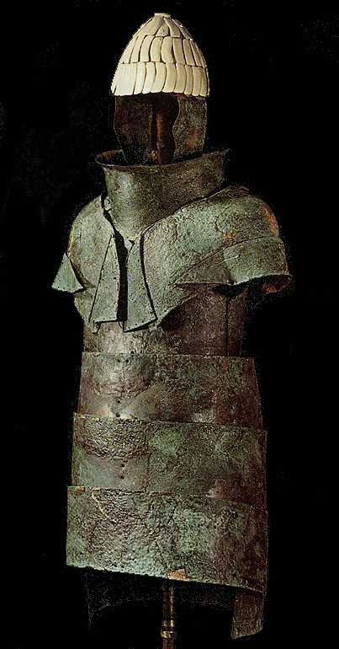
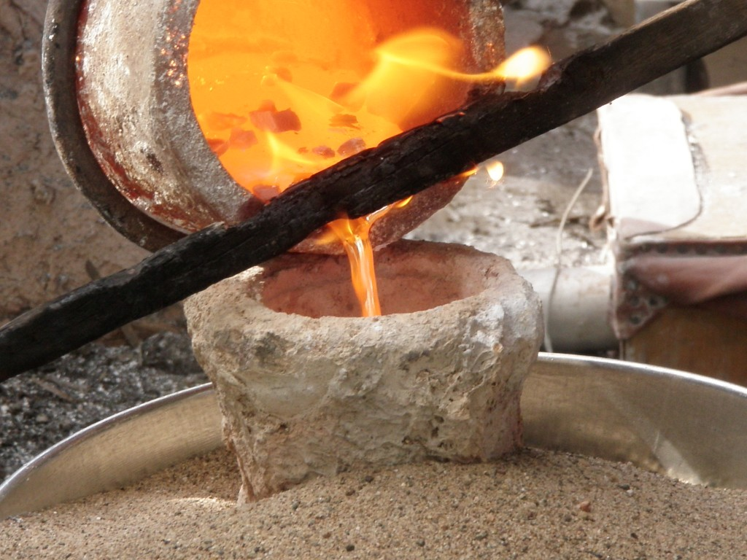
Pylos – ‘bronze’:
c. 576 kg allocated to
c. 300 smiths
at 17 locations
bronze
Dendra panoply

Slide 28
Pylos Deities
PO-TI-NI-JA. Potnia
PO-SE-DA-O-NE. Poseidon
PO-SI-DA-E-JA. Posidaieia
DI-WE/DI-WI-JE-U. Zeus
DI-W-JA. Diwia
E-RA. Hera
A-TI-MI-TE. Artemis
E-MA-A. Hermes
A-RE-JA. Ares?
DI-WO-NU-SO-JO. Dionysos
MA-TE-RE TE-I-JA. Mater theia
TE-O-I. The gods
TE-O. (The) god

Slide 29
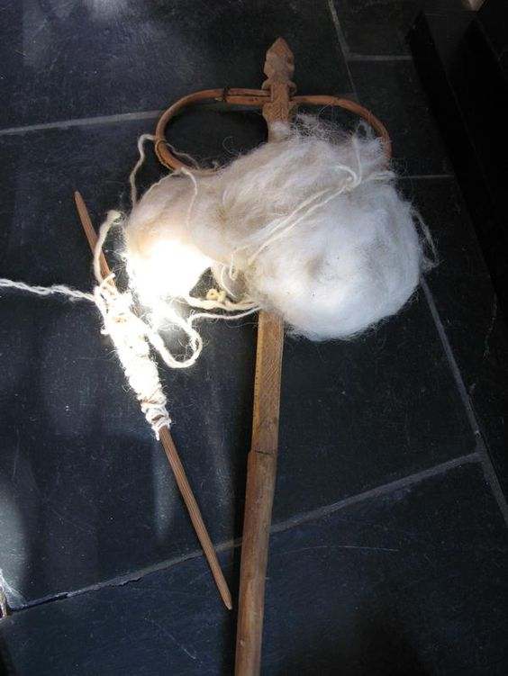
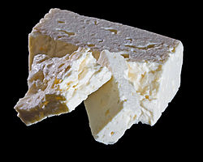
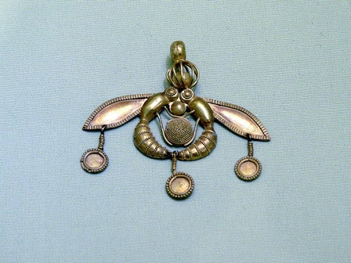
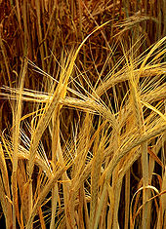
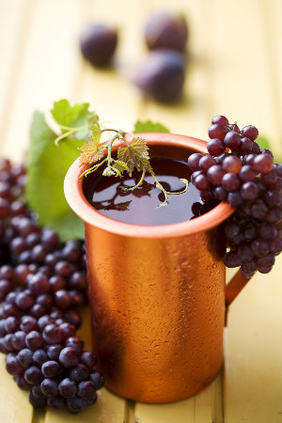
Offerings: bloodless
Honey
Cheese
Wool
Barley
Wine
Other terms:
TE-O-PO-RI-JA ( = theophoria). A festival

Slide 30
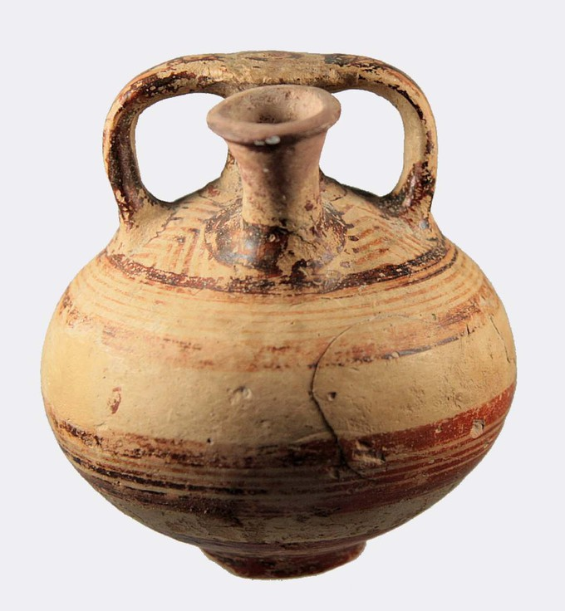
Offerings: bloodless
Blood sacrifice:
Suovetaurilia
Sus: pig
Ovis: sheep
Taurus: bull
Honey
Oil
Cult personnel:
I-JE-RE-U = hiereus
I-JE-RE-JA = hiereia
KA-RA-WI-PO-RO (=klarwiphoros)
PU-KO-WO (=purkooi)
KI-RE-TI-WI-JA
I-JE-RO-WO-KO (=the hierourgoi)
Festivals:
RE-KE-TO-RO-RI-JO. Lekhestroterion
TO-NO-E-KE-TE-RI-JO. Thronohelkesterion
ME-TU-WO NE-WO
TU-RU-PTE-RE-JA. Thrypteria

Slide 31
Implications of decipherment
Mycenaeans spoke Greek
Greek did not arrive with the ‘Dorian invasion’ after the fall of the palaces
Homer’s heroes spoke Greek in the Bronze Age
Oral poetry handed down traditions in Greek
The Mycenaeans worshipped deities with the same names as later Greeks
Rewriting of European history

Slide 32
Chronological sequence
Minoans Mycenaeans Dark Age Homer Classical
Birth of western history…

Slide 33



Mycenae Lion Gate
Dodwell 1834

Slide 34

Warrior Vase

Slide 35


Boar tusks helmets

Slide 36



Heinrich Schliemann and Troy

Slide 37

The ‘Jewels of Helen’

Slide 38

Troy II and Troy VI
Troy II unshaded: Early Bronze Age
Troy VI shaded: Late Bronze Age

Slide 39


Slide 40


uluburun

Slide 41




Uluburun –
raw materials
Copper Ingots
(354 oxhide; 121 bun)

Slide 42



Uluburun – manufactured goods
Luxury items
Gold chalice
Faience ram’s
head rhyton
Canaanite Figurine
Bronze with gold foil - Expensive / Prestigious:
Cargo or Protective Deity?

Slide 43





Mycenaeans on the uluburun ship?
Mycenaean pottery
Mycenaean steatite
lentoid seal
Glass beads

