Slide 1
GCSE Classical Civilisation
War & Warfare
4.3.The Roman Military in the Imperial Period
4.4 The Romans at War

Slide 2
4.3 The Roman Military in the Imperial Period
How the Roman army and navy were paid for, recruited and trained in the imperial period
The structure, organisation and command of the army and navy:
  how a legion was organised
  layout of a legionary fortress
The equipment of the army and navy and how it was used in battle
The tactics and formations used by the army and navy
TWO PRESCRIBED SOURCES (but can do more…)

Slide 3
E.g. Structure of a Legion
    contubernium – 8
    century – 80 [10 x contubernium]
    cohort – 480 [6 x century]
      except first cohort – 800 [5 x 160 centuries]
    legion – c.5120 [first cohort + 9 x cohort]
    BUT these numbers are not representative
      extras e.g. scouts etc
      and in practice, numbers differed
    century has centurions
      first cohort has 5 primi ordines
      most senior is primus pilus
      also signifier, optio, tesserarius & cornicen
    legion led by non-professionals
      legatus
      6 tribunes
        most senior = tribunus laticlavius
        Other 5 tribuni angusticlavi
    camp prefect
    aquilifer

Slide 4
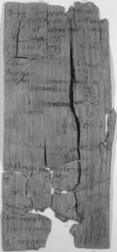
Tab. Vindol. 1 154
“18 May, net number of the First Cohort of Tungrians, of which the commander is Iulius Verecundus the prefect, 752, including centurions 6
of whom there are absent:
guards of the governor 46
at the office of Ferox
at Coria 337
including centurions 2 (?)
at London centurion 1 (?)
… 6
including centurion 1
… 9
including centurion 1
… 11
at (?) … 1 (?)
45
total absentees 456
including centurions 5
remainder, present 296
including centurion 1
from these:
sick 15
wounded 6
suffering from inflammation of the eyes 10
total of these 31
remainder, fit for active service 265
including centurion 1.”

Slide 5
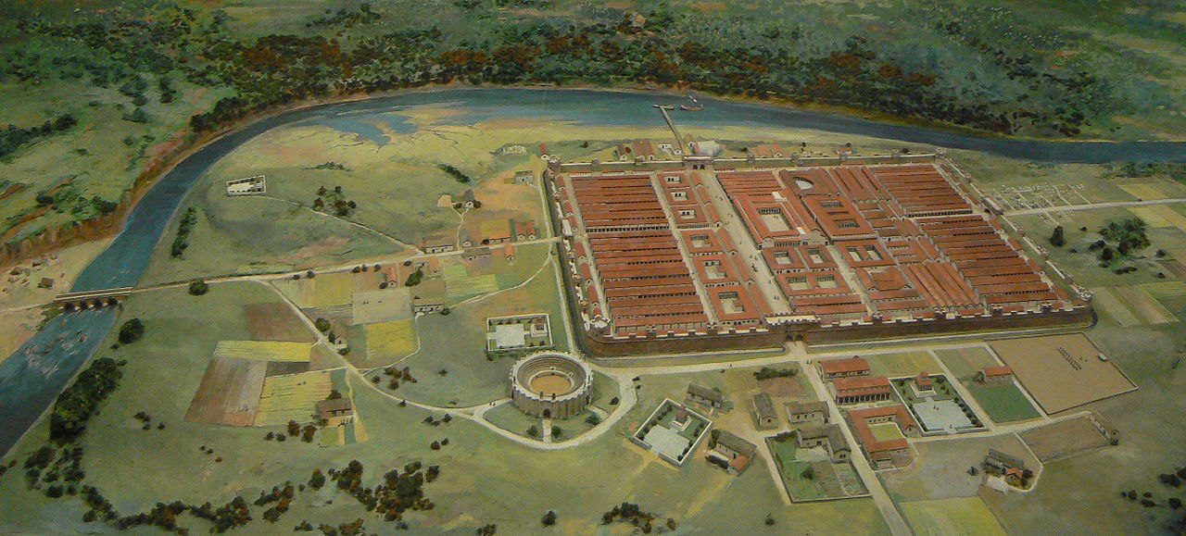
(Roman fortress at Chester)
E.g. Structure of a Fortress

Slide 6
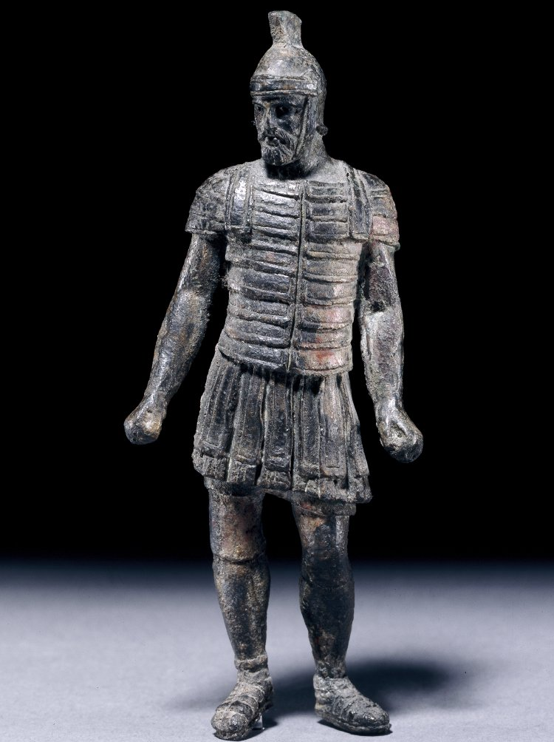
Bronze statuette of a legionary
British Museum (1867,0510.4)
E.g. Legionary Equipment
helmet
tunic & lorica segmentata
(& shield, sword, dagger & spear)
sporran
leather sandals

Slide 7
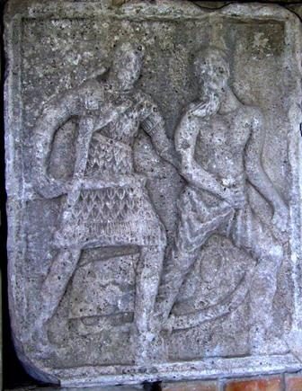
(BUT be aware of variety… and decoration)
“There has never been a regulation for dress and weapons in the Spanish infantry because that would remove the spirit which is necessary in a soldier. It is the finery, the plumes and the bright colours which give spirit and strength to a soldier so that he can with furious resolution overcome any difficulty or accomplish any valorous exploit.”
17th C officer, quoted in G. Parker, The Army of Flanders and the Spanish Road 1567-1659 (Cambridge, 1972), 164
Tropaeum Traiani (Adamklissi)

Slide 8
4.4 The Romans at War
The battle at Actium
  key events & individuals (Octavian, Marcus Agrippa, Mark Antony, Cleopatra)
  significance of the battle and how the Romans commemorated it
Trajan’s campaign against the Dacians
  reasons for the war
  presentation of warfare in the material sources
  image of Trajan as emperor
  pursuit of military glory
  victims of warfare
FOUR PRESCRIBED SOURCES (but can do more…)

Slide 9
Background
modules are both focused on the first and second centuries
the early and high Empire
Octavian/Augustus through to Trajan
period of Rome’s professional army (cf. Greece)
Actium and Dacian war bookend that period
  31BC: end of civil war & “start” of the imperial period?
  101-102AD; 105-106AD: height of Empire & Rome’s optimus princeps
about place of war in society: how used? how seen?
i.e. two battles actually tell us about wider politics & culture
war is a window onto changing nature of Empire

Slide 10
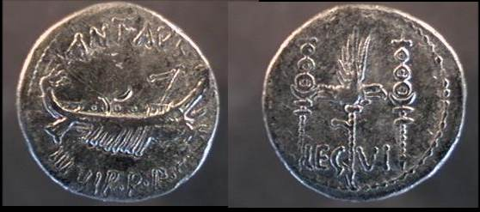
Mark Antony Legionary denarius, Obv: galley with banners; ANT AUG III VIR R P C (triumvir rei publicae constituendae), Rev: eagle between two standards, likely minted in Patrae 32 BC (example BMC 197, RSC 33, Sear 356)
E.g. A Propaganda War

Slide 11
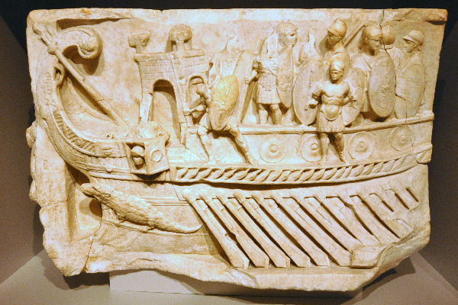
Relief commemorating the battle of Actium, Vatican Museum
(originally in Praeneste)

Slide 12
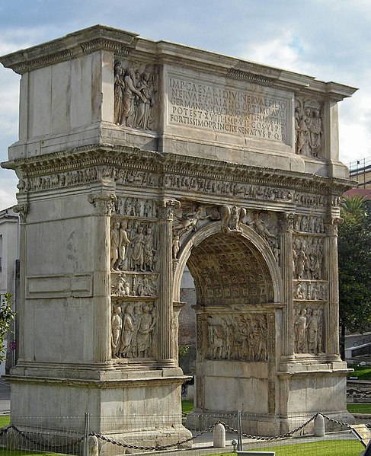
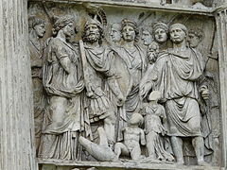
The Arch of Trajan, Benevento

Slide 13
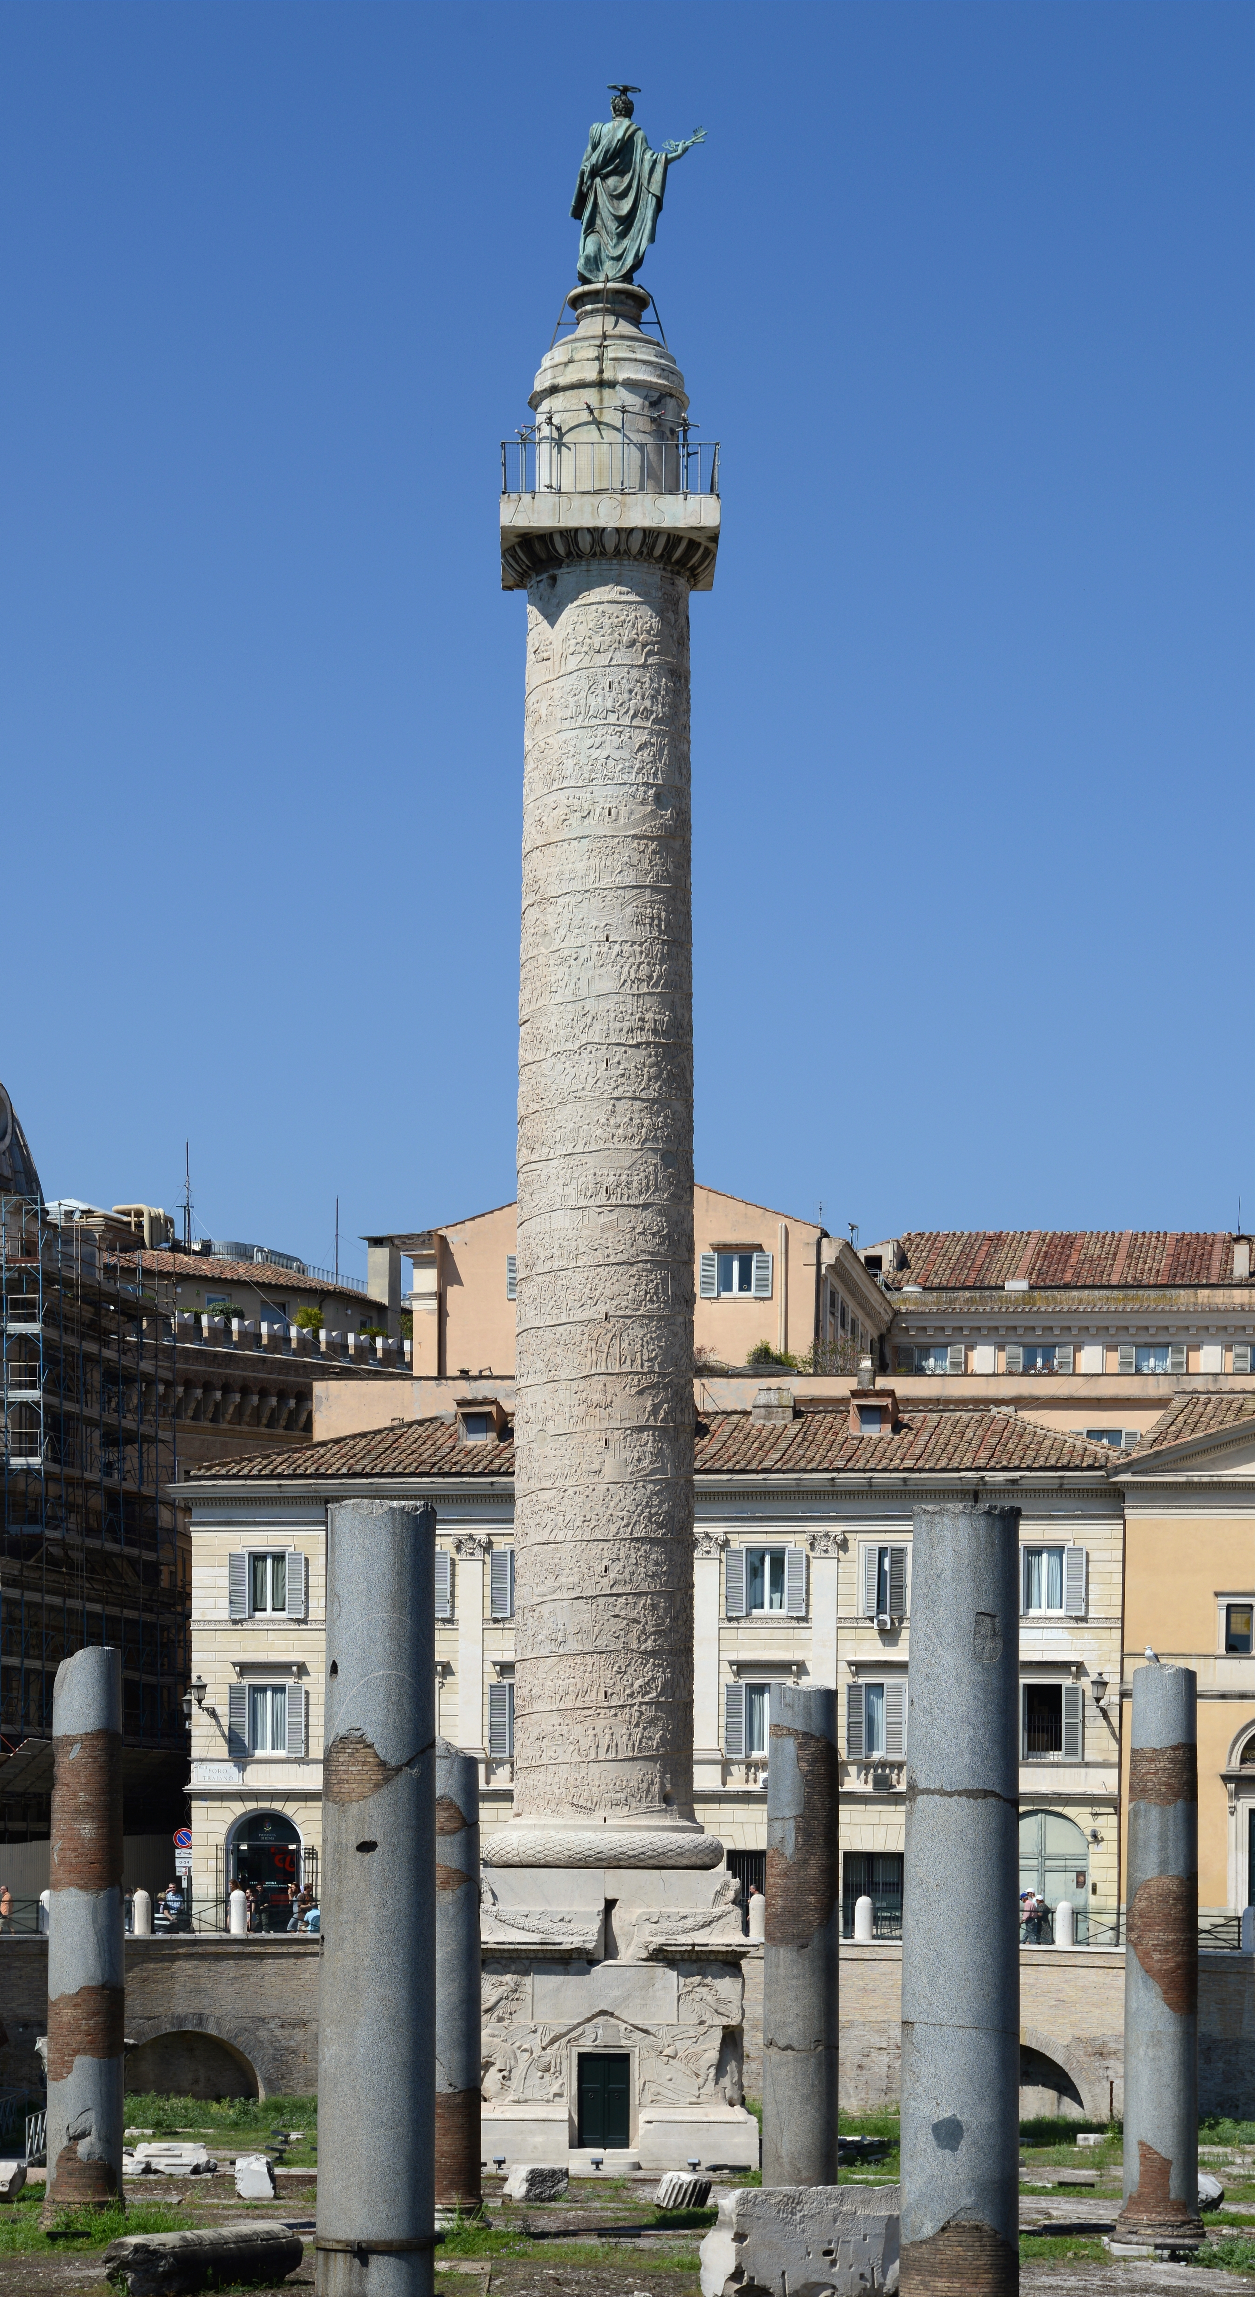
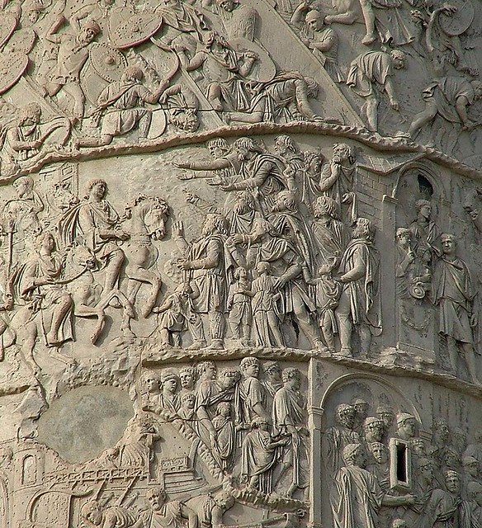
Trajan’s Column

Slide 14
Case Study: Trajan’s Column
A rather odd monument:
  why erect a war memorial?
  why here?
  why in this form?
    traditional?
    innovative?
  who is it about?
  who is it for?
  who paid for it?

