Slide 1
Rise up, o [king’s name]
Take your head
Collect your bones
Gather your limbs
Shake the earth from your flesh
Where was this found and what is it?

Slide 2
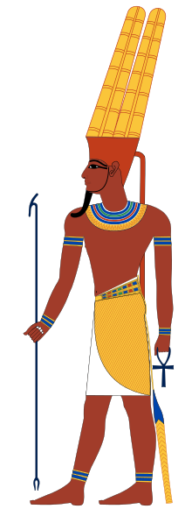
The fall of the Old Kingdom and rise of the Middle Kingdom
Alexander's gonna love me
Learning Objectives:
To learn about the fall of the Old kingdom and the rise of the Middle Kingdom
To learn about the changes in beliefs and power structures during this period

Slide 3
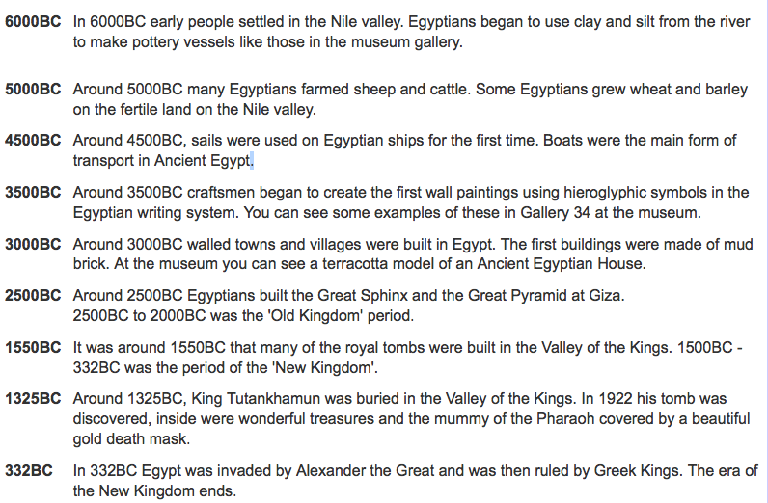

Slide 4
Read together the end of the Fourth Dynasty

Slide 5
List the changes in the fifth dynasty in terms of royal burials
What did many fifth dynasty kings add to their names?
How did the Egyptians attempt to protect their king in the after life from dangerous words – give examples

Slide 6
What reasons are there for the collapse of the Old Kingdom? List at least 4 points
What was the ‘First Intermediary Period’?
Which god came to prominence during the Middle Kingdom?
What evidence is there to suggest the end of the Middle Kingdom was a time of political instability?

Slide 7
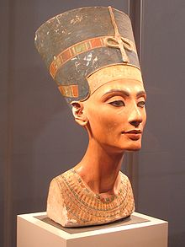
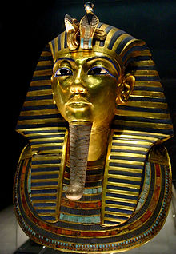
Ancient Egypt - homework
I will email!
Nefertiti
Dates of birth and death:
Religious controversy:
Position / power:
Tutankhamun
Dates of birth and death:
Name meaning:
Age he became Pharaoh:
Religious ideas:
Any other interesting facts:

Slide 8
The fall of the Old Kingdom and rise of the Middle Kingdom
Alexander's gonna love me
Learning Objectives:
To learn about the fall of the Old kingdom and the rise of the Middle Kingdom
To learn about the changes in beliefs and power structures during this period

Slide 9
Ancient Egyptian history is 3000 years long:
1. List all the changes from the beginnings of the Old kingdom to the collapse of the Middle Kingdom (3000-2000 BC)

