Slide 1
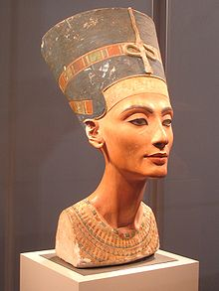
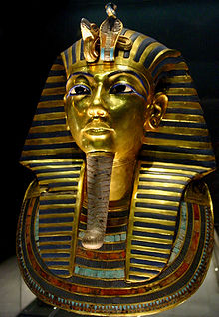
Ancient Egypt - homework
Nefertiti
Dates of birth and death:
Religious controversy:
Position / power:
Tutankhamun
Dates of birth and death:
Name meaning:
Age he became Pharaoh:
Religious ideas:
Any other interesting facts:

