Slide 1
True or false?
Cleopatra was Egyptian.
Egyptian women had fewer rights than slaves.
Most Pharaohs were overweight.
The Pyramids were built by slaves.
Egyptian men wore make-up.

Slide 2
Cleopatra was Egyptian – FALSE – came from a line of Macedonian Pharaohs after Alexander’s conquest.
Egyptian women had fewer rights than slaves – FALSE – own property, inherit, work, divorce and remarry!
Most Pharaohs were overweight – TRUE – a diet of beer, bread, wine and honey! Many mummies have been found to be suffering diabetes.
The Pyramids were built by slaves – FALSE – paid labourers – Herodotus is first to mention slaves!
Egyptian men wore make-up – TRUE – make up gave you protection from Horus and Ra.

Slide 3

The pharaohs
Objectives:
Investigate the role of the pharaoh.
Assess the reigns of six famous pharaohs in order to establish who deserves the best reputation.

Slide 4
Do you know the names of any pharaohs?
Do you know any facts?

Slide 5
6000BC - early people settled in the Nile valley.
3500BC - craftsmen began to create the first wall paintings using hieroglyphic symbols in the Egyptian writing system.
3000BC - walled towns and villages were built in Egypt.
2500BC - Egyptians built the Great Sphinx and the Great Pyramid at Giza.
2500BC to 2000BC was the 'Old Kingdom' period.
1550BC - many of the royal tombs were built in the Valley of the Kings.
1500BC - 332BC was the period of the 'New Kingdom’.
1325BC - King Tutankhamun was buried in the Valley of the Kings.
332BC - Egypt was invaded by Alexander the Great and was then ruled by Greek Kings. The era of the New Kingdom ends.

Slide 6
What did a Pharaoh have to do?
Embody the link between the gods and the people.
Defend and protect the people.
Make the nation prosperous.
Uphold order and justice.

Slide 7
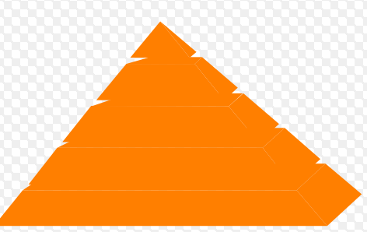
Pharaoh | Religious success | Building projects | Foreign policy
Ramesses II
Akenhaten
Tutankhamun
Thutmose I
Hatshepsut
Cleopatra
Very good
OK
Awesome

Slide 8
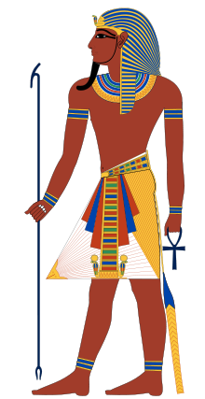
Rank your pharaohs based on their overall awesomeness (or lack of)…
1.
2.
3.
4.
5.
6.

Slide 9
Crash course world history - Egypt

Slide 10
The pharaohs
Objectives:
Investigate the role of the pharaoh.
Assess the reigns of six famous pharaohs in order to establish who deserves the best reputation.

