Slide 1
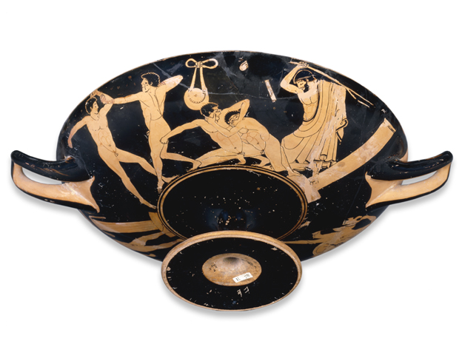
No biting or poking eyes out! I beat you fiend
Arghhh my EYES!!!!

Slide 2
Which of these are ancient Olympic events?
Boxing
Running
Chariot Racing
Discus
Curling
Fencing
Jumping
Wrestling
Riding
Sailing
Javelin
Notes:
Boxing, chariot, racing, discus, wrestling, javelin

Slide 3
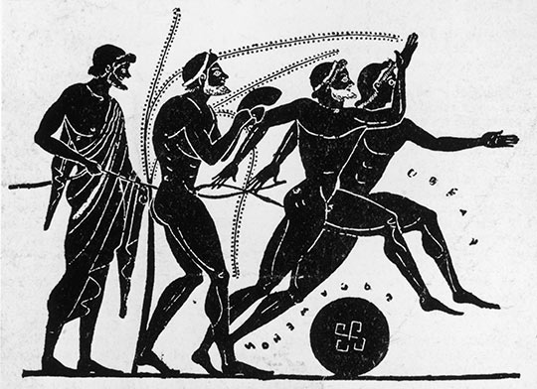
The Ancient Olympics
Leaning Objectives:
To learn about the ancient Olympics held at Olympia
To learn about some Greek super athletes

Slide 4
Ancient Olympics in a nutshell - 3mins

Slide 5
Why were the games held at Olympia?
Why were the games so important to the Greeks?
How did Sparta break the rules of the games in 420 BC?
Why were the Greek athletes naked?
When could women compete in the games?
What were some of the criticisms of the games in ancient Greek times?

Slide 6
Ancient Olympics clip

Slide 7
A victor received a crown made from olive leaves, and was entitled to have a statue of himself set up at Olympia.
Although he did not receive money at the Olympics, the victor was treated much like a modern sports celebrity by his home city.
His success increased the fame and reputation of his community in the Greek world. It was common for victors to receive benefits such as having all their meals at public expense or front-row seats at the theater and other public festivals.

Slide 8
Read about your given Greek Olympic Hero and list the key points to feed back to the class

Slide 9
True OR False?
Greek athletes competed NAKED!?
Some athletes chose to wear penis restraints!!!?
The Olympic Games was 1 of other ancient games?
Women competed in the games but were not naked?
Christianity killed the Olympics?

