Slide 1
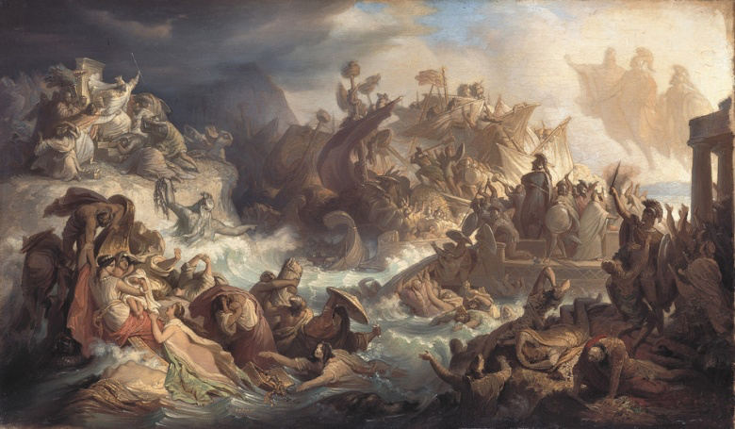
How did the Greeks stop the Persian invasion?

Slide 2
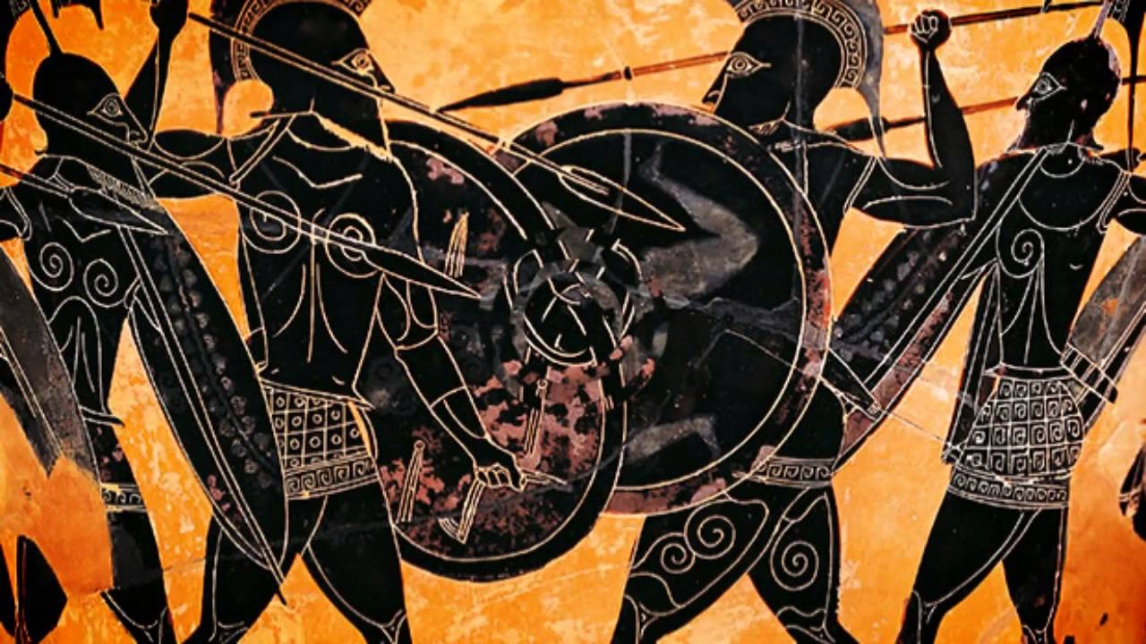
Sparta vs Athens Why did the Greeks fight each other?
Find out how Athens’ power increased after the Persian Wars.
Investigate what happened in the war between Athens and Sparta.

Slide 3
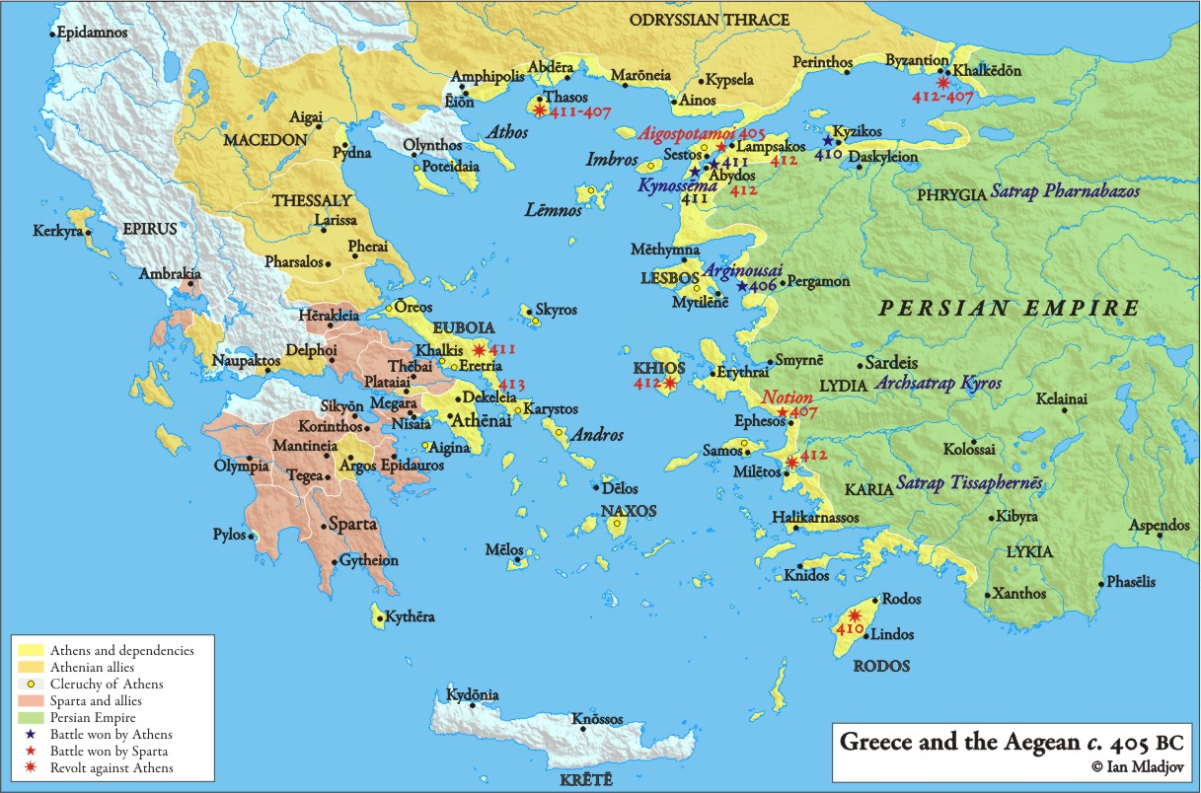
After the Persians had been defeated, some Greek cities wanted to work together to stop the Persians from returning.
Many Greeks felt that Athens should be the leader as they had been the ones that had fought the Persians the most.

Slide 4
This alliance was to be based on the island of Delos – no one lived there and the island was sacred to Apollo (Sun god).
The alliance was to be called the Delian League and Athens was the leader.

Slide 5
Athens and the Delian League
32 mins to 43 mins

Slide 6
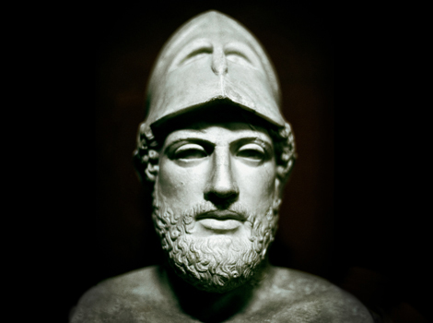
Pericles = Leader of Athens
Allies send money and soldiers to Athens
Allies NOT allowed to leave

Slide 7
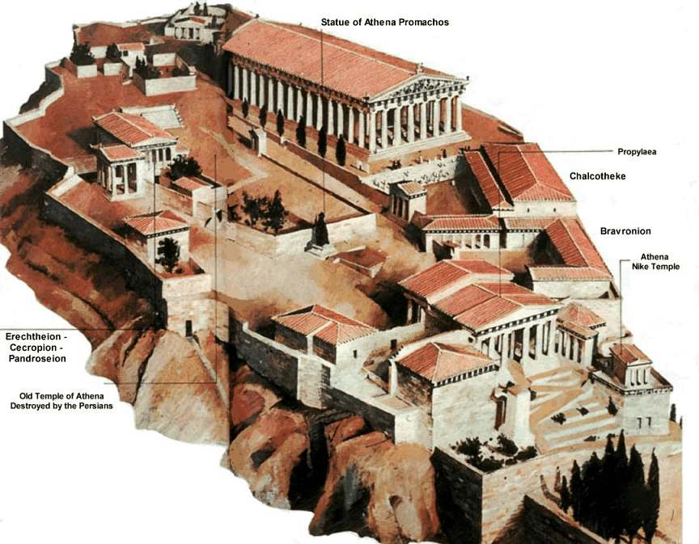
What did Pericles do?
Notes:
Recap walls to Piraeus

Slide 8
Two major problems affecting Athens:
Rebuilding
Unemployment
Building program - Parthenon
All these solutions cost a lot of money.
Where was Pericles getting his money from?
Payment for 20,000 Athenians to work in the Athenian democracy
Compulsary Naval service

Slide 9
Athens’ allies had had enough… They begged Sparta to attack the Athenians
Peloponnesian War
431 – 404 BC
27 years!

Slide 10
The Athenians and Spartans attacked each other’s territory and allies for many years – the war was a stalemate.
We’re going to look at one event in 416 BC – the mid point of the war.
In 416 BC the Athenians attacked the neutral island of Melos.

Slide 11
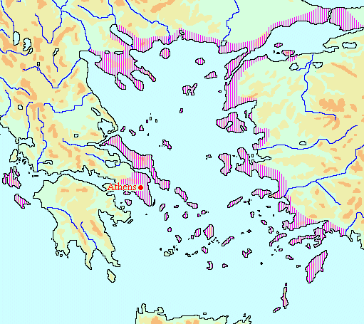
Melos
Notes:
Melos = neutral island

Slide 12
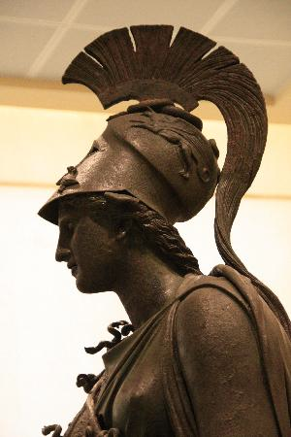
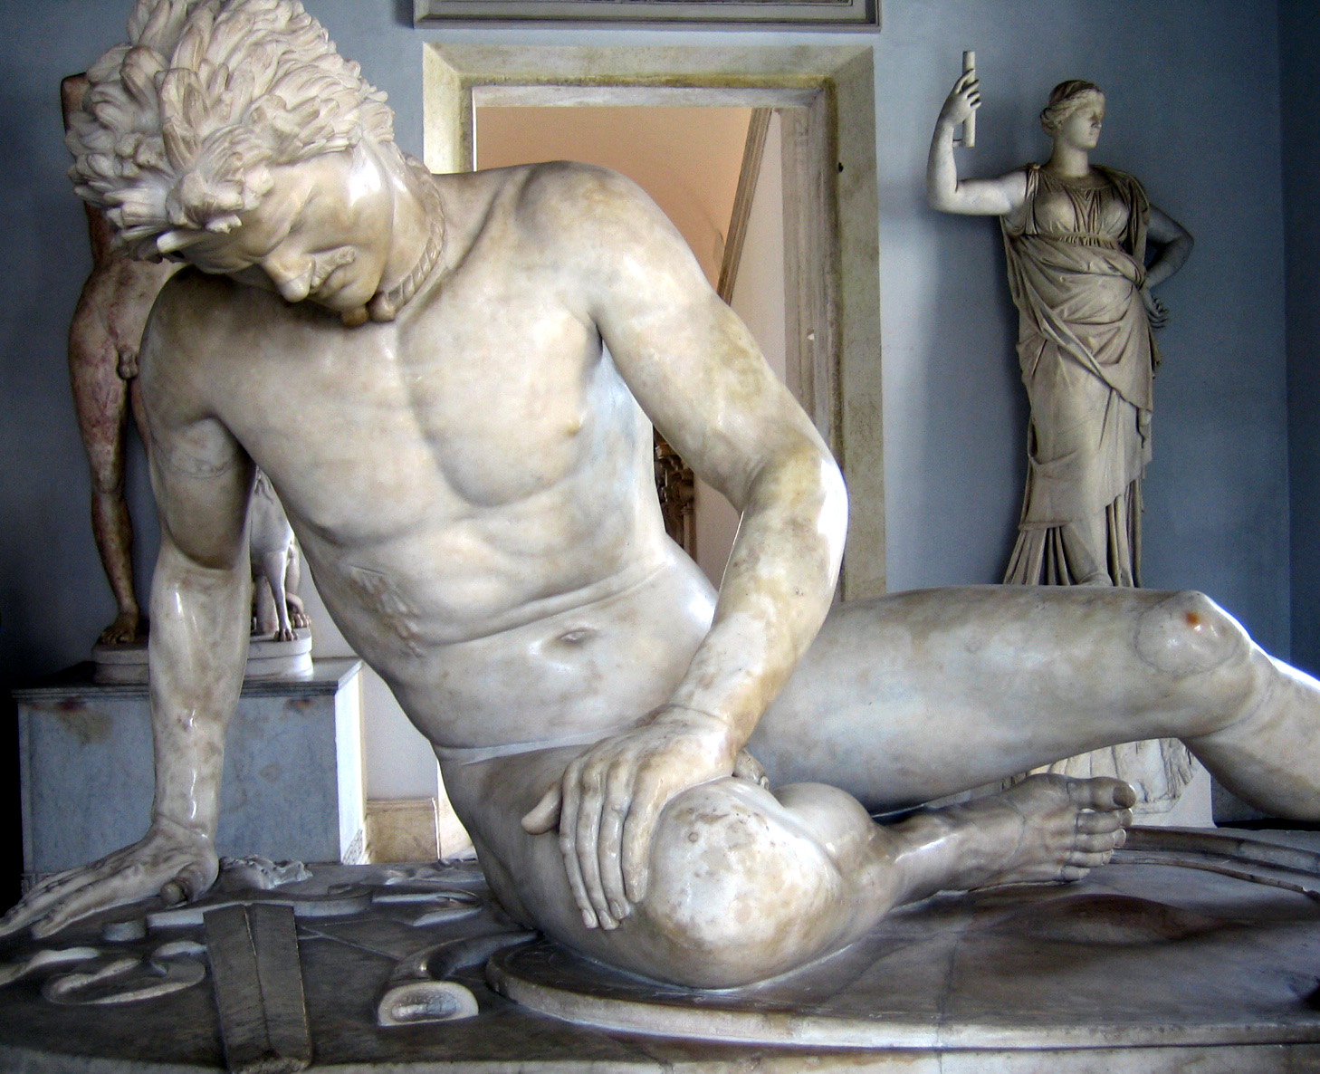
Atrocity on Melos
“…would you not agree to us being neutral? Friends instead of enemies?”
Athens sent a task force to Melos in 416 BC.
Melos, an old colony of Sparta, had not joined the Athenian Empire and was neutral.
The Athenians sent a delegation to “negotiate” with the Melians before attacking.
The Athenian arguments were chilling…
“No… your hatred of us is a sign of our power. The strong do what they have the power to do, the weak accept what they must…”

Slide 13
The writer Thucydides tells us about the meeting of the Athenian and Melian leaders.
It is called the Melian Dialogue – what is a dialogue?
Do the Athenians think Melos is a legitimate target?
Why does Athens deserve her Empire?
Why must Athens control Melos?

Slide 14
How could you describe Athenian actions at Melos?
Calculated
Aggressive
Ruthless
Read top paragraph page 407:
The last thing the Athenians say before the siege.
Vindictive
Savage

Slide 15
Eventually many of Athens’ allies went over to Sparta.
Athens defeated: 404 BC
Sparta also gained money from the Persians – who were scared of the Athenian navy.

