Slide 1

Answer the following questions in your book…
Name the two rivers around which Mesopotamia developed.
Name one city within Mesopotamia.
Identify 3 important developments that came from the Mesopotamian Empire.
What material were many Mesopotamian homes built out of?
What was the name of the first writing system developed in Mesopotamia?
What sort of jobs existed within Mesopotamia?
Challenge: Think of your own question that you do not think anyone else will be able to answer – 5 house points for anyone who can create a question that no one else can answer (YOU MUST KNOW THE ANSWER)

Slide 2
Answer the following questions in your book…
Name the two rivers around which Mesopotamia developed. Tigris and Euphrates
Name one city within Mesopotamia. Ur
Identify 3 important developments that came from the Mesopotamian Empire. Base 60 system, Zodiac, Years
What material were many Mesopotamian homes built out of? Sun-baked mud bricks
What was the name of the first writing system developed in Mesopotamia? Cuneiform
What sort of jobs existed within Mesopotamia? Builders, merchants, slaves, traders, farmers, craftsmen, tanners, blacksmiths etc.
Challenge: Think of your own question that you do not think anyone else will be able to answer – 5 house points for anyone who can create a question that no one else can answer (YOU MUST KNOW THE ANSWER)

Slide 3
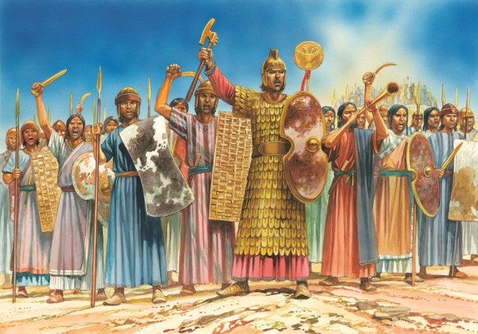
The new Hittite Kingdom 1400-1190BCE
May 5, 2020
RRR: Which was the most successful Hittite King?
(Write in your planner)
Lesson Objectives:
To understand the key features of the ancient Hittite Empire
To analyse the success of the Hittite Kings
Key words/Spellings: Chronology, centuries, BC, AD, Mesopotamia, Civilisation, Ur

Slide 4
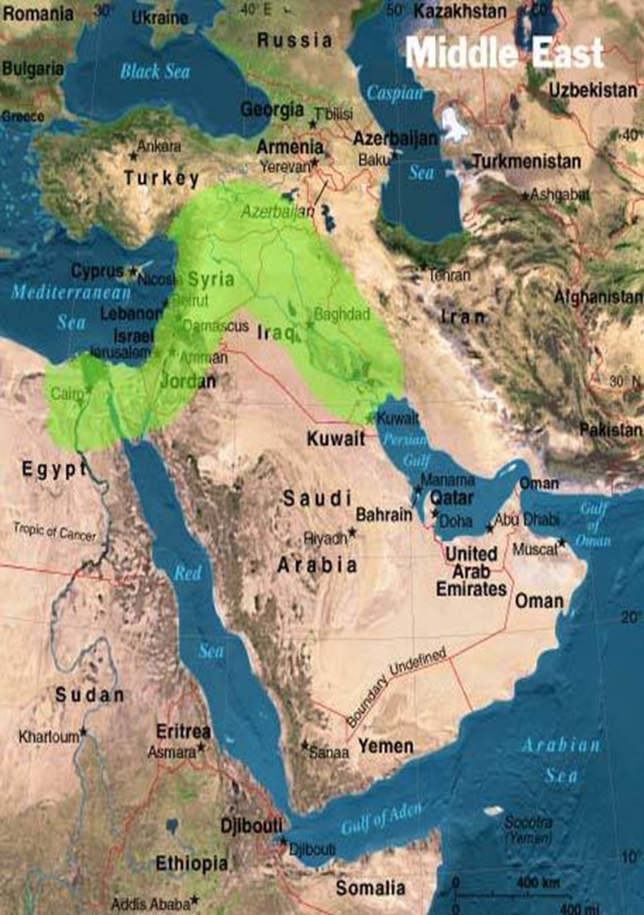
3000BCE
2000BCE
1000BCE
Last Lesson
479BCE
Xerxes I loses the Persian Wars
3000-2000BCE
The city of Ur
Today’s Lesson
1400-1190BCE
The New Hittie Kingdom
Where in the Ancient Middle East will we study the Hittites?
In Anatolia, or modern-day Turkey, as we know it!

Slide 5
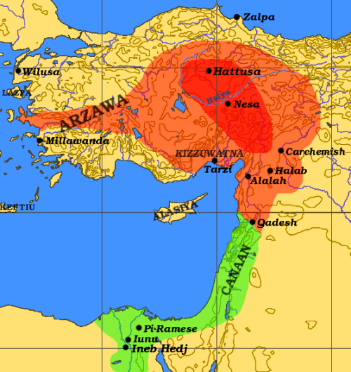
Who were the Hittites?
Before we compare the great kings of the Hittite empire, we need to understand who the Hittites were as a people; where they came from, what their culture was like and what they achieved.
TASK: complete the structured reading on the basics of the Hittite people.
Remember; do the ‘give the paragraph a title’ first, and then do the ‘summarise the paragraph in a sentence.
For each paragraph, these should make clear what the topic and most SIGNIFICANT information from each is.
Next Steps…
Given that the Hittites developed their empire around 600 years after the peak of the city of Ur, what can you tell that they took from that earlier civilisation?
How do you think the Hittites benefitted from the developments made in Ur?

Slide 6
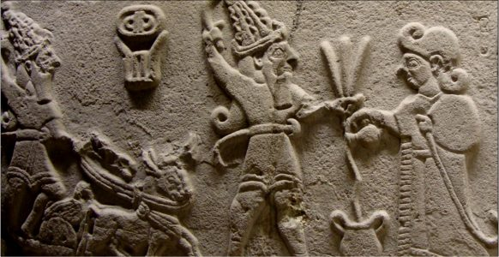
The Great Kings of the Hittite Empire
The height of the Hittite empire had 4 main kings, who followed each other in succession (no gaps between them). They were;
Suppiluliuma I
Mufsili II
Mutwatalli II
Hattusili III
EXTENSION - Powerful Hittite women!
Using your device, research the role and significance of the Hittite Queen, Pudu Hepa.
Explain;
How she helped the kingdom after her husband’s death.
How she was treated by the Kingdom of Egypt.
TASK: using the profile on each King, complete the table comparing the challenges they faced and their achievements.
Make sure to rank each king /5, in terms of how SUCCESSFUL a king you believe they were.
Once you have finished the table, write a paragraph explaining which Hittite king you believe was the most SIGNIFICANT and why.

Slide 7
Suppiluliuma I
Suppiluliuma reigned from 1344-1322BCE. He had been a leading general in the Hittite army and had been part of a VERY unsuccessful campaign to take the nearby kingdom of Mitanni. Suppiluliuma actually took the throne by organising a coup (a planned, military takeover) and killing the King before him and his own brother(!), Tudhaliya III.
Suppiluliuma successfully re-established Hittite power in Anatolia, which had been weakening under his brother, and brought competing kingdoms back under the king’s control. He also ADDED to the empire by conquering nearby areas of Syria, and he finally conquered the kingdom of Mitanni. All conquered kingdoms had to sign a treaty with the Hittites promising to pay tribute and serve in the military.
As his kingdom grew, a queen of Egypt reached out to him, asking for a marriage of allegiance now that her husband (Pharoh Tutankhamun) had died. Suppiluliuma was suspicious, but sent one of his favourite sons anyway. When this son was suddenly killed on the journey, he pulled back all help from Egypt and caused a rift (an argument) between the two empires.
He sent another of his sons to conquer areas in Palestine, which the son was successful at and the empire once again expanded. However, upon returning to the Hittite empire with slaves and prisoners from Palestine, it became clear that these people had brought a devastating plague back with them. Many Hittites died, including Suppiluliuma himself. The plague was recorded in writings called the ‘Plague Prayers’.

Slide 8
Mursili II
Mursili reigned from 1321-1295BCE. Suppiluliuma was meant to be succeeded by his son Arnuwanda II, but he died from plague, so Mursili took over. Arnuwanda II had been personally groomed for the throne by Suppiluliuma I, whereas Mursilli II had little experience and was regarded as no more than a child. None of the kings of the surrounding regions took the young monarch at all seriously when he ascended to the throne in 1321 BCE but, as they would soon find, this was a mistake.
Mursilli II had learned more from his father than anyone thought and quickly set about conquering tribes which had long proved a problem (such as the Kaska). He first secured the borders of the Hittite Empire and then expanded them.
According to the Plague Prayers, he spent at least 10years restoring the empire’s peoples and infrastructure following the devastating affects of the plague. He was particularly concerned about the supernatural origins of the plague, and after consulting oracles (priests who spoke to the gods), he apologised for his father’s murder of his own brother, and the takeover of Syria. Although no land was returned!

Slide 9
Mutwatalli II
Mutwatalli reigned from 1295-1272BCE, and was the son of Mursili II. By this point he inherited a large and powerful empire from his father. However, the Hittites had now illegally seized Egyptian lands, and this brought them into conflict (again!) with the incredibly strong Ancient Egyptians.
The Egyptians, under Pharaoh Rameses II (SUPPOSEDLY the same Pharoh who Moses saved the Jews from!), challenged Mutwatalli on this illegal seizure, and the two empires met at the battle of Qadesh in 1275BCE.
This was a very significant battle, as it demonstrated the ability of the Hittites to stand up to a dominating power like the Egyptians, but it was ultimately inconclusive – no side clearly won. This increased the hostility between both sides, as neither was willing to admit they had lost.
However, Mutwatalli did not lose any land as part of the battle of Qadesh, and he maintained the borders of the Hittite empire.
We know little else about his reign.

Slide 10
Hattusili III
Hattusili reigned from 1267-1237BCE, and took the throne by defeating and exiling Muwatalli’s son, Urhi-Teshub, once he became king after his father died. Hattusili was a brother of Muwatalli, so technically this was his own nephew! Once he took the throne, he released a propagandist (propaganda) text for the people, where he argued that his nephew had treated him poorly, and he only took the throne once matters had gotten ‘out of control’. He also stated that the boy was only the son of a concubine.
Hattusili had participated in the battle of Qadesh, and afterwards had married the impressive Hittie woman, Pudu-Hepa of Kizzuwadna – she would become one of the most influential Hittite queens ever.
The exiled nephew, Urhi-Teshub, became a thorn in Hattusili’s side, and consistently challenged him for the throne while in exile. Hattusili demanded he be exiled even further away, so the banished Urhi fled to Egpyt, where he was warmly welcomed by Rameses II, who was still angry over the battle of Qadesh.
At first Rameses refused to hand Urhi over, but later on the two kings signed a famous peace treaty, where they agreed a pact of nonaggression and said they were now a ‘brotherhood’. There were also diplomatic marriage between the two kingdoms, although the Hittites kept the land they took from egypt under the previous kings.

Slide 11
LOWER ABILITY VERSIONS BELOW!

Slide 12
Suppiluliuma I
Suppiluliuma was King from 1344-1322BCE. He had been a successful general in the Hittite army before he was king. Suppiluliuma actually took the throne by organising a coup (a planned, military takeover) and killing the King before him and his own brother(!) Tudhaliya III.
Suppiliuma made the Hittites more powerful in Anatolia again, when they Hittites had been weak when he brother was king before. He also ADDED to the empire by conquering nearby areas of Syria, and Mitanni. All conquered kingdoms had to promise to pay taxes and give soldiers.
As his kingdom grew, a queen of Egypt asked Suppiluliuma for a marriage to his son. But his son was suddenly killed on the journey to Egypt, so Suppiluliuma took back all his help from Egypt and caused a rift (an argument) between the two empires.
He sent another of his sons to conquer areas in Palestine, which the son was successful at and the empire got bigger. However, when the son returned with slaves and prisoners from Palestine, it became clear that these people had brought a devastating plague back with them. Many Hittites died, including Suppiliuma himself.

Slide 13
Mursili II
Mursili was king from 1321-1295BCE. Suppiluliuma was meant to be followed by his son Arnuwanda II, but he died from plague, so Mursili took over. Mursilli II didn’t have much experience of being a king, and most of the Hittite nobles thought of him as a child. None of the kings of the surrounding regions (areas) took the young monarch at all seriously, but as they would soon find, this was a mistake.
Mursilli II had learned more from his father more than anyone thought and quickly conquered really difficult tribes in the area (like the Kaska). He first secured the borders of the Hittite Empire and then expanded them.
According to the Plague Prayers (a historical source), he spent at least 10years putting the country back together after the devastating affects of the plague from Palestine.
He was very worried about the supernatural origins of the plague, and after asking the oracles (priests who spoke to the gods), he apologised for his father’s murder of his own brother, and the takeover of Syria. Although no land he didn’t give any of the land back to Syria!

Slide 14
Mutwatalli II
Mutwatalli was king from 1295-1272BCE, and was the son of Mursili II. He inherited a large and powerful empire from his father. However, the Hittites had now illegally taken Egyptian lands, and this caused a war with the incredibly strong Ancient Egyptians.
The Egyptians, under Pharaoh Rameses II (SUPPOSEDLY the same Pharoh who Moses saved the Jews from!), challenged Mutwatalli on this illegal takeover, and the two empires met at the battle of Qadesh in 1275BCE.
This was a very significant battle, as it showed that the Hittites could stand up to a dominating power like the Egyptians, but it was an inconclusive battle – no side clearly won. This made both sides even more angry, and neither side was willing to admit they had lost.
However, Mutwatalli did not lose any land as part of the battle of Qadesh, and he maintained the borders of the Hittite empire.
We know little else about his reign.

Slide 15
Hattusili III
Hattusili was king from 1267-1237BCE, and took the throne by defeating and exiling (sending away) Muwatalli’s son, Urhi-Teshub. Hattusili was a brother of Muwatalli, so technically this was his own nephew! Once he took the throne, he told people that his nephew had treated him poorly, and he only took the throne because the kingdom was being run badly. He also stated that the boy was only the son of a concubine (a royal prostitute).
Hattusili had been part of in the battle of Qadesh, and afterwards had married the impressive Hittite woman, Pudu-Hepa of Kizzuwadna – she would become one of the most important Hittite queens ever!
The exiled nephew, Urhi-Teshub, became a thorn in Hattusili’s side, and kept on challenging him the throne. Hattusili banished Urhi evne further away, so Urhi ran away to Egpyt, where he was warmly welcomed by Rameses II, who was still angry over the battle of Qadesh.
At first Rameses refused to hand Urhi over, but later on the two kings signed a famous peace treaty, where they agreed they were now a ‘brotherhood’. There were also marriage between the two kingdoms, although the Hittites kept the land they took from Egypt.

Slide 16
 | How did they gain the throne? | What was the great challenge they faced as king? | What was their greatest achievement as King? | What was their greatest failure as King? | Score /5
Suppiluliuma I
Mursili II
Mutwatalli II
Hattusili III
Notes:
PRINTABLE VERSION ON THE SYSTEM!

Slide 17
5 Key Points from today’s Lesson
The Hittite Kingdom was in modern day Turkey.
Suppiluliuma I was the first king major King of the Hittite Empire, he expanded the empire into Syria.
Mursili II was the son of Suppililiuma, he had to help rebuild the empire after the plague from Palestine.
Mutwatalli II fought against the Egyptians because of illegal land seizues by previous kings. He fought at the battle of Qadesh.
Hattusili III overthrew his own nephew to take the throne, he signed a peace treaty with Egypt to end the conflict.
BONUS EXTRA POINTS!
6. Seti I of Egypt expanded the kingdom of Egypt as it rose to power at the same time as the Hittites
7. Rameses II led Egyptian forces at the battle of Qadesh.

