Slide 1

Answer the following questions in your book…
The Battle of Qadesh took place in which modern day country?
In what year did the Battle of Qadesh take place?
Give two examples of things that got worse during the Bronze Age Collapse
Who did contemporaries blame for the Bronze Age Collapse?
Name one factor that lead to the Bronze Age Collapse
Name the Hittie King whose son was assassinated by Egyptians
Challenge:
How accurate (factually correct) do you believe the Egyptian sources on the Sea People are? Explain your answer

Slide 2
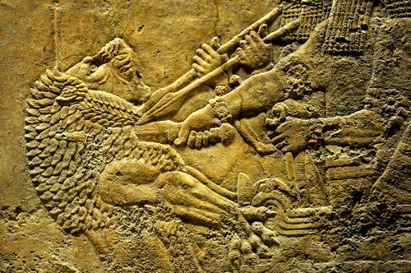
Ashurnasirpal II
01 May 2020
RRR: Was Ashurnasirpal II the first great Assyrian king?
(Write in your planner)
Lesson Objectives:
What made the Assyrian Empire strong?
What sort of king was Ashurnasirpal II?

Slide 3
1400-1190BCE
The New Hittie Kingdom
(Last Lesson)
1250-1150BCE
Rise of the ‘Sea Peoples’
3000BCE
2000BCE
1000BCE
3000-2000BCE
The city of Ur
1275BCE
The Battle of Qadesh
479BCE
Xerxes I loses the Persian Wars
883-859BCE
Assyria; Ashurnasirpal II
(Today’s Lesson)

Slide 4
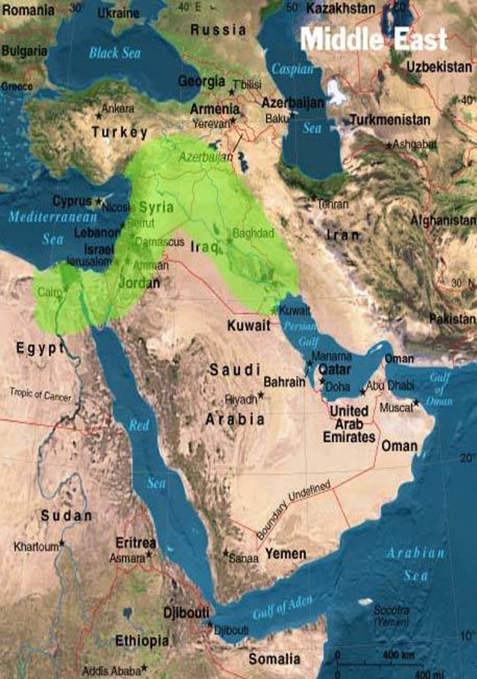
Where was the Assyrian Kingdom, where Ashurnasirpal II was King?
Modern day Iraq/ Iran!

Slide 5
Who rose out of the Bronze Age Collapse?
From about 1200-900BCE, the Middle East fell into a ‘Dark Age’ once the collapse took hold. We have VERY few historical sources from that time, because of what happened to literacy, pottery, governments, trade etc.
However, after 300years of the Dark Age, a small kingdom in modern day Iraq started to rise out of the gloom and began to expand its borders once again.
This was the kingdom of Assyria.
This kingdom had technically existed before the Collapse, but it was now that it really grew into a powerful empire.
The first king of this new Assyrian kingdom, Tiglath-pileser I re-established the boundaries of the kingdom and began expansion into the weakened Middle East.
By 744BCE, the Assyrian Empire would control lands from Iran to the coast of Turkey, down to Mesopotamia, and the entirety of the Fertile Crescent.
How did the Assyrians keep control of such a huge area of land?
Well-organised government throughout the empire.
Power of the King
Protecting the royal bloodline
Creating a terrifying army

Slide 6
What kept the Assyrian empire so strong?
TASK: using the info sheet on these four areas, complete the pyramid activity that will help you summarise the factors and explain why the Assyrian Empire was so strong.
Summaries of each factor can be brief, just 2-4 sentences.
Think carefully about how each factor would work well with the one next to it.
Come to a conclusion overall, on why these four factors allowed the empire to keep control of the Middle East.
As we just learned, there were four key parts of the Assyrian empire that meant it was able to rise up out of the Dark Age and rule the Ancient Middle East.
These were;
Well-organised government throughout the empire.
Power of the King
Protecting the royal bloodline
Creating a terrifying army
CHALLENGE:
Make new pairings of the four factors at the bottom of the sheet. – imagine the order they were typed in has been moved around.
In your book, explain how these newly paired factors could work together to keep the empire strong.
e.g. what if Royal Bloodlines and Local Government had been next to each other instead, how would they have worked together?

Slide 7
Local Government The empire was divided into areas called provinces, and each province had a local governor put there to rule on behalf of the king. Assyria had 70 of these provinces. It was the job of the governor to make sure that the law was obeyed and taxes were collected. The King personally chose each of these governors, and they answered directly to the King. The Governorship could not be passed from father to son, and each time the king chose who the next governor would be. The king tended to prefer his governors to be eunuchs (men whose testicles have been cut off), so that they couldn’t have sons who then wanted to be governors themselves. The king could directly intervene in local government whenever he wanted, but generally the governor of each province was allowed to act as they saw fit, given that they were usually good at their job. This meant the king was free to rule the empire as a whole, not be bogged down in local issues. | Power of the King Although governors had power at a local level, it was understood that the King ruled the empire with absolute control, and that he did this because he was the earthly (human) form of the Assyrian God, Ashur. This meant that people believed the king was everywhere and could see everything, much like their God could. This made them more likely to behave! In addition, the King would move through the empire throughout the year. He would move between palaces, taking his whole court with him, so that his people knew he was never far away. It also meant he could deal with any problematic governors. People of an Assyrian city would not always know if the king was in that palace, but the buildings were huge and imposing, and would be a reminder to the people that the king was the only true power. It made a close link between the people, the local government and the king.
Royal Bloodlines Assyrian royal families were usually very big, and technically any MAN could be a contender to the throne, whether his mother was queen or a royal ‘consort’. This meant that there were always potential candidates for the next king, and the royal line couldn’t die out. As long as a man was from that family, he was in with a chance of being named the next king. They also put rules in place that the current king HAD to name a successor before he died, so that no arguments could take place after a King’s death. They also ruled that in order to be king, the candidate had to be in PERFECT physical health. No mental or physical problems. All of these helped keep the succession of Kings smooth, and avoided a lot of internal conflict in the empire. | The Assyrian Army The expansion, and maintenance, of the Assyrian empire depended on its army. Carvings in royal palaces regularly show Assryian soldiers slaughtering their enemies, and clearly show that the army was a point of pride for the empire. The army after 900BCE was particularly successful because it was made up of paid, professional soldiers, and supported by men who served an annual army service as part of their taxes. Beforehand the army had just been made up of men who were quickly called up when fighting broke out. The army had a powerful cavalry, which was new in the area. The army also had siege machines that the kings used to siege enemy cities. The army had even been known to cross rivers by using inflated sheepskins as a floatation devices!

Slide 8
Local Government The empire was split into areas called provinces, and each province had a local governor. Assyria had 70 provinces. The governor had to make sure that laws were obeyed and taxes were collected. The King chose each of these governors. The Governorship could not go from father to son. The king liked his governors to be eunuchs (men whose testicles have been cut off), so that they couldn’t have sons who then wanted to be governors too. The king could get involved in the provinces whenever he wanted, but generally the governor of each province was allowed to act as they saw best. This meant the king was free to rule the empire as a whole, not be bogged down in local issues. | Power of the King Although governors had power at a local level, it was understood that the King ruled the empire with absolute control. This meant that people believed the king was everywhere and could see everything, much like their God could. This made them more likely to behave! The King would move around the empire during the year. He would move between palaces, taking his whole court with him, so that his people knew he was never far away. It also meant he could deal with any difficult governors. People of an Assyrian city would not always know if the king was in that palace, but the buildings were huge. It made a close link between the people, the local government and the king.
Royal Bloodlines Assyrian royal families were usually very big, and technically any MAN could be a contender to the throne. This meant that there were always someone who could become king. As long as a man was from that family, he was in with a chance of being named the next king. They also put rules in place that the current king HAD to name a successor (the next person to be king) before he died, so that no arguments could take place after a King’s death. They also ruled that in order to be king, the candidate had to be in PERFECT physical health. No mental or physical problems. All of these helped keep the royal line in power. | The Assyrian Army The Assyrian empire depended on its army. Carvings in royal palaces show Assryian soldiers slaughtering their enemies, and clearly show that the empire was proud of its army. The army was successful because the soldiers were paid professionals, and the army was paid for by taxes. It was NOT just made up of men who were quickly called up when fighting broke out. The army had a hugely powerful cavalry, which was new in the area, and was famed for its siege machines that the kings used to destroy enemy cities. The army had even been known to cross rivers by using blown up sheepskins as a floats!
Notes:
LOWER ABILITY VERSION

Slide 9
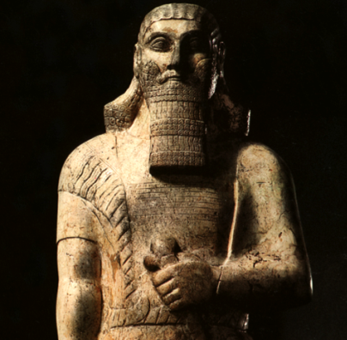
Ashurnasirpal II – the first great Assyrian King?
Although he was not the FIRST king of the new Assyrian empire, he was arguably the first ‘stand out’ King.
In some cases he is a violent, blood-thirsty megalomaniac (someone who is obsessed with having power), who slaughtered cities and peoples to prove his empire’s power.
In other cases, he was a practical king who created incredible new buildings and centres for his empire and people.
TASK: take a whole A4 page of your book, turn it landscape and draw in a Venn diagram.
STEP 1: Label on side ‘evidence Ashurnasirpal was a pragmatic (practical) King’ and label the other side ‘evidence Ashurnasirpal was a megalomaniac’
Remember – with a Venn diagram, the middle section is for info/ evidence that is true for both!
STEP 2: Read through the source pack and use the information you learn from each source to fill in your diagram.
THINK! – Does that info show him to be a thoughtful, rational king? Or a violent and power-hungry King?
6-7 sentences
Include quotes or description
Support points with your own knowledge
CHALLENGE:
Pick your favourite source from the pack. Using this source, answer the following question.
‘What can we learn from this source about the reign of the Assyrian King, Ashurnasirpal II?’
Notes:
TBH I’D DRAW OUT THE VENN DIAGRAM ON THE BOARD FOR THEM. IT’S AMAZING WHAT KIDS CAN MESS UP.

Slide 10
Ashurnasirpal was a pragmatic (practical) King
Ashurnasirpal was a megalomaniac
Both

Slide 11
Source A – A palace inscription telling what Ashurnsirpal did to rebels in the city of Tela. 883 BCE.
“I built a pillar over against the city gate and I flayed all the chiefs who had revolted and I covered the pillar with their skins. Some I impaled upon the pillar on stakes and others I bound to stakes round the pillar. I cut the limbs off the officers who had rebelled.
Many captives I burned with fire and many I took as living captives. From some I cut off their noses, their ears, and their fingers, of many I put out their eyes. I made one pillar of the living and another of heads and I bound their heads to tree trunks round about the city.
Their young men and maidens I consumed with fire. The rest of their warriors I consumed with thirst in the desert of the Euphrates”.
Interpretation B – Historian Stephen Bertman commenting on the reign of Ashurnasirpal II.
“Ashurnasirpal II set a standard for the future warrior-kings of Assyria. In the words of Georges Roux, he `possessed all the qualities of empire-builders: ambition, energy, courage, vanity, cruelty, magnificence’ (Roux 1992). His records were the most detailed of any Assyrian ruler, detailing the multiple military campaigns he led to secure or enlarge his nation.
From one raid alone he filled his kingdom’s coffers with 660 pounds of gold and the same again of silver, and added 460 horses to his stables. The sadistic cruelty he inflicted upon rebel leaders was legendary, skinning them alive and displaying their skin, and cutting off the noses and the ears of their followers or mounting their severed heads on pillars to serve as a warning to others.”

Slide 12
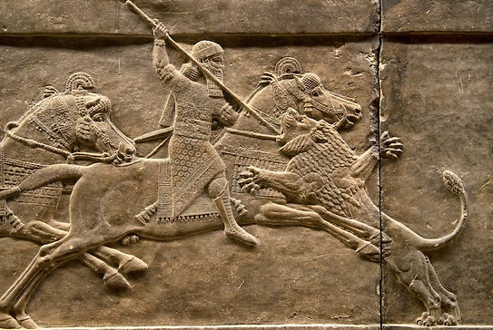
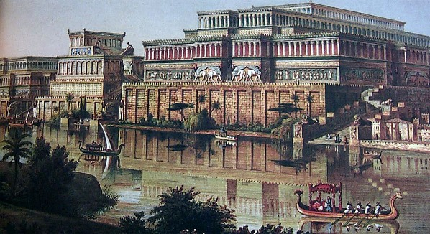
Below, Interpretation D.
A artists’ interpretation (version) of what the city of Kalah looked like. Aashurnasirpal built Kalah as new centre of the empire.
It was 900acres across and had a fortified wall protecting it.
Above, Source C -
A carving from a the palace at Kalah, showing Ashurnasirpal II hunting and killing a ferocious lion.
Hunting was something kings liked to do in their spare time.

Slide 13
Source E – A palace inscription telling us what Ashurnsirpal did to build the great city of Kalah. He mentions the orchards, the water system and the fortified walls.
“The former city of Kalah, which Shalmaneser, king of Assyria, a prince who preceded me, had built, that city had fallen into decay and lay in ruins, it had turned into a mound and ruin heap. That city I built anew.
I laid out orchards round about it, fruit and wine I offered unto Assur, my lord, I dug down to the water level.
I built the wall thereof; from its foundation unto its top I built and completed it.”
Interpretation F – Historian Karen Radner discussing the magnificence of the royal palace at Kalah. - When it was completed, Ashurnasirpal II re-located an entirely new population (16,000 people) within the city’s walls and took up residence in his new palace.
“Kalah's most impressive building at the time of Ashurnasirpal was certainly his new royal palace. At 200 metres long (656 feet) and 130 metres wide (426 feet), it dominated its surroundings.
It was organised around three courtyards, including the state apartments, the administrative wing and the private quarters which also housed the royal women.
Here, several underground tombs were uncovered in 1989, including the last resting place of Ashurnasirpal's queen Mullissu-mukannišat-Ninua. Her rich burial goods show us the luxury in which the king and his entourage lived.”
Interpretation G – entry from AncientEncyclopedia.com, discussing the ‘Feast of Thousands’ that Ashurnasirpal had when his building work was completed.
“In 879 BCE, when the palace was completed and fully decorated with the reliefs (carvings) lining the walls of its corridors, Ashurnasirpal II invited the surrounding population and dignitaries from other lands to celebrate. The festival lasted ten days, and his Banquet Stele records that 69,574 people attended. The menu from this celebration included, but was not limited to, 1,000 oxen, 1,000 domestic cattle and sheep, 14,000 imported and fattened sheep, 1,000 lambs, 500 game birds, 500 gazelles, 10,000 fish, 10,000 eggs, 10,000 loaves of bread, 10,000 measures of beer, and 10,000 containers of wine. When the celebration was done, he sent his guests home “in peace and joy” after allowing the dignitaries to view the reliefs in his new palace”.

Slide 14
For Lower ability groups, just use these two slides for the venn diagram activity

Slide 15
Source A – A message from a palace telling the people what Ashurnsirpal did to rebels in the city of Tela. 883 BCE.
“ I whipped all the chiefs who had revolted and I covered the pillar with their skins.
Some I impaled upon the pillar on stakes and others I tied to stakes round the pillar. I cut the limbs off the officers who had rebelled.
Many captives I burned with fire and many I took as living captives. From some I cut off their noses, their ears, and their fingers, of many I put out their eyes. I made one pillar of the living people and another of heads.
Their young men and maidens I burnt alive. The rest of their warriors let them died of thirst in the desert”.
Interpretation B – Historian Stephen Bertman talking about Ashurnasirpal II.
“Ashurnasirpal II set a standard for the future kings of Assyria. He had all the qualities of a good king: ambition, energy, courage, cruelty. His historical reports were the most detailed of any king, telling us about the many battles he fought to make the empire larger.
Just from one raid, he filled his kingdom’s treasury with 660 pounds of gold and the same again of silver, and added 460 horses to his stables.
The cruelty against rebel leaders was famous;, skinning them alive and displaying their skin, and cutting off the noses and the ears of their followers or putting their severed heads on pillars to serve as a warning to others.”
Notes:
LOWER ABILITY

Slide 16
Below, Interpretation D.
A artists’ interpretation (version) of what the city of Kalah looked like. Aashurnasirpal built Kalah as new centre of the empire.
It was 900acres across and had a defense wall protecting it.
Above, Source C -
A carving from a the palace at Kalah, showing Ashurnasirpal II hunting and killing a ferocious lion.
Hunting was something kings liked to do in their spare time.
Notes:
LOWER ABILITY

Slide 17
Was Ashurnasirpal II the first GREAT king of Assyria?
What do you think??
What should a king be, to be ‘great’ here?
Is Ashurnasirpal being that type of ‘great’?
Write a final conclusion in your books – Was Ashurnasirpal the first great king of Assyria?

