Slide 1
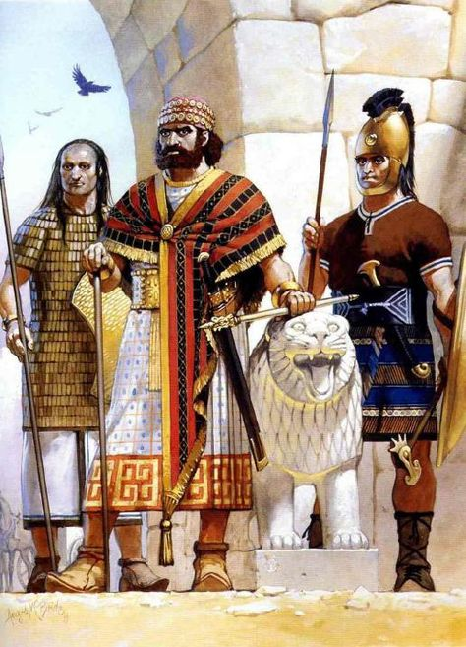
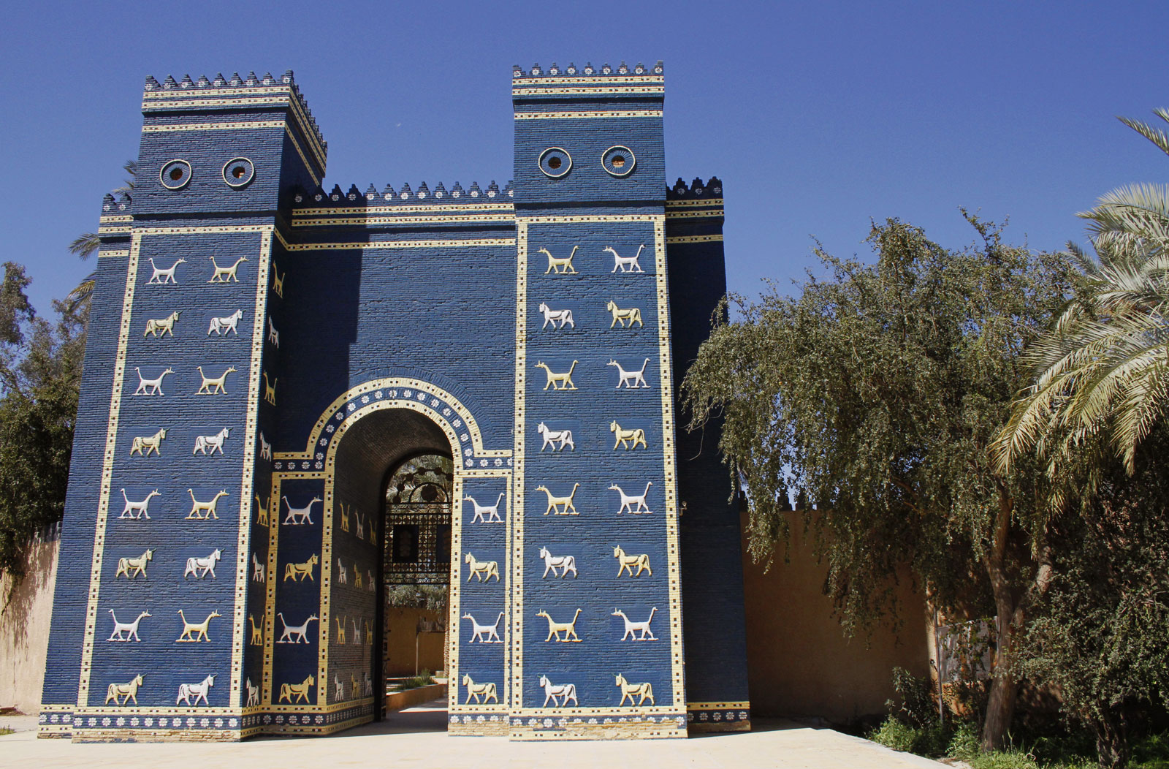
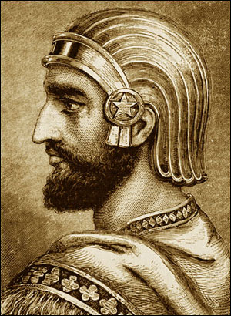
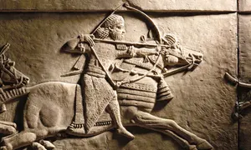
Title: Ancient Middle East Assessment
(Underline date and title using a pencil and ruler)
Key words/Spellings: Hittie, Assyrian, Babylonian, Persian, dynasty, success

Slide 2
“The Assyrian Kings were the most successful of the Ancient Middle Eastern dynasties”. How far do you agree with this statement?
The questions already gives you one of the groups (dynasties) of kings to talk about, this is The Assyrians. – So make sure that your answer includes a paragraph about them!
The question asks you which of the different groups (dynasties) of kings was most SUCCESSFUL? – Your answer will have to think what we mean by successful when talking about the Ancient Middle Eastern kings!
The question gives us a new word, DYNASTIES. – This is just a good way of saying families that stay in power for many generations.

Slide 3
Which ‘dynasties’ can we talk about?
“The Assyrian Kings were the most successful of the Ancient Middle Eastern dynasties”. How far do you agree with this statement?
The question wants us to compare the different dynasties of kings we have studied against one another, and decide on the best one based on how SUCCESSFUL they were.
So which ones do you remember??
CHALLENGE: do you think the size of the dynasty impacts on how successful it was?
TASK: with your partner, come up with a list of 3 other families of kings/ Dynasties that you could include in your answer to compare against the Assyrians

Slide 4
What do we mean by successful?
“The Assyrian Kings were the most successful of the Ancient Middle Eastern dynasties”. How far do you agree with this statement?
The question wants us to compare the 4 different dynasties of kings we’ve studied (Hittite, Assyrian, Babylonian and Persian) against one another, and decide on the best one based on how SUCCESSFUL they were.
So how do we judge if a king/ dynasty was successful in the Ancient Middle East?
TASK: with your partner, come up with 3 different ways in which a king/ dynasty could be judge as successful in the Ancient Middle East.
CHALLENGE: can you come up with a way of being successful, that works better for the OTHER dynasties, than it does for the Assyrians?

Slide 5
How should we structure our response?
“The Assyrian Kings were the most successful of the Ancient Middle Eastern dynasties”. How far do you agree with this statement?
Introduction | 2-3 sentences. Explain who the three/four main dynasties of the time/ area were. Explain what you will say in your conclusion – signpost where your argument is going!
Paragraph 1 – The Assyrians | You MUST discuss the families of kings that is mentioned in the question. Explain reasons why they were successful + Consider/ explain reasons why they were less successful -
Paragraph 2 – a 2nd dynasty of your choice. | You should aim to discuss at least TWO other families of Kings Explain reasons why they were successful + Consider/ explain reasons why they were less successful -
Paragraph 3 – a 3rd dynasty of your choice | “ “ “ “ “ “ “ “ “
OPTIONAL!! Paragraph 4 – a 4th dynasty of your choice | This paragraph is an optional one, but is necessary to achieve and Excelling in this assessment! Explain reasons why they were successful + Consider/ explain reasons why they were less successful -
Conclusion | 3-4 sentences. Explain, overall, how far you agree with the statement. A lot? A little? Not at all? Give 2-3 of the most significant reasons on why you came to this conclusion.
Things to consider #1
Aim to have + and – for each dynasty, but it’s ok to have some where you only have + OR -!
Things to consider #2
For Mastering/ excelling, you should be clearly linking back at the end of each paragraph, showing me your argument throughout the answer!

