Slide 1

Answer the following questions in your book…
What were temples called when built in Middle Eastern cities?
What was the name of the most famous battle between the Hittites and the Egyptians?
Which area of land did Tigalth Pileser conquer at the battle of Arpad?
Give one reason why Ashurbanipal supposedly led to his own downfall.
Name of the Babylonian leader who took over from Ashurbanipal?
Give one improvement that Nebuchadnezzar made to the city of Babylon?
Give one reason why the Hanging Gardens of Babylon are unlikely to have existed.
Challenge: Why was Babylon able to become the centre of the Middle Eastern world? Explain your answer using detailed historical information.

Slide 2
Your books have been marked…please check comments and find the stamp and question
Most of you are keeping your books neat and tidy and are really putting in effort with the work, so well done!
Common errors:
Not underlining the date and title
Not gluing in worksheets (or writing what they are)
Q1 – How far do you agree that Ancient Middle Eastern kings were always responsible for their own downfall?
Q2 – How far do you agree that the Assyrian Kings were better than the Hittite Kings?
Q3 – Which of the Assyrian Kings (Ashurnasirpal, Tiglath Pileser or Ashurbanipal) do you think was the best? Explain your answer.

Slide 3
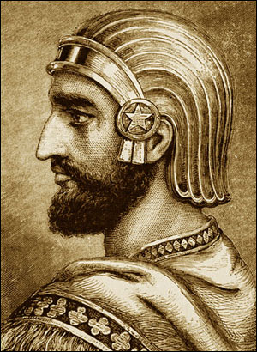
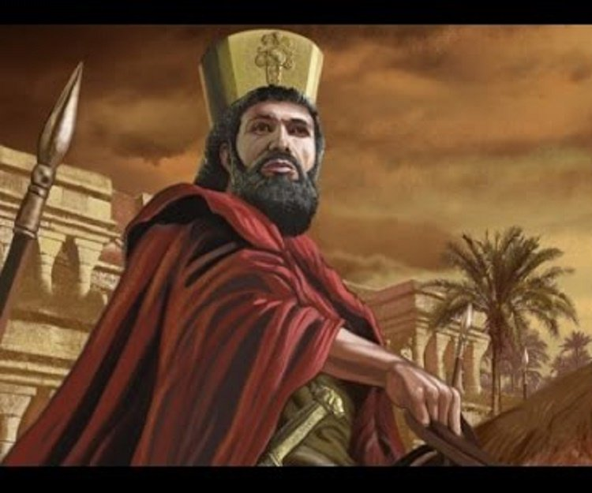
Persia; King Cyrus the Great?
01 May 2020
RRR: What factors lead to the fall of the Assyrian Empire? (Write in your planner)
Lesson Objectives:
understand the extraordinary origin story of Cyrus, King of Persia.
To assess how far he really was ‘Great’.

Slide 4
1400-1190BCE
The New Hittie Kingdom
626-612BCE
Fall of Assyria, Rise of Babylon
(Today’s Lesson)
744-727BCE
Assyria; Tiglath Pileser III
558-530BCE
Persia; Cyrus the Great
1250-1150BCE
Rise of the ‘Sea Peoples’
3000BCE
2000BCE
1000BCE
3000-2000BCE
The city of Ur
1275BCE
The Battle of Qadesh
479BCE
Xerxes I loses the Persian Wars
883-859BCE
Assyria; Ashurnasirpal II
605-562BCE
Babylon; Nebuchadnezzar II
668-627BCE
Assyria; Ashurbanipal
(Last Lesson)

Slide 5
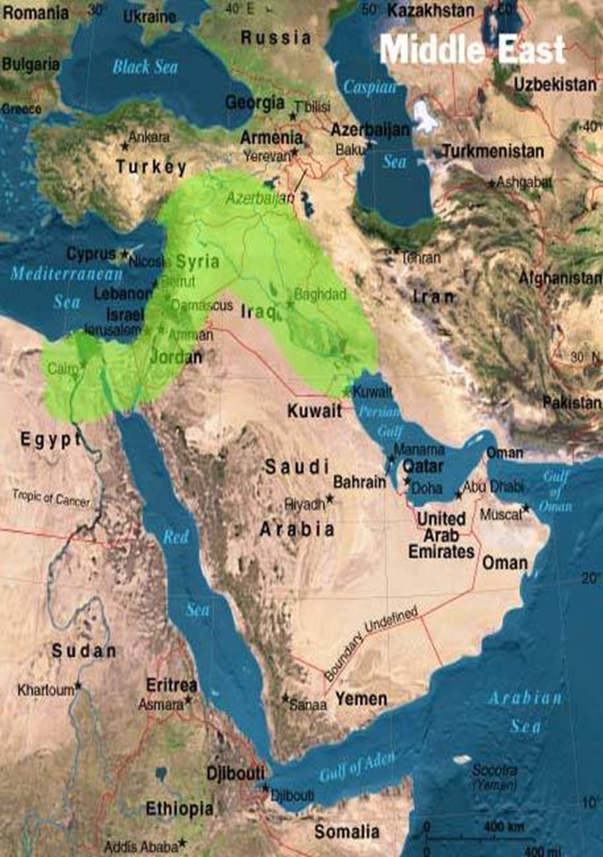
Where was the Persian Empire?
Pretty much the entirety of the Middle East!

Slide 6
Origin story of Cyrus the Great
When it comes to our final Persian Kings (also known as the Achaemenids), we have a very detailed source on these men. It is the book written by the Greek Historian, Herodotus.
Herodotus wanted to write a history book about the war between the Persian (Achaemenid) Kings and Greece. He wanted to tell us all about the kings that were in charge leading up to this war as well. – we will study this war (The Persian Wars) in future lessons!
Cyrus was the first of these Achaemenid kings, and Herodotus has a very detailed account of his early life. Many people think that Herodotus admired Cyrus, and it is clear that there is a very NEW type of King in town!
TASK: read through the account from the Ancient Greek Historian, Herodotus, where he tell us about the origin story of Cyrus the Great.
Select the 5 most important points from the story and summarise them in a story board that explains Cyrus’ childhood and how allies started to turn against Asytages.
In the final box, explain what we can learn about the character/ personality of Cyrus from this origin story.
CHALLENGE
How far do you agree that Herodotus chose to include this origin story in his book, to make Cyrus look like a more impressive king?
Explain your answer using detail from the passage.

Slide 7
Herodotus gave a mythological (based on myth) account of Cyrus's early life. In this account, King Astyages of the Medes had two prophetic dreams (dreams which tell the future) in which a flood, and then a series of fruit bearing vines, emerged from his daughter Mandane's pelvis, and covered the entire kingdom.
These were interpreted by his advisers as a foretelling that his grandson would one day rebel and replace him as king. Astyages summoned Mandane, at the time pregnant with Cyrus, back to Ecbatana to have the child killed. Harpagus (one of the kings advisers) was given the task, but he could not do it and instead gave Cyrus to a shepherd who raised the child and passed off his stillborn son to Harpagus as the dead infant Cyrus. Cyrus lived in secrecy, but when he reached the age of 10, during a childhood game, he had the son of a nobleman beaten when he refused to obey Cyrus's commands. As it was unheard of for the son of a shepherd to commit such an act, Astyages had the boy brought to his court, and interviewed him and his adopted father.
Upon the shepherd's confession, Astyages sent Cyrus back to Persia to live with his biological parents. However, Astyages summoned the son of Harpagus, and in retribution (punishment/ revenge), chopped him to pieces, roasted some portions while boiling others, and tricked Harpagus into eating his child during a large banquet.
Following the meal, Astyages' servants brought Harpagus the head, hands and feet of his son on platters, so he could realize his inadvertent (accidental) cannibalism.
When Cyrus came to battle against Astyages, for control of the Medes, Harpagus betrayed Astyages in the middle of the battle and brought key troops over to Cyrus. Cyrus then won this battle and his first kingdom.
Notes:
HIGHER ABILITY VERSION

Slide 8
Herodotus gave a mythological (based on myth) version of how Cyrus grew up. In this version, his grandfather, a man called Astyages who was king of the Medes, had a dream where his own grandson would take his throne.
To try and stop this happening, Astyages called his pregnant daughter to him, and sent her to the city of Ecbatana, where the child would be killed when it was born. Harpagus (one of the kings advisers) was told to kill the child, but when the time came he could not do it. So he gave Cyrus to a Shepard to raise in secret.
When Cyrus was 10, he beat the son of a noble in a playground game, and beat the noble child when he wouldn’t do what Cyrus told him. This was very strange, the son of a shepherd would never do this, so he was taken to the royal court and interviewed by the king, Astyages!
The Shepherd confessed that Cyrus was not his biological son, so Astyages sent Cyrus back to Persia to live with his real parents. Pretending everything was fine…
However, Astyages punished Harpagus for ignoring his orders to kill baby Cyrus. He called in the son of Harpagus, and in retribution (punishment/ revenge), chopped him to pieces, roasted some portions while boiling others, and tricked Harpagus into eating his child during a large banquet.
Following the meal, Astyages' servants brought Harpagus the head, hands and feet of his son on platters, so he could realise he had just eaten his own son! This turned Harpagus against his king…
When Cyrus came to battle against Astyages, for control of the Medes, Harpagus betrayed Astyages in the middle of the battle and brought key troops over to Cyrus. Cyrus then won this battle and his first kingdom.
Notes:
LOWER ABILITY VERSION

Slide 9
1. | 2. | 3.
 |  | From this passage from Herodotus, we can learn that…
4. | 5.

Slide 10
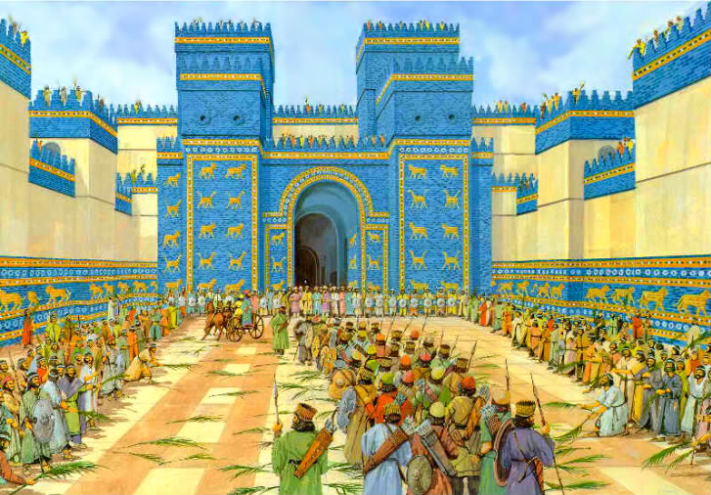
Cyrus’ greatest conquests - Lydia and Babylon
TASK: using the scanned pages from the textbook, complete the table summarising the two most significant conquests of Cyrus’ reign.
You are looking for info on;
How did he take over that kingdom?
What does he do that shows he is tolerant and fair as a king?
As we are used to seeing with Ancient Middle Eastern kings, conquest and military successes are a HUGE part of their kingship.
Cyrus had two particularly successful and important conquests in his time. The conquest of Lydia (modern day Turkey) and the Conquest of Babylon.
Both kingdoms increased the size of his empire, in just one life time, and made him very wealthy.
However, Herodotus’ account of both conquests also show’s Cyrus to be a fair and tolerant ruler too!
CHALLENGE
Our source for the conquest of Babylon is the Cyrus Cylinder. This was a source that was commissioned on Cyrus’ orders, and says what HE wanted people to know.
Based on this, why might we question the reliability of the record of the conquest of Babylon?

Slide 11
Name of the Conquest | How did Cyrus conquer this kingdom? | Examples of Cyrus being tolerant and fair to the newly conquered people.
Lydia
Babylon

