Slide 1

Answer the following questions in your book…
What was the name of Cyrus’ grandfather?
Why did Cyrus’ grandfather decide to have him removed from the family and killed?
What was the name of the general who had been ordered to kill Cyrus?
Why was this same general convinced to join Cyrus’ side when Cyrus finally challenged his grandfather?
What was the name of the Babylonian God that Cyrus said had welcomed him into the city?
Which enslaved peoples did Cyrus free when he conquered the city of Babylon?
What was the name of the King of Lydia, who Cyrus nearly put to death?
Challenge: Why was Babylon able to become the centre of the Middle Eastern world? Explain your answer using detailed historical information.

Slide 2
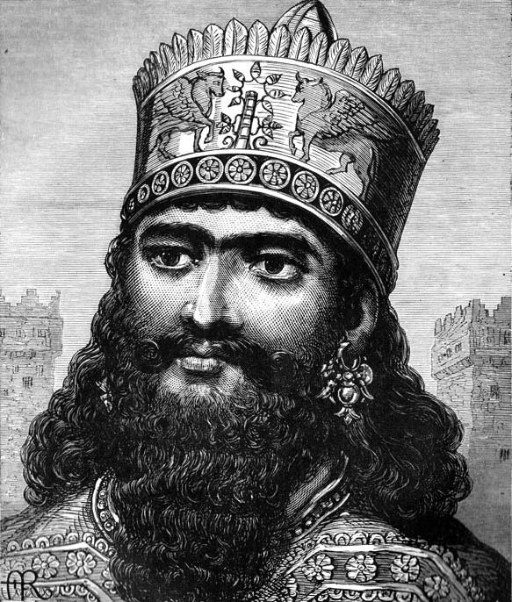
Persia; Cambyses
01 May 2020
RRR: What factors lead to the fall of the Assyrian Empire? (Write in your planner)
Lesson Objectives:
understand the extraordinary origin story of Cyrus, King of Persia.
To assess how far he really was ‘Great’.

Slide 3
1400-1190BCE
The New Hittie Kingdom
626-612BCE
Fall of Assyria, Rise of Babylon
(Last Lesson)
744-727BCE
Assyria; Tiglath Pileser III
558-530BCE
Persia; Cyrus the Great
1250-1150BCE
Rise of the ‘Sea Peoples’
3000BCE
2000BCE
1000BCE
3000-2000BCE
The city of Ur
1275BCE
The Battle of Qadesh
479BCE
Xerxes I loses the Persian Wars
883-859BCE
Assyria; Ashurnasirpal II
605-562BCE
Babylon; Nebuchadnezzar II
668-627BCE
Assyria; Ashurbanipal
530-522BCE
Persia; Cambyses II
(Today’s Lesson)

Slide 4
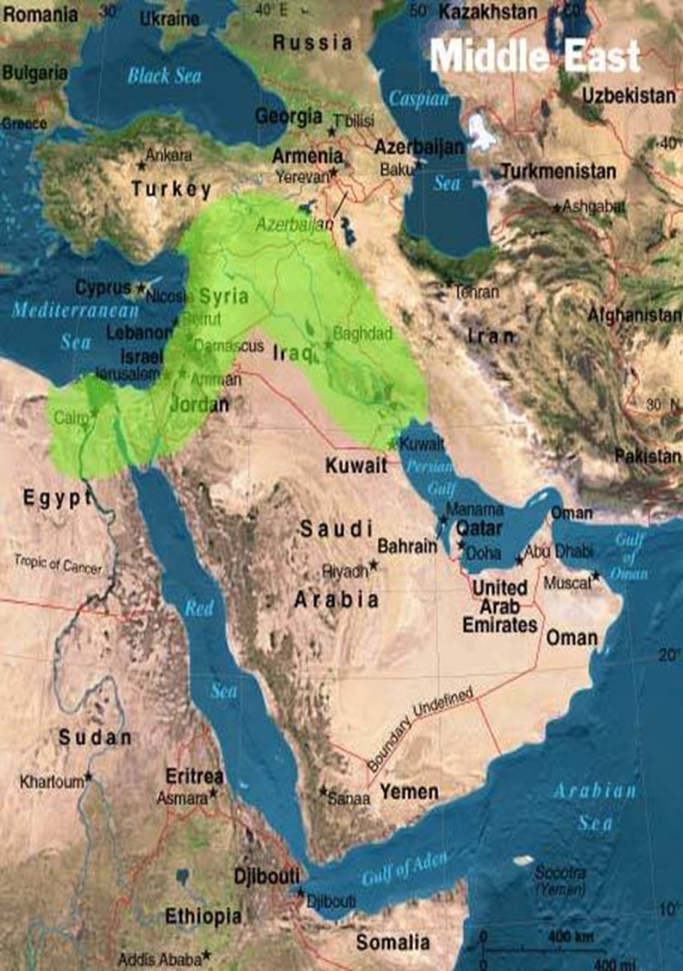
Where was the Persian Empire?
Pretty much the entirety of the Middle East!

Slide 5
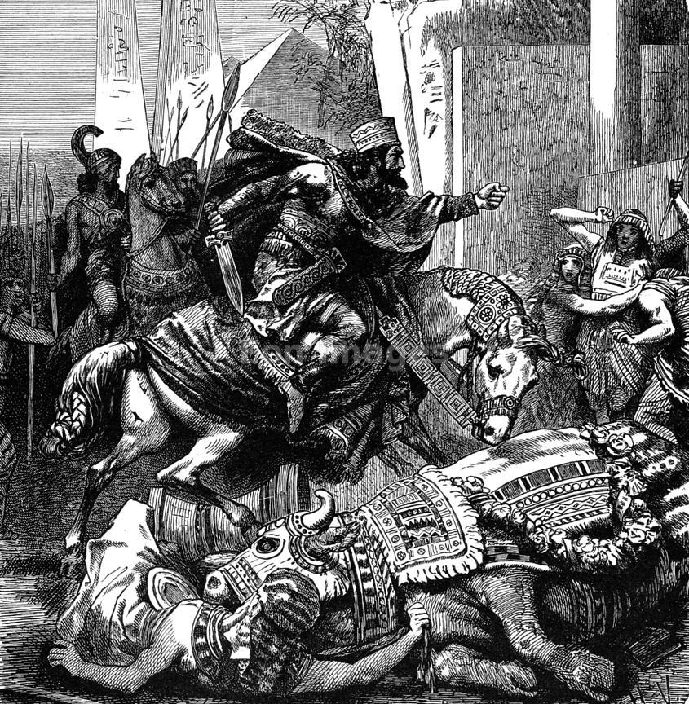
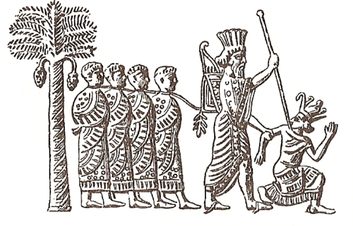
Cambyses; madman or reformer?
We don’t have much information on the reign of king Cambyses of Persia, apart from one event – his conquest of Egypt!
This was a very important event for the Persia empire as it expanded their territory even further, and brought this wealthy area into the empire.
HOWEVER, our ancient sources from this conquest are HUGELY contrasting – meaning they disagree with each other.
Some of them say that he was a fair leader and as part of his conquest he reformed corrupt parts of Egyptian religion. Other sources say that he was disrespectful and violent!
It is up to you what you think!
TASK: using p. 24-25 of the textbook, and the extra passages, complete the table on what type of a king Cambyses was.
Use the sources to collect your evidence, and don’t forget to include quotes to support each side of the argument!
CHALLENGE
In 2009, Italian archaeologists believed they had discovered weapons belonging to Cambyses’ lost army. Would this change your view of Cambyses? Explain your answer

Slide 6
Evidence that Cambyses was a Madman and a bad king | Best quotes that prove Cambyses was a madman | Evidence that Cambyses was a good king and challenged corruption
 | Best quotes that prove Cambyses was a good king

Slide 7
Herodotus. 3.37
Cambyses committed many such mad acts against the Persians and his allies; he stayed at Memphis, and there opened ancient coffins and examined the dead bodies.
Herodotus. 3.29-30
When the priests led Apis in, Cambyses—for he was all but mad—drew his dagger and, meaning to stab the calf in the belly, stuck the thigh. So the Egyptian festival ended, and the priests were punished, and Apis lay in the temple and died of the wound in the thigh. When he was dead of the wound, the priests buried him without Cambyses' knowledge.
- The Apis Bull was a scared animal to the Egyptians, they believed it was the living version of their god, Ptah.
Message on the side of the Tomb of the Apis Bull, buried at Memphis
The god Ptah, in the form of the Apis Bull, was taken up to heaven from the tomb that his majesty King Cambyses had made for him. All the correct ceremonies were performed for him, by his majesty King Cambyses.

Slide 8
PASSAGE A:
He (Cambyses) at once began his march against Ethiopia, without any order for the provision of supplies, and without for a moment considering the fact that he was to take his men to the ends of the earth… They had not, however, covered a fifth of the distance, when everything in the nature of provisions gave out, and the men were forced to eat the pack-animals until they, too, were all gone. If Cambyses, when he saw what the situation was, had change his mind and returned to his base, he would, in spite of his original error, have shown some sense; but as it was, he paid not the least attention to what was happening and continued his advance. The troops kept themselves alive by eating grass… some were reduced to cannibalism.
Provisions = food and water. Pack-animals = horses and donkeys used to carry equipment

Slide 9
Herodotus. 3.29-30
When the priests led Apis in, Cambyses—for he was all but mad—drew his dagger and, meaning to stab the calf in the belly, stuck the thigh. So the Egyptian festival ended, and the priests were punished, and Apis lay in the temple and died of the wound in the thigh. When he was dead of the wound, the priests buried him without Cambyses' knowledge.
What can we learn from the Egyptian source about the nature (personality) of King Cambyses?
Use the passage AND your own knowledge to answer the question.
STRUCTURE
1. Point
- From the source we can learn that Cambyses was…
2. Quote
- This is demonstrated in the source when…
3. Explain quote
- This quote shows that…
4. Add own knowledge
- In addition, we know that… - Make sure this O.K is connected to the same point you’re making!
CHALLENGE
How could the points you make in your answer be CHALLENGE by the evidence supplied by the Egyptian priest, Udjahorresnet?
Do this x2

