Slide 1

Answer the following questions in your book…
Name of the first peoples that Cyrus took over. – Clue; these were the people of his grandfather!
Give two reasons why Cyrus could be considered a ‘great’ king.
Give one way in which Cambyses was considered to be a ‘mad man’.
Name of the Egyptian priest who defends Cambyses in his writing.
Give one way in which Cambyses was supposedly a reasonable king.
Challenge: How far do you agree with Herodotus’s (the Greek Historian) assessment that Cambyses was a bad king?
Explain your answer using detailed historical information.

Slide 2
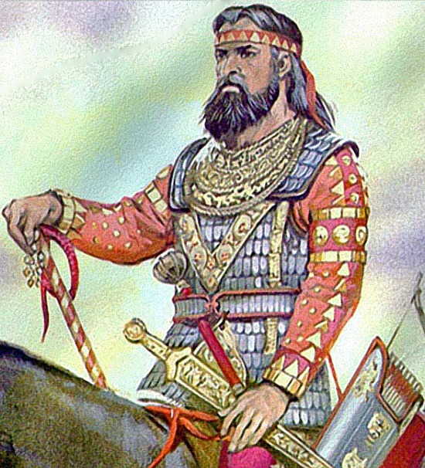
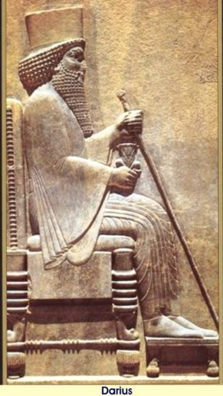
Persia; Darius
01 May 2020
RRR: How did Darius improve the Persian Empire? (Write in your planner)
Lesson Objectives:
decide if Darius tricked his way into power
assess how far he improved the Persian Empire

Slide 3
1400-1190BCE
The New Hittie Kingdom
626-612BCE
Fall of Assyria, Rise of Babylon
744-727BCE
Assyria; Tiglath Pileser III
(Today’s Lesson)
558-530BCE
Persia; Cyrus the Great
521 - BCE
Persia; Darius
1250-1150BCE
Rise of the ‘Sea Peoples’
3000BCE
2000BCE
1000BCE
3000-2000BCE
The city of Ur
1275BCE
The Battle of Qadesh
479BCE
Xerxes I loses the Persian Wars
883-859BCE
Assyria; Ashurnasirpal II
605-562BCE
Babylon; Nebuchadnezzar II
668-627BCE
Assyria; Ashurbanipal
530-522BCE
Persia; Cambyses II
(Last Lesson)

Slide 4
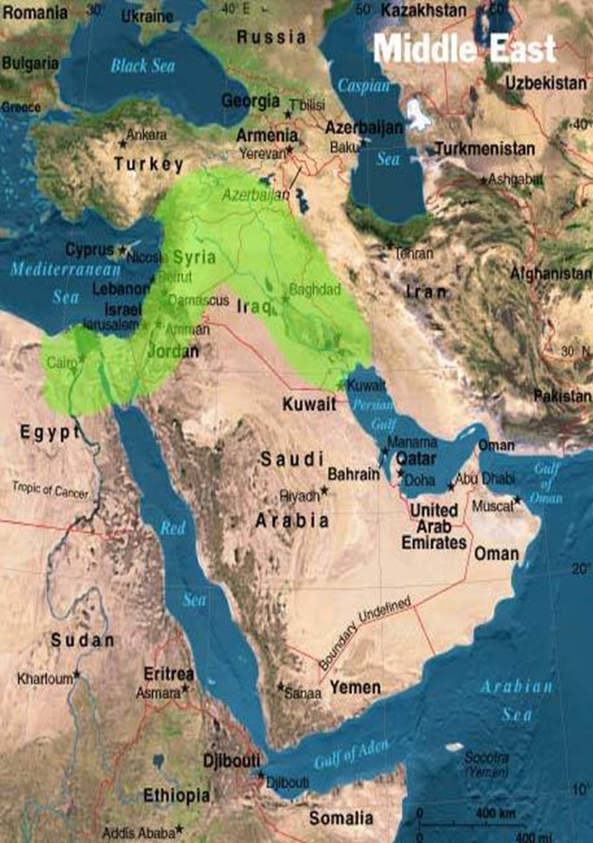
Where was the Persian Empire?
Pretty much the entirety of the Middle East!

Slide 5
Darius’ rise to the throne – Never look a gift horse in the mouth!
Cambyses died in an unfortunate way. Although he had ordered his own brother to be killed, while he was still in Egypt Cambyses got a message that a man claiming to be that same brother was challenging him for the throne.
This was NOT Cambyses’ brother, but a magi (Persian Priest) called Gaumata who looked enough like the dead brother to pass as him.
Cambyses raced to his horse to rush home, but accidently stabbed himself in the thigh as he mounted his horse, and he later died. – ironic!
The job of challenging this false-king, Guamata, then fell to a group of Persian noblemen, of which Darius was one of them. We have two versions of how he took the throne, one from Darius when he became king, and one from our Greek Historian, Herodotus.
TASK: read through the two versions of how Darius became king of the Persia Empire. One is from the Greek Historian Herodotus, and the other is from Darius himself!
Complete the Venn Diagram recording which features only belong to one of the versions, and then which features appear in both versions.
CHALLENGE
Why do you think there are such key differences between the two versions? Why might Darius have chosen to leave out particular parts?
Explain your reasoning.

Slide 6
Bisitun Inscription
Slew = killed/ to kill Dispossessed = to take something from someone
King Darius says: The following is what was done by me after I became king. A son of Cyrus, named Cambyses, was king here before me. That Cambyses had a brother, Smerdis by name. Afterwards, Cambyses slew this Smerdis. When Cambyses slew Smerdis, it was not known that Smerdis was slain. Thereupon Cambyses went to Egypt. When Cambyses had departed into Egypt, the people became hostile, and unrest multiplied in the land, even in Persia and Media, and in the other provinces.
King Darius says: Afterwards, there was a certain man, a Magian, Gaumâta by name, who raised a rebellion. On the fourteenth day of the month he rebelled. He lied to the people, saying: "I am Smerdis, the son of Cyrus, the brother of Cambyses." Then were all the people in revolt, and from Cambyses they went over to the pretend Smerdis, both Persia and Media, and the other provinces. He seized the kingdom; afterwards, Cambyses died of natural causes.
King Darius says: The kingdom of which the false Smerdis, the Magian, dispossessed Cambyses, had always belonged to our dynasty.
King Darius says: There was no man, either Persian or Mede or of our own dynasty, who took the kingdom from Gaumâta, the Magian. The people feared him exceedingly, for he slew many who had known the real Smerdis.
For this reason did he slay them, "that they may not know that I am not Smerdis, the son of Cyrus." There was none who dared to act against the false Smerdis, the Magian, until I came. Then I prayed to Ahuramazda; Ahuramazda brought me help. I, with a few men, slew that false Smerdis, the Magian, and the chief men who were his followers. At the stronghold in Media, I slew him; I dispossessed him of the kingdom. By the grace of Ahuramazda I became king; Ahuramazda granted me the kingdom.

Slide 7
Herodotus – Darius’ accession
Otanes was the first to guess that the Magus (false Smerdis) was not Cyrus' son Smerdis and who, in fact, he was; the reason was, that he never left the acropolis nor summoned any notable Persian into his presence.
When they (the men who believed Smerdis was a pretender) numbered six, Darius, whose father, Hystaspes, was a governor of the Persians, arrived at Susa. When he came, then, the six Persians resolved to include Darius too. Darius said, “I thought that I alone knew that it was the Magus who was king and that Smerdis son of Cyrus was dead; and it was for this reason that I made haste to come, that I might effect the Magus' death; but since it turns out that you know too and not only I, I think that we should act at once and not put it off.”
Darius argued that “There is no one who will not allow us to pass, from respect or from fear, because of who we are”.
The seven Persians, when they had decided to attack False Smerdis at once and not delay, prayed to the gods and set forth… When they came to the gate, it turned out as Darius had expected; the guards, out of respect for the leading men in Persia and never suspecting that there would be trouble from them, allowed them to pass, and no one asked any questions… When they had killed False Smerdis and his followers and cut off their heads, they left their wounded there because of their infirmity and for the sake of guarding the acropolis, while five of them carrying the heads ran outside with much shouting, calling all Persians to aid, telling what they had done and showing the heads.
As for the making of a king, they decided that he should be elected whose horse, after they were all in their saddles in the suburb of the city, should first be heard to neigh at sunrise. At dawn of day the six came on horseback as they had agreed. However, the night before Darius had ordered his man servant to visit his own horses’ favourite mare, and place his hands on her genitals. The next morning, as the horses rode out of the city and stopped at the sacred mountain waiting for sunrise, as the sun rose Darius’ servant raised his hand to Darius horse and Darius' horse trotted forward and whinnied; and as he so did there came lightning and thunder out of a clear sky. These signs given to Darius were thought to be foreordained and made his election perfect; his companions leapt from their horses and bowed to him.

Slide 8
Bisitun Inscription
Slew = killed/ to kill Dispossessed = to take something from someone
King Darius says: A son of Cyrus, named Cambyses, was king here before me. Cambyses had a brother, Smerdis by name. Afterwards, Cambyses slew this Smerdis. When Cambyses slew Smerdis, it was not known that Smerdis was slain. Thereupon Cambyses went to Egypt. When Cambyses had departed into Egypt, the people became hostile, and rebellion grew in the land.
King Darius says: Afterwards, there was a certain man, a Magian, Gaumâta by name, who raised a rebellion. He lied to the people, saying: "I am Smerdis, the son of Cyrus, the brother of Cambyses." Then were all the people in revolt, and from Cambyses they went over to the pretend Smerdis. He seized the kingdom; afterwards, Cambyses died of natural causes.
King Darius says: The kingdom of which the false Smerdis, the Magian, dispossessed Cambyses, had always belonged to our dynasty.
King Darius says: There was no man who could take the kingdom from Gaumâta, the Magian. The people feared him, for he slew many who had known the real Smerdis.
There was none who dared to act against the false Smerdis, the Magian, until I came.
Then I prayed to Ahuramazda; Ahuramazda brought me help. I, with a few men, slew that false Smerdis, the Magian, and his followers. At the stronghold in Media, I slew him; I dispossessed him of the kingdom. By the grace of Ahuramazda I became king; Ahuramazda granted me the kingdom.
Notes:
LOWER ABILITY

Slide 9
Herodotus – Darius’ accession
When they (the men who believed Smerdis was a pretender) numbered six, Darius arrived at Susa. When he came, then, the six Persians resolved to include Darius too.
Darius said, “I thought that I alone knew that it was the Magus who was king and that Smerdis son of Cyrus was dead; and it was for this reason that I made haste to come, that I might kill the Magus; but since it turns out that you know too and not only I, I think that we should act at once and not put it off.”
The seven Persians, when they had decided to attack False Smerdis at once, prayed to the gods and set forth… When they came to the gate, it turned out as Darius had expected; the guards, out of respect for who they were and never suspecting that there would be trouble from them, allowed them to pass, and no one asked any questions…
When they had killed False Smerdis and his followers and cut off their heads, five of them carrying the heads ran outside with much shouting, calling all Persians to aid, telling what they had done and showing the heads.
As for the making of a king, they decided that they should chose whoever’s horse neighed first at sunrise. At dawn of day the six came on horseback as they had agreed. However, the night before Darius had ordered his man servant to visit his own horses’ favourite mare, and place his hands on her genitals. The next morning, as the horses rode out of the city and stopped at the sacred mountain waiting for sunrise, as the sun rose Darius’ servant raised his hand to Darius horse and Darius' horse trotted forward and whinnied; and as he so did there came lightning and thunder out of a clear sky.
These signs given to Darius were thought to be foreordained and made his election perfect; his companions leapt from their horses and bowed to him.
Notes:
LOWER ABILITY

Slide 10
Darius – The smartest King yet?
TASK: using p.28-31 of the textbook to read up on the many ingenious ideas that Darius had as the new Persian King.
Pick the three that you think are the most significant, and fill in the table using the information on these ideas.
Persepolis is a BIG idea, but can be one of your 3 choices if you’d like a challenge!
For each one, make sure you explain;
What the idea/ initiative was.
How that initiative helped him become a strong king.
Mark on the bar chart how good an idea that one is, compared to the others. 1 is least clever, 5 is most clever!
As we now know, Darius route to the throne was more than a little dodgy! This meant that when he did become king he had to think very carefully about what idea (or INITIATIVES) he would put in place to help him rule.
Darius did this VERY well, and lots of what he did was new to the kingship of the area; e.g. Communications across land and sea, Arta and the God Ahuramazda in the law and new coins.
He built the most incredible palace at Persepolis, which stood as a testament to his tolerance and inclusive attitude towards ruling.
CHALLENGE
Think about the problems that you know previous kings have had. Which of Darius’ new initiatives do you think would have helped solve the problems of previous kings?

