Slide 1

Answer the following questions in your book…
The Hittite Kingdom was located in which region?
Who were the main rivals of the Hittites?
Who was the ruler of the Hittites during its peak?
What led to the downfall of the Hittite Kingdom?
What challenge did Mursili II?
Challenge:
Think of your own question that you do not think anyone else will be able to answer.
You must know the answer.
If no one else can get your answer then you will get 5 House Points.

Slide 2
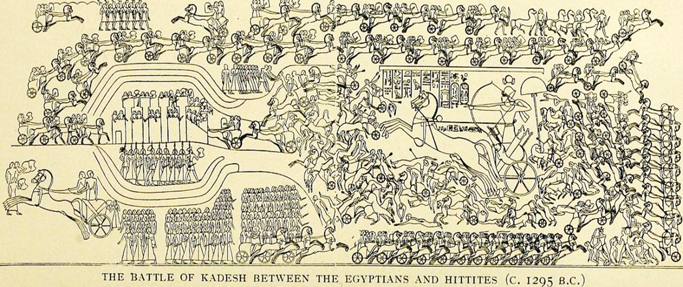
The Battle of Qadesh
01 May 2020
RRR: What can we learn about the Hittite Empire from the Battle of Qadesh?
(Write in your planner)
Lesson Objectives:
To understand the events of the battle of Qadesh.
To assess the consequences of the battle

Slide 3
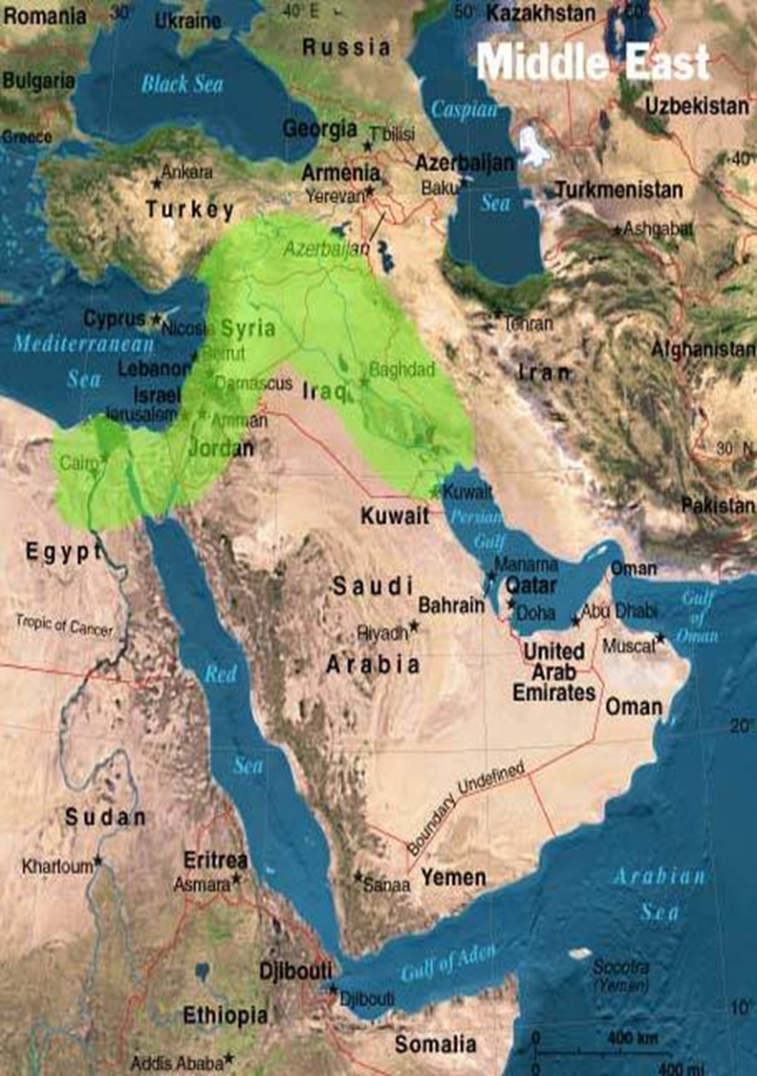
Where did the Battle of Qadesh take place?
In the region of modern day Syria

Slide 4
3000BCE
2000BCE
1000BCE
3000-2000BCE
The city of Ur
1400-1190BCE
The New Hittie Kingdom
479BCE
Xerxes I loses the Persian Wars
Today’s Lesson
Last Lesson
1275BCE
The Battle of Qadesh
Where did the Battle of Qadesh take place?
In the region of modern day Syria

Slide 5
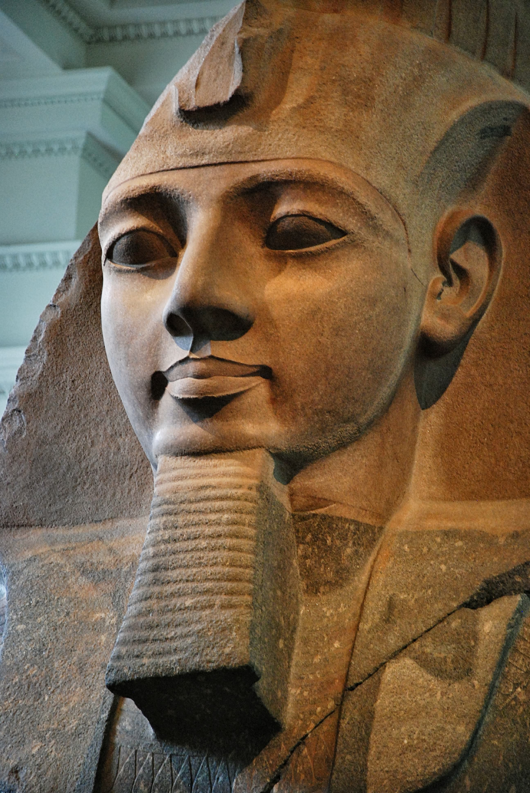
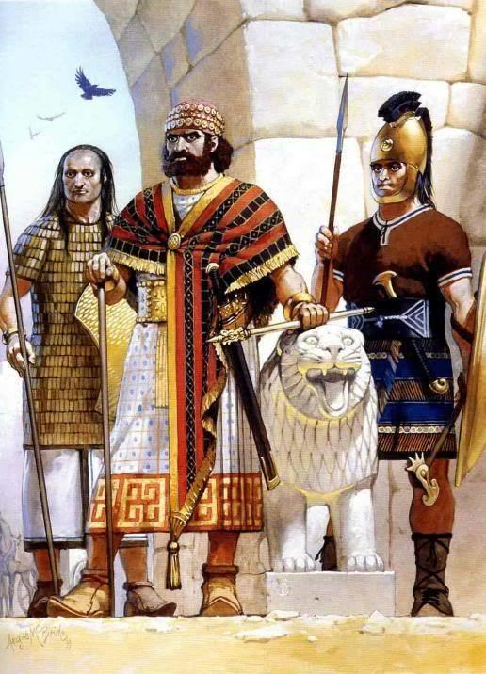

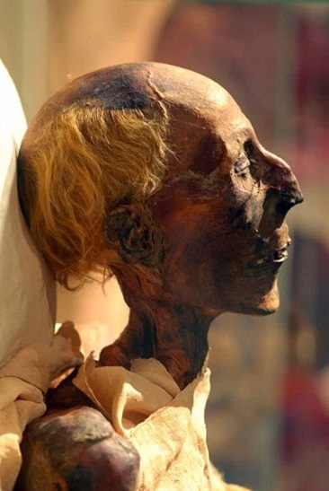
Hittites under Muwatalli
The Battle of Qadesh (1275BCE) is one of the most important military battles in the history of the Hittite.
In a bid to keep lands that they had reportedly taken from the Egyptian Kingdom, Hittite forces successfully ambushed the Egyptians, led by the ambitious new Pharaoh Rameses II, and pushed back the Egyptian invasion.
Egyptians under Rameses II

Slide 6
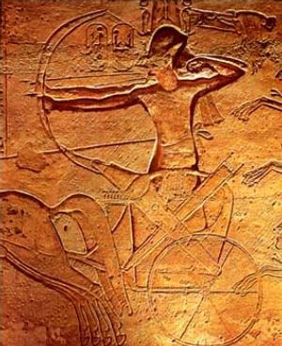
Which factors led to the Battle of Qadesh?
Most significant factor
Averagely significant factor
Least significant factor
Rameses II inherited an Egypt that was on the rise. Rameses’ father, Seti I, had worked hard during his life time to take back lands that had been lost while Egypt had weakened as a Kingdom.
Seti I had been an exceptional military commander and was beloved by the people; Rameses was determined to continue the work of his father.
Rameses looked to the lands that the Hittites had stolen from them, to the East of Egypt, and was determined to take them back…
TASK; using the information on this slide, and rereading the notes from last lesson on the Kings of the Hittite empire. Create a pyramid of causes for the Battle of Qadesh.
Think carefully about the order you choose to write the factors down in! The most SIGNIFICANT factor goes in the top third of the triangle, the least significant at the bottom.
HINT! – Reread your notes on Suppiluliuma I if you’re struggling for a 3rd factor!
NEXT STEP - Write a 4-5 sentence explanation for your choice of most significant factor leading to the outbreak of the conflict.
Notes:
Factors should be –
1 – Rameses ambitions to continue/better the work of his father
2 – Hittite seizure of land
3 – long-standing distrust after the assassination of Suppiluliuma I’s son.

Slide 7

Events of the Battle of Qadesh
When the battle of Qadesh finally came, it was an unpredictable and quick-changing conflict. As soon as one side appeared to have certain victory, mistakes would be made, and the other side would suddenly have the upper hand.
It ended inconclusively (without a clear conclusion). The Hittites appeared to have been bested, but Rameses failed to actually take back the city of Qadesh. Each side would play it off as their victory…
Why do you think that the Hittites were unable to win the battle outright?
Before sharing back to the class, and after discussing your opinion with your partner, WRITE a 3-4 sentence explanation for why the Hittites failed to win the battle
Make sure to explain using good historical detail!
TASK:
Watching the documentary clip on the events of the Battle of Qadesh, complete the quiz sheet covering the main points and consequences of the battle.
Notes:
https://www.youtube.com/watch?v=9b_Ab9GGb6g - PLAY CLIP FROM 2.40MINS!

Slide 8
Events of the battle – PLAY CLIP FROM 2.40min
Who was the first Pharaoh to take Qadesh back off of the Hittites?
What did the Hittites and the Egyptians sign after this first time?
Why, according to the clip, did the city of Qadesh fall back to the Hittites?
When did Rameses become Pharaoh? What did he want to do in the Fertile Crescent?
What did Hittite forces decide to do, once they knew that Rameses would move to attack Qadesh?
How many divisions did the Egyptians have altogether? What were the 4 main divisions named after?
What types of weaponry did the Egyptians bring to the battle?
List one advantage that the Hittite chariots had over the Egyptian chariots
List one disadvantage of the Hittite chariots
What claim did the 2nd set of captives make, about the whereabouts of the Hittite army?
Why were the 2,000 Hittite chariots able to defeat the first division of Egyptians they encountered?
Which side of the main camp did the Hittites attack from?
What mistake did the Hittite charioteers start to make, because they were so sure of victory?
Why was Rameses able to capture and kill most of the Hittite charioteers?
How many soldiers did Muwatalli send into the Egyptian cam, after he saw the charioteers suffering?
What happened to most of the Hittite troops that were trapped up against the Orontes river?
What did Egypt and the Hittite empire sign in 1278BCE?
Notes:
USE QUIZ SHEET!

Slide 9
Interpretations and consequences of the battle
As we know, the battle was inconclusive, and neither side technically won. The Egyptians caused the most damage, but the Hittites kept the city of Qadesh.
This led to a HUGE step forwards in politics. The Hittites signed the world’s first ever peace treaty with the Egyptians, agreeing to terms now that neither side had won.
This treaty was written in both languages, hieroglyphics for the Egyptians and Akkadian for the Hittites, and we still have both versions today!
Unsurprisingly, the Hittite version is written in a tone that suggests THEY really won the battle, and the Egyptian version is written in a tone that suggests THEY really won the battle.
We also have temple carvings (known as reliefs) at the Temple of Luxor, commissioned by Rameses II to describe the battle. Again, these are presented in a way to make the Egyptians look more impressive.
TASK: study/ read the three sources on the Battle of Qadesh, and answer the following questions;
Why might a historian be sceptical (having doubts) when using the relief from the temple of Luxor as evidence on how the battle of Qadesh went?
How far does the quote from Rameses prove that the Egyptians might have been less successful in the battle, than the relief suggests?
How does the Hittite’s version of the peace treaty make it sound like the Egyptians were the ones who lost the battle. – include quotes!

Slide 10
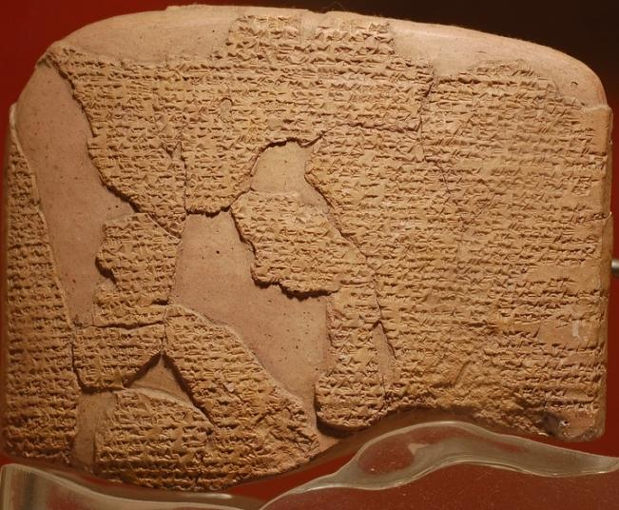
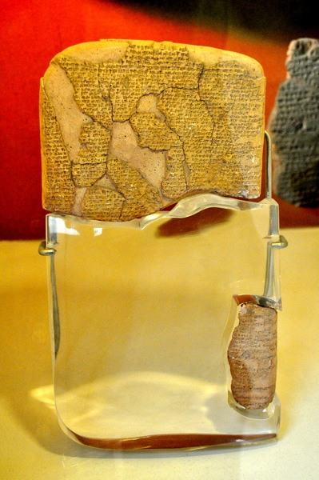
Surviving pieces of the Akkadian peace treaty after the Battle of Qadesh.

Slide 11
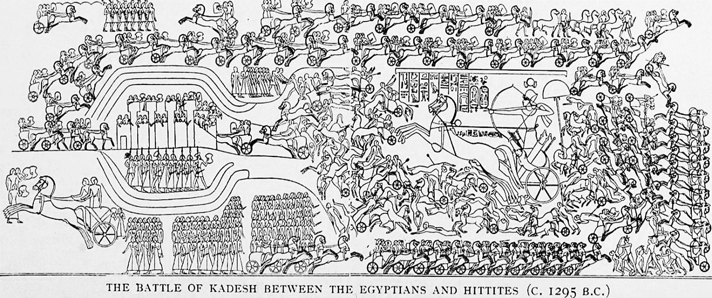
What can we learn from the source about the events of the Battle of Qadesh?
Aim to make 2 points in your answer! – this is how you should structure each point you make:
State the point you are making
Include a quote (if a written source) or a clear description (if a picture source) of the part of the source that shows you that point.
Add 2 sentences of own knowledge to support the point you’re making.
Sentence starters!
From this source we can learn that…
This is shown in the source when…
To support this idea we know that…
Notes:
An extra task to do if you want to split this over two lessons – technically practise for the GCSE

