Slide 1

Answer the following questions in your book…
The Battle of Qadesh took place in which modern day country?
In what year did the Battle of Qadesh take place?
Who was the Pharaoh of Egypt during the Battle of Qadesh?
Identify one mistake that the Hittites made during the battle.
How did the Hittite and Egyptian chariots differ?
What was the final result of the Battle of Qadesh?
Challenge:
Think of your own question that you do not think anyone else will be able to answer.
You must know the answer.
If no one else can get your answer then you will get 5 House Points.

Slide 2
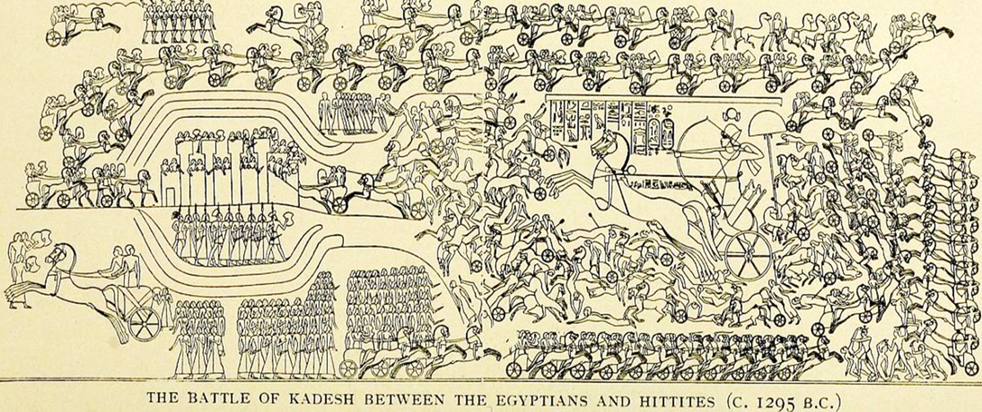
Who were the Sea Peoples?
01 May 2020
RRR: What caused the Bronze Age collapse?
(Write in your planner)
Lesson Objectives:
To understand the factors that lead to the Bronze Age collapse.
To assess the contemporary sources on the Sea People

Slide 3
1400-1190BCE
The New Hittie Kingdom
(Today’s Lesson)
1250-1150BCE
Rise of the ‘Sea Peoples’
3000BCE
2000BCE
1000BCE
3000-2000BCE
The city of Ur
1275BCE
The Battle of Qadesh
479BCE
Xerxes I loses the Persian Wars
(Last Lesson)

Slide 4
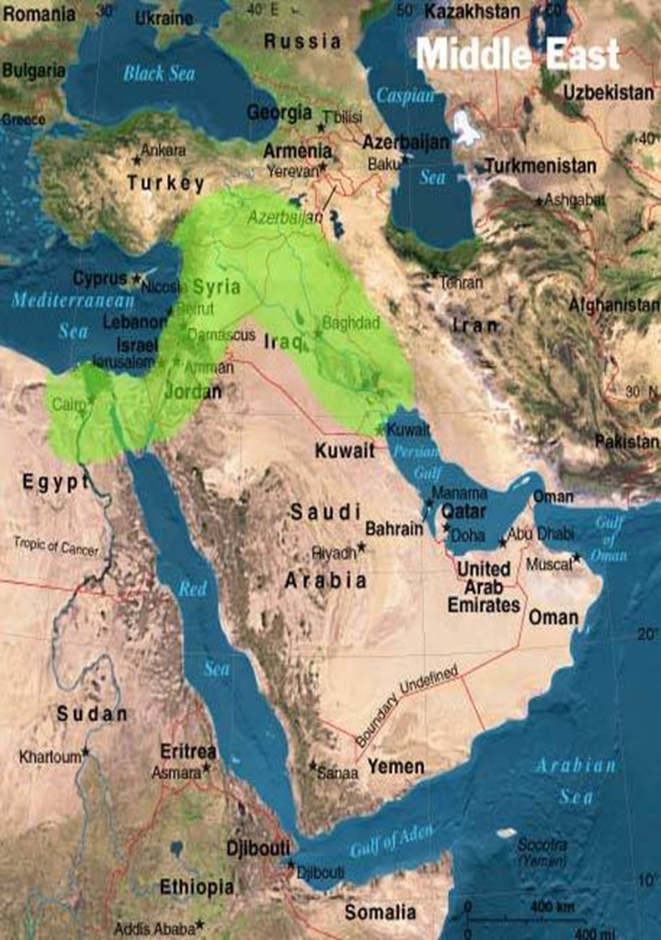
Where did the Sea People invade?
Modern day Turkey, and down the Mediterranean coast!

Slide 5
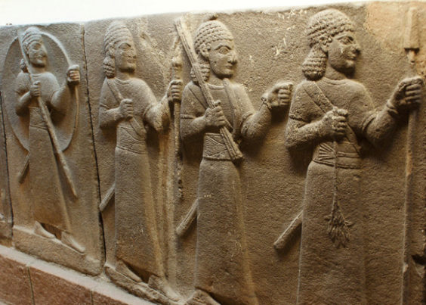
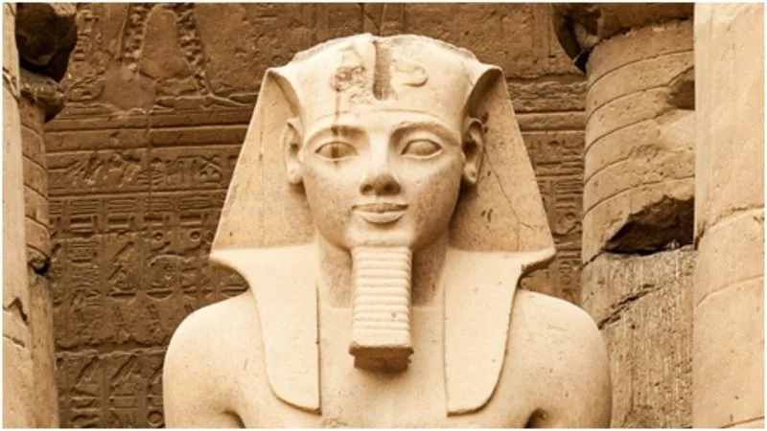
At the end of the 13thC/ beginning of the 12thC BCE the Middle East appeared to be at its strongest.
As our study of Mesopotamia, Ur and the Hittite empire has shown, the area was full of powerful, intelligent and forward-thinking cultures.
In addition, the Ancient Egyptians were on the rise again, as Seti I and Rameses II brought the New Kingdom to new heights.
All is well, all is good….
IT IS NOT!
The ancient Middle East is about to experience one of history’s greatest mysteries.
All this strength, and the dominance of the Hittite empire, is about to dissolve.
Historians and archaeologists have come to call this cataclysmic event, ‘The Bronze Age Collapse’.

Slide 6
What was the Bronze Age Collapse?
The Bronze Age Collapse was the cultural/ societal (society’s) collapse of major ancient kingdoms, such as the Hittite Empire in Anatolia and Syria and Mesopotamia.
It was experienced all over Eurasia!!
Trade routes completely disappeared
Some societies lost the knowledge of how to read and write
People stopped building great cities and monuments (no more pyramid in Egypt after this time!)
Governments and kingdoms faltered and disappeared.
But what actually happened when we say ‘collapse’?
Craft skills degraded, people made pottery WORSE than they had before.
Cities were completely levelled (destroyed)

Slide 7
Well, what do contemporaries (people from the time) say about this collapse???
Due to the fact that the collapse lead to a huge reduction in rates of literacy (reading and writing) we don’t have many records from this event.
BUT, the ones we do, repeatedly mention the arrival and onslaught of group they call ‘Sea Peoples’….

Slide 8
So who were the Sea People?
The truth is that we don’t know, they may not have even been one group of organised people.
BUT, the sources we do have about them, say that they came from the Aegean Sea (that’s the sea between Greece and Turkey), which borders the Hittite Empire.
The sources portray them as violent and aggressive peoples. They fought with the Egyptians and destroyed the cities of the Hittite Empire.
TASK: read through the contemporary sources on the Sea People. There are two written, and one pictorial (picture) source.
What can we learn about the damage the Sea People caused in the Middle East? – include quotes
What differences do there seem to be, between the Hittite experience with the Sea People, and the Egyptian experience with the Sea People? – include quotes
CHALLENGE:
Why might we question the reliability of Rameses III’s account of his experiences with the Sea People?
Overall, how accurate do you believe the Egyptian relief of the battle of the Delta is?
Notes:
Reliable = how trustworthy
Accurate = factually correct

Slide 9
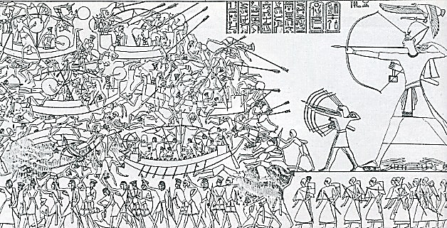
A letter from the Hittite city, Ugarit. – The letter begs the Hittite King for help and warns of the danger of Sea People.
My father, behold, the enemy's ships came (here); my cities were burned, and they did evil things in my country. Does not my father know that all my troops and chariots are in the Land of Hatti, and all my ships are in the Land of Lukka? ... Thus, the country is abandoned to itself. May my father know it: the seven ships of the enemy that came here inflicted much damage upon us.
Carving from the north wall of Egyptian temple, Medinet Habu – Showing the Egyptian campaign against the Sea Peoples at the Battle of the Delta.
Translation of Hieroglyphics accompanying the carving of the Battle of the Delta – written according to Rameses III’s instructions…
"Now the northern countries (Sea People) had penetrated the channels of the Nile delta. His majesty (Rameses III) is gone forth like a whirlwind against them…. The dread of him and the terror of him have entered in their bodies; (they are) capsized and overwhelmed. Their weapons are scattered in the sea…. His majesty is like an en- raged lion, attacking his assailant with his pawns; plundering on his right hand and powerful on his left hand, like Set[h] destroying the serpent 'Evil of Character‘ ”.

Slide 10
A letter from the Hittite city, Ugarit. – The letter begs the Hittite King for help and warns of the danger of Sea People.
…The enemy's ships came (here); my cities were burned, and they did evil things in my country.
…The country is abandoned to itself. May my father know it: the seven ships of the enemy that came here inflicted much damage upon us.
Carving from the north wall of Egyptian temple, Medinet Habu – Showing the Egyptian campaign against the Sea Peoples at the Battle of the Delta.
Translation of Hieroglyphics that came with the carving of the Battle of the Delta – written according to Rameses III’s instructions…
"Now the northern countries (Sea People) had attacked the Nile. His majesty (Rameses III) is gone against them…. The terror of him has entered in their bodies; (they are) capsized and overwhelmed. Their weapons are scattered in the sea…. His majesty is like an en- raged lion, attacking his enemies.
Notes:
LOWER ABILITY

Slide 11
Answer the following questions in your book…
Which modern day country did the Sea People invade?
The invasion of the Sea People happened around the time of which collapse?
Identify three consequences of this collapse.
Why is it difficult to get strong evidence about the collapse?
How did the Hittite and Egyptian experience of the Sea People differ?
Why should we be careful in trusting the reliability of the Egyptian sources about the Sea People?
Challenge:
Think of your own question that you do not think anyone else will be able to answer.
You must know the answer.
If no one else can get your answer then you will get 5 House Points.

Slide 12
What do some historians think that the Sea People did?
According to contemporary sources, and some historians, the Sea People were responsible for the Bronze Age Collapse, due to their invasion of the Middle East and destruction of the cultures/ societies they came into contact with.
They successfully attacked and killed people
They burnt the cities they came across
It was too difficult for the societies and cultures to recover.
TASK: watch the following clip on the Sea People and the Bronze Age Collapse and respond to the questions on your quiz sheet.
Follow up questions after the video;
Why could famine have LEAD to the arrival of the Sea People?
To what extent do you think that the Bronze Age collapse was caused by INTER-CONNECTED factors?
Notes:
https://www.youtube.com/watch?v=y-8uv4D7cOE

Slide 13
How did Egypt respond to the Sea People?
What is version 1 of the Sea People?
What is version 2 of the Sea People?
What is the 3rd hypothesis of the Sea people?
Why does it not look like natural disasters were to blame for the collapse
Why does famine seem like the strongest argument for the collapse?
Notes:
https://www.youtube.com/watch?v=y-8uv4D7cOE

Slide 14
So what caused the Bronze Age Collapse in the Middle East?
Modern Historians and archaeologists are becoming increasingly suspicious of the Sea People are the most significant/ likely explanation for collapse.
The Bronze Age Collapse happened across Eurasia, but the Sea People are only mentioned in the Ancient Middle East.
Many would argue that other factors were more significant, or that a number of factors had to work together to cause the collapse…
TASK: read through the factors on the collapse.
Step 1: order these factors from 1-6, with 1 being the most likely cause, to 6 being the least likely cause. – this is your own opinion.
Step 2: in your books, draw and complete your own summary thread, explaining your opinion on the most and least likely factors leading to the collapse.
For each give two reasons why you came to that decision, on that factor.
I would argue that the MOST likely factor is…
Firstly…
Secondly…
I would argue that the LEAST likely factor is…
Firstly…
Secondly…
CHALLENGE:
How far do you agree that the collapse was caused by a COMBINATION of factors working together?
Explain your answer using good historical detail!
Notes:
Reliable = how trustworthy
Accurate = factually correct

Slide 15
Sea People According to ancient sources, from 1250-1150BCE, the Middle East was invaded by a violent and dangerous group of people who arrived from the East/ the Sea. These people ransacked towns and cities, destroyed the cultures they came into contact with, and did this so badly that the local people couldn’t recover. They could do this because they had superior, iron weapons and chariots This meant that society collapsed, and future generations suffered from lost knowledge. | Drought & Famine Archaeologists have found fossilised pollen from the 12th C BCE, and when they studied them, the pollen showed that there are been years of drought in the Middle East. – the pollen showed the plants hadn’t been getting enough water. Drought leads to famine, and famine could explain cities being abandoned, lots of people dying, and even the arrival of people from different areas…. | Earthquakes A number of archaeologists have argued that the collapse, and particularly the destruction of cities, was the result of a series of earthquakes in the Middle East. Excavations of a number of key cities in Cyprus and Syria seem to have ‘destruction layers’ in their archaeology, which are caused by damage from an earthquake. Others argue that some of the damage in other cities CAN’T be caused by an earthquake, so this theory can’t explain the whole of the Bronze Age Collapse.
Warfare Other historians have argued that society collapsed because of the type of warfare in the Middle East. They argue that Middle Eastern armies depended too heavily on chariots, which were actually far less effective when put against large numbers of infantry (foot soldiers). Invading peoples used many more infantry soldiers in their armies, so were able to crush societies from the Middle East. | Collapse of governments Some historians have argued that the government of the Hittite Kingdom collapsed, and that is was lead to the collapse. These historians argue that people such as clerks, advisors and finance managers abandoned the governments as they became over-populated with people. This then led to cities and societies falling apart, which is why archaeologists find abandoned cities. | Iron trade The Bronze Age is called so because bronze was the main metal of that time. Around the 12th C, humans started to produce iron instead, which was much stronger and easily formed into weapons. This mean iron became hugely popular, and then started to ruin the bronze trade in the Middle East. This could have lead to families, town and societies becoming bankrupt as their main source of trade/ income was becoming worthless.
Notes:
If teaching a Lower ability set, I would reduce the 6 down to 3, and keep the following;
Sea People
Drought and Famine
Earthquakes

Slide 16
Sea People According to ancient sources, from 1250-1150BCE, the Middle East was invaded by a violent and dangerous group of people who arrived from the East/ the Sea. These people ransacked towns and cities, destroyed the cultures they came into contact with, and did this so badly that the local people couldn’t recover. They could do this because they had superior, iron weapons and chariots This meant that society collapsed, and future generations suffered from lost knowledge. | Drought & Famine Archaeologists have found fossilised pollen from the 12th C BCE, and when they studied them, the pollen showed that there are been years of drought in the Middle East. – the pollen showed the plants hadn’t been getting enough water. Drought leads to famine, and famine could explain cities being abandoned, lots of people dying, and even the arrival of people from different areas…. | Earthquakes A number of archaeologists have argued that the collapse, and particularly the destruction of cities, was the result of a series of earthquakes in the Middle East. Excavations of a number of key cities in Cyprus and Syria seem to have ‘destruction layers’ in their archaeology, which are caused by damage from an earthquake. Others argue that some of the damage in other cities CAN’T be caused by an earthquake, so this theory can’t explain the whole of the Bronze Age Collapse.
Notes:
If teaching a Lower ability set, I would reduce the 6 down to 3, and keep the following;
Sea People
Drought and Famine
Earthquakes

