Slide 1

Answer the following questions in your book…
Give one form of knowledge that was lost as part of the Bronze Age Collapse
Name of the Battle where Rameses III fought the Sea Peoples
Give one factor that Historians think lead to the Bronze Age Collapse.
Give two factors that explain why the Assyrian Empire was so strong.
How did Assyrian royal families ensure that there was no argument over who would be king after a king died?
Give one example of Ashurnasirpal being pragmatic
Give one example of Ashurnasirpal being violent
Challenge:
How well do you think that Ashurnasirpal compares to Suppiliulima, in terms of being the most successful king? Explain your answer

Slide 2
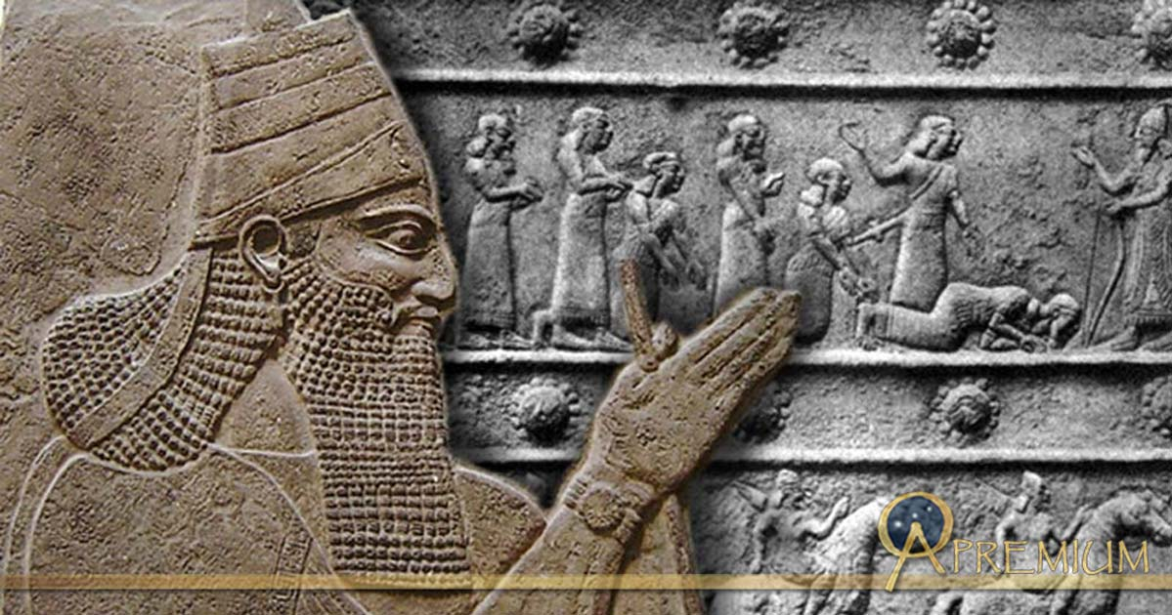
Tiglath Pileser III
01 May 2020
RRR: How far did Tiglath Pileser improve the Assyrian empire? (Write in your planner)
Lesson Objectives:
What made the Assyrian Empire strong?
How did Tiglath expand and improve the Assyrian empire?

Slide 3
1400-1190BCE
The New Hittie Kingdom
(Today’s Lesson)
744-727BCE
Assyria; Tiglath Pileser III
1250-1150BCE
Rise of the ‘Sea Peoples’
3000BCE
2000BCE
1000BCE
3000-2000BCE
The city of Ur
1275BCE
The Battle of Qadesh
479BCE
Xerxes I loses the Persian Wars
883-859BCE
Assyria; Ashurnasirpal II
(Last Lesson)

Slide 4
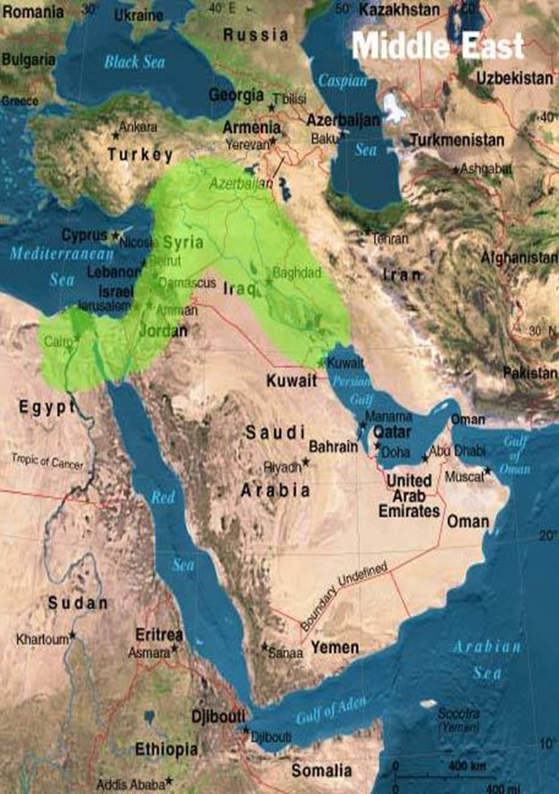
Where was the Assyrian Kingdom, where Tiglath Pileser was King?
Modern day Iraq/ Iran!

Slide 5
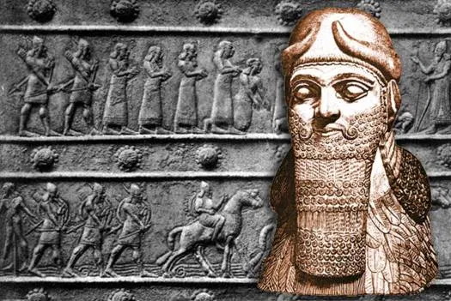
Tiglath Pileser – origins and achievements!
Where did he come from?
Tiglath did not follow immediately after Ashurnasirpal, he took power 2 generations later.
He took the throne in a palace coup and was not of the royal line, although it seems he was of royal blood.
Before Tiglath came to power, the Assyrian Empire had been weakening due to poor quality kings that had come after Ashurnasirpal II. – because they were weak, lesser nobles like Tiglath were able to challenge them!
What did he achieve?
Tiglath Pileser re-organized the government
Reigned in the power of the local governors
Re-structured the military, and revitalized the empire.
During his reign, the Assyrian Empire expanded and populations were forcibly re-located to keep communities strong discourage revolt.
He was an great administrator and is regularly regarded as one of the greatest military leaders in history.

Slide 6
Military expansion under Tiglath
As we have just read, historians argue that Tiglath was a HUGELY successful military leader.
He won the battle of Arpad, which brought Syria back under control.
He conquered modern-day Israel and Palestine
He took the kingship of Babylon
TASK: using source pack of information, complete the map with detail on each of Tiglath’s military successes and times he expanded the Assyrian empire.
CHALLENGE
How far do you agree that these military achievements make Tiglath Pileser a MORE successful ruler than Ashurnasirpal?
Think about
What do you mean by ‘successful’ when comparing the Kings?
Do you think that Ashurnasirpal’s building projects were more significant for the empire than Tiglath’s military achievements?

Slide 7
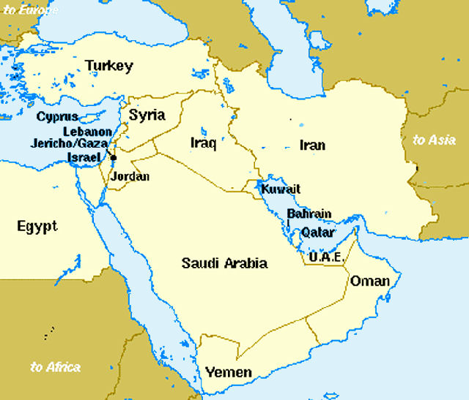
Taking the Kingship of Babylon
Taking the Kingship of Babylon
Anatolia, Syria and the Battle of Arpad
Conquest of Palestine and Israel
Conquest of Palestine and Israel
Notes:
PRINT TO A3!!!

Slide 8
Conquest of Palestine and Israel
In 736 BCE Tiglath Pileser III marched on the north and conquered the Medes and Persians (in modern-day Iraq/ Iran), expanding his empire far into the region now known as Iran.
At this point his empire niw encompassed the whole of Mesopotamia and the Levant, an area stretching from modern-day Iran, across to the Mediterranean Sea, and down through Israel and Palestine.
Local kings, like King Menachem of Israel, saw Tiglath and his fearsome Assyrian army threatening their cities. In Menachem’s case, he chose to submit without resistance, paying Tiglath 1,000 talents of silver as tribute.
This transaction is mentioned in the Bible in II Kings 15:19 and I Chronicles 5:26, as well as in Assyrian inscriptions andby doing this, Menachem saved himself and his city from destruction. He only had to swear loyalty and pay tribute to the Assyrian government to avoid having his city sacked and the people slaughtered.
As the Historian Kriwaczek writes, “the decision, and the huge cost, paid off. Thanks to Assyrian support, Menachem was the only Israelite ruler during this period who managed to keep his position and die naturally” (239). Once loyalty was assured, regions such as Israel under Menachem were allowed to retain some autonomy and continue on with their lives as before.

Slide 9
Anatolia, Syria and the Battle of Arpad
In the first half of the 8th century BC, Assyria found itself in a difficult situation. With the rise of Urartu in eastern Anatolia, Assyrian supremacy was no longer automatically accepted by the smaller kingdoms in Syria and Anatolia. The treaties binding these states to Assyria, and guaranteeing their tribute for the Assyrian treasury, were vulnerable as long as an alliance with this new Urartu tribe was possible.
At that time, Urartu's army was certainly Assyria's equal and in 754 BC, Sarduri II, king of Urartu, defeated the Assyrian army in Arpad (a place in Northern Syria). This glorious achievement was celebrated in Sarduri's inscriptions and was quite clearly a disaster for Assyria: in the succeeding years, Assyrian troops did not leave the borders of Assyria. Tiglath-pileser returned to Arpad in 743 BC, and on the very same battlefield destroyed the Urartu troops.
After defeating the Urartian troops in Arpad, Tiglath-pileser went on to punish this kingdom for providing Urartu with access to Syria and to Assyria's frontier. His army waged war in Arpad for three years until all resistance was crushed in 740 BC. When Arpad was ultimately defeated, the Assyrian army did not leave, as in previous centuries: instead, the country was turned into two provinces and transformed into a permanent part of Assyria.
Anatolia and Syria were now firmly under the control of Tiglath’s Assyrian empire!

Slide 10
Taking the Kingship of Babylon
Having established himself on the Assyrian throne, Tiglath-pileser first took the army to the south and decided the situation at the Babylonian frontier in his favour. In 744 BC, he founded two new provinces in the region controlled by the Medes, situated along the important trade route which we know today as the Silk Route: Bit-Hamban, at the headwaters of the Diyala river , and Parsua, further to the east in the Zagros Mountains.
From the beginning of his reign, the Assyrian king had been active in Babylonia: he came to work with Mukin-zeri, chief of the tribe of Bit-Amukani, but Mukin-Zeri attempted to unite the region of Babylon under his own leadership and assumed the kingship of Babylon in 731 BC. Tiglath-pileser saw this as a provocation and a challenge to Assyria's primacy in the region. He repeatedly led the Assyrian army against Mukin-zeri and ultimately defeated him, taking the crown of Babylon for himself in 729 BC.
In 729 BCE a revolt broke out in the city of Babylon after the death of the king Nabonassar, who had been a loyal vassal, and Tiglath Pileser III marched on the city, put down the revolt, and executed the pretender to the throne. He then had himself crowned King Pulu of Babylon and officiated at the sacred festival celebrating the New Year. He was now king of both Assyria and Babylon and was at the height of his reign.
For the remainder of his reign, Tiglath-pileser ruled both as the king of Assyria and the king of Babylon.

Slide 11
LOWER ABILITY READING!

Slide 12
Conquest of Palestine and Israel
In 736 BCE Tiglath Pileser III conquered the Medes and Persians (in modern-day Iraq/ Iran), expanding his empire far into the region now known as Iran.
At this point his empire now had the whole of Mesopotamia and the Levant, an area including from modern-day Iran, across to the Mediterranean Sea, and down through Israel and Palestine.
Local kings, like King Menachem of Israel, saw Tiglath and his fearsome Assyrian army threatening their cities. Menachem chose to surrender and pay Tiglath money, instead of fighting.
Menachem saved himself and his city from destruction. He only had to swear loyalty and pay tax to the Assyrian government to avoid having his city sacked and the people killed.

Slide 13
Anatolia, Syria and the Battle of Arpad
In the first half of the 8th century BC, Assyria was challenged by the Urartu tribe. This mean that smaller kings like Syria and Anatolia didn’t automatically accept Assyria power anymore.
At that time, Urartu's army was just as good as Assyria's, and in 754 BC the Urartu defeated the Assyrian army in Arpad (a place in Northern Syria). This was quite clearly a disaster for Assyria: in the next few years, Assyrian troops did not leave the borders of Assyria.
Tiglath-pileser returned to Arpad in 743 BC, and on the very same battlefield destroyed the Urartu troops in a second battle.
After defeating the Urartian troops in Arpad, Tiglath-pileser went on to punish this area for giving the Urartu access to Syria and to Assyria's borders. His army waged war in Arpad for three years until all resistance was crushed in 740 BC.
When Arpad was defeated the Assyrian army did not leave, instead, the country was turned into two provinces and transformed into a permanent part of Assyria!
Anatolia and Syria were now firmly under the control of Tiglath’s Assyrian empire!

Slide 14
Taking the Kingship of Babylon
Having set himself up on the Assyrian throne, Tiglath-pileser took his army south to Babylon. In 744 BC, he creataed two new provinces in the region controlled by the Medes, and took control of the important trade route which we know today as the Silk Route.
In 731, a rival leader called Mukin-zeri, chief of the tribe of Bit-Amukani, attempted to unite and take control of Babylon and said that HE was now the king of Bbaylon.
Tiglath-pileser saw this as a challenge to himself and Assyria’s power in Babylon. He repeatedly led the Assyrian army against Mukin-zeri and ultimately defeated him, taking the crown of Babylon for himself in 729 BC.
In 729 BCE a revolt broke out in the city of Babylon after the death of the king Nabonassar, who had been a loyal servent to Tiglath, and Tiglath marched on the city, put down the revolt, and executed the rebels. He then had himself crowned King Pulu of Babylon. He was now king of both Assyria and Babylon and was at the height of his reign.
For the rest of his reign, Tiglath-pileser ruled both as the king of Assyria and the king of Babylon.

Slide 15
QUEEN YABA – Tiglath’s Wife
In 1988, archaeologists discovered an incredible tomb in the Assyrian city of Kalah. The tomb was the burial was full of stunning golden artefacts and jewellery, and was protected by a curse.
It was the tomb of Tiglath’s wife, Queen Yaba.
It was a huge discovery, but it also raised some very confusing questions as to who was REALLY buried in there with her!
TASK: using information from the 3 sources and 1 interpretation from the tomb of Queen Yaba, answer the following question.
How can we tell that Queen Yaba was a significant figure to the Assyrian Empire, and her husband?
2-3 points of discussion
For each point, make sure include details quotes from one of the sources AND your own wider knowledge.
CHALLENGE
How could the ANCIENT sources that we have been left about Queen Yaba actually limit the amount we can learn about her?
What other types of sources would you want to have been left, to help you learn more about her significance? – why these sources?
Notes:
LOWER ABILITY SETS – have student create a table of evidence. One side that she WAS significant, the other side that she WASN’T significant

Slide 16
The curse carved into Queen Yaba’s tomb
By command of the great gods of the underworld, mortal destiny caught up with Queen Yaba in death, and she travelled the path of her ancestors.
Whoever comes to this tom; whether they are a queen who sits on the throne, or a lady of the palace who is a favourite concubine (prostitute) of the king…
If any of them remove me from my tomb, or place anyone else with me, or lays hand on my jewellery with evil intent, or breaks open the seal of this tomb - let their spirit wander in thirst in the open countryside for ever.
Below, in the Underworld, let him not receive any pure water, beer, wine, or flour as an offering!
May the great gods of the underworld impose on his corpse and spirit, restlessness for all eternity.
WorldArchaeology.com – discussing the Tomb of Queen Yaba
It was explicitly forbidden to bury another women in the tomb with Yaba, yet archaeologists discovered the tomb contained not one body but two!
Queen Yaba may have been the body on the bottom, but above her was a second female who had been put in perhaps a generation later. This second body had been gently ‘cooked’ to a temperature of 100-200 degrees C: had she perhaps died far from home and been cooked to preserve the body until it could be buried at home in familiar surroundings under the floor of the Royal Palace?
The tomb contained four magnificent gold bowls, three of them had the names of different queens; there were two bodies but three inscribed bowls.
One was inscribed with the name of Yaba, the second with the name Atalia, the wife of Sargon II, they may have been mother and daughter and both of them queens. The third was inscribed with the name of Banitu, the wife of Shalmaneser V, but historians think Banitu and Yaba may actually have been the same woman!

Slide 17
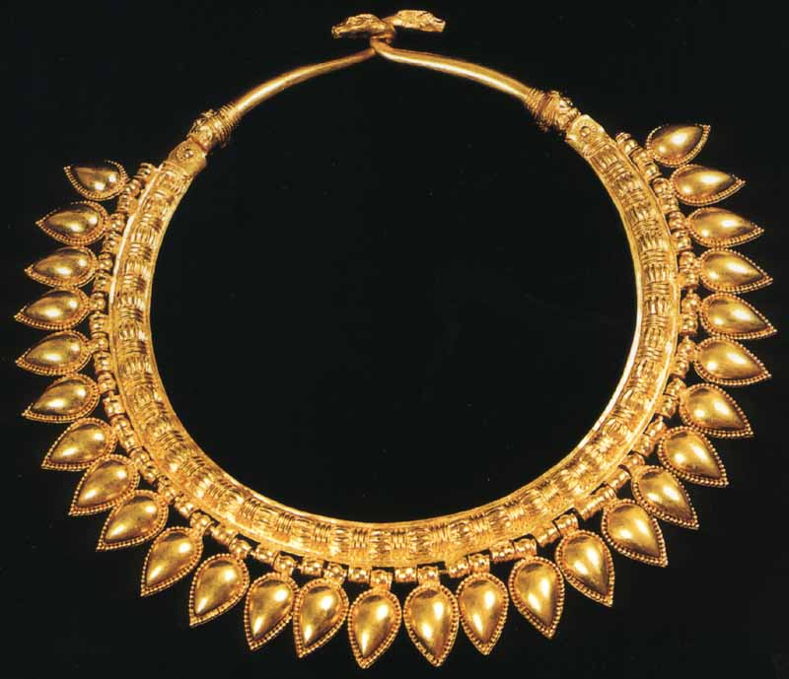
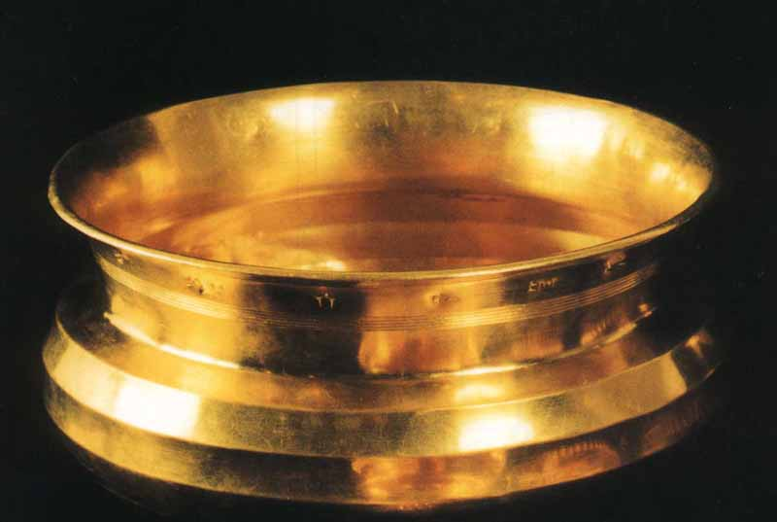
Gold bowl with the name Banitu carved into the rim.
– Found in Yaba’s tomb
Solid gold necklace, one of 6 found in the tomb.
– it was found alongside solid gold ankle bracelts, a crown and other jewelry.

