Slide 1

Answer the following questions in your book…
Tiglath Pileser took the kingship of which Middle Eastern city?
What was the name of Tiglath Pileser’ wife?
What was the name of the Battle where Tiglath defeated the Urartu tribe?
Which kingdom most successfully rose out of the Bronze Age Collapse?
Why was the Assyrian army so successful?
What did Tiglath’s queen have carved onto her tomb to ward off visitors?
Give one example of Ashurnasirpal being a megalomaniac.
Challenge:
How well are female figures represented in Ancient History? What challenges do you think we have to study women in the Ancient Middle East? Explain your answer

Slide 2
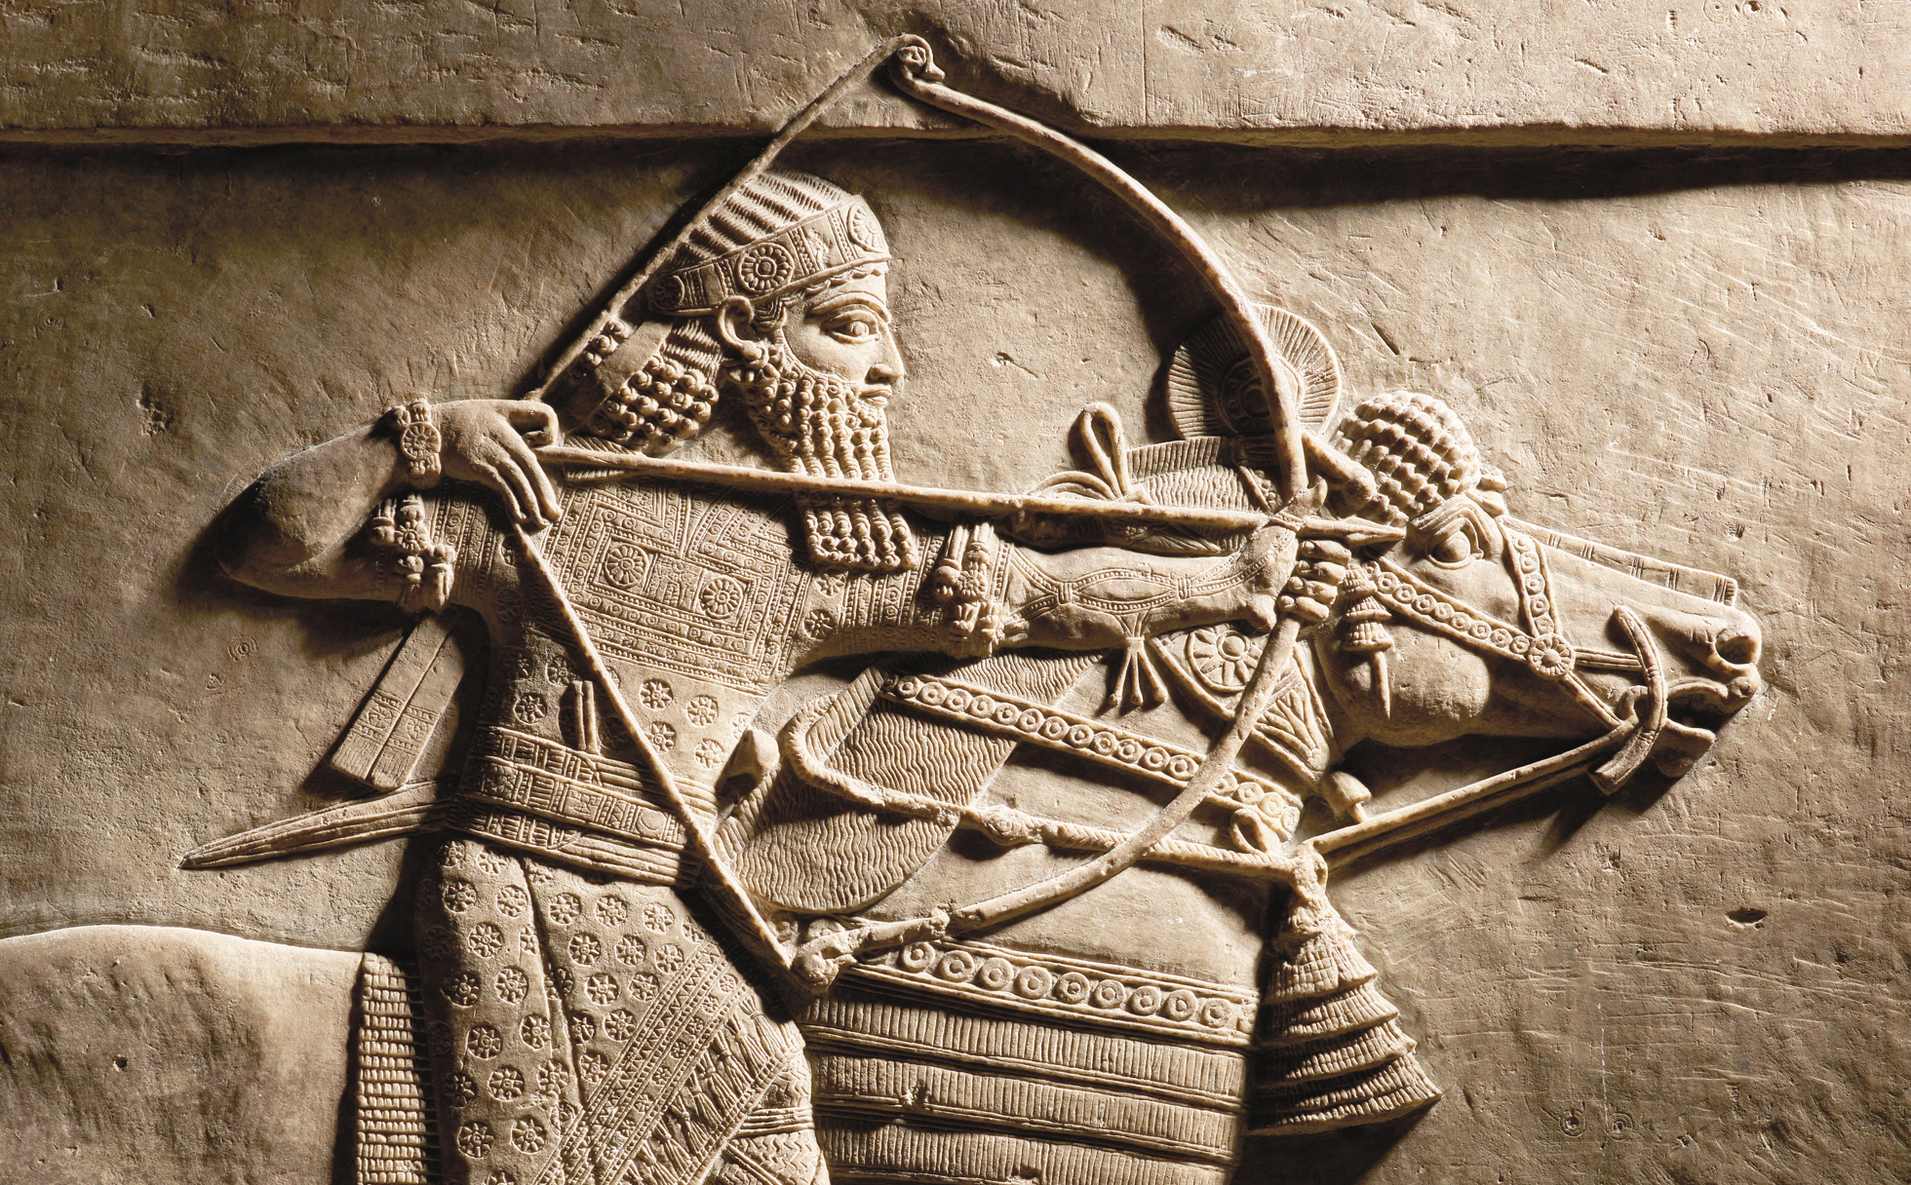
King Ashurbanipal; scholar or soldier?
01 May 2020
RRR: How was Ashurbanipal a different leader from the Assyrian Kings before him? (Write in your planner)
Lesson Objectives:
The key features of Ashurbanipal’s kingship.
How did Ashurbanipal differ from the kings before him?

Slide 3
1400-1190BCE
The New Hittie Kingdom
(Last Lesson)
744-727BCE
Assyria; Tiglath Pileser III
1250-1150BCE
Rise of the ‘Sea Peoples’
3000BCE
2000BCE
1000BCE
3000-2000BCE
The city of Ur
1275BCE
The Battle of Qadesh
479BCE
Xerxes I loses the Persian Wars
883-859BCE
Assyria; Ashurnasirpal II
668-627BCE
Assyria; Ashurbanipal
(Today’s Lesson)

Slide 4
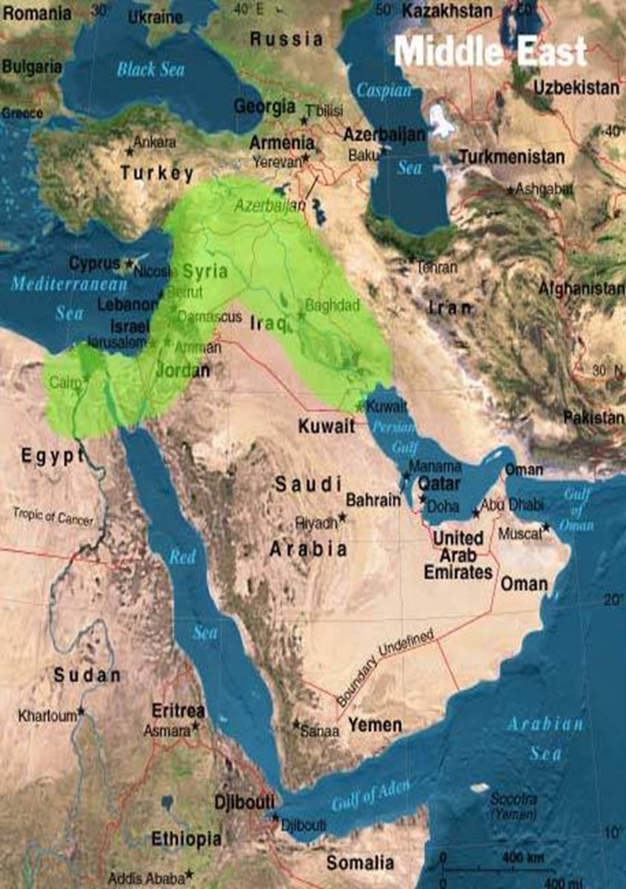
Where was the Assyrian Kingdom, where Ashurbanipal was King?
Modern day Iraq/ Iran!

Slide 5
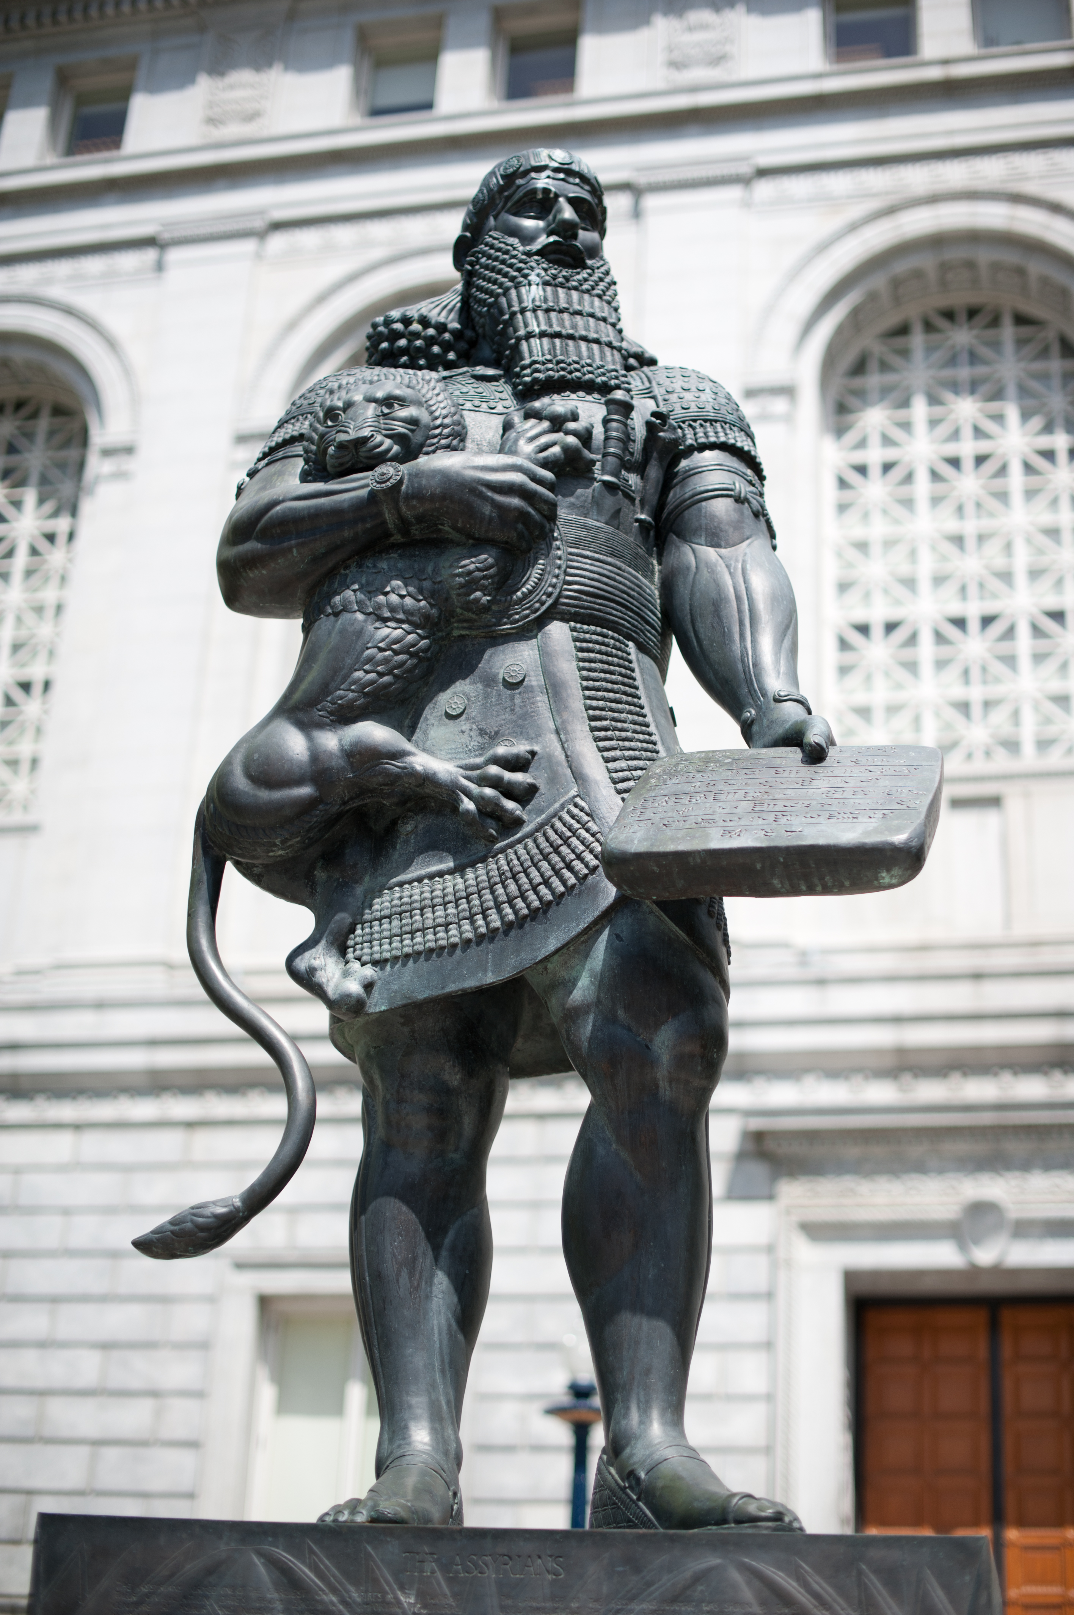
Ashurbanipal – king of the world?
Ashurbanipal was the next in a line of great Assyrian kings that we have studied, and in many ways he continued the work of earlier kings.
He defeated rivals, he protected and expanded the empire. However, in some ways he was very DIFFERENT from the kings who had come before him…
TASK: watch the clip from the British Museum, twice, as it is quite short.
Create a quick spider diagram, one half which has the ways that he is similar to previous kings, the other side which has differences to previous kings.
Think about
What he does
What achievements he has!
Notes:
https://www.youtube.com/watch?v=0OZe-y5tk9Q

Slide 6
The many sides of Ashurbanipal
Ashurbanipal is thought to be one of the greatest kings in the history of the Ancient Middle East.
This is because he was not just a military leader, but he took steps to protect and improve the education and culture of the Assyrian empire.
After his reign, Assyria would never be as strong again!
TASK: using blog from the British Museum, complete the revision spider diagram on the different parts of Ashurbanipal’s Kingship.
For each section of the spider diagram, include 2-5 pieces of information.
CHALLENGE
Can you see any links between the different parts of Ashurbanipal’s kingship?
Use arrows and a short annotation to explain where these links are on the spider diagram.
Notes:
https://blog.britishmuseum.org/who-was-ashurbanipal/?_ga=2.165434559.1636850546.1569507844-727808298.1569507844

Slide 7
Ruled the largest empire Ashurbanipal was king of the Assyrian empire. At the time of his reign (669–c. 631 BC) it was the largest empire in the world. It went from Cyprus in the west to Iran in the east, and at one point it even included Egypt. Its capital Nineveh (in modern-day Iraq) was the world’s largest city. This is at a time when the Greek city-states (like Athens and Sparta) were still very young and Rome was just a small town. Ashurbanipal wasn’t humble about being the king of the Assyrian empire – he called himself ‘king of the world’! Quite a claim, but given the size of the empire, it wasn’t far from the truth. | Hunted Lions As part of his military training, the young crown prince was taught to drive chariots, ride cavalry horses, and develop skills such as archery. He also learnt how to hunt lions. In Assyria lion hunting was a royal ‘sport’. Although this perhaps seems cruel to modern eyes, killing lions represented the king’s ability to protect his kingdom. | Crushed his enemies Ashurbanipal was popular among his subjects but harsh in dealing with enemies. He was said to have put a dog chain through the jaw of a defeated king and made him live in a dog kennel. That’s pretty brutal, even by the standards of the ancient world. When the state of Elam tried to rise up against Assyria, Ashurbanipal crushed them. He claimed to have killed the Elamite king and his son with his own sword (in reality, he was not at the battle, but at home in the safety of his palace). The Elamite king’s head was brought back to the palace in Nineveh where it was hung from a tree in the garden as a decoration.
He built a great library While he wasn’t crushing enemies and killing lions, Ashurbanipal enjoyed reading and education. He could read and write, which was unusual for a king. He loved to boast about his education, and even had images of himself carved with a pencil next to a sword in his belt! Ashurbanipal developed the first collected and catalogued library in the world. He wanted a copy of every book worth having and sent his minions across the empire to gather all the knowledge in the world. Assyrian books were mostly written on clay tablets, not on paper, in a script called cuneiform. In total he gathered hundreds of thousands of these tablets. . | He lived in luxury Ashurbanipal reigned from his royal capital at Nineveh. The Assyrian kings built on a huge scale. The city of Nineveh was transformed into a large city whose size and splendour amazed the ancient world. Ashurbanipal ruled for most of his reign from the ‘Palace Without Rival’, which was built ‘to be an object of wonder for all the people’. Visitors entered the palace through massive gateways with huge human-headed winged bulls (known as lamassu) that protected the king from dangerous supernatural forces. | BONUS INFO! – He worked as a spy for this father. When Ashurbanipal was appointed crown prince, he started his training to be king. He learnt royal behaviour, important military skills and was instructed in reading and writing. He shadowed his father in court where he could learn the way of Assyrian kingship. He also worked as a spymaster for his father, gathering information from agents across the empire and creating intelligence reports. This helped to develop Ashurbanipal’s knowledge of the empire – and learn who his enemies were.
Notes:
INFO FOR LOWER ABILITY SPIDER DIAGRAM

Slide 8
The library of Nineveh
Ashurbanipal’s Library is one of the most important archaeological discoveries ever made.
The ‘Library of Ashurbanipal’ is a collection of over 30,000 clay tablets and fragments inscribed with cuneiform – a type of writing used in Mesopotamia (ancient Iraq).
The tablets were discovered in the ruins of the city of Nineveh (now northern Iraq), once capital of the mighty Assyrian empire.
They were excavated in a series of digs from the 1840s through to the 1930s.
Nineveh was destroyed by a fire in around 612 BC. But while paper books are destroyed by fire, the clay tablets were in most cases baked harder, making them among the best preserved documents from thousands of years of Assyrian history!
TASK: watch the clip on the library of Nineveh, that Ashurbanipal commissioned and developed.
Make notes on;
Why it is an important development for the Ancient Middle East
Why it was an important development for humanity.
Post-video reflection question
How far does Ashurbanipal’s work on his library prove that he was the most important of the Assyrian Kings?
Think about;
What do you mean by ‘important’?
Have other kings done things that are as important as this library?
Notes:
https://www.youtube.com/watch?v=Ra2ju6xSjNc

Slide 9
Plenary table
Evidence that Ashurbanipal was SIMILAR to other Assyrian Kings | Evidence that Ashurbanipal was DIFFERENT to other Assyrian Kings
Draw out and complete this table, using the knowledge you have gained from today and previous lessons on the Assyrian Empire

