Slide 1

Answer the following questions in your book…
Which city did Ashurnasirpal build and improve while he was King?
Give one example of when Ashurnasirpal acted like a violent megalomaniac?
List 2 countries/ areas that Tiglath Pileser took control of.
Name of Tiglath Pileser’s wife?
Give an example of two objects that were found in her tomb.
Which animal did Ashurbanipal hunt to prove his strength as a king?
What was the most significant building project of Ashurbanipal’s reign?
Challenge:
How different a king was Ashurbanipal, compared to the Assyrians and Hittites we have previously studied? Explain your answer

Slide 2
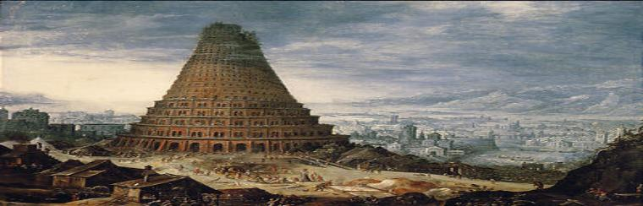
Fall of Assyria; Rise of Babylon
01 May 2020
RRR: What factors lead to the fall of the Assyrian Empire? (Write in your planner)
Lesson Objectives:
Understand how Assyria weakened and Babylon took over.
Assess the most significant factors in Assyria’s fall from power.

Slide 3
(Today’s Lesson)
1400-1190BCE
The New Hittie Kingdom
626-612BCE
Fall of Assyria, Rise of Babylon
744-727BCE
Assyria; Tiglath Pileser III
1250-1150BCE
Rise of the ‘Sea Peoples’
3000BCE
2000BCE
1000BCE
3000-2000BCE
The city of Ur
1275BCE
The Battle of Qadesh
479BCE
Xerxes I loses the Persian Wars
883-859BCE
Assyria; Ashurnasirpal II
668-627BCE
Assyria; Ashurbanipal
(Last Lesson)

Slide 4
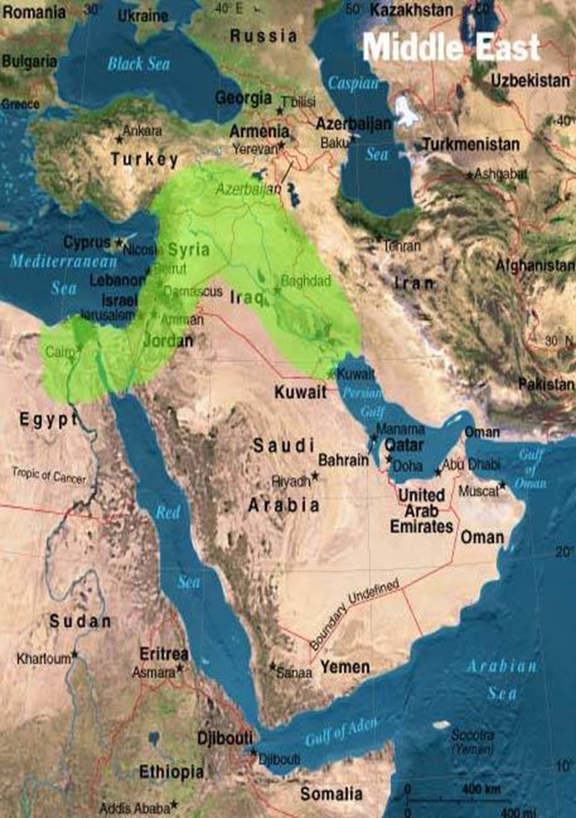
Where was the Assyrian Kingdom, where Ashurbanipal was King?
Modern day Iraq/ Iran!

Slide 5
The fall of the great Assyrian Empire
Under Ashurbanipal, the Assyrian empire was at its’ height, but by the end of his rule it was severely weakened.
Historians debate how far this was Ashurbanipal’s fault. Some say he gave too much power to his lowly advisors, others argue that attacks from the Medes and Babylonians brought down the empire.
TASK: read through the card sort that explains the different factors that lead to the fall of the Assyrian empire. Decide where each piece of information belongs on your table.
Think, does some of the information belong in two of the factors? – if you think this is the case, write a sentence under that factor, in the table, explaining WHY!
Next step
Give a 4-6 sentence explanation as to which of the factors YOU think is most significant when explaining why the Assyrian empire broke down.
CHALLENGE
‘It is clear that the Assyrian empire fell as a result of the invasion of Medes and enemy troops’.
How far do you agree with this statement? - Agree, disagree, conclude.

Slide 6
Ashurbanipal left the Empire weak | Nabopolassar challenged for the throne of Babylon | The Medes and the Babylonians invaded Assyria

Slide 7
Egypt challenged the power and control of the Assyrian empire, lead by the royal Psammetichus, and won! Egypt was now free from the empire, and although Ashurpanibal condemned the actions, he did nothing! | Female relatives in the royal family began to assume positions of great influence in court, and therefore take charge in political decision making. This was not the normal way for Assyrian women, and it undermined the strength of Ashurbanipal | Ashurbanipal handed out important positions in government to people who were close to him, but not appropriate for the role. E.g. his chief singer and chef were given important political jobs that normally went to the highest officials in the kingdom! | Ashurbanipal no longer led his troops out to battle himself, instead he left it to his generals. This distanced him from his generals and made him look like a weak leader, when he had once been very strong. | During the later years of his reign, Ashurbanipal became hugely suspicious that plots were being made against him, so he ordered several mass executions of people he thought were working against him. He did this without proof!
Ashurbanipal’s sons took up the throne after him, but they were very young and the empire had to be run by a priest on their behalf. Both sons died soon into their reigns. | In 626BCE, a Babylonian noble called Nabopolassar came forwards and claimed that HE was king of Babylon, not the Assyrians kings. - The crown of Babylon had belonged to the Assyrian since Tigalth Pileser II. | Babylon did not want to be under Assyrian control, so they were happy and willing to accept Nabopolassar as their new king and join him in the fight against Assyria. | Nabopolassar claimed that the same priest who had been given the hob of running the country for Ashurbanipal’s sons actually killed the boys and took the throne for himself. | Nabopolassar led Babylonian and Median troops to destroy the city of Nineveh in 612BCE. Destroying the capital of the Assyrian empire was the end of this empire.
The king of the Medes, Cyaxares, joined with Nabopolassar against the Assyrians. He provided troops for major battles, and he actively worked to weaken the Eastern borders of the Assyrian empire. | The Medes helped the Babylonians win the decisive battle against the Assyrians at the city of Assur in 614BCE. This city was of huge strategic importance to the Assyrians, and a real loss. | Cyaxares signed a treay with Nabopolassar, agreeing to be allies against the Assyrians. After this, the Medes began to attack the Assyrians | Once the Assyrians were defeated, the Medes received large areas of land that had once been part of the Assyrian empire.

Slide 8
Egypt challenged the power and control of the Assyrian empire, lead by the royal Psammetichus, and won! Egypt was now free from the empire, and although Ashurpanibal condemned the actions, he did nothing! | The Medes helped the Babylonians win the decisive battle against the Assyrians at the city of Assur in 614BCE. This city was of huge strategic importance to the Assyrians, and a real loss. | Ashurbanipal handed out important positions in government to people who were close to him, but not appropriate for the role. E.g. his chief singer and chef were given important political jobs that normally went to the highest officials in the kingdom! | Ashurbanipal no longer led his troops out to battle himself, instead he left it to his generals. This distanced him from his generals and made him look like a weak leader, when he had once been very strong. | During the later years of his reign, Ashurbanipal became hugely suspicious that plots were being made against him, so he ordered several mass executions of people he thought were working against him. He did this without proof!
The king of the Medes, Cyaxares, joined with Nabopolassar against the Assyrians. He provided troops for major battles, and he actively worked to weaken the Eastern borders of the Assyrian empire. | In 626BCE, a Babylonian noble called Nabopolassar came forwards and claimed that HE was king of Babylon, not the Assyrians kings. - The crown of Babylon had belonged to the Assyrian since Tigalth Pileser II. | Babylon did not want to be under Assyrian control, so they were happy and willing to accept Nabopolassar as their new king and join him in the fight against Assyria. | Cyaxares signed a treay with Nabopolassar, agreeing to be allies against the Assyrians. After this, the Medes began to attack the Assyrians | Nabopolassar led Babylonian and Median troops to destroy the city of Nineveh in 612BCE. Destroying the capital of the Assyrian empire was the end of this empire.
Notes:
LOWER ABILITY CARD SORT

Slide 9
Successes of Nabopolassar and the failures of Ashurbanipal.
‘Ashurbanipal was responsible for the fall of the Assyrian Empire’, how far do you agree with this statement?
TASK: using what you have learned from today’s lesson, and your knowledge of Ashurbanipal from last lesson, plan a response to this question.
NEXT STEP: in 10mins, write a response to the same question. You can focus on one side of the argument (a weighted argument), or try to give points from both sides (a balanced argument).
As we know, from 626BCE, Nabopolassar had challenged Assyrian authority and had claimed the kingship of Babylon for himself.
Once he had done this, he secured his power by taking control of other Babylonian cities like Nippur and Uruk.
He then took credit for capturing the Assyrian city of Assur in 614BCE (it was actually the Medes who did this!), and he led troops to victory at Nineveh in 612BCE. He destroyed the last of the Assyrian army at Harran in 609BCE.
Peer Assess
In green pen, mark your partner’s work. Mark for;
SpaG?
Is it a weighted or a balanced argument?
Are they using correct historical detail to support their point
Give a WWW and an EBI

Slide 10

Notes:
Planning sheet for weaker groups/ students if needed

