Slide 1

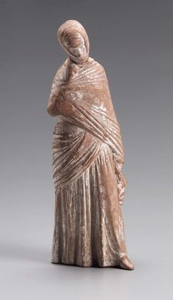
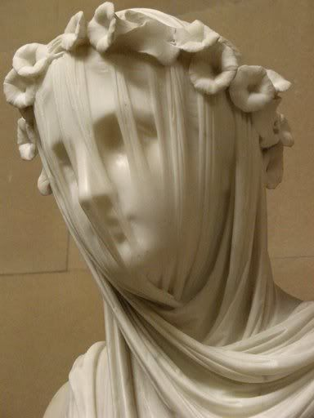
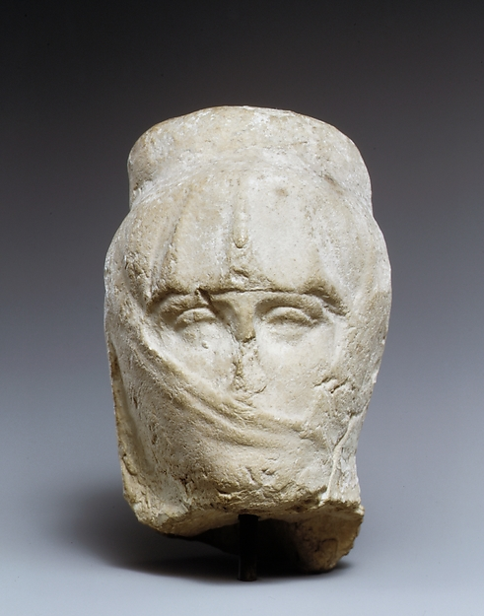
What are these women wearing?
Ancient Greek women (450 BC) wearing a himation.
What culture would you associate this with?

Slide 2
The Roman Empire was massive.
Rome dominated the Mediterranean from around 300 BC to 500 AD.
Roman attitudes have had a great influence on many later cultures, including our own!

Slide 3
Why is it difficult to find out about the lives of women throughout history?

Slide 4
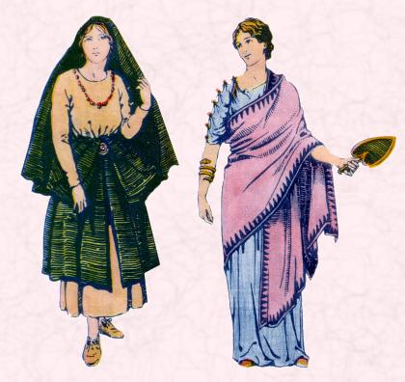
Rich
Poor
We’re going to focus on the rich because most writers tend to write about the rich and powerful.
Rome was always a patriarchal society.

Slide 5
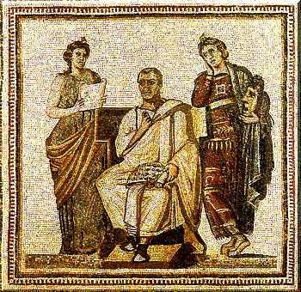
The Paterfamilias
Each family under the control of the oldest male.
He had complete control over all relatives and servants.
The Materfamilias’ job was the run the household.

Slide 6
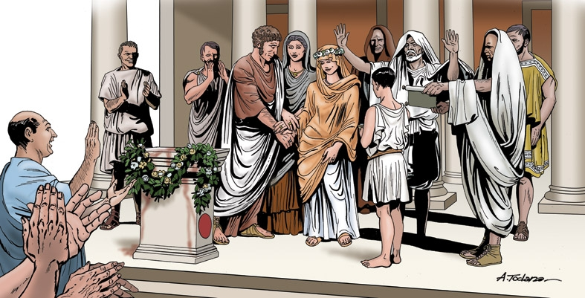
Roman marriage
Card sort task
Con Manu
Sine Manu
‘Without control’
‘With control’
Still regarded as part of her father’s family.
A woman became the property of her husband.
Husband did not own her.
Her husband inherited all property.
She could inherit property.

Slide 7
Feedback from card sort activity: positives and negatives for women
1928!
When did all women get the vote in England?
1882!
When could women inherit property in England?
When could women divorce their husband and still have custody of the children?
1839!

Slide 8
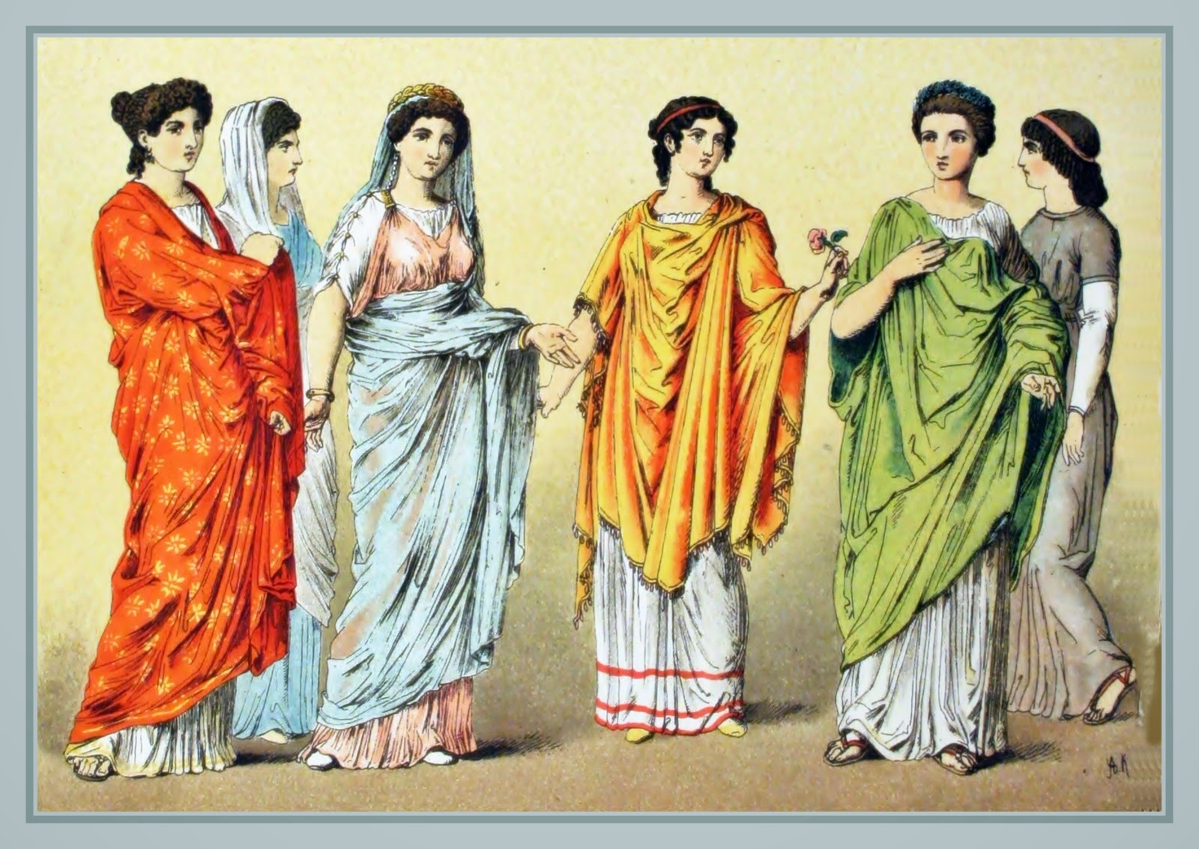
Roman women were expected to display ‘Pietas’
Chastity
Harmony
1 min: What do these mean?
Industriousness
Temperance

Slide 9
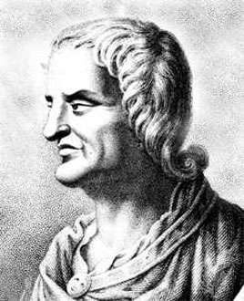
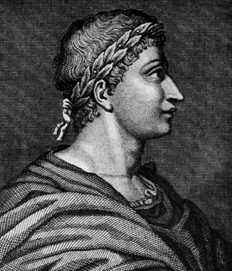
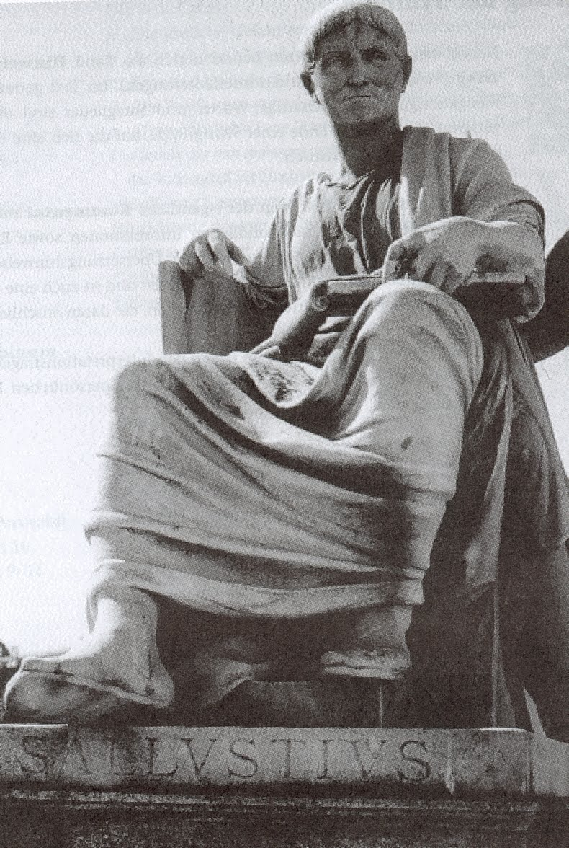
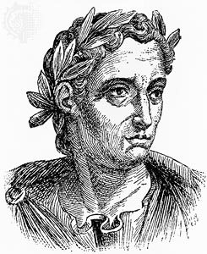
Roman writers on women…
Juvenal
Ovid
Pliny
Sallust

Slide 10
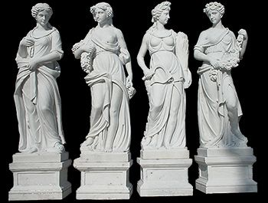
4 sisters in Rome
Ted talk
Why is it difficult to find out about the lives of women in Rome?

