Slide 1
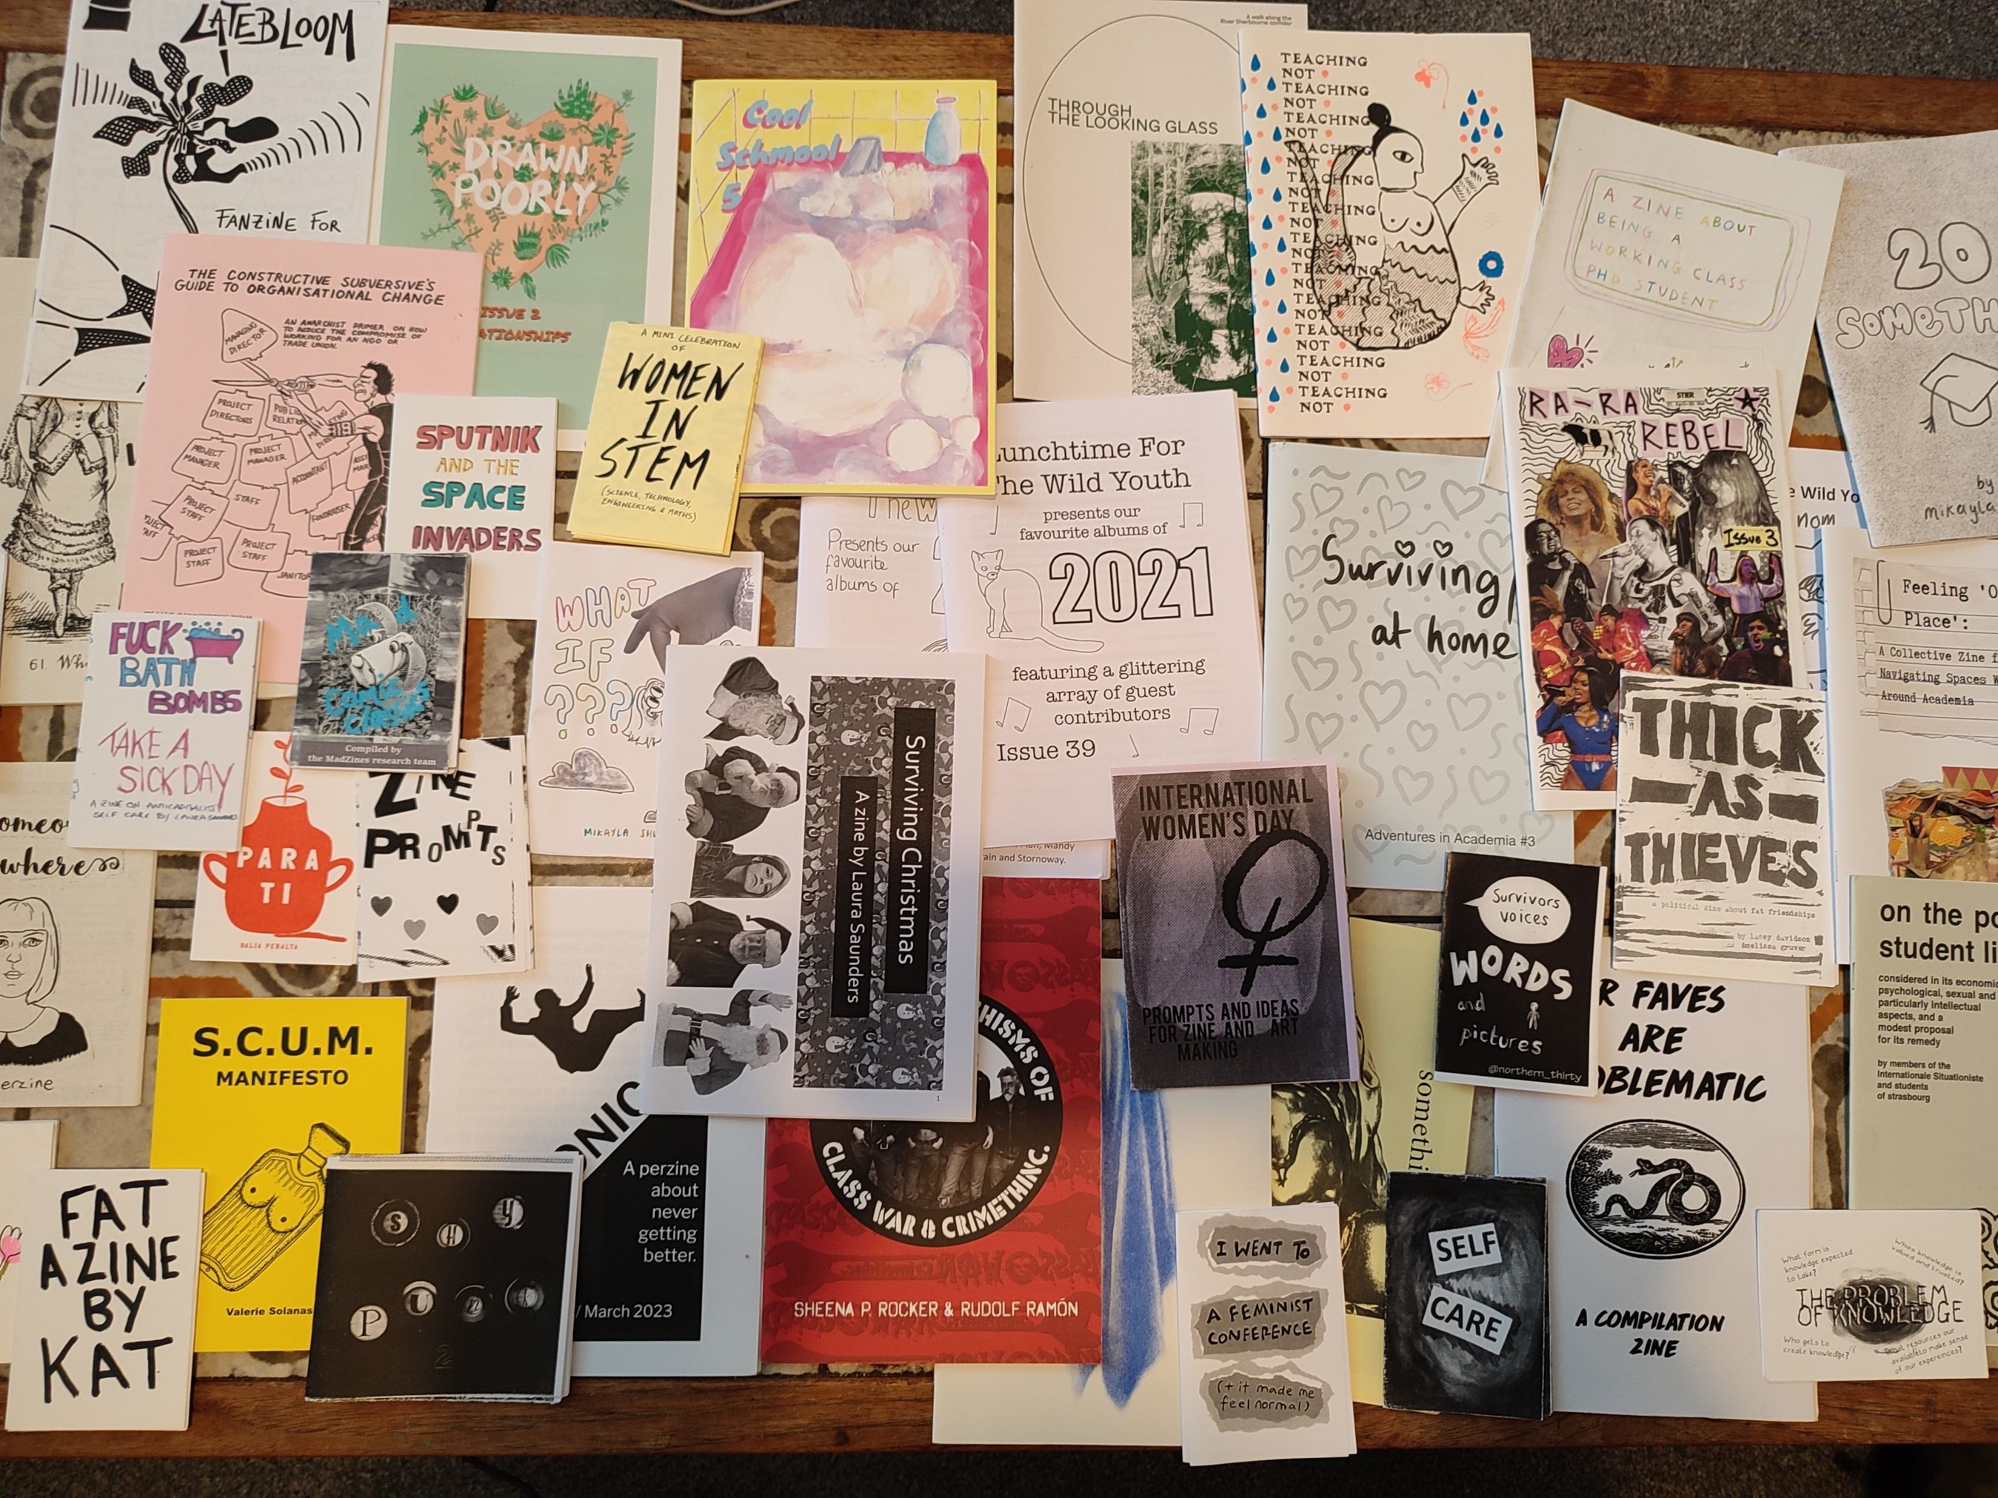
Zines as Method: An Introduction
Carys Hill, PhD Researcher @ Warwick Sociology
c.hill.1@warwick.ac.uk

Slide 2
What’s a zine?

Slide 3
What’s a zine?
“scruffy, homemade little pamphlets. Little publications filled with rantings of high weirdness and exploding with chaotic design” (Duncombe, 1997: 6)

Slide 4
What’s a zine?
“scruffy, homemade little pamphlets. Little publications filled with rantings of high weirdness and exploding with chaotic design” (Duncombe, 1997: 6)
Counter-culture cultural object, “independently produced, written, and designed, [existing] outside, or on the fringes of, the mainstream” (Ramdarshan Bold, 2017: 218)

Slide 5
What’s a zine?
“scruffy, homemade little pamphlets. Little publications filled with rantings of high weirdness and exploding with chaotic design” (Duncombe, 1997: 6)
Counter-culture cultural object, “independently produced, written, and designed, [existing] outside, or on the fringes of, the mainstream” (Ramdarshan Bold, 2017: 218)
Intimate objects: the “paper bears the marks of the body that created it, as well as other sensory material” (Piepmeier, 2009: 63)

Slide 6
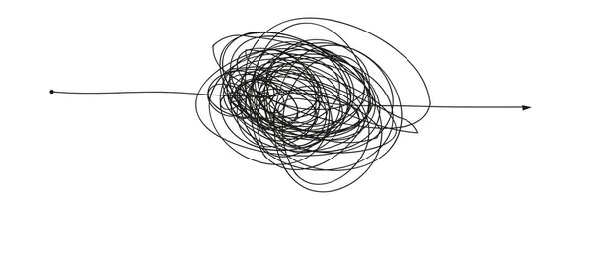
(some) zine history

Slide 7
(some) zine history
political manifestos/
pamphlets (19th/20th century)

Slide 8
(some) zine history
sci-fi fan zines (1930s)
political manifestos/
pamphlets (19th/20th century)

Slide 9
(some) zine history
sci-fi fan zines (1930s)
political manifestos/
pamphlets (19th/20th century)
underground, punk + riot grrl (1960s-1990s)
subversive/resistive form and content
photocopier as a means of (re)production
(anti-capitalist/consumerist) distribution networks
expanse in genre

Slide 10
(some) zine history
today:
broad variety of zines (inc. different forms of production, e.g. riso printing)
zines in institutional contexts
sci-fi fan zines (1930s)
political manifestos/
pamphlets (19th/20th century)
underground, punk + riot grrl (1960s-1990s)
subversive/resistive form and content
photocopier as a means of (re)production
(anti-capitalist/consumerist) distribution networks
expanse in genre

Slide 11
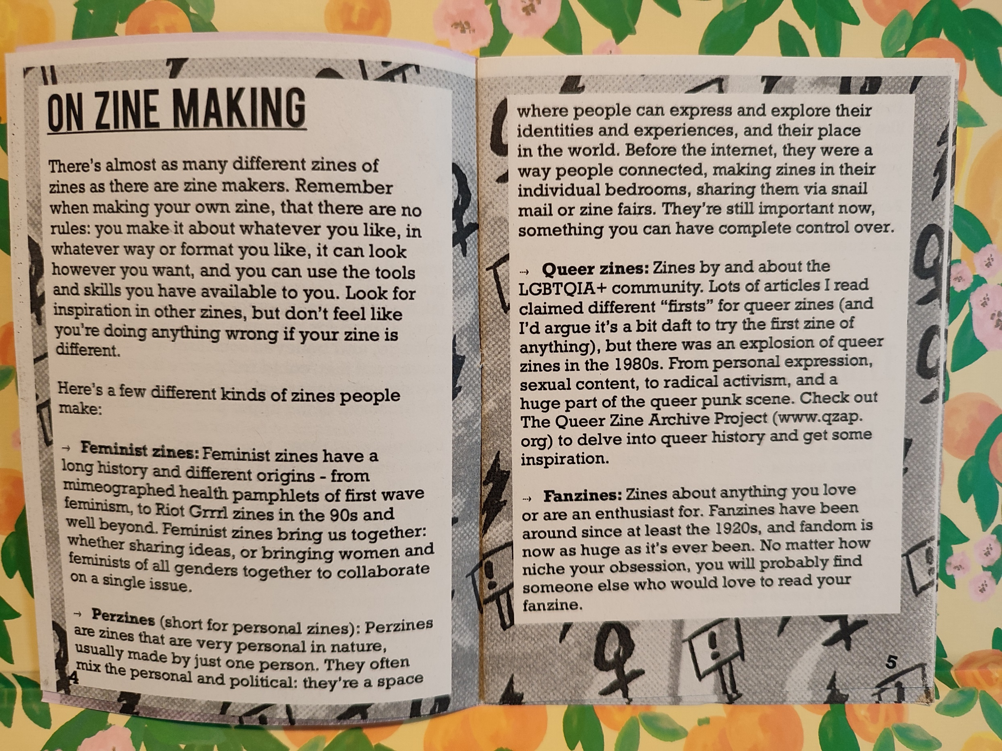
(by penfightzine)

Slide 12
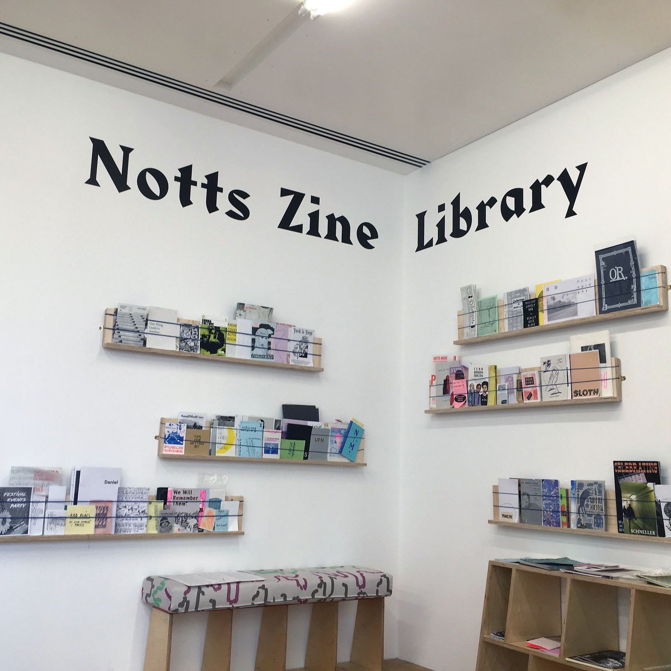
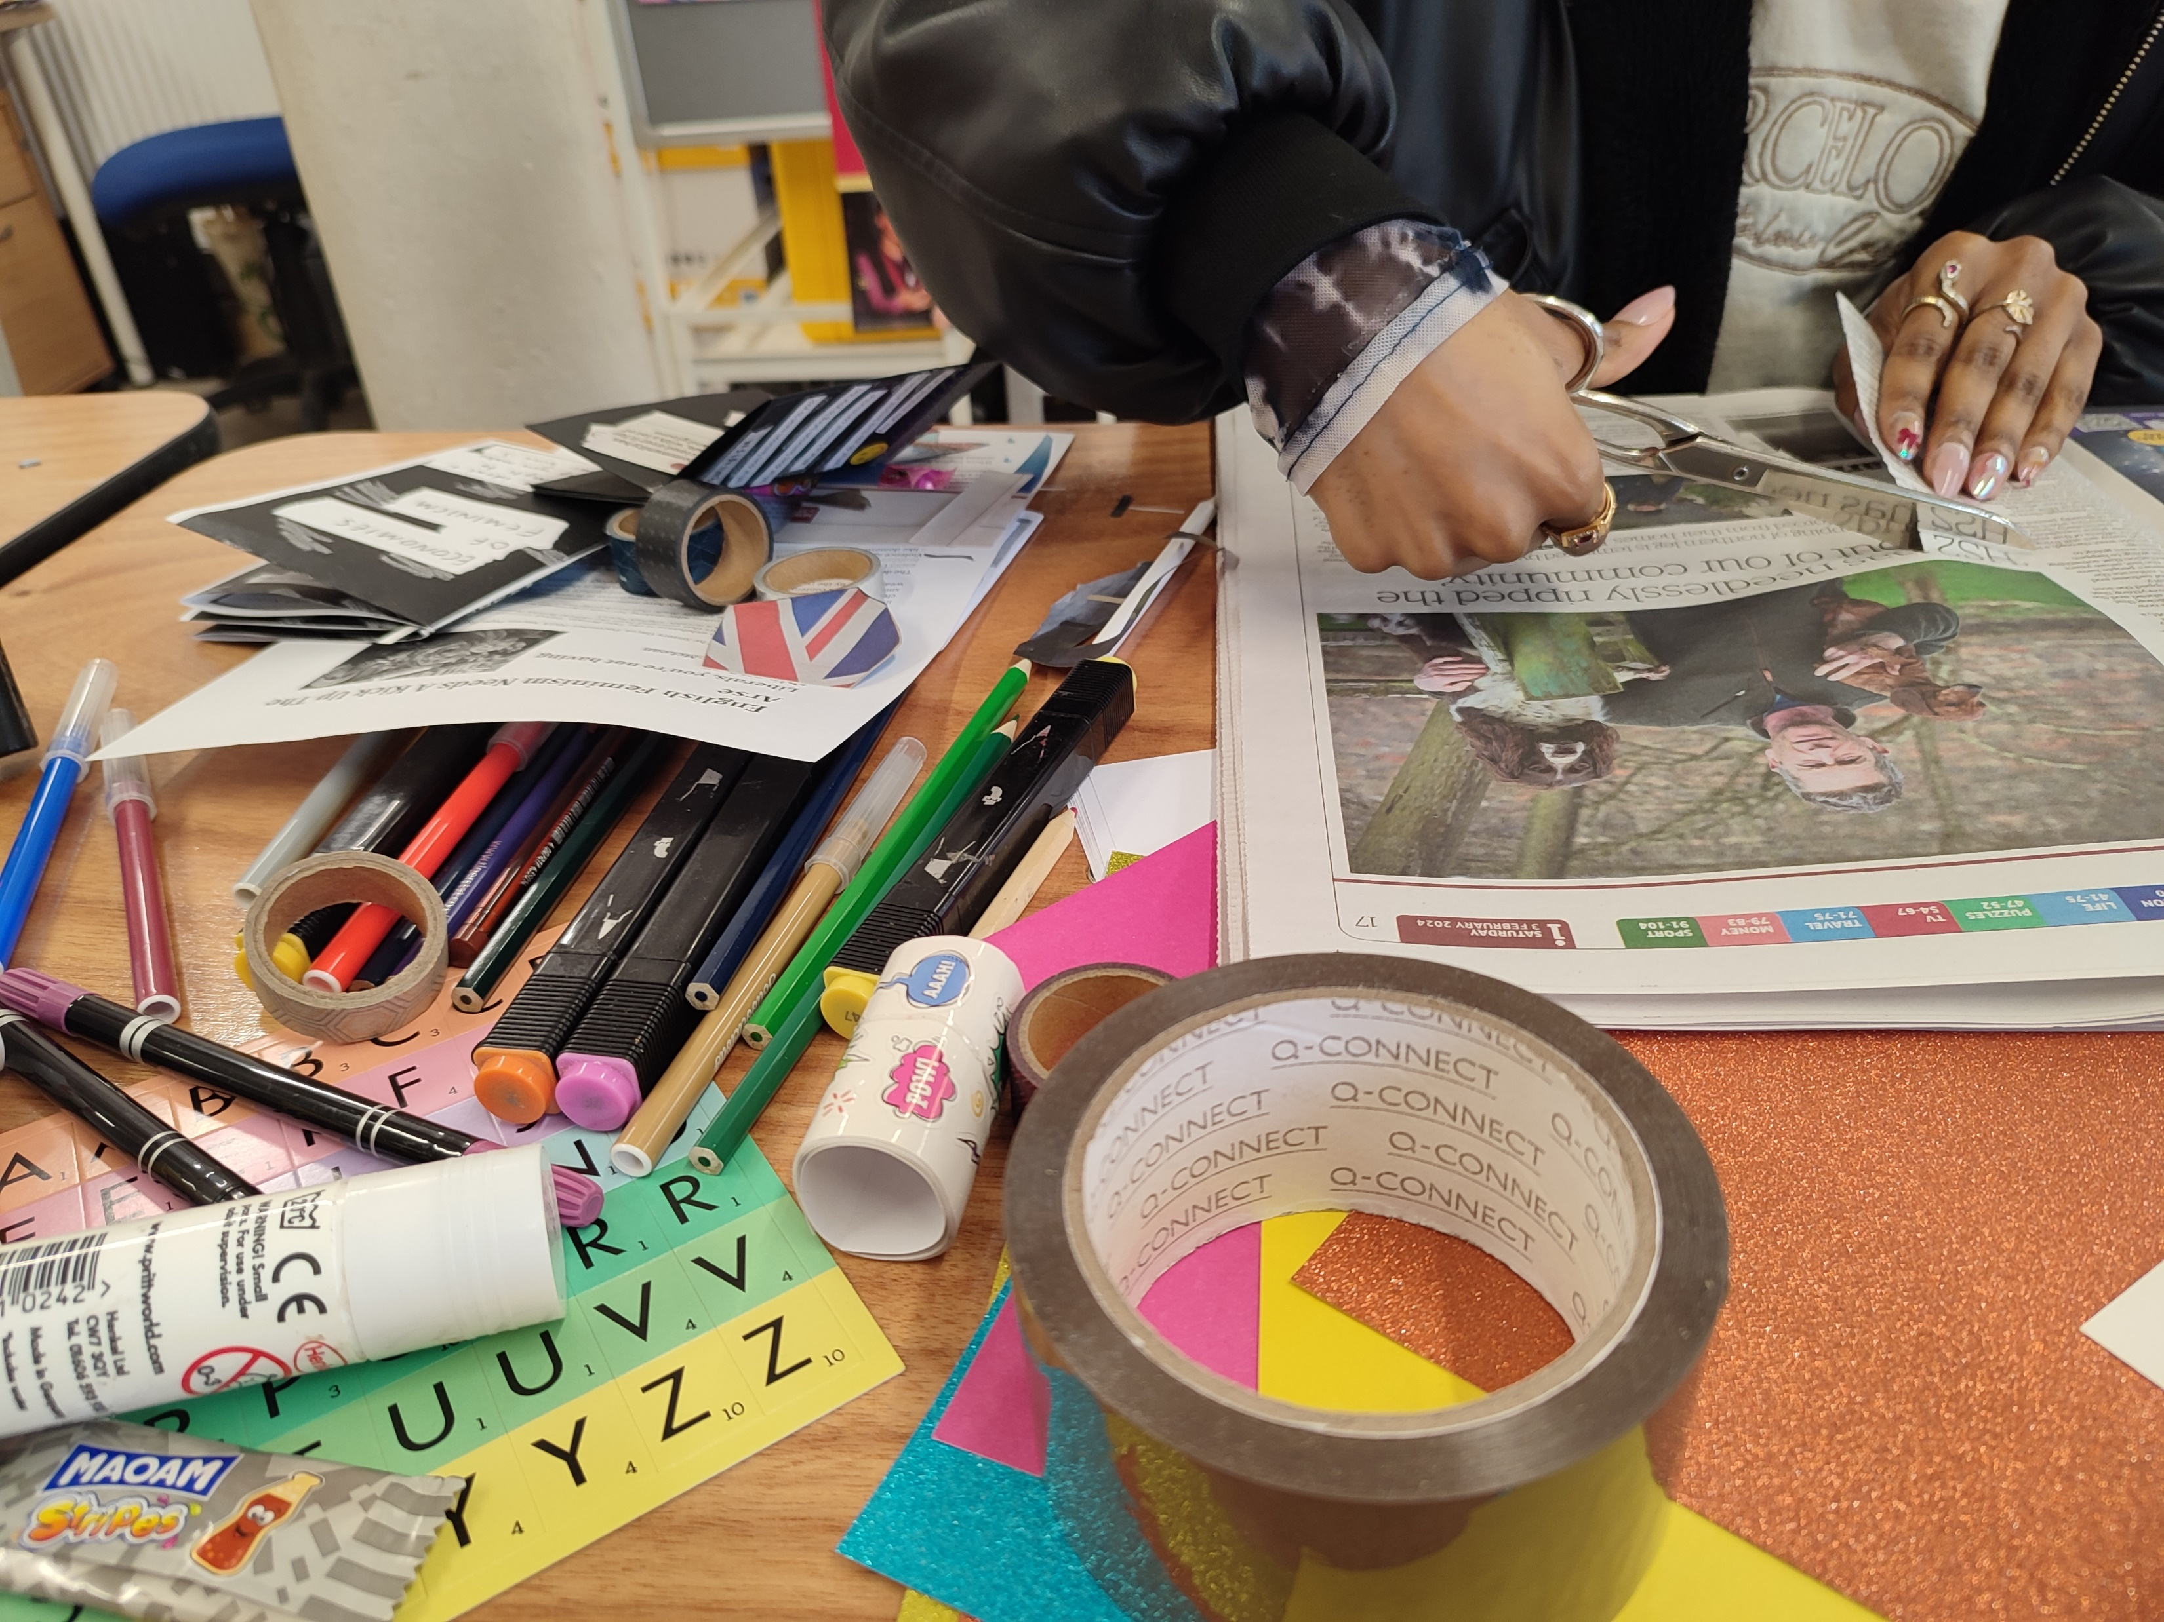
Zines as Method
Two approaches (Way, 2017):
‘Zines as resource’ (zines as secondary data)
‘Zines as creation’ (zines produced as part of the research)
or

Slide 13
Zines as Method
Two approaches (Way, 2017):
‘Zines as resource’ (zines as secondary data)
‘Zines as creation’ (zines produced as part of the research)
or

Slide 14
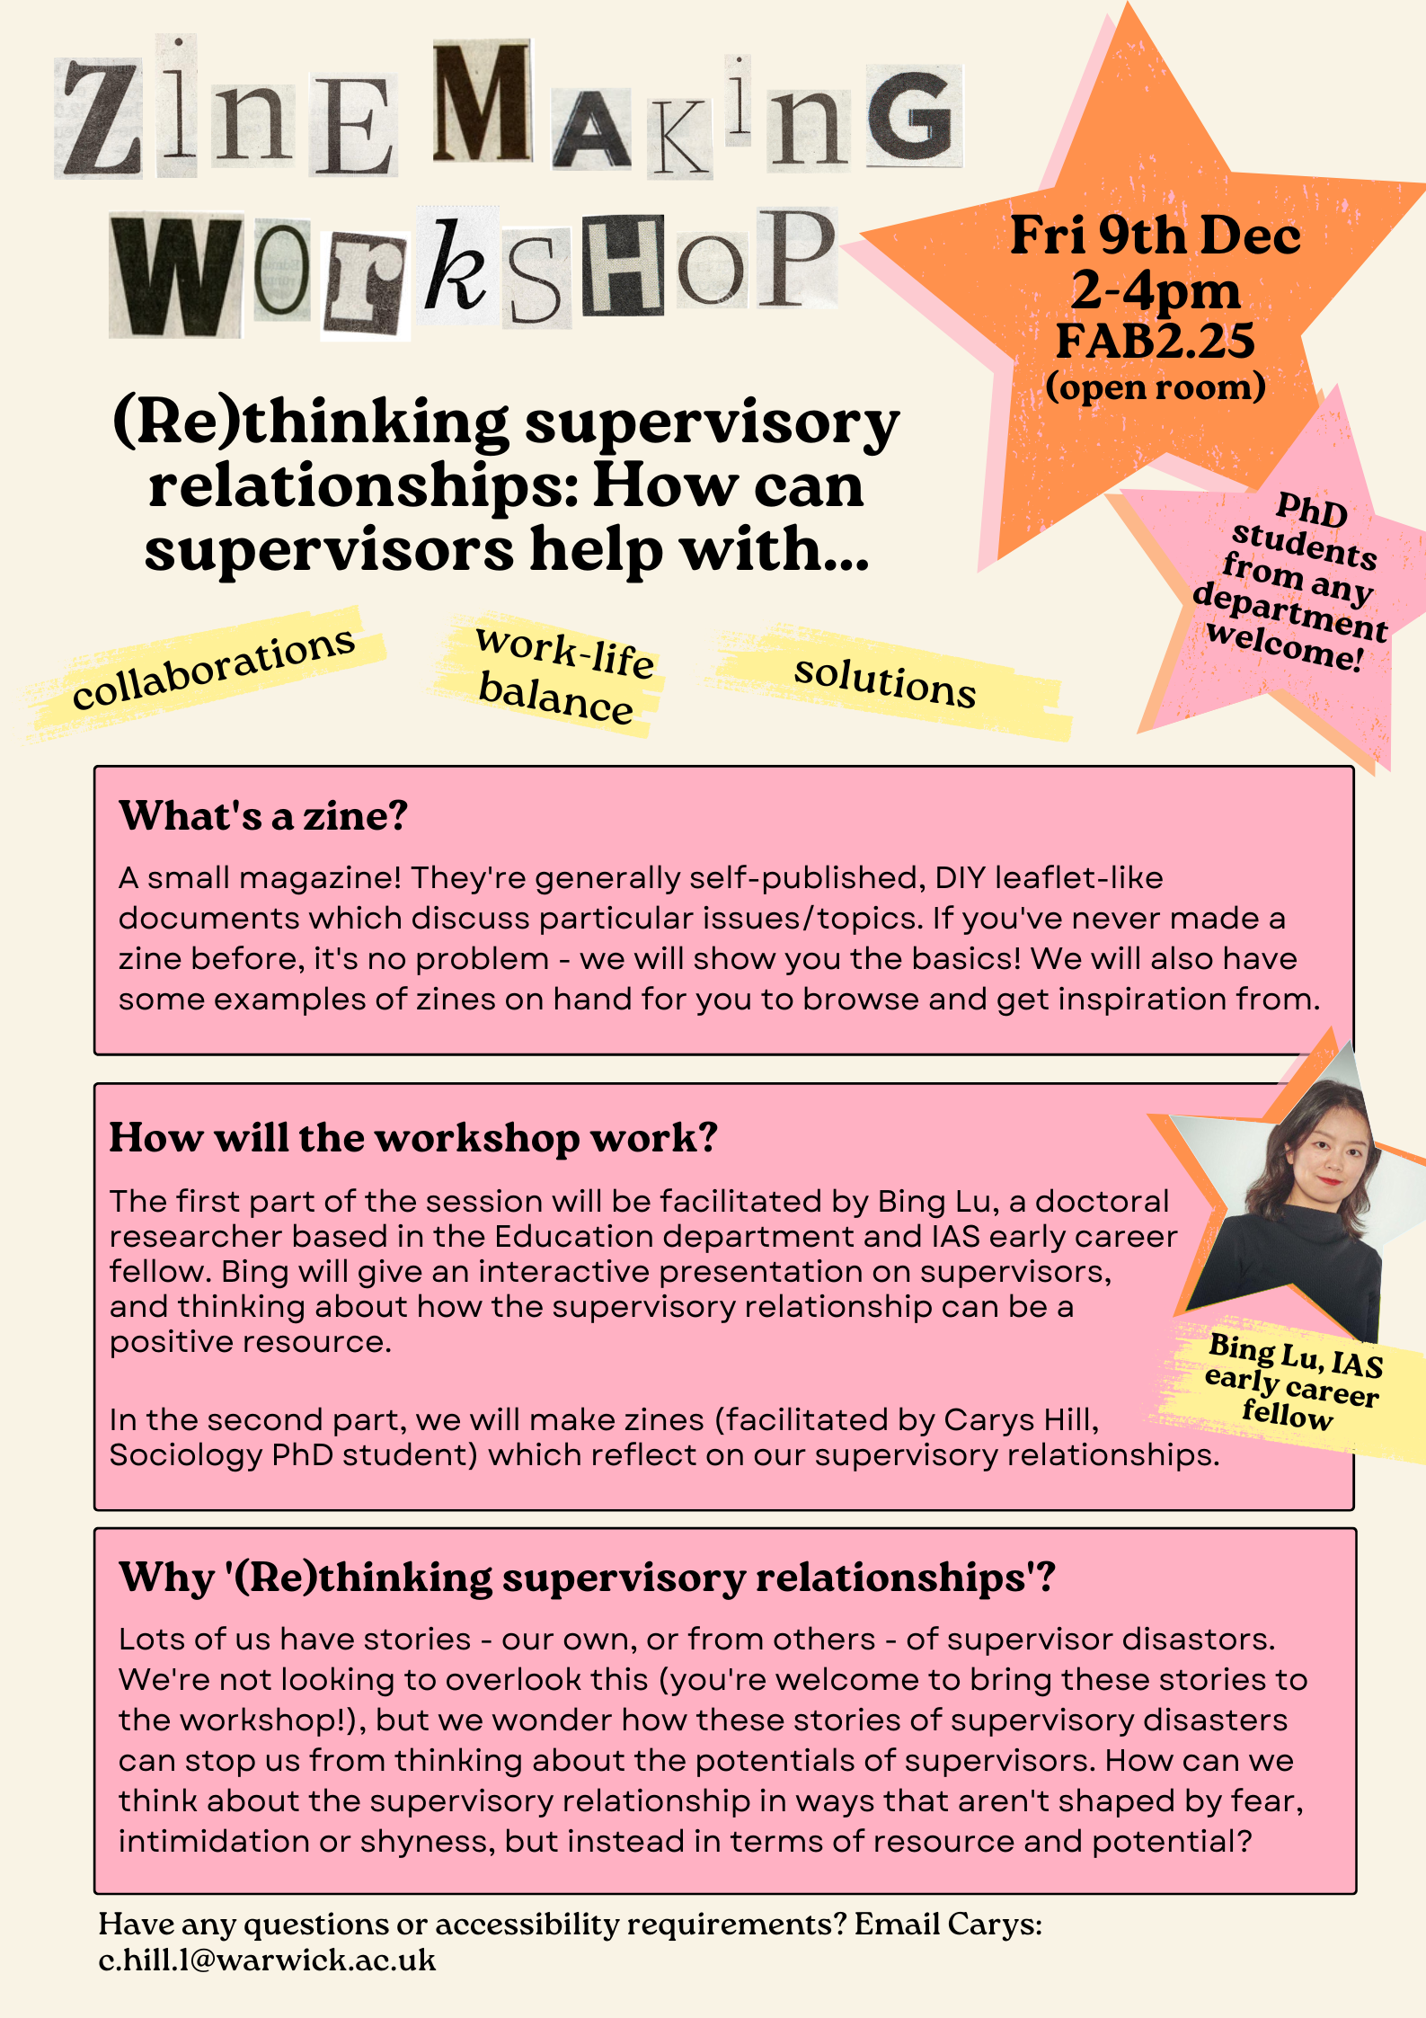
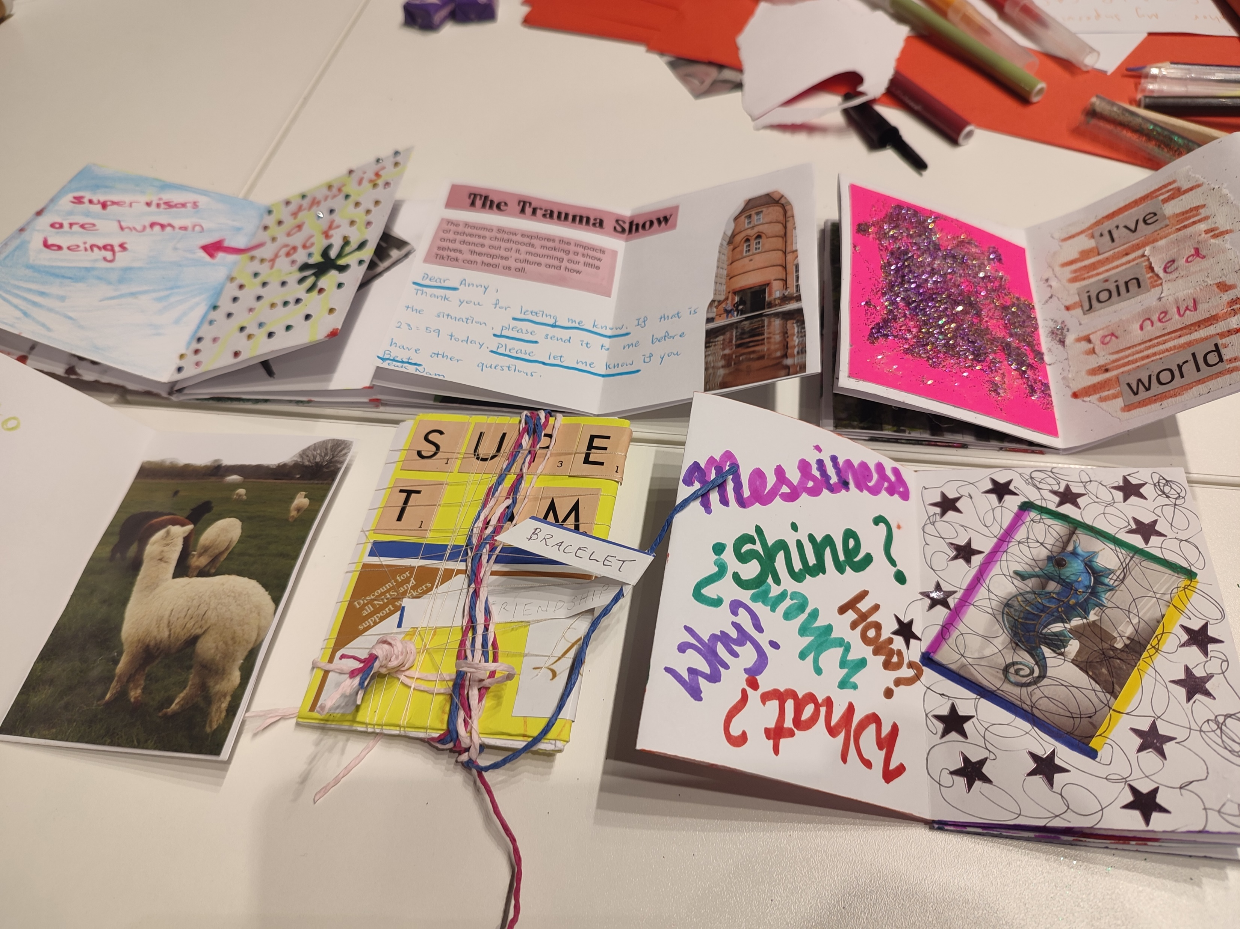
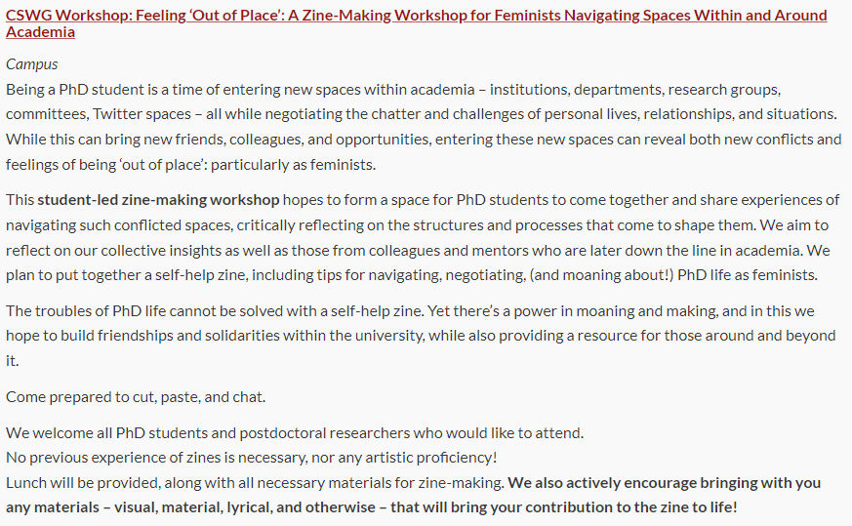
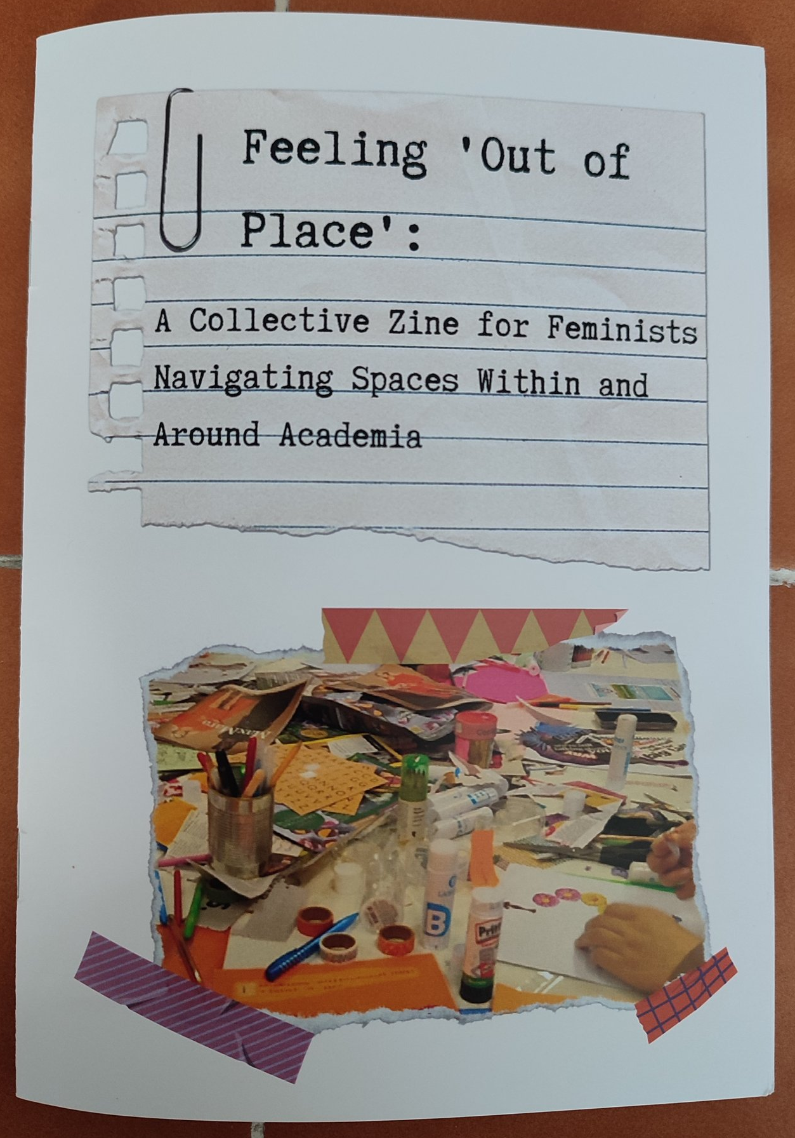
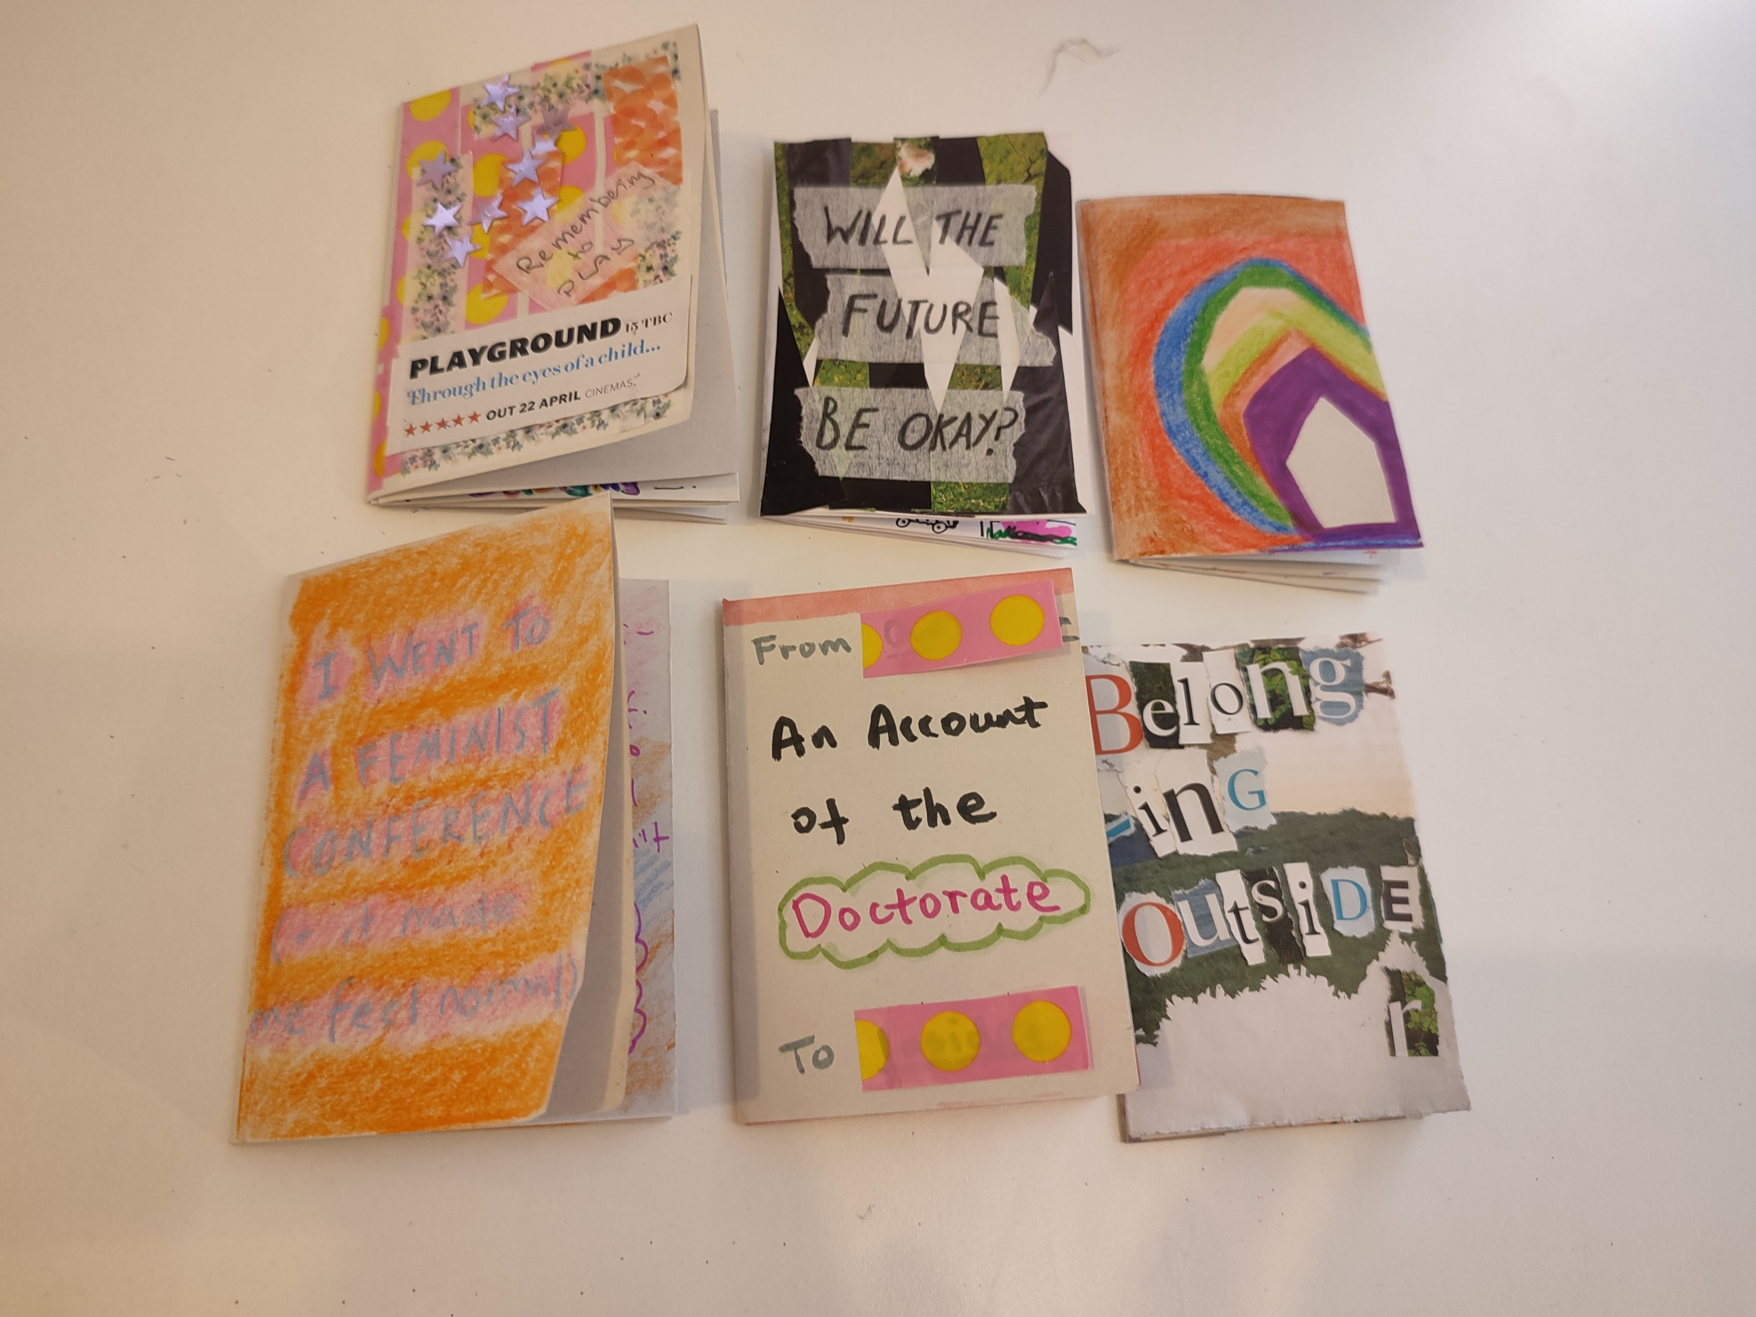
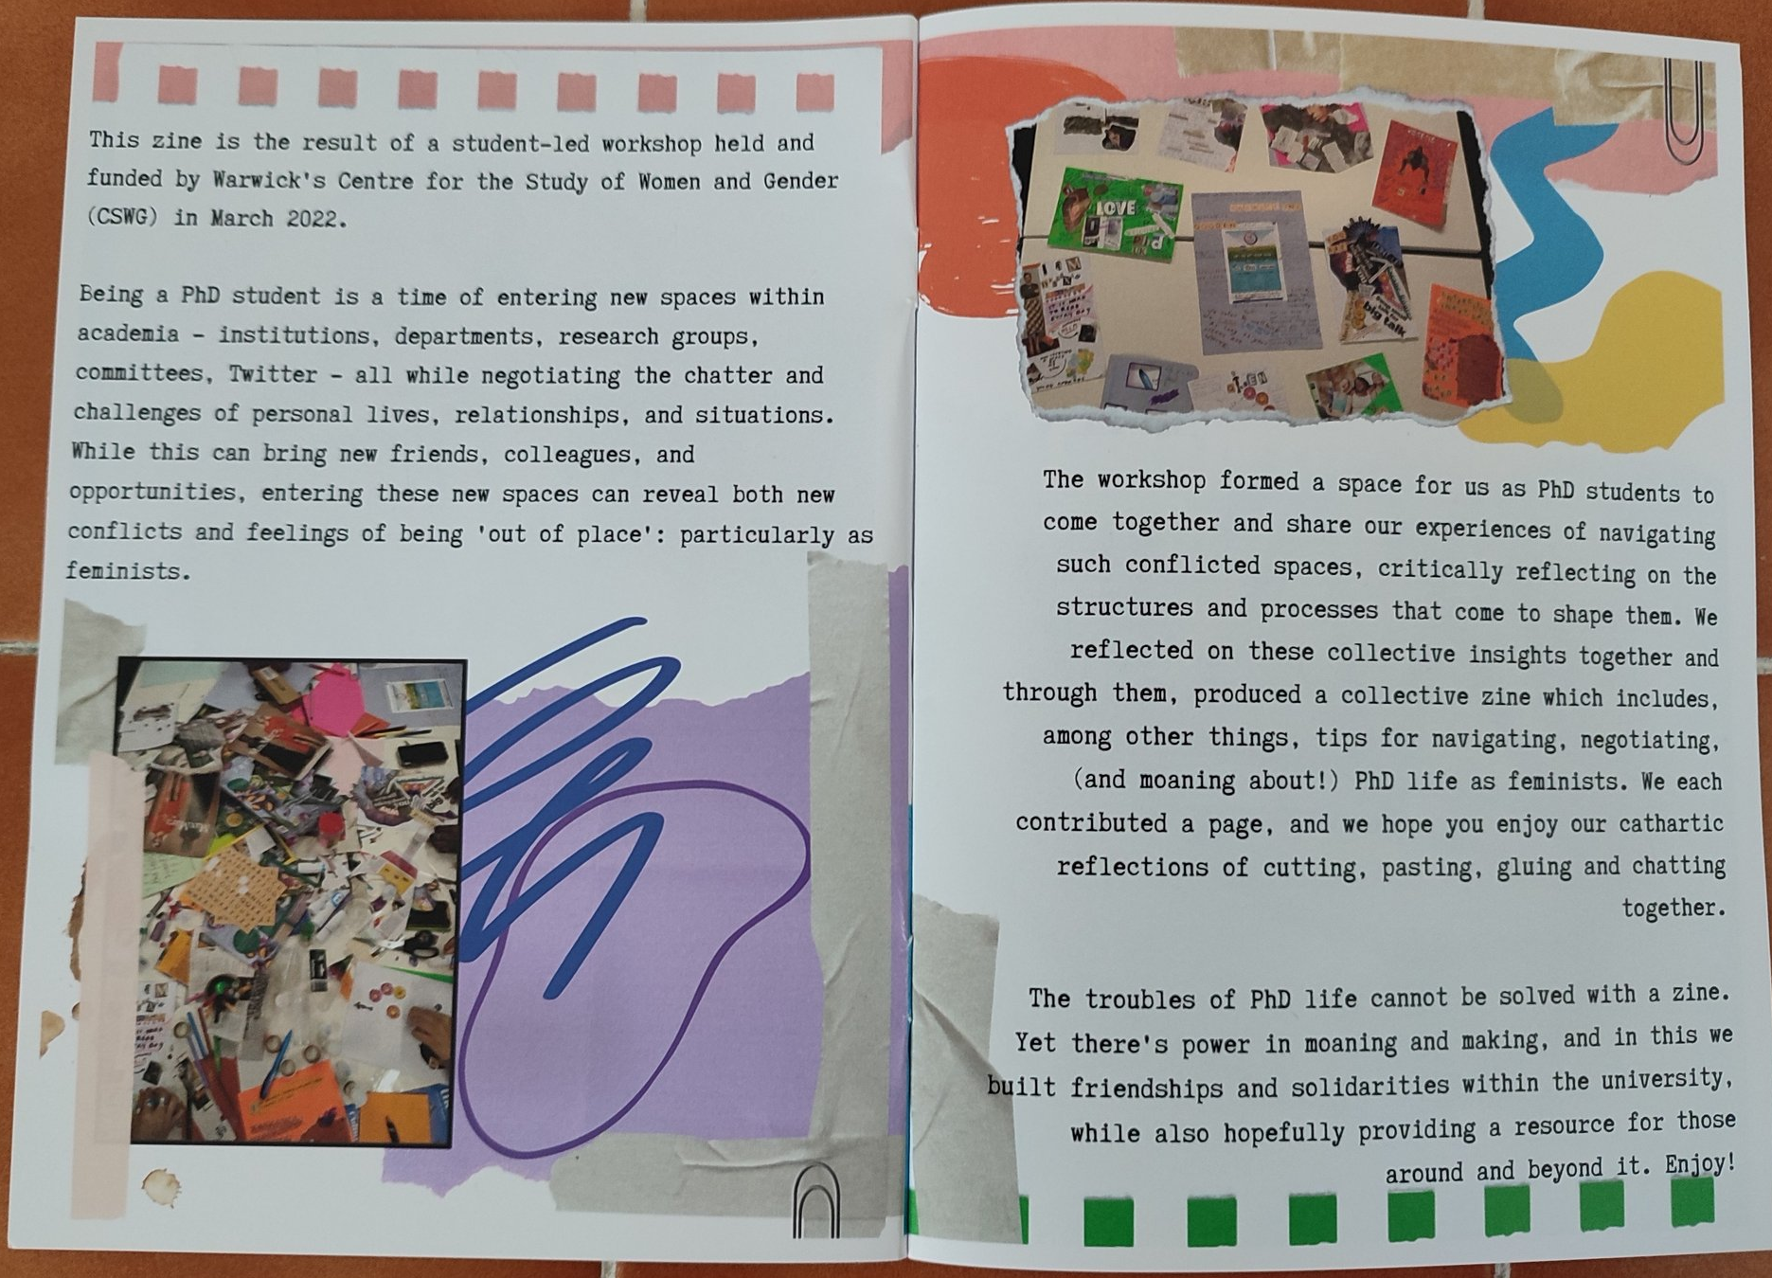
(a note on other uses)

Slide 15
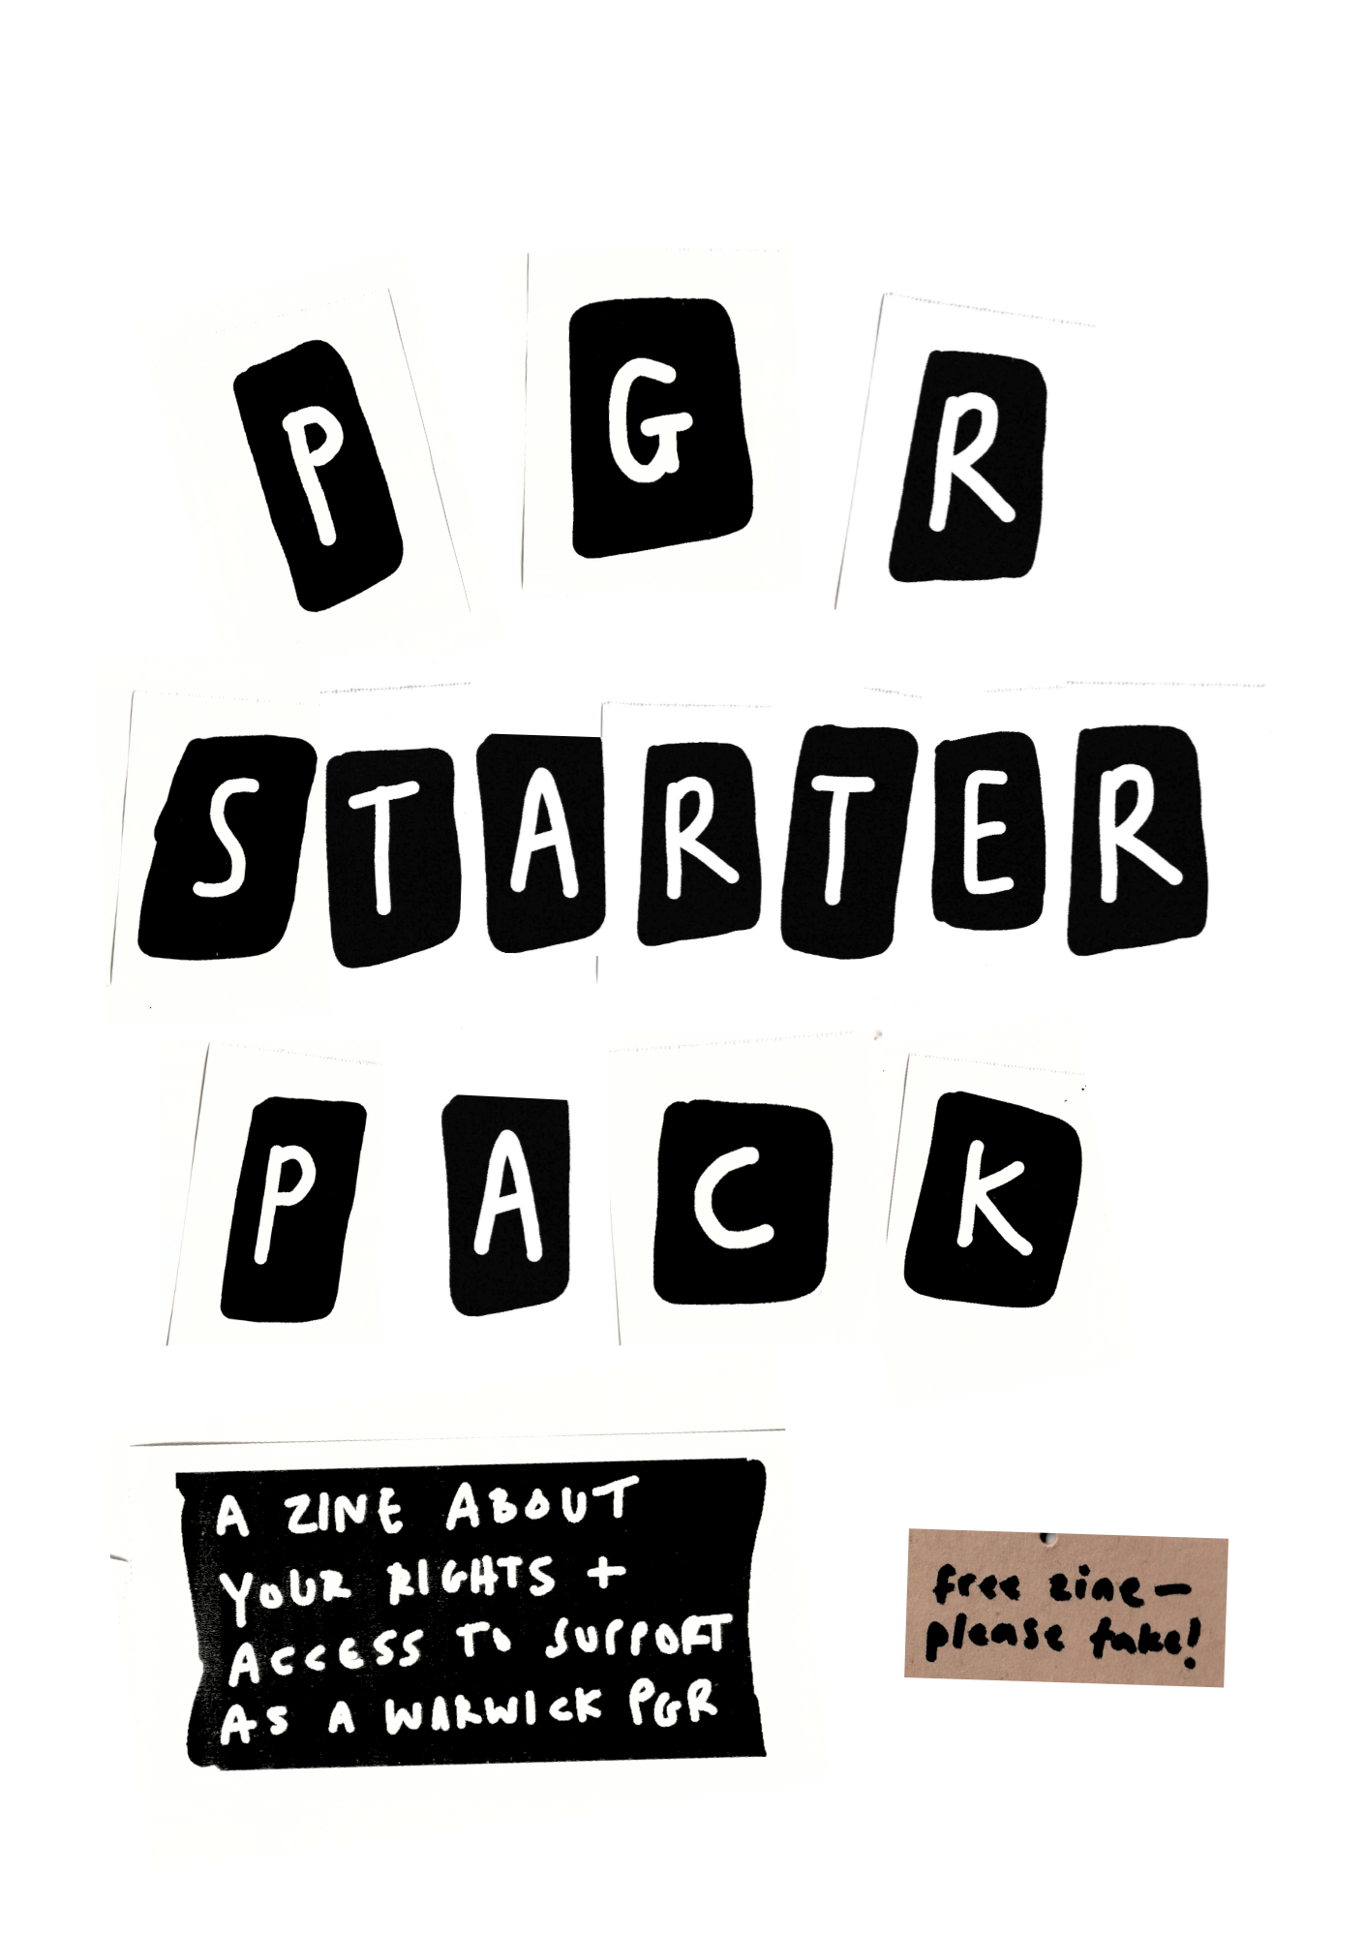
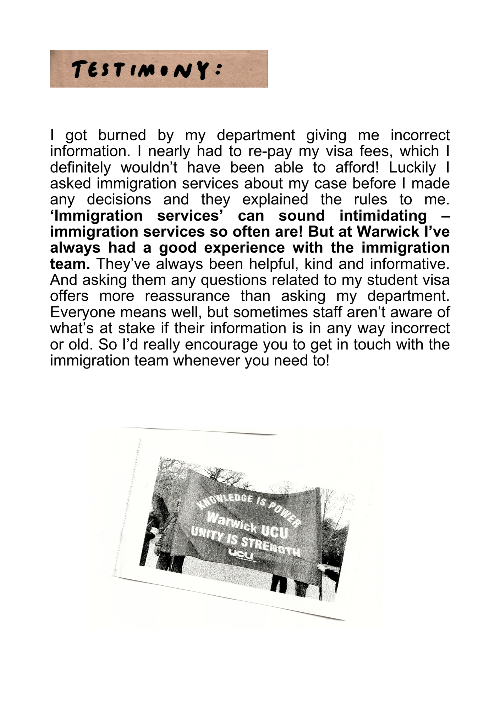
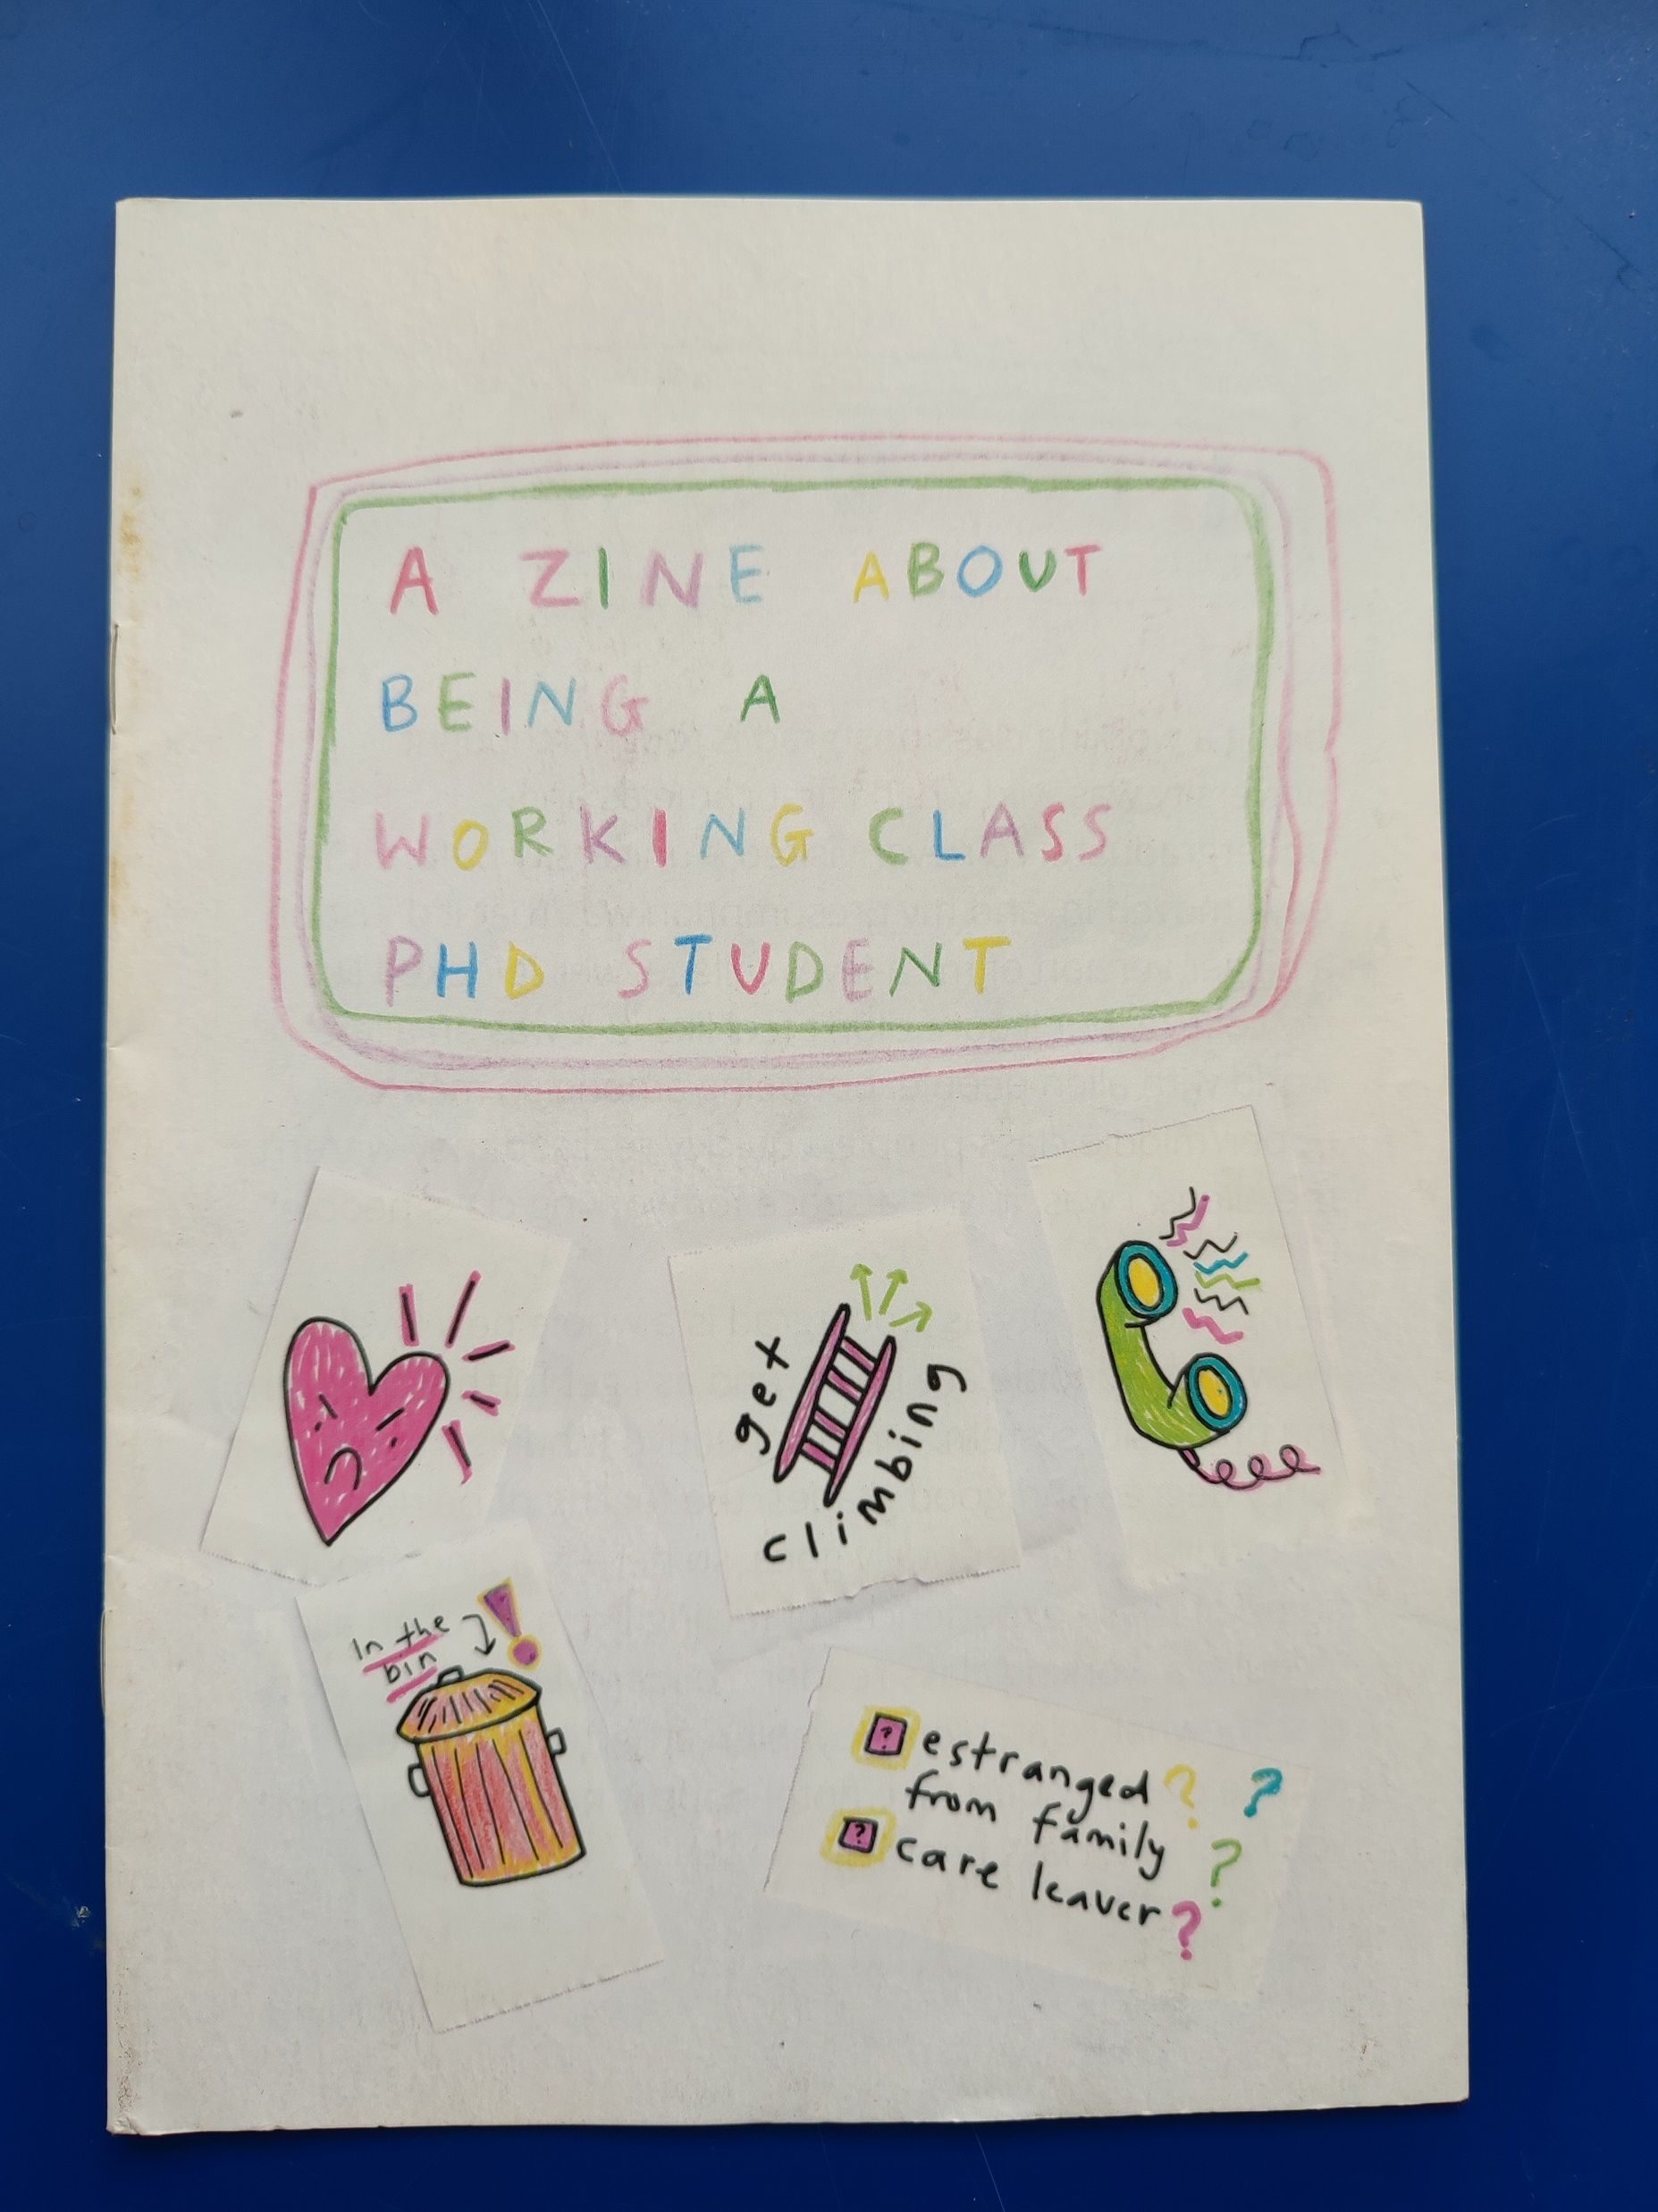
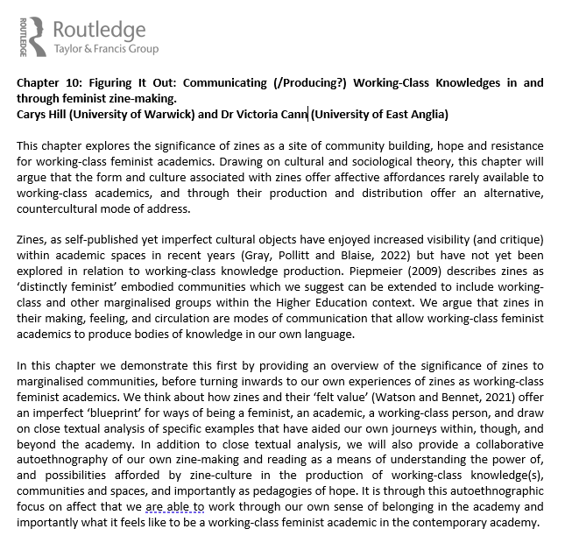
(a note on other uses)

Slide 16
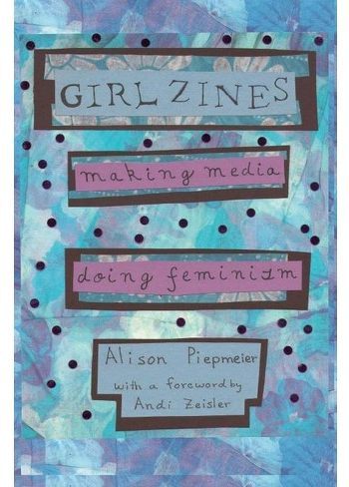
Zines as Method: The Literature
Zines as democratic + participatory
Zines as able to break down hierarchies (French and Curd, 2022)
The relevance of zines’ DIY ethics + culture
Do it yourself attitude; imperfect as a politics; about sharing + community; experimental
Zines as political + transformative
Because of all the above

Slide 17

Zines as Method: The Literature
Increasing interest in zines, but also reason for caution
Should be careful not to overstate zines’ capacity to challenge pre-existing power relations
Zines carry their own conventions, histories and power relations
Zines also have histories of exclusion

Slide 18
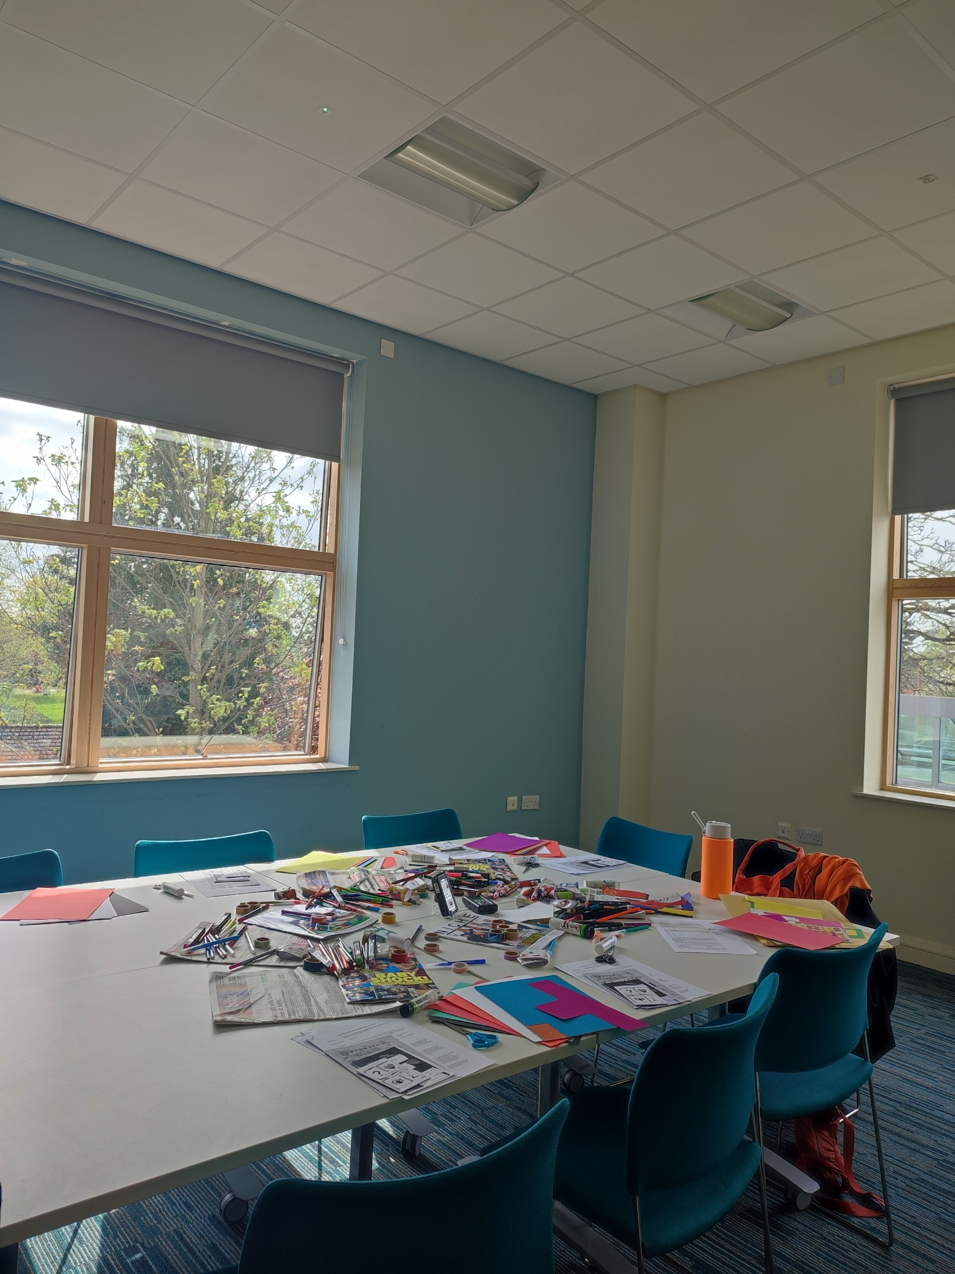
Zines as Method: My Approach #1
Zines as a method for alternative modes of communication
Piepmeier: zines ‘remove some of the stakes’ (2009: 85) which can be present in difficult or uncomfortable conversations.
Arts-based methods can avoid ‘individualizing, blaming “bad apples” discourse[s] […] Instead, discussions were characterized by an empathetic, while critical, recognition of structural issues […] and their manifestations in a university context’ (Lambert, Williams and Douglas, 2023: 361)

Slide 19
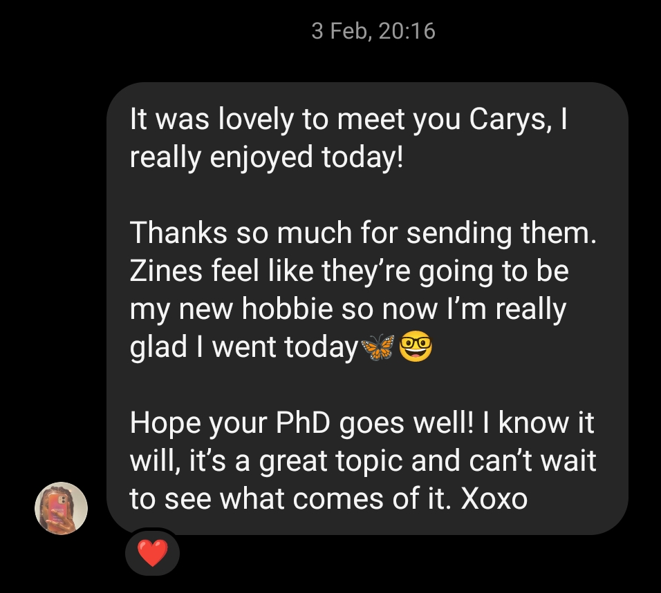
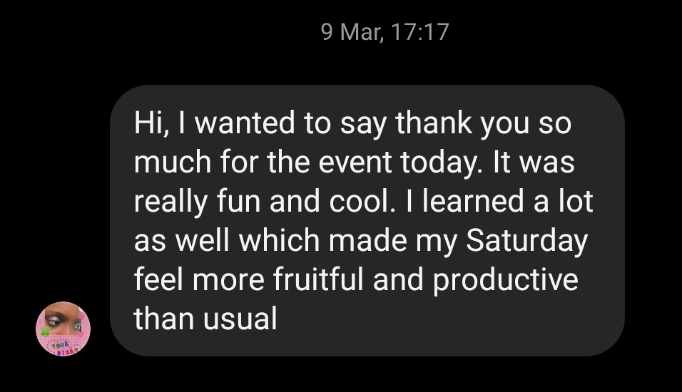
Zines as Method: My Approach #2
Zines + building care, connection and dialogue
How can the materiality of zines as both something scrappy and in-progress yet with a ‘felt value’ have methodological effects → how can it shape discussions and my analysis?
The political and communal possibilities of the connections that zines foster
Effects beyond the workshop?

Slide 20
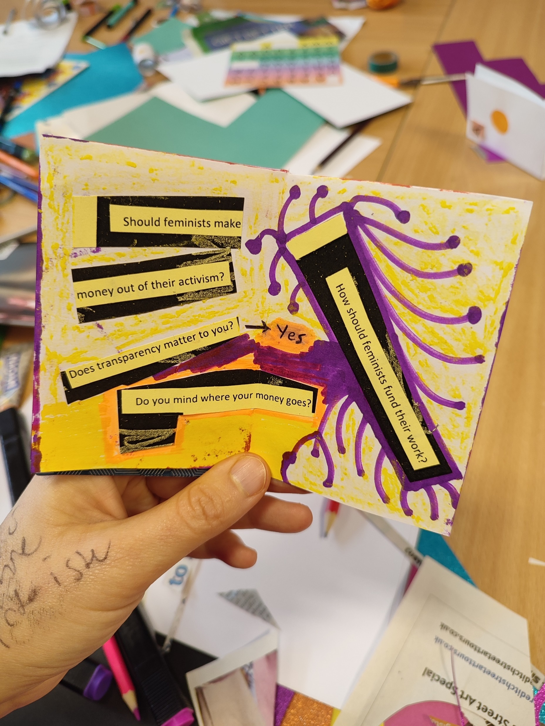
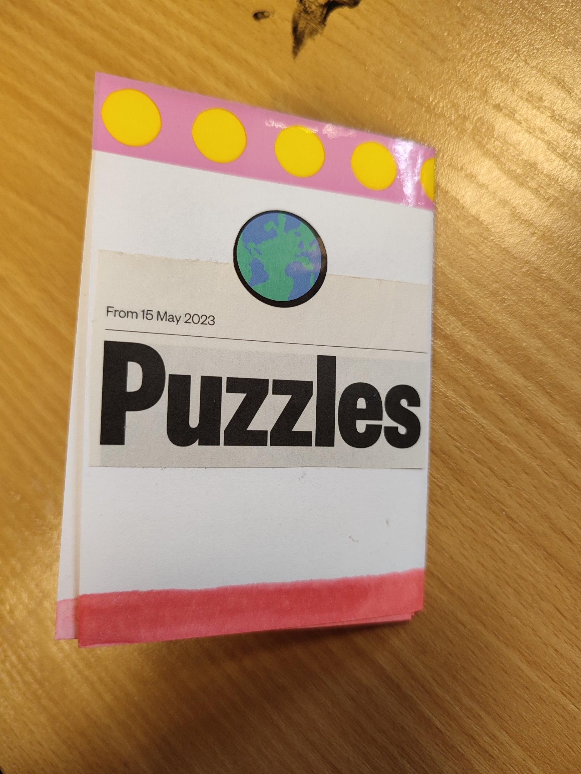
Zines as Method: My Approach #3
Zines as decision-making
‘zines demand a level of aesthetic decision-making that digital media like blogs sometimes don’t’ (Piepmeier, 2009: 65).
The politics of aesthetics are important in my project thinking about digital activism → what aesthetic decisions will people make?
What themes will be important to participants → what will make it to the page?

Slide 21
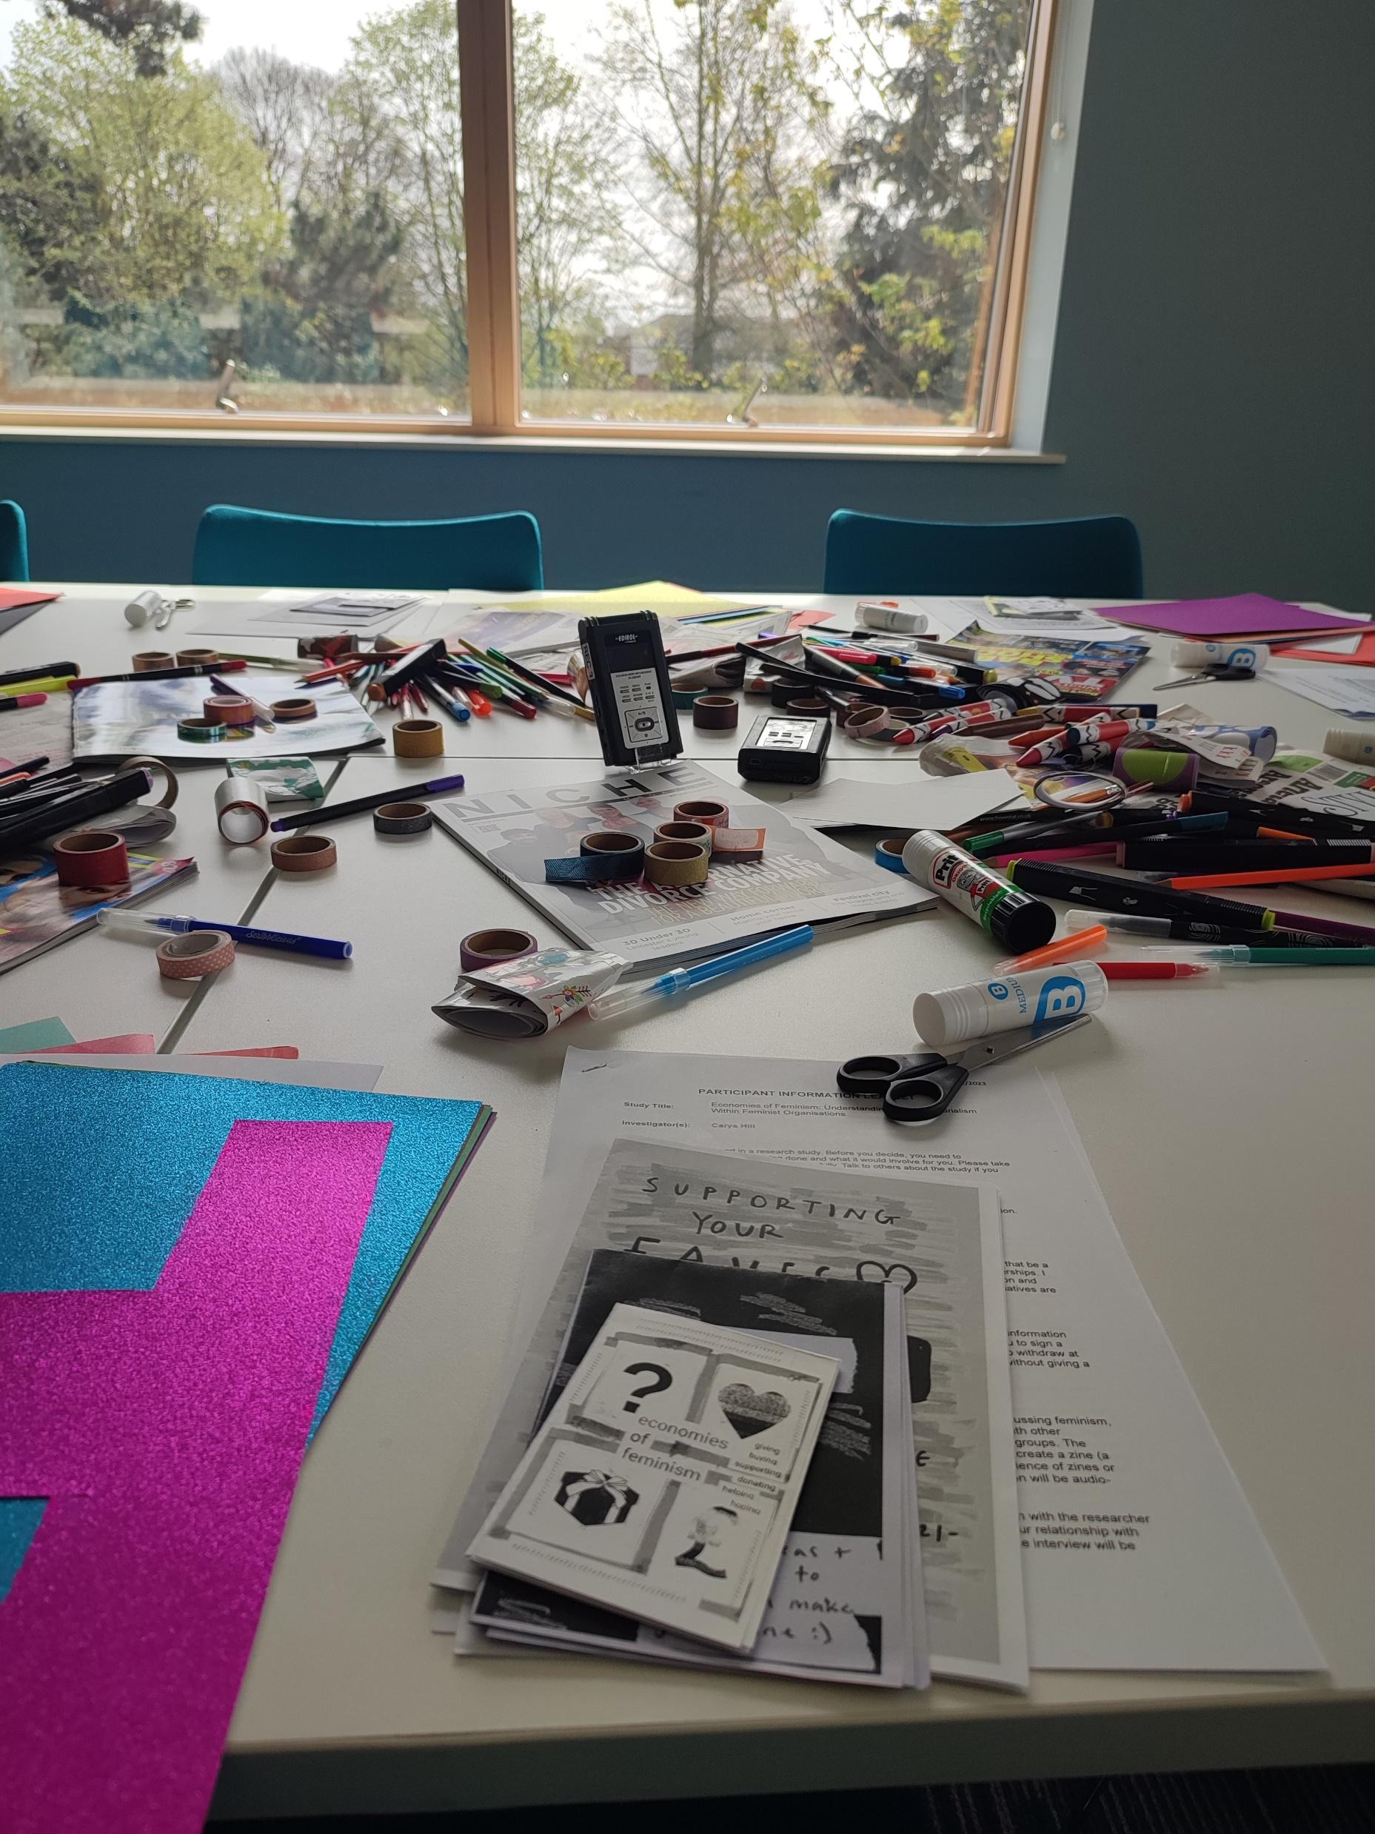
Practical considerations
Workshop or individual?
Collective or individual zines?
  For collective zines, each person can make an individual page which is made into a collective zine
Materials
  Think about how the materials can shape the zines made
Sensory snacks
How will you introduce zines and the purposes of the workshop?→ need good ‘scaffolding’
How will you ask questions?
Audio recording?
How will the zines be shared + collected?
  Do you need access to a scanner?

Slide 22
Zines as Method Bibliography
Baker, S., & Cantillon, Z. (2022). Zines as community archive. Archival Science, 22. doi:10.1007/s10502-022-09388-1
Creasap, K. (2014). Zine-Making as Feminist Pedagogy. Feminist Teacher, 24(3), 155-168. doi:10.5406/femteacher.24.3.0155
Duncombe, S. (2008) Notes from the underground: zines and the politics of alternative culture. Bloomington: Microcosm Publishing.
French, J., and Curd, E. (2022). Zining as artful method: Facilitating zines as participatory action research within art museums. Action Research, 20(1), 77–95. https://doi.org/10.1177/14767503211037104
Gordon, J. (2012). Sexual assault support zines as a pedagogy of hope: An exploration of zines as a method of integrating community voices into the research process. Thinking gender papers, 1-18.
Gray, E.M., Pollitt, J. and Blaise, M. (2022) Between activism and academia: zine-making as a feminist response to COVID-19, Gender and Education, 34:8, 887-905, DOI: 10.1080/09540253.2021.1931045
Houpt, K., Balkin, L.A., Broom, R.H., Roth, A.G. and Selma (2016) Anti-Memoir: Creating Alternate Nursing Home Narratives Through Zine Making, Art Therapy, 33:3, 128-137, DOI: 10.1080/07421656.2016.1199243
Lambert, C., Williams, S., & Douglas, R. (2023). Sexual cultures in university: an arts-based intervention. Gender and Education, 35(4), 348-364. doi:10.1080/09540253.2023.2186375
Millward, P. (2008). The Rebirth of the Football Fanzine: Using E-zines as Data Source. Journal of Sport and Social Issues, 32(3), 299–310. https://doi.org/10.1177/0193723508319718
Piepmeier, A. (2009). Girl Zines Making Media, Doing Feminism. New York and London: NYU Press.
Ptolomey, A. M., & Nelson, E. L. (2022). A Creative Conversation for Re-imagining Creative Visual Methods with Children and Young People in Pandemic Times and Beyond. Sociological Research Online, 27(3), 684–689. https://doi.org/10.1177/13607804221089681
Turner, A. (2022). Perfectly Designed for Connections: Zine Making in Denver Shelters. Western American Literature 57(2), 153-167. https://doi.org/10.1353/wal.2022.0016.
Valli, C. (2021) Participatory dissemination : bridging in-depth interviews, participation, and creative visual methods through Interview-Based Zine-Making (IBZM). Fennia, 199(1), 25–45. https://doi.org/10.11143/fennia.99197
Velasco, G. Faria, C. and Walenta, J. (2020) Imagining Environmental Justice “Across the Street”: Zine-making as Creative Feminist Geographic Method, GeoHumanities, 6:2, 347-370, DOI: 10.1080/2373566X.2020.1814161
Watson, A. (2020) Zine Making as a Method (video) https://youtu.be/4osG86KDK8A?feature=shared
Watson, A., & Bennett, A. (2021). The felt value of reading zines. American Journal of Cultural Sociology, 9(2), 115-149. doi:10.1057/s41290-020-00108-9
Way, L. (2017) Here’s some scissors, here’s some glue, now go make a zine! A teacher’s reflections on zine-making in the classroom. In Smith, G.D., Dines, M. and Parkinson, T. Punk Pedagogies. Taylor Francis. CH09
Weida, C. L. (2020). Zine Objects and Orientations in/as Arts Research: Documenting Art Teacher Practices and Identities Through Zine Creation, Collection, and Criticism. Studies in Art Education, 61(3), 267-281.
Biagioli, Passila and Owens_Accepted Manuscript Version.pdf (arts.ac.uk) The Zine Method as a Form of Qualitative Analysis.

Slide 23
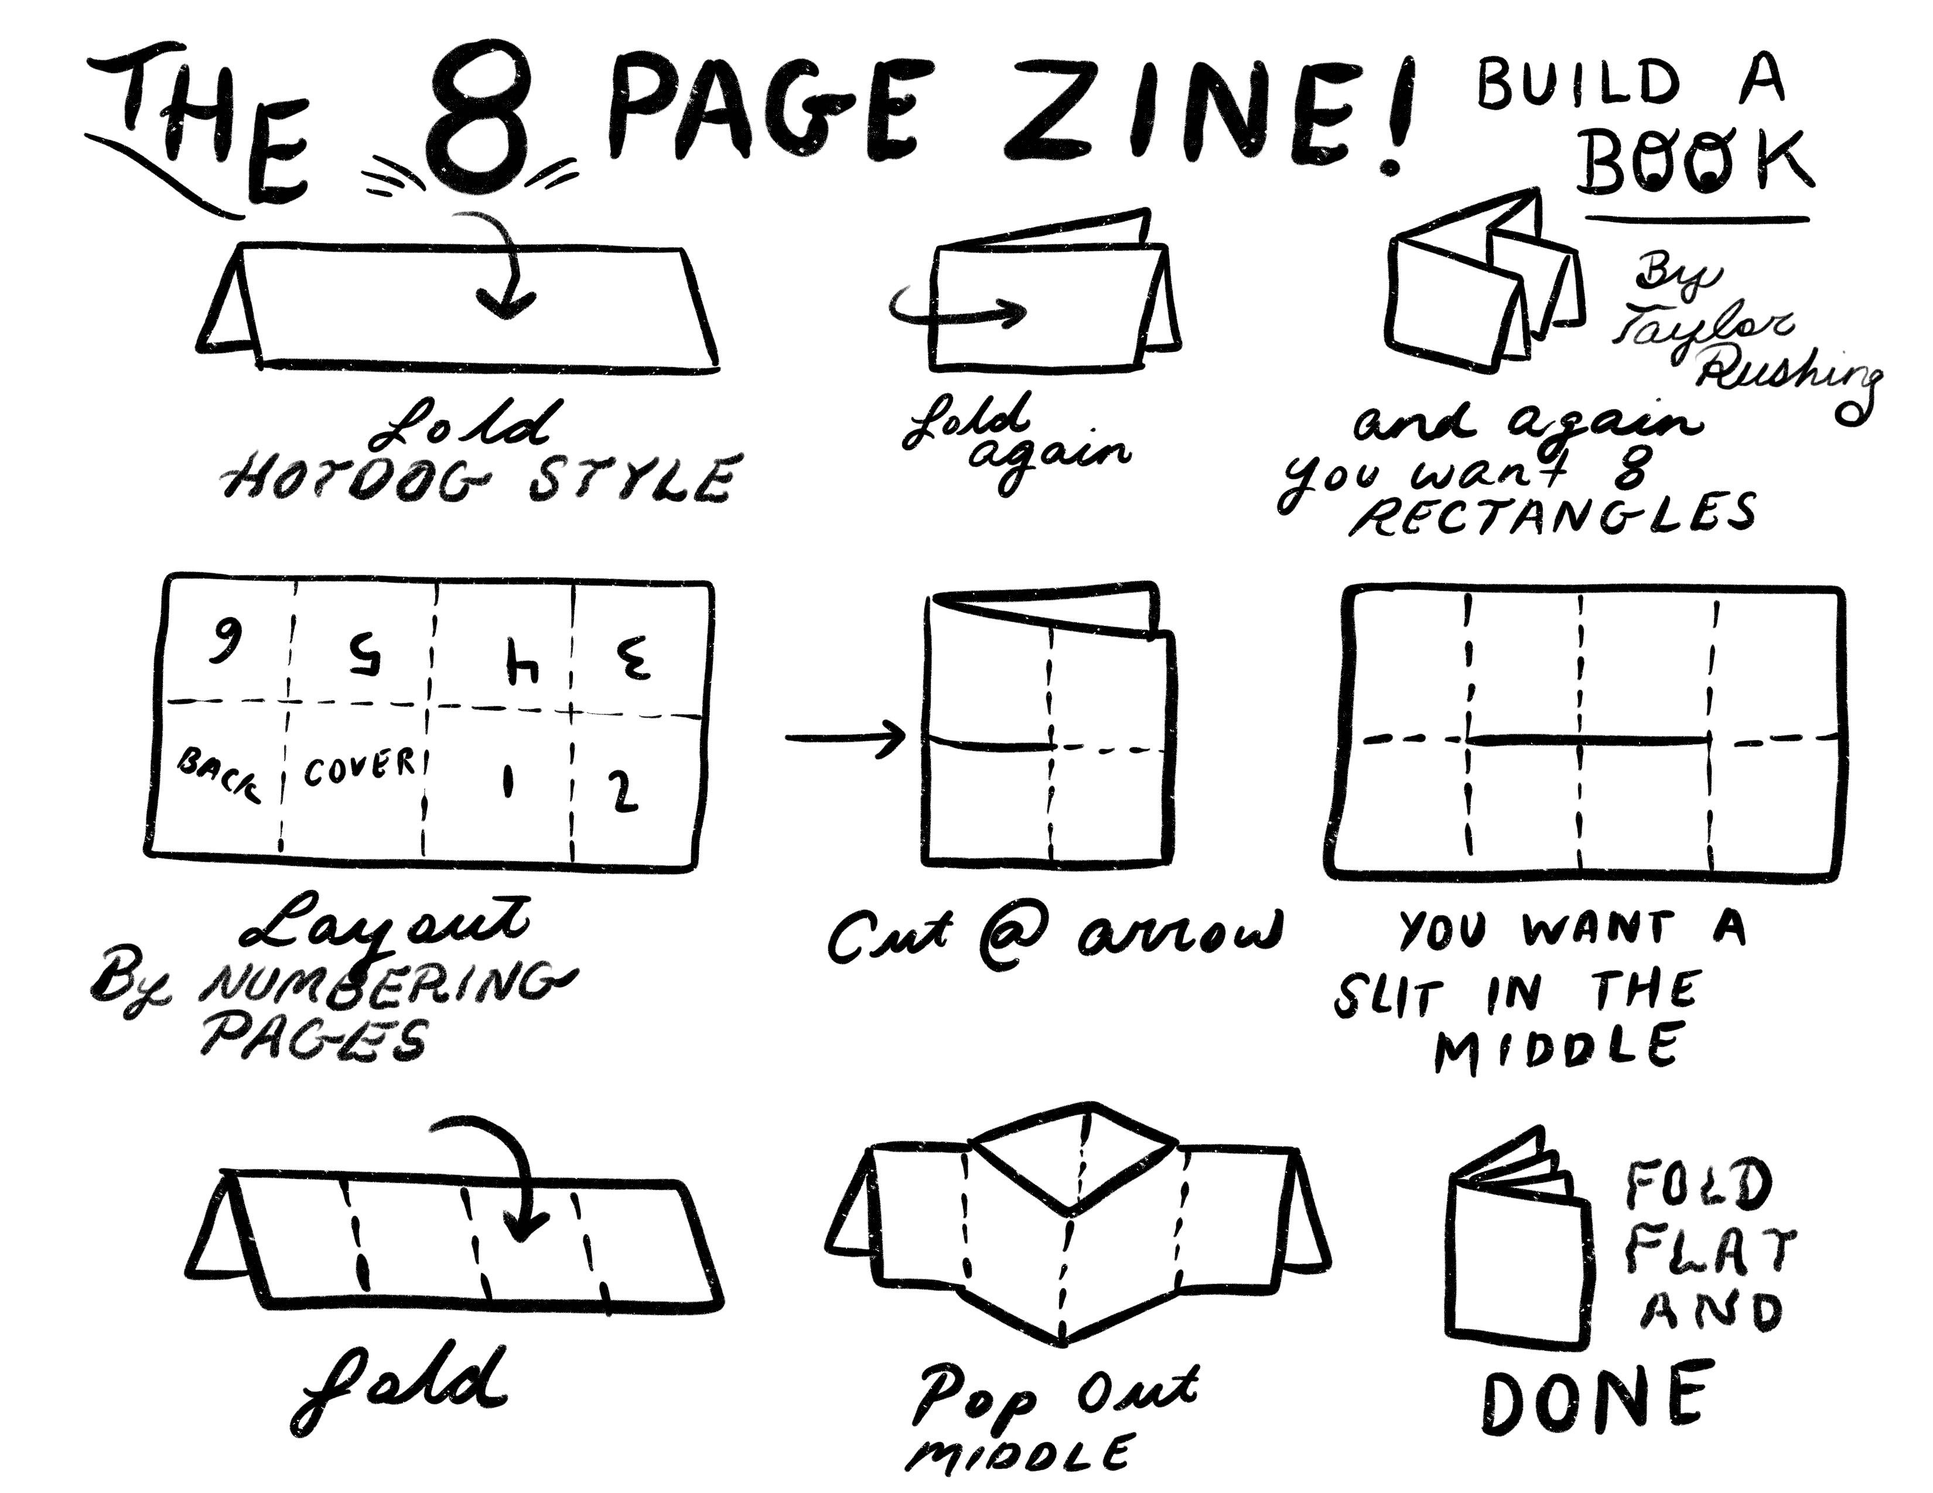
Make your own zine

