Slide 1

GIS in Digital Humanities
An overview of spatial data and mapping with Geographic Information System (GIS)
By Dr Godwin Yeboah, IDG Technology for Research, Information and Digital Group (IDG)
31/05/2023
Notes:
Hello everyone!
My name is Godwin Yeboah
I am a Senior Research Software Engineer based in the Information and Digital Group (IDG).
I work in the IDG Technology for Research team.
My presentation is about GIS in Digital Humanities where I intend to give an overview of spatial data and mapping with Geographic Information System (GIS).
[next]

Slide 2
Context
Basic definitions and concepts
Examples of use of GIS in Digital Humanities
References and other pointers
Q & A and or walkthrough
Notes:
As an outline of my presentation, I will
present some basic definitions and concepts;
After that, I will give some Examples of use of GIS in Digital Humanities including references to tools and potential data sources as well as training materials;
The last few minutes will be dedicated to Q & A and or a short walkthrough.
The content is designed also as a “go-to” resource so you may find it useful to re-visit for GIS related information where necessary.
There is also a short abstract as a supplement to this presentation which has the short steps for a walkthrough.
[Next]

Slide 3
Basic definitions and concepts – Digital humanities (DH)
“… an area of scholarly activity at the intersection of computing or digital technologies and the disciplines of the humanities …
… new ways of doing scholarship that involve collaborative, transdisciplinary, and computationally engaged research, teaching, and publishing. It brings digital tools and methods to the study of the humanities [digital resources] with the recognition that the printed word is no longer the main medium for knowledge production and distribution.
Source: Wikipedia
Computing
or
Digital Technologies
Digital
Humanities
(DH)
Humanities
Notes:
In the context of this presentation, Digital Humanities (DH) is
an area of scholarly activity at the intersection of digital technologies and the disciplines of the humanities which involves new ways of doing scholarship.
Digital Humanities draws on digital tools and methods in the study of the humanities.
It takes the view that printed word is no longer the main medium for knowledge production and distribution.
[Next]

Slide 4

Basic definitions and concepts – GIS
“A geographic information system (GIS) consists of integrated computer hardware and software that store, manage, analyze, edit, output, and visualize geographic [spatial] data.”
In a broader sense, one may consider such a system also to include human users and support staff, procedures and workflows, the body of knowledge of relevant concepts and methods, and institutional organizations.”
Source: Wikipedia
Source: Wikipedia
Hardware
Computers, networks, printers, drones, etc.
Software
GIS software, database software, etc.
Data
Vector data, raster/satellite images, tables, meta etc.
Methods
Approaches, standards, procedures, etc.
People
GIS experts, clients, administrators etc.
Geographic Information System (GIS)
Notes:
At the core, GIS may be defined as an integrated computer hardware and software that store, manage, analyze, edit, output, and visualize geographic data.
From a broader perspective, one may also include people and scientific methods.
In a nutshell, you may just consider this five main pillars covering hardware, software, data, people and methods as constituting a GIS.
[Next]

Slide 5
Basic definitions and concepts – Spatial turn | Spatial Humanities
“Scholars in the humanities have a long tradition in the investigation of spatial theory and methods, as well as on the analysis of space and place within its multiple disciplines. Although technologies such as Geographic Information Systems have been used in Humanities fields such as Archaeology for over four decades, it has been only in recent years that the development of new technologies and methods have led to the emergence of the field that is now more commonly known as the Spatial Humanities, often also referred to as GeoHumanities.” - Murrieta-flores & Martins (2019)
“There is a move towards using GIS technology to highlight … the locatedness of everyday life and the spatialities of cultural practices … [and the] … The production of maps and other data visualizations related to history, literature, and the arts is an important contribution in and of itself.” … DH GIS is in rare position to demand and create more free, open source, … accessible software that fits its needs.” - GIESEKING, J.J., 2018. Where Are We? The Method of Mapping with GIS in Digital Humanities. American Quarterly, 70(3), pp. 641-648.
Spatial Humanities
Geographic Information System (GIS)
GeoHumanities
Digital
Humanities
(DH)
DH GIS
Geospatial Humanities
Notes:
The idea of Spatial Turn is that social change cannot be explained without considering and re-conceptualising categories related to the spatial component of social life (Löw Citation2013).
This idea has been used in the humanities in the past several decades, particularly in Archaeology.
However, the development of new GIS technologies and methods have led to the emergence of the field commonly known as Spatial Humanities.
Spatial Humanities is situated at the intersection of GIS and DH.
A look into literature suggest that scholars have different terms for Spatial Humanities such as GeoHumanities, DH GIS, and Geospatial Humanities.
Some scholars agree that production of maps and other data visualizations related to history, literature, and the arts is an important contribution in and of itself!
[Next]

Slide 6

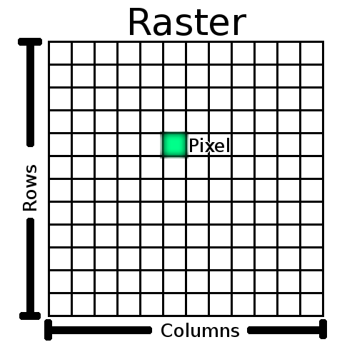
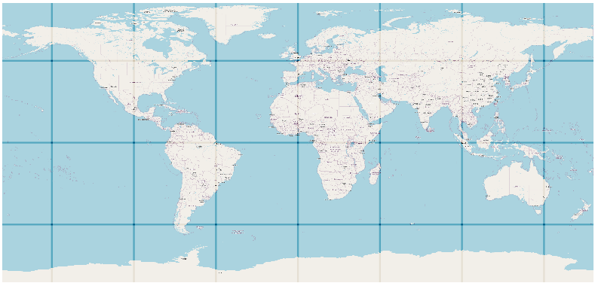
Basic definitions and concepts – Spatial data
Spatial data [or GIS data or Geographic data] is the type of data that represents/references directly or indirectly a specific geographical area or location.
Why spatial -> Geographic coordinate reference systems
GIS data categories: Vector or Raster
Geographic Coordinate Reference
System
(Ellipsoidal earth)
Vector data representation
Raster data representation
Point
(e.g., historical event)
Line
(e.g., ancient river)
Projected Coordinate Reference
System
(flat earth)
Polygon
(e.g., Medieval castle)
Source: QGIS + OSM data + globe icon in PowerPoint
Formats - shp, geojson, etc.
Source: Presenter
Formats - png, tiff, jpg, etc.
Notes:
Spatial data, which is another term for GIS data or Geographic data, is the type of data that references directly or indirectly a specific geographical space or location.
We say it is spatial because of the known geographic coordinate system.
There are two main categories of spatial data; namely, vector data and raster data.
Vector data are made up of 3 basic geometries which are points, lines, and polygons (areas). Some of the file formats are geojson or shapefiles.
Raster data is made up of pixels (also referred to as grid cells). The grids are usually square and regularly spaced, but they don’t have to be. Some of the file formats are tiff and jpeg.
[Next slide]

Slide 7
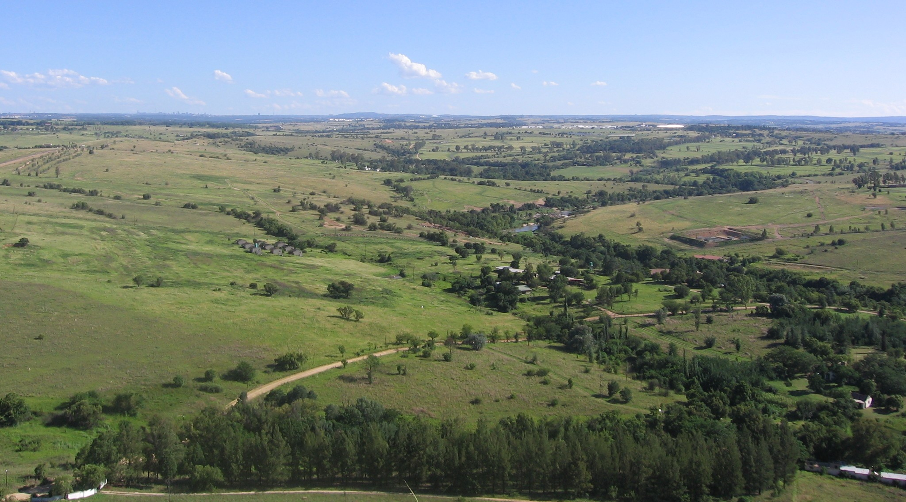
Some data models you may come across
Looking over this landscape, what are the main features that you can see and put on a map?
Source: https://docs.qgis.org/2.8/en/docs/gentle_gis_introduction/vector_data.html
Notes:
Now let’s do a little exercise.
Looking over this landscape, what are the main features that you can see and put on a map?
Feel free to respond now.
[Next]

Slide 8
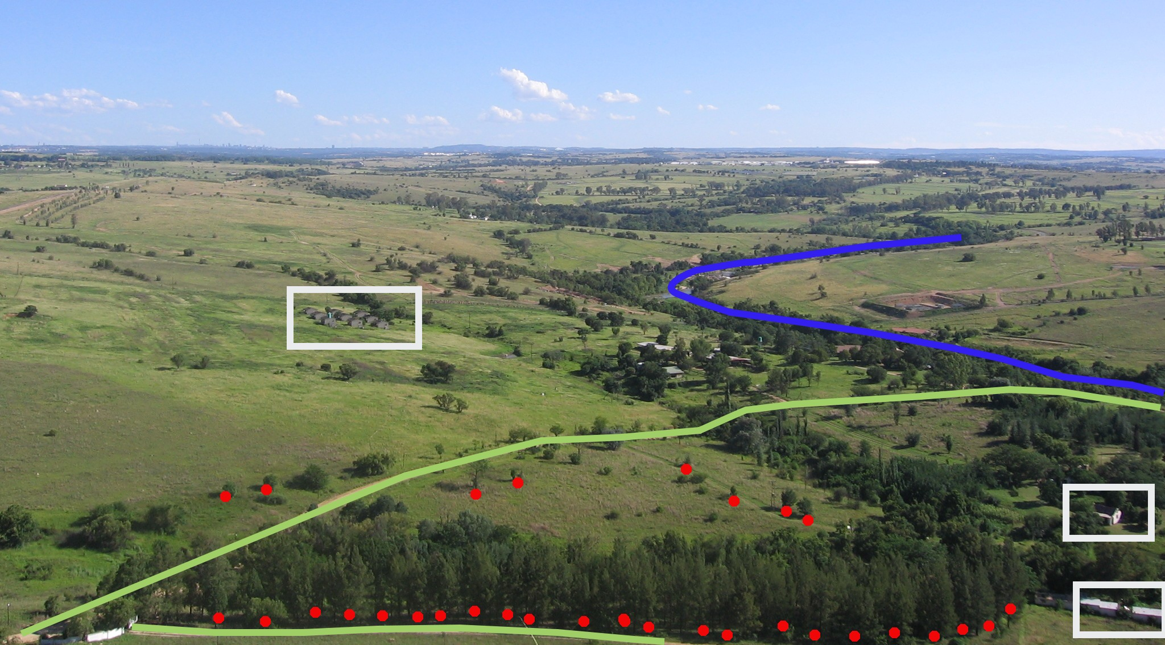
Some data models you may come across
Looking over this landscape, what are the main features that you can see and put on a map?
Source: https://docs.qgis.org/2.8/en/docs/gentle_gis_introduction/vector_data.html
Notes:
I could see some buildings, road, trees, and river.
[Next]

Slide 9
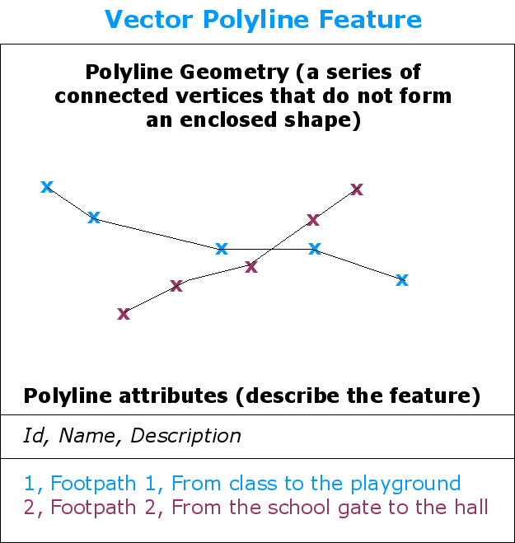
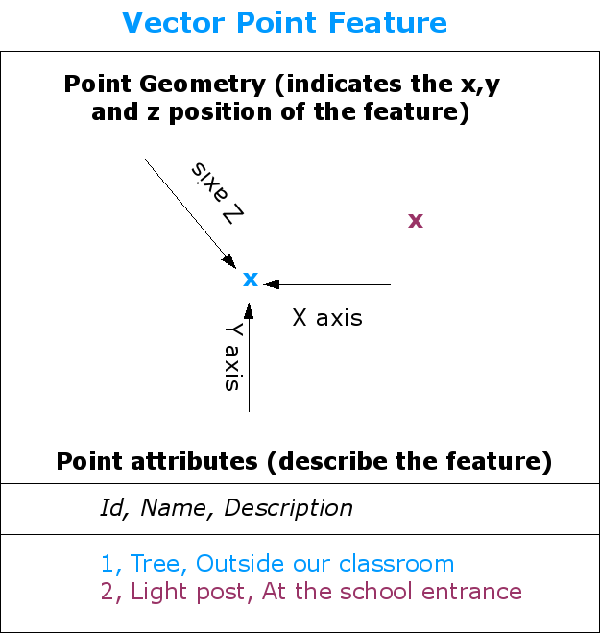
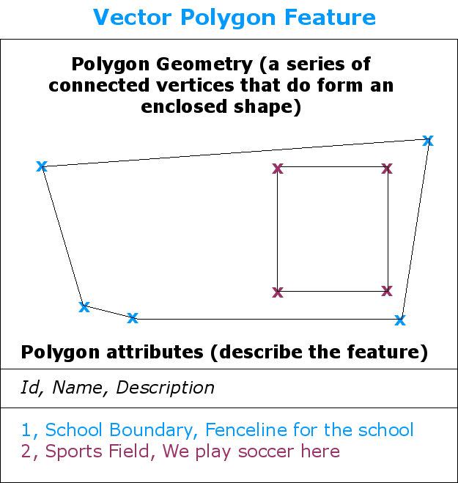
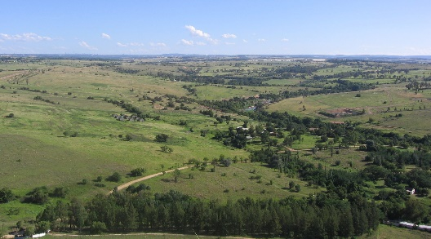
Some data models you may come across: Vector data versus Raster data
Source: https://docs.qgis.org/2.8/en/docs/gentle_gis_introduction/vector_data.html
Notes:
In terms of representation of the features that we have identified in the image, we have two options.
For example, we can use point geometry to store the locations of the trees and even attach additional attributes such as name and description.
Similarly, we can do same for road and rivers using line features and their attributes.
We can also use polygon geometry for the buildings and their attributes.
Another option, is to use grid cells to represent the features of interest. Here, a grid cell value could either be an RGB value representing the pixel value of the image at that space.
[Next]

Slide 10
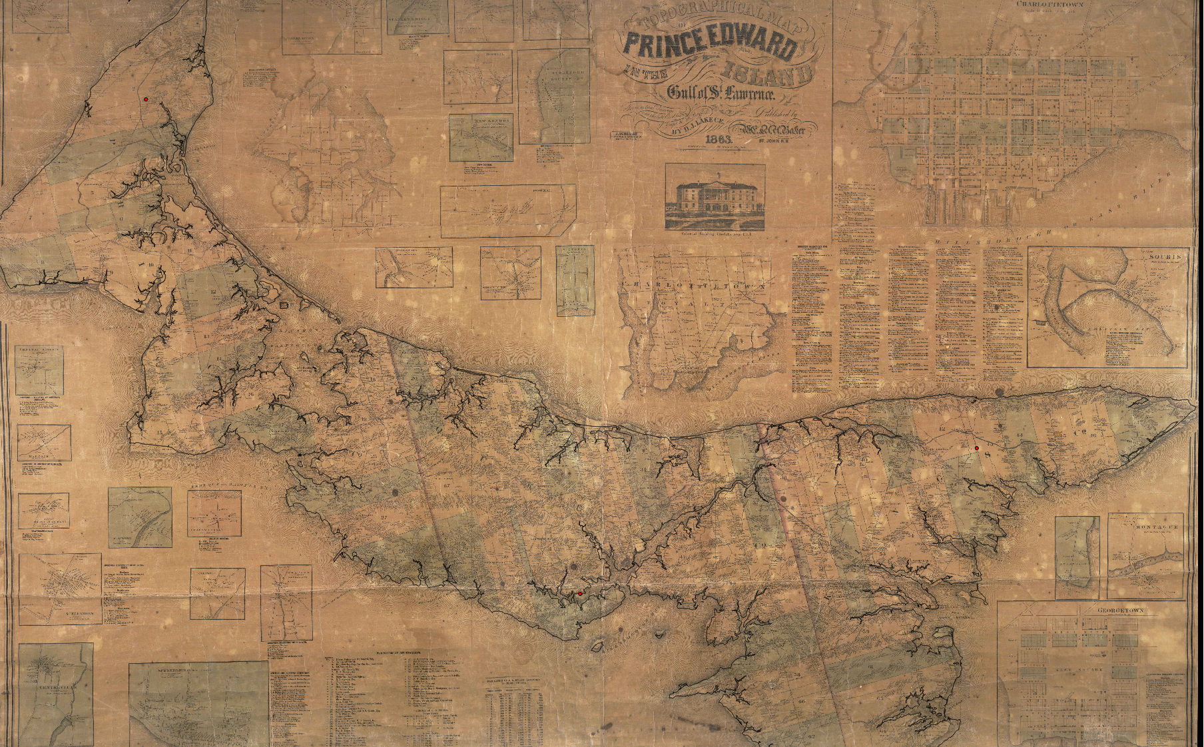
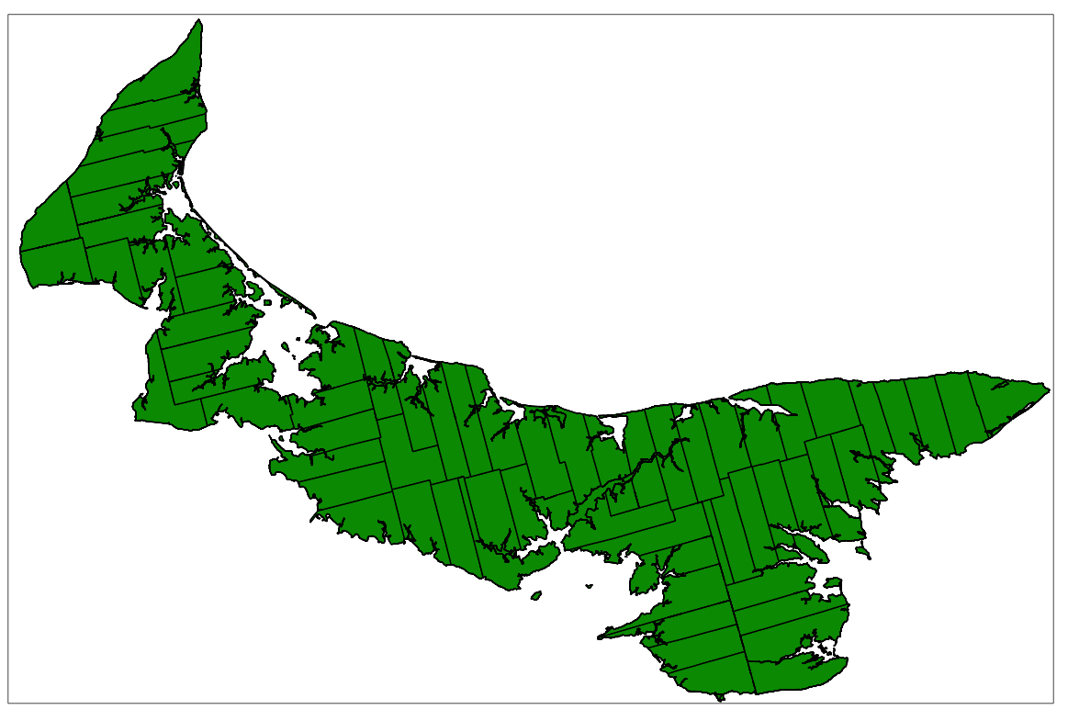
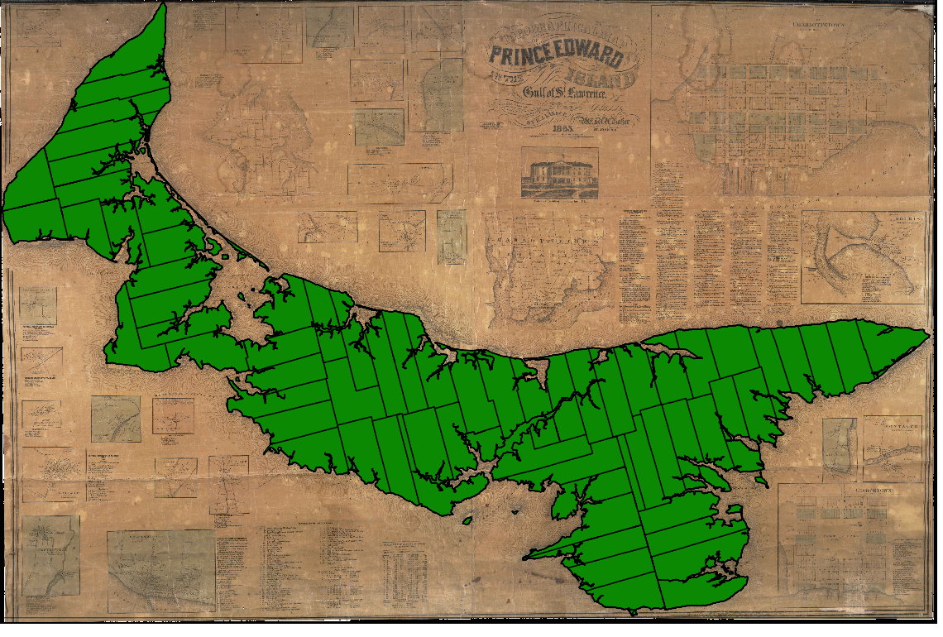
What is Georeferencing and a georeferenced map?
Old scanned map with no coordinate reference system
New map with known coordinate/spatial reference system
Georeferenced map showing both old and new maps
+
+
+
+
+
+
+
+
=
+
+
+
+
+
+
+
+
… the process of using a series of control points to give a two-dimensional object like a paper map the real world coordinates it needs to align with the three-dimensional features of the earth in GIS software. Source: https://programminghistorian.org/en/lessons/georeferencing-qgis
Notes:
Now let’s look at two spatial processes that are commonly used in spatial humanities.
The first is called Georeferencing which the process of using a series of control points to give a two-dimensional object like a paper map the real world coordinates it needs to align with the features of the earth in GIS software.
Let’s say you have an old scanned paper map and want to use it in a GIS system having other data of same area.
To bring the two data together, you will need to use some control points like the red points here which share similar properties in both the old map and the already referenced GIS features.
When the old map is integrated into the GIS system, the map becomes a georeferenced map. Thus, the map now has a geographic coordinate reference system.
[Next]

Slide 11
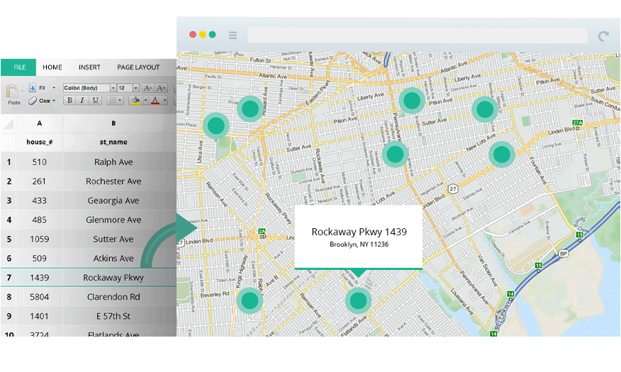
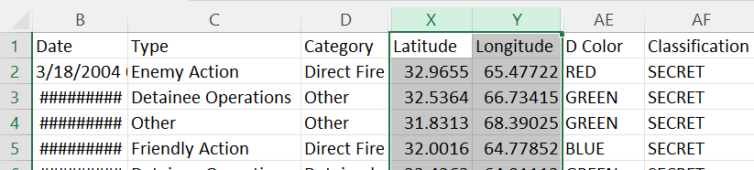
What is Geocoded text data?
Place-names (e.g., historic places)
Text data that can be translated into geographic coordinates and represented on a map
Notes:
The 2nd spatial process is called Geocoding where text is translated into geographic coordinates and drawn on a map.
Geocoded text data are text data that can be translated into geographic coordinates and represented on a map.
Such text could be tabular data containing place names such as historic places from archives, longitudes and latitudes, or street names among others.
[Next]

Slide 12
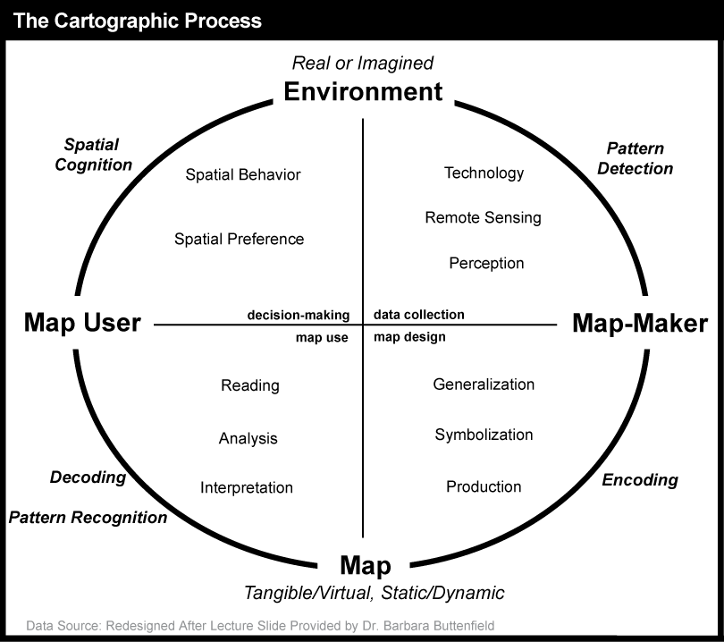
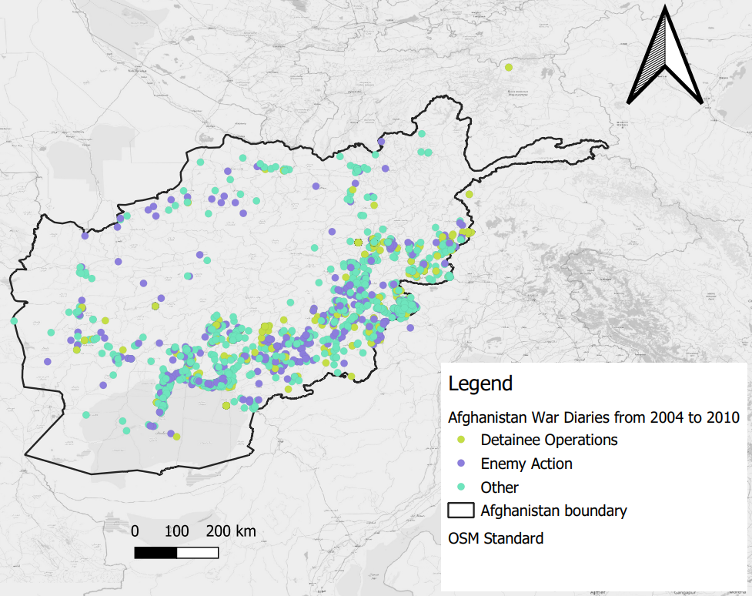
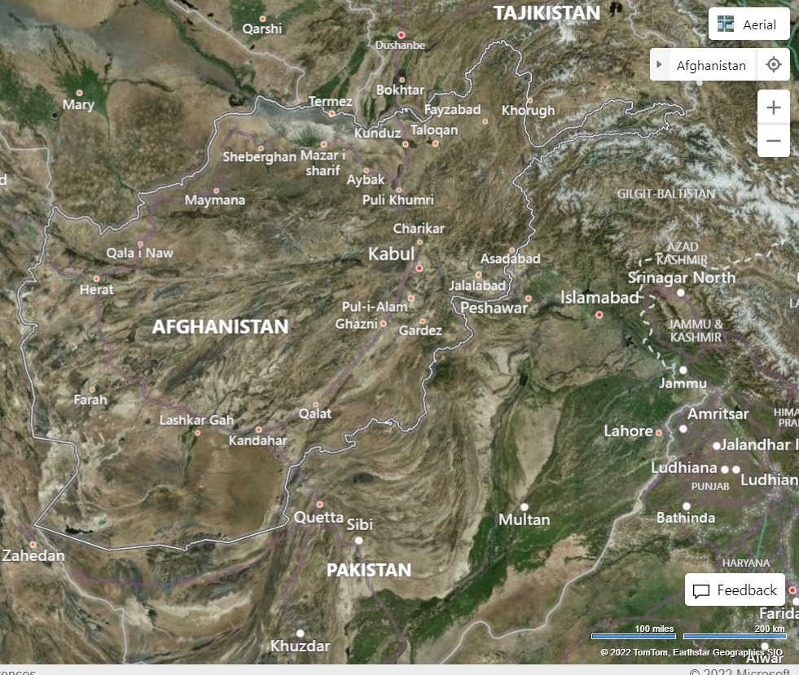
What is a map in cartographic context?
A map is a symbolic depiction emphasizing relationships between elements of some space, such as objects, regions, or themes.
Cartography is the term given to the study and practice of making and using maps.
Example of maps
Source: Wikipedia
Notes:
A map is a symbolic depiction emphasizing relationships between elements of some space, such as objects, regions, or themes.
The study and practice of making and using maps is what is usually referred to as Cartography.
The cartographic process encompasses an imagined or real environment with the objective of creating a map of that environment for some target users.
There are two key groups in the process: map-users and map-makers.
There are also intermediaries which make the process possible such as technology, theories, concepts, etc.
I have here some example maps which are showing some information from Afghanistan.
The maps show some features such as
north arrow which is important for orientation of the map
Boundary of Afghanistan to give an indication of the size of the country
Scale to indicate the relative size to the real environment
Legend as a key for reading the theme of the map
You will also notice that one of the basemaps look like raster data such as satellite imagery.
[Next slide]

Slide 13
Some questions to consider when planning to map with spatial data
Before you make any map, ask yourself these critical questions:
What is the purpose of the map? For self learning, group, article, conference, e.g.?
Who will read it? Lay person, experts like historians, parliamentarians, etc.?
What is the story in the data? Events from War diaries, historical places, etc.?
What type of symbols are appropriate? Points, polygons/areas, lines, etc.?
Where and how will you share the map? Printed maps, website, etc.?
You need to continue to ask such questions throughout the mapping process.
Notes:
The following are some critical questions to consider when making any map.
What is the purpose of the map? Is it for self learning, article or conference?
Who will read it? Lay person, experts like historians or parliamentarians?
What is the story in the data? Here, you may consider events from War diaries, historical places, etc.?
What type of symbols are appropriate? Points, polygons/areas, lines, etc.?
Where and how will you share the map? Printed maps, website, etc.?
These should be ongoing questions until the map is generated.
[Next]

Slide 14
Plethora of GIS application areas worldwide
Groundwater
GeoStatistics
Geology
Gardening
Health
History
Hydrology
Gaming
Agriculture
Humanitarian
Forestry
Astronomy
Surveying/Geodesy
Telecommunications
Insurance
Environment
Sports/Recreation
Engineering
Archaeology
Soils
Tourism
GIS application areas
Land Use Planning
Energy
Society
Transmission
Architecture
Education
Reporting/News
Mail Services
Transportation
Economics
Arctic/Antarctica
Real Estate
Municipality/Urban
Aquatics
Politics/Government
Utilities
Mining
Ecology
Aviation
Parks
Volunteer
Disaster
Weather
Oil/Gas
Defence
Automobile
Nautical
Crime
Ocean/Marine
Banking
Climate Change
Business
Consumer Behaviour
Adapted from: https://gisgeography.com/gis-applications-uses
Notes:
GIS can deal with almost every phenomenon that relates to geographical space.
As such, there are plethora of application areas including fields in the humanities such as history.
[Next]

Slide 15
Some examples of GIS use cases in DH
Mapping the English Lake District: a literary GIS (2011): used GIS to create static maps of two accounts of actual journeys through the Lake using ArcGIS, Google Earth, etc.
Crossing the Mediterranean Sea by Boat (2019): mapped and documented migrants’ journeys and experiences using Leaflet library for interactive maps.
The Atlas of Early Printing (2019): mapped and visualised early printing via fairs, trade routes, etc. using Google maps API, ArcGIS software, Leaflet, etc.
GIS uses cases in DH
Foodscapes of bread in sixteenth-century New Spain using a historical gazetteer (2022): mapped types of bread with a DECM historical gazetteer using ArcGIS and QGIS
Developing Geographically Oriented NLP Approaches to Sixteenth – Century Historical Documents: Digging into Early Colonial Mexico [DECM] (2020): used GIS to auto-link text analysis results to spatial data.
A Digital Botanical Garden: Using Interactive 3D Models for Visitor Experience Enhancement and Collection Management (2023): created an interactive 3D web map using ArcGIS and 3D City Modelling tools.
Static and interactive maps from the “Anti-Eviction Mapping Project (AEMP)”: used GIS tools like leaflet for static/ interactive map visualisations and storytelling. Won 2016 ASA Garfinkel Prize in Digital Humanities.
Find more GIS use cases here: https://geohumanities.org/?page_id=125
Notes:
Here are examples of GIS use cases in DH.
Some of these research used desktop GIS like ArcGIS and QGIS while others use GIS tools like leaflet for interactive map visualisations.
There was also use of gazetteers for geocoding processes.
[Next]

Slide 16
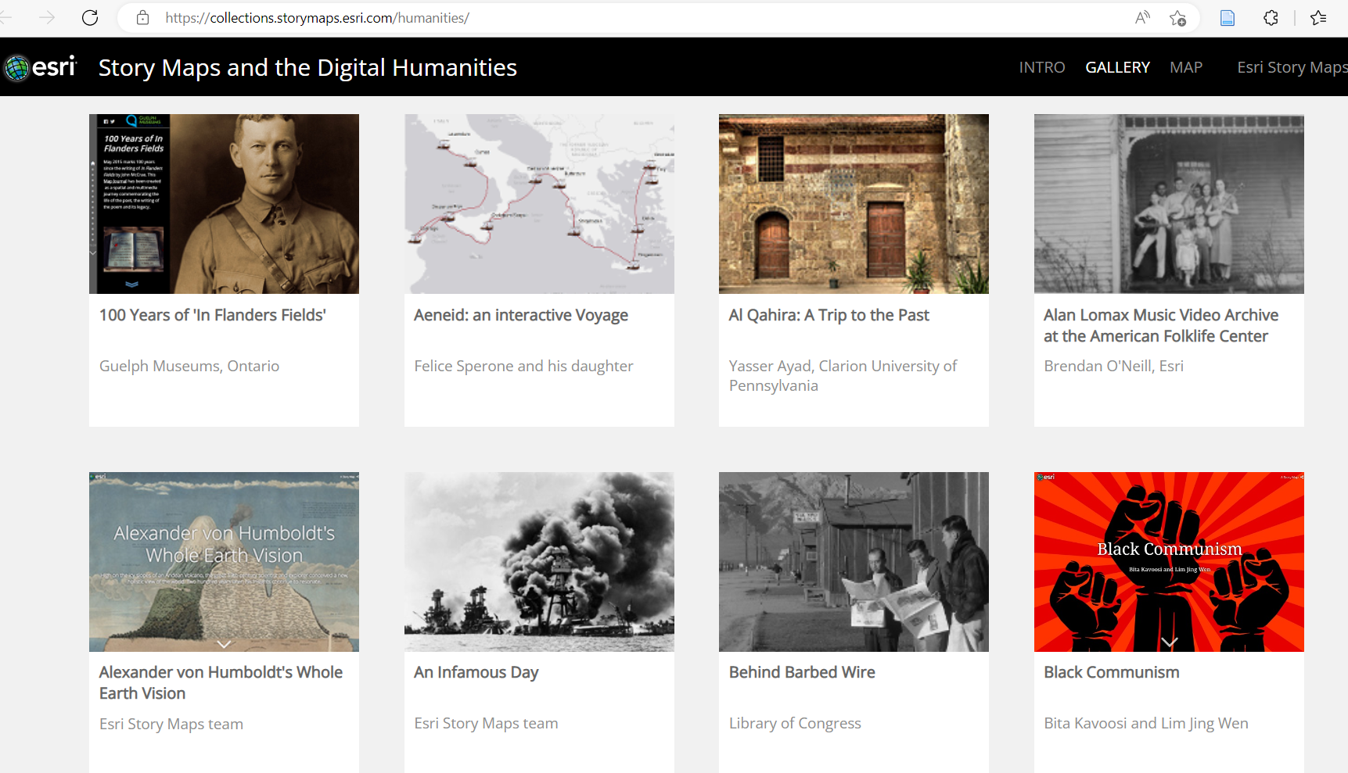
Notes:
There are also plethora of projects in which maps were used for story telling; what is usually refer to as story maps.
[Next]

Slide 17
Potential of Generative AI/ChatGPT in Spatial Humanities?
Question 1: Provide a table of the top five libraries in England and their geographic coordinates
Question 2: Provide a table of the top five libraries in England during the 18th Century and their geographic coordinates
Notes:
What is the potential of Generative AI like ChatGPT in Spatial Humanities research?
I tried asking ChatGPT these two questions:
Question 1: Provide a table of the top five libraries in England and their geographic coordinates
Question 2: Provide a table of the top five libraries in England during the 18th Century and their geographic coordinates
[Next]

Slide 18
Potential of ChatGPT in Spatial Humanities?
ChatGPT response to question 1
ChatGPT response to question 2
Library | Latitude | Longitude
British Library | 51.5294° N | -0.1270° W
Bodleian Library | 51.7548° N | -1.2544° W
University of Manchester Library | 53.4668° N | -2.2339° W
John Rylands Library | 53.4742° N | -2.2452° W
Cambridge University Library | 52.2053° N | 0.1218° E
I apologize, but I don't have access to specific data about libraries during the 18th century. My training only includes information up until September 2021. It would be best to consult historical records, books, or online resources specializing in the history of libraries in England during the 18th century to obtain accurate information about the top libraries and their geographic coordinates during that time.
Which is easy to create a map from it using Geo-Browser or GIS.
A gap for future research? Possibly around AI assisted historical spatial data, etc.
Notes:
ChatGPT answered question 1 well with a nice table.
ChatGPT could not answer question 2 well but offered good suggestions.
Obviously, there is a gap when dealing with questions that are related to historical data.
This offers an opportunity for future research.
[Next]

Slide 19
Some GIS tools in DH
Programming (analysis / mapping / visualisation libraries):
JavaScript libraries (Leaflet, OpenLayers, CesiumJS, Turf, etc.)
R programming (for geocoding, creating mapping, etc)
Python programming (GeoPy, PySAL Rasterio, etc.)
php programming (Geotools etc.)
APIs (ArcGIS APIs/SDKs, etc.) *
Publish / Share / WebGIS:
ArcGIS Online *
GeoServer *
MapServer *
QGIS Server*
ArcGIS Enterprise *
Mapping module (Omeka S) *
Carto *
QGIS2Web plugin*+ Github Pages*
GeoNode - a geospatial content management system*
GIS tools
Desktop GIS software:
ESRI’s ArcGIS Pro (21 day trial)*
QGIS*| GeoDa*
GRASS*| SAGA*
uDig*| gvSIG*
Microsoft Excel (Map Chat, Power Map, etc)
MapInfo (30 day trial)*
Geocode /Georeference:
ESRI’s ArcGIS Pro, LocateXT *
QGIS
Map Warper
Edinburgh Geoparser*
IPUMS GeoMarker*
DECM Place name search*
Allmaps Editor*
Database software:
PostGIS (and PostgreSQL)*
MySQL/ MariaDB* *
SpatiaLite (and SQLite) *
MongoDB*
Oracle Spatial*
3D GIS software:
ArcGIS Pro, Earth, etc.
Google Earth
Microsoft Power 3D Map for Excel*
Notes:
There are so many GIS tools available for Spatial Humanities research.
You can use desktop GIS tools which will require computer programming.
There are options also for programming, geocoding, georeferencing, publishing as well as storage.
[Next]

Slide 20
Some GIS data sources in DH
Gazetteers:
Gazetteer of British place names *
World Historical Gazetteer *
Pleiades - community-built gazetteer of ancient places*
GeoNames - geographical database of place names*
DECM Historical Gazetteer*
Digital Gazetteer of Song Dynasty China*
Base maps:
OpenStreetMap – free editable world map*
OpenMapTiles – vector maps for self-hosting *
Google maps**
Bing maps**
GIS data sources
Some other data:
Harvard dataverse for Arts and Humanities*
Public libraries in England*
UK ONS historical data search *
Free maps from The Ancient World Mapping Center *
UK Ordnance Survey Historical maps of Great Britain *
US National Historical Geographic Information System*
ARCHI UK MAPS - Find old maps of Britain*
Free GIS Data (over 500 sites providing freely available geographic datasets - freegisdata.rtwilson.com)
Searchable (spatial) data sources:
Harvard Geospatial Library (hgl.harvard.edu) *
Georeferenced Maps – Find/upload old georeferenced maps (mapwarper.net)*
OpenStreetMap (OSM.org) – free editable world map**
Google maps**
Bing maps*
Google Dataset Search *
Earth Explorer (Historical Satellite Images)*
Notes:
Similarly, there are so many GIS data sources that are available for Spatial Humanities research.
There are gazetteers and base maps as well as many searchable data sources.
[Next]

Slide 21
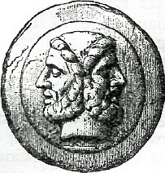
Janus-faced challenges of GIS data for DH research
Information Overload
High-volume data streams
Unstructured data
Variable credibility and quality of spatial information
Information Dearth
Lack of spatial and temporal (historical) coverage
Low integration into decision-making (research) processes and tools due to (sometimes) lack of geo-codable text
Mismatch between needs and offers
“Big Data”
“No Data”
Notes:
It is important to also consider the dual challenges around the use of GIS data for spatial humanities research.
On one hand, we have information overload where we have huge volume of unstructured data with varying quality.
On other hand, there could be information dearth where there is lack of spatial and temporal coverage.
[In ancient Roman religion and myth, Janus is the god of beginnings, gates, transitions, time, duality, doorways, passages, frames, and endings. He is usually depicted as having two faces.]
[Next]

Slide 22
References and other pointers
Journal articles
  Mapping the English Lake District: a literary GIS
  Where Are We? The Method of Mapping with GIS in Digital Humanities
Other research project websites
  Analysing 18-Century Tourism in the English Lake District
  Crossing the Mediterranean Sea by Boat
  DH GIS Projects
Tools
  ArcGIS StoryMaps – A digital platform to create inspiring, immersive stories by combining text, interactive maps, and other multimedia content. You can publish and share your story with your organization or everyone around the world. An ArcGIS StoryMaps cheat sheet.
  QGIS - A Free and Open Source Geographic Information System.
  ArcGIS Online - Build interactive web maps with ArcGIS Online, Esri's web-based mapping software.
  StoryMap JS - a free tool to help you tell stories on the web that highlight the locations of a series of events.
  Mapping is a module for Omeka S - allows you to geolocate Omeka S items and add interactive maps to Site Pages.
  DARIAH-DE Geo-Browser Geo-Browser – Create visualizations with geotagged data.
Training materials
  Georeferencing in QGIS 2.0
  Create a map using ArcGIS ( ~ 20 mins)
  Getting started with ArcGIS StoryMaps
  Nine steps to great storytelling
  How to create a basic map for print and web using QGIS
  QGIS Training Manual
  GIS and Humanities lecture
Spatial data sources
  The GeoNames - geographical database covers all countries and contains over eleven million placenames that are available for download free of charge.
  HARVARD Geospatial Library
  OpenStreetMap – free crowd-sourced editable/downloadable map of the world made up GLAM items such as Museum/Library locations etc.
  Rectified Maps - Find old maps and other imagery or upload a map and rectify against a real map.
  Other list of data sources
Journal articles / book
  Digital Spatial Infrastructures and Worldviews in Pre-Modern Societies
  The Spatial Humanities : GIS and the Future of Humanities Scholarship (Warwick library access)
  The Visualization of Spatial Data in the Humanities
Others
  The Spatial Humanities: GIS and the future of humanities scholarship (book review)
  The geospatial humanities: past, present and future
  GeoHumanities Project and Resource Listings
  The Historical GIS Research Network Resources
  A tutorial on Datums
  Awesome Digital Humanities
Tools
  Map Warper - open-source georeferencing service (upload scanned maps and georeferenced them against OpenStreetMap)
  PLATIN - HTML5-based tool for presentation and analysis of spatial and temporal data, with a focus on historical data.
  Other list of tools
  GeoDa – a free desktop GIS software.
  ArcGIS Pro - a commercial desktop GIS software.
  R programming (geocoding, mapping, tutorials, etc)
  Edinburgh Geoparser
Training materials
  Finding Places in Text with the World Historical Gazetteer
  GIS for Humanities
  Getting started with GIS
  Introduction to Map Warper
  Geocoding Historical Data using QGIS
  Repository of ArcGIS lessons/tutorials
  ArcGIS Tutorials – gallery of tutorials about using ArcGIS tools.
  Lecture with GIS
Spatial data sources
  World Historical Gazetteer
  Gazetteer of British Place Names
Notes:
This slide shows a compilation of some useful references such as training materials for future use.
[Next]

Slide 23

Thank you
Q & A / Walkthrough using war data and ArcGIS MapViewer
Dr Godwin Yeboah
IDG Technology for Research team member, Information and Digital Group (IDG), University of Warwick, UK.
Email: g.yeboah@warwick.ac.uk
Twitter: @GodwinYeboah
OrcID: 0000-0003-4618-3175
ResearchGate: https://www.researchgate.net/profile/Godwin-Yeboah
Notes:
Thank you for your attention.
Let me know if you have any questions.
[Next – you can wait for Q&A or do the walkthrough]

