Slide 1
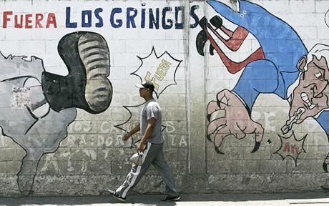
Week 7
The New Monroe Doctrine

Slide 2
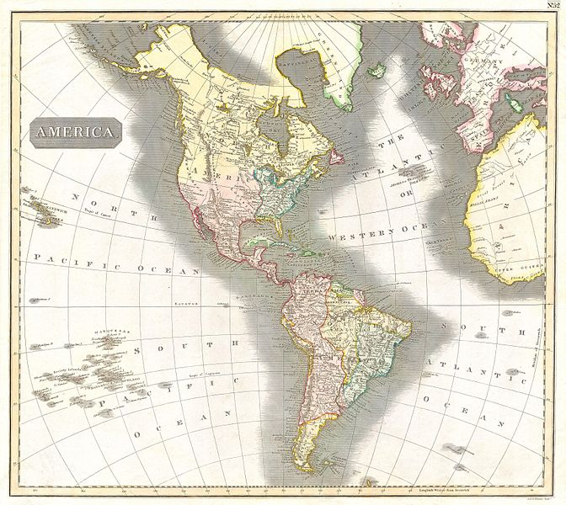
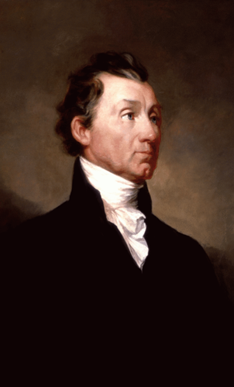
The Monroe Doctrine

Slide 3
In the wars of the European powers in matters relating to themselves we have never taken any part…. It is only when our rights are invaded or seriously menaced that we resent injuries or make preparation for our defense. With the movements in this hemisphere we are of necessity more immediately connected, and by causes which must be obvious to all enlightened and impartial observers…. We owe it, therefore, to candor and to the amicable relations existing between the United States and those powers to declare that we should consider any attempt on their part to extend their system to any portion of this hemisphere as dangerous to our peace and safety. With the existing colonies or dependencies of any European power we have not interfered and shall not interfere. But with the Governments who have declared their independence and maintain it, and whose independence we have, on great consideration and on just principles, acknowledged, we could not view any interposition for the purpose of oppressing them…in any other light than as the manifestation of an unfriendly disposition toward the United States.
Secretary of State John Quincy Adams / President James Monroe, 1823

Slide 4

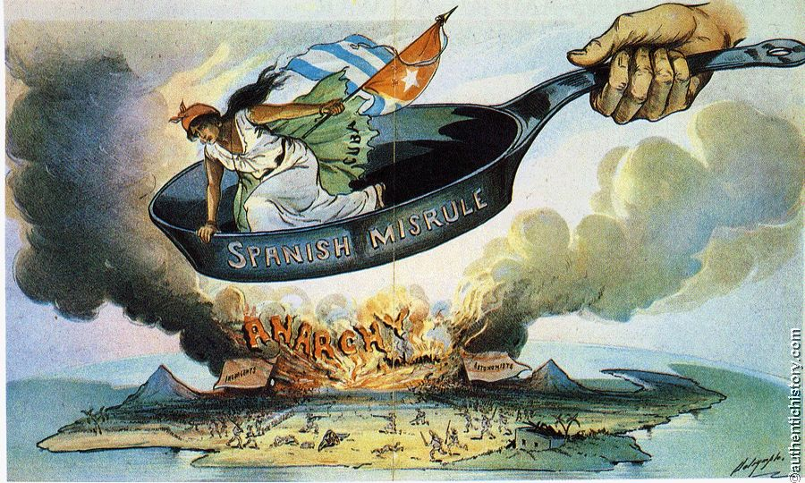
Spanish-American War,
April-August 1898

Slide 5
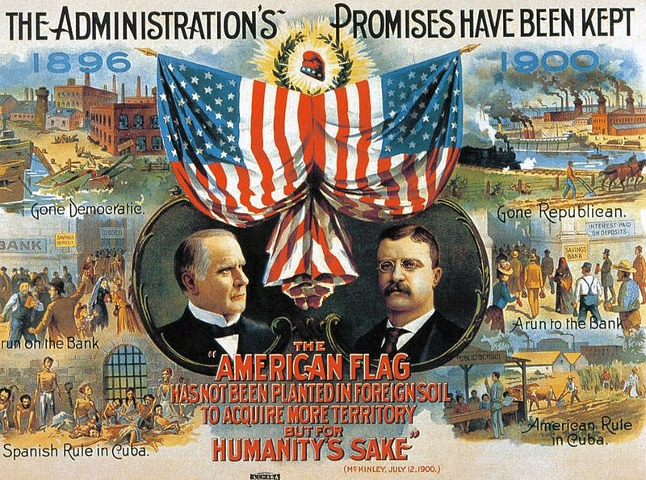

Slide 6
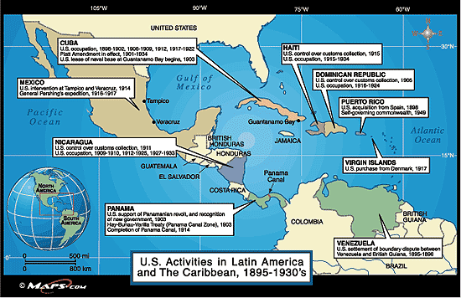

Slide 7
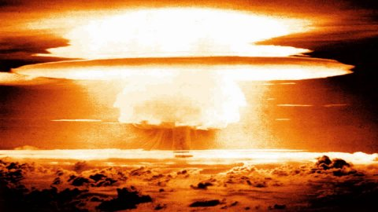

Slide 8
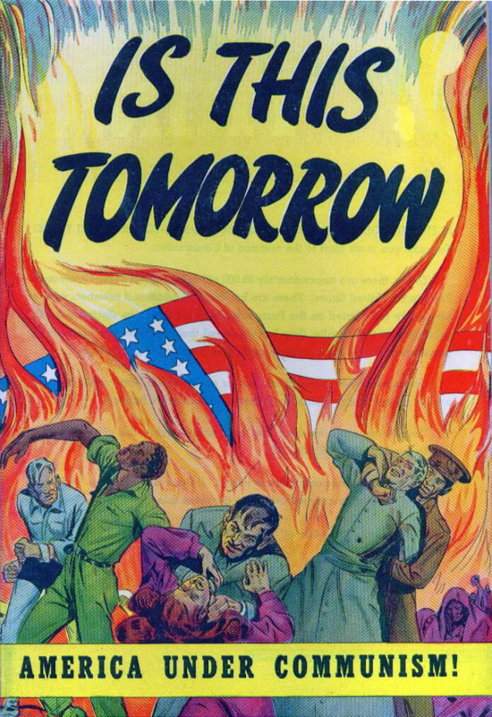
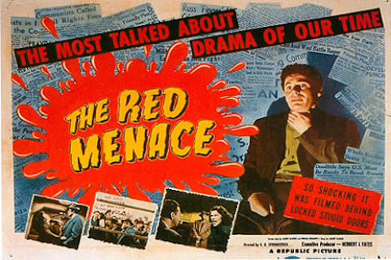
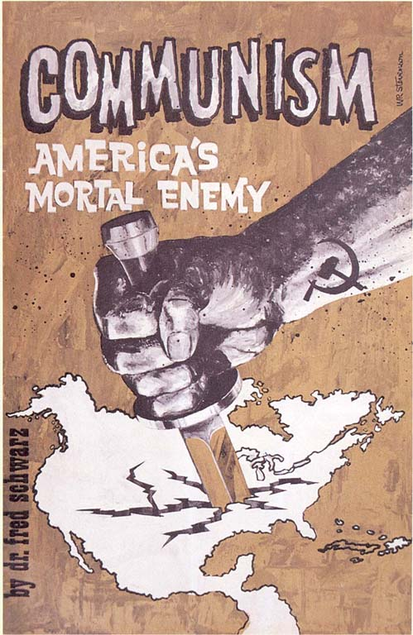
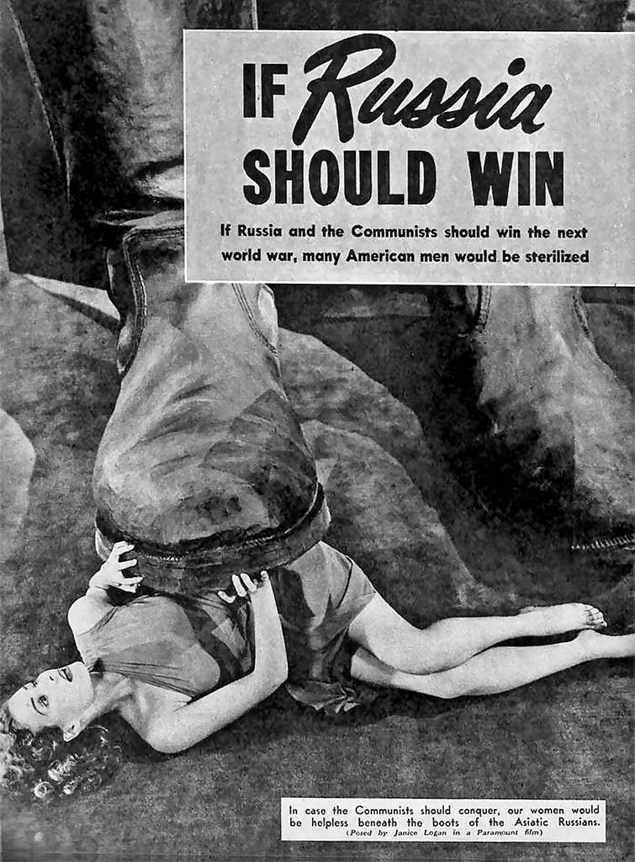
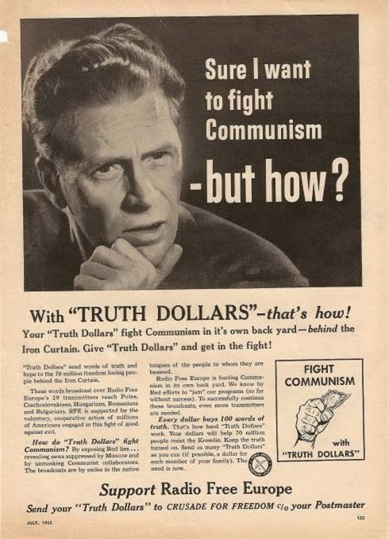

Slide 9
‘Containment’
The main element of any United States policy toward the Soviet Union must be that of a long-term, patient, but firm and vigilant containment of Russian expansive tendencies.
[We must counter] Soviet pressure against the free institutions of the Western world [through] adroit and vigilant application of counter-force at a series of constantly shifting geographical and political points, corresponding to the shifts and maneuvers of Soviet policy.
George Kennan, 1947

Slide 10


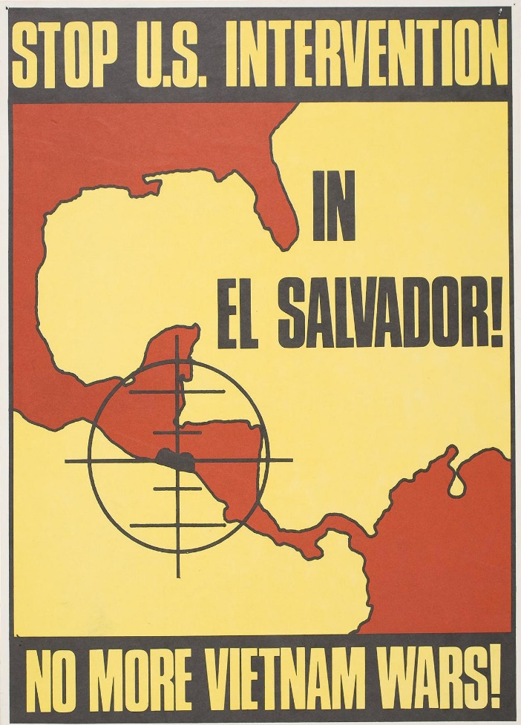
Salvadoran Civil War, 1979-1992

Slide 11
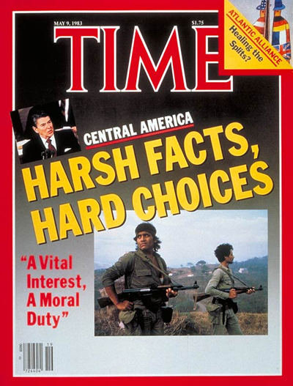
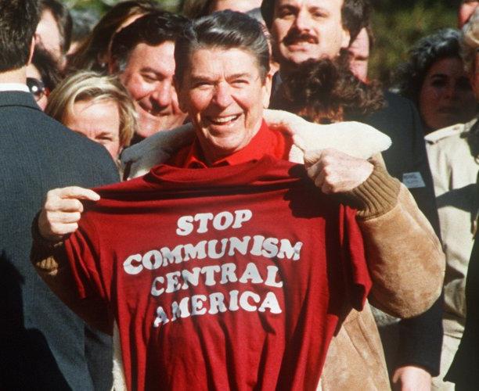

Slide 12
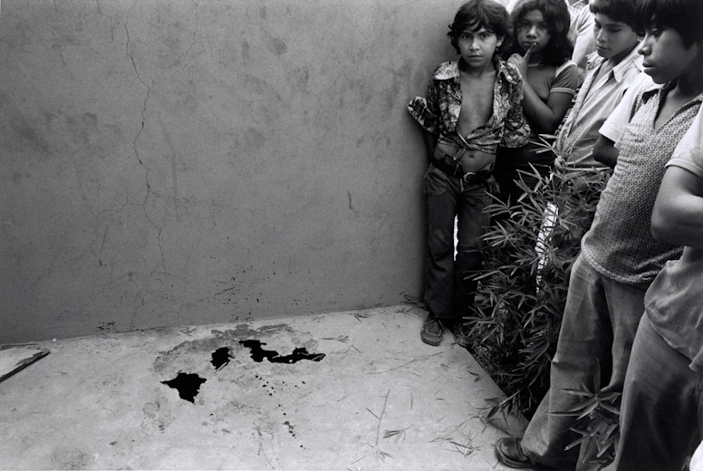
Susan Meiselas

Slide 13
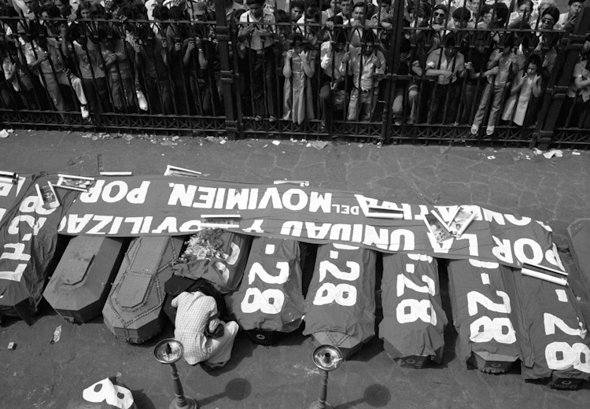

Slide 14
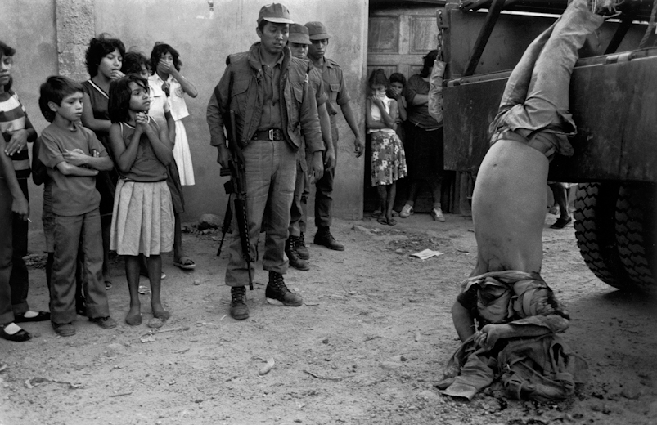

Slide 15
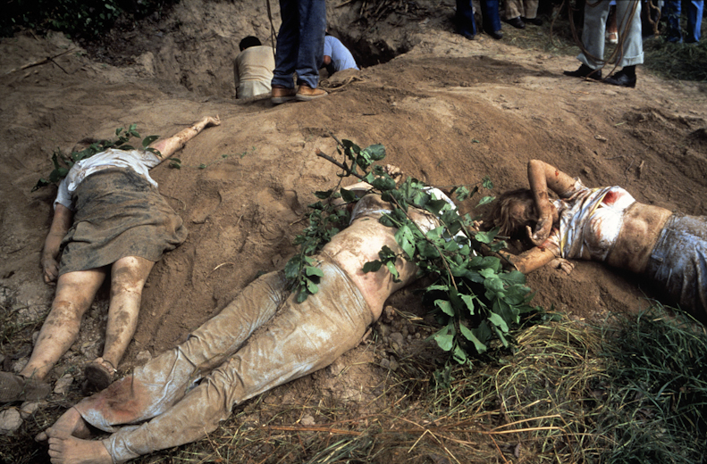

Slide 16


