Slide 1
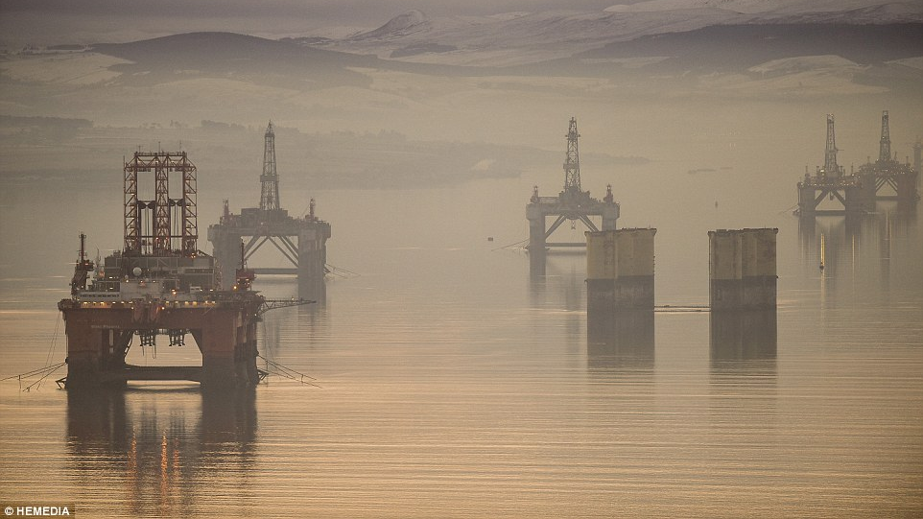
Critical Environments, Week Four – Energy Cultures

Slide 2


Slide 3


Slide 4
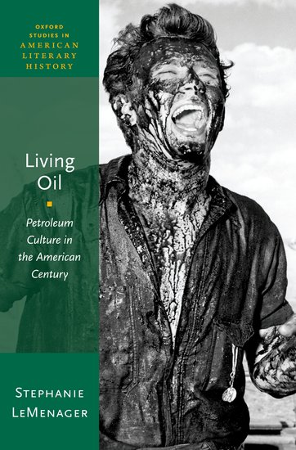
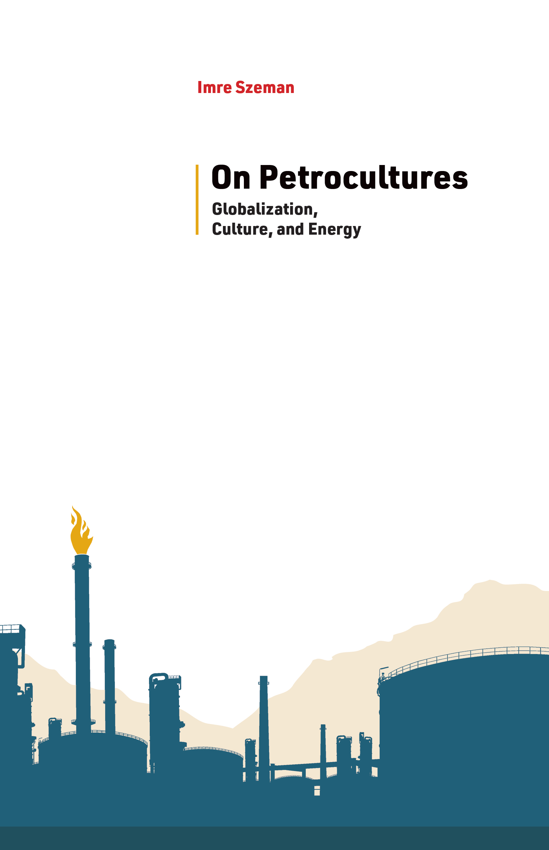
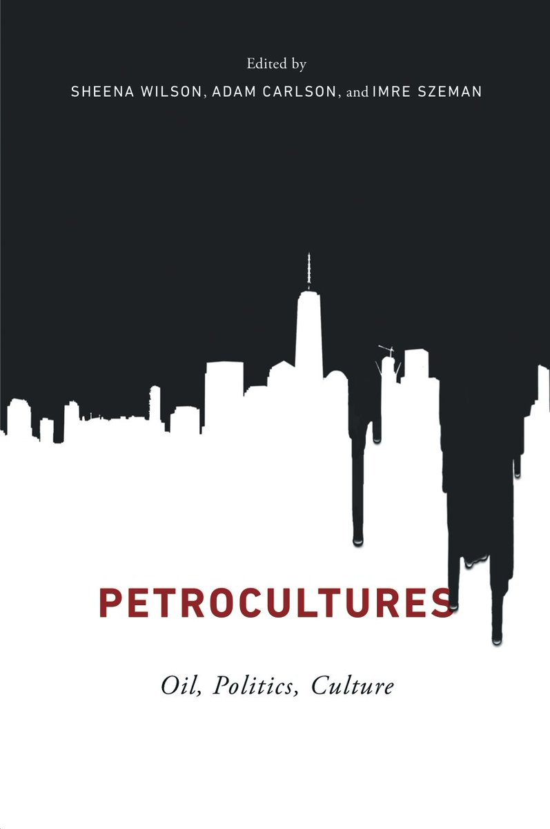

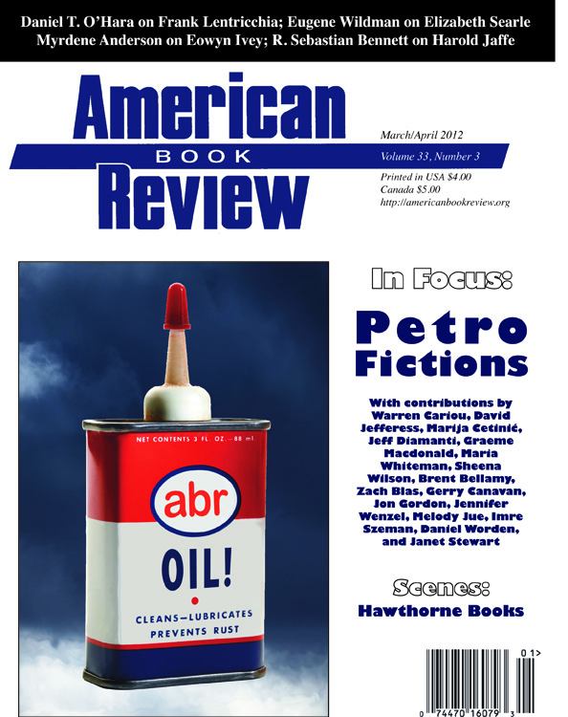

Slide 5
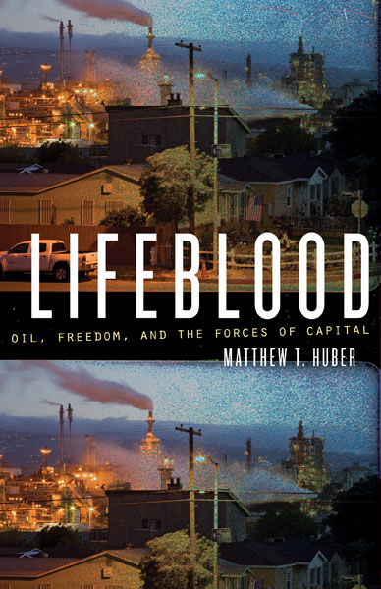
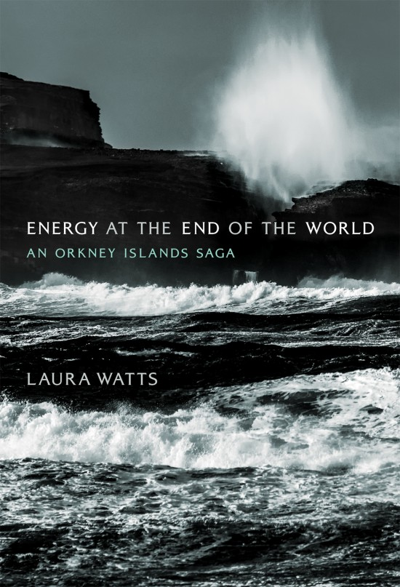

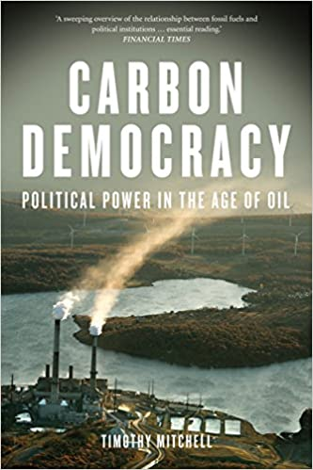
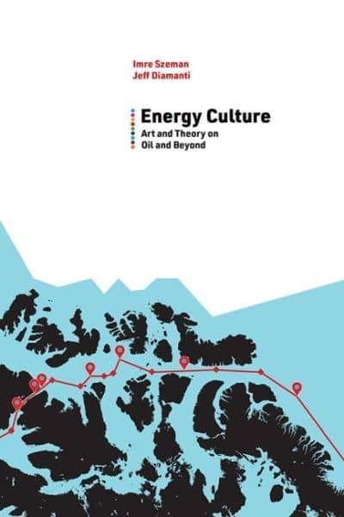
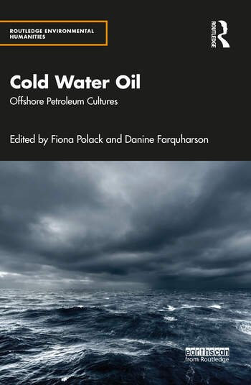
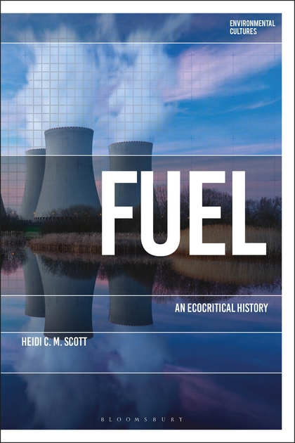
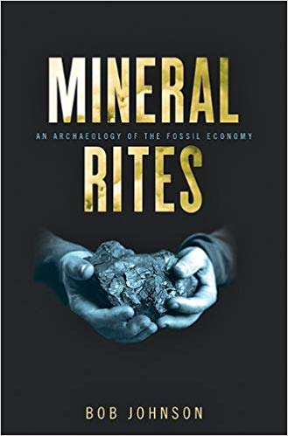
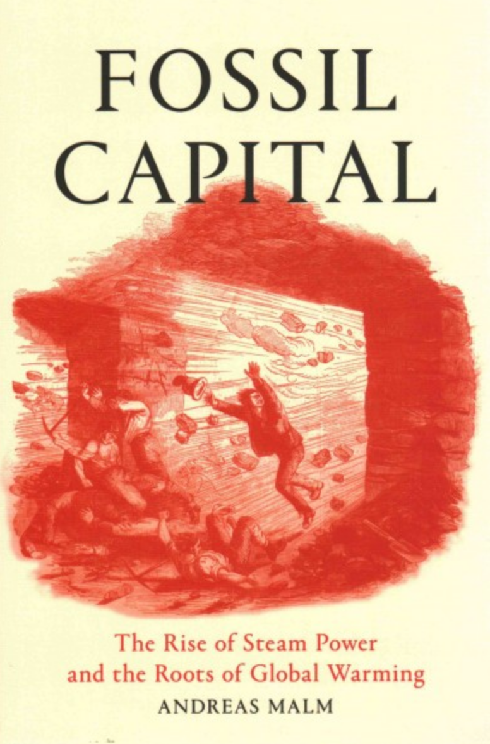
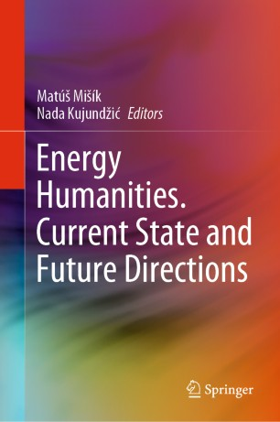
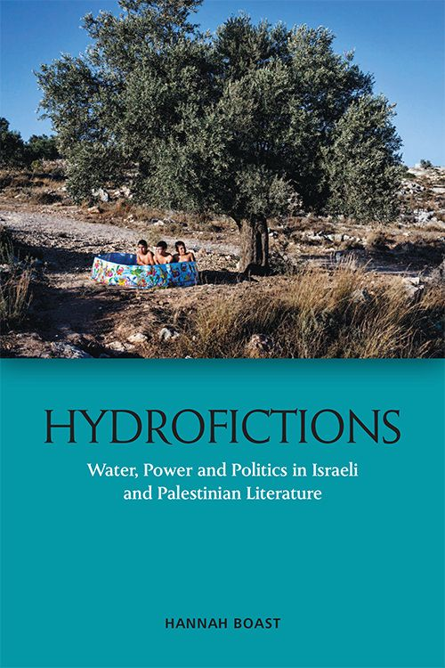
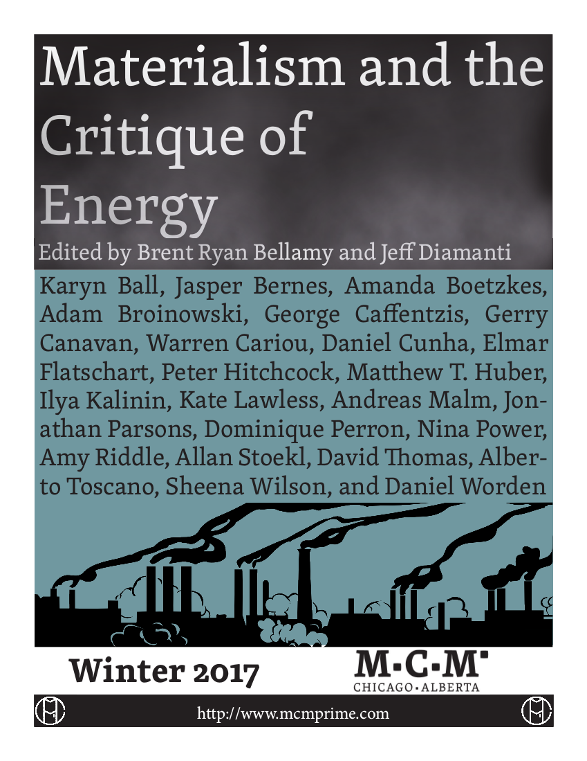

Slide 6

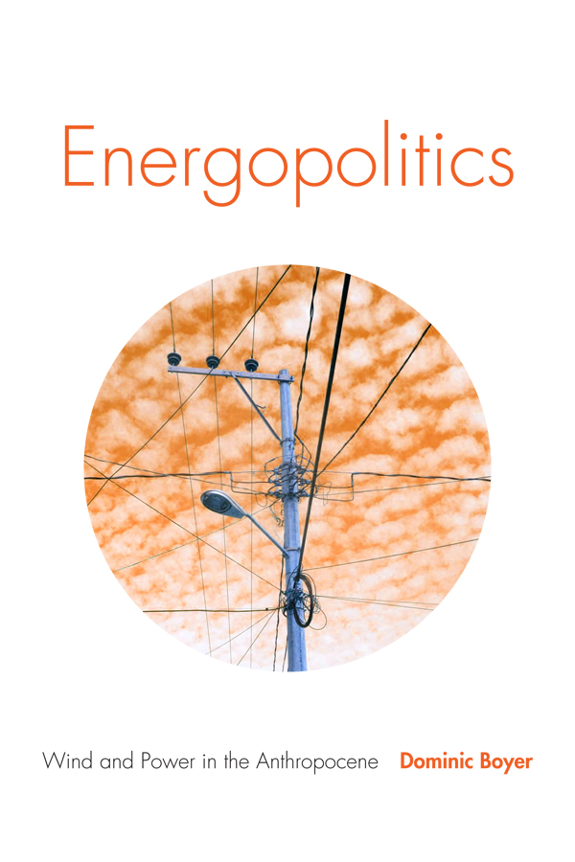

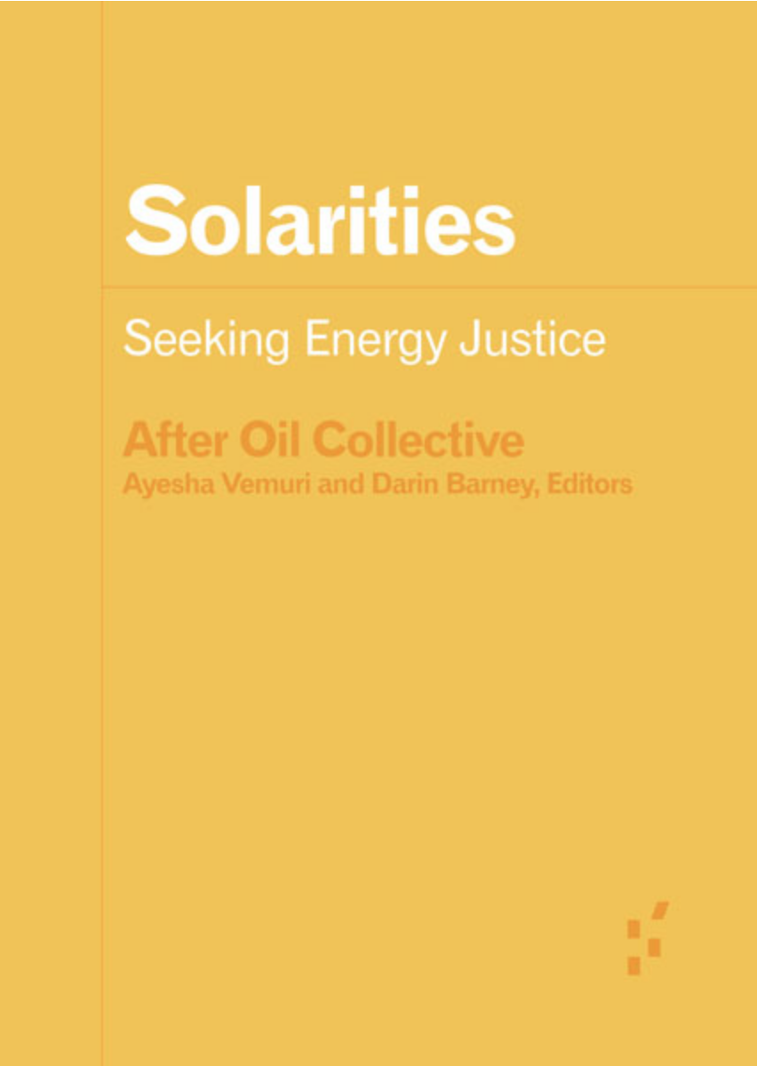
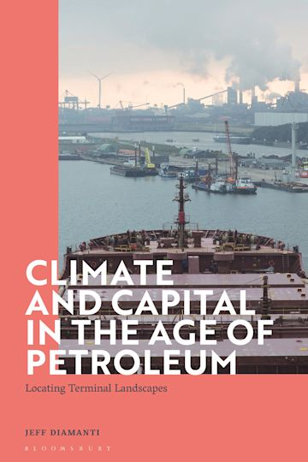
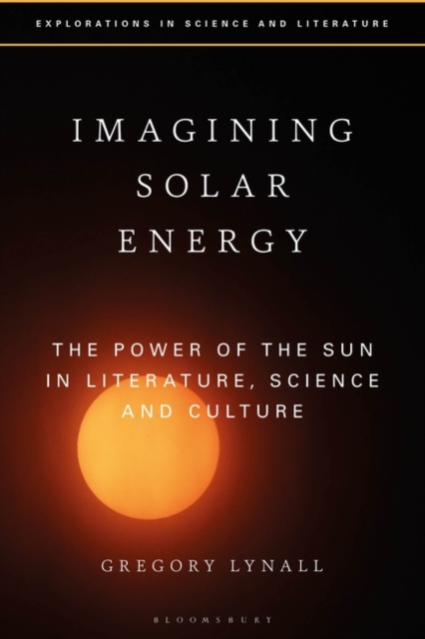
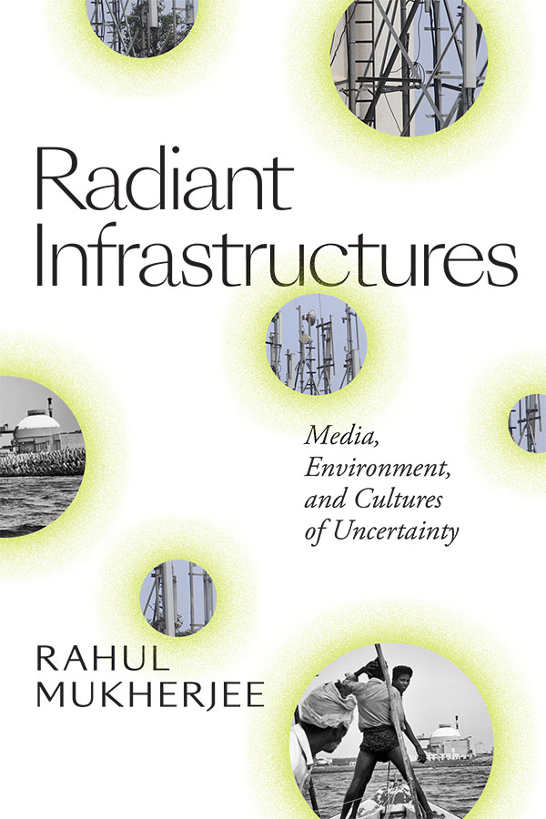

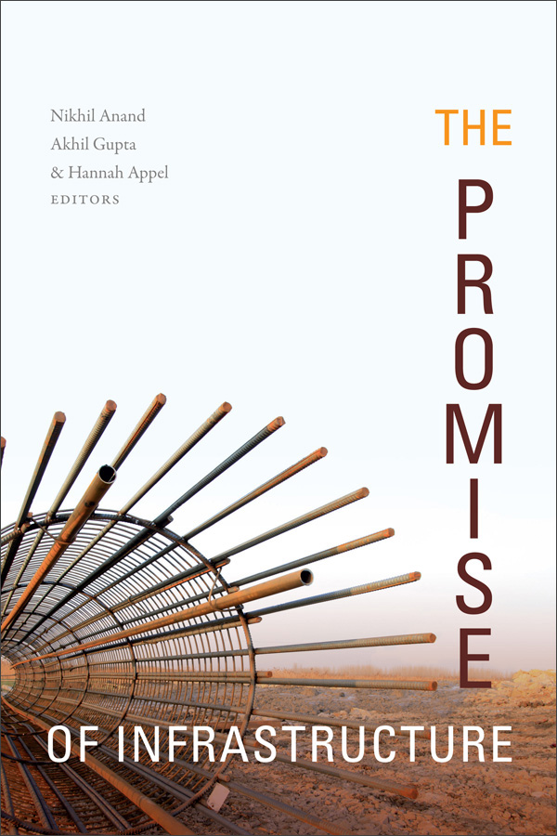

Slide 7
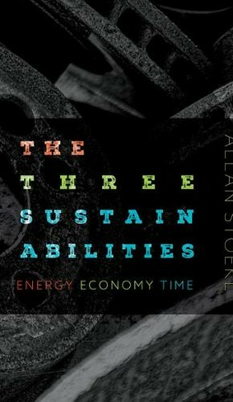
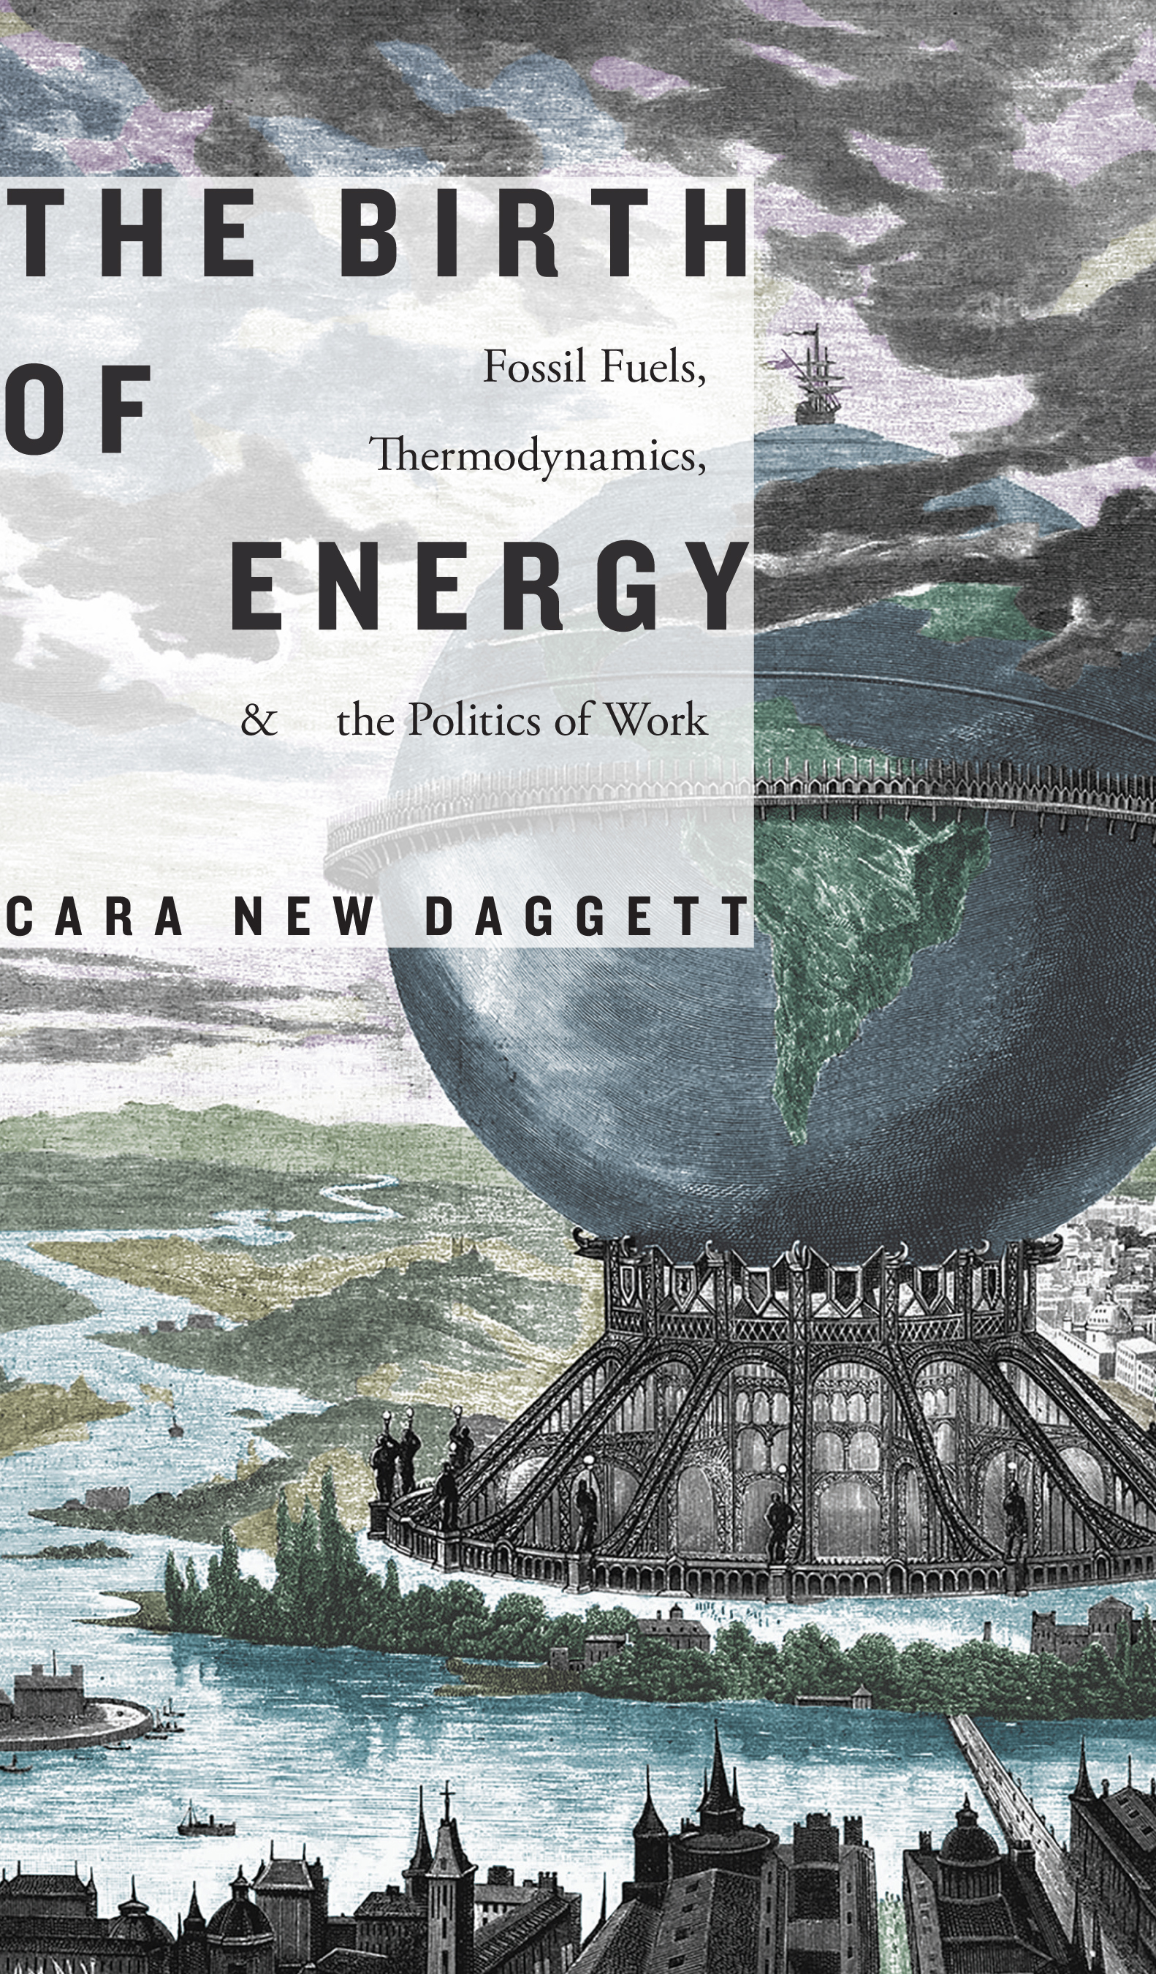


Slide 8
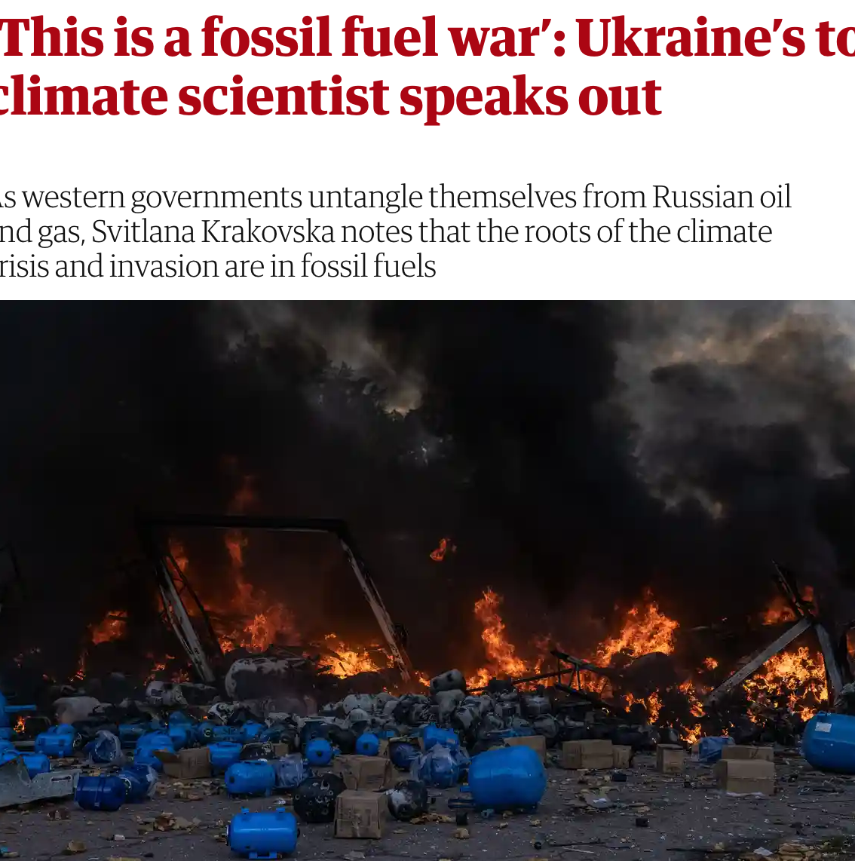


Slide 9
What is oil culture? (And are there cultures, more than one?) Along with that, and perhaps conditioning it: How are oil and culture conjoined? What is it for oil to be cultural? And culture to be oily? Why is oil culture and its fragmentation in cultures so fundamentally important?
Allan Stoekl, “Foreword” to Oil Culture, eds. Ross Barrett and Daniel Worden (Minneapolis: University of Minnesota Press, 2014), p. xi.

Slide 10
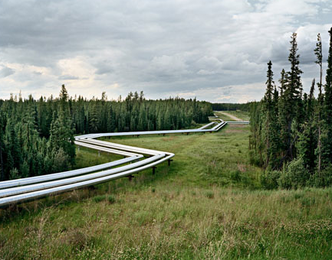
Ed Burtynsky, “Oil Fields #22, Cold Lake Production Project, Cold Lake, Alberta, Canada, 2001.”

Slide 11
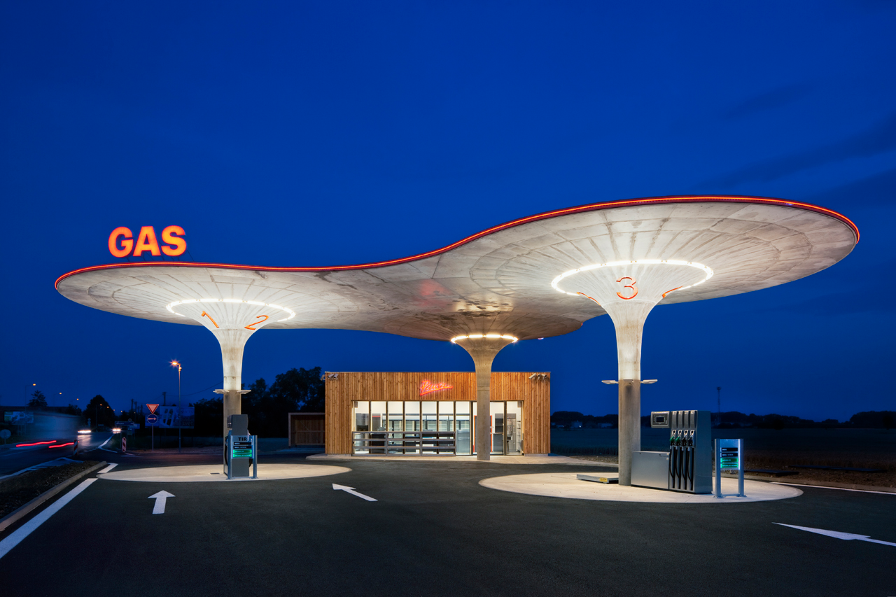

Slide 12
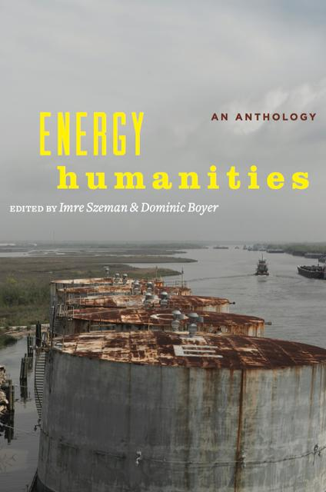
Some energo-cultural questions:
“How might we use the critical insights provided by research in energy humanities to develop a different relationship to energy, to fossil fuels?”(Boyer & Szeman)
What happens if we put “energy” in the mix? What role does “energy” play in literary and cultural texts?
How is “energy” cultural/social?
What does culture and its texts do with energy – and how is this related to the natural environment/ecocriticism?
What does it mean to ‘embody’ energy?
How does culture represent energy, how does it define it, narrate it, visualise it, characterise it, broadcast it, etc.?
How do we access/see/feel/produce “energy” through our reading of such “natural/social” representations?
What literary/cultural genre, if any, best represents the energy “trilemma”?

Slide 13

The night darkened as Selver went, until even his nightseeing eyes saw nothing but masses and planes of black. It began to rain. He had gone only a few miles from Cadast when he must either light a torch, or halt. He chose to halt, and groping found a place among the roots of a great chestnut tree. There he sat, his back against the broad, twisting boal that seemed to hold a little sun-warmth in it still. The fine fine rain, falling unseen in darkness, pattered on the leaves overhead, on his arms and neck and head protected by their silk-fine hair, on the earth and ferns and undergrowth nearby, on all the leaves of the forest, near and far. Selver sat as quiet as the grey owl on a branch above him, unsleeping, his eyes wide open in the rainy dark. 43-44

Slide 14
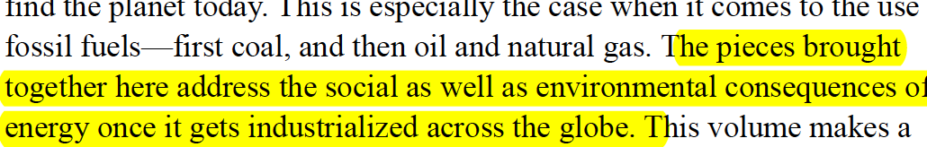
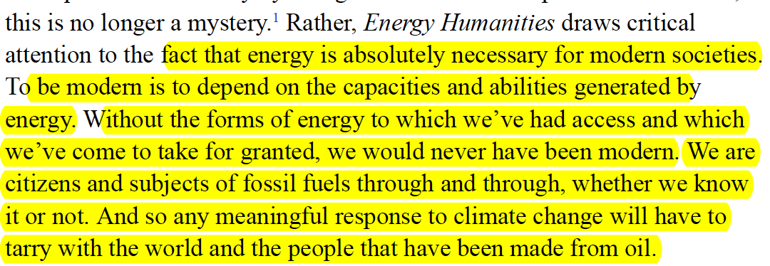
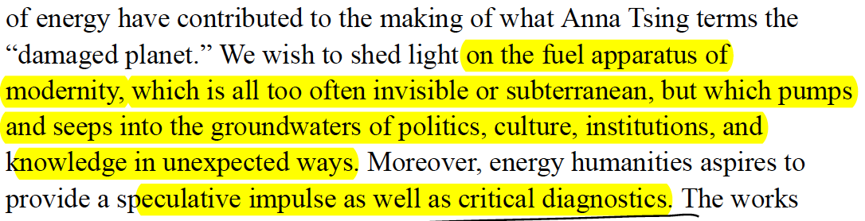

Slide 15
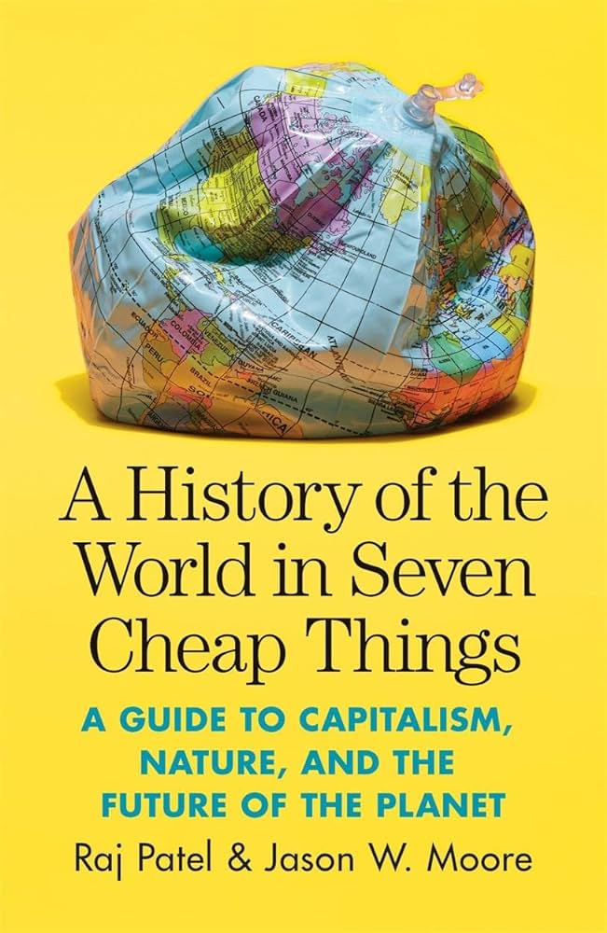
“Capitalism’s ecology has a distinctive pyrogeography.”
People have been fighting for centuries over the fuel and
construction material that wood can become. It’s
worth mentioning all this because it’s too often forgotten that
capitalism’s energy revolution began not with coal but with
wood—and with the privatization that forest enclosure implies. 165
The reason to look at energy in Europe lies in the different
use of fuel—a kind of cheap nature—as an intrinsic part of capitalism’s
ecology. Cheap energy is a way of amplifying—and in
some cases substituting for—cheap work and care. If cheap food
is capitalism’s major way of reducing the wage bill, cheap energy
is the crucial lever to advance labor productivity. 165
In this chapter we explore how energy became one of capitalism’s
cheap things through energy revolutions in Europe and
the Americas, and what cheap energy means for the twenty-first
century’s global ecology. Energy qualifies as a “thing” insofar as
it is transformed from part of the web of life into a commodity
to be bought and sold…capitalism’s energy system does several tasks
at once. It makes both energy and inputs cheaper: cheap coal makes
cheap steel; cheap peat makes for cheap(er) bricks. This reduces the
costs of doing business and enhances profitability.

Slide 16
“Earth needs wood. Needs it bad.”
“Get enough humans here, build machines and robots, make farms and cities...the dark forests cut down for open fields of grain.”
“….clean sawn planks, more prized on Earth than gold. Literally, because gold could be got from seawater and from under the Antarctic ice, but wood could not; wood came only from trees. And it was a really necessary luxury on earth. So the alien forests became wood.”
The Word for World is Forest

Slide 17
“Maybe he could send them back to Central in exchange for some fuel. You give me two, three tanks of gas and I’ll give you two, three warm bodies, loyal soldiers, good loggers, just your type, a little far-gone in bye-bye dreamland….”

Slide 18

This book is an archaeology of the present. It unearths a buried set of
stories about the origins of modern life that center on the pivotal, if sublimated,
role that fossil fuels have played in the growth of capitalism and in
fueling our affective attachments to modernity. It recovers, in this respect,
a genealogy of the modern self, one oriented to a postcarbon future, by
demonstrating how our bodies, minds, identity, nature, reason, and faith are
energized by, given life by, an infrastructure of carbon flows where we are
fleshed out in everyday mineral rites, fossilized rituals, that imbue our sinews
with muscle memory, provide material for our imagination and senses,
and shape our expectations about being fully human in the twenty-first century.
In short, this book proposes an alternative history of modernity that
returns our attention to the dialectic of materiality and consciousness, body
and affect, that has taken shape under the terms of fossil combustion during
the past two hundred years—or, to push the matter further, under the terms
of “fossil capitalism” during that time. (1)

Slide 19
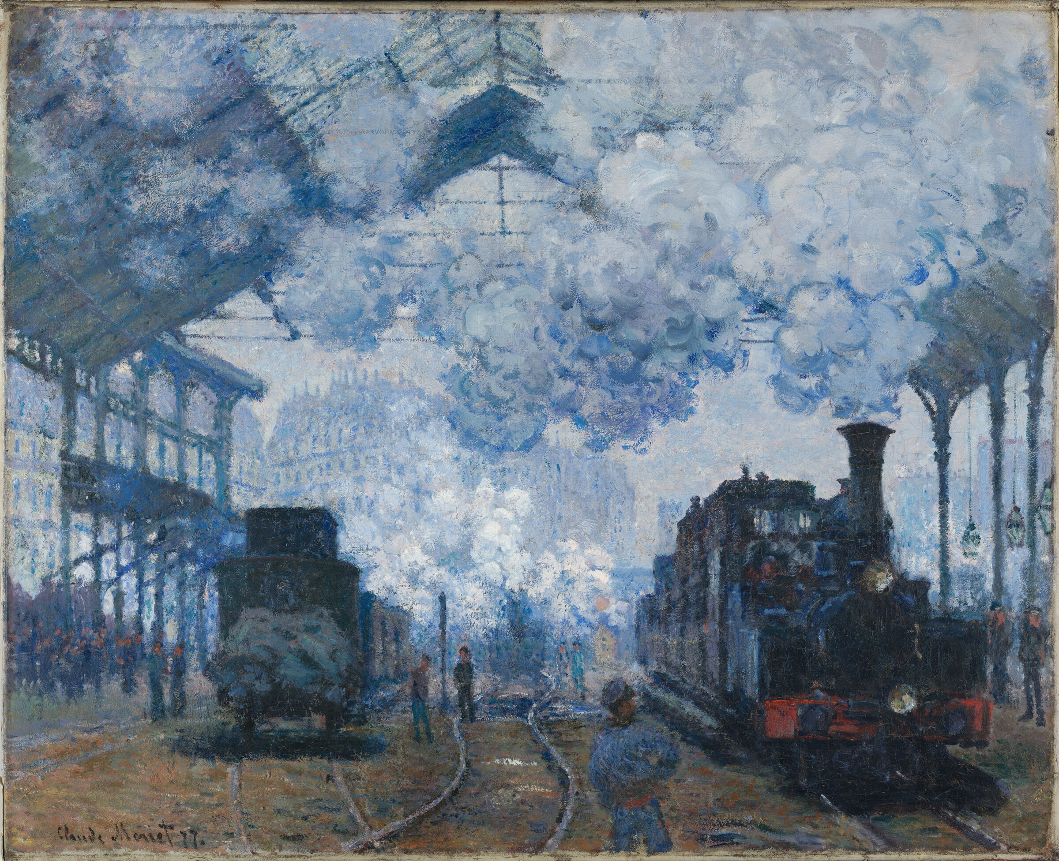
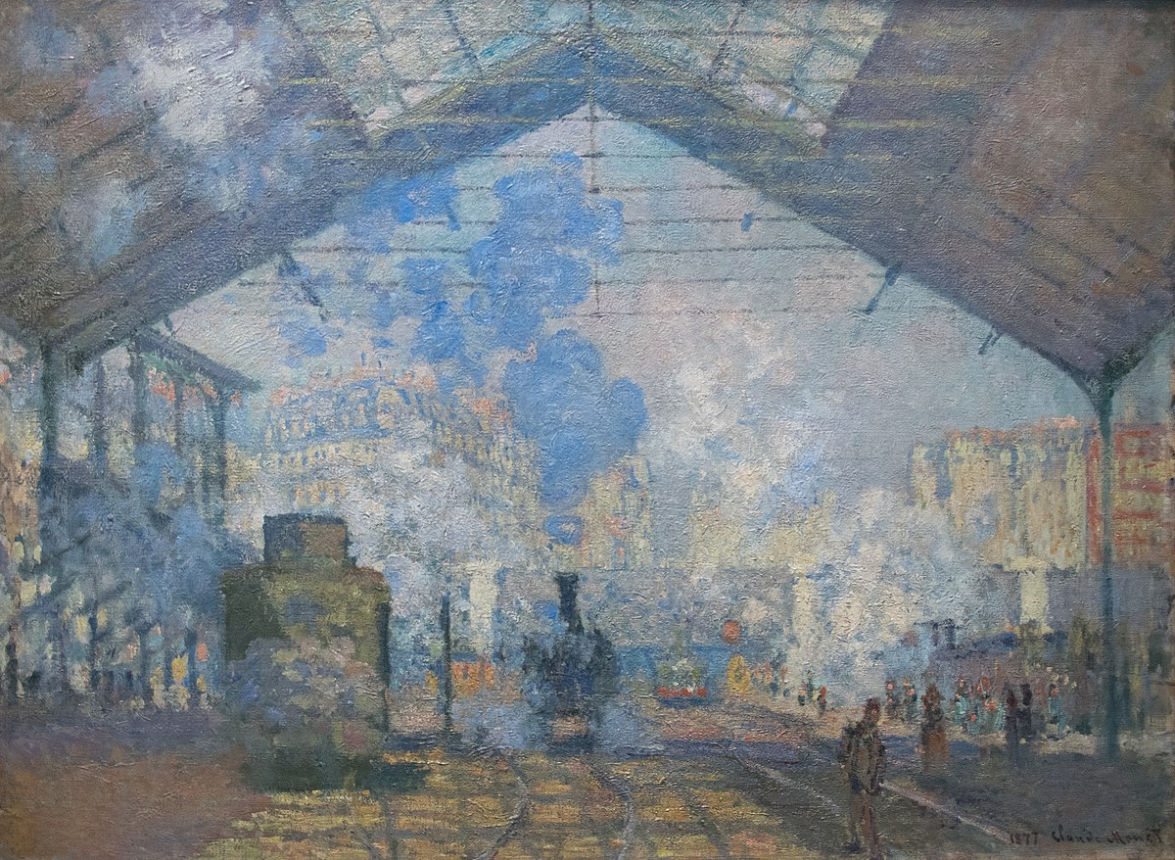
Monet, Gare Saint-Lazare, 1877

Slide 20

“The Energy Unconscious…..”
This Editor’s Column peruses the relation between energy resources and literature. Instead of divvying up literary works into hundred-year intervals (or elastic variants like the long eighteenth or twentieth century) or categories harnessing the history of ideas (Romanticism, Enlightenment), what happens if we sort texts according to the energy sources that made them possible?
What happens if we rechart literary periods and make energy sources a matter of urgency to literary criticism? What happens if we think systematically about how… texts relate to energy sources across time and space?
Patricia Yaeger, “Editor’s Column: Literature in the Ages of Wood, Tallow, Coal, Whale-Oil, Gasoline, Atomic Power and Other Energy Sources.” PMLA 126.2 (2011): 305–10.

Slide 21
Finally, the essays in this book strike a different, even uncanny, register
of the human experience under fossil capital. They do that by breathing life
back into modernity’s ontological empire, by resuscitating a repressed body—
its layers of sense, affect, emotion, touch, sentiment—that otherwise gets
buried in the world’s official business and all but disappears from its historiographical
record. That is, the following essays touch down here and there
on the elusive and yet bone-deep domain of infrapolitics where modern bodies
are charged by carbon, where they feel the warmth of its heat, the chill of
its absence in the blood, the eroticism of its automobility, wind in the hair,
sun through the window, and the drip of its sweat deep down in the boiler
rooms and back alleys of the world. Such attention to affect—to a feel for the
world—is reinforced stylistically in these essays by a parallel challenge to
the depersonalized rhetoric of academic writing. These essays challenge, at
least periodically, what can be too-precious of a commitment to the fiction
of detachment that while vital to our labor and profession can at times become
a hindrance to communication, understanding, and audience. (14-15)
Our erotic attachments to fossil fuels are ultra deep, to repurpose a phrase
used by critics of deep-water drilling. They are rooted in minutia, in the intimate quotidian rituals of the home, workplace, streets, and stores, and
such unlikely spaces as the boudoir, the lavatory, and the yoga studio. Fossil fuels compose time and space in the modern world and they leave an imprint on our emotional, aesthetic, and sensory lives. (17)

Slide 22
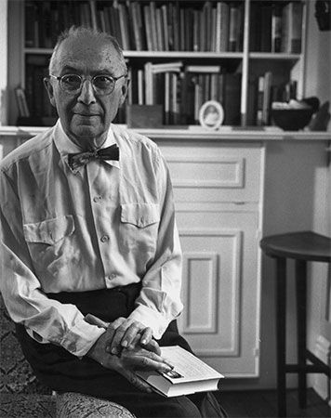
The Red Wheelbarrow
so much depends
upon
a red wheel
barrow
glazed with rain
water
beside the white
chickens
(1923)
This Is Just To Say
I have eaten
the plums
that were in
the icebox
and which
you were probably
saving
for breakfast
Forgive me
they were delicious
so sweet
and so cold
(1934)
William Carlos Williams

Slide 23
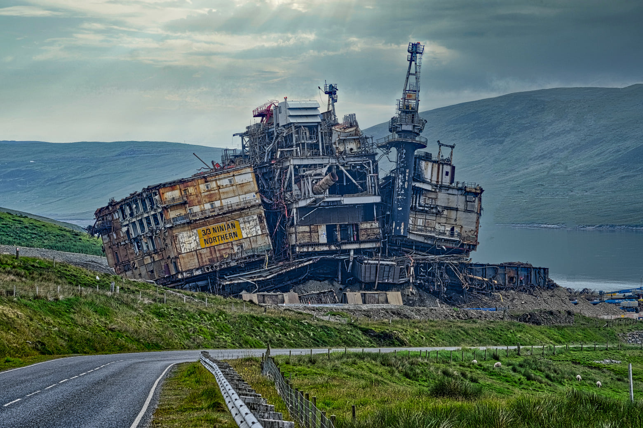

Slide 24
Why is cheap oil so important? It’s not that capitalism can’t
do without fossil fuels. After all, retailers and manufacturers
don’t care if their electricity comes from ancient fossils, windmills, or solar panels. Cheap oil is so important because today’s capitalists don’t wish to support the kinds of massive investment that would make a solar transition possible. Clearly, some businesses will cash in on various renewable energy initiatives. It is, however, hard to believe that all of the world’s businesses will pitch in the forty-five trillion dollars necessary for a large-scale conversion to renewables by 2050.

Slide 25

Hayao Miyazaki
Howl’s Moving Castle
(2003)

Slide 26
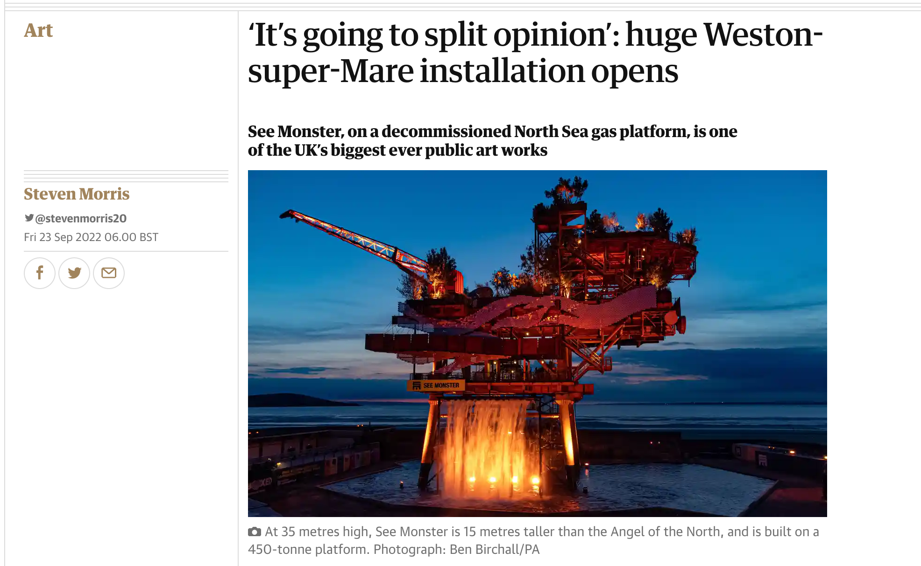

Slide 27
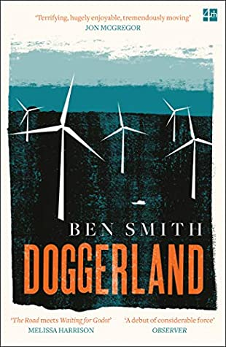
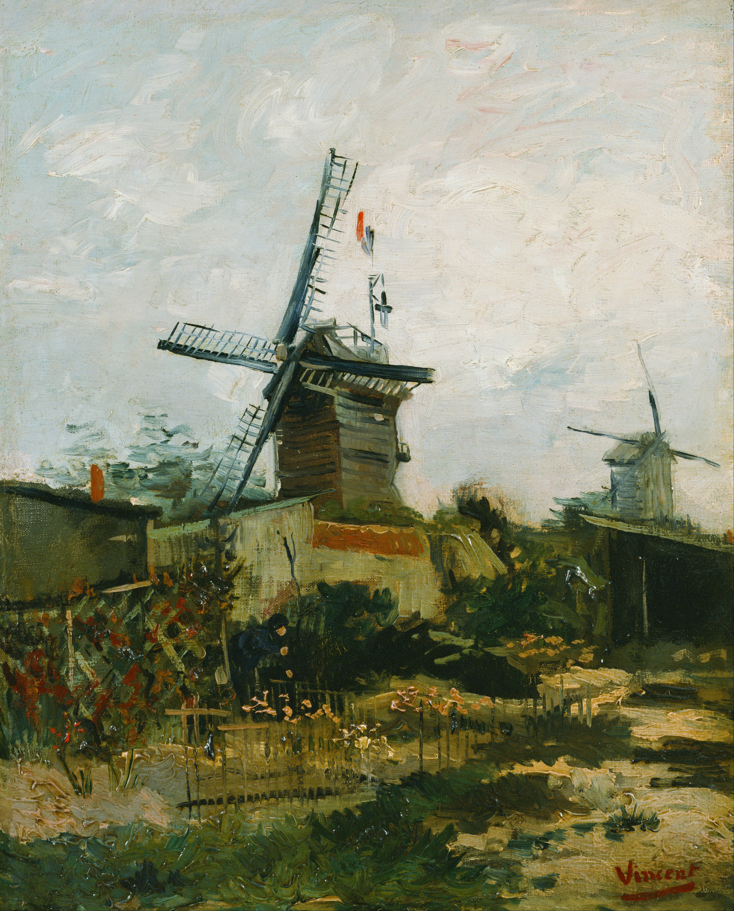

Slide 28
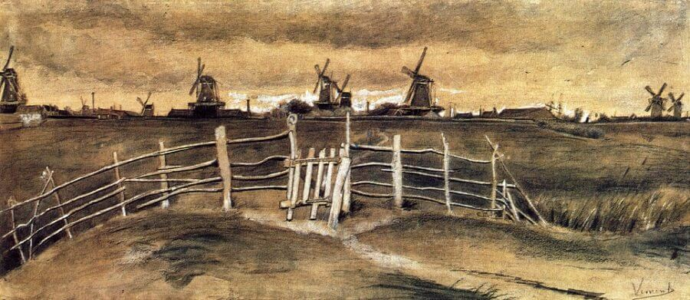
Vincent Van Gogh, Windmills at Dordrecht (sketch)

Slide 29
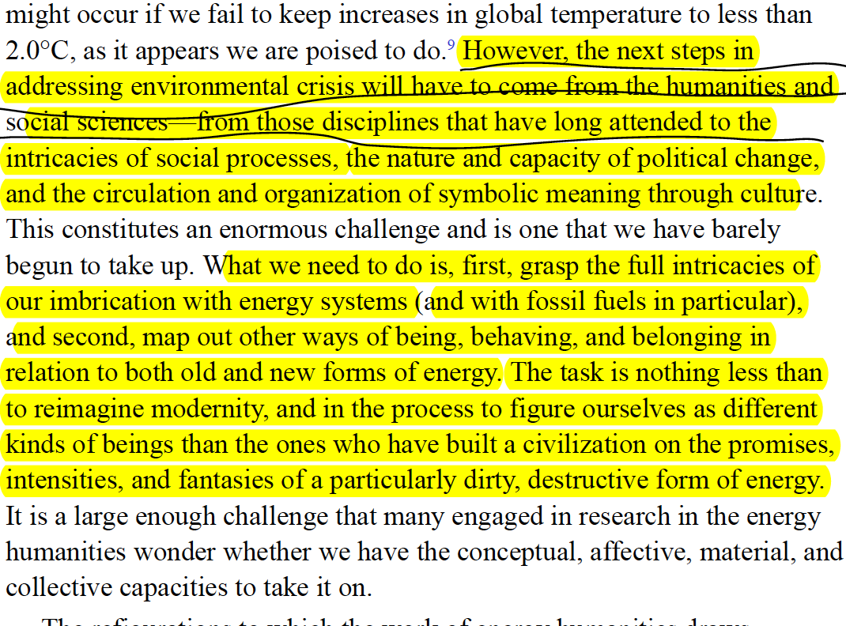

Slide 30
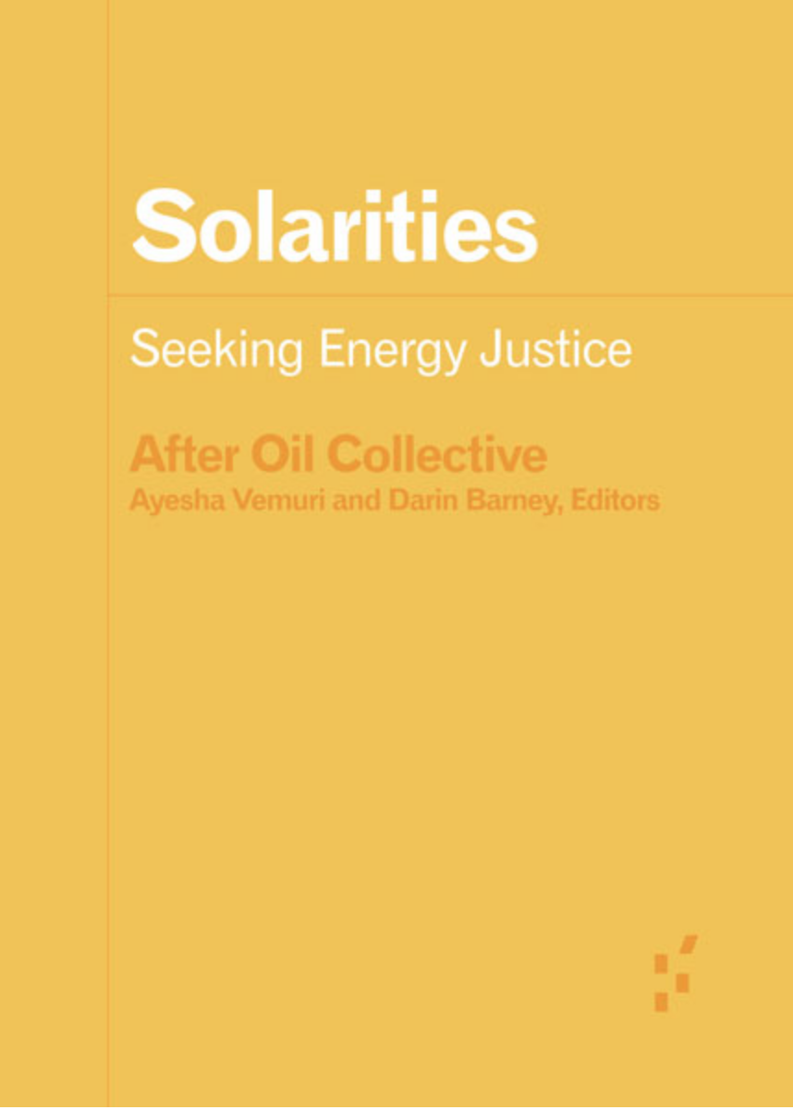
Solarities are orientations to the energy of the sun.
These orientations also imply terrestrial relationships,
including relationships to lands, minerals, waters,
animals and people, relationships that are mediated by
and materialized in infrastructure. What will the
infrastructures of solarity be? What will they be made of,
and what will they make of us? One of the imaginaries
attached to solar energy is that, in its universal
availability and infinite supply, it does not require
the sorts of mediation necessary for energy to become
fuel. This is precisely what makes it “imaginary.”
An orientation that approaches the sun as a source
of unlimited energy, capable of saving the planet by
replacing fossil-fuels, necessarily implies
infrastructural mediation with specific material
implications.
University of Minnesota Press, Forerunners Series, 2022
(Open Access)

Slide 31
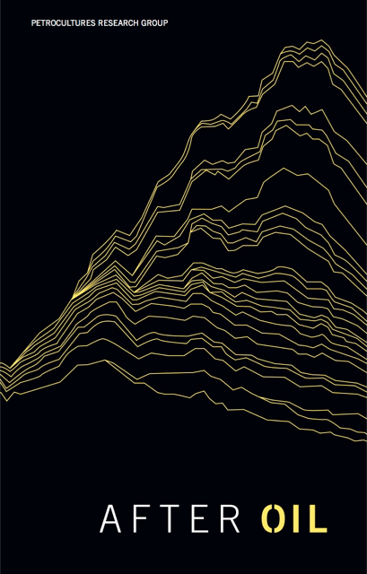
We will not make an adequate or democratic transition to a world after oil without first changing how we think, imagine, see, and hear [transition] is an “imaginative” exercise, with distinct roles played by words, images, and performances.
Petrocultures Research Group: After Oil (2016)
(www.afteroil.ca)

Slide 32
Solarity, then, requires a reckoning with our material and affective attachments to the present. For those of us in the overdeveloped world living lives of hyperconsumption, shame, guilt, and anger are often our first emotional responses to the climate crisis. Solarity asks for much more: it demands a radical hope as well as a radical reassessment of what, of the present, we might wish to retain as we attempt to rescue our future.
The promise of solarity’s redistribution must contend not only
with the temporal and spatial logics of the sun’s radiation but also
with the forms of technological and infrastructural mediation required
to convert solar energy into electrical energy. It also requires
us to overcome decades of negative campaigning by the many-tentacled
arms of the fossil fuel complex, from media to politics, that have not
only consistently emphasized—falsely and heinously—its material limits
but also preposterously claimed it as destructive to industry, environment,
and even health.

Slide 33
But today, this desire cannot be disentangled from an impetus to
overturn the prevailing energy order and its coextensive injustices.
Petroculture is premediating the way solarity unfolds. The utopian
aspirations of solarity will be informed by global oil’s history
of social and environmental exploitation. In other words, while
solarity might supplant the petrocultural regime, it is also at risk
of succumbing to its slow violence and necropolitics. What seems
certain is that the transition to solarity will be messy, incomplete,
and unevenly distributed.
What will solarity mean if a primary use of the sun as fuel is to power
air conditioners that make it possible (for some) to withstand the sun’s
relentless heat? The desire for infinite and limitless energy seems,
in many ways, too deeply intertwined with capitalist obsessions
with limitless growth that have ignored the needs of the many in
favor of serving the greed of the few. Can the desire for infinite energy
be disentangled from these extractive and oppressive histories of
unfettered growth?
An abundant energy transition would untether our visions of the
good life from narratives of growth and private accumulation and
mobilize behind equitable sharing of energy as a collective good.

Slide 34
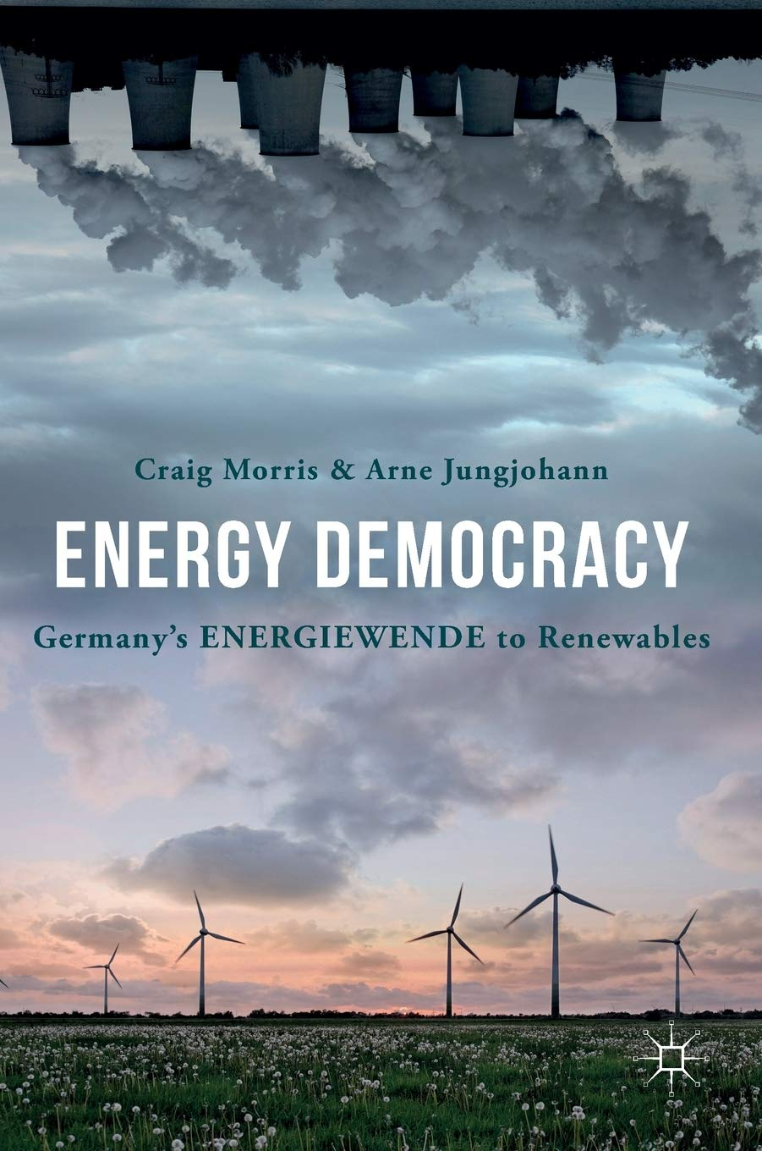
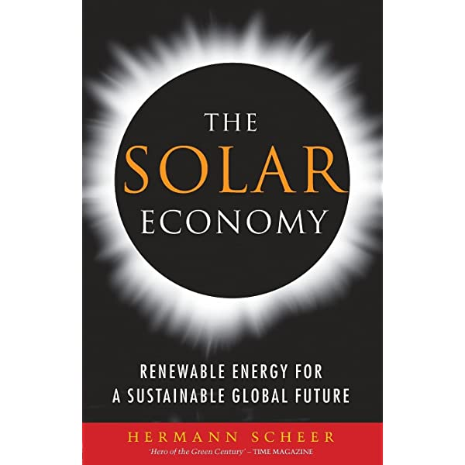
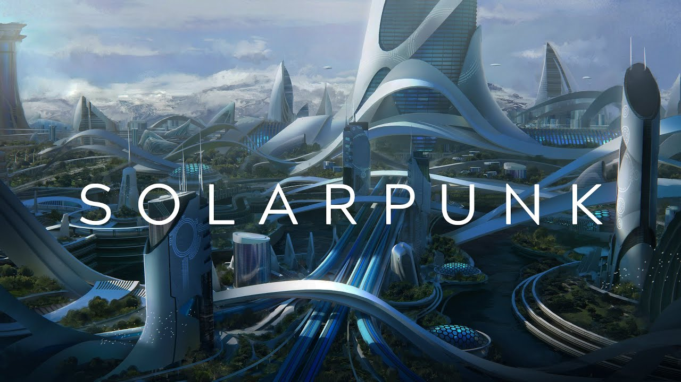

Slide 35


Slide 36
We can detect this bright depiction of “solar power” in the
popular image bank of solarity. A quick internet search for “solar
power,” for example, presents standard images of large-scale
Farms and arrays tending toward an aesthetics of gleaming futurity and
industrial-scale possibility. The future is bright and upscaled in such
visions. [Jamie] Cross’s warning, however, of the reality of “green dystopias”
has powerful representative examples in some solar imaginaries.

Slide 37
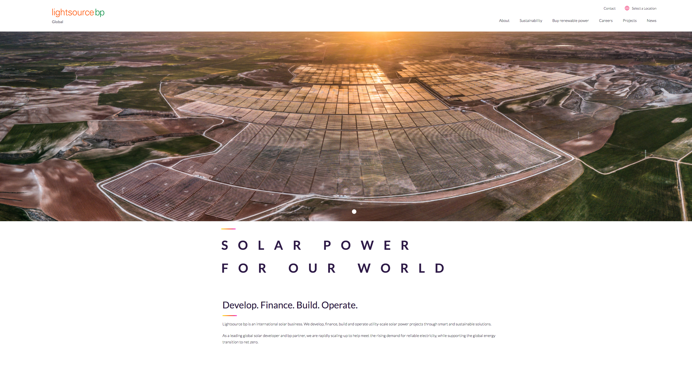

Slide 38
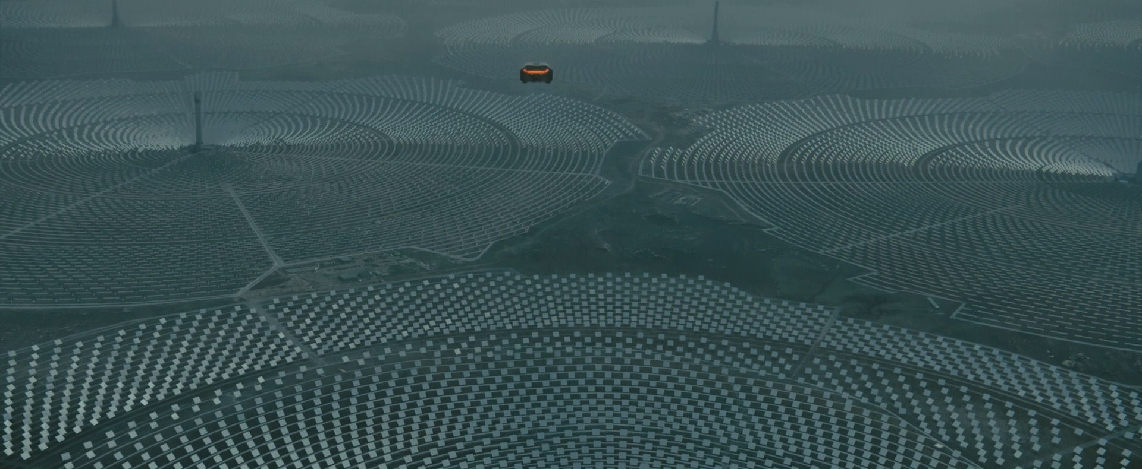
“A resource aesthetic may be mere ideological cover for appropriation and exploitation—
that “improvement” in its myriad senses is the friendly face of ruthless extractivism.”
Jennifer Wenzel, “Afterword, Improvement and Overburden”, Postmodern Culture (2016)

Slide 39
We don’t know yet how to live in solarity; we are not, and don’t
know how to be, solar subjects. The world that would produce such
a subject has not (yet) come into being. That leaves us in a position of
radical insecurity, where our knowledges, embedded in practice and
habit and tradition, concretized in our infrastructures, articulated
in our politics, are insufficient, improper, polluted, and polluting.
Solarity confronts us with the challenge of learning to live and do and
think and love again, to hold ourselves askance to the world
we knew, to estrange ourselves from both the world we know and
ourselves, to begin to be differently and to build differently.
A key difficulty here is the willed relinquishing of expertise. We
have learned how to successfully be in the world.

Slide 40

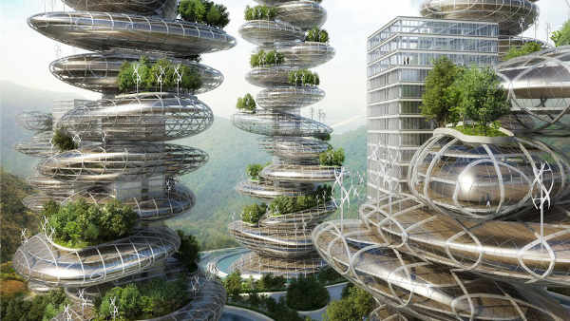
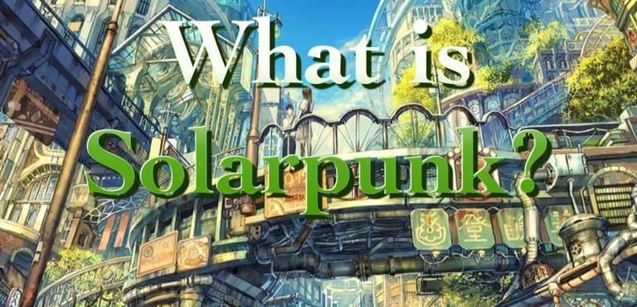

Slide 41


Slide 42
What makes speculating about energy futures productive is that it highlights all the more powerfully the political fantasies in which literature currently indulges.
What if after energy surplus comes deficit? How might literature respond to a future of less rather than more?
We can only speculate, for even in the genre that deals with the future – science fiction – there are strikingly few examples of cultures of less…lack of energy is found only in postapocalyptic scenarios – cautionary tales about where our fiction of surplus might lead.
Imre Szeman, “Literature and Energy Futures”, PMLA

Slide 43


