Slide 1
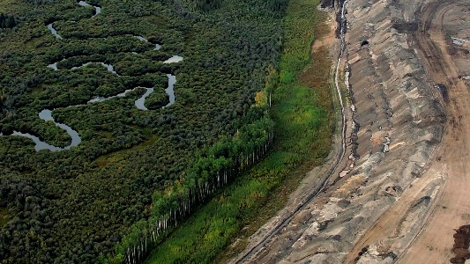
Critical Environments
Week 2
Questioning Nature/Questioning Environments

Slide 2
Some ‘ecocritical’ questions:
What role does “nature” play in cultural texts; in culture generally?
What does culture and its texts do with nature and the natural environment?
How does culture/cultural production represent nature, how does it define it, narrate it, visualise it, characterise it, broadcast it, etc.?
How do we understand/access/see/feel/produce “nature” through our reading of such “natural” representations?
What literary/cultural form or genre, if any, best represents nature/ecology?

Slide 3
“When we say nature, do we mean to include ourselves?”
(Williams)
“The separation [between man and nature] is a function of increasing real interaction.”
(Williams)
“I would prefer to speak of a contrast between what might be termed ‘nature-endorsing’ and
‘nature-sceptical’” (Soper)
“It is one thing to challenge various cultural representations of nature, another to represent
nature as if it were a convention of culture.” (Soper)
“There can be no adequate attempt, that is, to explore ‘what nature is’ that is not centrally
concerned with what it has been said to be.” (Soper)
“‘Nature’ is in this sense both that which we are not and that which we are within.” (Soper)
“The environment is all around us…Where did it come from? (Warde et al)
“…who speaks for the environment. Which people are concerned about it? How do
people think about it? (Warde et al)
“…the environment was an idea that burst forth in a futurological soup…. a crisis concept,
” (Warde et al)

Slide 4
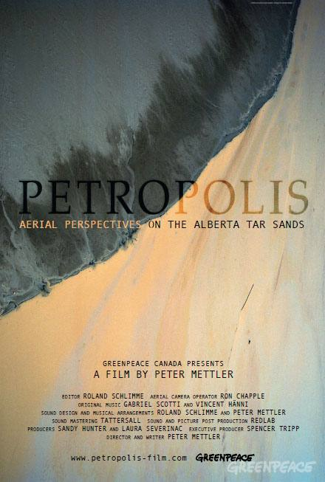
Petropolis (2010)

Slide 5
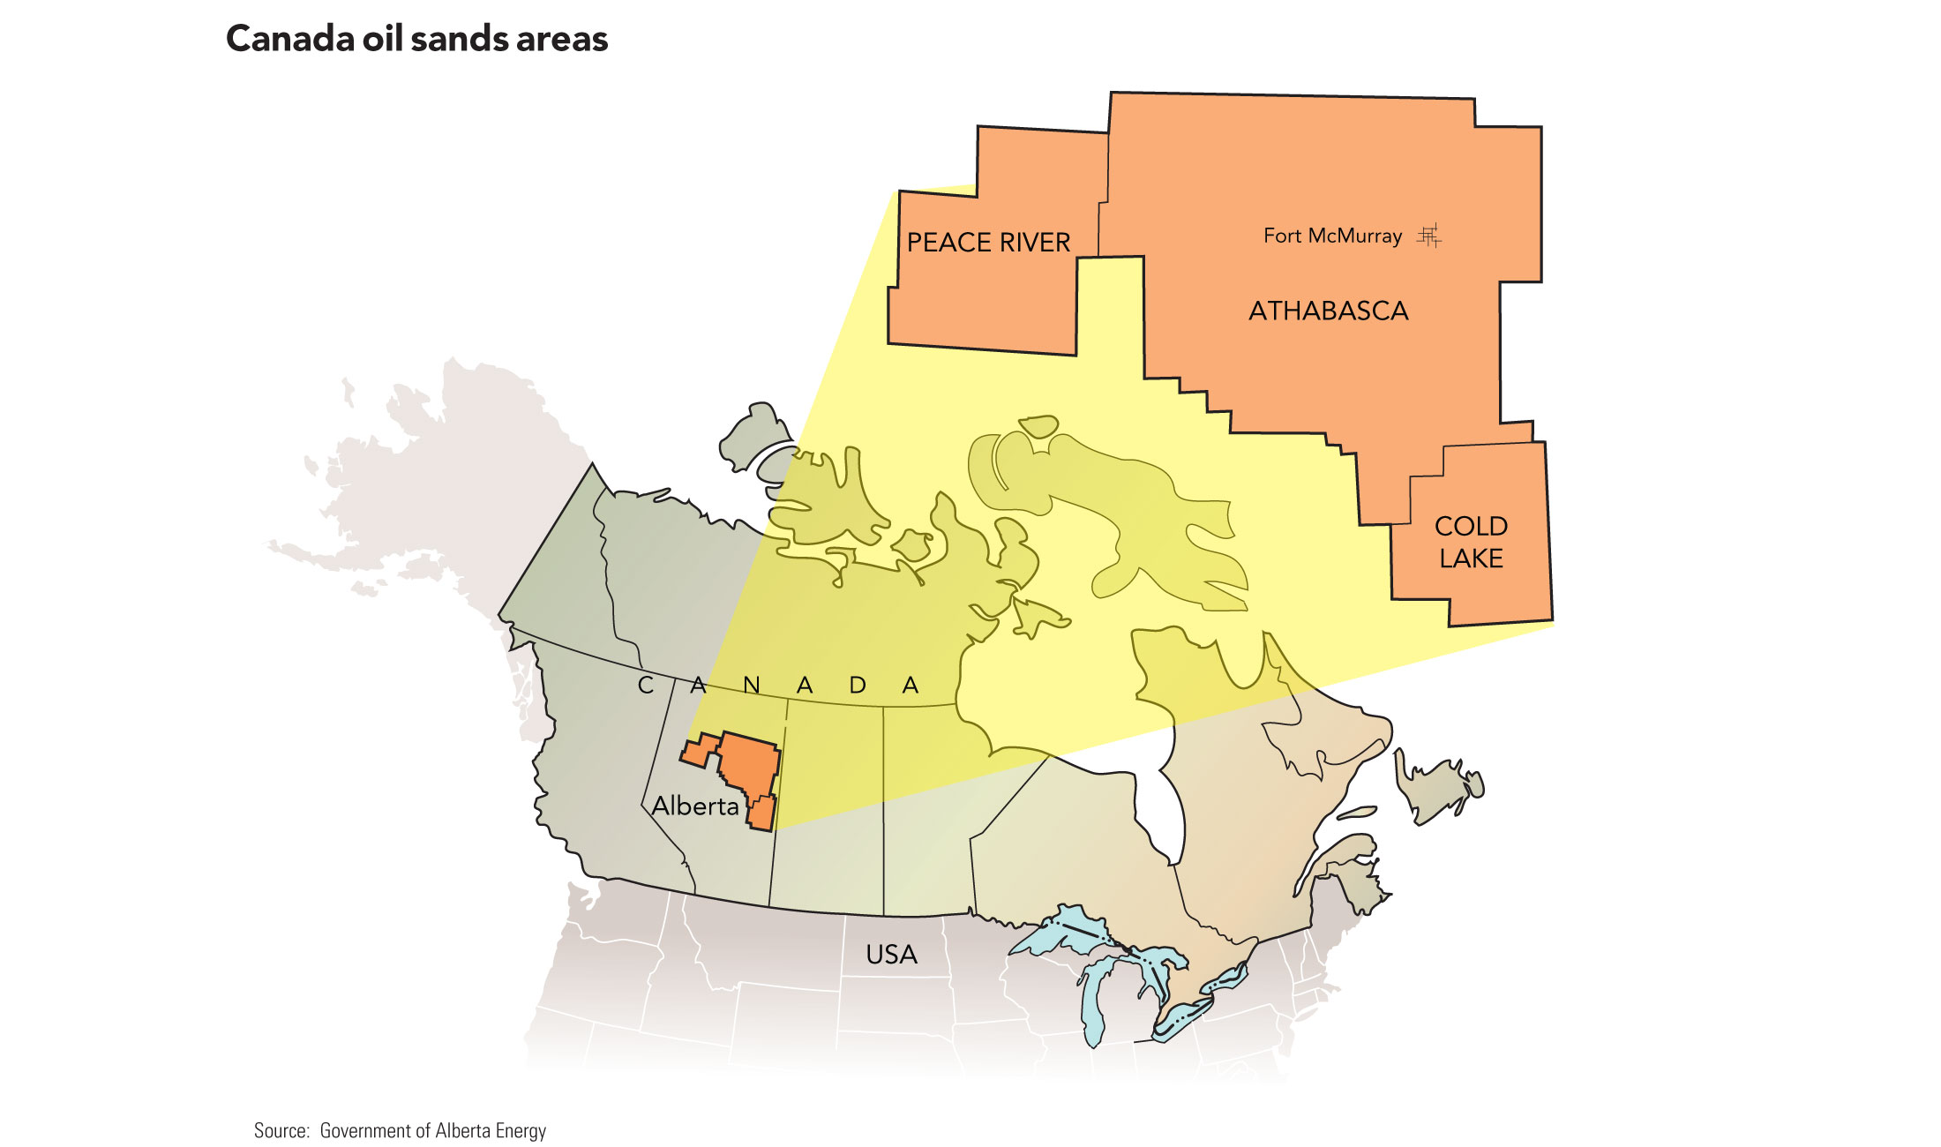

Slide 6
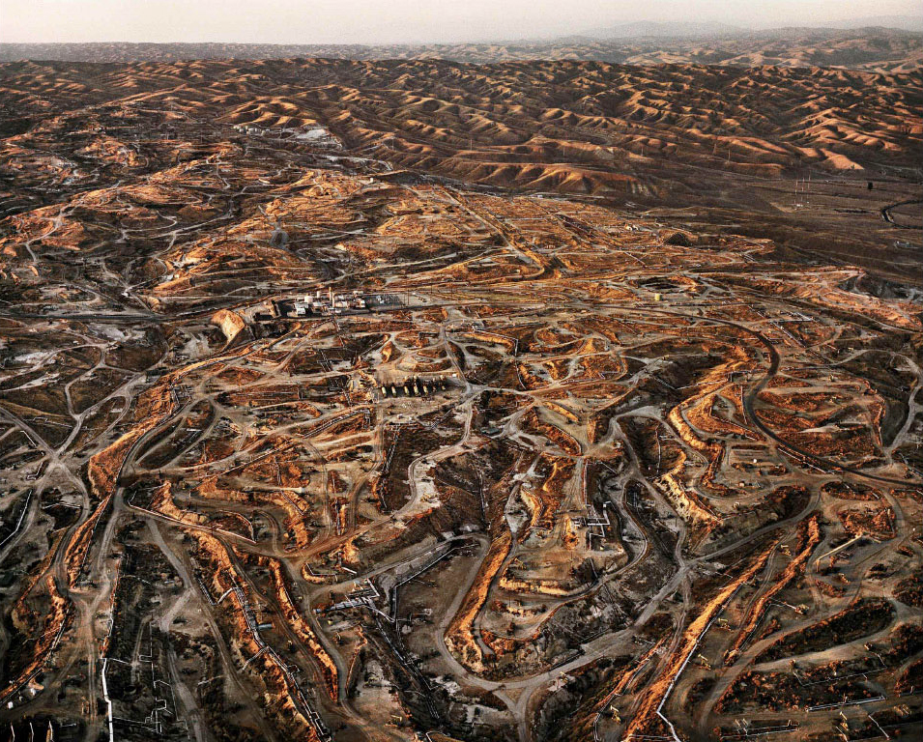

Slide 7
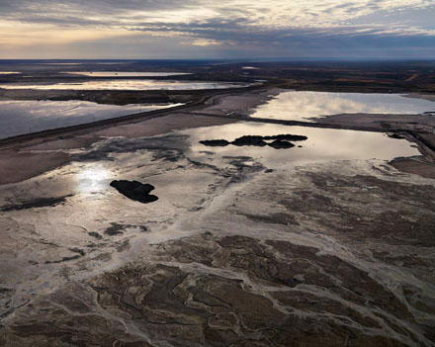

Slide 8
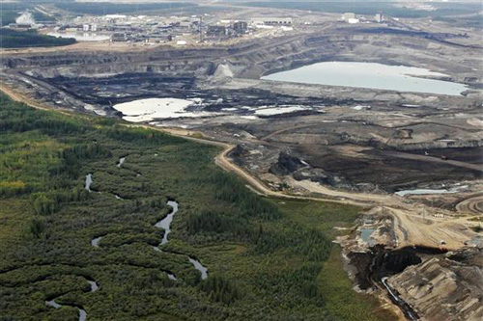
The Division of Nature and Culture?

Slide 9
“The argument can go either way, can be conservative or radical. But once we begin to speak of men mixing their labour with the earth, we are in a whole world of new relations between man and nature, and to separate natural history from social history becomes extremely problematic…. with applied science, the conscious intervention for human purposes. Agricultural improvement and the industrial revolution follow clearly from this emphasis, and many of the practical effects depended on seeing nature quite clearly and even coldly as a set of objects, on which men could operate…
Yet at just the first peak of this kind of activity another and now very popular meaning of nature emerged. Nature, in this new sense, was in another and different way all that was not man: all that was not touched by man, spoilt by man: nature as the lonely places, the wilderness.” Williams 76-77

Slide 10
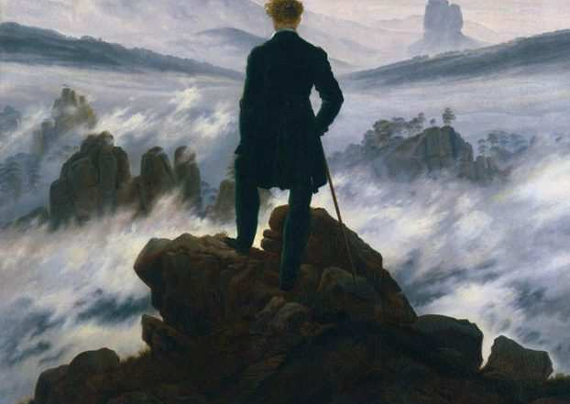
“Nature in any other sense than that of the improvers indeed fled to the margins: to the remote, the inaccessible, the relatively barren areas. Nature was where industry was not…. in Wordsworth and beyond him, there came the sense of nature as a refuge, a refuge from man; a place of healing, a solace, a retreat….. As the exploitation of nature continued, on a vast scale, and especially in the new extractive and industrial processes, the people who drew most profit from it went back, where they could find it (and they were very ingenious) to an unspoilt nature, to the purchased estates and the country retreats. And since that time there has always been this ambiguity in the defence of what is called nature, and in its associated ideas of conservation, in the weak sense, and the nature reserve.” Williams 81

Slide 11
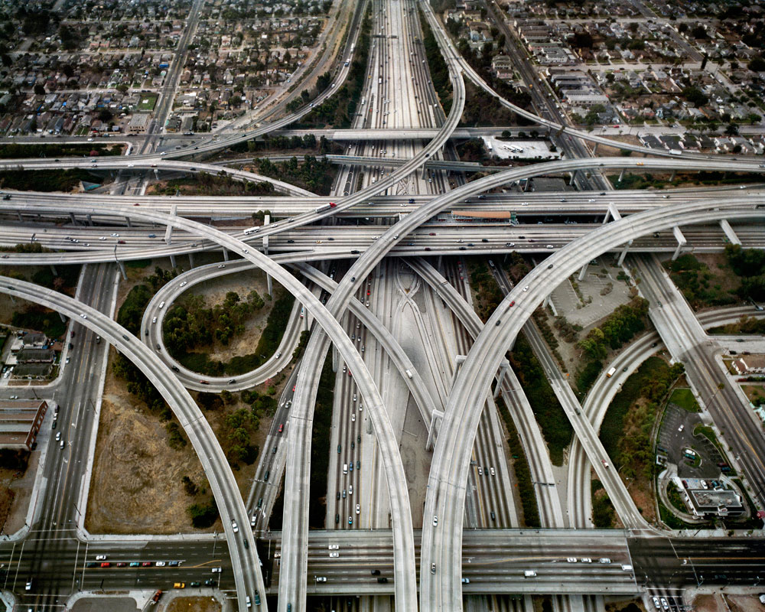
Furthermore, we ourselves are in a sense products: the pollution of industrial society is to be found not only in the water and in the air but in the slums, the traffic jams, and not these only as physical objects but as ourselves in them and in relation to them. In this actual world there is then not much point in counterposing or restating the great abstractions of Man and Nature. We have mixed our labour with the earth, our forces with its forces too deeply to be able to draw back and separate either out. Williams 83

Slide 12
We have to look at all our products and activities, good
and bad, and to see the relationships between them which are our own
real relationships. More clearly than anyone, Marx indicated this,
though still in terms of quite singular forces. I think we have to develop
that kind of indication. In industry, for example, we cannot afford to go
on saying that a car is a product but a scrapyard a by-product, any more
than we can take the paint-fumes and petrol-fumes, the jams, the
mobility, the motorway, the torn city centre, the assembly line, the time and-
motion study, the unions, the strikes, as by-products rather than the
real products they are. But then of course to express this we should need
not only a more sophisticated but a more radically honest accounting
than any we now have. It will be ironic if one of the last forms of the
separation between abstracted Man and abstracted Nature is an intellectual
separation between economics and ecology. It will be a sign that we
are beginning to think in some necessary ways when we can conceive
these becoming, as they ought to become, a single discipline. Williams 84

Slide 13
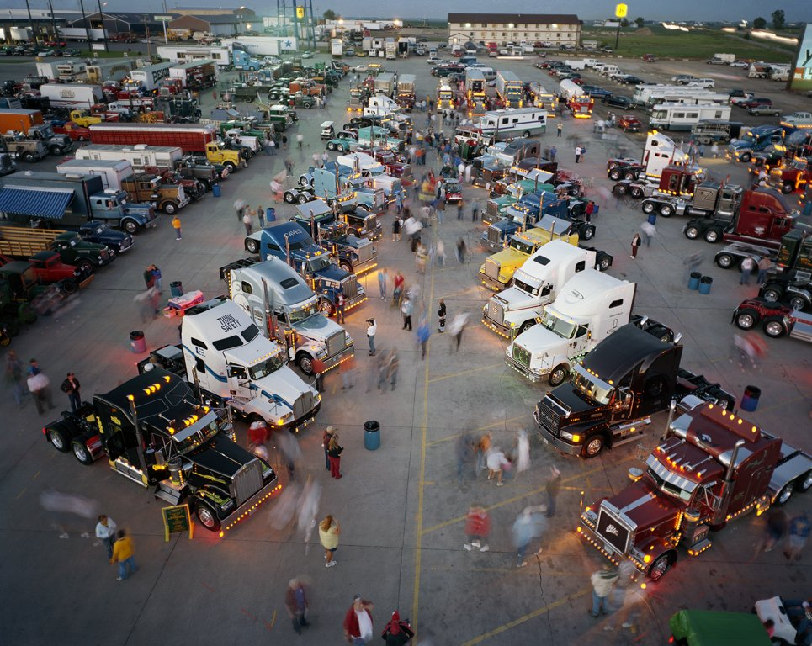

Slide 14


Slide 15
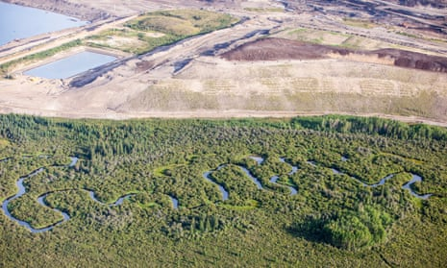
…one of the main divisions which can be drawn is between those ethical, political and aesthetic arguments that are constructed upon a view of culture as offering an essential corrective to ‘nature’ and those that view nature as releasing us from the repressions or deformations of culture and as itself a source of wisdom and moral guidance. Soper, 28
the Enlightenment sought to realize the inherent dignity of the individual as a self-motivating rational and moral being: the progressive development of
art, science and culture is thus viewed as the vehicle for the realization of a ‘human nature’ previously held in thrall to superstitious fears of ‘nature’ and
theological bigotry. In the Romantic reaction, which is profoundly influenced by Rousseau’s summons to attend to conscience as the ‘voice of nature’ within
us, the integrity of nature is counterposed to the utilitarianism and instrumental rationality through which the Enlightenment ideals were practically realized
and theoretically legitimated: the point is not to return to a past primitivity, but to discover in ‘nature’, both inner and outer, the source of redemption from
the alienation and depredations of industrialism and the ‘cash nexus’ deformation of human relations. Soper 29

Slide 16
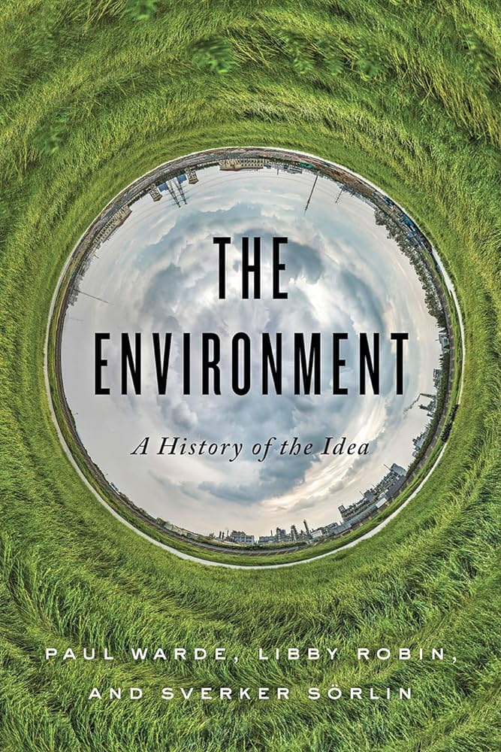
In the decades since [Chernobyl], ecologists have measured how wild
nature has responded and evolved in an area where people have been
excluded. A “new nature” has grown up in this place of catastrophe: it will
have a different future because of this moment. For many people ecologists
have been the key experts of the environment. Indeed, in some places,
people call the environment “the ecology.”
As we trace the environment from 1948 onward in history and into the
future, we find different experts are important at different times. (Warde et al)
So this is not so much a book about what the environment is as much as
it is about what humans have wanted to make of it. It is about the
imagination, the history, and the creativity of the experts, as well as their
technical and diplomatic skills, and how well ordinary people have
understood these and contributed to framing environmental concerns.
Expertise has moved popular opinion, business practices, and
understandings of the world, but only so far. Expertise has limits in the
political world. We all share the environment and have a say in what is
possible. Thus, the environment is a key concept: it drives conversations
about what it means to be human in the world on many scales. (Warde et al
)

Slide 17
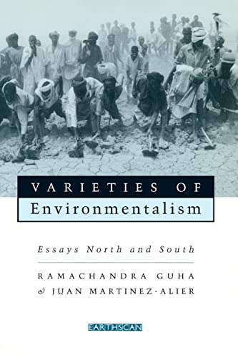
I begin with the origins of the environmental impulse in the two
contexts. Environmental movements in the North have, I think, been
convincingly related to the emergence of a post-materialist or post-industrial
society. The creation of a mass consumer society has not only time off work
to the most diverse uses. Nature is made accessible through
the car, now no longer a monopoly of the elite but an artefact in almost
everyone’s possession It is the car which, more than anything else, opens
up a new world, of the wild, that is refreshingly different from the worlds
of the city and the factory. In a curious paradox, this “most modern creation
of industry” becomes the vehicle of anti-industrial impulses, taking one to
distant adventures to “homey little towns, enchanting fairy tale forests, far
from stale routine, functional ugliness or the dictates of the clock. Guha and Martinez-Alier, 26
Here lies the source of popular support for the protection of wilderness in the
United States - namely, that nature is no longer restricted to the privileged
few, but available to all. 17

Slide 18
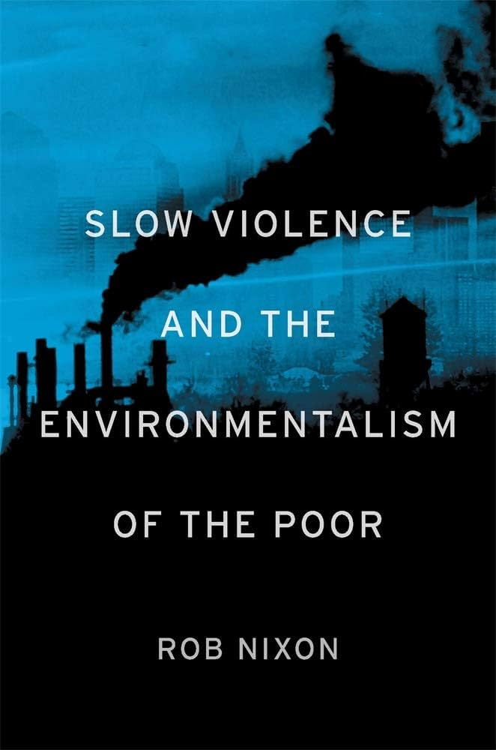
SLOW VIOLENCE
Often it is “slow catastrophes” that change the environment, working over
longer time periods. Droughts and famines, the acidification of the oceans
from agricultural chemicals, lead poisoning in children playing in areas
with lead paint are all disasters, but they evolve more slowly than the
human eye can see. (Warde et al)
Three primary concerns animate this book, chief among them my conviction
that we urgently need to rethink—politically, imaginatively, and
theoretically—what I call “slow violence.” By slow violence I mean a violence
that occurs gradually and out of sight, a violence of delayed destruction
that is dispersed across time and space, an attritional violence that is
typically not viewed as violence at all. Violence is customarily conceived as
an event or action that is immediate in time, explosive and spectacular in
space, and as erupting into instant sensational visibility. We need, I believe,
to engage a different kind of violence, a violence that is neither spectacular
nor instantaneous, but rather incremental and accretive, its calamitous
repercussions playing out across a range of temporal scales. In so doing,
we also need to engage the representational, narrative, and strategic challenges
posed by the relative invisibility of slow violence. Climate change,
the thawing cryosphere, toxic drift, biomagnification, deforestation, the
radioactive aftermaths of wars, acidifying oceans, and a host of other
slowly unfolding environmental catastrophes present formidable representational
obstacles that can hinder our efforts to mobilize and act decisively.
The long dyings—the staggered and staggeringly discounted casualties,
both human and ecological that result from war’s toxic aftermaths or climate
change—are underrepresented in strategic planning as well as in human memory.
A central question is strategic and representational: how can we convert into
image and narrative the disasters that are slow moving and long in the making,
disasters that are anonymous and that star nobody, disasters that are
attritional and of indifferent interest to the sensation-driven technologies of
our image-world? How can we turn the long emergencies of slow violence
into stories dramatic enough to rouse public sentiment and warrant political
intervention, these emergencies whose repercussions have given rise to
some of the most critical challenges of our time?

Slide 19
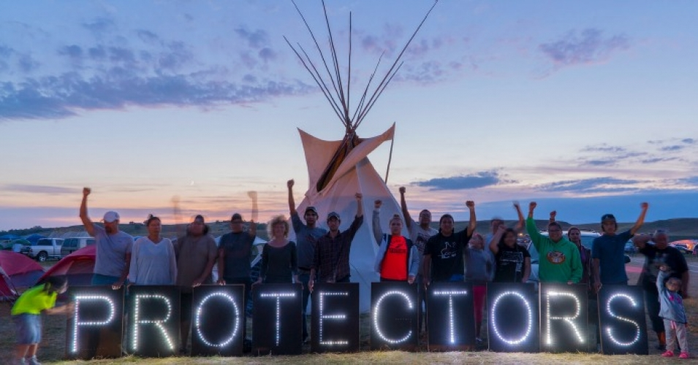

Slide 20
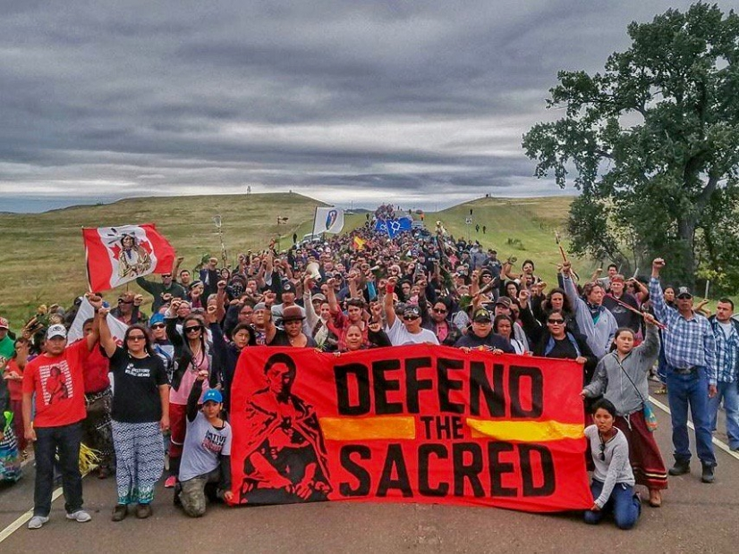

Slide 21


Slide 22
But in fact techniques of direct action have at the same time a utilitarian and an
expressive dimension. In adopting a particular strategy, social protesters are both
trying to defend their interests and passing judgement on the prevailing social arrangements.
The latter, so to say, ideological dimension of social protest needs to be inferred even when
it is not formally articulated - the fact that protesting peasants do not distribute a printed manifesto
does not mean that they do not have developed notions of right and wrong. In field or factory, ghetto or grazing ground, struggles over resources, even when they have tangible material origins, have always also been struggles over meaning. Thus my preference for the term “vocabulary of protest”.….
most forms of direct action, even if unaccompanied by a written manifesto, are both statements of purpose and of belief. In the act of doing, protesters are saying something too. Thus the Kithiko-Hachiko satyagraha was not simply an affirmation of peasant claims over disputed property: as
a strategy of protest, its aim was not merely to insist, “This land is ours”, but also, and equally significantly, to ask, “What are trees for?” Guha and Martinez-Alier, 13

Slide 23
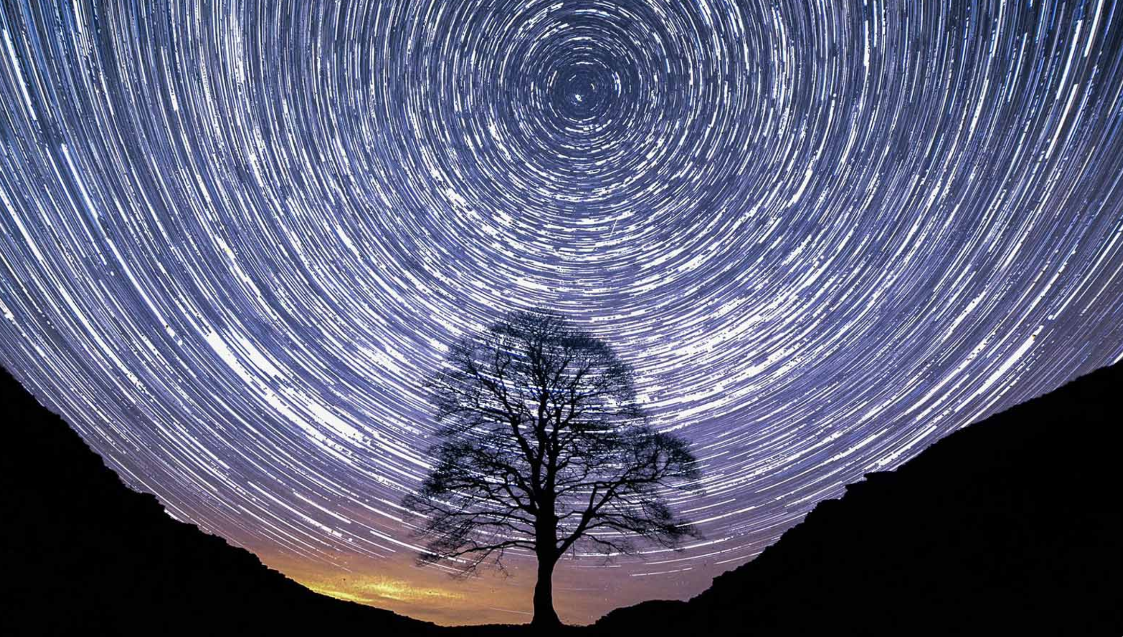

Slide 24
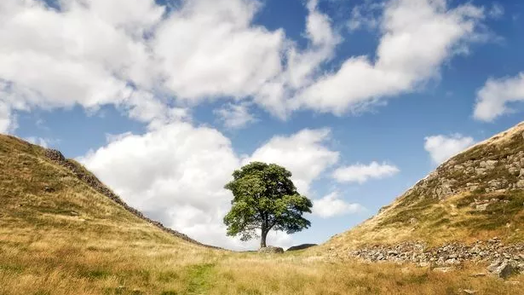
https://www.bbc.co.uk/sounds/play/p0ghlxrx

Slide 25
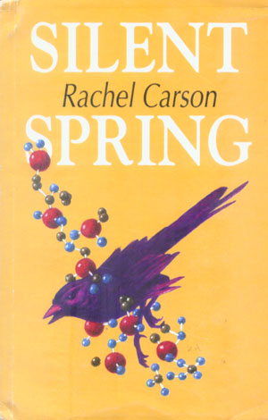
Rachel Carson, Silent Spring (1962)

Slide 26
