Slide 1
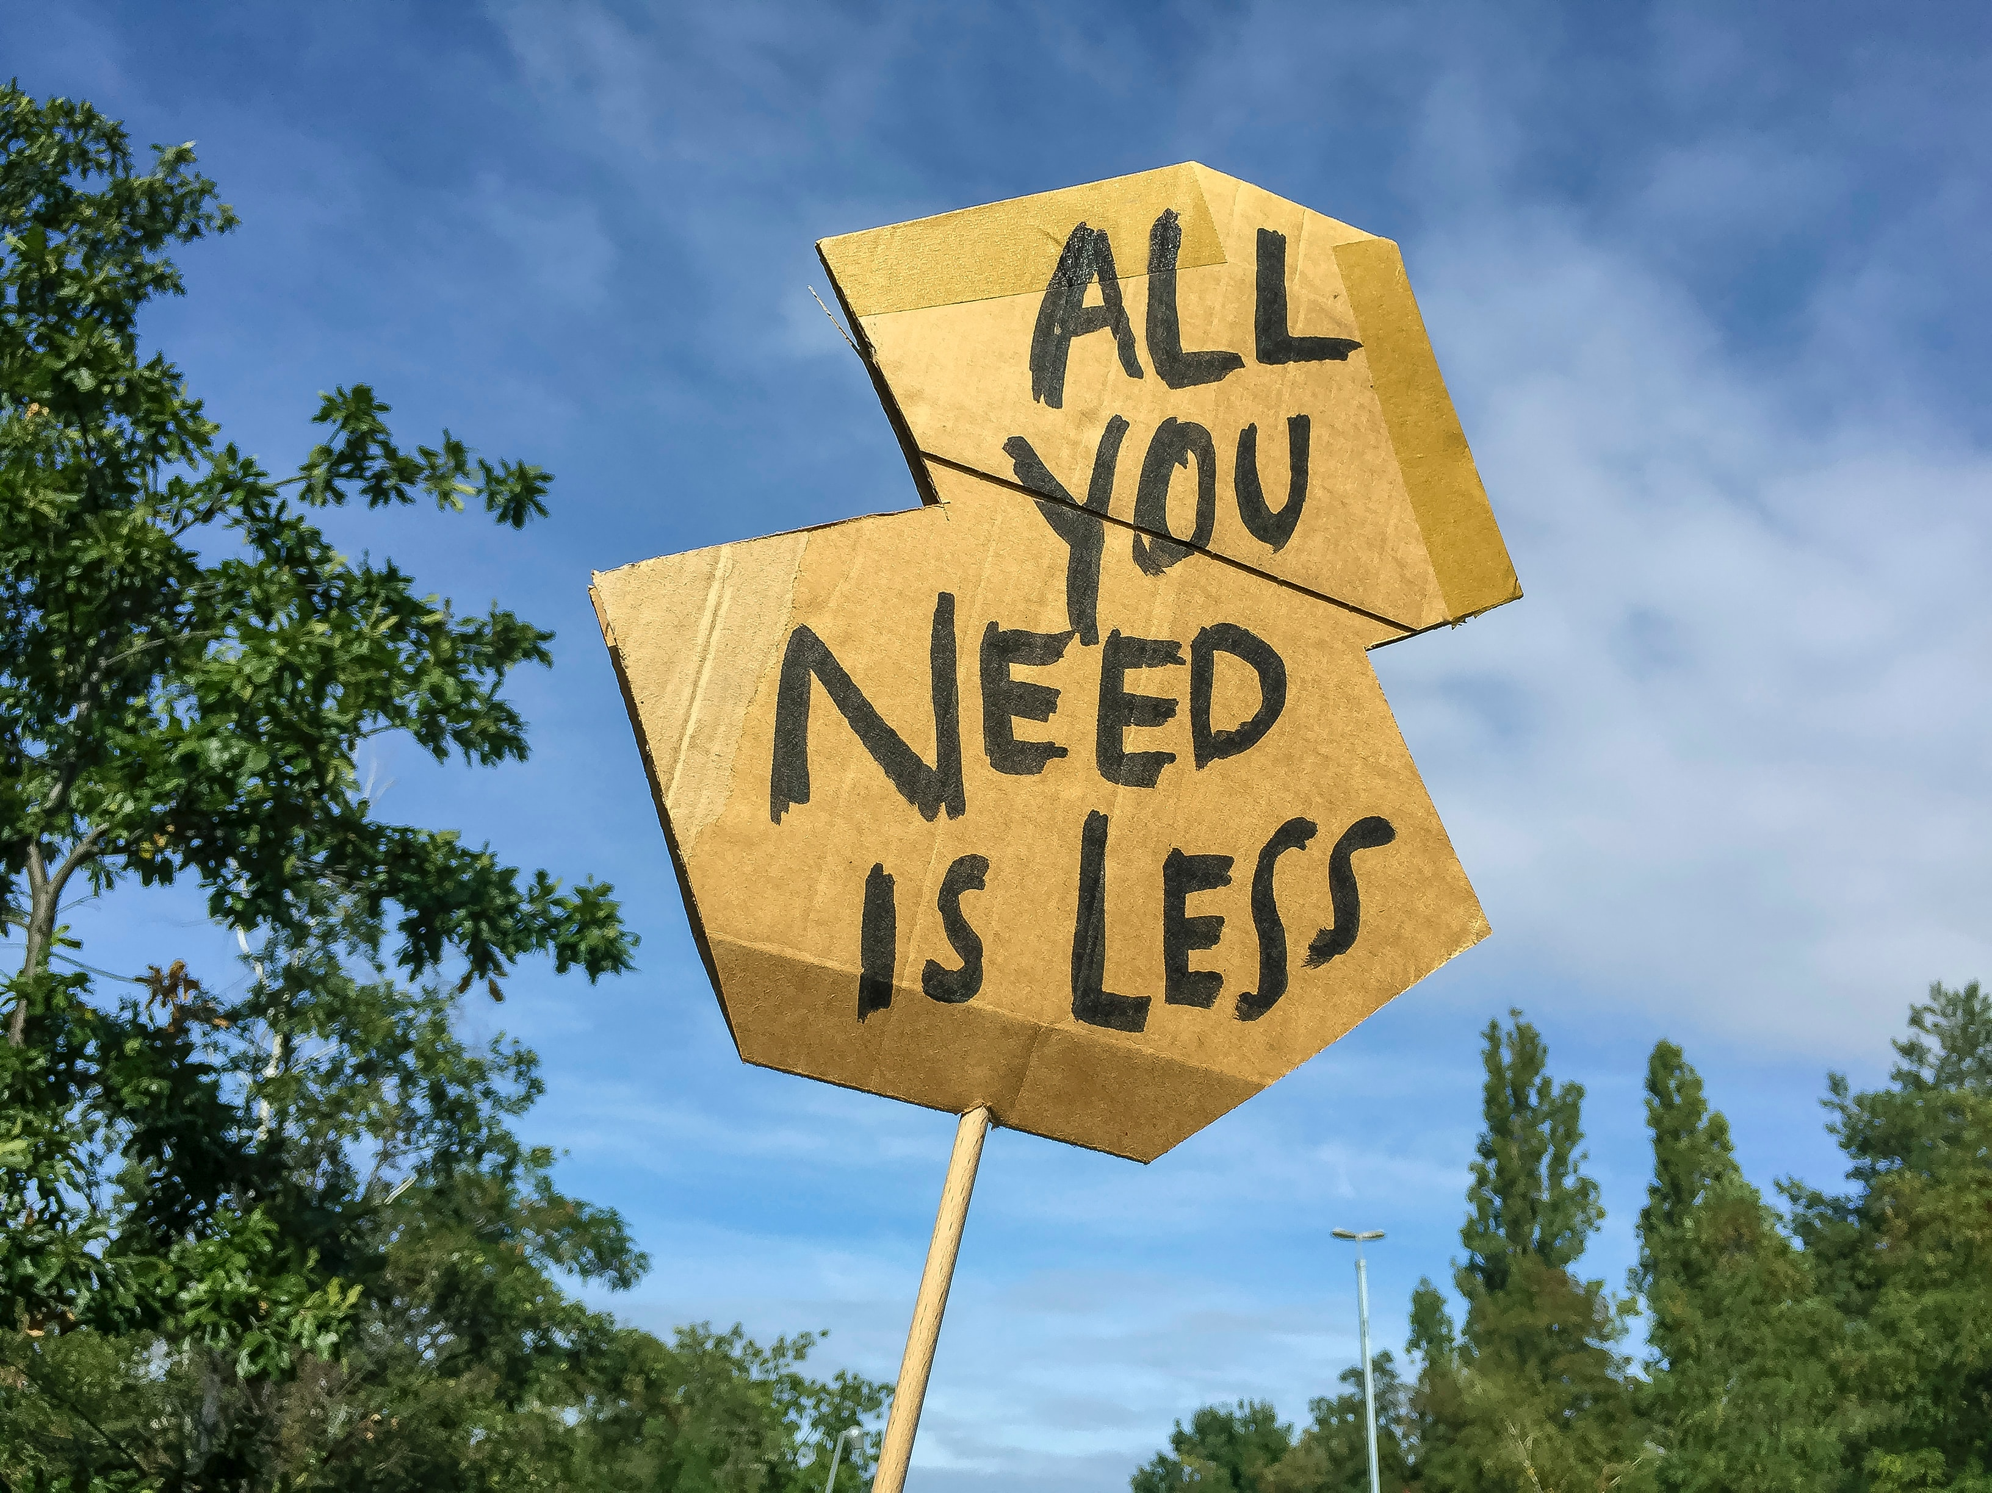

Week 9
Degrowth

Slide 2
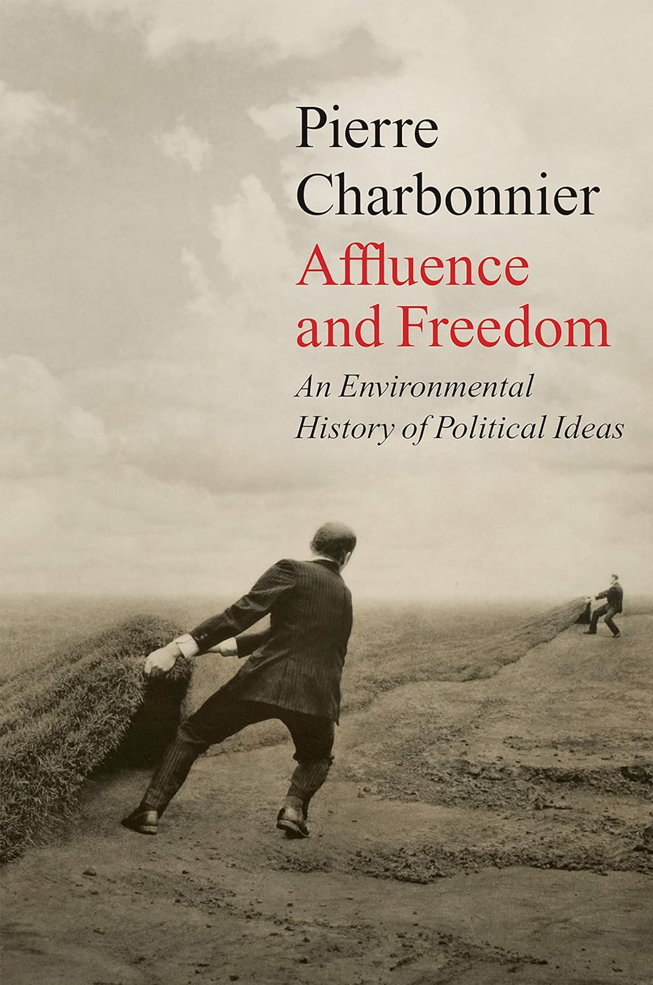
At the end of the Second World War, defenders of the liberal pact
and also its apparently harshest critics were both subjugated by the
power of affluence. The spectacular increase in material possibilities
then provided the conceptualization of liberty with its most solid basis,
regardless of which side people took. The modernizing project experienced
a prosperous period during which the industrialist faith assured
a very powerful structuring role, one that also had the effect of limiting
intellectual and political horizons. But that period did not last – or at
least it quickly led to serious questioning.
Very quickly, certainties with regard to the future forged in the
combination of affluence and freedom faced critiques that then took
the form of research programmes, and which thus found their real place
in the history of knowledge. On the one hand, there was a new concern
for the finite, limited nature of natural resources and a series of alarms
targeting the dogma of unlimited growth. Along with Malthusian fears
about the world’s population, the ecological limits of the spaceship
Earth seemed closer than ever and the dream of prosperity compromised.

Slide 3
For the proponents of the paradigm of limits, whose most famous
expression was the 1972 Club of Rome report The Limits to Growth,1
it was a question of showing to what extent the project of political
autonomy understood as emancipation from nature was paradoxically
dependent on material conditions that lead to an impasse. By collecting
data relating to metabolic exchanges and the energy dependencies
that were formed between the social world and nature from the
industrial revolution onwards, a very large body of work helped to
shape a counternarrative. The general idea was quite simple: it is
possible to contrast the cornucopian ideal born in the eighteenth
century with all the ecosystemic disturbances that this ideal ended
up triggering, consciously or not. The culmination of these disturbances,
the prospect of a demographic and political collapse caused
by the return of scarcity and the degradation of the environments
that support us, acted as the keystone to the system of thought
organized around limits. Thus, thinking in terms of limits to grasp the
embedding of society in pre-existing geo-ecological balances requires
the adoption of a systemic and holistic scale of analysis, one that sees
human societies as material realities engaged in physical, chemical and
biological exchanges with their environment.
‘Risks and Limits’

Slide 4
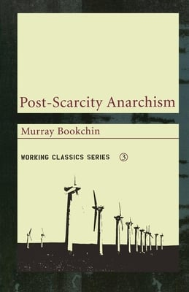
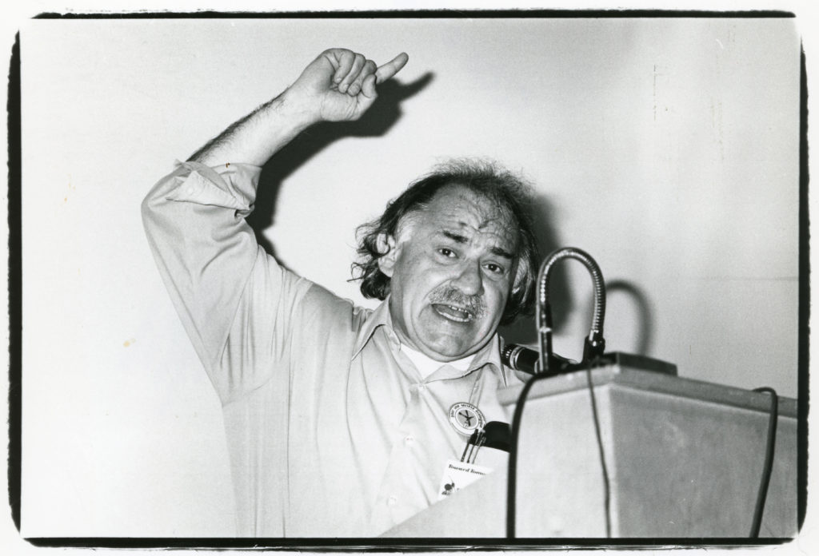
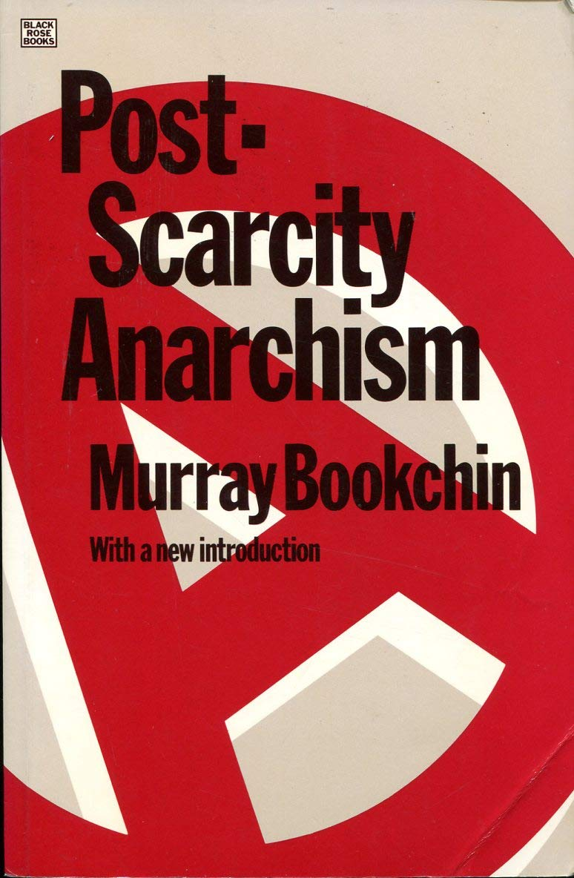
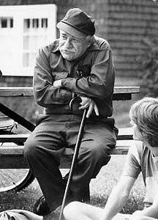
(1971)

Slide 5
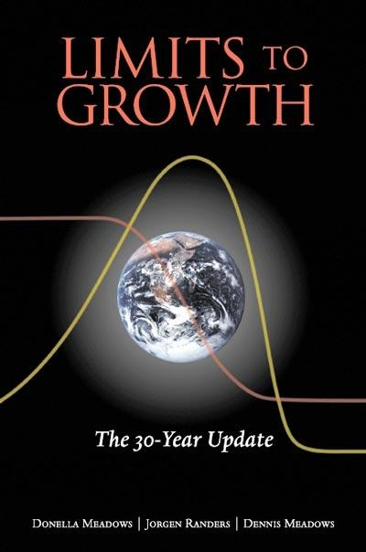
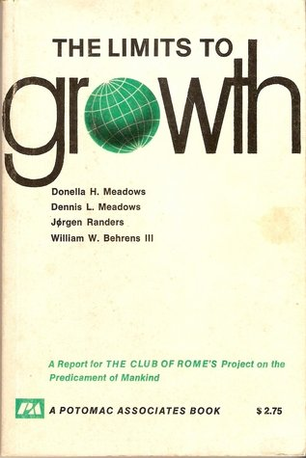
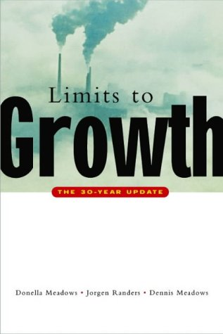
(1972)

Slide 6
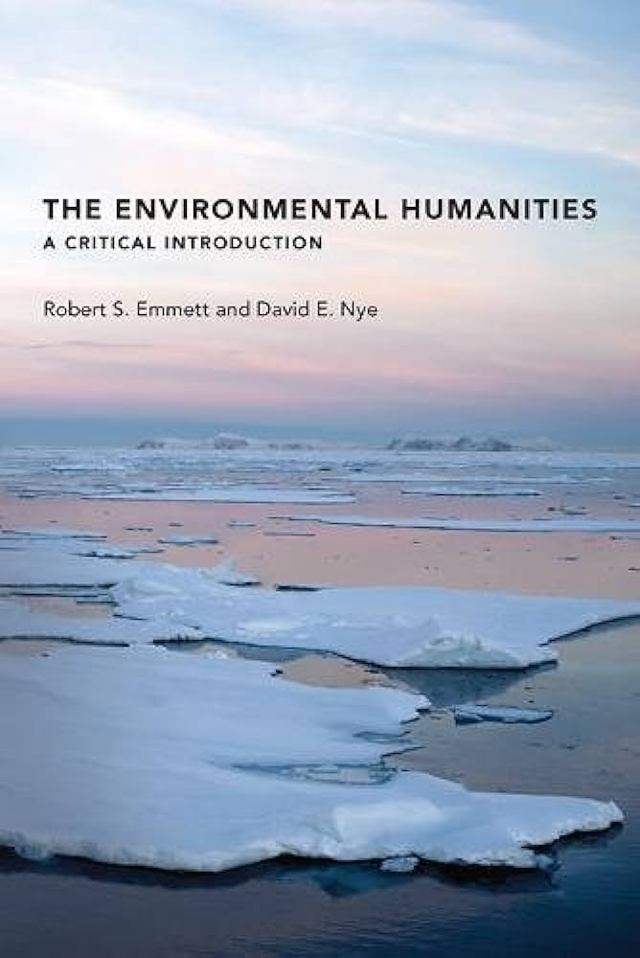
Globalization has been centrifugal, based on inexpensive energy
and abundant raw materials, and it has reinforced the centralization
of political and economic power. In contrast, localization is centripetal,
decentralizing power into regional communities and using resources sustainably. Globalization is based on an ideology of continual growth and treats
waste and pollution as externalities that at times are exported to Third World
dumping grounds. In contrast, localization is based on sustainable growth
that includes recycling and improvements in design and manufacturing, in order to minimize waste. People can reduce resource use and yet improve their quality of life. Localization is a logical response to the Anthropocene.

Slide 7
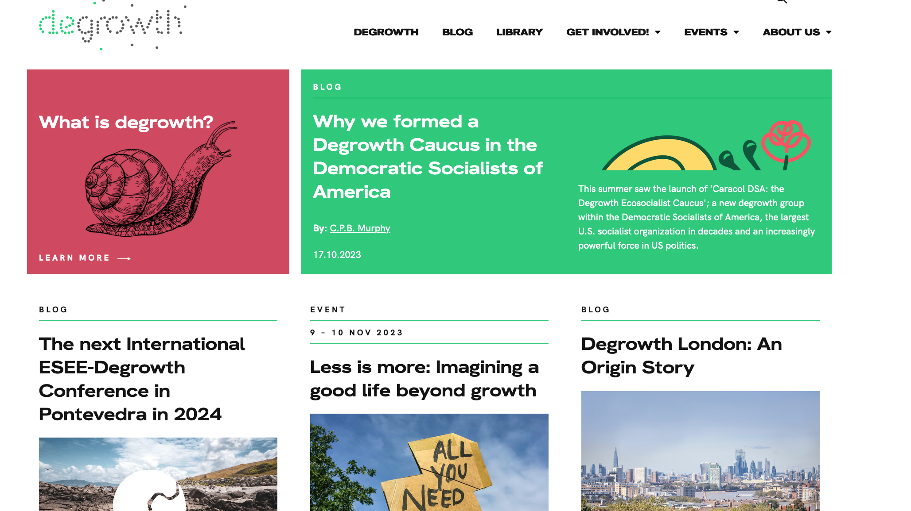

Slide 8
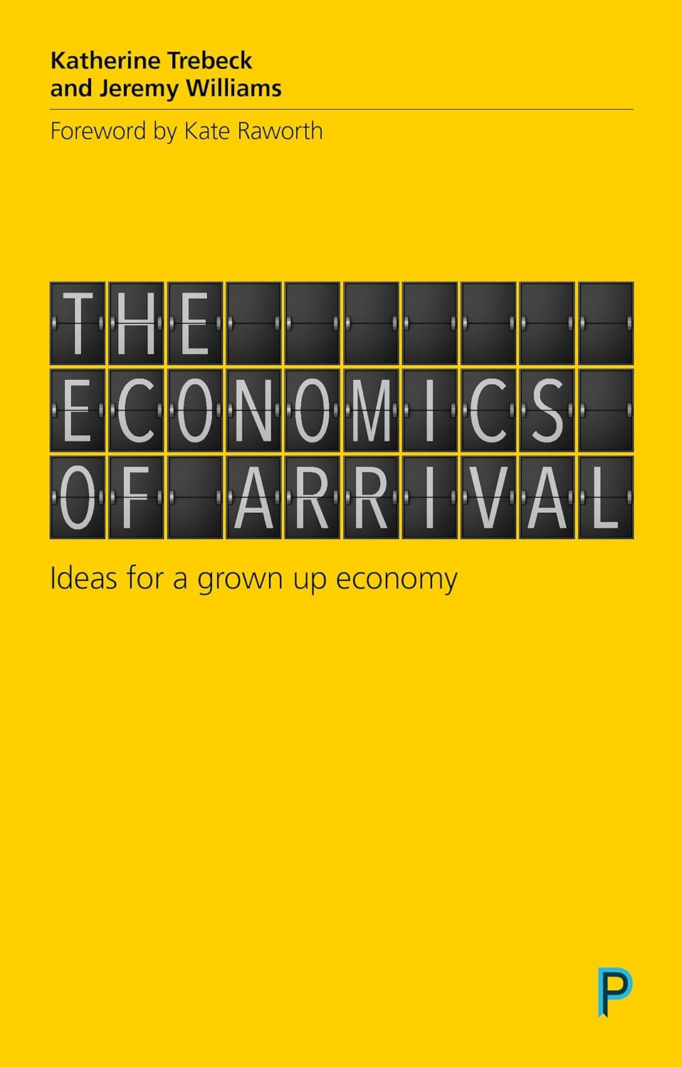
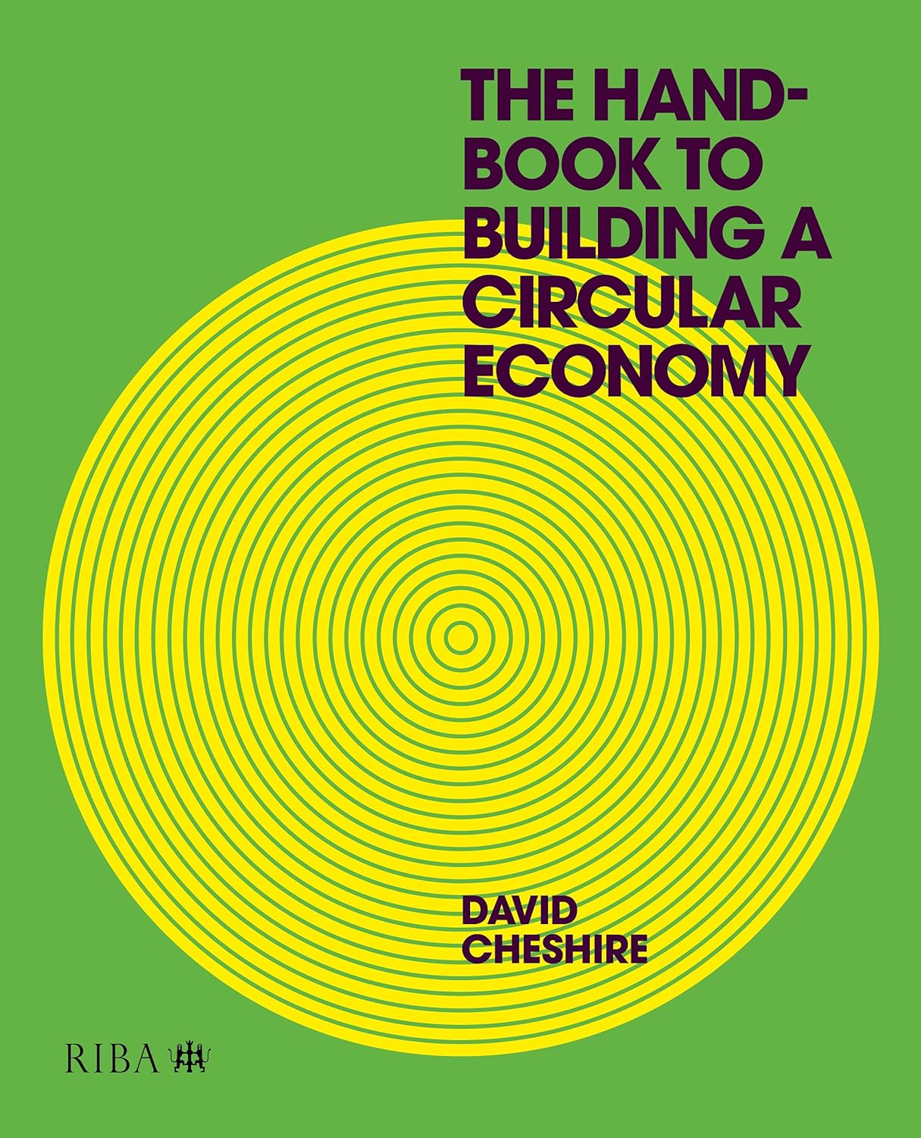
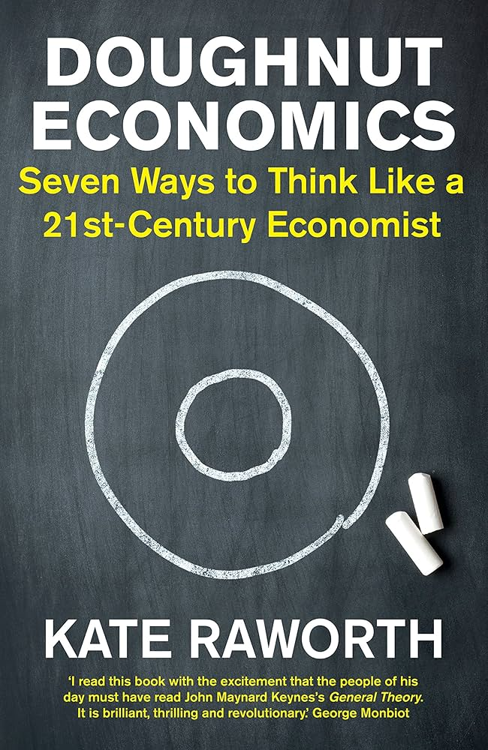

Slide 9
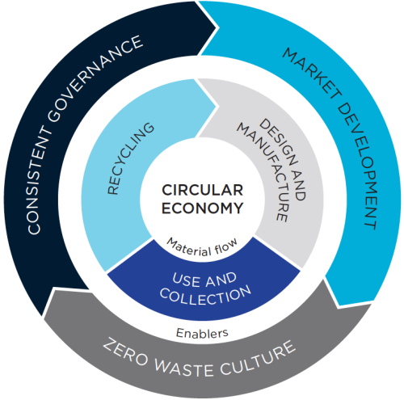
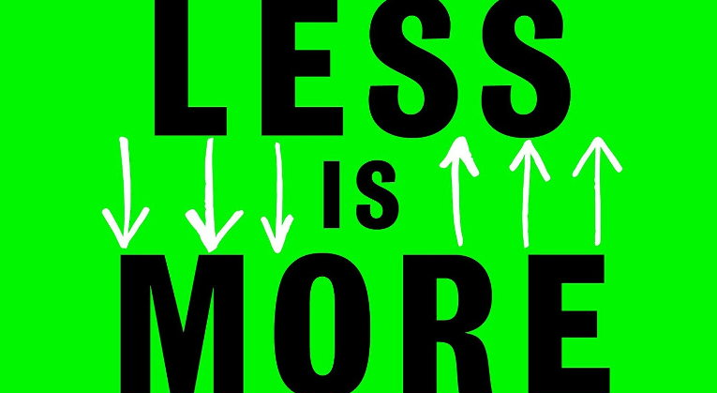
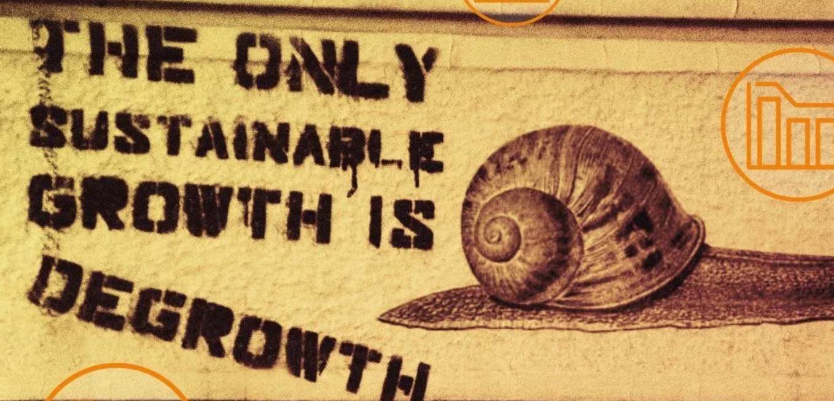

Slide 10
“The emergence of the enormous productive capacity that characterizes capitalism depended in the first instance on subjecting humans to artificial scarcity. Scarcity – and the threat of hunger – created the impetus for competitive productivity and served as the engine of growth. The scarcity was artificial in the sense that there was no actual net depletion of resources: all of the same land and forests and waters remained, just as they always had, but people’s access to them was restricted. Scarcity was, in this sense, created in the process of elite accumulation. And it was enforced by state violence: peasant uprisings against enclosures were repeatedly put down by force, and often by massacre.”
We can also see the logic of artificial scarcity at work in the realm of consumption. Industrialists who fear that people’s existing needs are too limited to absorb capitalism’s immense productive output must seek to create new needs, or else the juggernaut will grind to a halt. This is accomplished by various means. One is to expand desires through sophisticated advertising campaigns – and to extend these campaigns into all public and private spaces – manipulating people’s emotions and psychology to create new “needs” for products that promise to grant them a sense of self-esteem, status, identity, sexual prowess and so on that did not exist before and indeed do not have to exist. Another is to create products that are designed to break down quickly (like laptops and smart phones today) or become rapidly obsolete (as with the rise of throwaway fashion), and which therefore must be replaced more frequently than would otherwise be necessary. Another is to preclude the development of public goods in order to ensure that people have no choice but to purchase private alternatives: for instance, blocking the construction of effective public transportation systems in order to ensure a steady stream of demand for the automobile industry.
Jason Hickel. “Degrowth: A theory of radical abundance.” Real-World Economics Review (2019): 54-68.

Slide 11
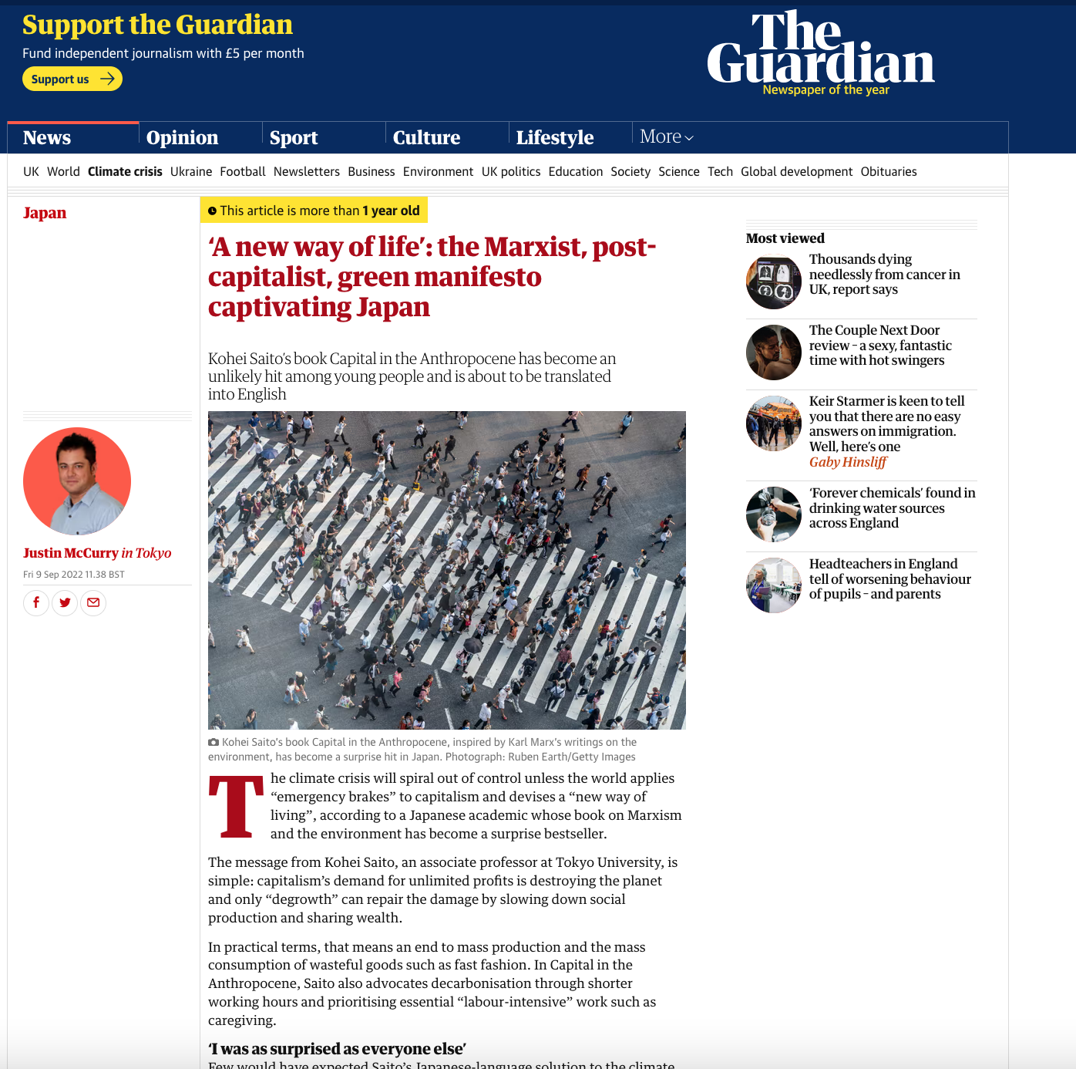

Slide 12
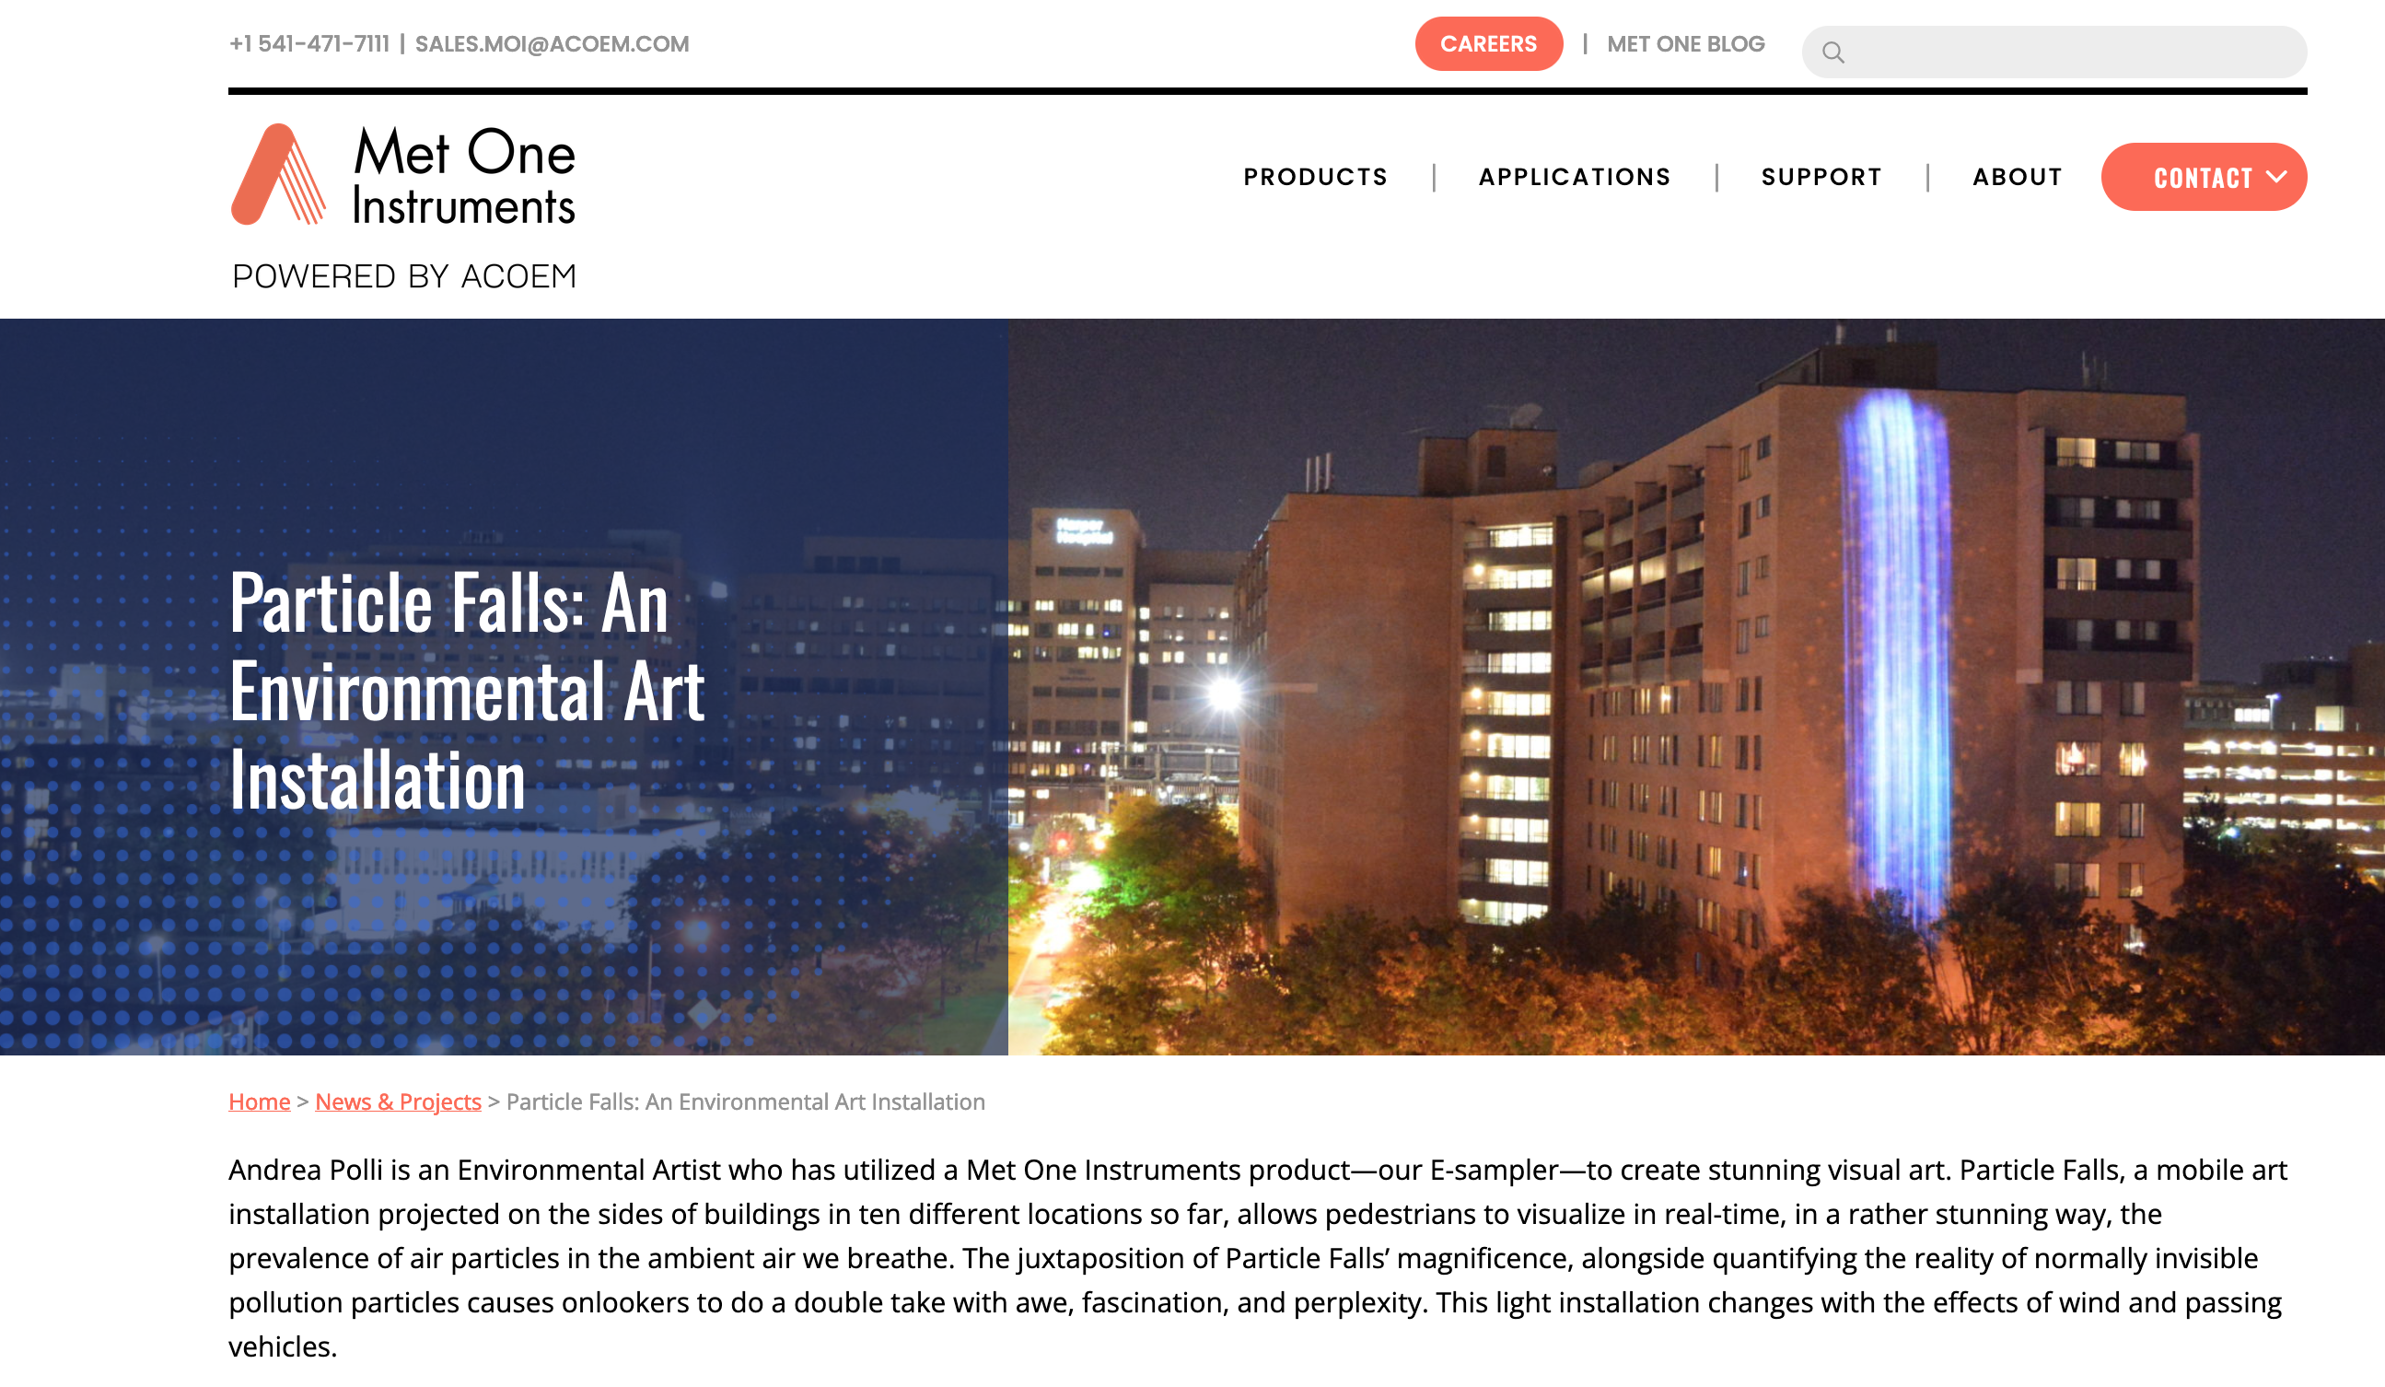

Slide 13
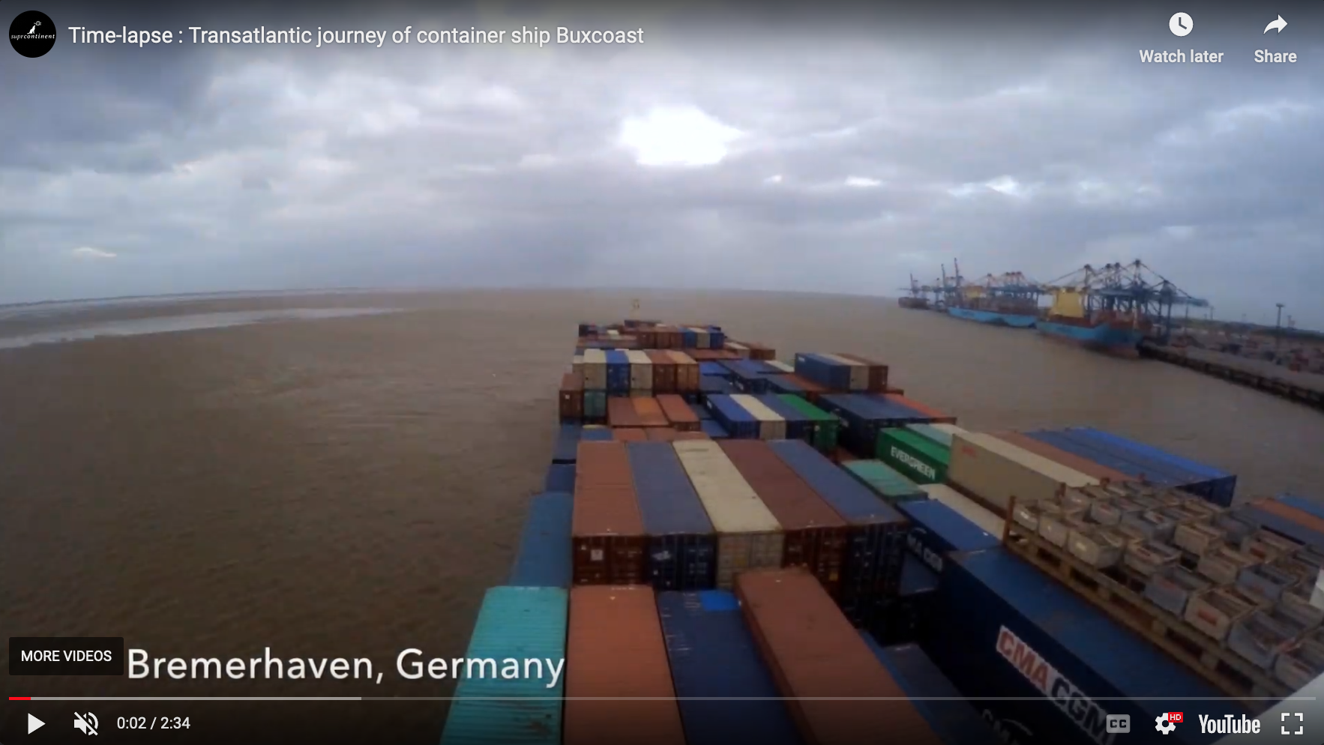
The food on the supermarket shelves and the goods in the
warehouse came from somewhere, but people tend to forget
the material flows. With the invention of barcodes on containers,
These flows are now easier to track, and at least in theory enable
researchers to follow a commodity across the globe as easily as
they follow a package shipped from Fedex. This in turn would
make it possible to construct a commodity’s environmental footprint.
Indeed, photographer Alan Sekula created Fish Story, a hybrid work
of text and photography that documents the transformation of harbors
and shipping after containerization, based on visits to many ports around
the world as well as taking passage on a container ship.36 Sekula
deliberately crosses many disciplinary boundaries as he situates his work
in the histories of painting the sea and of documentary photography.
Among the many purposes of this assemblage was to re-materialize
the abstraction of globalization, reconnecting it to visible processes,
specific places, and identifiable people. (Emmett & Nye)
Contrary to what the whole of political economy and its critics
had established, the commodity would, in a regime of generalized
risk, no longer be the sole and irreplaceable object of trade, since
the lateral effects of productive activities now involved heavier costs
and preventive measures, more able to impose constraints on the
economic world in general. Yet it was precisely because nature had
been thought of as a reality prior to and external to the economy,
as a simple reservoir from which to draw wealth, raw materials and
other factors of production, that its return produced such devastating
effects. (Charbonnier, ‘Risks and Limits’)

Slide 14
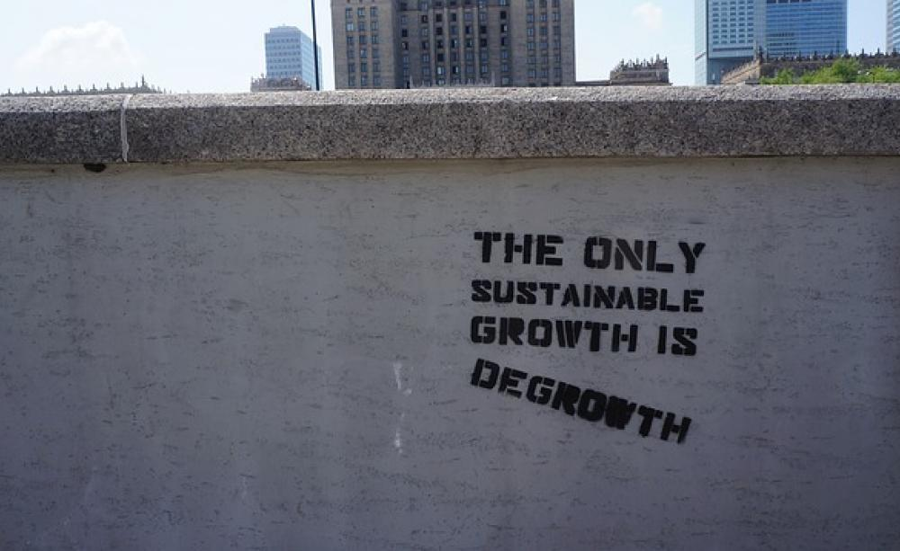
If we are going to imagine a new economy altogether, why not imagine one without growth? This brings us to the key point. It is not growing throughput that is ultimately the problem: the problem is the growth imperative itself. To illustrate, one can imagine that in an economy where growth must happen despite a cap on throughput, and where all new value therefore has to be immaterial, capital would seek to enclose immaterial commons that are presently abundant and free (knowledge, songs, green spaces, maybe even parenting, physical touch, love, and perhaps even the air itself) and sell them back to people for money. Subject to these new waves of artificial scarcity, people would find themselves compelled to work and earn wages in the new immaterial industries simply in order to acquire immaterial goods that used to be freely available. This may be an ecological economy, but it is not an economy that makes any sense, or one that anyone would actually want to live in.
Hickel.

Slide 15
The scale of the current upheavals is measured by the strength of the
new counter-movements, but especially, alas, by the radicalization of
the economic elites who are determined to continue full steam ahead to
growth. Faced with the evidence now unanimously accepted, including
and perhaps even especially by those whose plans it most disrupts,
that the planet is no longer large enough or flexible enough to accommodate
a limitless economy, the persistence of liberalism is becoming
more obvious than ever. While the pact forged between affluence and
freedom, between growth and democracy, had worked as a global
project until quite late into the twentieth century (whatever one thinks
of the value of this project), in the sense that it formed the basis for
the discourse of progress, the search for growth is now turning against
its old political ally and causing an extraordinary corruption of the
democratic ideal. Naomi Klein and Bruno Latour, even though they
come from very different intellectual traditions, have drawn from it
a common observation and working hypothesis: the exacerbation of
political conservatisms, the consolidation of alliances between market
forces and identitarian nativism and the electoral outlet that they
depend among populations seeking protection against offences, which,
however, stem in large part from the logic of the markets, must all
be understood in the context of the climate crisis. As Bruno Latour
would put it, faced with the observation that there is no longer a world
able to host the project of infinite economic growth, its defenders have
preferred to liquidate the idea of a common world and to build illusory
ideological lifeboats.

Slide 16
In the not-too-distant future, people may well look at the present with
wonder and disgust, much as people today look back at slavery. Why did
entire societies refuse to develop or adopt indicators that included the environment
as part of the economic health of a country? Why did so many
leaders cling blindly to the ideology of endless growth, when anyone could
see that the resources were finite? Why did human beings overfish the seas,
devastate rain forests, and eliminate entire species? It would seem obvious
that such behavior was perversely shortsighted and self-destructive.
There is another possibility, however, that our descendants will look
back and see a successful deceleration of growth, coupled with a shift
away from fossil fuels to alternative energies, away from extensive mining
to cradle to cradle recycling, along with the expansion of regional economies
based on localization. This may not be merely wishful thinking.

Slide 17
