Slide 1
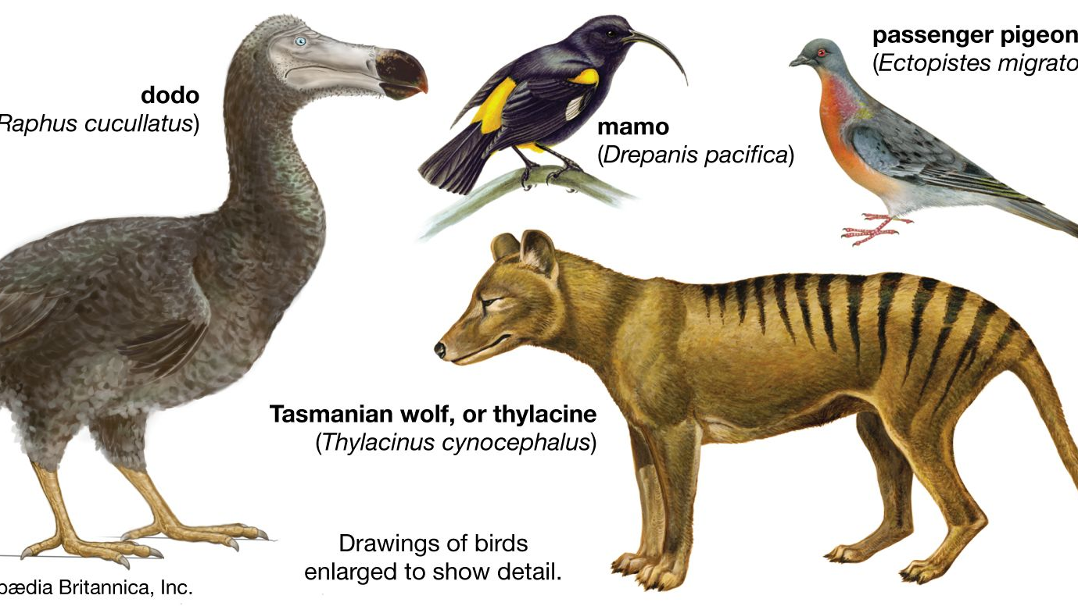
Week 5:
More than human: species studies and extinction

Slide 2
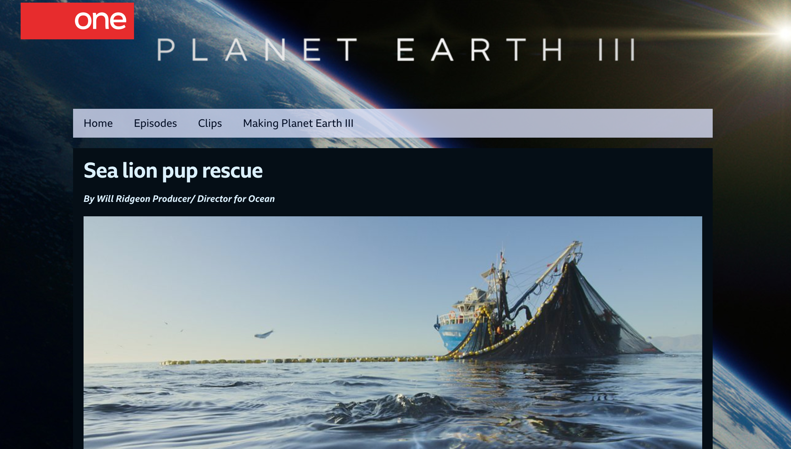
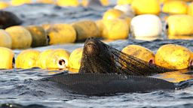
“Sea Lion Pup Rescue”

Slide 3
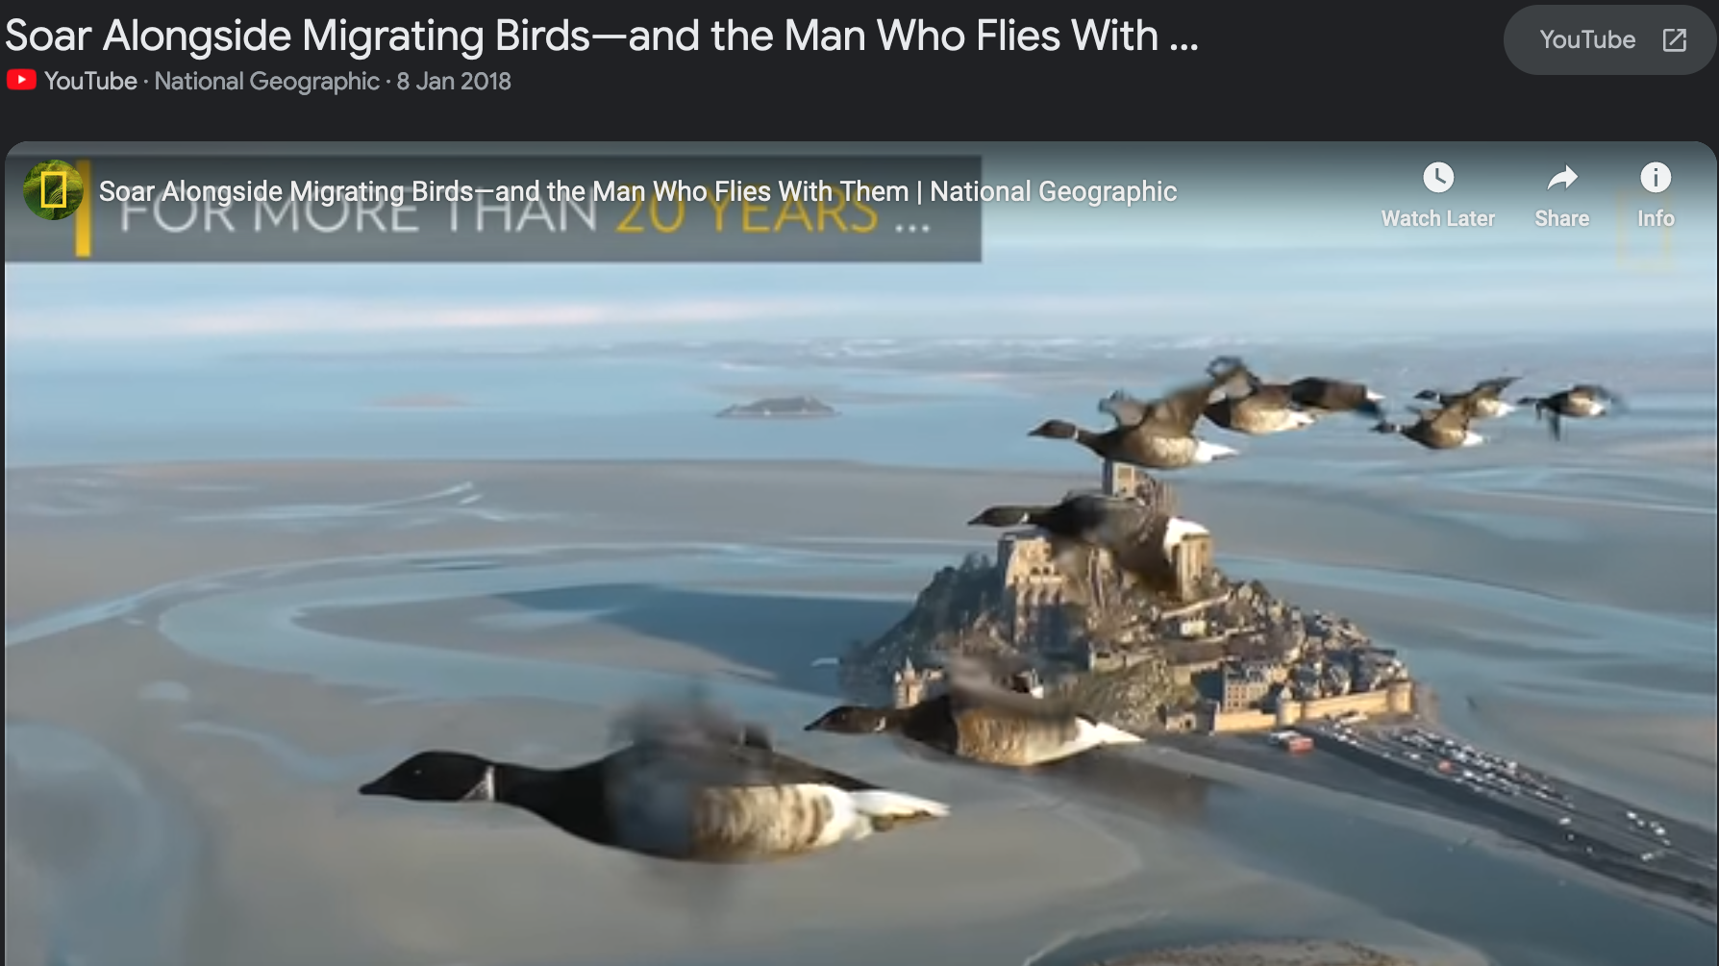
This chapter takes up this conservation story through a
close focus on the elaborate captive breeding and release program that for
some young birds culminates in the use of ultralight aircraft to teach them
a new migratory route. My particular interest is in the strange juxtaposition
of care and violence that lies at the heart of this effort and the ethical
dimensions of the human–crane relationships that are being established.
Flight Ways (17)

Slide 4
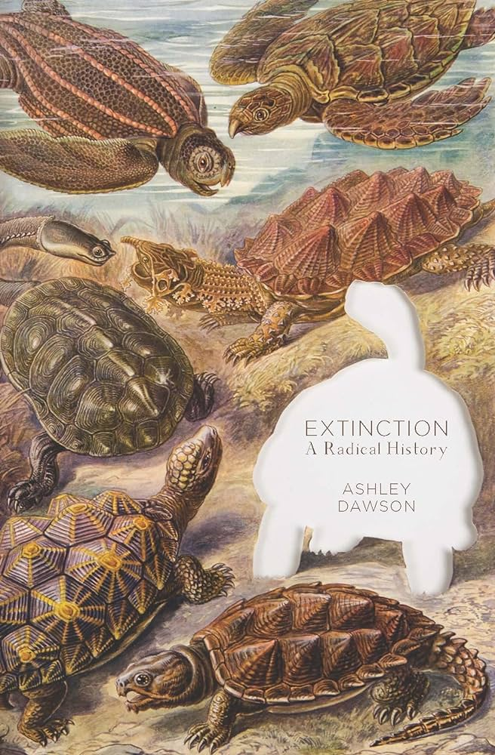
Three destructive aspects of the capitalist system stand out when we view this system in
relation to the extinction crisis: 1) capitalism tends to degrade the conditions of its
own production; 2) it must expand ceaselessly in order to survive; 3) it generates a
chaotic world system, which in turn intensifies the extinction crisis. By wrenching
specific elements out of the complex ecosystems in which they are intertwined and
turning them into commodities, that is, capital remorselessly breaks down the complex
natural world into impoverished but exchangeable forms, simultaneously discarding all
those elements that don’t appear to have immediate exchange value.
Dawson, 42-43
capital is figuratively sawing off the tree branch it is sitting on. 52

Slide 5
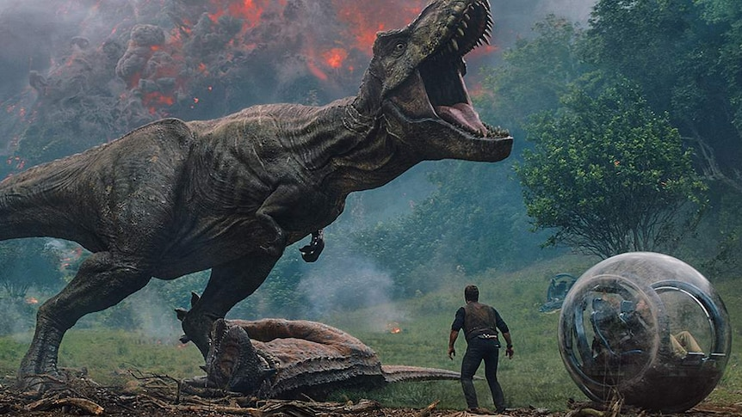
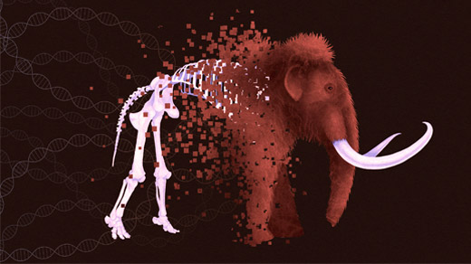
De-Extinction

Slide 6
De-extinction offers a seductive but dangerously
deluding techno-fix for an environmental crisis generated by
the systemic contradictions of capitalism. It is not simply that
de-extinction draws attention—and economic resources—
away from other efforts to conserve biodiversity as it currently
exists. 107
The fundamental problem with de-extinction
is that it relies on the thoroughgoing manipulation and
commodification of nature, and as such dovetails perfectly
with biocapitalism. US lawyers have already begun arguing
that revived species such as the mammoth would be “products
of human ingenuity,” and should therefore be eligible for
patenting. 79

Slide 7
What would a radical anti-capitalist conservation movement
look like? It would begin from the understanding that the extinction
crisis is at once an environmental issue and a social justice issue,
one that is linked to long histories of capitalist domination over
specific people, animals, and plants. The extinction crisis needs to
be seen as a key element in contemporary struggles against accumulation
by dispossession. This crisis, in other words, ought to be a key
issue in the fight for climate justice. If techno-fixes such as deextinction
facilitate new rounds of biocapitalist accumulation, an anti-capitalist
movement against extinction must be framed in terms of a refusal
to turn land, people, flora, and fauna into commodities….. Most of all,
an anti-capitalist conservation movement must challenge the privatization of
the genome as a form of intellectual property, to be turned
into an organic factory for the benefit of global elites. 86

Slide 8
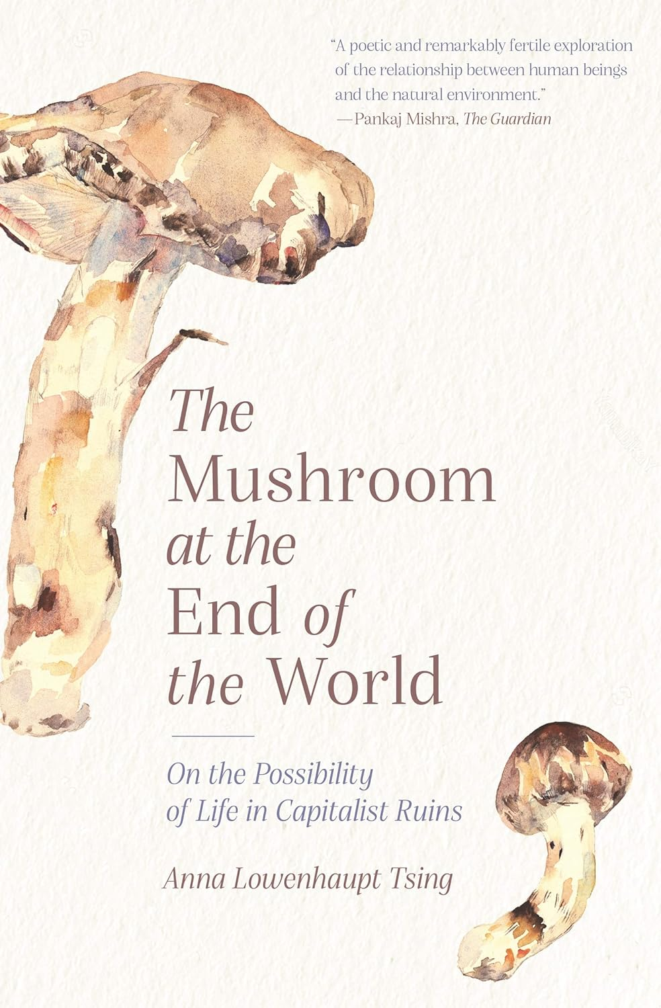
This is what I call “salvage,” that is, taking advantage of value
produced without capitalist control. Many capitalist raw materials
(consider coal and oil) came into existence long before capitalism.
Capitalists also cannot produce human life, the prerequisite of labor.
“Salvage accumulation” is the process through which lead firms amass
capital without controlling the conditions under which commodities
are produced. Salvage is not an ornament on ordinary
capitalist processes; it is a feature of how capitalism works.
Sites for salvage are simultaneously inside and outside capitalism; I
call them “pericapitalist.” All kinds of goods and services produced by
pericapitalist activities, human and nonhuman, are salvaged for capitalist
accumulation. If a peasant family produces a crop that enters capitalist
food chains, capital accumulation is possible through salvaging
the value created in peasant farming. Now that global supply chains
have come to characterize world capitalism, we see this process everywhere.
“Supply chains” are commodity chains that translate value to
the benefit of dominant firms; translation between noncapitalist and
capitalist value systems is what they do.

Slide 9
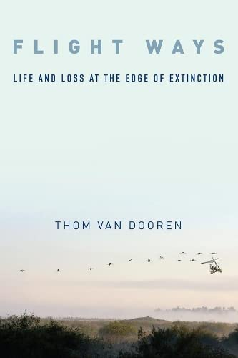
In an important sense Flight Ways: Life and Loss at the Edge of Extinction is
a continuation of the now well-established tradition of telling “extinction
stories” that implicate people. But it is also an effort to tell these all-too familiar
stories in a new way. Specifcally, the approach to thinking through
extinction taken up in this book centers on “avian entanglements.” Which
is to say that this is a book about birds and their relationships, about the
webs of interaction in which living beings emerge, are held in the world,
and eventually die. Life and death do not take place in isolation from others;
they are thoroughly relational affairs for fleshy, mortal creatures. And
so it is, in the worlds of birds-woven into relationships with a diverse
array of other species, including humans. These are relationships of coevolution
and ecological dependency. But they are also about more than
“biology” in any narrow sense. It is inside these multispecies entanglements
that learning and development take place, that social practices and
cultures are formed. In short, these relationships produce the possibility
of both life and any given way of life. And so these relationships matter.
This is true at the best of times, but in times like these when so many
species are slipping out of the world, these entanglements take on a new
significance. 4

Slide 10
What brings Mien and matsutake together
in Oregon? Such seemingly trivial queries might turn everything around
to put unpredictable encounters at the center of things.
We hear about precarity in the news every day. People lose their jobs
or get angry because they never had them. Gorillas and river porpoises
hover at the edge of extinction. Rising seas swamp whole Pacific islands.
But most of the time we imagine such precarity to be an exception to
how the world works. It’s what “drops out” from the system. What if, as
I’m suggesting, precarity is the condition of our time— or, to put it another
way, what if our time is ripe for sensing precarity? What if precarity,
indeterminacy, and what we imagine as trivial are the center of the
systematicity we seek?
Precarity is the condition of being vulnerable to others. Unpredictable
encounters transform us; we are not in control, even of ourselves.
Unable to rely on a stable structure of community, we are thrown into
shi<ing assemblages, which remake us as well as our others. We can’t
rely on the status quo; everything is in flux, including our ability to survive.
Thinking through precarity changes social analysis. A precarious
world is a world without teleology. Indeterminacy, the unplanned nature
of time, is frightening, but thinking through precarity makes it
evident that indeterminacy also makes life possible.
The only reason all this sounds odd is that most of us were raised on
dreams of modernization and progress. 20

Slide 11
One thing that preoccupied me was the trainers' habit of
talking in highly anthropomorphic, morally loaded language.
That was the language I wanted to understand because it seemed
to me after a while that it was part of what enabled the good
trainers to do so much more than the academic psychologists
could in the way of eliciting interesting behavior from animals.
Trainers, for example, have no hesitation in talking about how
much a mare loves or worries about her foal, a cat her kittens
or a dog or a horse their work. But for philosophers and
psychologists to speak of love was to invoke abilities that are,
for reasons I am still not clear about, as rigidly restricted to
Homo sapiens as some religious doctrines have restricted the
possession of a soul to members of certain races, cultures and
sometimes genders. Hearne, 6
By this I mean that implicit as well as explicit in the trainers'
language is the notion that animals are capable not only of
activities requiring "IQ"-a rather arid conception-but also of
a complex and delicate (though not infallible) moral understanding
that is so inextricably a function of their relationships with
human beings that it may well be said to constitute those
relationships. Hearne, 8
HumanNonHuman
Much of the history of Western thought has utilized
understandings of and responses to death to construct a
dualism between “the human” and “the animal.” This is
dualistic thinking is at the core of a human exceptionalism
that holds us apart from the rest of the world and, as such,
contributes to our inability to be affected by the incredible
loss of this period of extinctions, and so to mourn the ongoing
deaths of species. In contrast to this tradition, this chapter
explores some of the ways in which taking crows’ grief seriously
may, in fact, work to undermine our sense of human exceptionalism
in particular, by highlighting both a deep evolutionary
continuity between humans and other social animals, and our
ecological entanglement in a more-than-human world. V-D, 17-18

Slide 12
IMAGINATION
The wave of extinction that is decimating plants
and animals around the planet strikes at the most intimate
and potent of human faculties: our ability to imagine. The
power of human dreams has historically been closely tied
to the generative multiformity of the plant and animal
life that surrounds us.141
Even in the “advanced” capitalist
cultures, we encourage our children to learn basic forms
of empathy and imagination by giving them toy animals
and reading them stories like The Tale of Peter Rabbit. We
have always used animals and plants to symbolize our most
intimate fears, our hopes, and even our greatest loves. As
capitalism tears increasingly gaping holes in the beautiful
web of life of which we are a part, our capacity to dream,
to imagine different, more manifold worlds is radically
impoverished. Dawson, 102-03
Koshka revealed that theme in his from time to
time "doggy" behavior, but most cats don't reveal it so directly,
which is why it can seem to us that there is no theme, no
focus, to a cat's activities. They stalk the web of our imaginations
as carefully as they stalk prey and by and large elude
our grosser interpretations with skill and care, not because they
wish to remain unknown to us, but because they cannot bear
to be falsely known, known. Hearne, 237
They take infinite trouble that we should
continue to be aware of their way of looking. Hearne, 241
We need to reopen our imaginations. Tsing, 5

Slide 13
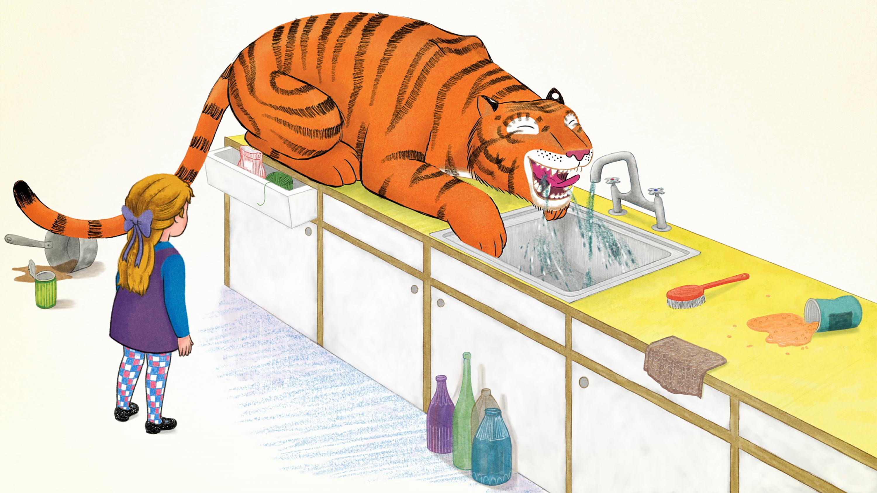
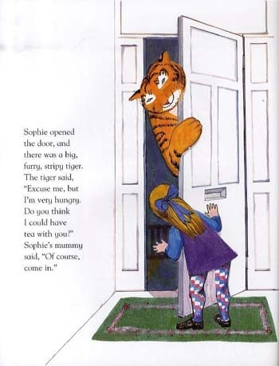


Slide 14

There are other things at stake. I knew a woman named
Shelley Mason, who took a job running an animal shelter in a
small desert town. She didn't do this because she thought that
the activity of merely housing dogs and feeding them was an
especially meaningful activity (especially as one of her duties
was destroying unwanted animals) but because she understood
the importance of training as a way of increasing the number
of animals who were wanted and who would not be abandoned,
thus reducing the piles of corpses. 168

Slide 15
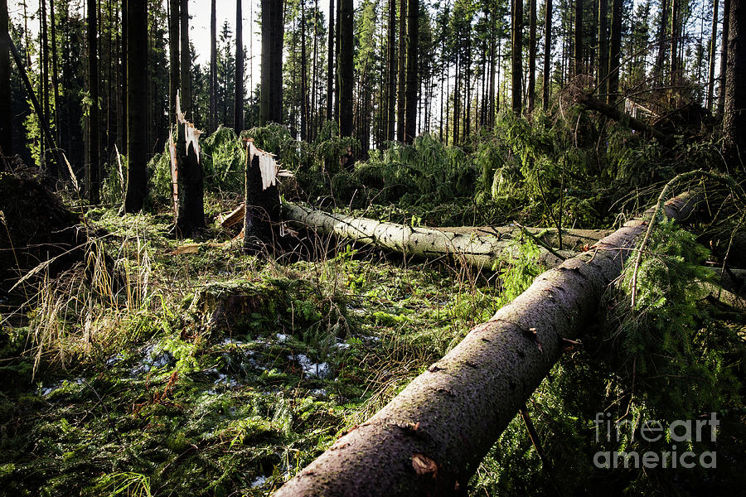
“The question for us, then, is what kind of end we wish to make.” Dawson, 101
This book takes a particularly “lively” approach to telling stories about life and death in the shadow of extinction. It is an effort to weave tales that add flesh to the bones of the dead. Van Dooren, 8
Mushroom collecting is a place to look after progress. Tsing 66
But, more than comparison, I seek histories through which humans,
matsutake, and pine create forests. I work the conjunctures to raise unanswered
research questions rather than to create boxes. I look for the
same forest in different guises. Each appears through the shadows of the
others. Exploring this simultaneously single and multiple formation,
the next four chapters take me into pines. Each illustrates how ways of
life develop through coordination in disturbance. As ways of life come
together, patch- based assemblages are formed. Assemblages, I show, are
scenes for considering livability— the possibility of common life on a
human- disturbed earth.
Precarious living is always an adventure. Tsing 163

Slide 16
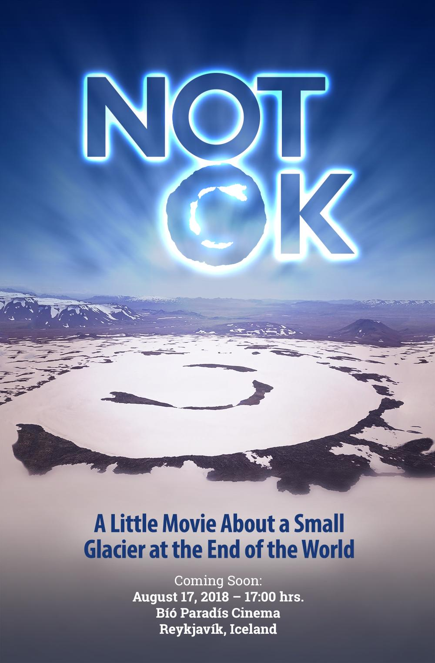

Slide 17
Import of an Environmental Humanities
But the natural sciences also need the humanities. This is the domain
of the “environmental humanities,” of a thinking that inhabits complex
multi species worlds without the aid (and impediment) of simplistic divisions
between the human and the nonhuman, the cultural and the natural.
The world is far messier and more interesting than this. And so the tools
of ethnography and philosophy are required to develop a fuller picture of
the entangled signi" cance of extinction, of its myriad meanings and the diverse ways in which it matters . Van-D, 147

