Slide 1
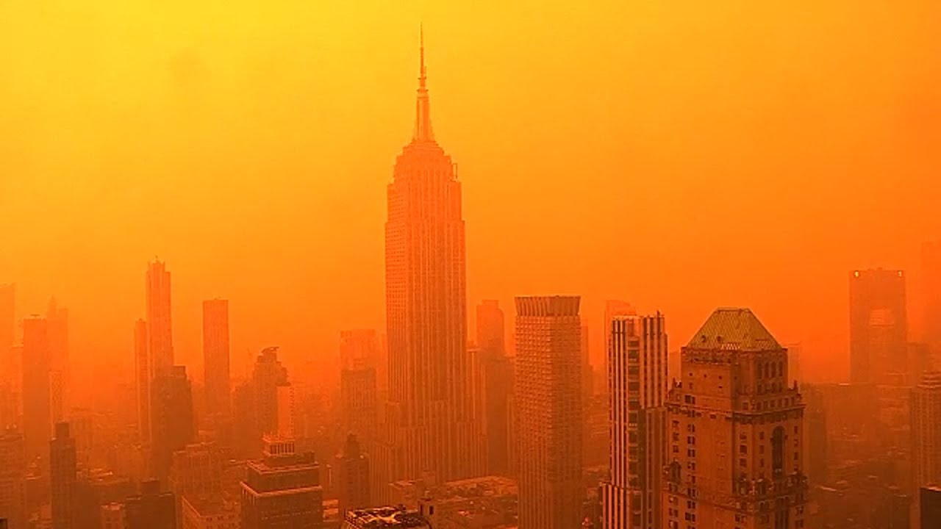
Week 6 Climate Imaginaries

Slide 2
Imaginary

Slide 3
Contemporary culture finds it so hard to deal with climate change. Indeed, this is perhaps the most important question ever to confront culture in the broadest sense—for
let us make no mistake: the climate crisis is also a crisis of culture, and thus of the imagination.

Slide 4
Imagination here is understood as a way of seeing, sensing, thinking, and dreaming the formation of knowledge, which creates the conditions for material interventions in and political
sensibilities of the world.
An alternative approach might consider how imagination is actively produced through iterative processes and practices that establish dominant framings of the imagination.
There are two distinct schools of thought here. (1) Imagination as a relational space that is informed by the objects and subjects with which it is entangled. (2) Imagination as a mediator between the positivist world and the human mind.
Kearney suggests that while there is a plurality of terms for the imagination, they all adhere to a basic trait of capturing ‘the human power to connote absence into presence, actuality into possibility, what is into something—other-than-it-is […] What we can say now of the imagination is that rather than being the site of division it is a site of interplay between material
and perceptual worlds, where concepts cohere, forces
pull and attract, and things, discourses, subjects, and
objects are framed, contested, and brought into being.
Yusoff & Gabrys
Climate change… is being reimagined as an
ethical, societal, and cultural problem that poses
new questions and reconfigures the geographic
imaginaries of the world. These new cultures of
climate change can be characterized by three
distinct temporal and spatial imaginative
framings of climate change:
- futurity of climate change.
- adaptation: imagination by degree
- climate practices
Imagination can be thought of as a way of
seeing, or rather a constellation of a way of thinking
and sensing that becomes typified or consolidated in
images and social actions.

Slide 5

The warming condition is still, however, far from constituting a total ‘cultural logic’ in Jameson’s “sense.
Indeed, climate fiction (or cli-fi) in film and literature notwithstanding, one might argue that most culture
still ignores the facts of global warming and that denial is the real hallmark of the present. Malm
Moreover, denial, particularly in its suppressive and obsessive forms, is a negative confirmation. It suggests
that the thing is there, everywhere, only just below the surface, a distressing presence in the collective
subconscious – perhaps global warming is, to use another term of Jameson’s, a political unconscious that
already pervades culture. Malm
The freakish weather events of today, despite their radically nonhuman nature, are
nonetheless animated by cumulative human actions. In that sense, the events set in
motion by global warming have a more intimate connection with humans than did the
climatic phenomena of the past—this is because we have all contributed in some measure,
great or small, to their making. They are the mysterious work of our own hands returning to
haunt us in unthinkable shapes and forms. Ghosh
Notes:
maybe the dystopia is with us now, we are living it - and have been for some time - since when? Its easier to drmatise disaster than resilience, repair, the changed world – maybe the first steo is actually turning the generic tables and recognizing the dystopian in the every day – in what you will do now as you leave the building and drive home, have a beer, eat a burger, buy a book, have a bath – maybe the dystopias are the police dramas, the soaps that show business as usual….maybe its hard to imagine ourselves in a totally retoriftted utopan world of regulated climate and natural restoration, a clean transition

Slide 6
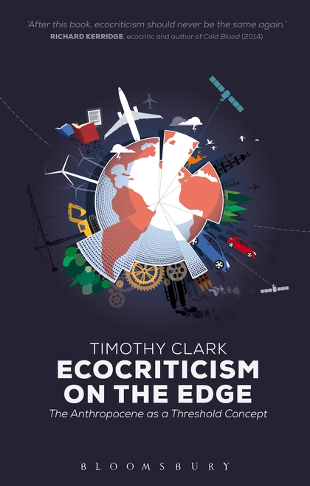
The twenty-first century has seen an increased awareness of forms of environmental destruction that cannot immediately be seen, localized or, by some, even acknowledged. Phenomena such as ocean acidification, climate change, the general effects of incremental forms of ecological degradation across the planet, global overpopulation and resource depletion do not present any obvious or perceptible target for concern or protest at any one place, or often any immediate antagonist perceptible at the normal human scale. The largely benumbed recognition of this reality has become one feature of life in the so-called Anthropocene, to use the currently still informal term for the epoch at which largely unplanned human impacts on the planet’s basic ecological systems have passed a dangerous, if imponderable, threshold. One major new effort at work in contemporary literary and artistic practice and criticism is to find some way of usefully or authentically engaging such crucial but elusive concerns, precisely when it is acknowledged that they resist representation at the kinds of scale on which most thinking, culture, art and politics operate.
Timothy Clark, from ‘Preface’ to Ecocriticism on the Edge

Slide 7
Representation

Slide 8
The age of global warming defies both literary fiction and contemporary common sense: the weather events of this time have a very high degree of improbability. Indeed, it has even been proposed that this era should be named the “catastrophozoic” ... It is certain ...that these are not ordinary times: the events that mark them are not easily accommodated in the deliberately prosaic world of serious prose fiction.
But the modern novel, unlike geology, has never been forced to confront the centrality of the improbable: the concealment of its scaffolding of events continues to be essential.
If that is true of a small fluke of chance, consider how much harder a writer would have to work to set up a scene that is wildly improbable even in real life? For example, a scene in which a character is walking down a road at the precise moment when it is hit by an unheard-of weather phenomenon?
To introduce such happenings into a novel is in fact to court eviction from the mansion in which serious fiction has long been in residence; it is to risk banishment to the humbler dwellings that surround the manor house—those generic outhouses that were once known by names such as “the Gothic,” “the romance,” or “the melodrama,” and have now come to be called “fantasy,” “horror,” and “science fiction.”
Amitav Ghosh (2016)
‘It is a tough assignment to show that the changing climate is profoundly altering the way we write, communicate, plan, view imagine’ Malm, Progress..
Notes:
Phenomena such as ocean acidification, climate change, the general effects of incremental forms of ecological degradation across the planet, global overpopulation and resource depletion do not present any obvious or perceptible target for concern or protest at any one place, or often any immediate antagonist perceptible at the normal human scale. The largely benumbed recognition of this reality

Slide 9
I have come to recognize that the challenges that climate change poses for the contemporary writer, although specific in some respects, are also products of something broader and older; that they derive ultimately
from the grid of literary forms and conventions that came to shape the narrative imagination in precisely that period when the accumulation of carbon in the atmosphere was rewriting the destiny of the earth.
That climate change casts a much smaller shadow within the
landscape of literary fiction than it does even in the public
arena is not hard to establish.
In a substantially altered world, when sea-level rise has swallowed
the Sundarbans and made cities like Kolkata, New York, and Bangkok uninhabitable, when readers and museumgoers turn to the art and literature of our time, will they not look, first and most urgently, for traces and portents of the altered world of their inheritance? And when they fail to find them, what should they—what can they—do other than to conclude that ours was a time when most forms of art and literature were drawn into the modes of concealment that prevented people from recognizing the realities of their plight? Quite possibly, then, this era, which so congratulates itself on its self-awareness, will come to be known as the time of the Great Derangement.

Slide 10


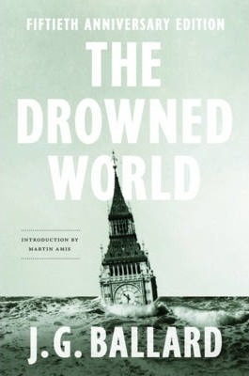

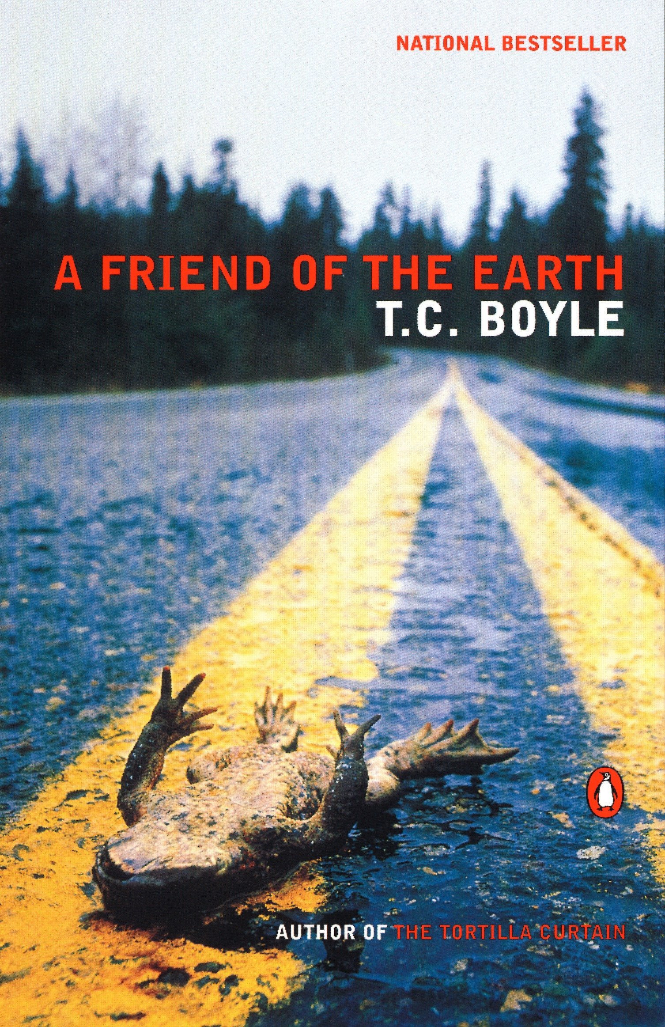
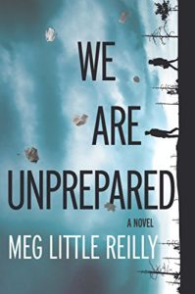


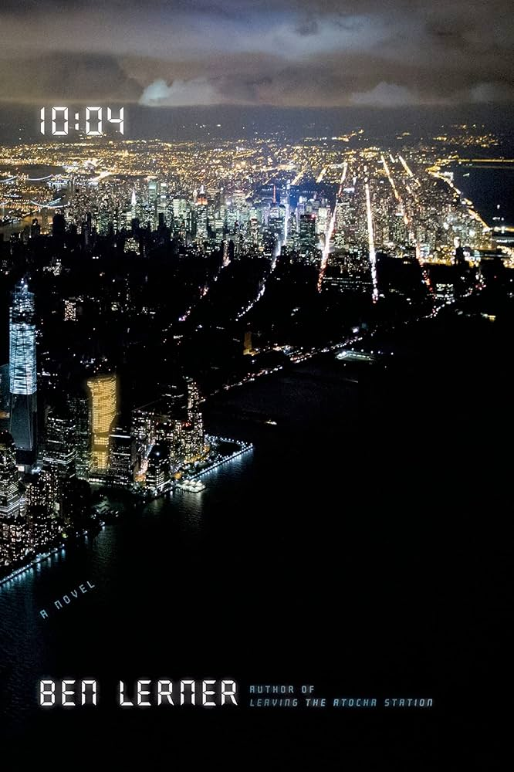

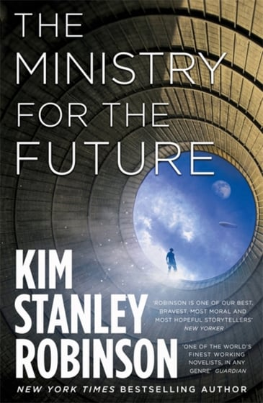








Notes:
YET – there IS A strong idenfiiable strand of climate fiction - ‘clifi’ – what Ghosh resigned to the ‘outhouses’ of culture – there are indeed so many examples of societal meltdown and earth system collapse on our screens that it’s harder to choose one. Predilection for dystopia and apocalypse (end times threats; cautionary tales; extrapolations of the present; also small morality tales within of how to deal wth it and how to be better and perhaps prevent it)
Examples of clifi from all over and through various genres and audicnes, YA fiction to sf to fantasy and the orthodox novel – this fiction is almost always trying to register a massive change and usually involves dystopian worlds, either of adapation to a new and radically transformed climate or a word where an apocalypse is creating dystopian forms of reaction and governance – next slide is benumbing reality in this work….

Slide 11




Slide 12

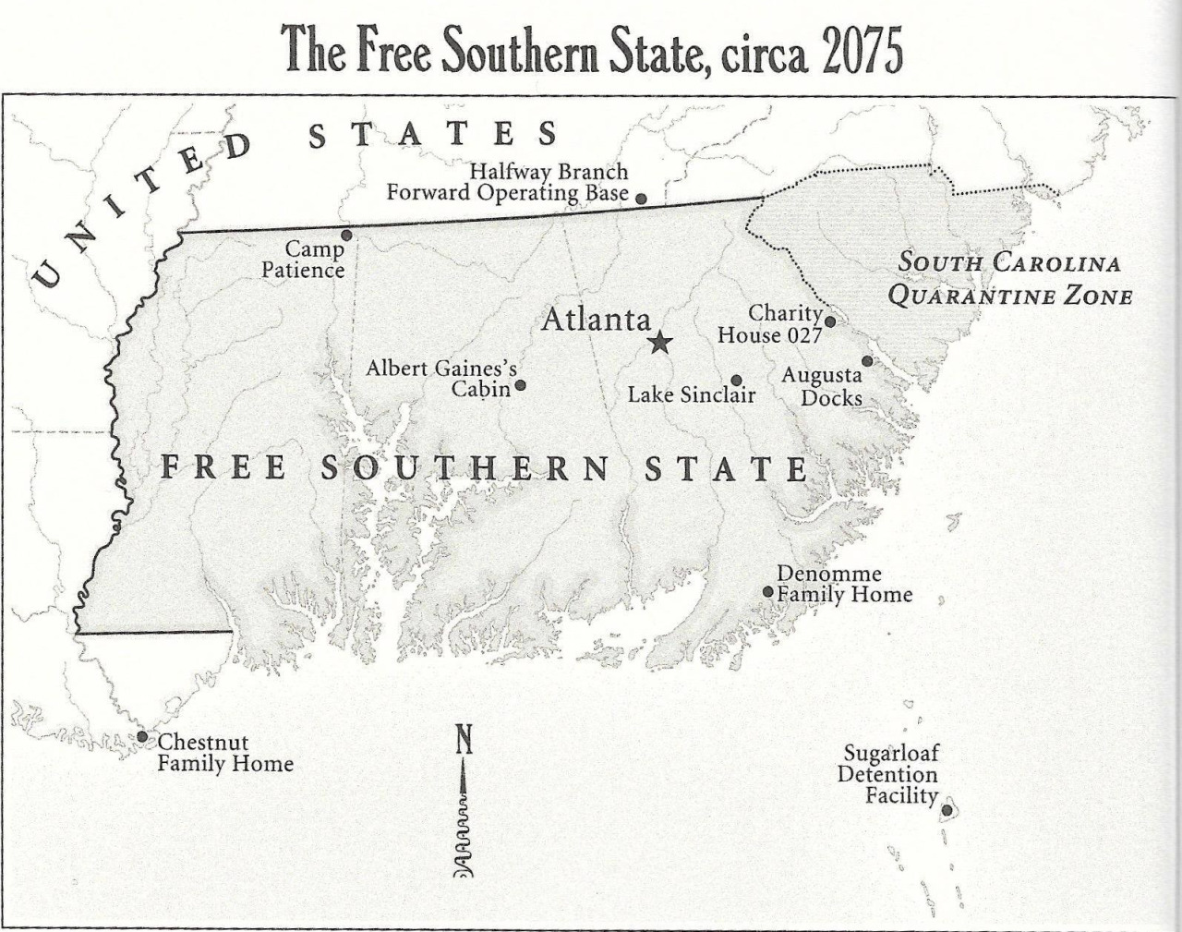


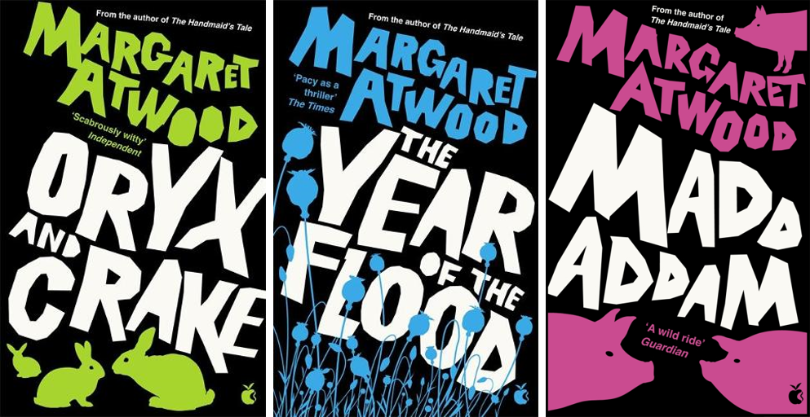

Slide 13
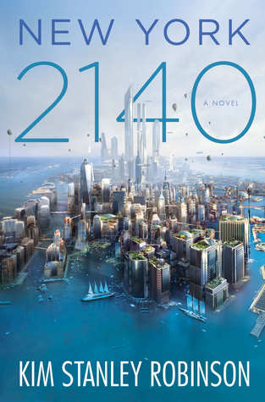
The flood went up to about Thirtieth. And even though it was fast, it did take two hours. So people just ran north ahead of it. They abandoned whatever they were doing and ran in the streets. We did too. Central Park had millions of people in it, standing there looking at each other….No one could believe it. But it was true. A new day had come. We knew it had happened, because there we were. We knew it would never be the same. Downtown was gone. So that was very strange. People were stunned, you could see it. We stood there looking at each other! No one could believe it but there we were. Everyone was like, well, here we are – it must be real. But it was like a dream.
Kim Stanley Robinson, New York 2140

Slide 14
Leaning on the balcony rail, the slack water ten storeys below reflecting his thin angular shoulders and gaunt profile, Kerans watched one of the countless thermal storms rip through a dump of huge horse-tails lining the creek which led out of the lagoon. Trapped by the surrounding buildings and the inversion layers a hundred feet above the water, pockets of air would heat rapidly, then explode upwards like escaping balloons, leaving behind them a sudden detonating vacuum. For a few seconds the steam clouds hanging over the creek dispersed, and a vicious miniature tornado lashed across the 6o-feet-high plants, toppling them like matchsticks. Then, as abruptly, the storm vanished and the great columnar trunks subsided among one another in the water like sluggish alligators.
Rationalising, Kerans told himself that he had been wise to remain in the hotel—the storms were erupting more and more frequently as the temperature rose—but he knew that his real motive was his acceptance that little now remained to be done. The biological mapping had become a pointless game, the new flora following exactly the emergent lines anticipated twenty years earlier, and he was sure that no-one at Camp Byrd in Northern Greenland bothered to file his reports, let alone read them. (1962)

Slide 15
to develop the syndrome of ‘pretrauma’ – not the usual post-traumatic stress disorder, in which people suffer past wounds, but rather ‘fear of a future terrifying event of a similar kind’. Our culture as a whole, Kaplan suggests, is now developing pretrauma. With more and more film, television, literature. “journalism inflected by the creeping insight that catastrophic climate change is approaching, consumers of popular culture make up ‘a pretraumatized population.” Malm
Apocalypse is the single most powerful master
metaphor that the contemporary environmental imagination
has at its disposal. Of no other dimension of
contemporary environmentalism, furthermore, can it
be so unequivocally said that the role of the imagination
is central to the project; for the rhetoric of apocalypticism
implies that the fate of the world hinges on
the arousal of the imagination to a sense of crisis.
Lawrence Buell, The Environmental Imagination: Thoreau,
nature writing, and the formation of American Culture (1995)
But to frame all such attempts to engage with
disastrous or catastrophic renderings of climate
change as negative misses the point of the
creative role of fiction and the cautionary offerings of
the disaster. Yusoff & Gabrys
In the modern novel…catastrophism was
relegated to the margins. Ghosh

Slide 16


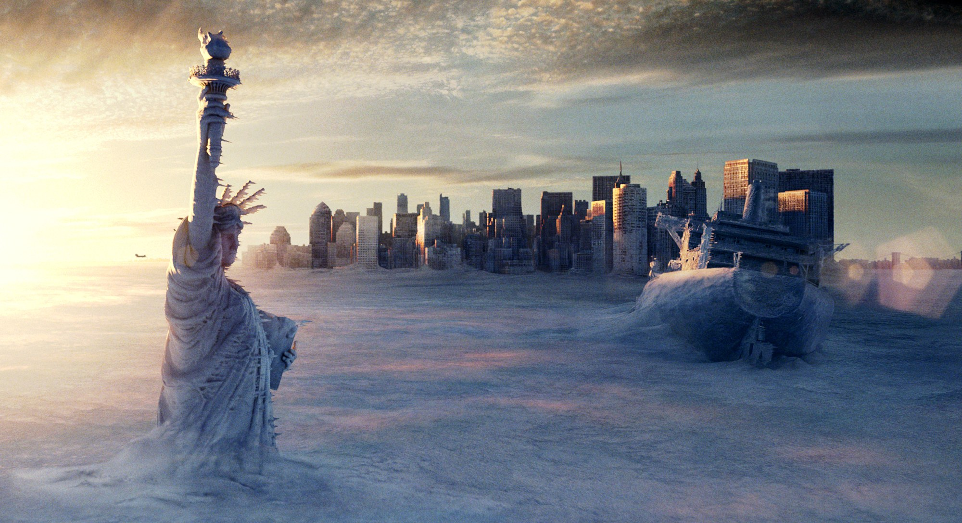
Notes:
collapse, entropy, painful pedestrianism, without maps, following the cracked highway - the bunker episode - Predilection for dystopia and apocalypse (end times threats; cautionary tales; extrapolations of the present; also small morality tales within of how to deal wth it and how to be better and perhaps prevent it)
One vein of thinking is that this seems to be not real at all, difficult to grasp – so maybe bunker thinking is both a natural response and also a fearful/problematic one. other forms of escape and shelter are seen in fagan -

Slide 17
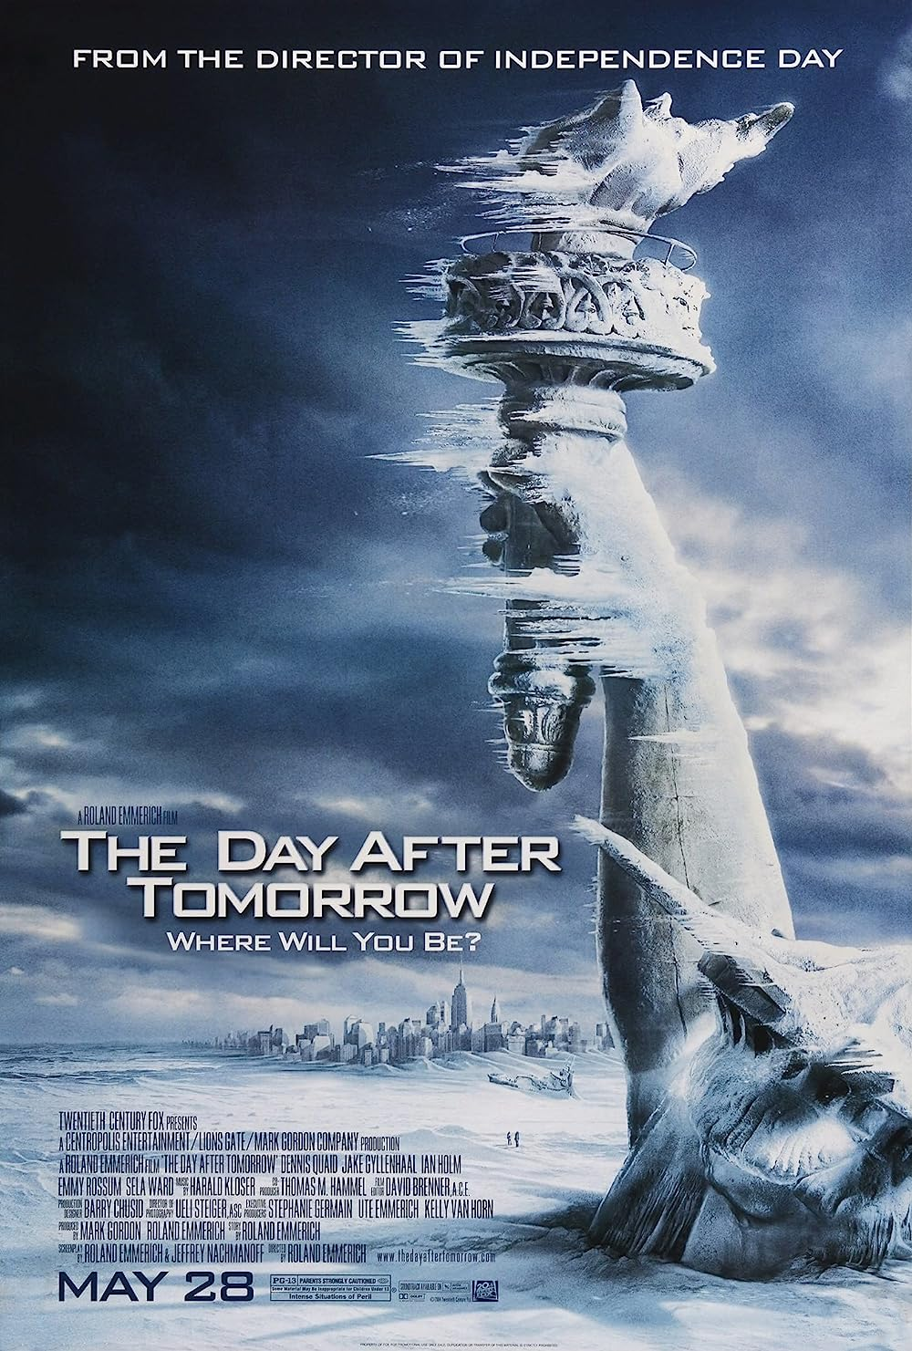
Apocalypse is the single most powerful master
metaphor that the contemporary environmental imagination
has at its disposal. Of no other dimension of
contemporary environmentalism, furthermore, can it
be so unequivocally said that the role of the imagination
is central to the project; for the rhetoric of apocalypticism
implies that the fate of the world hinges on
the arousal of the imagination to a sense of crisis.
Lawrence Buell The Environmental Imagination: Thoreau,
nature writing, and the formation of American Culture (1995)

Slide 18
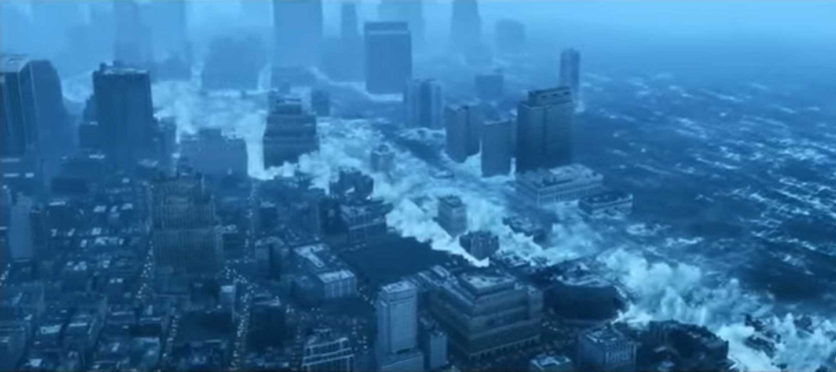
And it appears that we are now in an era that will
be defined precisely by events that appear, by our current standards of normalcy, highly improbable: flash floods, hundred-year storms, persistent droughts, spells of unprecedented heat, sudden landslides, raging torrents pouring down from breached glacial lakes, and, yes, freakish tornadoes. Ghosh, The Great Derangement

Slide 19
Historic Material

Slide 20
4 THESES
Thesis 1: Anthropogenic Explanations of Climate Change Spell
the Collapse of the Age-old Humanist Distinction between
Natural History and Human History
Thesis 2: The Idea of the Anthropocene, the New Geological
Epoch When Humans Exist as a Geological Force, Severely
Qualifies Humanist Histories of Modernity/Globalization
Thesis 3: The Geological Hypothesis Regarding the
Anthropocene Requires Us to Put Global Histories of Capital in Conversation with the Species History of Humans
Thesis 4: The Cross-Hatching of Species History and the History of Capital Is a Process of Probing the Limits of Historical Understanding
Chakrabarty. “The Climate of History: Four Theses.” Critical Inquiry 35. 2 (2009): 197–222.

Slide 21
the current crisis can precipitate a sense of the present that
disconnects the future from the past by putting such a future beyond the
grasp of historical sensibility. The discipline of history exists on the assumption
that our past, present, and future are connected by a certain
continuity of human experience.
our usual historical practices for visualizing times, past and future, times inaccessible to us personally—the exercise of historical understanding—are thrown into a deep contradiction and confusion. Weisman’s experiment indicates
how such confusion follows from our contemporary sense of the present
insofar as that present gives rise to concerns about our future. Certain scientific
propositions have come into circulation in the public domain that have profound, even transformative, implications for how we think about human history
The current planetary crisis of climate change or global warming elicits
a variety of responses in individuals, groups, and governments, ranging
from denial, disconnect, and indifference to a spirit of engagement and
activism of varying kinds and degrees. These responses saturate our sense of the now.
If, indeed, globalization and global warming are born of overlapping processes, the question is, how do we bring them together in our understanding of the world?
Chakrabarty

Slide 22
The uncountable repetitions of the same act over the past two
centuries form the defeated time now pouring down from the sky.
How can we apprehend that process? Malm
Scholars writing on the current climate-change crisis are indeed saying
something significantly different from what environmental historians
have said so far. In unwittingly destroying the artificial but time-honored
distinction between natural and human histories, climate scientists posit
that the human being has become something much larger than the simple
biological agent that he or she always has been. Humans now wield a
geological force. As Oreskes puts it: “To deny that global warming is real is
precisely to deny that humans have become geological agents, changing
the most basic physical processes of the earth.”
In no discussion of freedom in the period since the Enlightenment was
there ever any awareness of the geological agency that human beings were
acquiring at the same time as and through processes closely linked to their
acquisition of freedom. Geological time and the chronology of human
histories remained unrelated. This distance between the two calendars, as
we have seen, is what climate scientists now claim has collapsed. The period
I have mentioned, from 1750 to now, is also the time when human
beings switched from wood and other renewable fuels to large-scale use of
fossil fuel—first coal and then oil and gas. The mansion of modern freedoms
stands on an ever-expanding base of fossil-fuel use. Most of our
freedoms so far have been energy-intensive.
Chakrabarty

Slide 23
Time

Slide 24
‘We continue to live on a stage where there is nothing but the present. Past and future alike have dissolved into a perpetual now, leaving us imprisoned in a moment without links backwards or forwards: only the dimension of space extends in all directions, across the seamless surface of a globalised world, in which everyone is connected to everyone else through uncountable threads – but time has ceased flowing.’
‘We can never be in the heat of the moment only in the heat of this ongoing past…it is the legacy of what people have done….the air is heavy with time.’
‘The links do not only run backwards. The shadow of anthropogenic CO₂ covers the foreseeable and extends into the unfathomable future.’
‘There is no synchronicity in climate change. Now more than ever, we inhabit the diachronic, the discordant, the inchoate.’
‘Much of this can still be avoided. That possibility supercharges our moment with time… “ An eternity is determined now.’
“We are only in the very early stages, but already our daily life, our psychic experience, our cultural responses, even our politics show signs of being sucked back by planetary forces into the hole of time, the present dissolving into past and future alike. Postmodernity seems to be visited by its antithesis: a condition of time and nature conquering ever more space. Call it the warming condition.”
From “Introduction: Theory for the Warming Condition”

Slide 25

The formal study of climate science introduces the global to individual and local scales of experience, which literature – most obviously, the novel – accommodates. But literary convention is rather more stretched by climatic conceptions of time. Alongside individual and local timescales (that is, human lifetimes and historical epochs), climate science and, particularly, this century’s concerns about climate change bring into purview not just individual and local but geological durations of time. It is, then, not the climatological expansion of the concept of time as universal time that is at stake here – universal time is a function of a global sensibility and thus a matter of rendering time as spatially simultaneous. What matters as climate science turns its gaze to climate systems and climate change is not the apprehension of time as universal, as a function of the apprehension of space as global, but the ability to expand time frames and durations.
Adeline Johns-Putra, ‘Introduction’ to Climate and Literature, CUP, 2019

Slide 26



Douglas Coupland

Slide 27

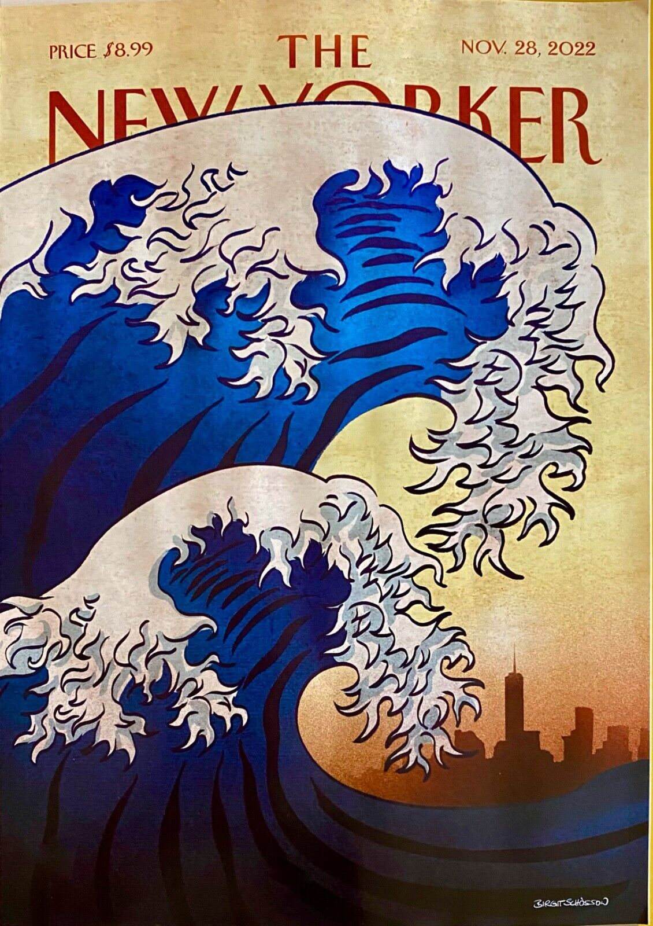
Richard McGuire
2010

Slide 28

It tends to upset schedules and routines by dint of the weight it carries from the past. The tempest has a twisted, multiplex temporality, as registered by Lerner’s protagonist, who compulsively reports days of ‘unseasonable warmth’ when walking down October streets:
The unusual heat felt summery, but the light was distinctly autumnal, and the confusion of seasons was reflected in the clothing around them: some people were dressed in T-shirts and shorts, while others wore winter coats. It reminded him of a double exposed photograph or a matting effect in film: two temporalities collapsed into a single image.
Andreas Malm. The Progress of This Storm.
(excerpt is from Ben Lerner’s novel 10:04 )

Slide 29
The task of placing, historically, the crisis of climate change thus requires us to bring together intellectual formations that are somewhat in tension with each other: the planetary and the global; deep and recorded histories; species thinking and critiques of capital. In saying this, I work somewhat against the grain of historians’ thinking on globalization and world history.
It seems true that the crisis of climate change has been necessitated by the high-energy consuming models of society that capitalist industrialization has created and promoted, but the current crisis has brought into view certain other conditions for the existence of life in the human form that have no intrinsic connection to the logics of capitalist, nationalist, or socialist identities. They are connected rather to the history of life on this planet, the way different life-forms connect to one another, and the way the mass extinction of one species could spell danger for another. Without such a history
of life, the crisis of climate change has no human “meaning.” For, as I have said before, it is not a crisis for the inorganic planet in any meaningful sense.
The crisis of climate change calls for thinking simultaneously on both registers, to mix together the immiscible chronologies of capital and species history.
Chakrabarty

Slide 30
All of this makes climate change events peculiarly resistant
to the customary frames that literature has applied to “Nature”:
they are too powerful, too grotesque, too dangerous, and
too accusatory to be written about in a lyrical, or elegiac, or
romantic vein. Indeed, in that these events are not entirely of
Nature (whatever that might be), they confound the very idea
of “Nature writing” or ecological writing: they are instances,
rather, of the uncanny intimacy of our relationship with the
nonhuman…. Now that nonhuman agencies have dispelled that
illusion, we are confronted suddenly with a new task: that of finding other ways in which to imagine the unthinkable beings and events of this era.

Slide 31


Slide 32
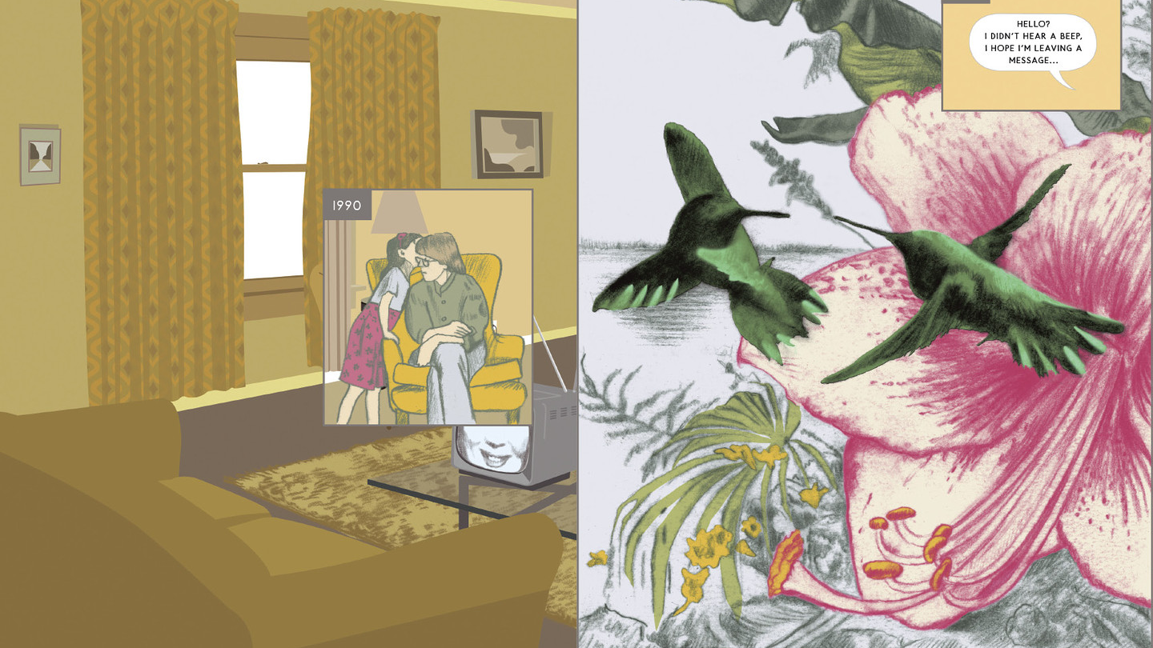

Slide 33
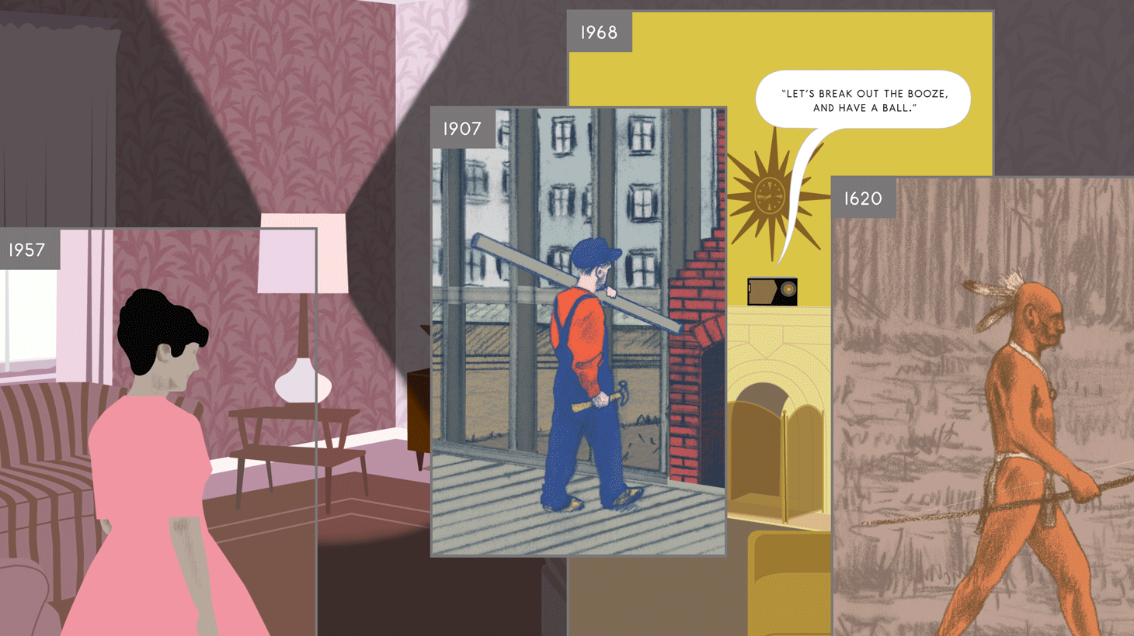

Slide 34
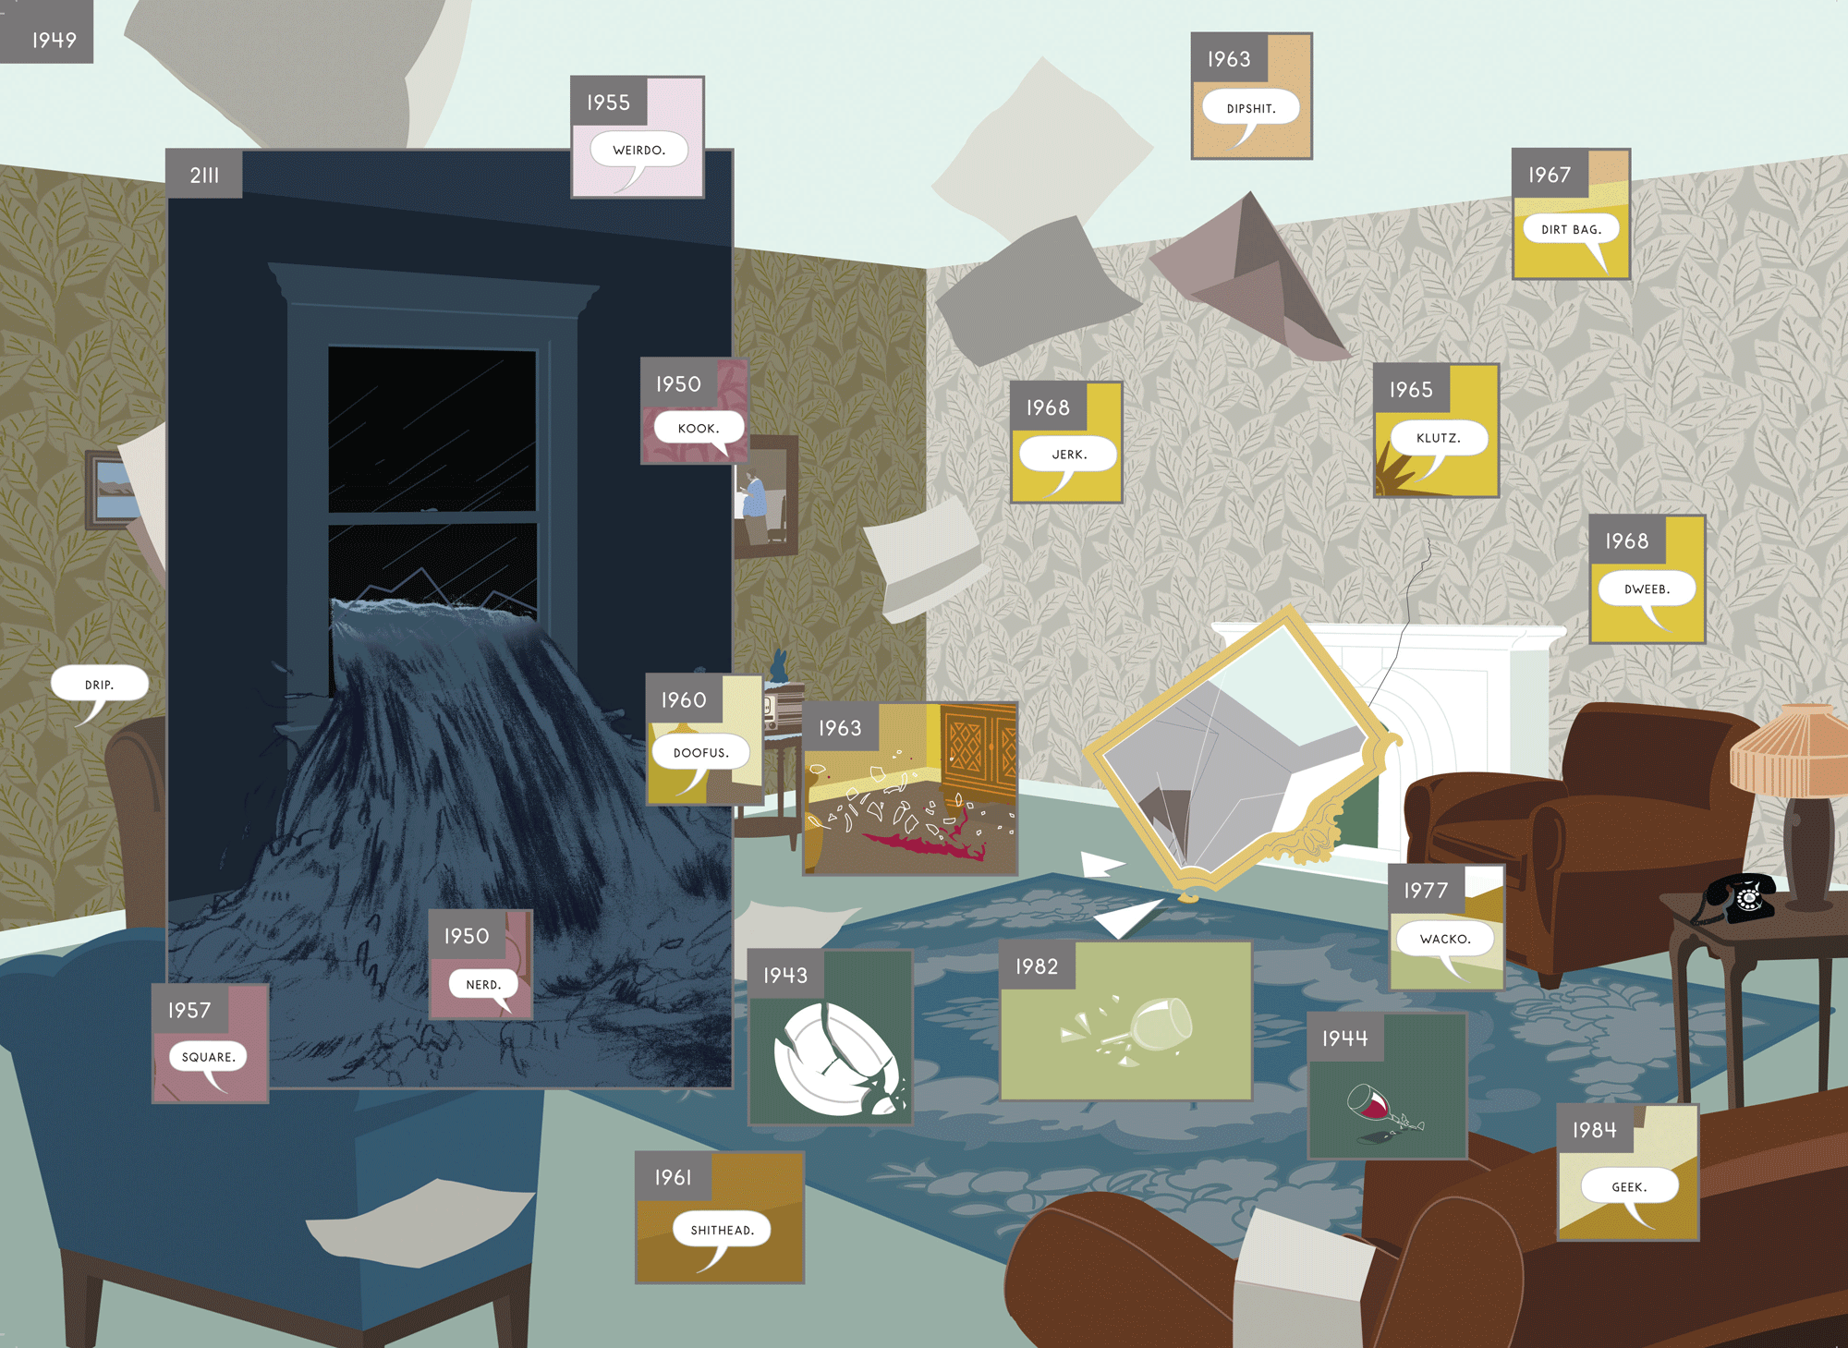

Slide 35


Slide 36


Slide 37
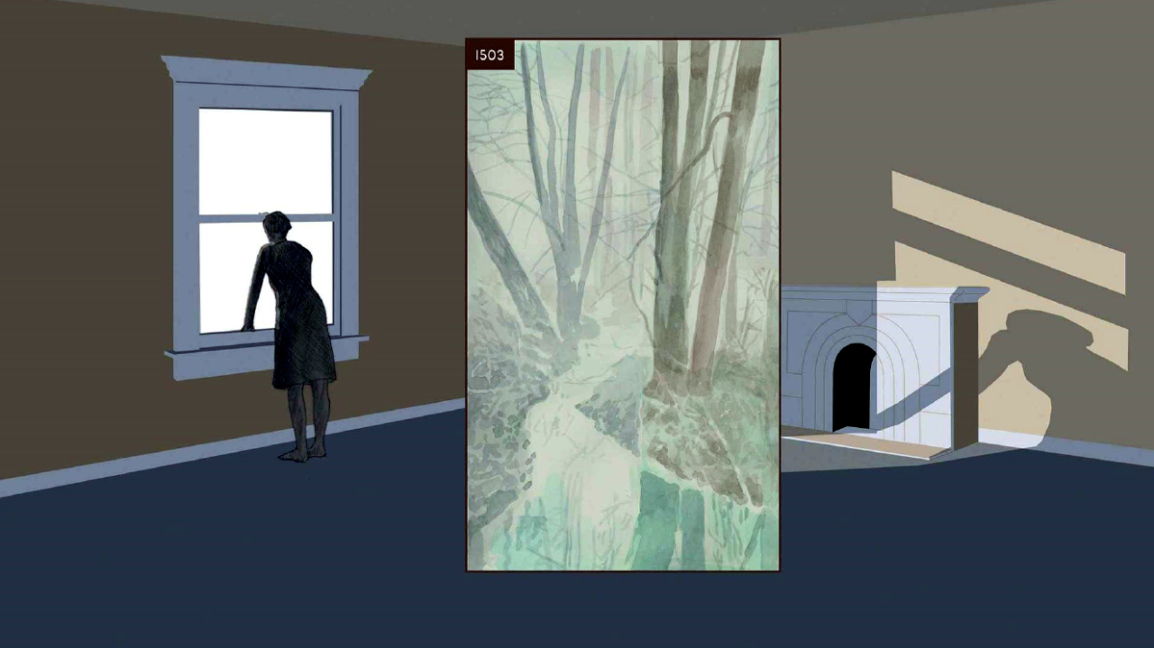

Slide 38
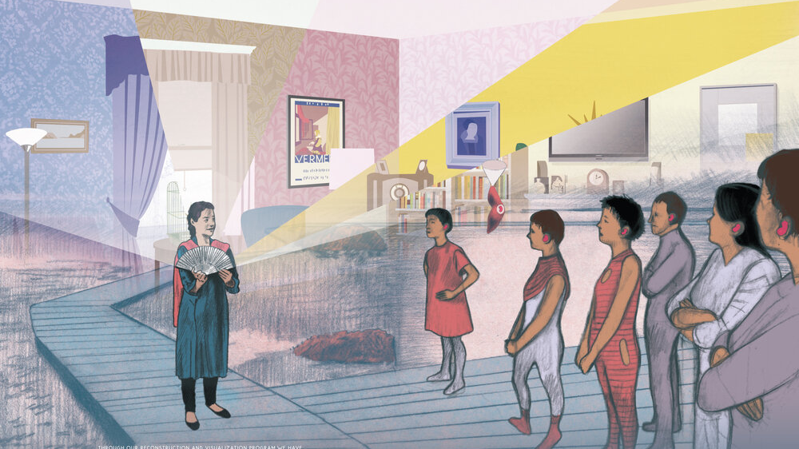

Slide 39
Futures

Slide 40
First, there has been a concentration on the futurity of climate change including the arts and techniques of imagination that are bound up with making scenarios, narratives, and contingency plans that project toward or back from uncertain futures. An engagement with the arts of futurity can be seen in the workings of the Intergovernmental Panel on Climate Change (IPCC); the practices of scenario modeling; back-casting and forward-looks that characterize much of the science–policy interface of climate science; and the economics of futures markets. These uncertainties open a generative space of unknowing that has been populated by various ‘visions’ of the future. The arts of this futurity are anticipatory, pre-emptive, and promiscuous.
…..this ‘cultural turn’ in climate change has
seen a critical engagement with the practices of climate
science. Multiple creative practitioners and researchers
are now seeking to expand modes of climate science
production to reconsider the social spaces of climate
interaction at the science-policy-public interface, and
to promote new forms of the coproduction knowledge
between different communities of practice (such
as science–art or art–public collaborations).
Yusoff & Gabrys
Yet within this work, there has been scant attention as to
how futures could be deployed as a cultural and creative
method of environmental imagining and how the arts and
humanities could contribute to future narratives. The
arts and humanities play an important role in thinking
through our representations of environmental change
and give tangible form to the imagination of different
worlds outside of the constraints of the given present….
Arts and humanities scholars and practitioners
in collaboration with scientists can reconsider
how climate futures are imagined.

Slide 41

“We should conclude, first of all,
that building a new coal-fired power plant,
or continuing to operate an old one, or
drilling for oil, or expanding an airport,
or planning for a highway is now irrational
violence.” Malm, The Progress of This Storm

Slide 42
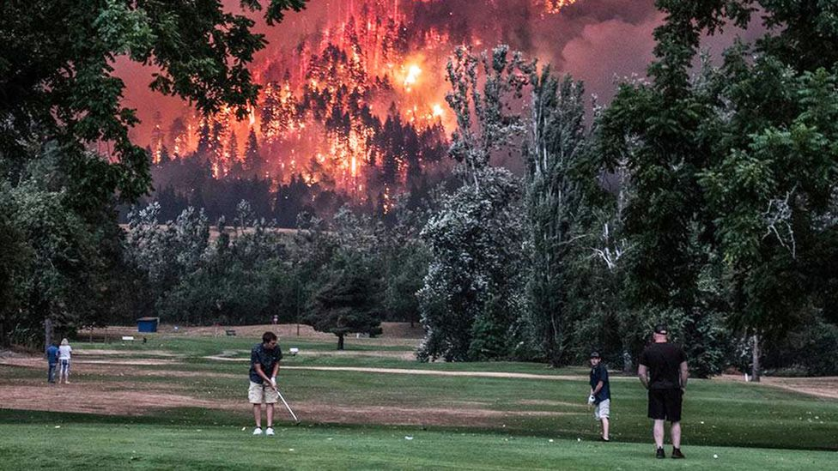

Slide 43


Slide 44



Slide 45
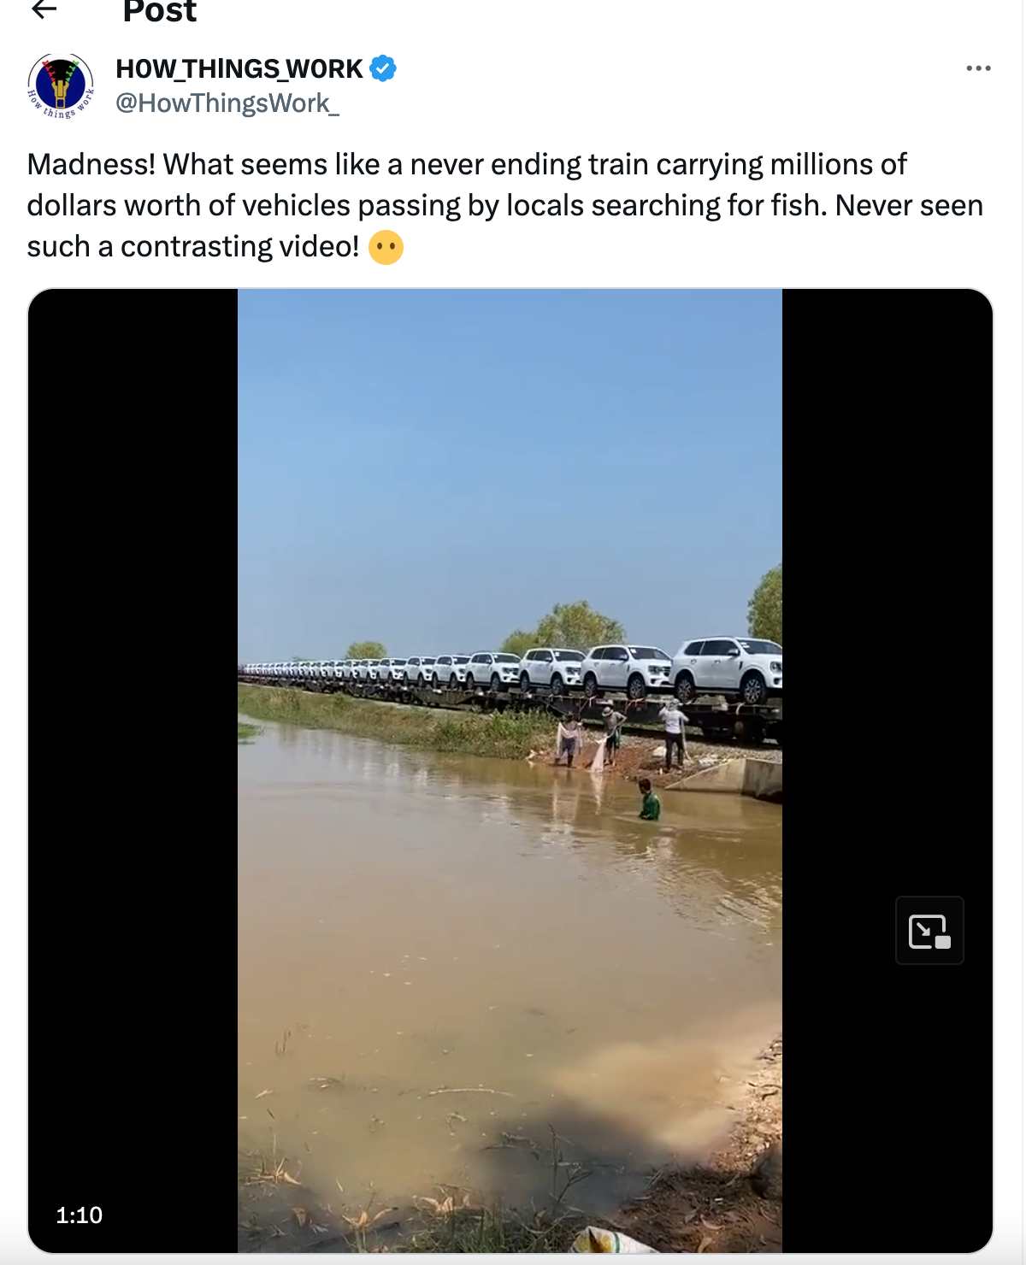

Slide 46
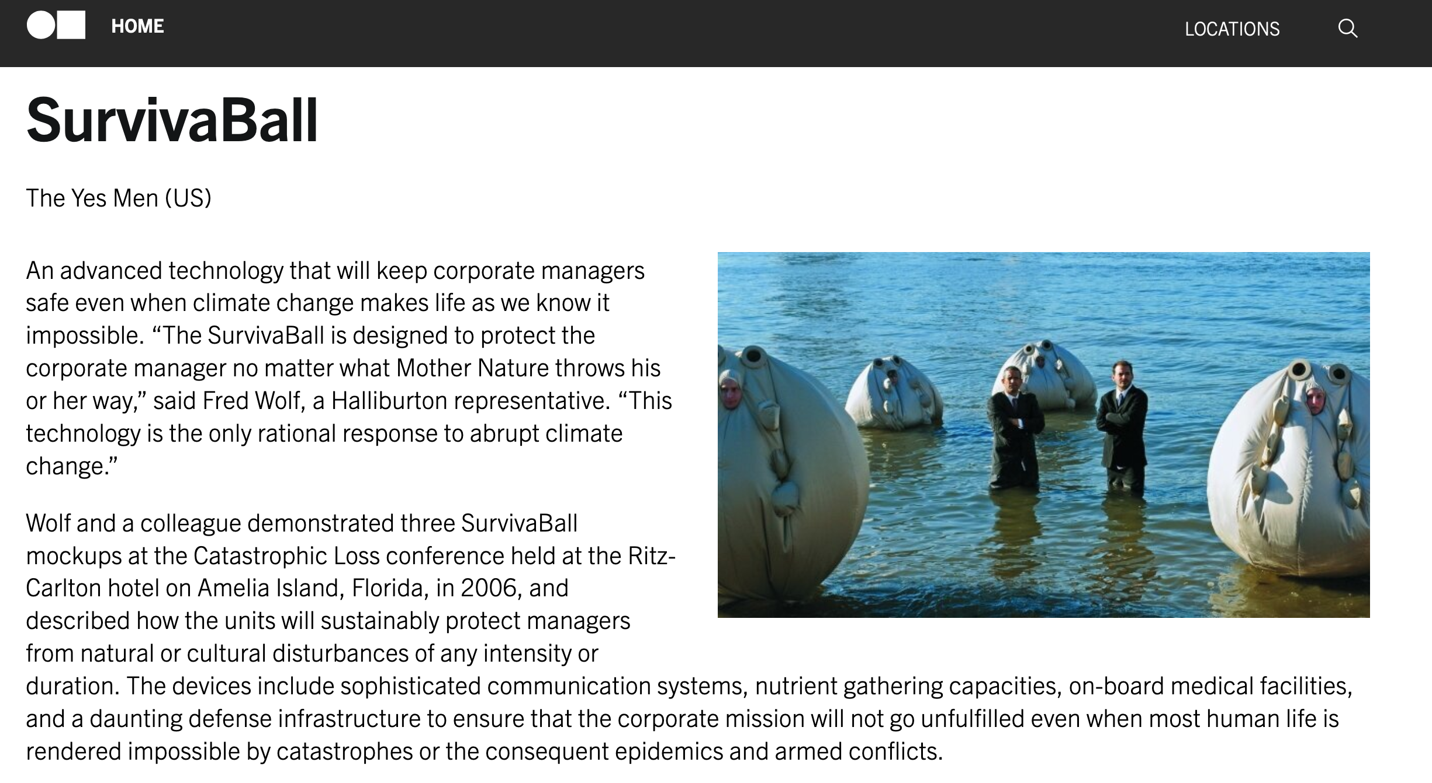

Slide 47
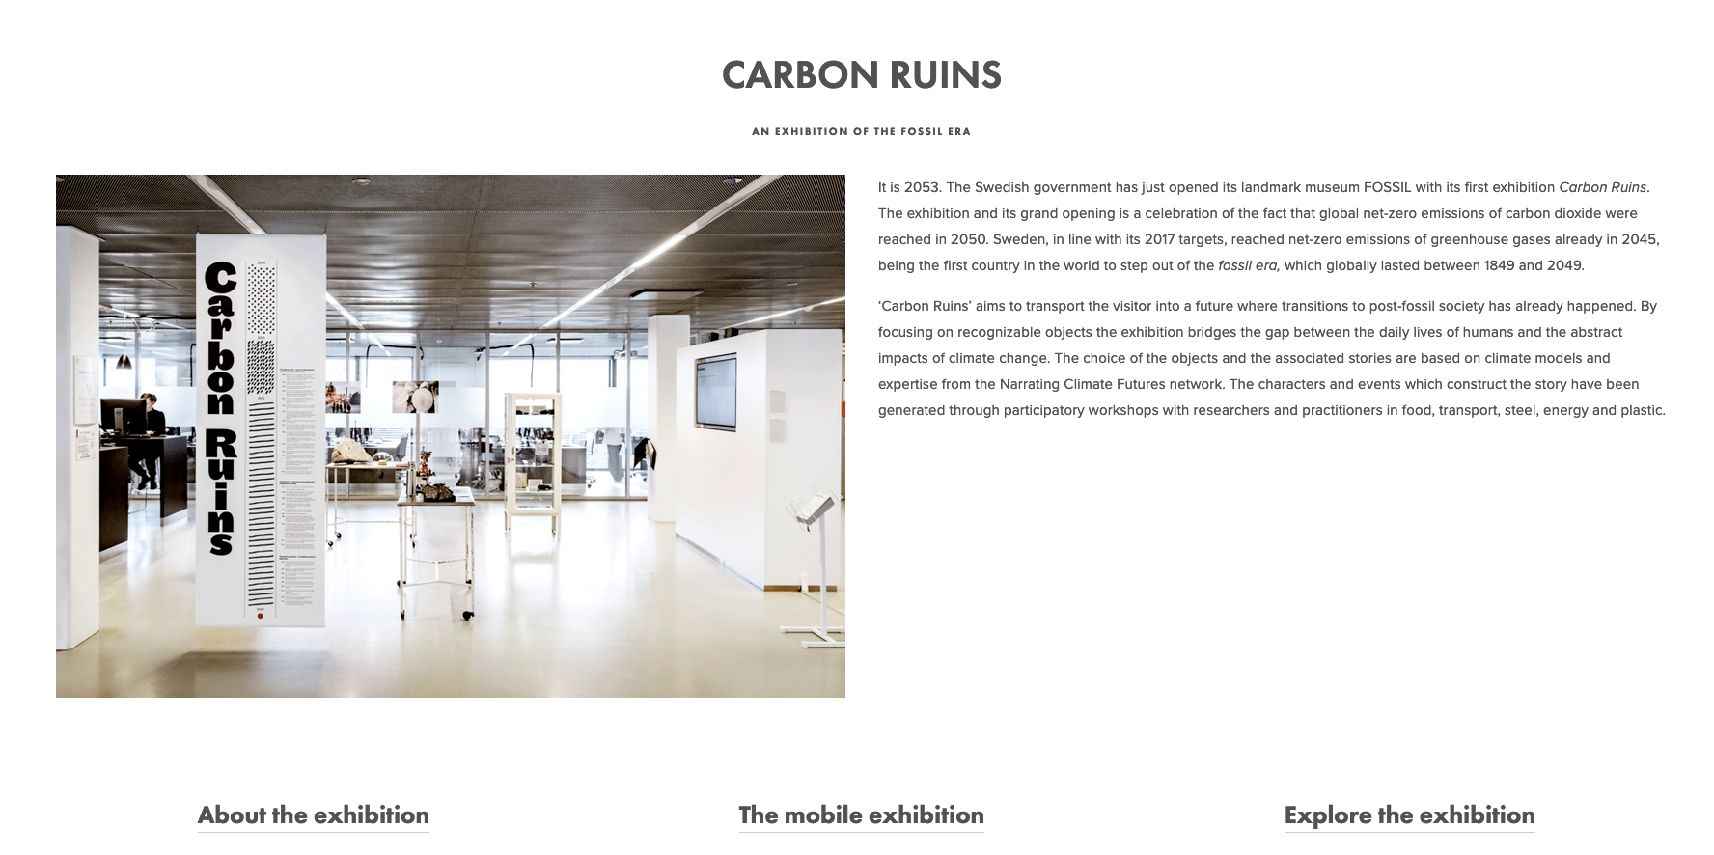
https://www.climaginaries.org/carbon-ruins

Slide 48
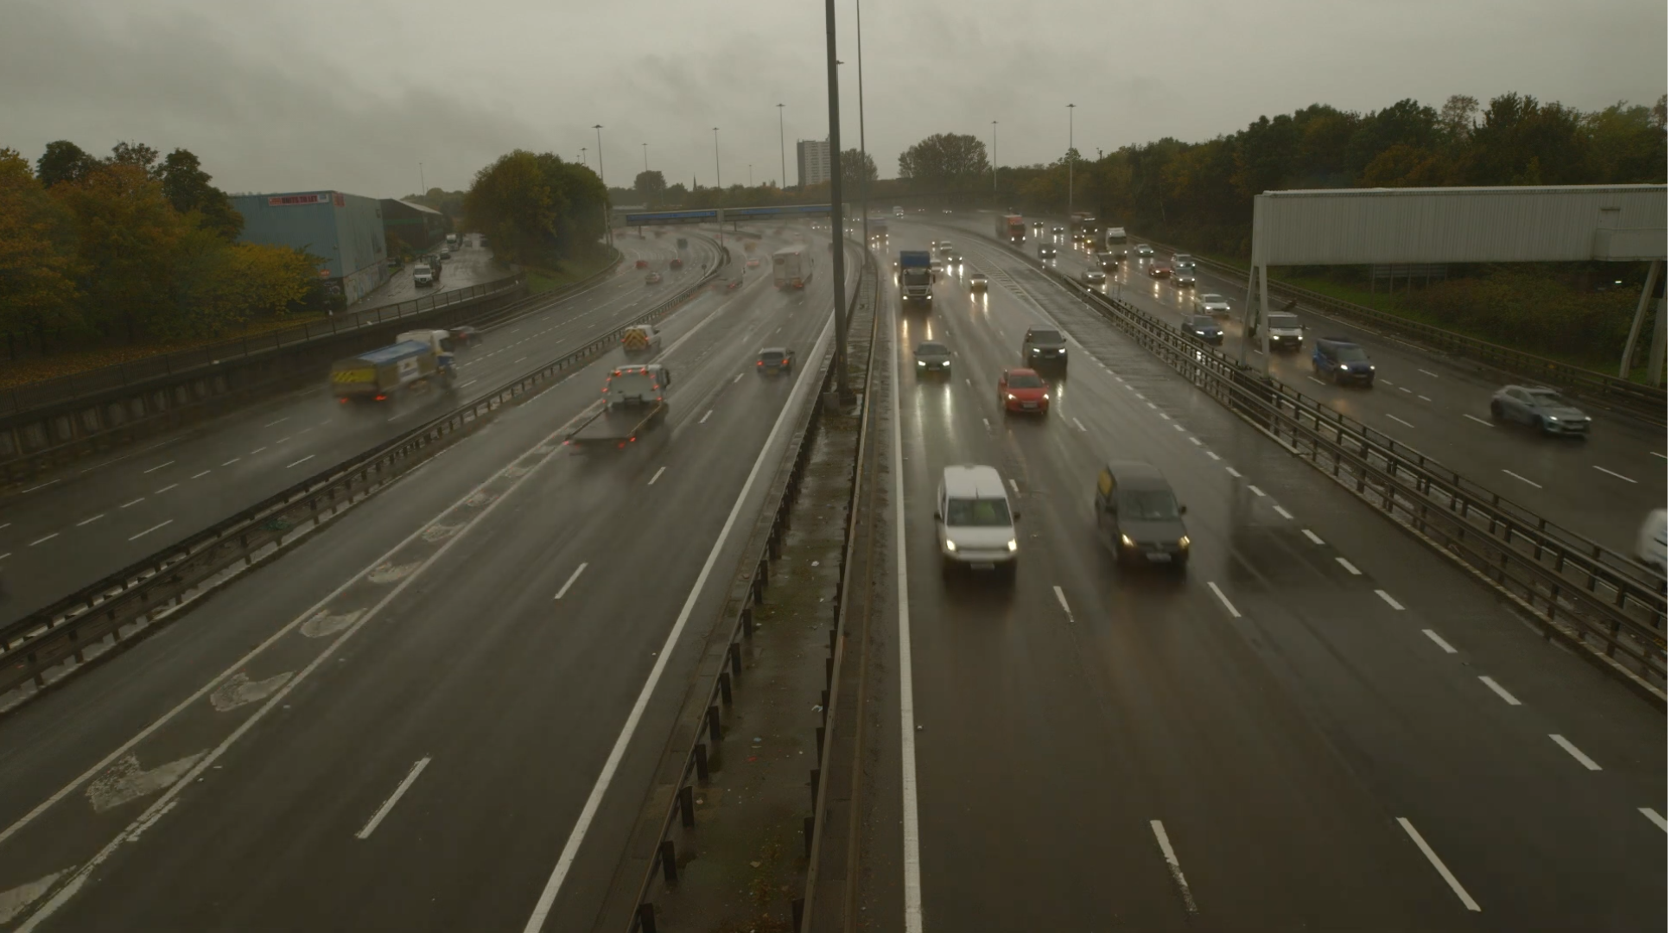

Slide 49
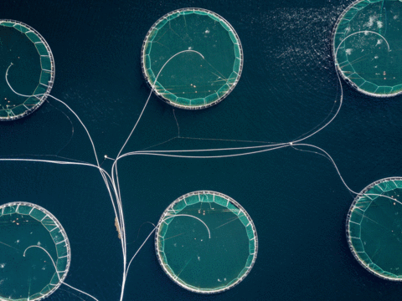
Notes:
What you are about to experience is an exhibition from the future. The Museum of Carbon Ruins opened in Lund, Sweden in 2053, in part to celebrate the successful transition, made across the world, away from the fossil-fuel era. The critical challenges set down in the Paris Agreement of 2015, to reach a world of net-zero emissions of carbon-dioxide – were met. Emergencies were declared. Arguments were had. But calls were answered. Actions were taken. We held 1.5 degrees. Concerted efforts by a variety of stakeholders across the world made the high-carbon lifeworld, born in the mid-19th century, intensified and accelerated in the 20th ­– an obsolescence. This was not effortless or without struggle, some of it violent. It was not without some mourning. Remember, those of you alive then, back in 2019: the range of the structures, products and practices of that world were formidable – and often invisible. They went deep. They saturated our social and cultural domains. They built our economies and our banking practices. They materialized and made functional all manner of incredible infrastructures – transport, energy, health, agriculture, digital. We were citizens of carbon. It percolated into our affective lives. It fired our emotions, generated a great many of our bodily and intellectual pleasures. Our sense of freedom and the good life, were at root, carbon refinements, oily mediations, fossily pleasures. But these practices we knew and eventually almost universally acknowledged, were destructive – on multiple levels. So. We made the necessary shifts. Some countries led the way, Sweden among them. The objects gathered in the Museum of Carbon Ruins are testament to that.

Slide 50
Why a museum from the future?
Making the familiar, unfamiliar.
Neither dystopia nor utopia.
Stories anchored in everyday objects affect the visitor.
A science communication tool.
A site for deliberation and discussion.
Notes:
So why did we do this?
A core idea of this project is that carbon is deeply embedded in our lives. Looking back at the fossil age allows us to make that which today is familiar, unfamiliar.
The dominating climate imaginaries are either dystopic catastrophe porn or utopic techno-fix scenarios. The museum is hopeful in that we reach our climate targets – but we highlight the pain and suffering that might be associated with such a transtion. Minerals are extracted from sensitive biotopes and people are displaced, insects go extinct due to an increasingly intensive forestry sector and violence ensues as the benefactors of the fossil society react to their new position in society.
Climate communication have long had a problem of perceived distance: we are far away from the impacts and the causes of climate change. By using places, characters and objects that are distinctly Swedish climate science is embodied with a new meaning.
The museum deliberately does not tackle every issue, and the visitors are invited to suggest objects and topics for us to cover. By transporting them in space and time, we allow discussions to escape the trenches of 2019 climate politics and instead focus on the type of society we want to build.

Slide 51

Notes:
A guided tour of Carbon Ruins would normally look more like this.
It has been a joint effort between four researchers at Lund University, an artist and an art historian within the Climaginaries research project and the Narrating Climate Futures network.
The boundary conditions were set early on: we suceed in our ambitions to limit warming to 1.5C, we reach net-zero emissions in Sweden by 2045 and globally by 2050. We knew the physical limitations of that goal, 500 gigatons of CO2 between 2018 and 2050, but how we got there was an excersise in imagination.
We then held workshops with experts in agriculture, energy, transport, materials and with the think-tank LU Futura to decide on the objects, the stories and the characters that would be shown in the museum.
After an intense three months, the inagurual version of the museum was opened to the public in April this year.

Slide 52
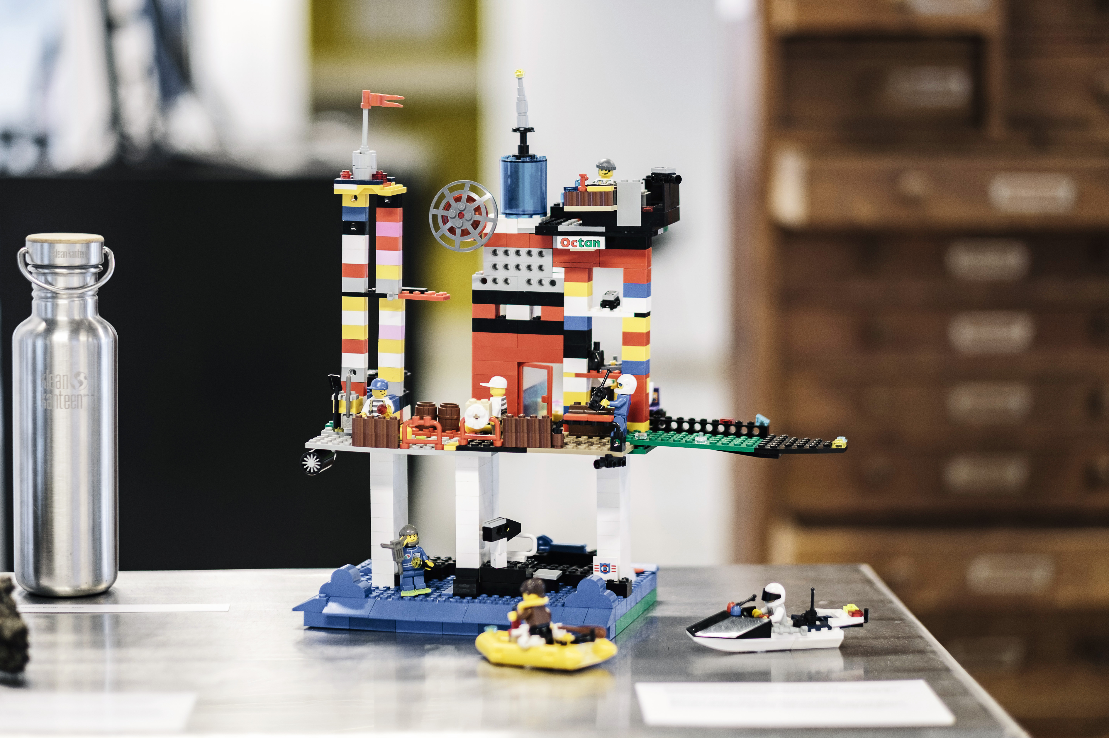
Notes:
Here we see an oil-platform built from vintage, oil-based LEGO-bricks, we've borrowed it from one of the toy-libraries in Lund. In a sense, oil-drilling was seen as a great job prospect for young people – especially in countries such as Norway and Nigeria with vast oil reserves. And the fossil fuel industry wanted to keep it that way – which is why they often partnered with LEGO to produce models of oil wells, gas stations, SUVs. ‘get them while they’re young as you say’.
I repeat: this plastic was made from oil, not the bio-based stuff you find in stores today. As parents of school-striking kids looked around their living rooms, LEGO came to represent the refiniries, the pipelines, the fossil structures that were endangering the childrens’ futures. Protests where held outside Billund where LEGO's headquarters were located. Children were dressed up in white gowns and had black liquid pouring down their hands. When these images hit the front-page of Jyllandsposten, LEGO’s stock plummeted but were eventually bailed out by the Danish state on the condition that they wholly transition into bio-plastic.

Slide 53


Slide 54
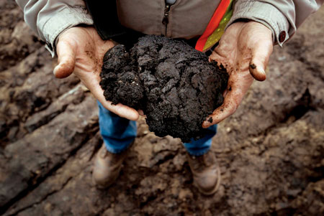
450 × 301

Slide 55


Slide 56


Slide 57
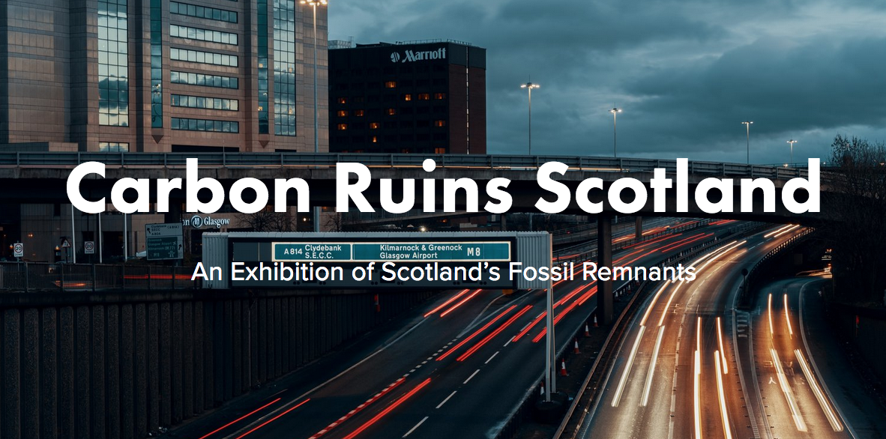

Slide 58


Slide 59
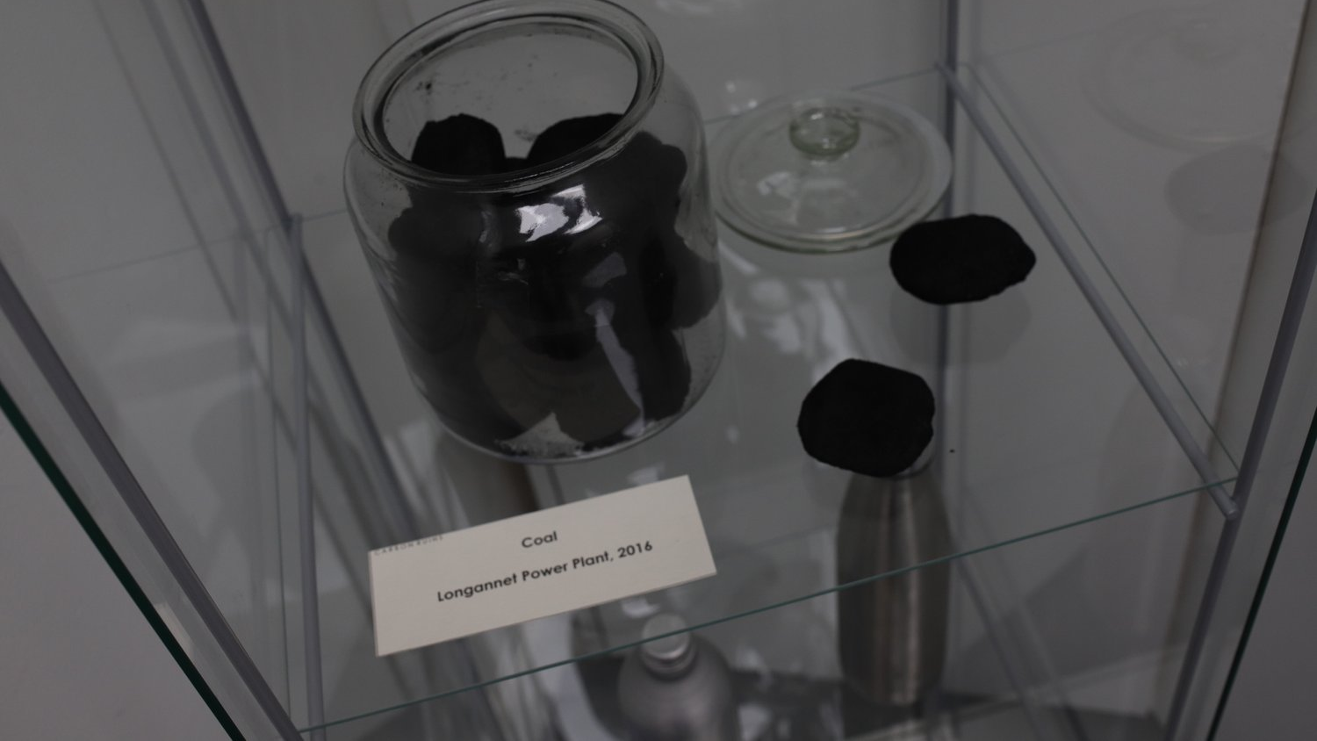

Slide 60


Slide 61


Slide 62


Slide 63
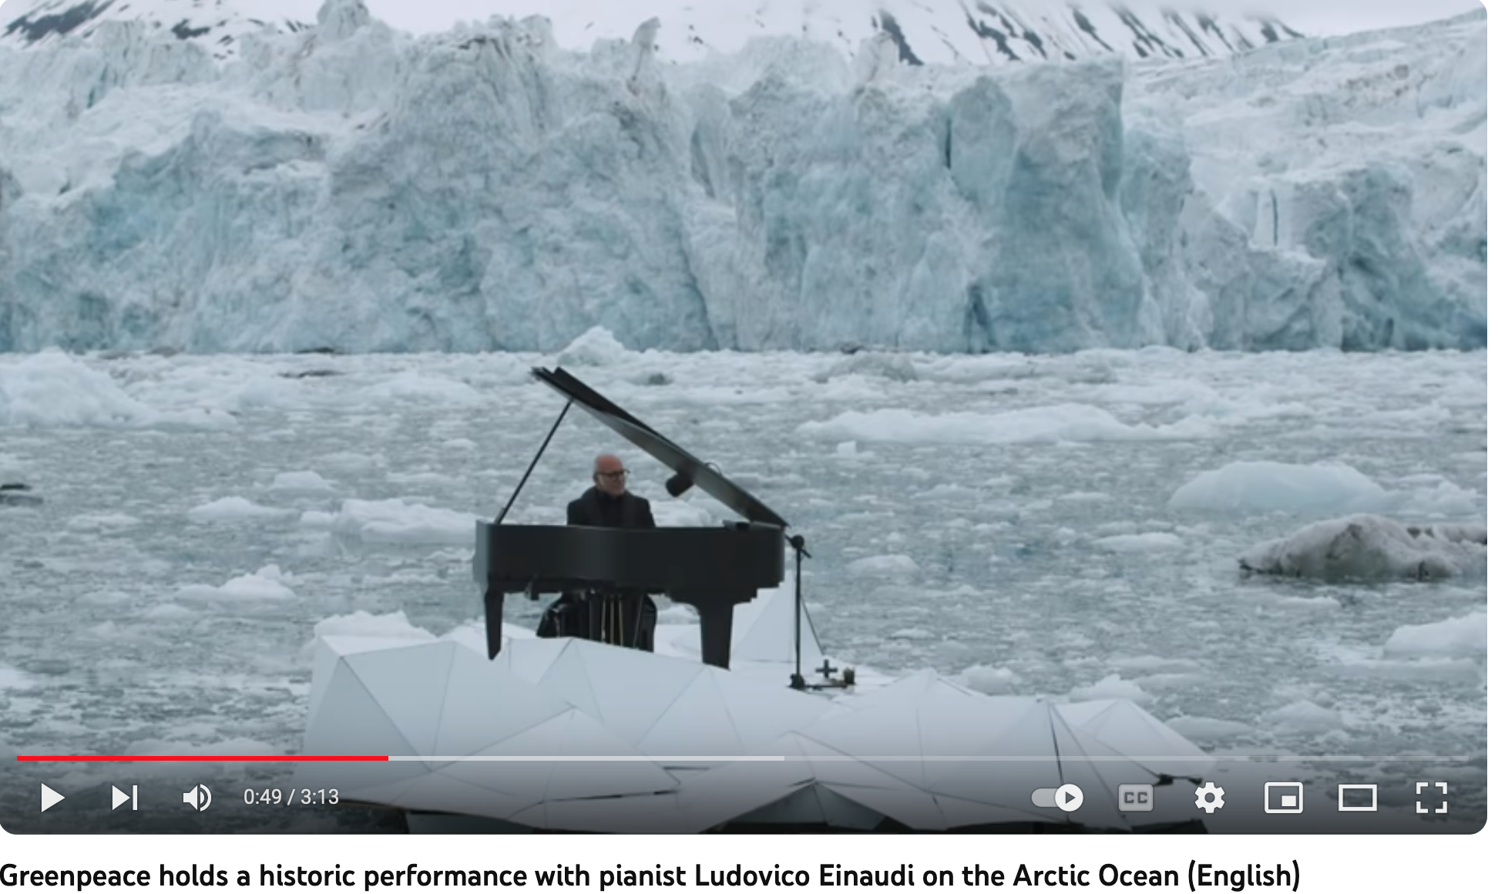

Slide 64
I hope to open a conversation on which styles of music might be best suited to connect with diverse publics on climate emergency. When Anohni composed the song “4 Degrees” with Hudson Mohawke for United Nations Climate Change Conference (COP)21, she did so to provoke anger and action in response to dangerously commonplace climate defeatism. But what was the scope of the song’s impact? What was the effect of its anger? Can certain songs and genres of music better address particular constituencies? Climate music must gauge the breadth of its influence. Determine a means of finding “sweet spots” between forms of sonic expression too broad or too rarefied. A principal way that artists achieve this is by speaking from a highly specific place lyrically, musically, and ecopolitically. Producing music from a rooted place can help artists evolve a musical vocabulary for climate breakdown.
he music I am curious about exists in counterpoint to the hollow spiritualism of high-profile environmentalist anthems like “Love Song to the Earth,” where a cavalcade of celebrity singers represent a vision of the Earth as a “diamond in the universe / Heaven’s poetry to us” and declare that “tomorrow’s in our hands” so we must “make it better somehow.” What would a musical language that expresses the unsettling feelings associated with climate change— anger, anxiety, mourning, vexation, helplessness—sound like? The climate music with the greatest resonance grows out of the attunement of artists to their imperiled places. Music more directly connected to the destruction of a particular place may not necessarily trigger a transformation, but it has potential.
The communication of climate grief, anxiety, and the need for radical change is at odds with the normative constraints of many genres of music, especially pop. As Pedelty puts it, a “pop show, a rite of spectacular excess, is inappropriate for communicating sustainability” (2015 204). There is little question that pop music is an awkward fit for “ecopolitical aesthetics,” given that it is a veritable “soundtrack for overconsumption” (Pedelty 204). Even so, music is “an activity by means of which bodies are synchronized into a social body” (2009 44). Music that feels prescient or prophetic is typically participatory, while music dedicated to inspiring awe through the artist’s mastery onstage tends to encourage a level of passive reverence. The collective experience of music appears to be fading. Jonathan Sterne charts historical shifts in music in The Audible Past, explaining that “as a form of expression becomes more legitimate and … prestigious, its audience quiets down;” eventually, the effect is that “the individuated listener comes before the collective sonic experience” (2003 161). In Western hyper-capitalist cultures, participatory music “tend[s] to be conceptualized as ‘less-than’ the more ‘important’ (i.e., professional and performative) spaces” (Walcott 2016, 9). Jeff Titon affirms the idea that participatory music “repositions culture workers collaboratively” and “help[s] to revitalize musical traditions and ... ensure their continuation” (2020 155).
Scott Stoneman, Songs of Prescience: Canadian Musical Activism in Climate Breakdown, Janus Unbound (2022)

Slide 65
Selected climate music playlist:
Anohni, "4 Degrees"
Automatic, "New Beginning"
Beach Boys, "A Day In The Life Of A Tree"
Björk, "Sacrifice"
Bo Burnham, “That Funny Feeling”
Childish Gambino, "Feels Like Summer"
Jeremy Dutcher, “Mehcinut”
Electricity for Everybody!, "Keeperess"
Sylvan Esso, "PARAD(w/m)E"
Mort Garson, “Ode to an African Violet”
Marvin Gaye, "Mercy Mercy Me (The Ecology)"
Hard Red Spring, "How High the Water"
Jimi Hendrix, "Up from the Skies"
Hurray for the Riff Raff, "LIFE ON EARTH"
Mos Def, "New World Water"
Radiohead, “Idioteque”
John K. Samson, "Vampire Alberta Blues"
Santigold, "Ushers of the New World"
SAULT, "Solar"
Leanne Betasamosake Simpson, "Head of the Lake"
Tanya Tagaq, "Retribution"
tUnE-yArDs, "Water Fountain"
The Weather Station, "Robber"
Weyes Blood, “A Lot’s Gonna Change”
Wintersleep, "Amerika"
Neil Young, "Mother Earth"

Slide 66
