Slide 1

Week Eight - Activism

Slide 2
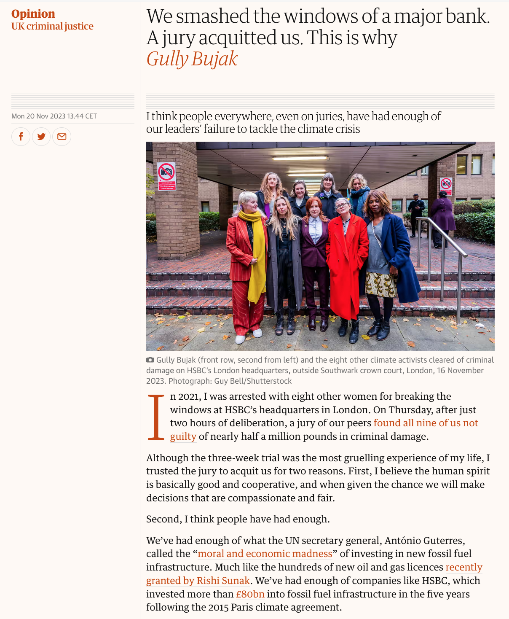
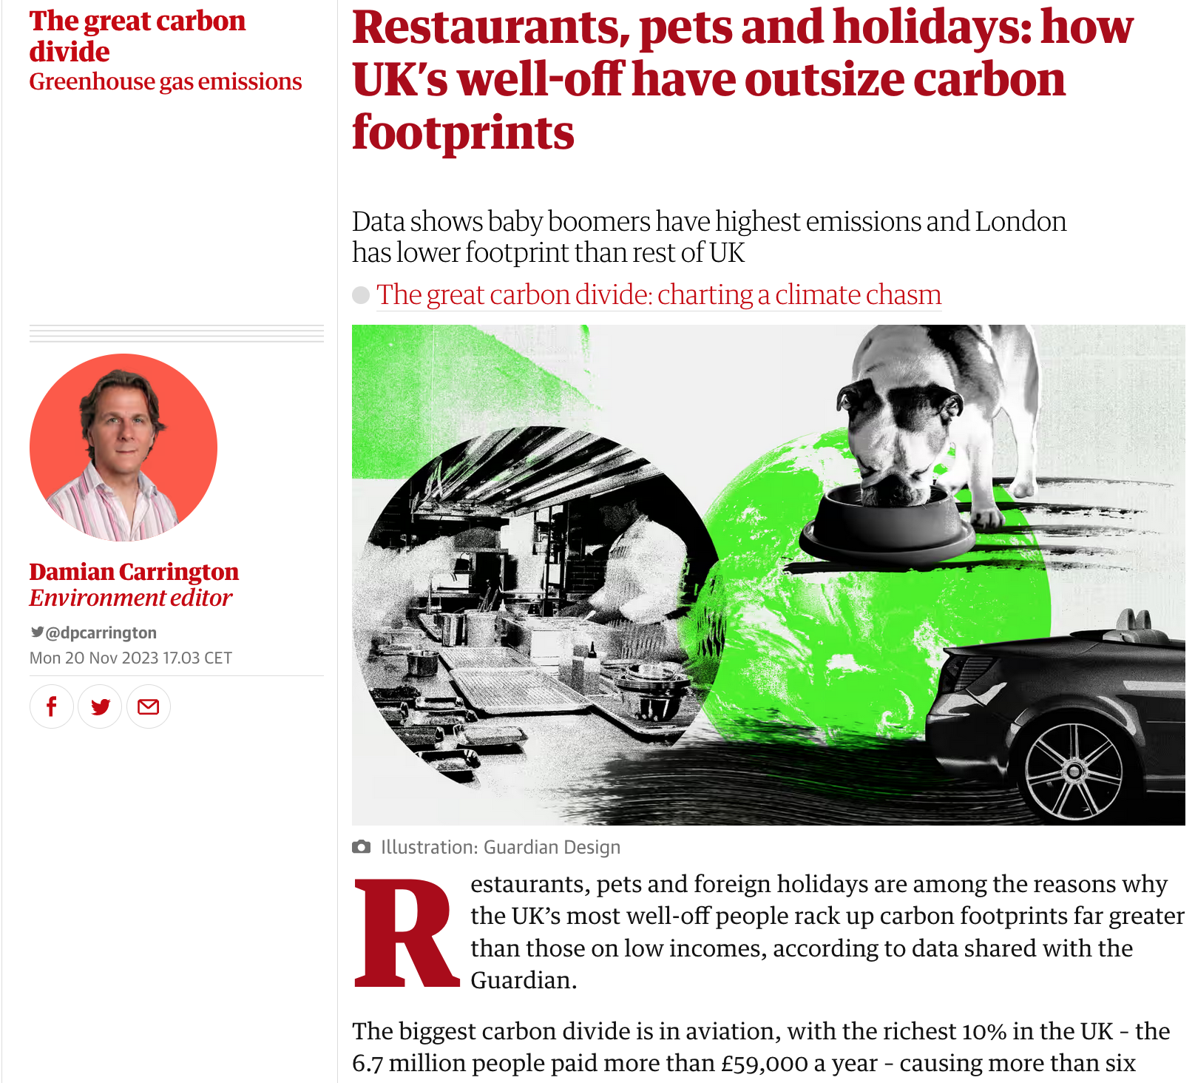
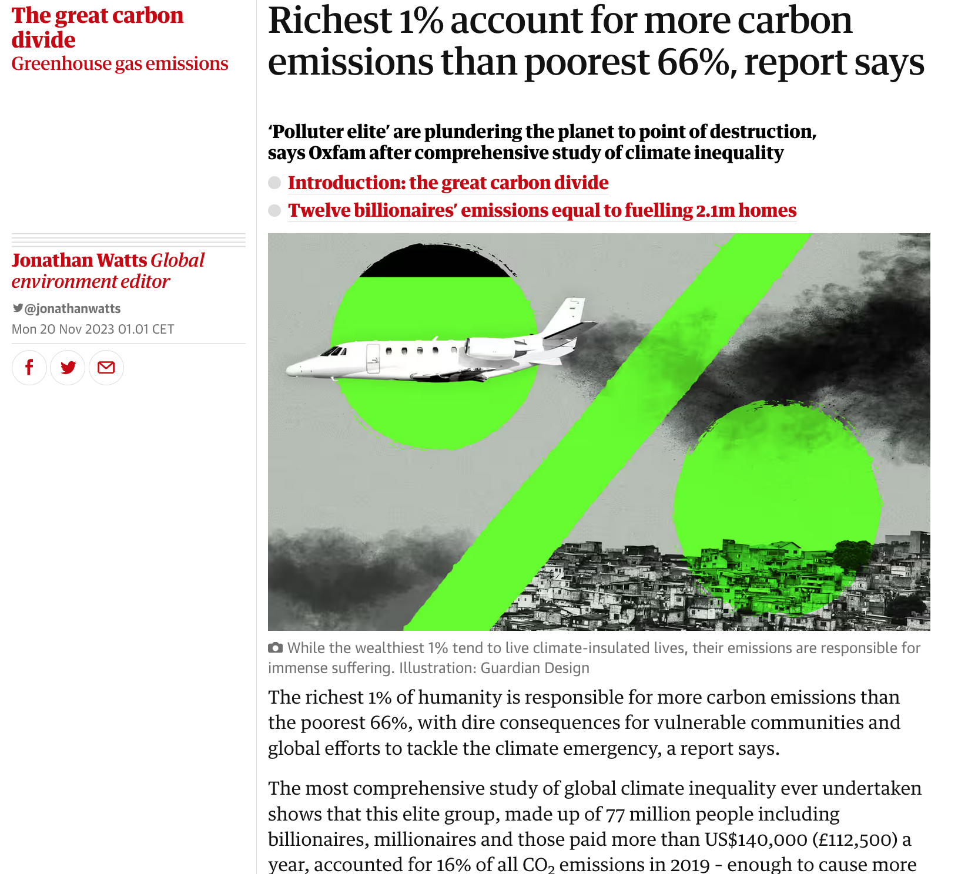

Slide 3


Slide 4
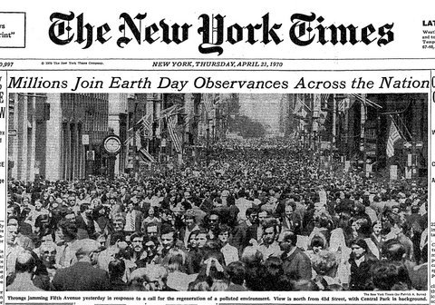
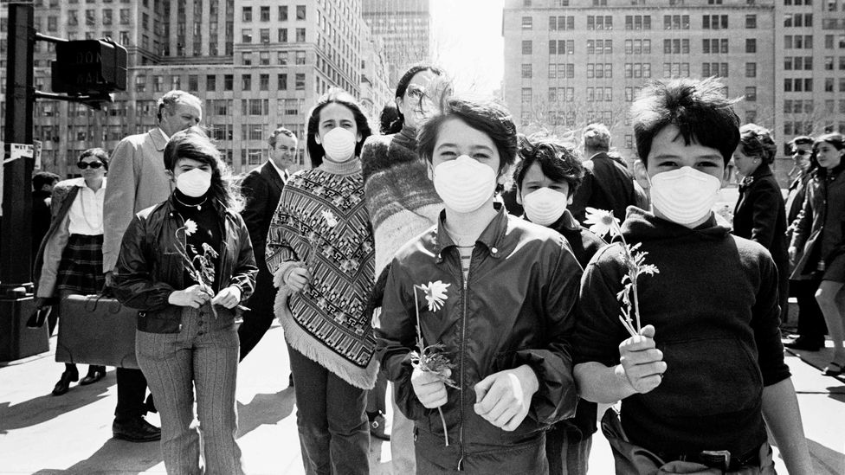

Slide 5
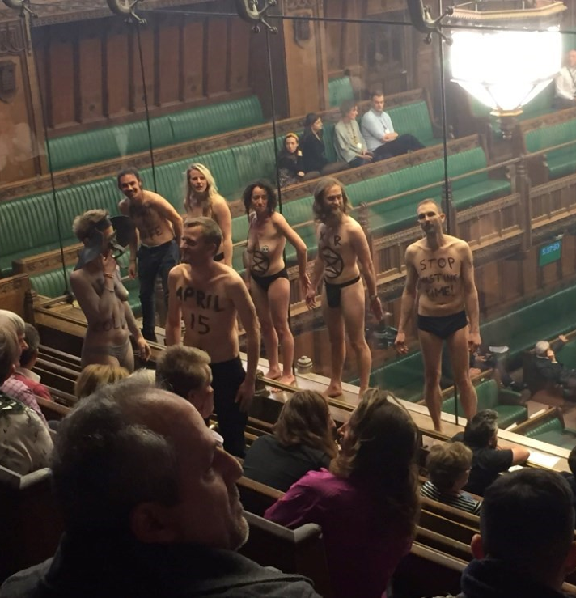
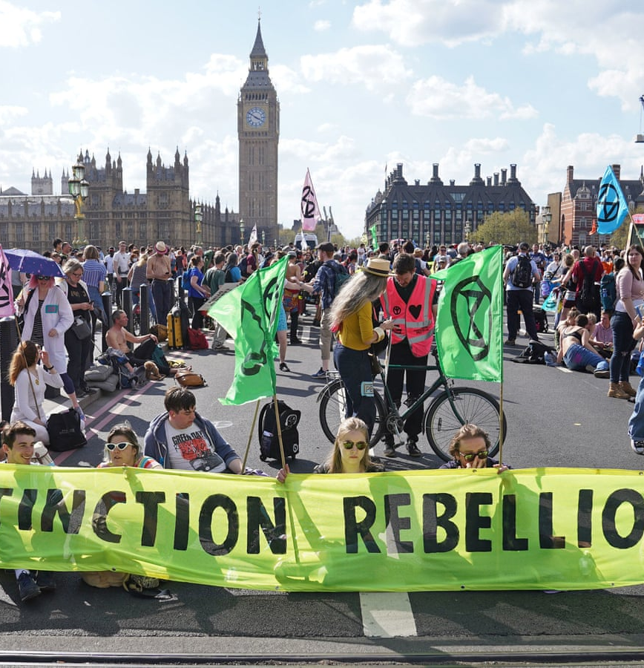

Slide 6


Slide 7
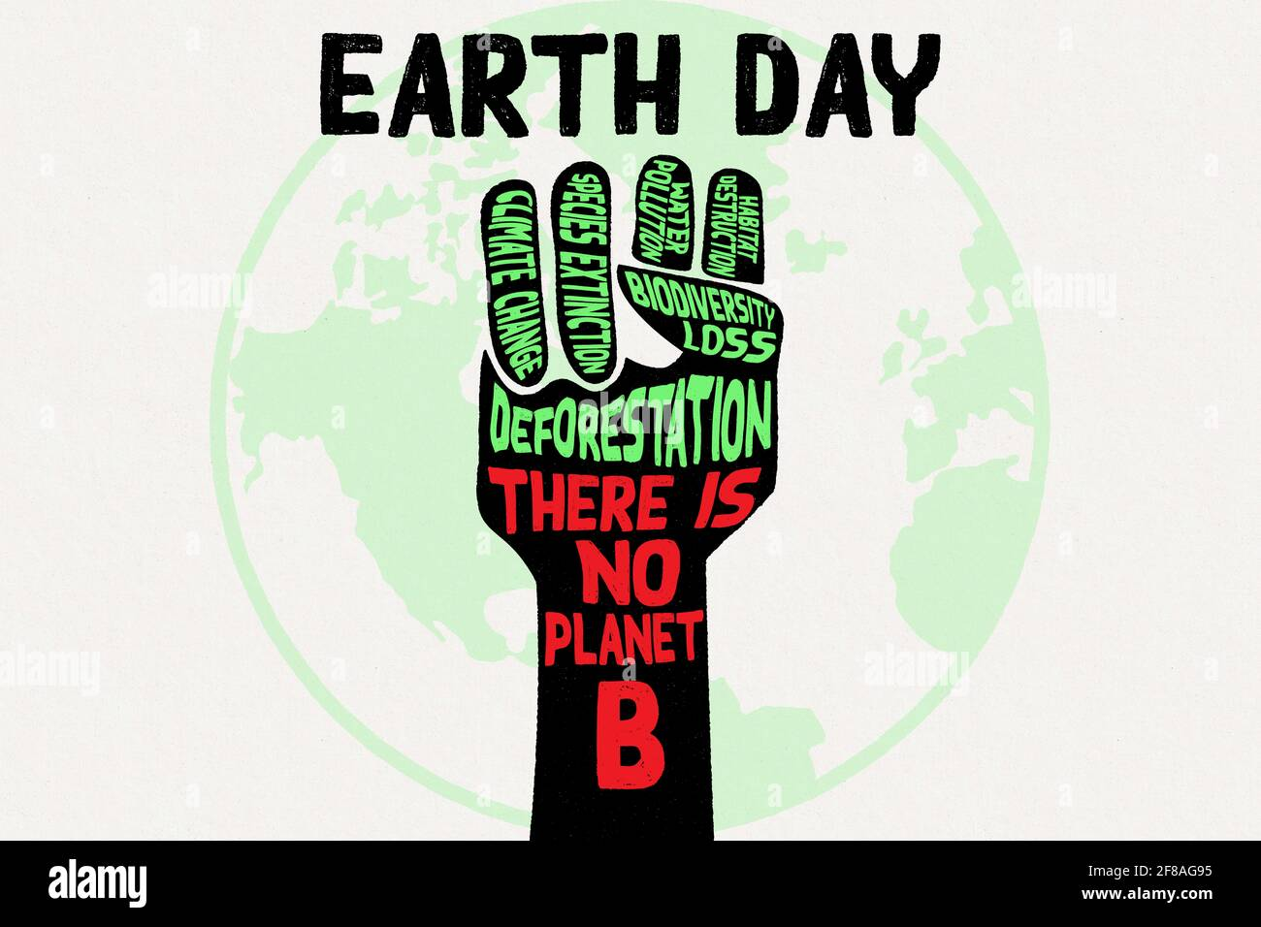
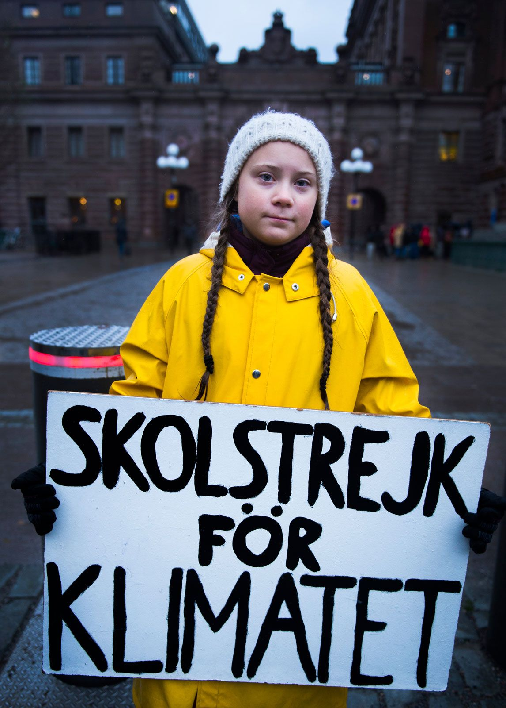


Slide 8

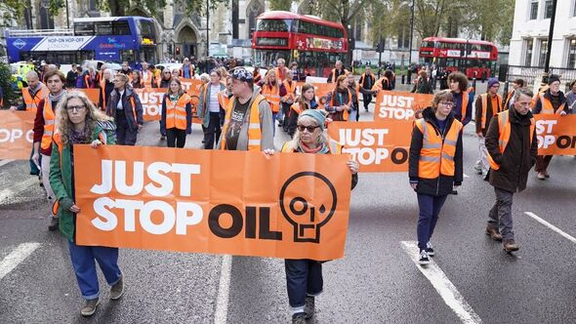

Slide 10
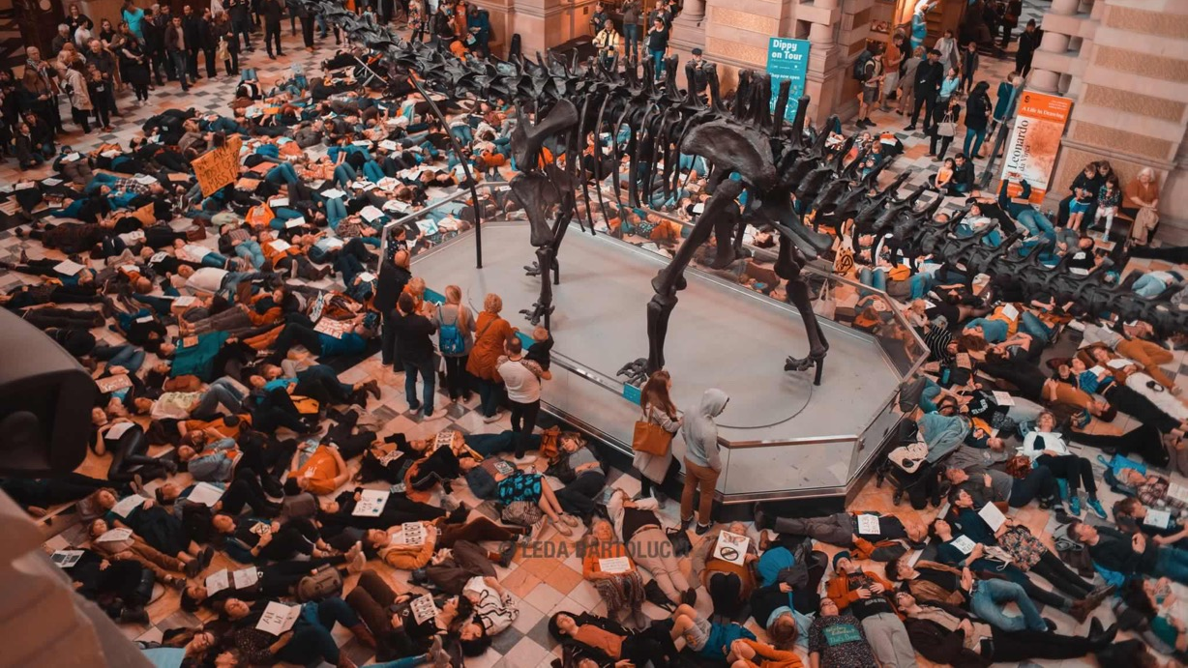

Slide 11
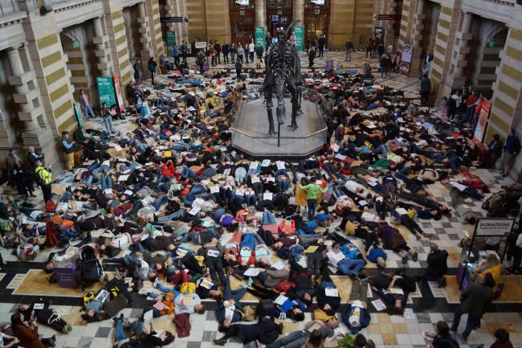

Slide 12
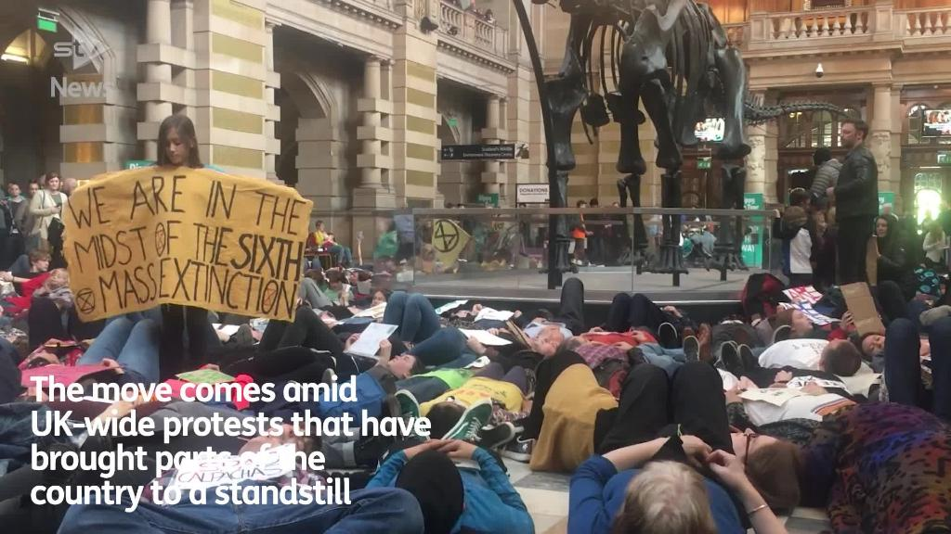

Slide 13

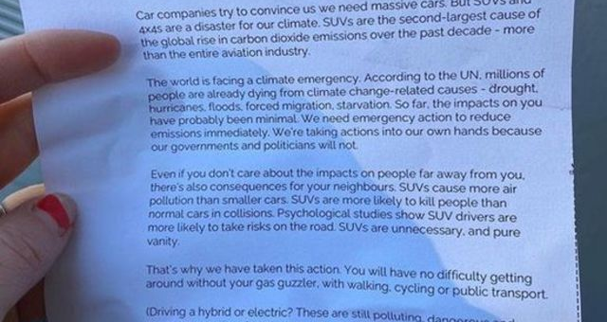

SUVs have conquered car markets, with stunning consequences for
the planet: in late 2019, the IEA reported that this was the second-largest
driver of the increasing global CO2 emissions since 2010. The power
sector came first, the swelling SUV fleet second, beating heavy industry
– cement, iron, aluminium – and aviation and shipping by wide margins.
If SUV drivers were a nation, in 2018 they would have ranked seventh
for CO2 emissions. The incessantly growing share of SUV sales offset
all gains from fuel efficiency and electric vehicles; so large and so heavy,
these cars continued to devour prodigious amounts of gasoline, as well
as energy in the stage of manufacturing. But the latter was excluded
from the IEA’s calculations. How to Blow Up a Pipeline

Slide 14
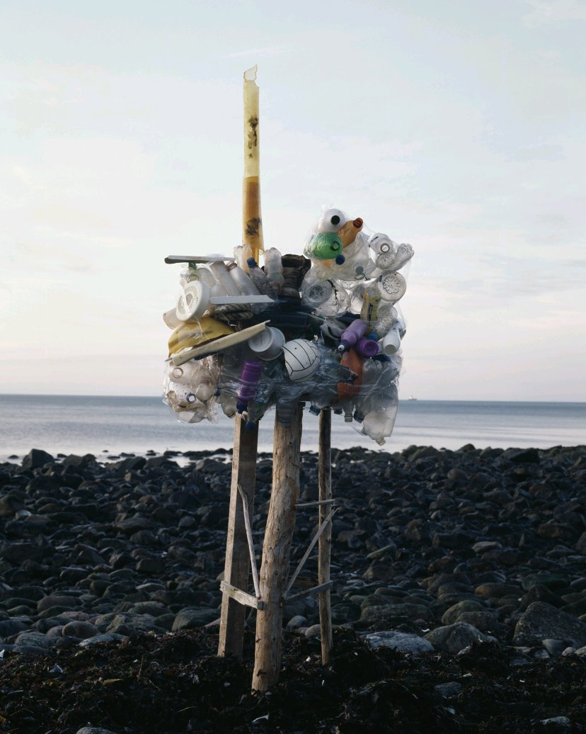
Ernst Logar
“Tillydrone”
From Invisible Oil

Slide 15
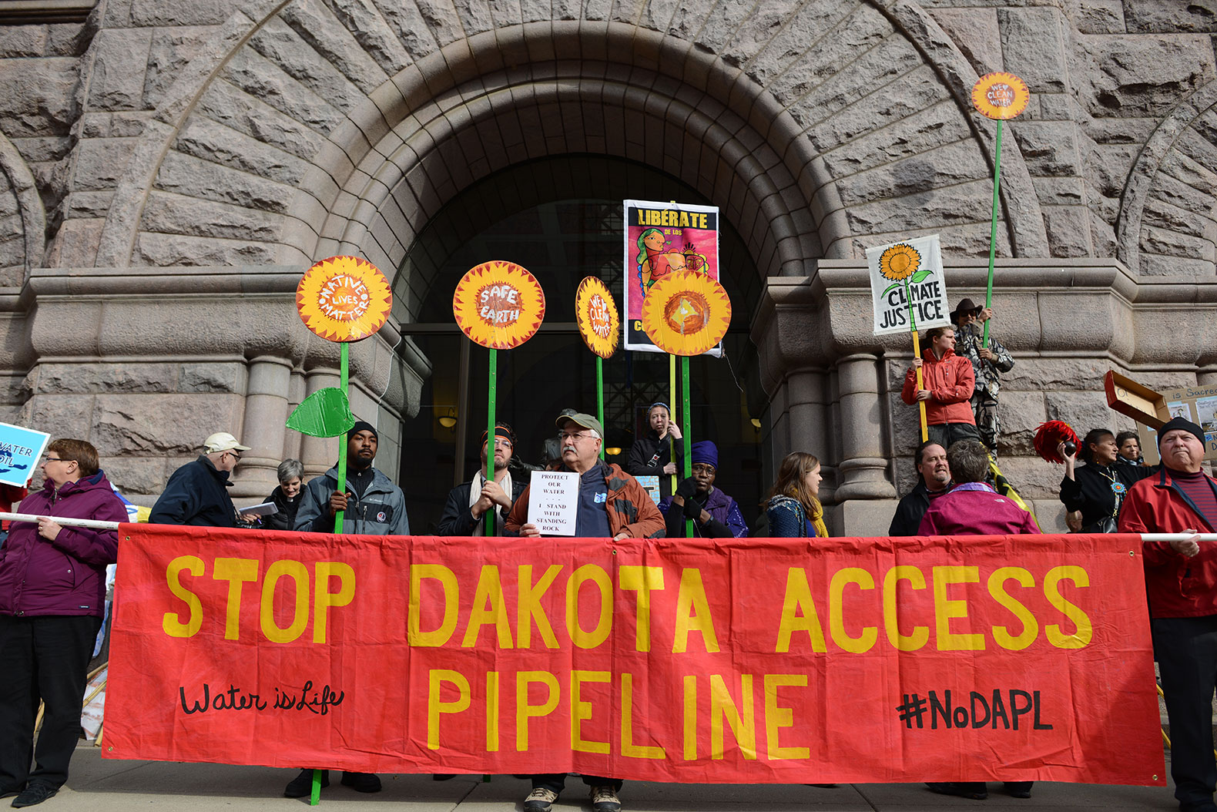

Slide 16
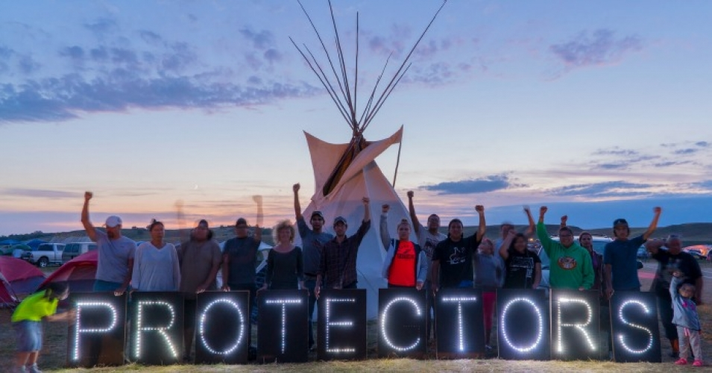

Slide 17
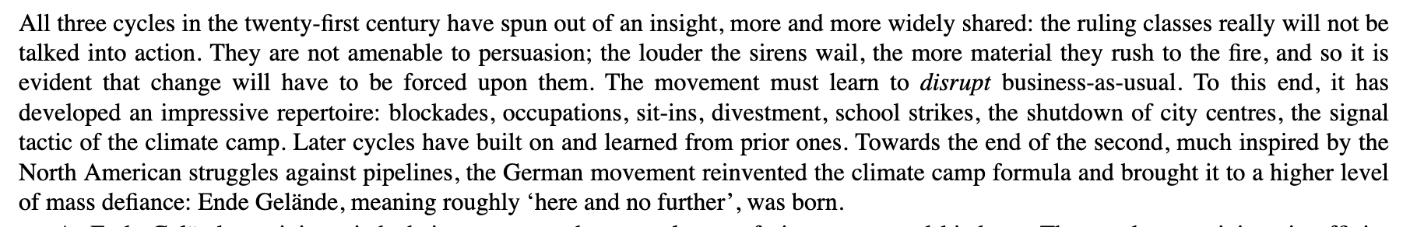
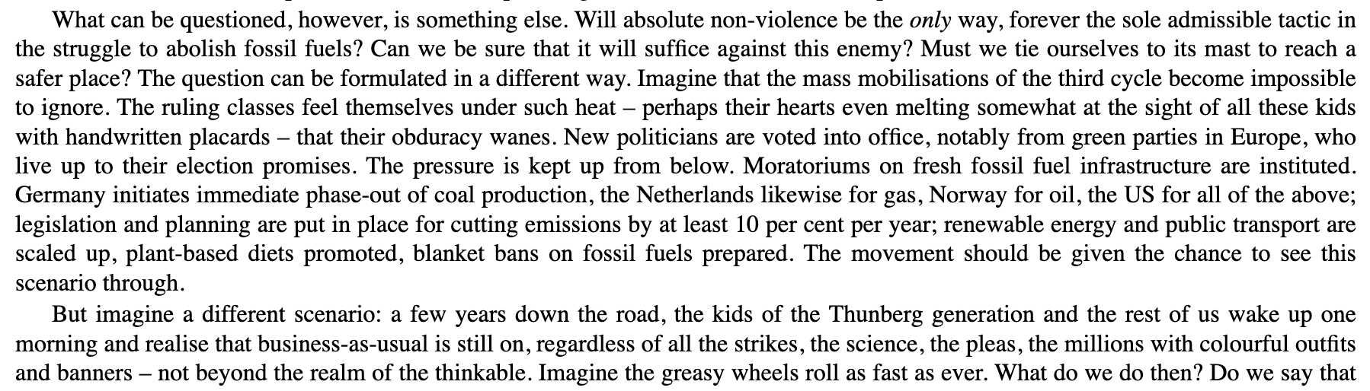
Malm, How to Blow Up….

Slide 18

“In the climate breakdown, the scales might tip quickly – on the one side, things like pipelines and diggers and SUVs; on the other, a weight that must tend towards the infinite because it encompasses all values. A woman’s life, her health and limbs, the right of a people to life itself and everything else is in peril. Because of the temporal dimension, moreover, Pankhurst’s question must also be posed from the standpoint of future generations: will those in school today or born next year grow up to think that the machines of the fossil economy were accorded insufficient respect? Or will they look back on this moment in time rather like we, or at least those of us with a modicum of feminist leanings, look back on the suffragettes and see smashed windows as a price worth paying? But when suffragettes broke panes, torched letterboxes and hammered on paintings, these things had, in and of themselves, at most a tangential relation to the problem of male monopoly on the vote. Now the machines of the fossil economy are the problem.” 104-105
How to Blow Up a Pipeline: Learning to Fight in a World on Fire
Andreas Malm

Slide 19
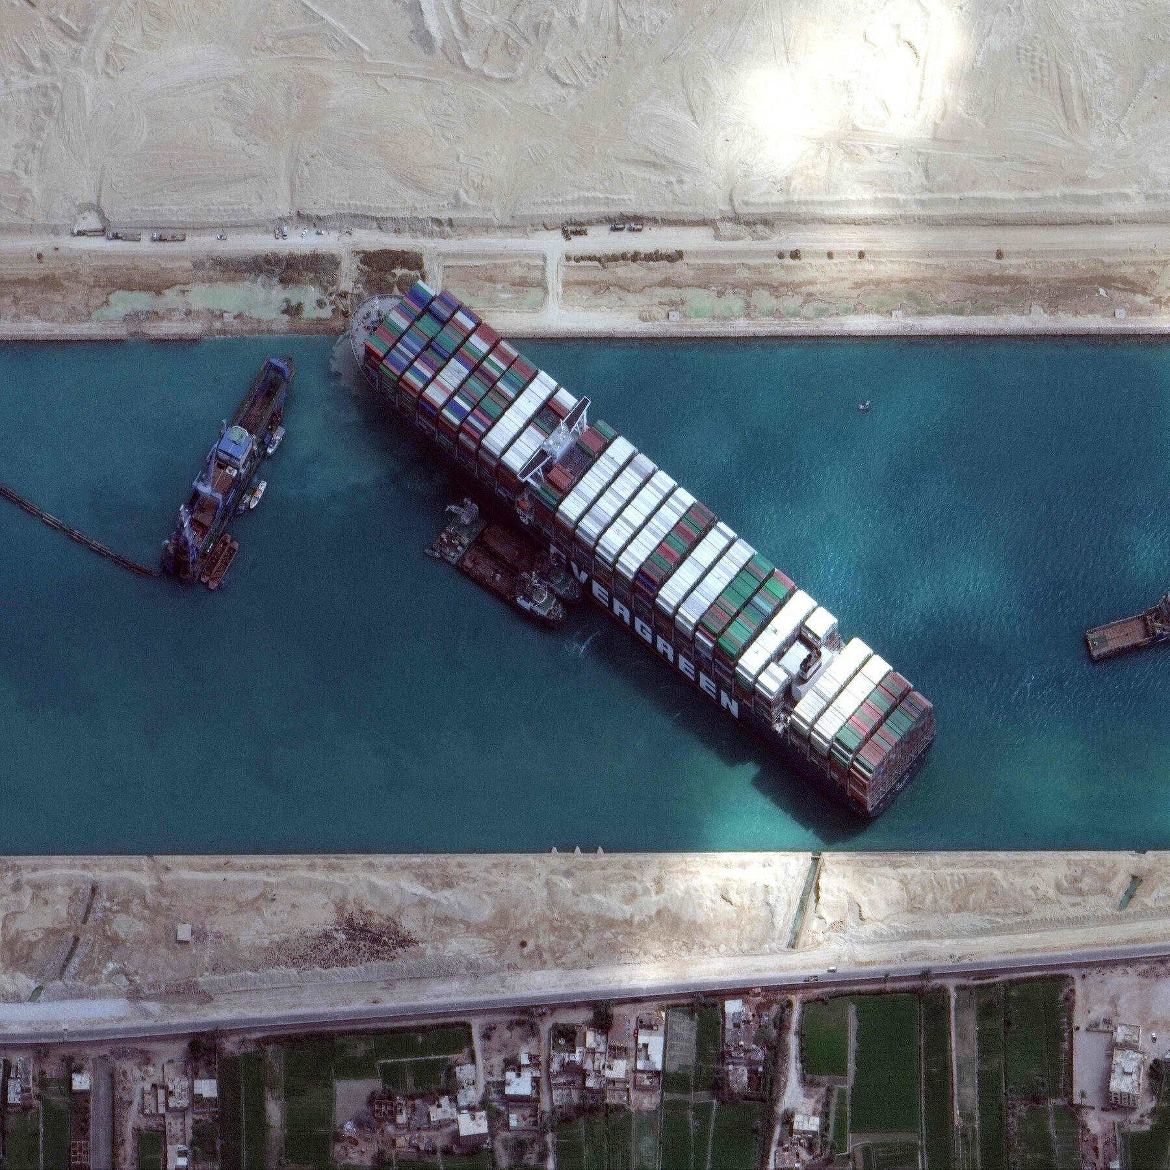
We will here describe…capital’s
sabotage from above, the sabotage of the nascent
conditions of a self-organising labour force –
materialises today in the managerial malignancy of
cloud computing, digital technology, automation, renewable
energy and the great swell in the (post)industrial
reserve army of labourers. Hence any genuinely
meaningful transition today cannot trigger a
change in energy form without simultaneously triggering
wholesale social transformation – precisely because
carbon energy and capital remain inextricable.
And in such a setting, the question with
which we began – what will trigger transition away
from fossil fuels? – cannot be answered except by
reckoning how capital became dependent on energy
both to dominate and to exploit. No amount of ethical
delegitimisation will divorce capital from energy.
Collective forms of struggle will.
Simpson & Diamanti, “Five Theses on Sabotage….”

Slide 20

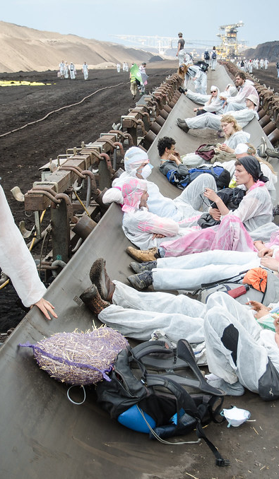
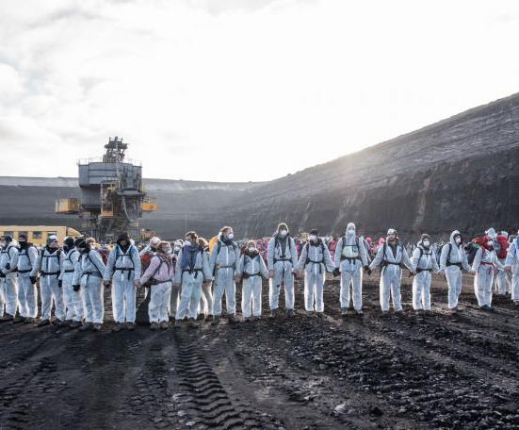
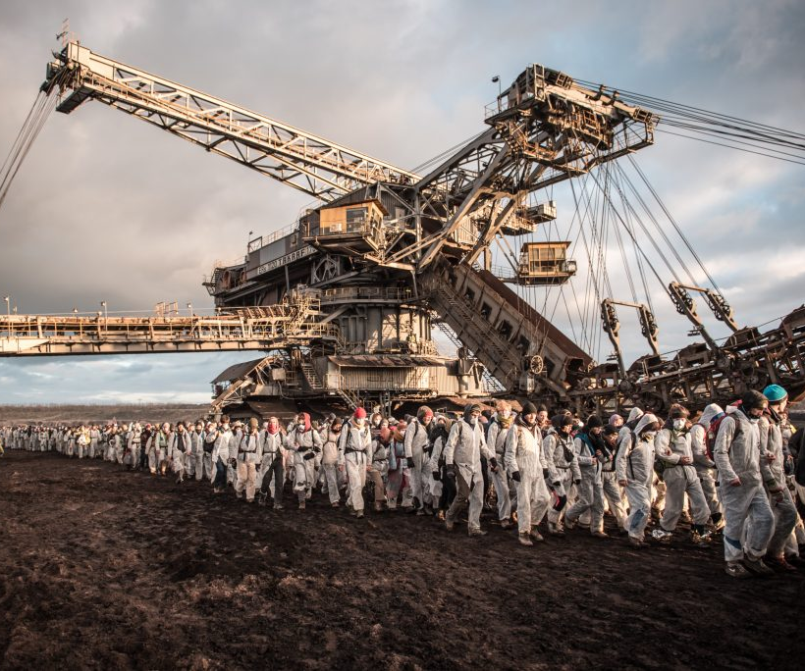

Slide 21
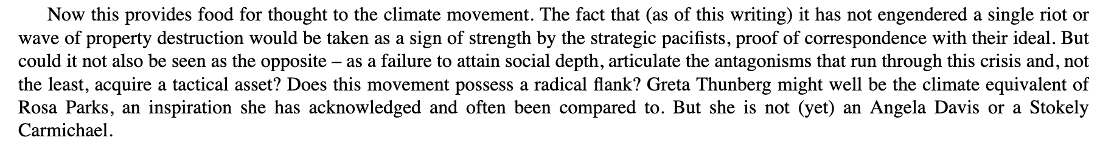
“This is the impasse in which the climate movement finds itself, the historical victory
of capital and the ruination. Of the planet are one and the same thing. To break out
of it, we have to learn how to fight all over again in what might be the most
unpropitious moment so far in the history of human habitation on this planet.
New paragraph and here we reached the one dimension that most distinctly sets
this crisis apart. Time….The onrush of catastrophe does have a temporality of its own.” 62-63.
“This is the temporal predicament in which the climate movement has to devise meaningful strategies.”
“So here is what this movement of millions should do, for a start: announce and enforce the prohibition.
Damage and destroy new CO2-emitting devices. Put them out of commission, pick them apart, demolish
them, burn them, blow them up. Let the capitalists who keep on investing in the fire know that their
properties will be trashed. ‘We are the investment risk’, runs a slogan from Ende Gelände, but the risk
clearly needs to be higher than one or two days of interrupted production per year. ‘If we can’t get a
serious carbon tax from a corrupted Congress, we can impose a de facto one with our bodies,’ Bill McKibben
has argued, but a carbon tax is so 2004. If we can’t get a prohibition, we can impose a de facto one with our
bodies and any other means necessary.” 67
“What forms of sabotage could not go down well, even in this most depoliticised of social formations, in 2025 or 2040?”
“Should we wait for approval for a near consensus?”
Malm, How to Blow Up a Pipeline

Slide 22
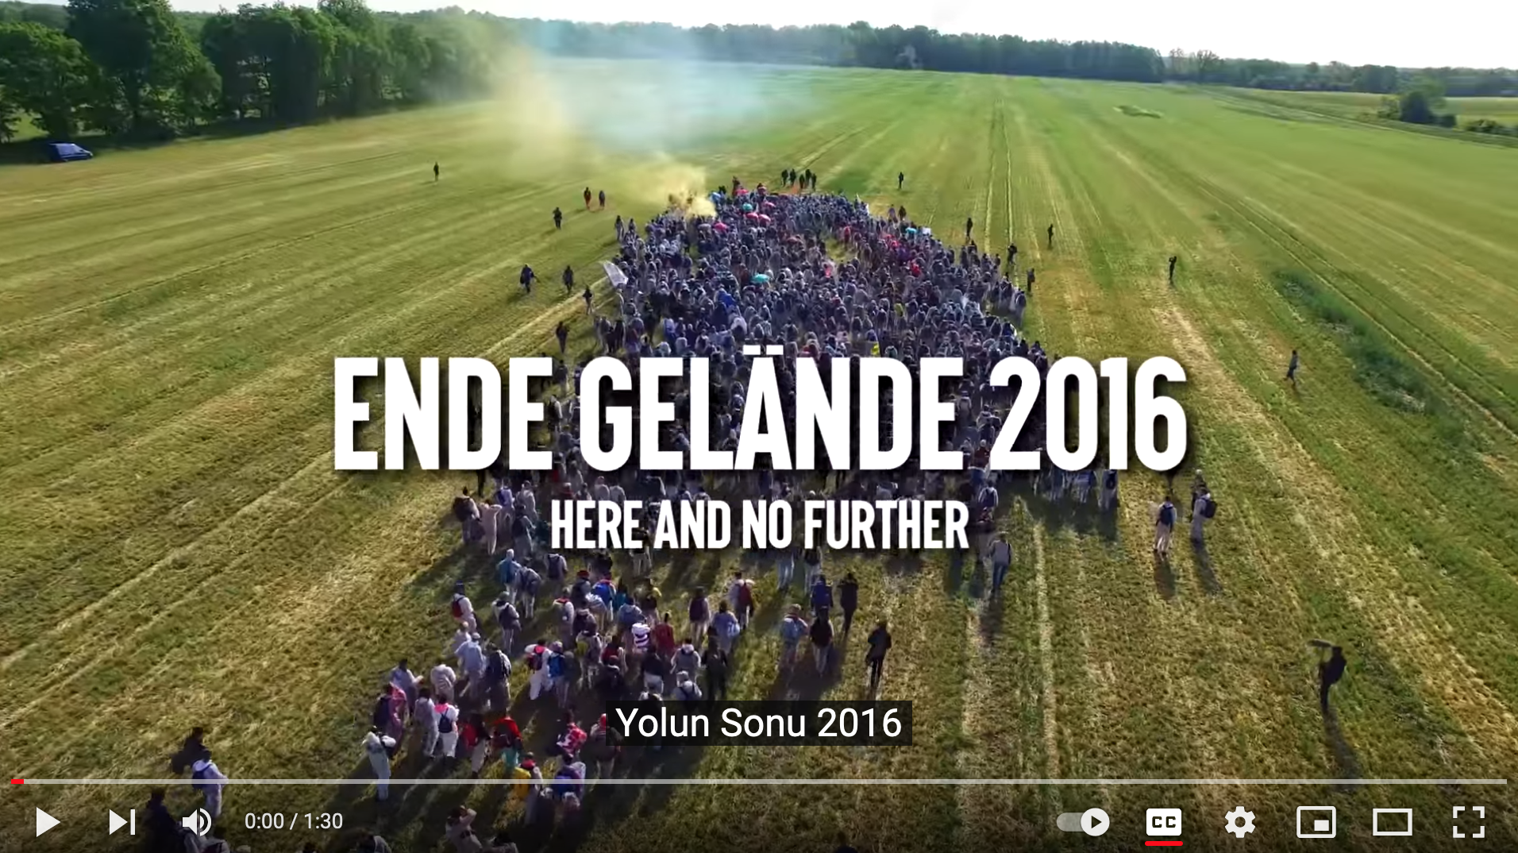

Slide 23
“At the end of the day, it will be states that ram through the transition or no one will.
But the states have fully proven that they will not be the prime movers. The question is not if sabotage from a militant wing of the climate movement will solve the crisis on its own – clearly a pipe dream – but if the disruptive commotion necessary for shaking business-as-usual out of the ruts can come about without it. It would seem foolhardy to trust in its absence and stick to tactics for normal times. Recognising the direness of the situation, it is high time for the movement to more decisively shift from protest to resistance: ‘Protest is when I say I don’t like this. Resistance is when I put an end to what I don’t like. Protest is when I say I refuse to go along with this anymore. Resistance is when I make sure everybody else stops going along too’, as one West German columnist wrote in 1968, relaying the words of a visiting Black Power activist. There will be no shortage of objections to such resistance. Would it, to begin with, be technically possible?” 69-70
“Given this record from the past and present, the question is not whether it’s technically possible for people organised outside of the state to destroy the kind of property that destroys the planet; it evidently is, just as it’s technically possible to shift to renewable energy. The question is why these things don’t happen – or rather, why they happen for all sorts of reasons good and bad, but not for the climate. ” 75-6
How to Blow Up a Pipeline: Learning to Fight in a World on Fire
Andreas Malm

Slide 24


Slide 25
Thesis 1: The history of fossil capital is the history of capital’s sabotage of labour through fossil fuelled subsumption.
Thesis 2: Sabotage by fossil capital is serial sabotage
Thesis 3: Sabotage from below targets energic dispositions
Thesis 4: Sabotage after the onset of oil is a form of critique that takes capital’s ‘hidden factory’ as its object
Thesis 5: Sabotage as counter-disposition is hermeneutic and aesthetic: a new way of knowing and seeing.
Simpson & Diamanti, 5 Theses on Sabotage….

Slide 26
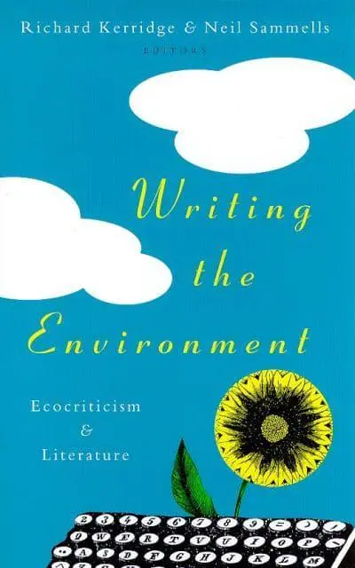
The ecocritic wants to track environmental ideas and representations wherever they appear, to see more clearly a debate which seems to be taking place, often part-concealed, in a great many cultural spaces. Most of all, ecocriticism seeks to evaluate texts and ideas in terms of their coherence and usefulness as responses to environmental crisis.
Richard Kerridge, Writing the Environment (1998)

Slide 27










Slide 28






Slide 29
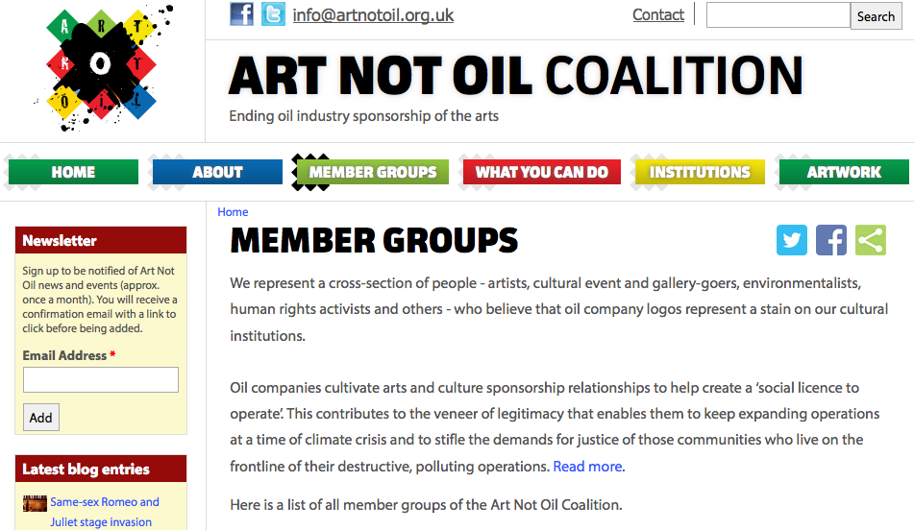

Slide 30
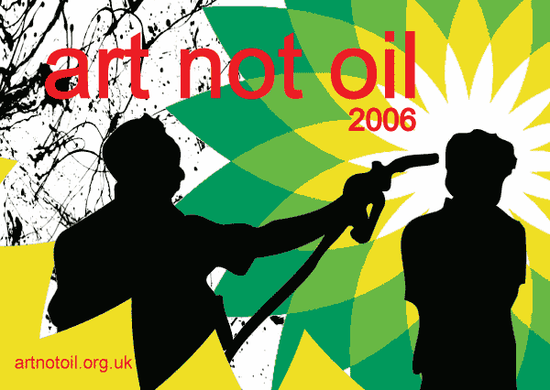

Slide 31
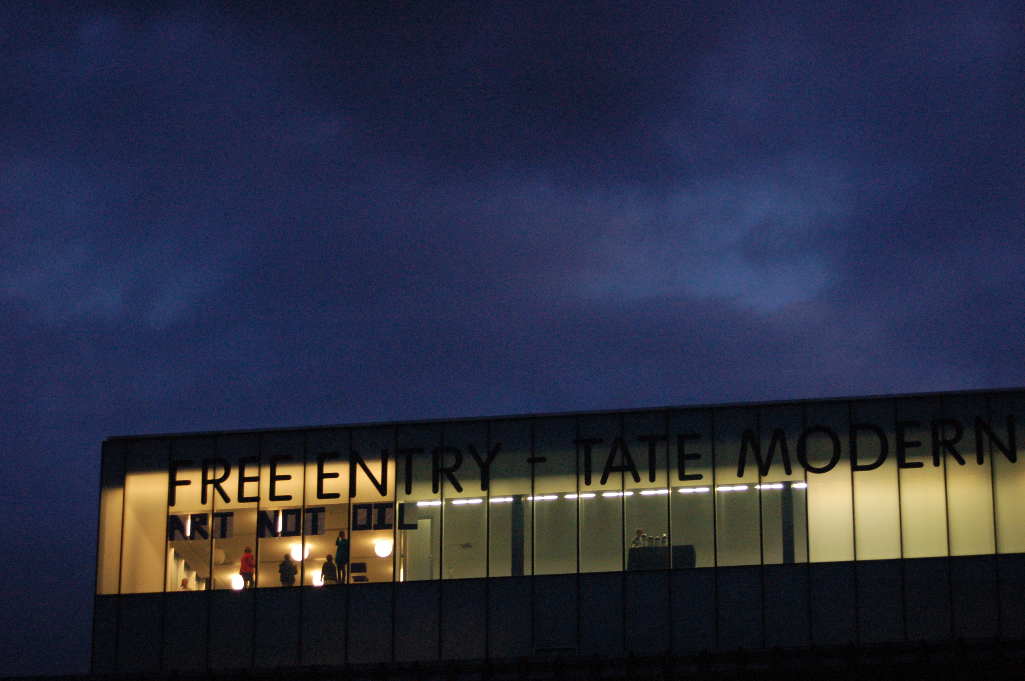
Liberate Tate

Slide 32
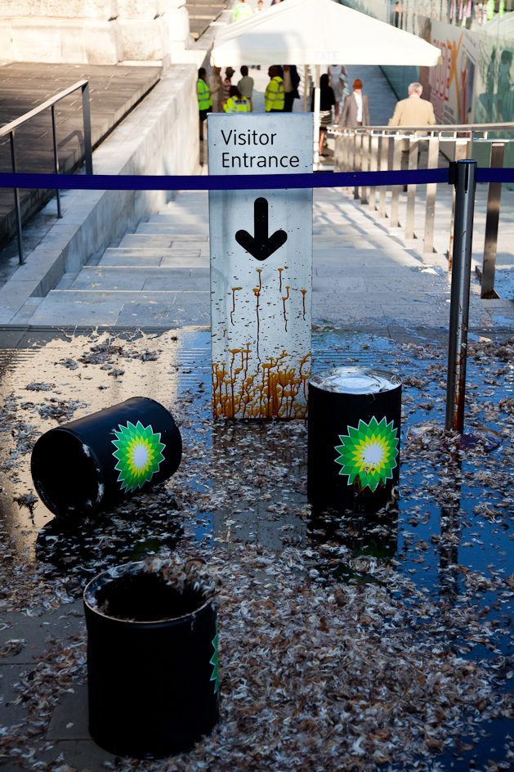
Licence to Spill
(2010)
“Next time A Caribbean island is battered beyond Recognition, burst in upon banquet of luxury emissions or a Shell board meeting.”
Andreas Malm, How to Blow Up a Pipeline

Slide 33
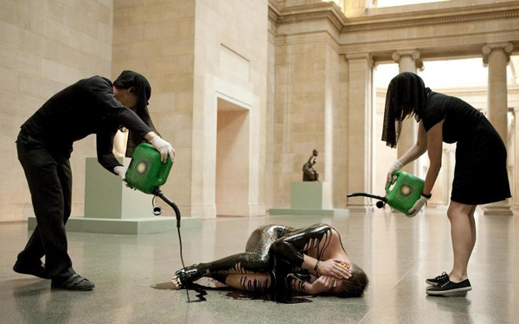
Human Cost (2011)

Slide 34
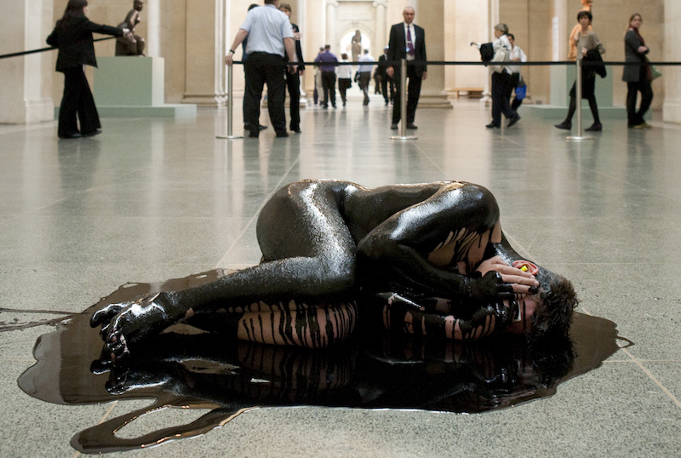

Slide 35
“How could a militant climate struggle avoid veering down into such deep ditches? The set-up would, for a start, inverse deep ecology: whereas the latter wants to wage war against civilisation and indeed humanity as such, the former would fight for the possibility of civilisation, in the sense of organised social life for Homo sapiens. Unlike the deep variety, it would target a particular deformed kind of civilisation – namely, that erected on the plinth of fossil capital – and tear it down so that another form of civilisation can endure (or none will). This implies that climate militancy would have to be articulated to a wider anti-capitalist groundswell, much as in earlier shifts of modes of production, when physical attacks on ruling classes formed only minor parts of societywide reorganisation. How could that happen? This cannot be known beforehand. It can be found out only through immersion in practice.” 157-8
How to Blow Up a Pipeline: Learning to Fight in a World on Fire
Andreas Malm
To make an effective challenge to the ethics of the art museum, a
confrontation needs to be made from within the gallery. This might
mean from within a community of artists who hold a stake in the
formation of the institutional politic, from within the public realm that
can claim the museum as a public space, or to be sufficiently confrontational
to pose opposition, from physically within the galleries. This
sheds light on the space to be opened out by artists wishing to create
institutional critique in their work: not too close yet not too far, seeking
to open up an ‘interstice’, or crack, of dissent within the institution.
This opening is forged at an ‘interstitial distance’ between the inside
and the outside of the institution.
Sometimes art as intervention might not have the proximity to the
subject to give sufficient leverage to create a space within it, at other
moments too great an intimacy and acceptance by the gallery might
limit efficacy. A tightrope must be walked, or a route in especially
carved. In this understanding, artists are critical friends of the larger
institution: part of Cutler’s Guattarian ecosophic whole, but acting at
enough critical distance to make an effective challenge. In this way
artworks can open up an interstice of opposition to the status quo of
the gallery. Artwash 161

Slide 36
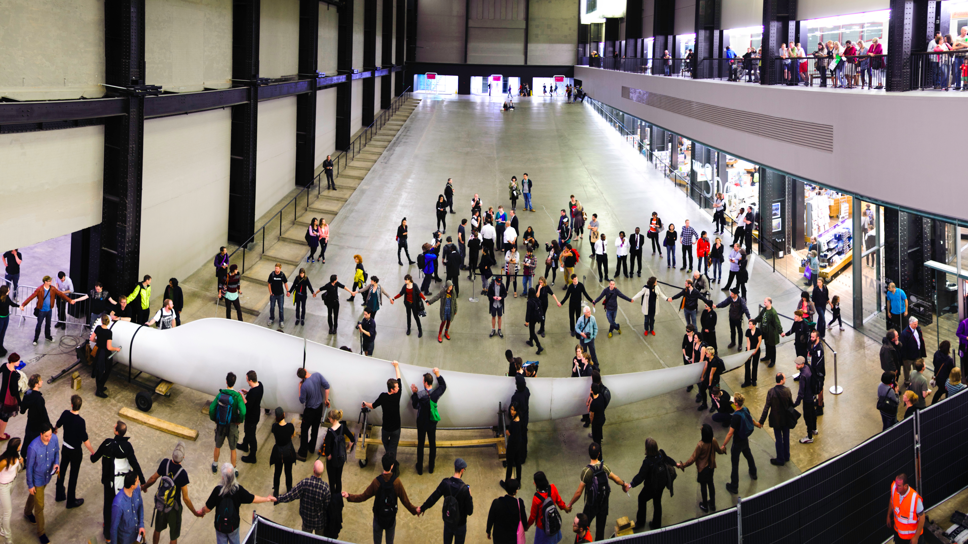
The Gift (2012)

Slide 37
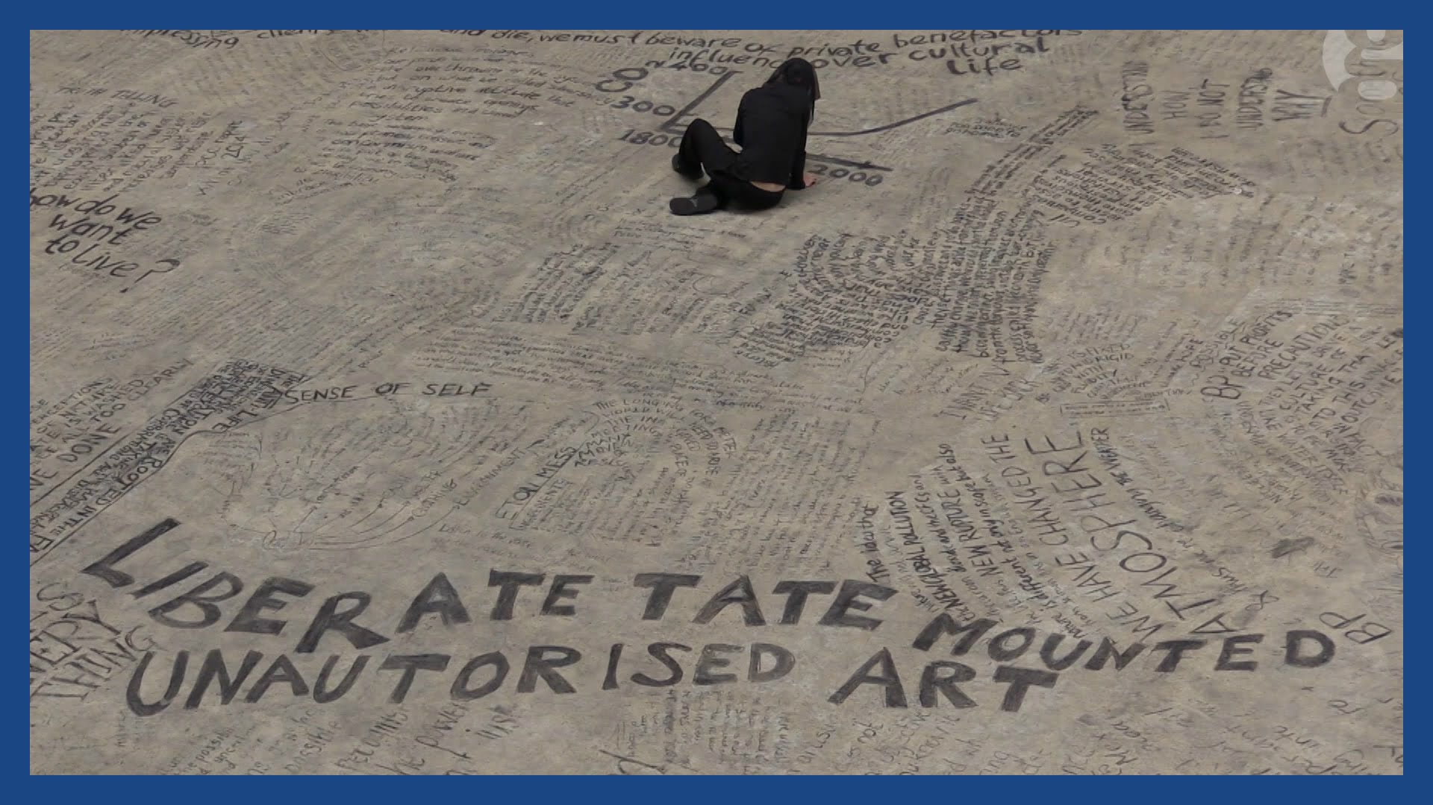

Slide 38
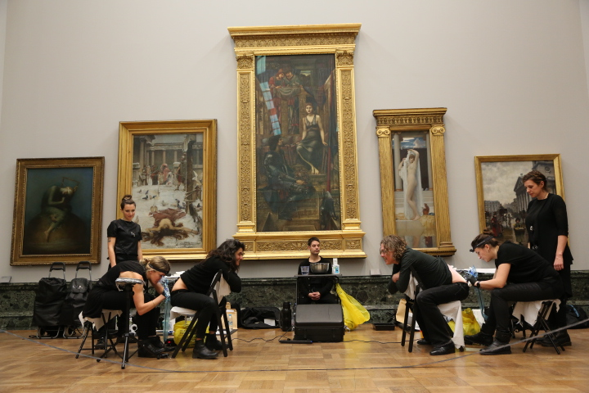
Birthmark (2015)

Slide 39
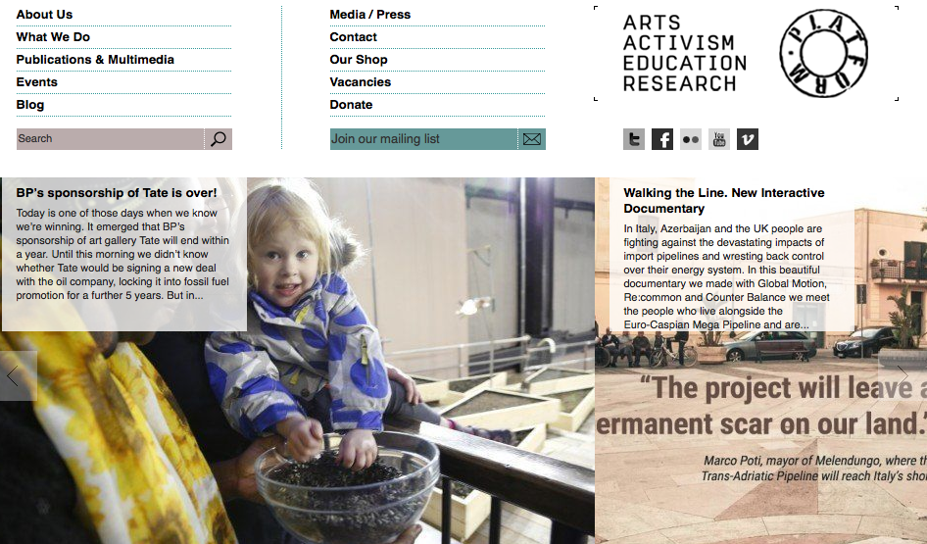

Slide 40

There is a cynical PR strategy to every oil sponsorship deal, and the companies themselves do not deny this….Oil companies’ desire to associate themselves with prestigious arts institutions is a survival strategy of an industry that itself feels increasingly precarious, both upstream and downstream. In the theatre of the global public relations and brand management industry, arts sponsorship becomes a way for the global, transnational corporation to present and benefit from a nationally specific brand identity: it offers a pretence of corporate responsibility for the callous profiteer; and becomes an illusionary act of cultural relevance for outmoded industries.
Mel Evans, Artwash

Slide 41
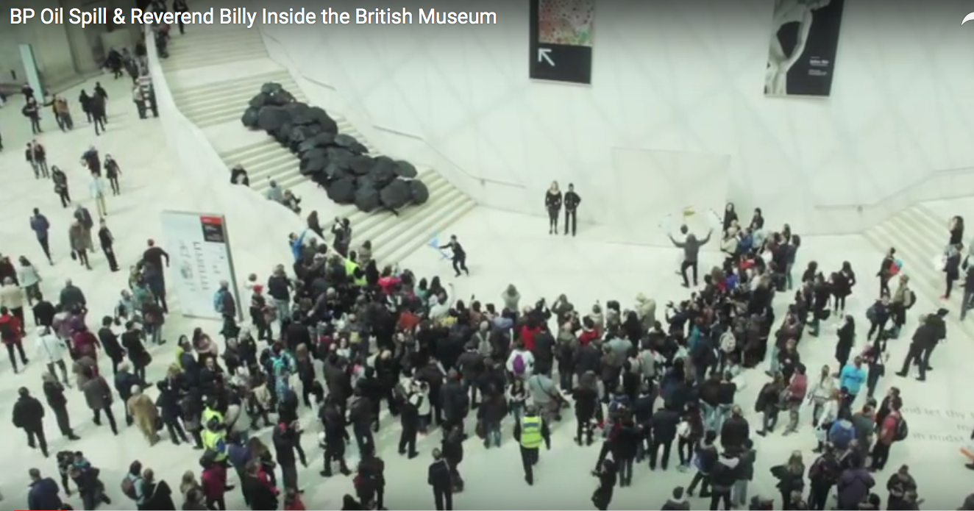
“It started with a crude spill/on the Gulf Coast/from a rig of BP…”

Slide 42
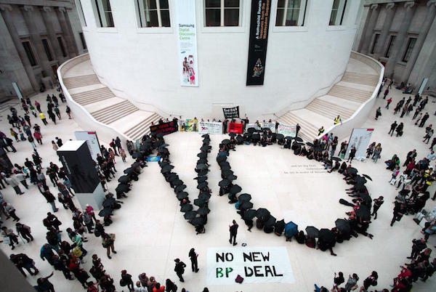

Slide 43
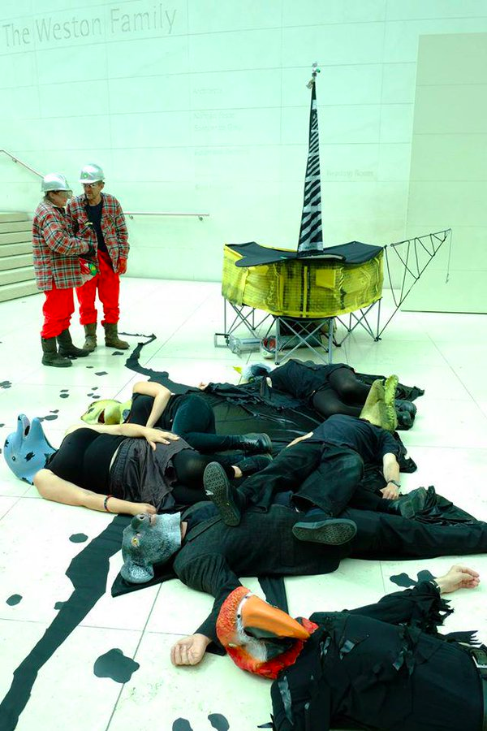
Performance is a core part of communications.
This rule applies from public relations to protest.
To artwash is therefore part public relations and
part theatre. Mel Evans, Artwash

Slide 44
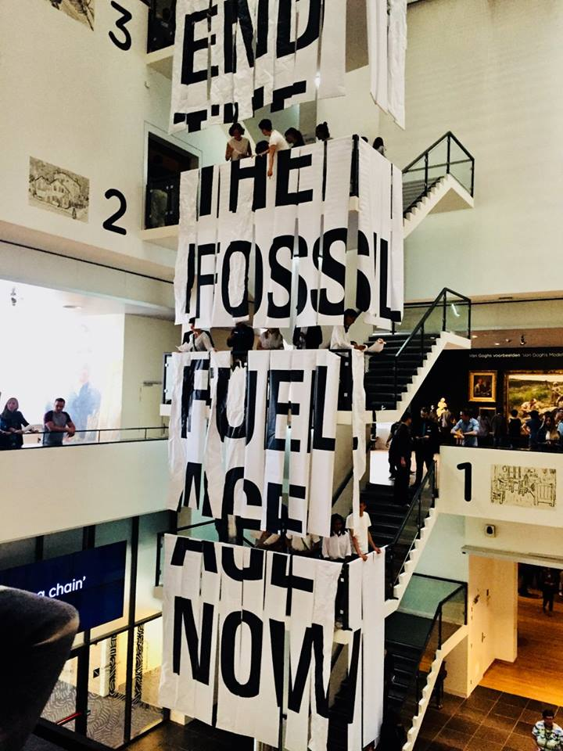


Slide 45
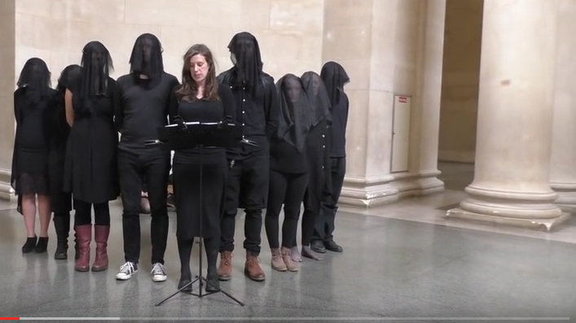
Our words spill into this space like oil. We utter a stain; a slick black trail traced through spheres of art and history. It’s a gestural embodiment of the BP oil money invested in the cultural estate. Sponsorship money that artwashes the oil giant’s image and grants its social license to operate. This oil trail leads our performance intervention from Tate, through the National Portrait Gallery. Liberate Tate – 5th Assessment 2015 http://www.liberatetate.org.uk/5th-assessment/

Slide 46


