Slide 1
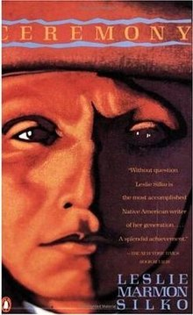
Radioactive Colonialism and Leslie Marmon Silko’s Ceremony

Slide 2
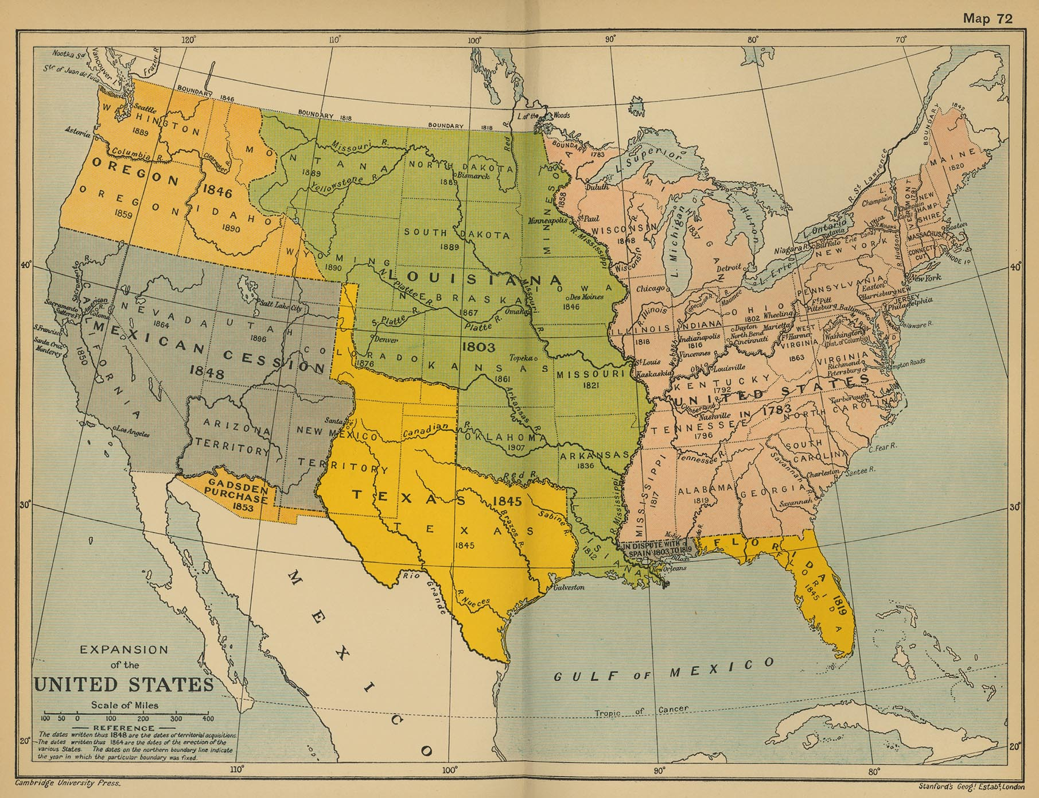
Louisiana Purchase (1803)
Indian Removal Act 1830
Mexican-US War 1848
Dawes ‘Homesteading’ Act 1887

Slide 3
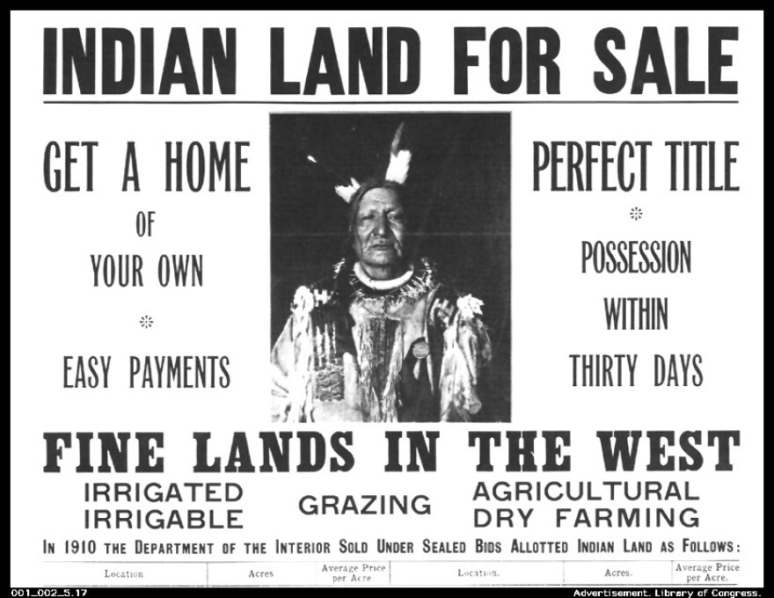
“Allotment combined the making of land into private property and the taking of that private property from Indians.”
– David Chang Chang, David A. The color of the land: race, nation, and the politics of landownership in Oklahoma, 1832-1929. Univ of North Carolina Press, 2010. 108.

Slide 4
“He had a stack of books on the floor beside his bed, with his reading glasses sitting on top. Every night, for a few minutes after he got in bed, he’d read about cattle breeding in the books the extension agent had loaned to him. Scientific cattle breeding was very complicated, he said, and he used to wait until Rocky and Tayo were doing their homework on the kitchen table, and then he would come in from the back room, with his glasses on, carrying a book. “Read this,” he would tell Rocky, “and see if you think it’s saying the same thing I think it says,” When Rocky finished it, Josiah pushed the book in front of Tayo and pointed at the passage. Then he’d say, “Well?” And the boys would tell him what they got out of it. “That’s what I thought too,” Josiah would say, “but it seemed like such a stupid idea I wasn’t sure if I was understanding it right.” The problem was the books were written by white people who did not think about drought or winter blizzards or dry thistles, which the cattle had to live with. […] “I guess we will have to get along without these books,” he said. “We’ll have to do things our own way. Maybe we’ll even write our own book, Cattle Raising on Indian Land, or how to raise cattle that don’t eat grass or drink water.” Tayo and Robert laughed with him, but Rocky was quiet. He looked up from his books. “Those books are written by scientists. They know everything there is to know about beef cattle. That’s the trouble with the way the people around here have always done things—they never knew what they were doing.” He went back to reading his book. He did not hesitate to speak like that, to his father and his uncle, because the subject was books and scientific knowledge —those things that Rocky had learned to believe in. Tayo was suddenly sad because what Rocky said was true. What did they know about raising cattle? They weren’t scientists.”

Slide 5
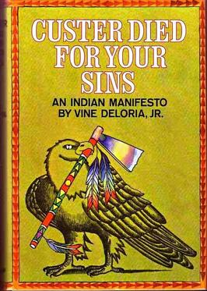
“It allegedly cares for Indian lands and resources. Education, health services, and technical assistance are provided to the major tribes by the Bureau of Indian Affairs which is in the Department of the Interior” (Vine Deloria, Custer Died for Your Sins: An Indian Manifesto, 13)

Slide 6
“A primary (and classic) vehicle of neocolonialism was created under the so-called ‘Indian Reorganization Act’ (1934) whereby the United States imposed a system of ‘tribal council’ governments on each reservation, a mechanism designed to replace traditional (and resistant) Indian governmental forms with an apparatus approved by and owing its allegiance to Washington DC […] The US rational was/is readily apparent. The new ‘governments’ were charged with responsibilities for ‘economic planning:’ mineral lease negotiations, contracting with external corporate agencies, long-term agricultural/ranching leasing, water-rights negotiations, land transfers, and so on, all of which required direct approval from Bureau of Indian Affairs representatives prior to consummation, and most of which had long been staunchly resisted by the traditional leadership” (Winona LaDuke and Ward Churchill, “Radioactive colonialism,” 54)

Slide 7
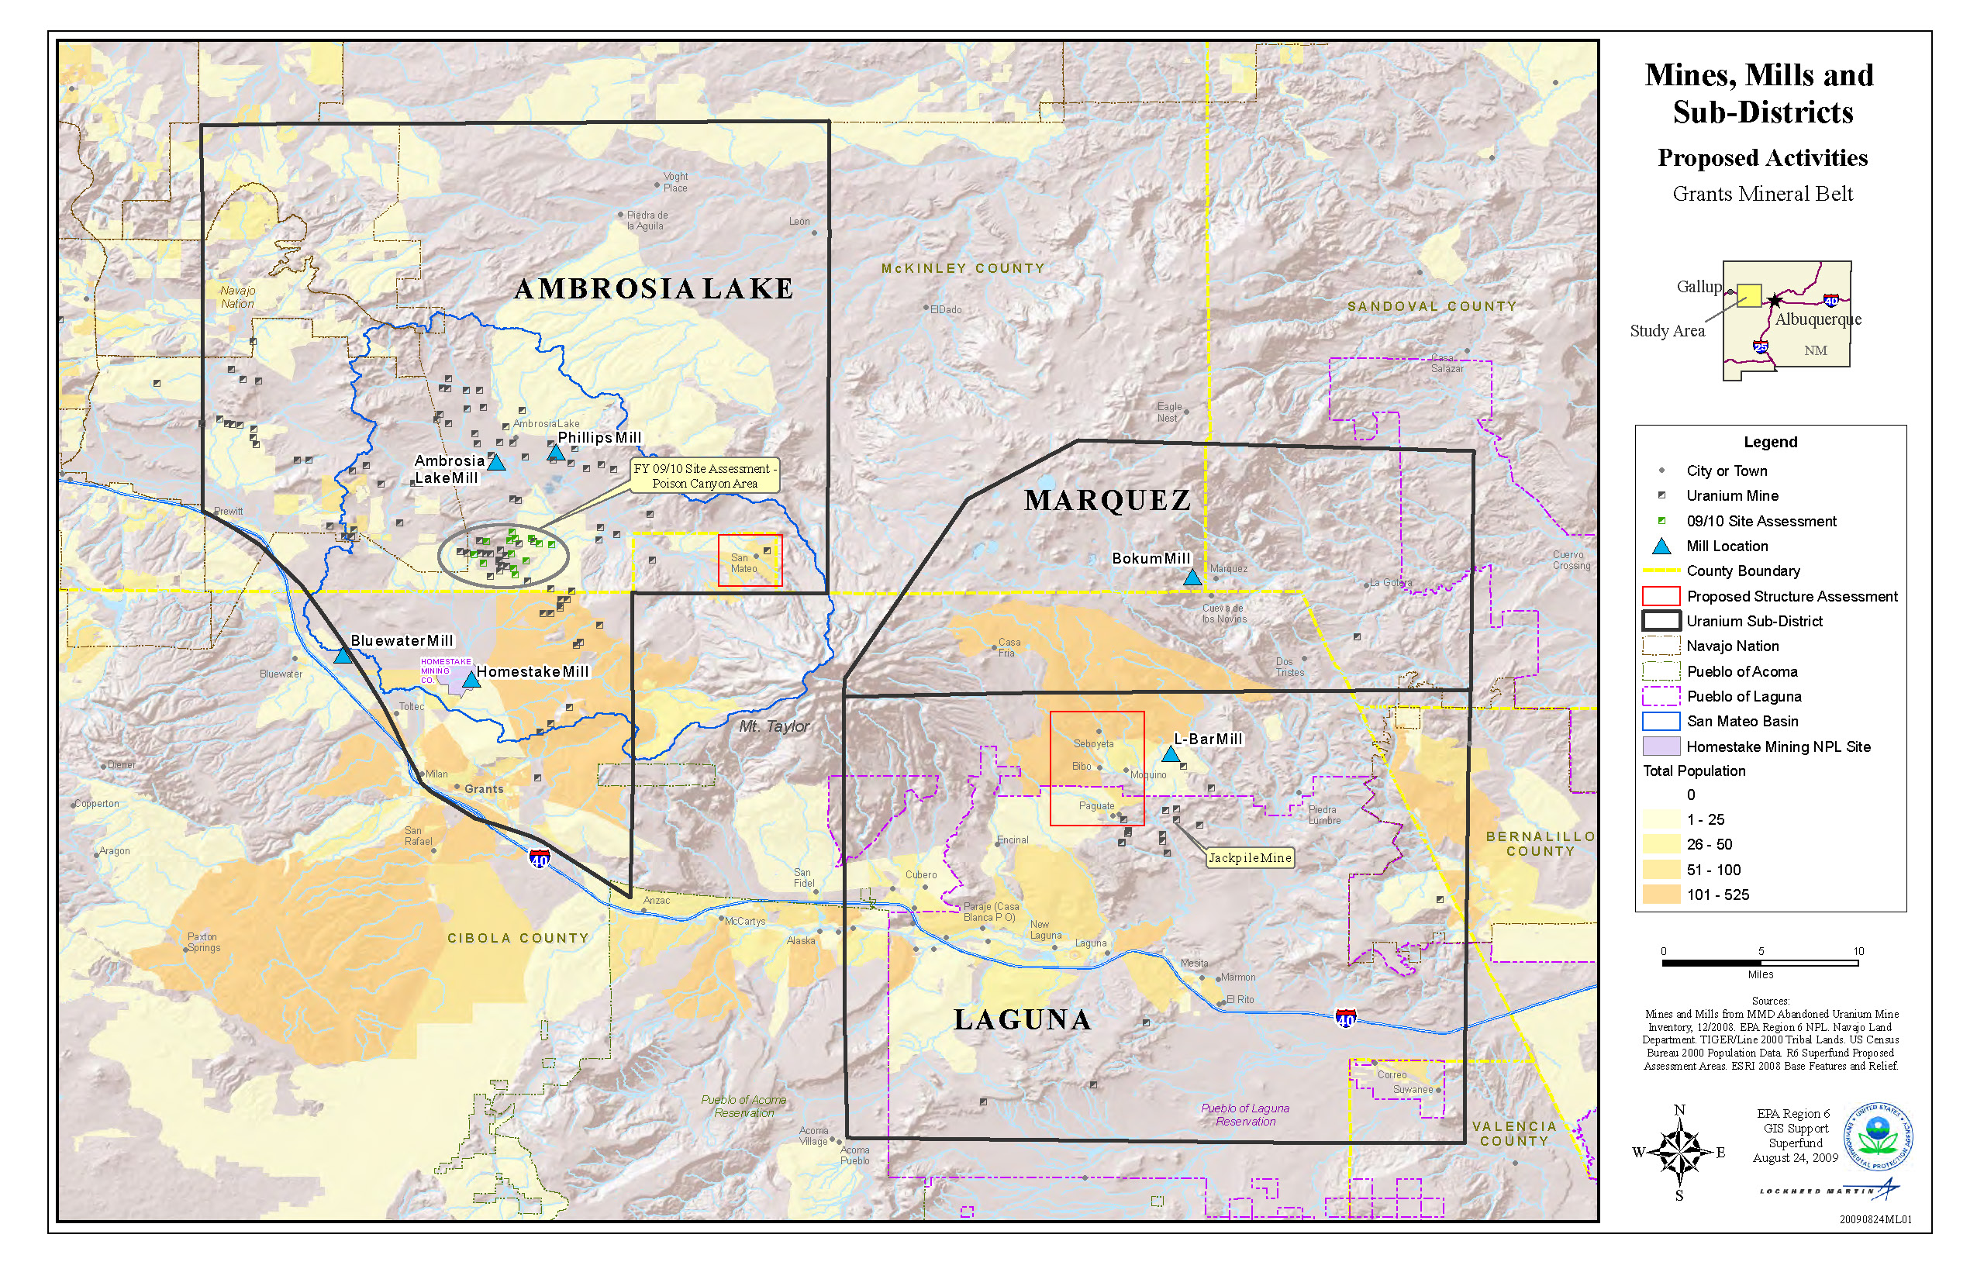

Slide 8
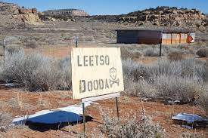
“Having grown up poor, I know I felt personally better off, was able to help my family, and I bought a car shortly”
Simon Ortiz, “Introduction,” Woven Stone, University of Arizona Press, 2022, 22).

Slide 9
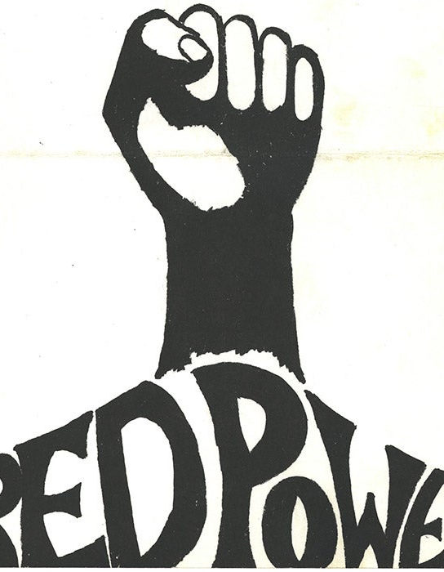
“The ripening of contradictions and the growth of the struggle in the Middle-East, the main source of oil for imperialism, brought about an energy crisis in the imperialist nations. [...] From that time, we could detect an alteration in their profit-making strategy. They re-directed their investments in oil exploration from the Middle-East [...] to the imperialist nations”
“The Native Study Group” qtd in Glen Coulthard, “"Once Were Maoists: Third World Currents in Fourth World Anti-colonialism, Vancouver, 1967–1975." Routledge Handbook of Critical Indigenous Studies, Routledge, 2020, 383)

Slide 10
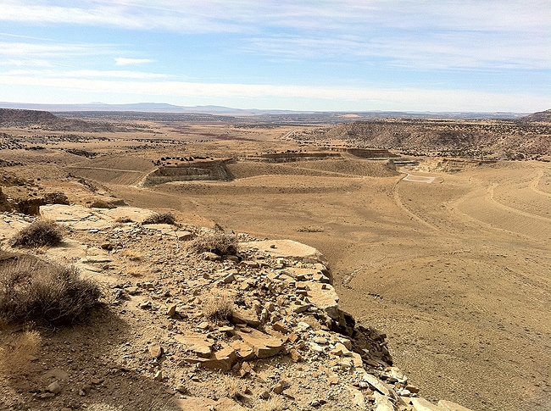

Slide 11
“All that remains of the gardens and orchards that used to grow in the sandy flats of southeast of Paguate village are the stories of the lovely big peaches and apricots that people used to grow. The Jackpile Mine is an open pit that has been blasted out of the many hundreds of acres where the orchards and melon patches once grew. The Laguna people have not witnessed changes to the land without strong reactions. Descriptions of the landscape before the mine are as vivid as any description of the present-day destruction by the open-pit mining. By its very ugliness and by the violence it does to the land, the Jackpile Mine insures that, from now on, it, too, will be included in the vast body of narratives that makes up the history of the Laguna people and the Pueblo landscape. And the description of what that landscape looked like before the uranium mining will always carry considerable impact” (Leslie Marmon Silko, “Interior and Exterior landscapes” Yellow Woman and a Beauty of the Spirit: Essays on Native American Life Today, Simon & Schuster, 1996. pp 43-4)

Slide 12
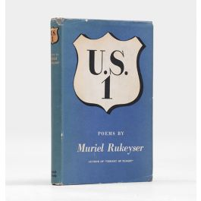

Slide 13
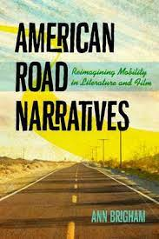
“the road trip is not merely the means but the actual manifestation of an authentic American experience” Ann Brigham, American Road Narratives: Reimagining Mobility in Literature and Film. University of Virginia Press, 2015.
“Postwar and postmodern road stories offer a glimpse not only of contemporary automobility but also of the revolution in authority between people clinging to prewar social privileges […] and those who turned the story of America’s open road into a declaration of independence. “Katie Mills, The road story and the rebel. SIU Press, 2006.

