Slide 2

“The four scenes of violence to which I refer are:
1) The implosion of violence in homes as an effect of the crisis of the figure of the male breadwinner, and his subsequent loss of authority and privileged role in relation to his position in the labor market;
2) the organization of new forms of violence as a principle of authority in popular-sector neighborhoods, rooted in the expansion of illegal economies that replace other modes of provisioning resources;
3) the dispossession and looting of common lands and resources by transnational corporations, and thus the deprivation of the material autonomy of other economies;
and 4) the articulation of forms of exploitation and value extraction for which the financialization of social life—particularly through the apparatus of debt—is a common code.” (59-60)

Slide 3
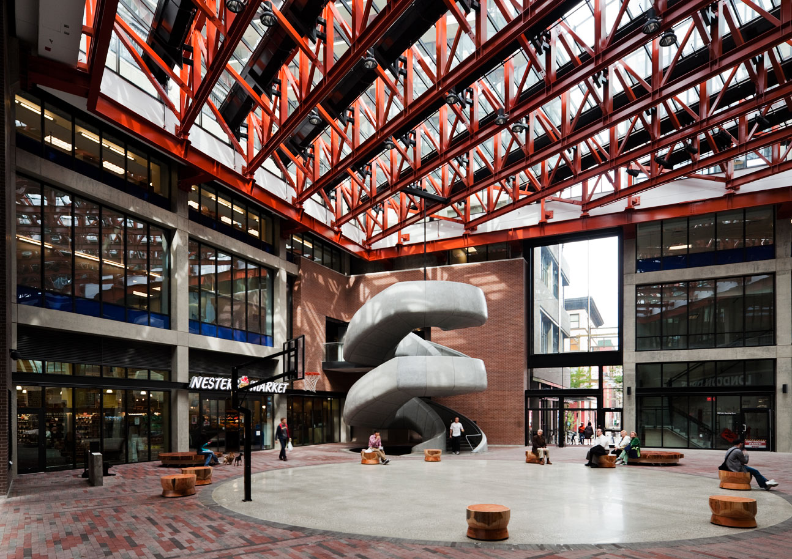
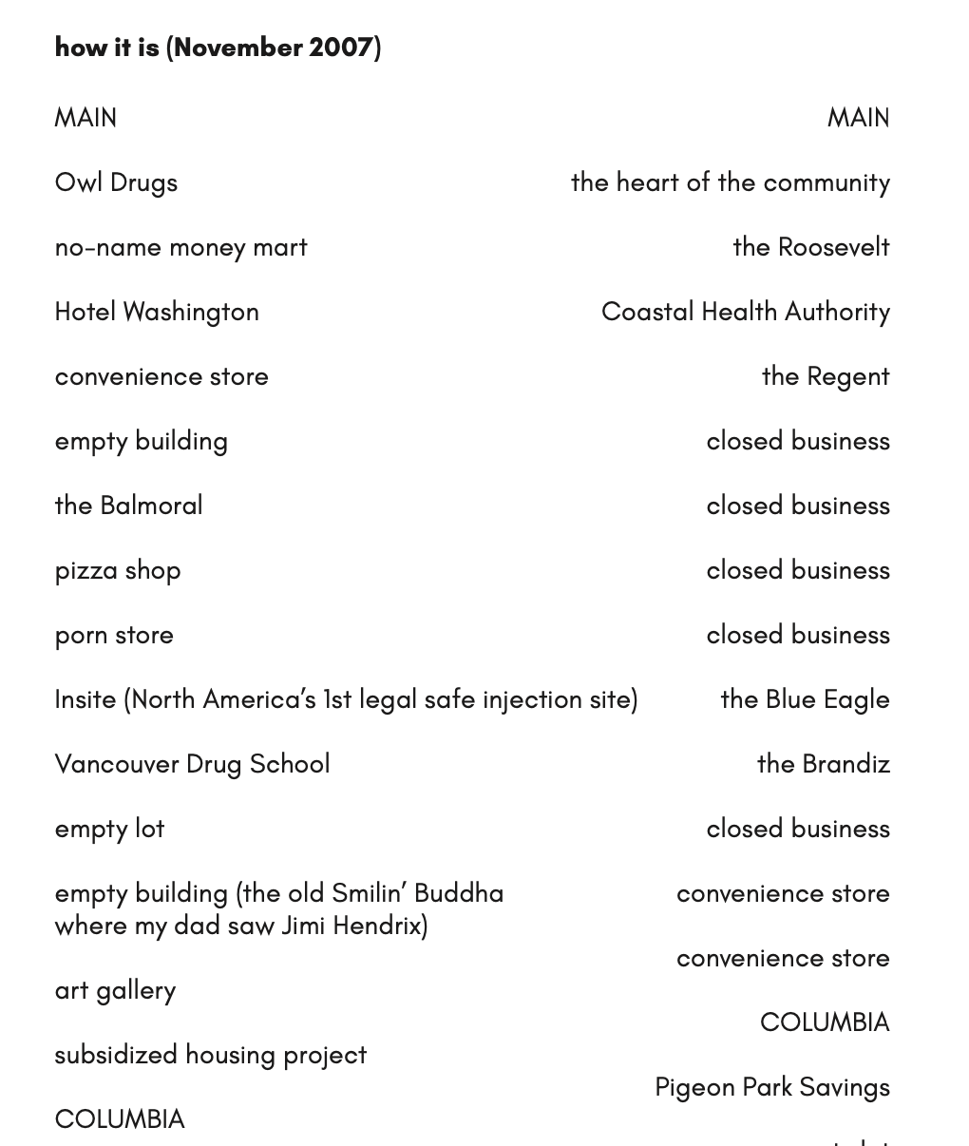
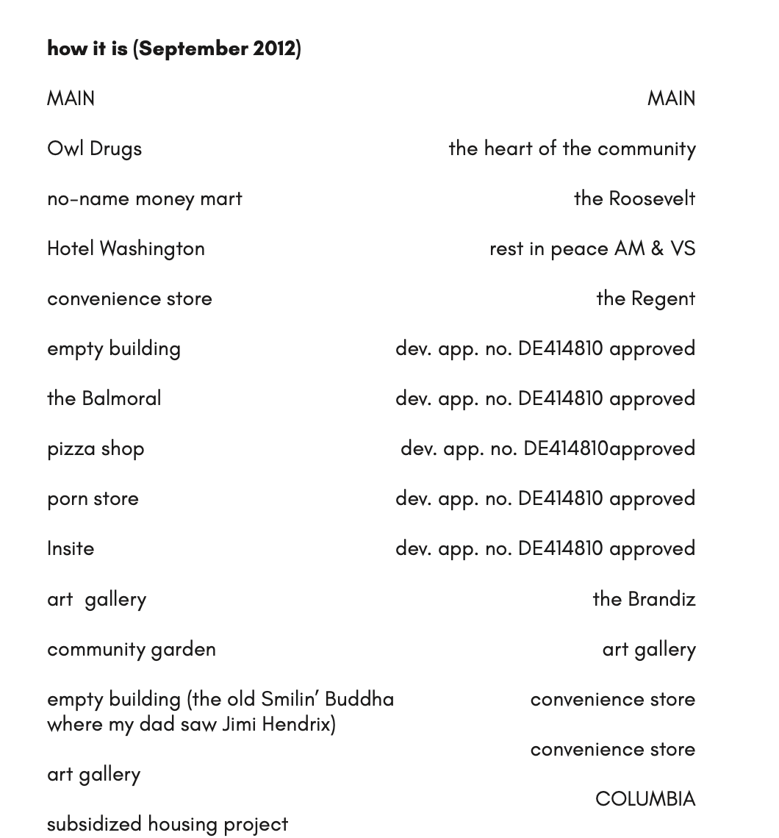

Slide 4
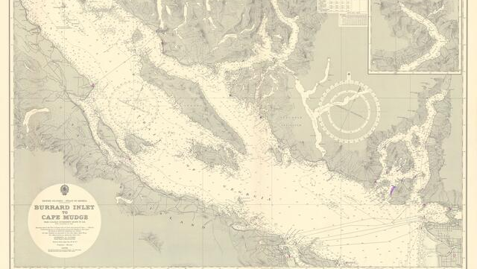
“Topography is both the detailed description of a particular location and the totality of the features that comprise the place itself. Both are produced, and an examination of how this is done can reveal the interested nature of both topographies and topographical knowledge. Topographies provide deliberate, purposeful, and systematic—albeit partial—information at all geo- graphic scales to the military, the state, and business. Topographical knowledge provides the grist for Global Information Systems (GIS) and related spatialized data bases that guide and inform resource extraction, public and private surveillance, military movements, and various forms of governance and domination. […] Topographies produced to counter these impulses [e.g. countertopographies] will provide thick descriptions of particular places that can get at the ways in which a process associated with—for example—the globalization of capitalist production, the prosecution of war, or the imposition of structural adjustment programs affects a particular place. Topographies allow us to look, not only at particular processes in place, but at the effects of their encounters with sedimented social relations of production and reproduction there” (Cindi Katz, "Vagabond capitalism and the necessity of social reproduction," Antipode 33.4 (2001), 720)

Slide 5
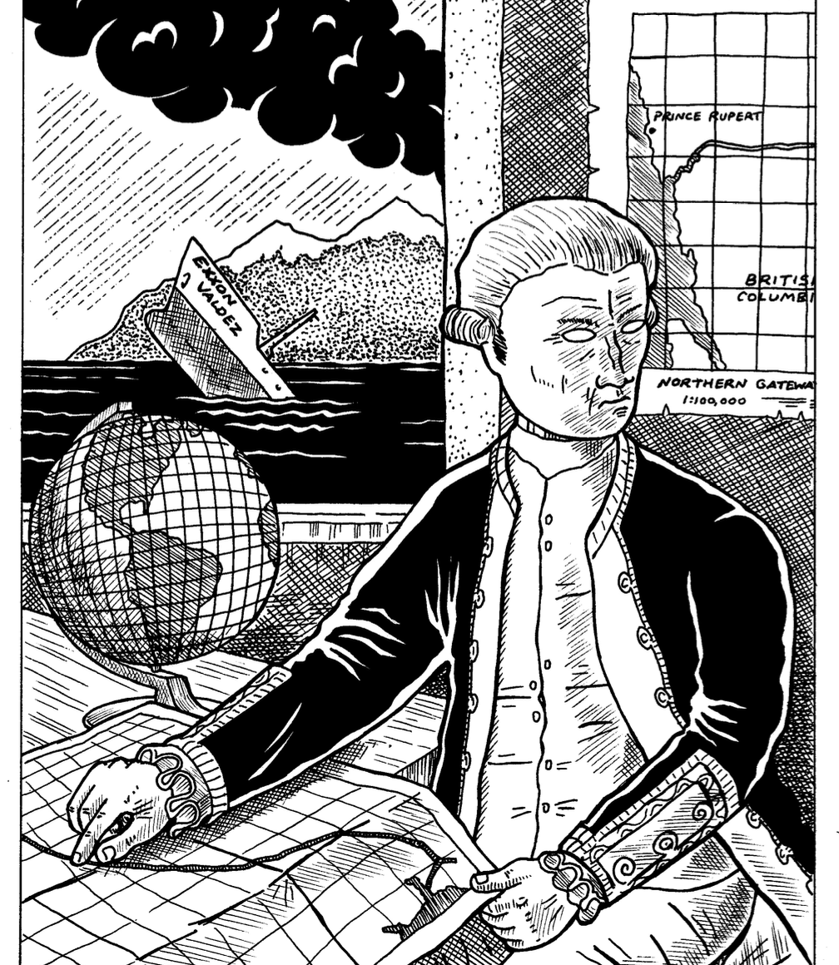
“only by producing a political cartography, connecting the threads that make different forms of violence function as interrelated dynamics, can we denounce the ways their segmentation seeks to enclose us in isolated cells. Such a cartography implies overflowing the confines of ‘gender-based violence’ to link it with the multiple forms of violence that make it possible” (Gago 57)

Slide 6
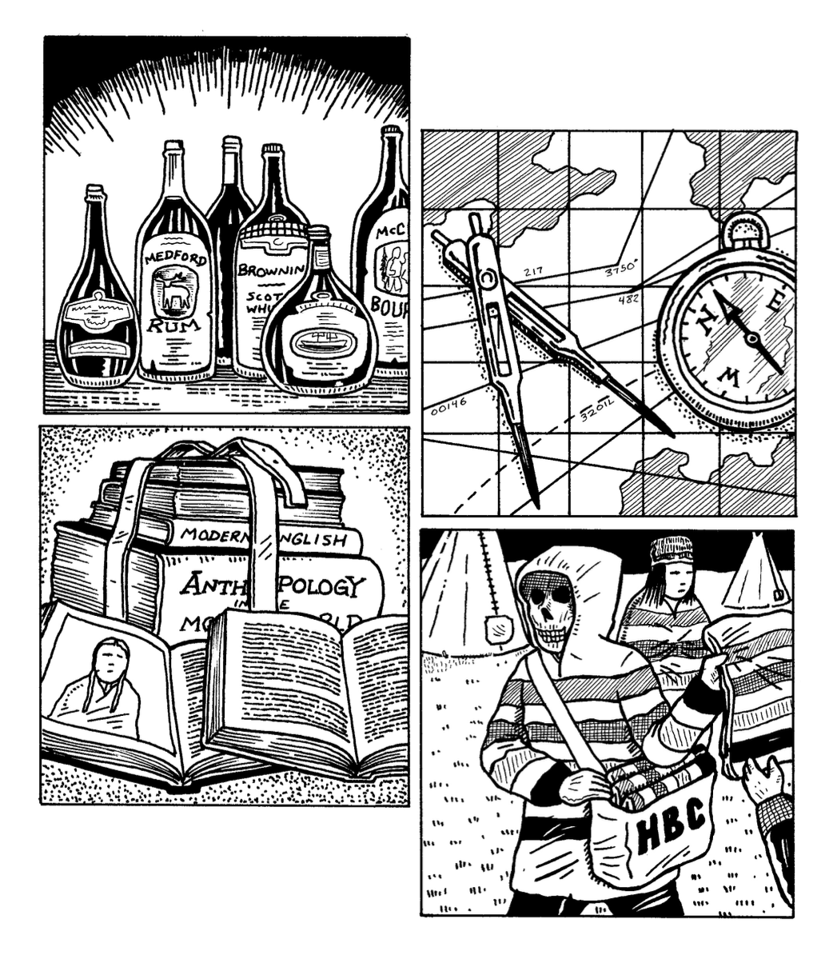
“When I moved to the Downtown Eastside in 1996, I was an addict and street sex worker, and the space that one of the picketed restaurants occupies was a second-hand shop, then a pharmacy where I filled my methadone prescription when I went into recovery, and the space above it, now occupied by expensive private residences, was low-income housing. I’ve changed too: in socioeconomic class and attendant privilege, I now typify the new residents that have displaced the kind of resident I used to be. My life is far removed from that of the women I worked with. For one, I am among the living.” (Mercedes Eng, “Afterword: there goes the neighbourhood!” Mercenary English, Mercenary Press, 2016. 118)

Slide 7
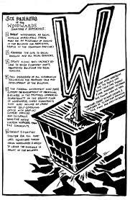
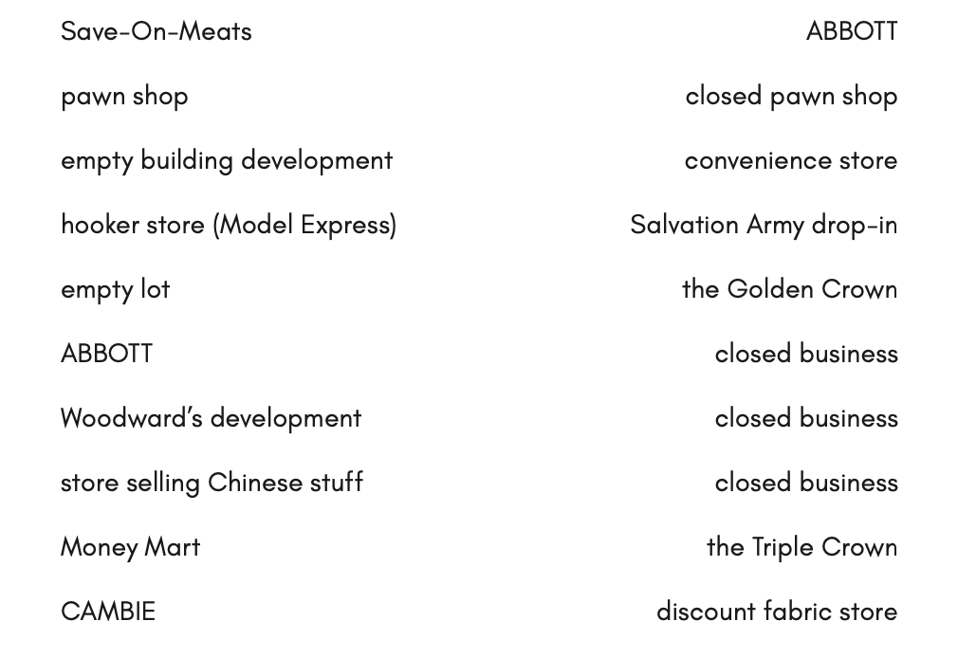
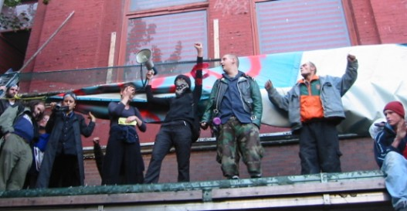




Slide 8
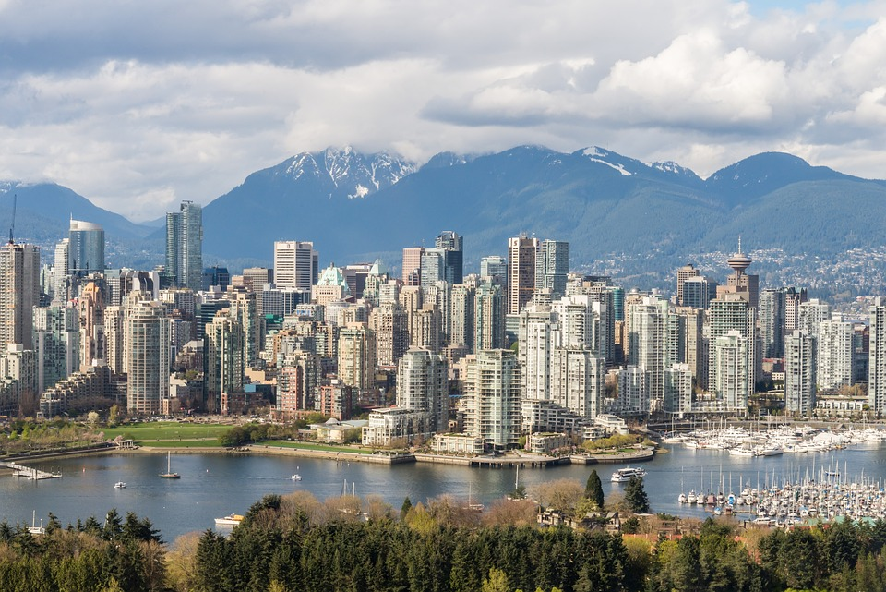
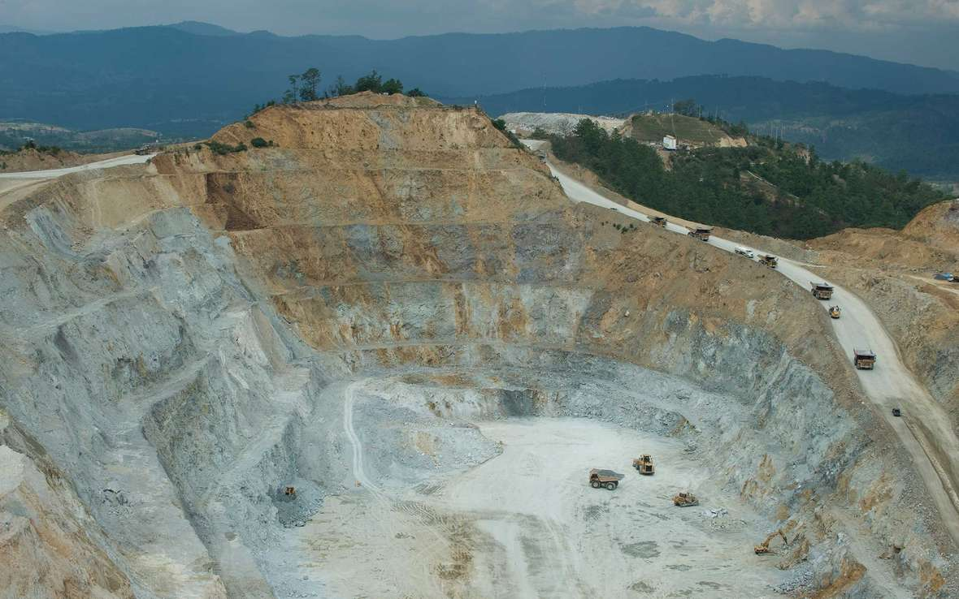

Slide 9
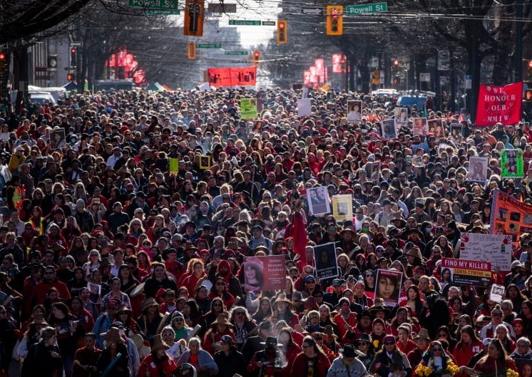
“Protesting the Olympics was when my beliefs became praxis, and I was ready, able, to oppose the violence of genocide and accumulation, which my whole life has been teaching me about, but it was during the Olympics that I voiced and bodied my opposition to it in a public way. The poem about the dick my mouth was initiated by the fear I had that the City, in their effort to limit dissent and thus control public perception about the Olympics (everyone’s super into it!), wouldn’t grant the Memorial March Committee a permit. Knowing that many women were gonna march anyway both excited and scared me. I thought: these women are so tough to not be scared of the police, or to be scared and do it regardless! And the police were stockpiling all these weapons like the MRAD and I was worried they’d use them. But the march was glorious! You straight up can’t fuck with these women.” (Merceds Eng, “echolocation: in conversation with Fred Moten” Mercenary English, 124)

