Slide 1
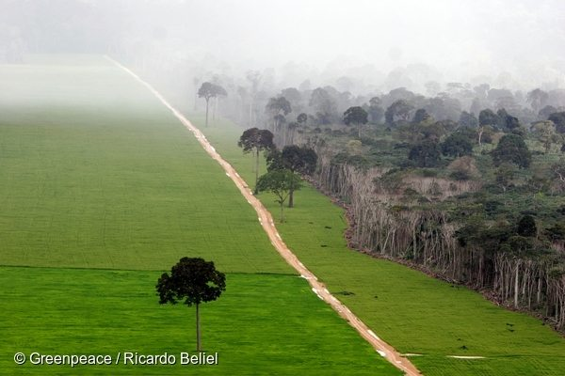
Week 2: Contesting the Anthropocene

Slide 2



Slide 3
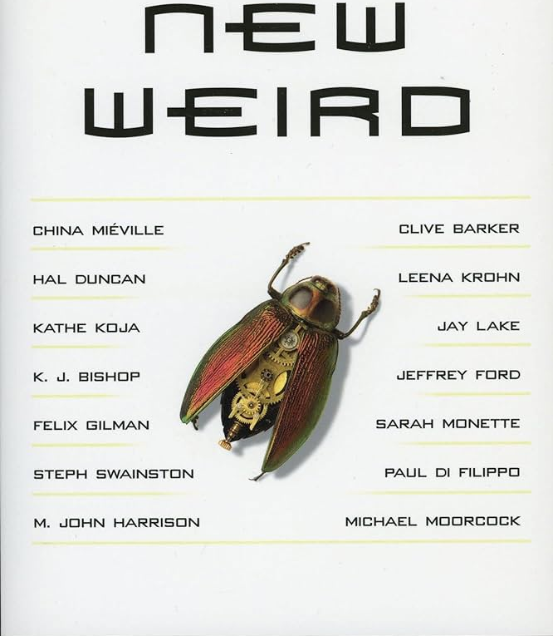
The New Weird
Jeff VanderMeer: “New Weird is a type of urban, secondary-world fiction that subverts the romanticized ideas about place found in traditional fantasy, largely by choosing realistic, complex real-world models as the jumping off point for creation of settings that may combine elements of both science fiction and fantasy”

Slide 4





The ‘old’ Weird:
commonly associated with e.g., H. P. Lovecraft, Arthur Machen, Algernon Blackwood, Clark Ashton Smith, and M. R. James
supernatural, horror, and sf tales, typically shot through with imperialist, racialized, and gendered anxieties

Slide 5





Slide 6

Lovecraft, “The Shunned House”:
“All along the hill people tell of the yellow day, when virulent and horrible fumes arose from the factory waste dumped in the Providence River, but I know how mistaken they are as to the source. They tell, too, of the hideous roar which at the same time came from some disordered water-pipe or gas main underground—but again I could correct them if I dared. It was unspeakably shocking, and I do not see how I lived through it. I did faint after emptying the fourth carboy, which I had to handle after the fumes had begun to penetrate my mask; but when I recovered I saw that the hole was emitting no fresh vapours.”

Slide 7
“Weird tales tend to cluster, or achieve a density of appearance at moments of the first instantiation of an incipient downward phase of economic (and social) contraction. The Weird registers initial perceptions of what ought not to be present – i.e. capitalism in crisis – in times otherwise dominated by wealth creation and continuing expansion [. . .]. Narratives that foreground the seepage of other, seemingly inexplicable lifeworlds and temporalities into the everyday are tremblors before the onset of larger transformations within the capitalist world-system. [. . .] [Weird] tales often deploy bizarre sensorium juxtapositions because no commonsensical (or dominant rational) language is readily available or allowed to express such inconvenient truths about the oncoming decline or overall heterogeneous composition of capital””
Stephen Shapiro, “Woke Weird and the Cultural Politics of Camp Transformation” The American Weird : Concept and Medium, eds. Julius Greve and Florian Zappe)

Slide 8



Slide 9




Slide 10
Maristella Svampa:
Neoextractivism is defined as a “pattern of accumulation based on the overexploitation of generally nonrenewable natural resources, as well as the expansion of capital’s frontiers toward territories previously considered nonproductive” (66)
characterized by large-scale, capital-intensive enterprises; its “emblematic figures include strip mining, the expansion of the petroleum and energy frontier (which also includes the exploitation of nonconventional gas or shale gas [. . .]), the construction of large hydroelectric dams, the expansion of the fishing and forestry frontier, and the generalization of the agribusiness model (soy and biofuels)” (“Commodities Consensus: Neoextractivism and Enclosure of the Commons in Latin America.” South Atlantic Quarterly 114.1).

Slide 11
neoextractivism also differentiated by the tendency of the state to use a portion of the extraordinary rent from natural resources for the financing of social policies directed towards marginalized sectors of the population
e.g., in Latin America, the neoextractivist turn coincided with the so-called pink tide in electoral politics, which saw progressive governments sweep to power in a number of countries across the region

Slide 12
Jeffrey Webber: “The new Centre-Left and Left regimes were buoyed by the Chinese driven commodities boom, and a shift toward the consolidation of what the Uruguayan political economist Eduardo Gudynas calls “compensatory states” began; that is, through modest increases in taxes and royalties progressive governments were able to skim from the high rents being generated by extractive industries to finance targeted redistribution programs without challenging the underlying class structures of society. Poverty fell and social conditions improved, sometimes dramatically. But the organizational capacities of the popular sectors began to decline, and patterns of paternalistic clientelism rose to the fore. Left governments were offering palliative care to the victims of perversely unjust societies, treating their visible symptoms with the revenue brought in by extractive industry in a context of a commodities boom”
https://salvage.zone/latin-america-from-reform-to-resistance-an-interview-with-jeffery-webber-part-1/

