Slide 1
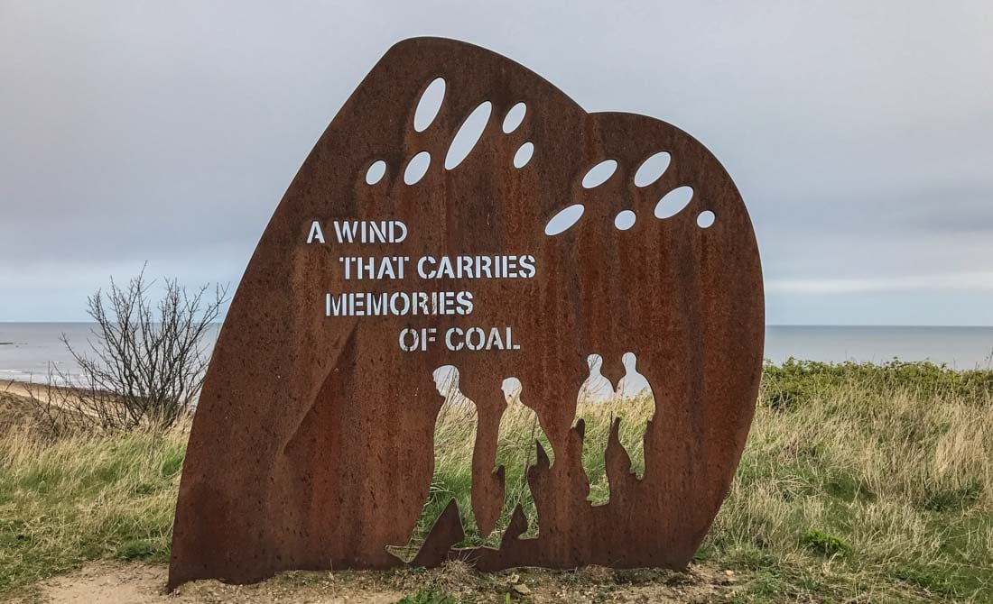
Week 4: Energy

Slide 2
Jason Moore: the dominant energy sources through which the world-system has re-made itself; the “great energy transitions of the modern world” (Moore, “Transcending the Metabolic Rift”, 22):
Peat and charcoal – 1450s-1830s
Coal – 1750s-1950s
Oil and natural gas – 1870s-present
Moore cautions against “the conventional view that sees a ‘structurally invariant’ capitalism (or industrial society) incorporating new external resources” (22). For these energy sources “did not make capitalism so much as capitalism remade itself through their incorporation. To paraphrase Marx, coal is coal. It becomes fossil fuel only in certain relations (22).

Slide 3
Imre Szeman: “When one discusses the end of oil and imagines the main issue to be the possibility of replacement fuels […] one fails to grasp that we are not dealing with an input that can easily take other forms, but with a substance that has given shape to capitalist social reality” (“The Cultural Politics of Oil: On Lessons of Darkness and Black Sea Files.” Polygraph 22: 33–45)

Slide 4
“the ‘dominant culture of automobility’ is implicated in a deep context of affective and embodied relations between people, machines and spaces of mobility and dwelling, in which emotions and the senses play a key part”
“A key overlooked aspect of car cultures is the emotional investments people have in the relationships between the car, the self, family and friends, creating affective contexts that are also deeply materialized in particular types of vehicles, homes, neighbourhoods and cities.”
Mimi Sheller (2004). “Automotive Emotions: Feeling the Car.” Theory, Culture & Society 21 (4–5): 221–42.
oil has powered “a certain kind of mobility characterized by an individuated command over space” (Matt Huber, Lifeblood, 2013: x)

Slide 5
John Davidson’s “The Testament of Sir Simon Simplex Concerning Automobilism” (1908):
But convalescence with the car begins
And petrol expiates our railway sins.
Before we know we shall with joy behold
A world as sane as any world of old;
From labour and electoral problems free,
A world the fibre of whose health shall be,
No Will to be the Mob, but mastering all,
A Will to be the Individual;
[. . .]
To go by train from one place to another
You have to brave the station’s smoke and smother
[. . .]
But with your automobile at the door
Why, there you are, nor need you stir a foot,
Man and portmanteau instantly en route! (102-03)

Slide 6
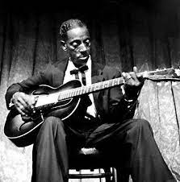
Mississippi Fred McDowell

Slide 7

Mississippi Fred McDowell, “Freight Train Blues”:
I got on that freight train; I tried to beat my way.
Lord, them rocks and gravel, Lord, flew all in my face. (What happened, boy?)
I asked the conductor, let me ride it blind. (Okay...)
I asked the conductor to let me ride it blind. (What did he say?)
Lord, he shook his head, said, "The train ain't none of mine." (Left you shook up, then...)
I got a letter from Hot Spring. I tell you how it was read. (Feel any better, boy.)
I got a letter from Hot Spring. I tell you how it was read. Lord, it's come at once, boy: your sure-'nough gal is dead. (...know whether to go blind, then...)
Come at, come at once, sure-'nough gal, sure-'nough gal is dead.
Said I left my baby standin' out back door cryin'. (Felt like somethin' else.)
I left my baby standing out back door cryin'.
I never felt so sorry, Lord, till she said goodbye.
Lord, she—, Lord, she said good—, Lord, she said goodbye.

Slide 8
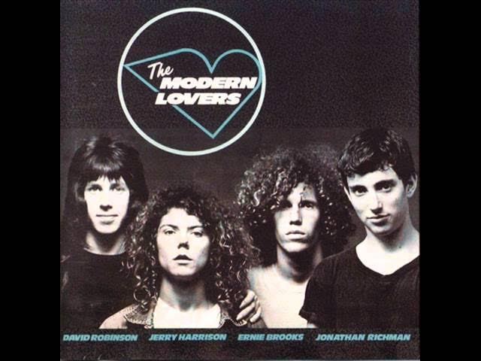

Slide 9
“Roadrunner”, The Modern Lovers (1970)
Roadrunner, roadrunner
Going faster miles an hour
Gonna drive past the Stop 'n' Shop
With the radio on
I'm in love with Massachusetts
And the neon when it's cold outside
And the highway when it's late at night
Got the radio on
I'm like the roadrunner
Alright
I'm in love with modern moonlight
128 when it's dark outside
I'm in love with Massachusetts
I'm in love with the radio on
It helps me from being alone late at night
It helps me from being lonely late at night
I don't feel so bad now in the car
Don't feel so alone, got the radio on
Like the roadrunner
That's right
Said welcome to the spirit of 1956
Patient in the bushes next to '57
The highway is your girlfriend as you go by quick
Suburban trees, suburban speed
And it smells like heaven
And I say roadrunner once
Roadrunner twice
I'm in love with rock & roll and I'll be out all night
Roadrunner
That's right
Well now
Roadrunner, roadrunner
Going faster miles an hour
Gonna drive to the Stop 'n' Shop
With the radio on at night
And me in love with modern moonlight
Me in love with modern rock & roll
Modern girls and modern rock & roll
Don't feel so alone, got the radio on
Like the roadrunner

Slide 10
“Fiction, in its various modes, genres, and histories, offers a significant (and relatively untapped) repository for the energy aware scholar to demonstrate how, through successive epochs, particularly embedded kinds of energy create a predomi­nant (and oftentimes alternative) culture of being and imagining in the world; or­ganizing and enabling a prevalent mode of living, thinking, moving, dwelling and working.” (Graeme Macdonald, “Research Note: The Resources of Fiction.” Reviews in Cultural Theory 4 (2013): 1-29).

Slide 11
“Like the laws of thermodynamics, fiction relies on momentum and trans­ference; absorbing and exuding, circulating, conserving and converting energy and resources, not only on the level of narrative, metaphor and content but also in forma­tion, production, dissemination and reception. (Is it churlish to point out that you are, after all, reading this on once-oil or once-wood?)”
“The question, however, of how the remarkable energy of fiction is inextricably connected to the (often entirely unre­marked and unremarkable) energy in fiction – the stuff that makes things go and hap­pen in literary worlds – goes mostly unstated. This despite the spectacular products and results of primary and secondary energy conversions being visible throughout literature’s modern history: imagine, say, Anna Karenina, Things Fall Apart or One Hundred Years of Solitude without coal-powered locomotives! Contemplate Conrad’s novels without wind or steam. Consider the sprawling fiction of twentieth century suburbia – relating psyches, bodies and worlds saturated in oil-based products – sud­denly shorn of plastics, deprived of automobility or domestic electric power, bereft of pharmaceuticals, denied the cheap food supplies of prime-moved fertilizer!” (Macdonald)

Slide 12
Some topics to consider:
Think about the narrative energetics of a particular text (see some examples on the handout). How do the such narrative energetics register and encode different energy sources and what does this do to the narrative and the different kinds of subjectivities, affects, experiences, etc depicted
How might we read for the political-ecology of certain energy sources, e.g., coal as described by Malm, in literary texts?
How is energy entangled with classist, racist, and sexist regimes of power, and how might we read for this in literary texts? How might texts enable us to critique and even resist such entanglements?

Slide 13
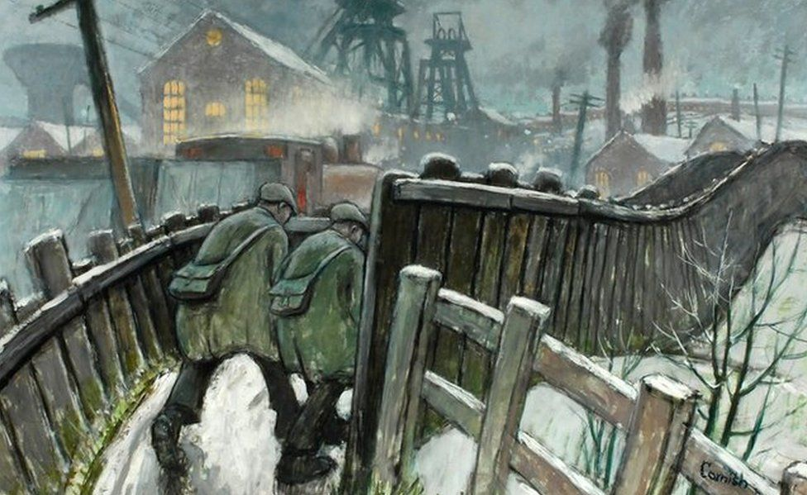
Sid Chaplin: “coal soaked into your being, if only from the interminable coal talk, good and bad cavils, coal wet, coal dry, coal you could push down with the toeplate of your boot, coal a diamond drill wouldn’t touch, how many score this one got, how many this didn’t…” (“Durham Mining Villages” in Mining and Social Change, 68)

Slide 14


Slide 15
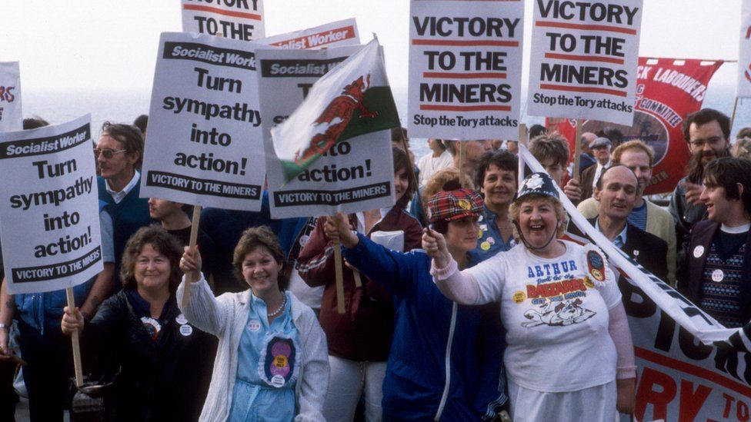
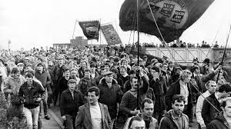
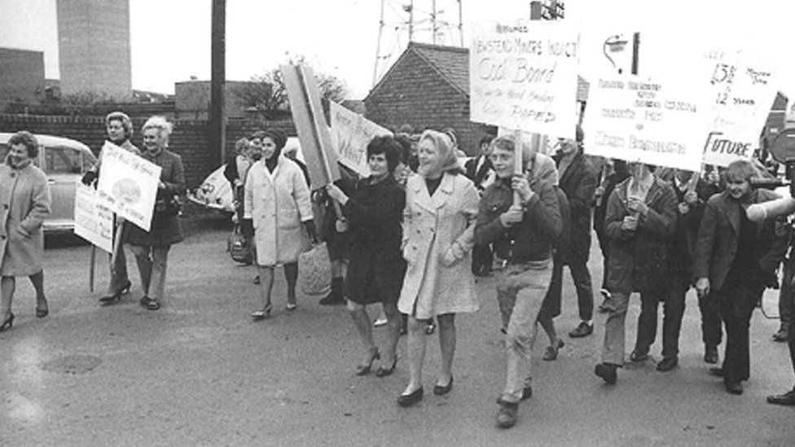
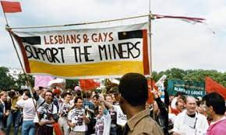

Slide 16
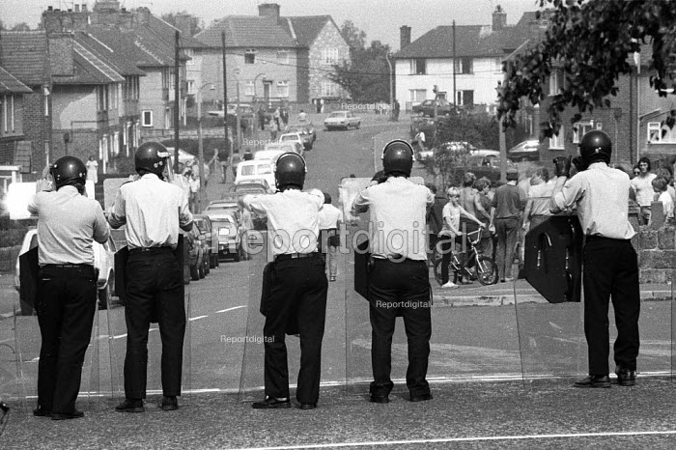
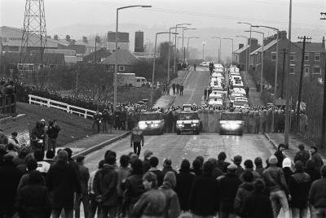

Slide 17
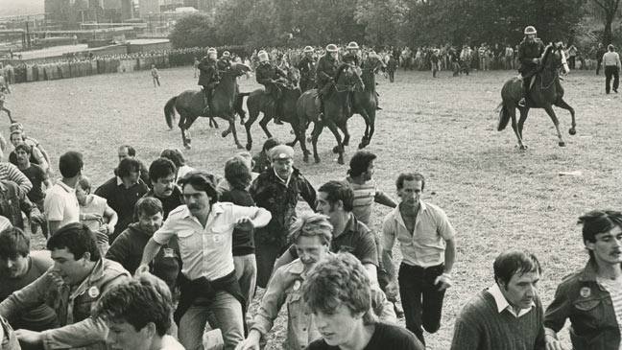
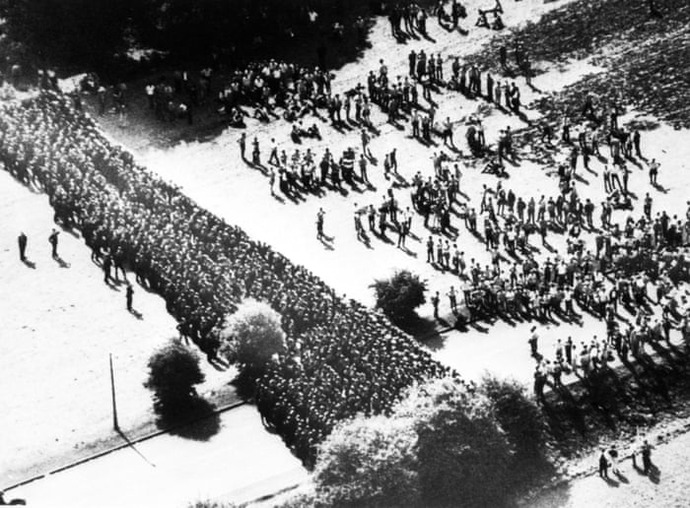
Battle of Orgreave, June 1984

Slide 18
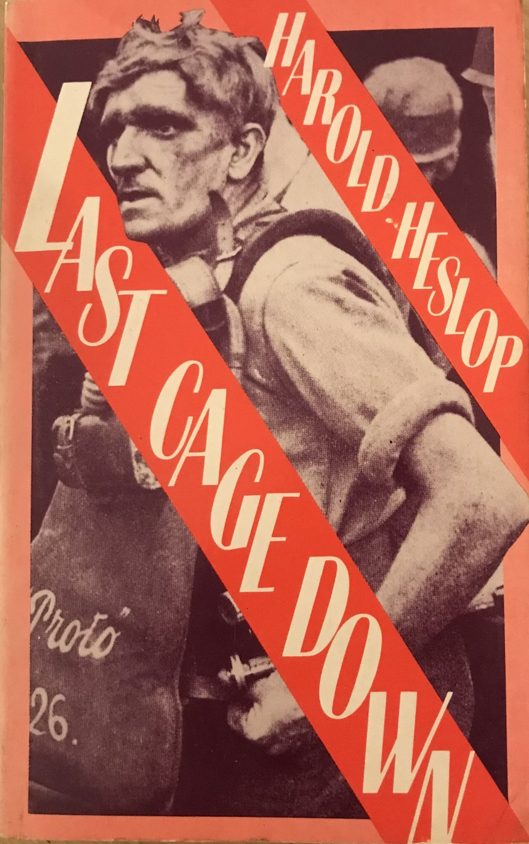
Harold Heslop, Last Cage Down (1935)
“He could see a great part of Darlstone stretching out lazily on either side of him. [. ..] A changed Darlstone, in all conscience, once so busy, now so dead. Joe Frost had appreciated that he was a derelict himself, walking in a derelict district. Darlstone was completely doomed. It seemed as if the very land knew of that doom. The birds seemed to cry more plaintively as they hovered about their nests than was their wont. The bird cries reminded him of the swamp. Damp, damned and doomed. It almost broke his spirit. A million people nurtured on Darlstone’s soil, a million fully equipped people, the finest miners in the world, the direct descendants of the world’s first miners, rotting and stagnating. He was walking in the graveyard of a gigantic industry.” (294)

Slide 19
Barry Supple on the British coal industry:
following the First World War “the emergence of competing coalfields in other countries, the slowing-down of world economic growth and trade, together with economies in the use of coal, all combined to reduce demand and depress the industry” (179)
after 1924, “the new situation asserted itself decisively: coal-mining entered a prolonged period of stagnation as its excess capacity and superfluity of workers were exposed. A high level of unemployment (between 1928 and 1936 there were never less than 24 per cent of miners wholly or partly out of work) and widespread distress, especially in South Wales, the North East and Scotland, became endemic to the industry. And the benefits of the modest revival of demand in the late 1930s were feasible only because so many miners had left the industry and so many mines had closed. Prosperity never fully returned and, ironically, with the Second World War, in spite of severe shortages of coal and desperate needs, output and employment continued to decline. Coal never regained its pre-eminence among Britain’s exports, and in peacetime domestic demand never recovered sufficiently to sustain the industry. (“The British Coal Industry Between the Wars.” New Directions in Economic and Social History. Eds. Anne Digby et al. London: Macmillan, 179-80)

