Slide 1
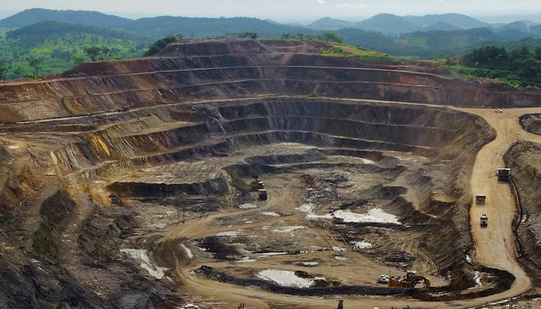
Week 6: Resource Wars
“the planetary situation had played a big role to the extent that it favoured the movement of goods” (Congo Inc.)

Slide 2
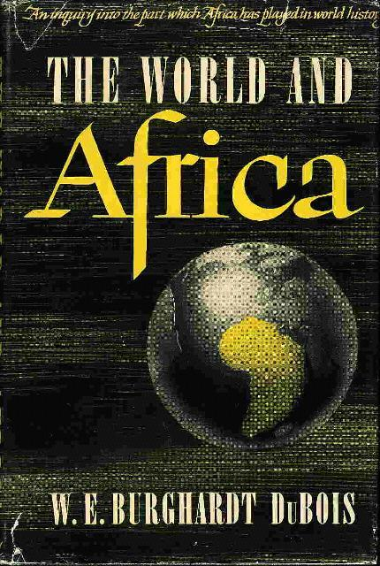
W. E. B. Du Bois, The World and Africa (1946):
“It all became a characteristic drama of capitalist exploitation, where the right hand knew nothing of what the left hand did, yet rhymed its grip with uncanny timeliness; where the investor neither knew, nor inquired, nor greatly cared about the sources of his profits; where the enslaved or dead or half-paid worker never saw nor dreamed of the value of his work (now owned by others); where neither the society darling nor the great artist saw the blood on the piano keys; where the clubman, boasting of great game hunting, heard above the click of his smooth, lovely, resilient billiard balls no echo of the wild shrieks of pain from kindly, half-human beasts as fifty to seventy-five thousand each year were slaughtered in cold, cruel, lingering horror of living death; sending their teeth to adorn civilization on the bowed heads and chained feet of thirty thousand black slaves, leaving behind more than a hundred thousand corpses in broken, flaming homes.” (86)

Slide 3
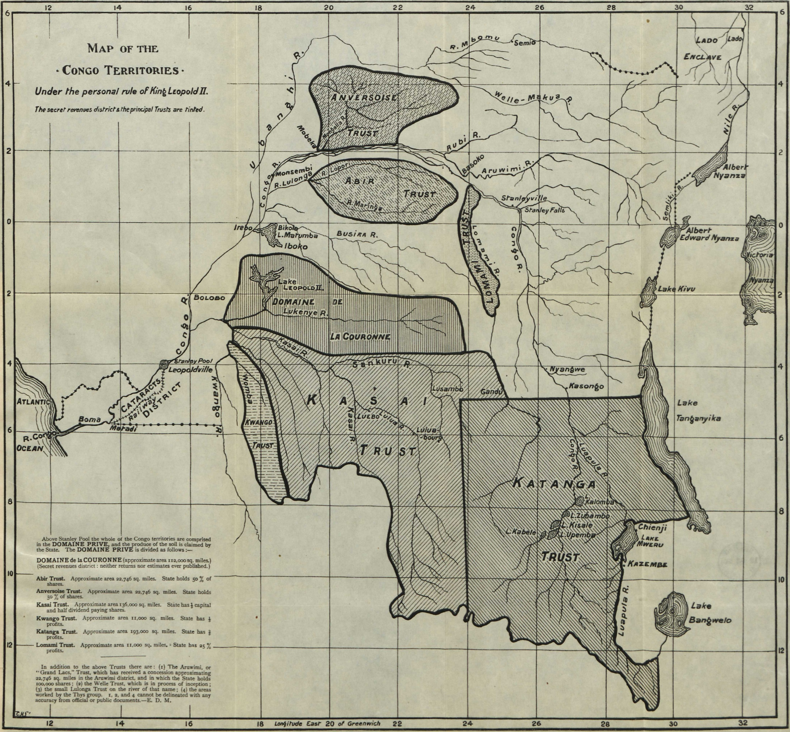
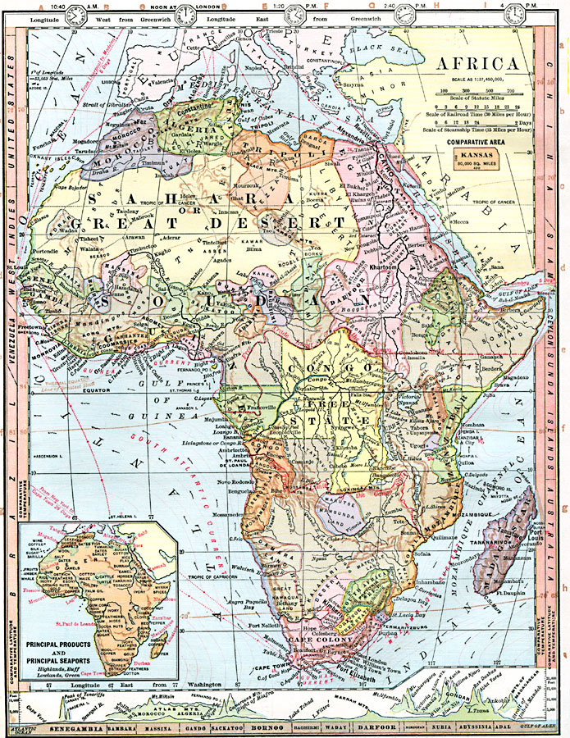

Slide 4
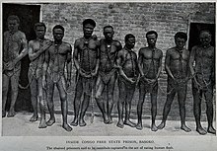
from 1875 to 1905, Europeans extracted 70,000 tons of ivory from the Congo every year
75,000 elephants were slaughtered annually

Slide 5
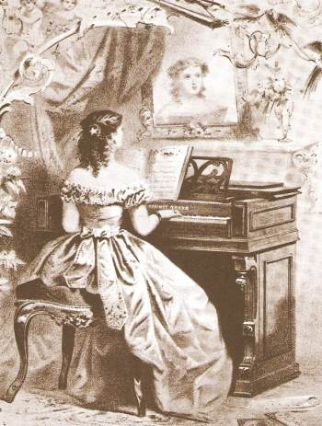

Slide 6
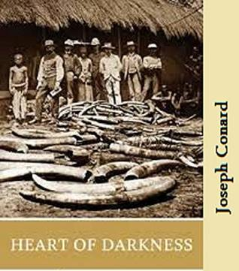
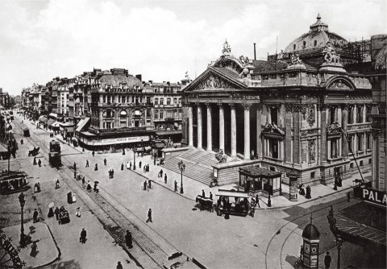

Slide 7
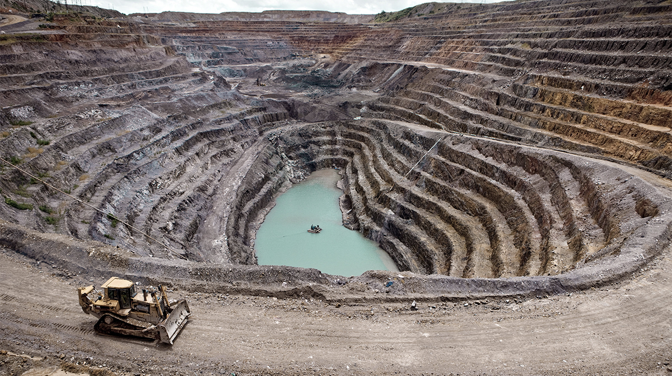
Jennifer Wenzel:
“If the Congo did not exist, it would be necessary to invent it. Time and again, whatever natural resource became indispensable to European capitalist expansion and technological innovation was to be found in the Congo in vast stores, beginning with slave labour in the sixteenth century. In the nineteenth century, the Congo had ivory, which [. . .] was like an expensive “plastic,” capable of being carved into numerous items. Then, in 1890, wild rubber, ready for harvesting to meet the booming demand for tires, hoses, and electrical and telegraph insulation. In an era of electrification and industrial manufacturing, copper for wires and cobalt for alloys. At the dawn of the nuclear age, the uranium the United States used in the bombs that marked the transition from World War to Cold War. In the age of globalization, [. . .] the Congo has coltan, or columbo-tantalite, a heat-resistant conductor used in the capacitors that power cell phones, pagers, and laptops. [. . .] [Could] modernity [. . .] have been “invented” (or, indeed, “conducted”) without the resources of the Congo.”
"Remembering the past's future: Anti-imperialist nostalgia and some versions of the Third World." Cultural Critique 62 (2006): 1-32.

Slide 8
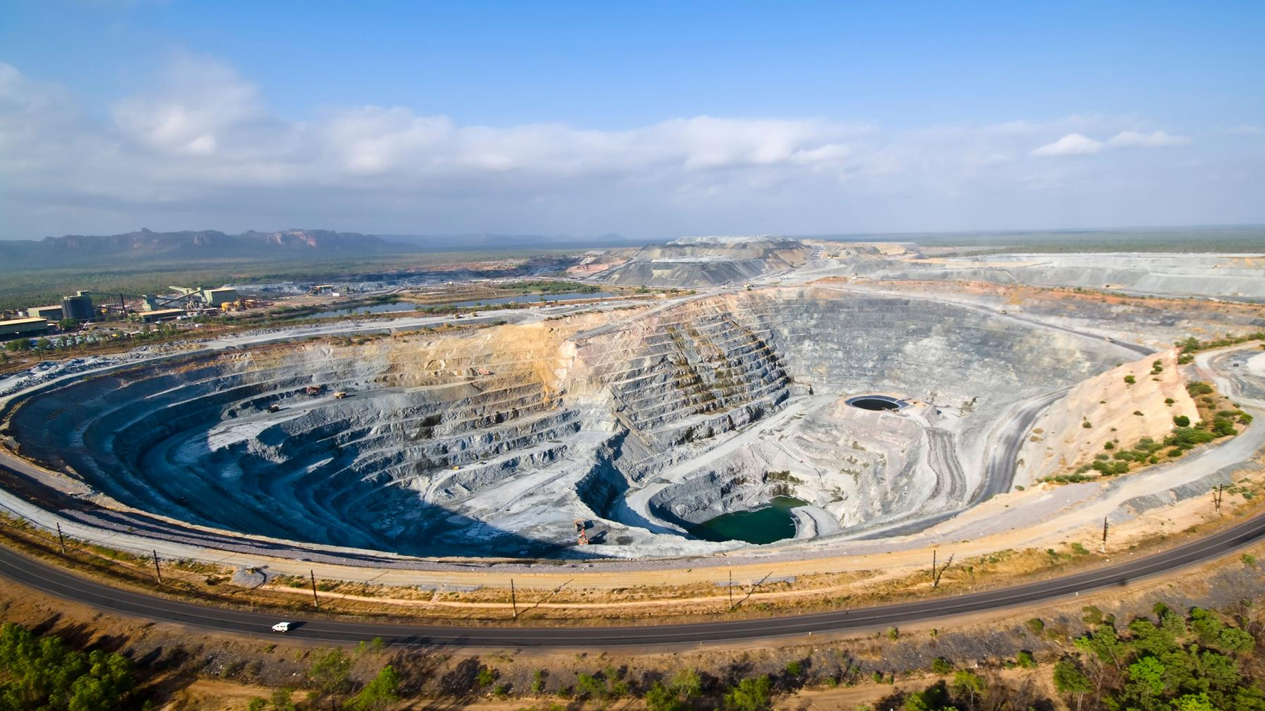
“The algorithm Congo Inc. had been created at the moment that Africa was being chopped up in Berlin between November 1884 and February 1885. Under Leopold II’s sharecropping, they had hastily developed it so they could supply the whole world with rubber from the equator, without which the industrial era wouldn’t have expanded as rapidly as it needed to at the time. [. . .] The involvement of Congo Inc. in the Second World War proved decisive. The final point had come with the concept of putting the uranium of Shinkolobwe at the disposal of the United States of America, which destroyed Hiroshima and Nagasaki once and for all, launching the theory of nuclear deterrence at the same time, and for all time. It contributed vastly to the devastation of Vietnam by allowing the Bell UH1-Huey helicopters, sides gaping wide, to spit millions of sprays of the copper from Likasi and Kolwezi from high in the sky over towns and countryside from Danang to Hanoi, via Huế, Vinh, Lao Cai, Lang Son, and the port of Haiphong. [. . .] Loyal to Bismarck’s testament, Congo Inc. more recently had been appointed as the accredited supplier of internationalism, responsible for the delivery of strategic minerals for the conquest of space, the manufacturing of sophisticated armaments, the oil industry, and the production of high-tech telecommunications.” (174)

Slide 9

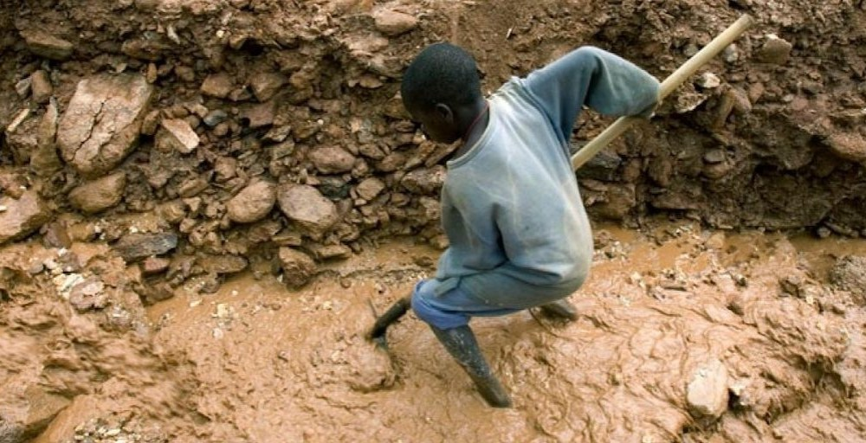
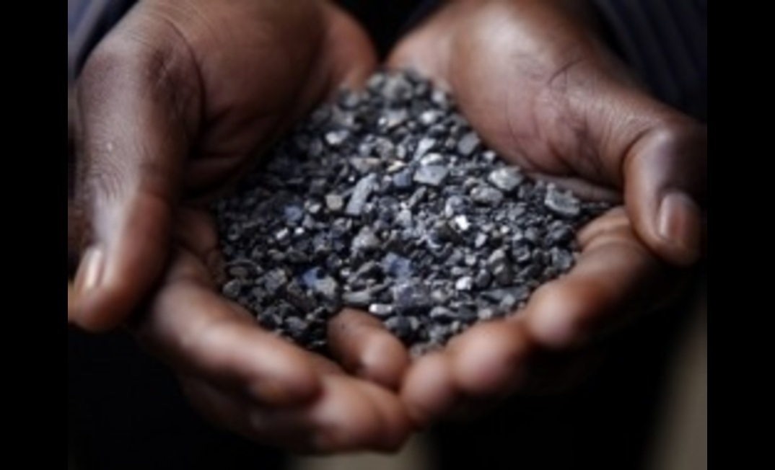

Slide 10
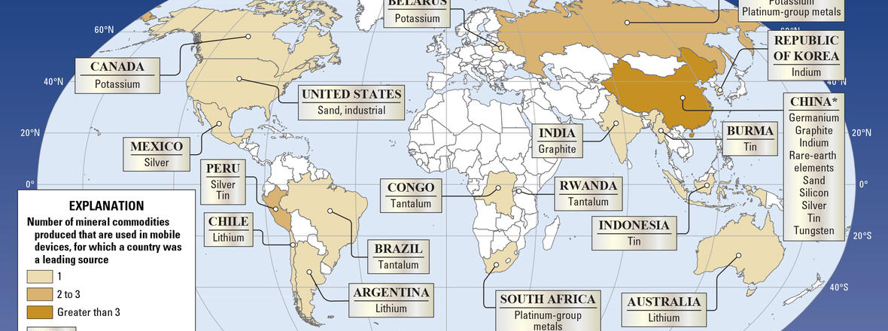
Brian Merchant,
The One Device: The Secret History of the iPhone
“Your iPhone begins with thousands of miners working in often brutal conditions on nearly every continent to dredge up the raw elements that make its components possible.”

Slide 11
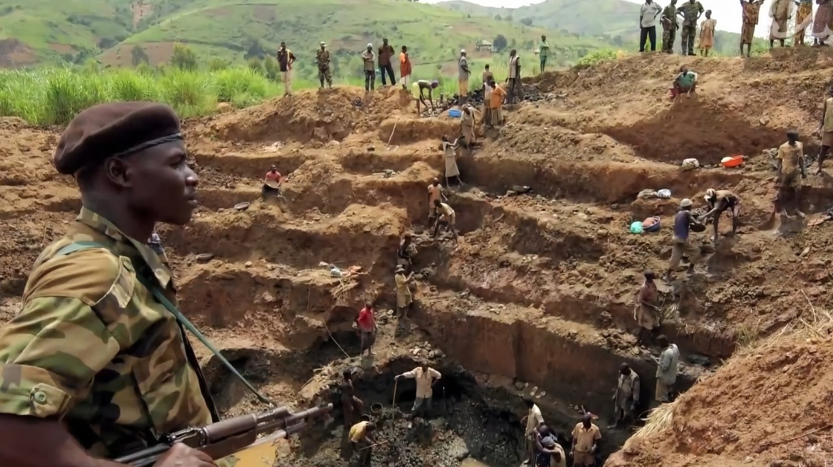
“Plaintiffs in the court documents say they worked at mines owned by Zhejiang Huayou Cobalt, a major Chinese cobalt firm, which the lawsuit claims supplies Apple, Dell, and Microsoft and is likely to supply the other defendants. In the court documents, the Congolese families describe how their children were driven by extreme poverty to seek work in large mining sites, where they claim they were paid as little as $2 (£1.50) a day for backbreaking and dangerous work digging for cobalt rocks with primitive tools in dark, underground tunnels. The families claim that some of the children were killed in tunnel collapses while others were paralysed or suffered life-changing injuries from accidents.” (Annie Kelly, “Apple and Google named in US lawsuit over Congolese child cobalt mining deaths.” The Guardian. 16th December, 2019)

Slide 12
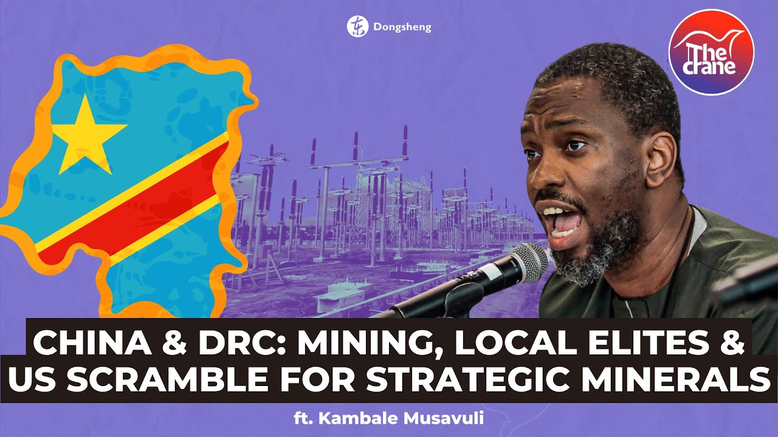

Slide 13
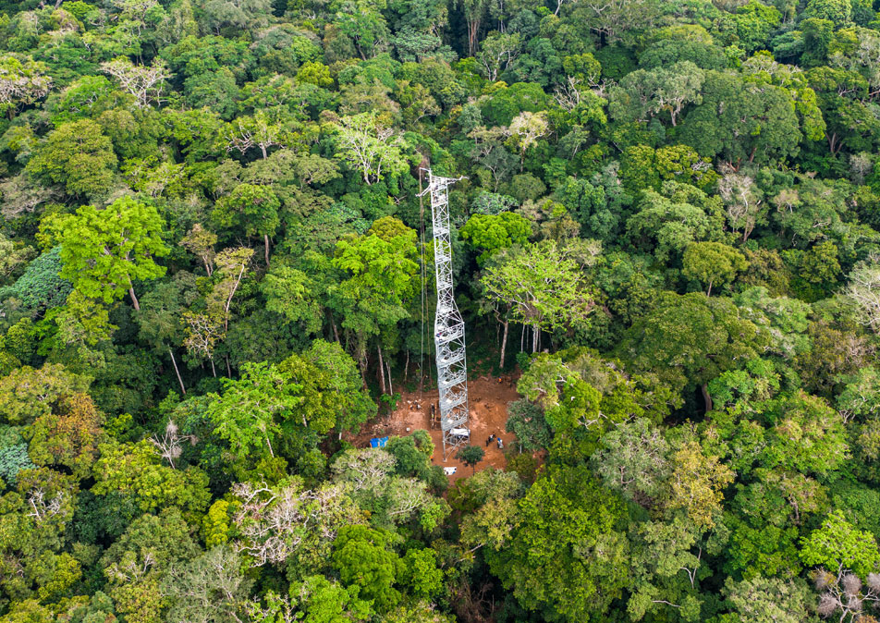
Isookanga: it is “absolutely necessary to open up the forest by placing telecommunication towers everywhere so that everyone could be connected to the rest of the world. Opening up information highways, certainly, but not just that; they also had to open up highways, period, so that the consumer goods that abounded elsewhere could benefit everyone” (12).

Slide 14
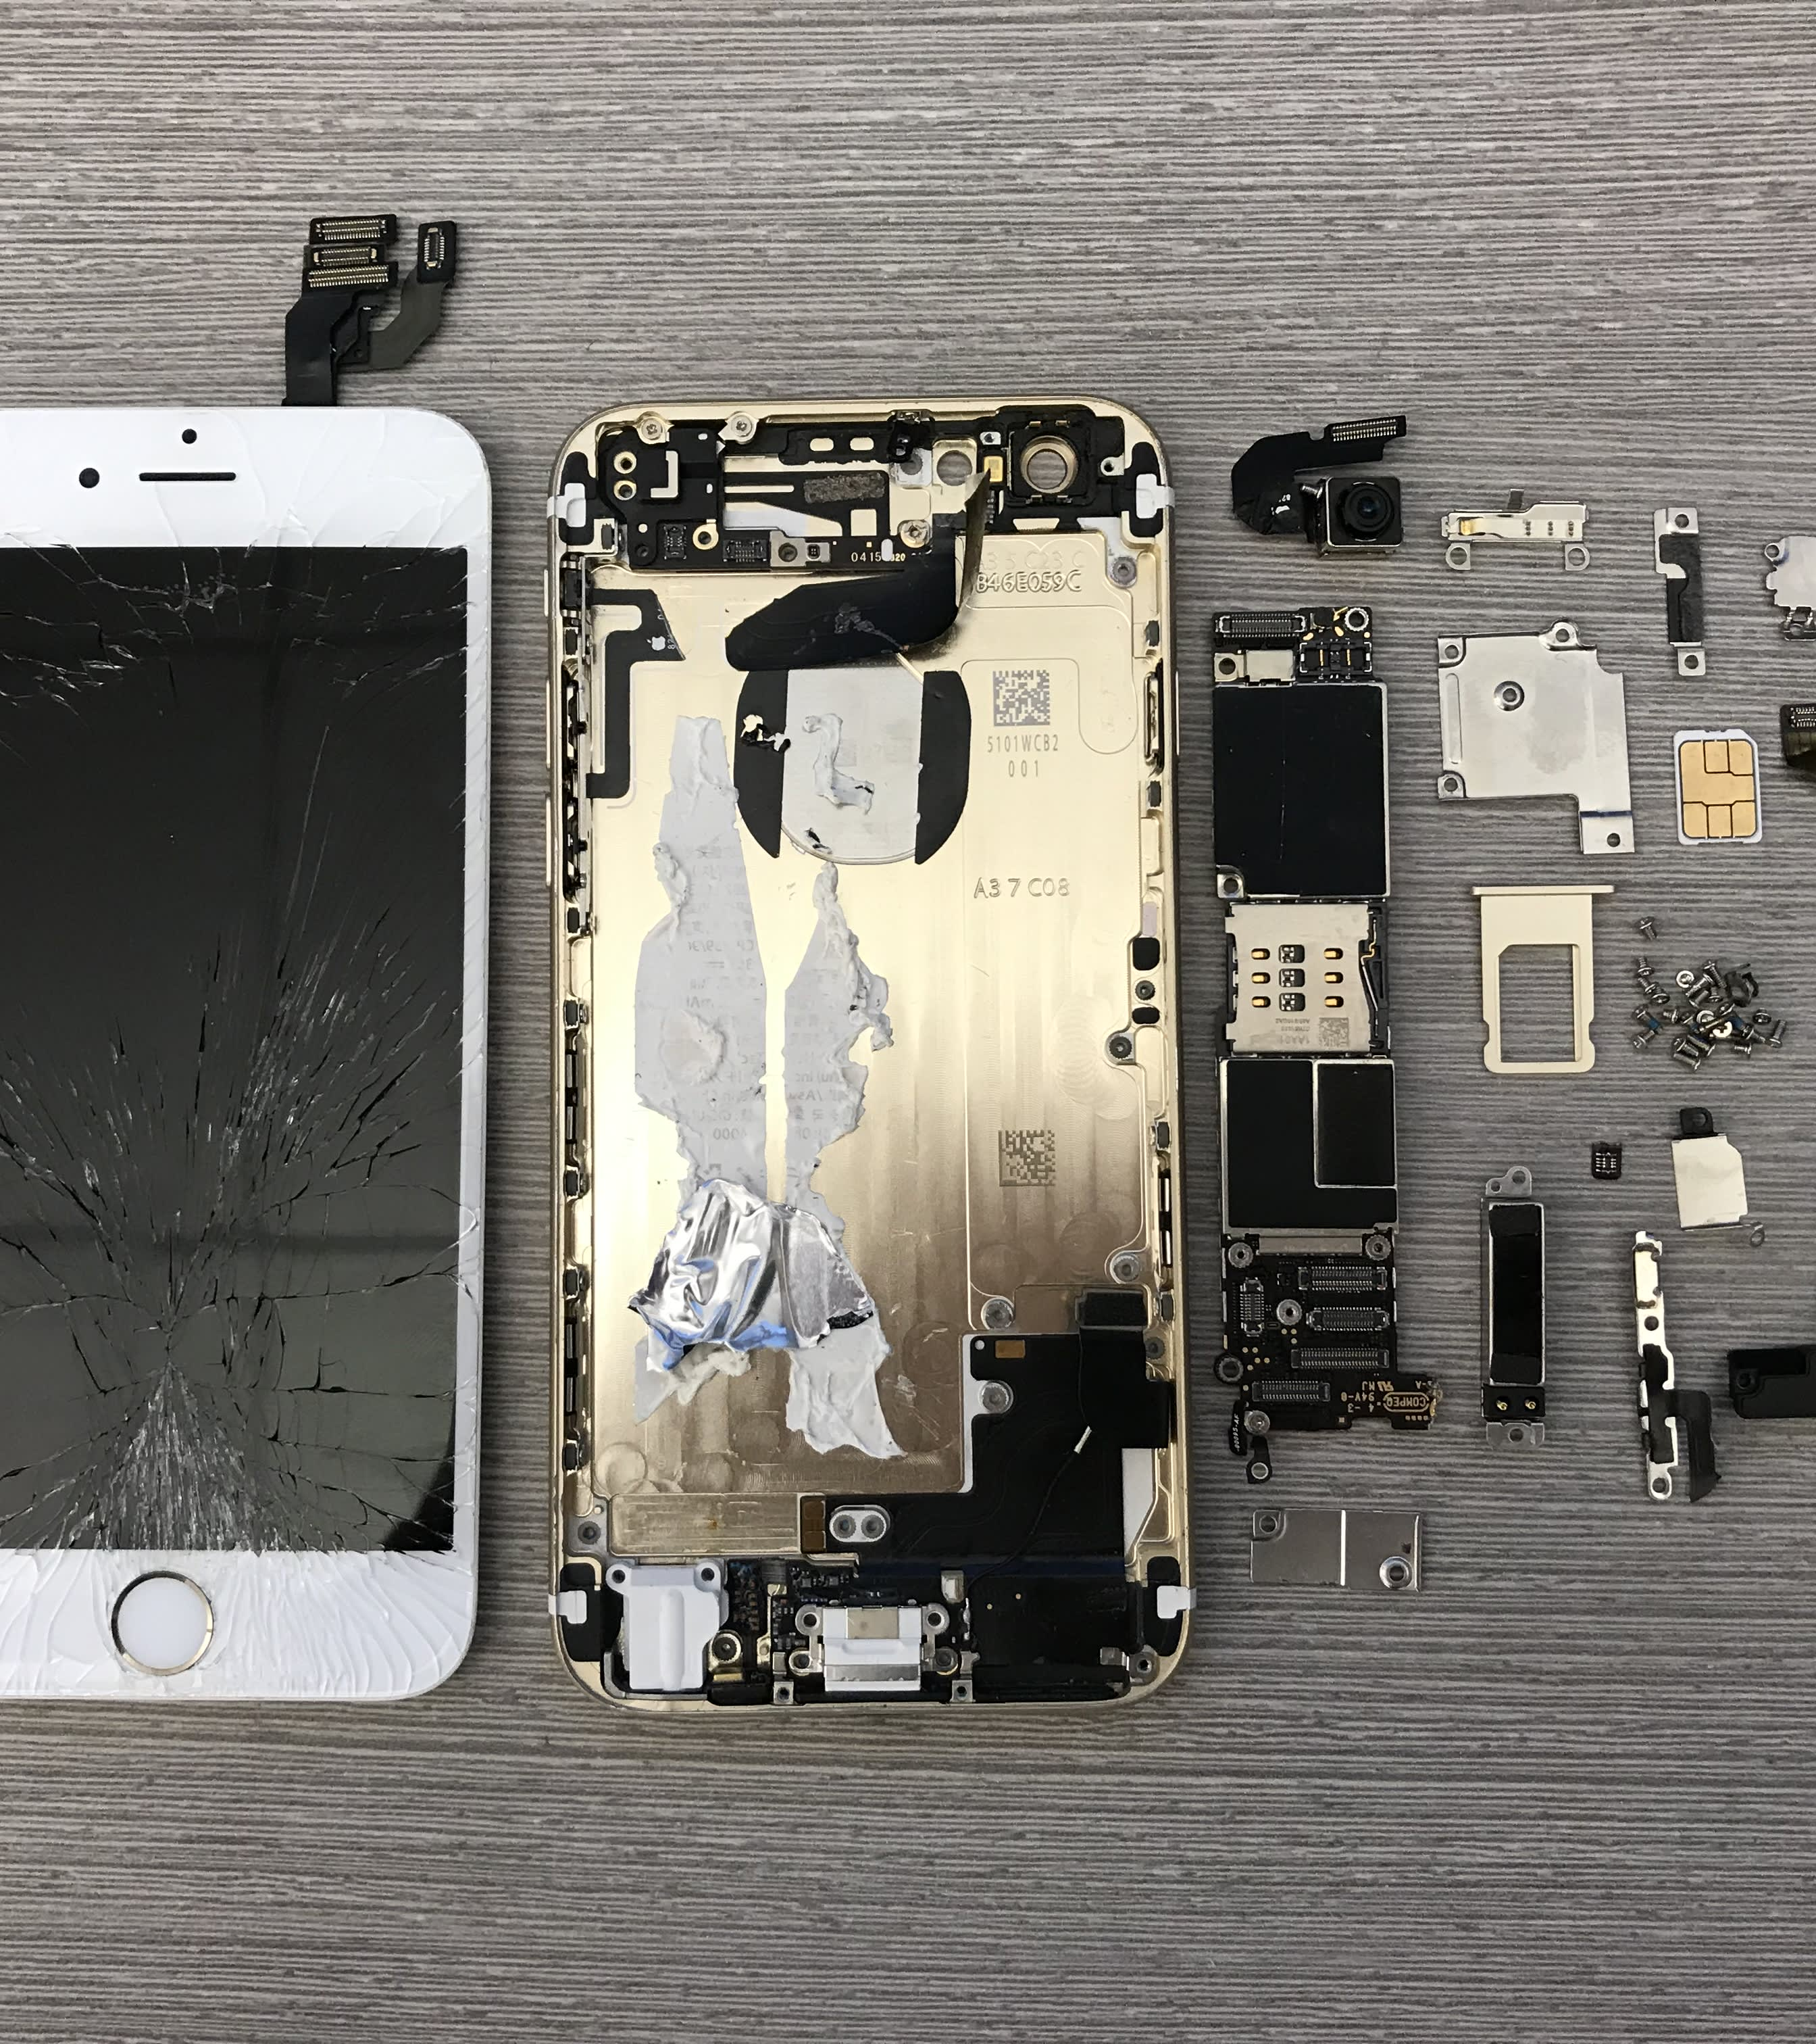
Vijay Prashad: “The copper under the ground enters the cell phones of people around the world. The copper is inside your hand. It is in your identity. You are shaped by copper wires everywhere. You are directly connected to that child in Zambia. [. . .] The child is intimately linked to you by imperialist exploitation of the copper resources in Zambia. But you do not see it.”
“[The copper is] mined for low wages, driven to Durban’s port, shipped away to China, then put into an iPhone. It then comes out of the factory in Shenzhen packaged in Apple’s design. Between the child in Zambia and the consumer are a series of transformations, a range of commodities added to each other [. . .] and the accumulation of these commodities vanished into the phone itself. [. . .] The raw copper becomes processed copper becomes copper wiring becomes highly sophisticated copper instruments. This is then inserted into an iPhone, which is then boxed up. By the time the consumer sees the phone, the child has disappeared. Zambia has disappeared, Chile has disappeared, Peru has disappeared. There is a fetish character that makes the people in Zambia, the child and the miner both, othered, separated from the consumer in the rest of the world. But they are of course linked intimately by the socialization of labour, by the social relations underneath the surface.” (55)

Slide 15
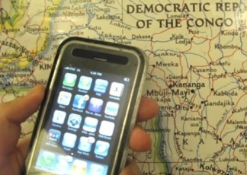
Immanuel Wallerstein: “The opacity of the distribution of the surplus-value in a long commodity chain is the most effective way to minimize political opposition, because it obscures the reality and the causes of the acute polarization of distribution that is the consequence of the endless accumulation of capital” (The End of the World As We Know It: Social Science for the Twenty-First Century, 58).

Slide 16
Justin Parks: “the role of literature, with its particular world-building capacities, is precisely to challenge habits of perception that render such sites [of resource extraction] – and the processes linking them together – invisible” ("The poetics of extractivism and the politics of visibility." Textual Practice 35.3 (2021): 355).

