Slide 1
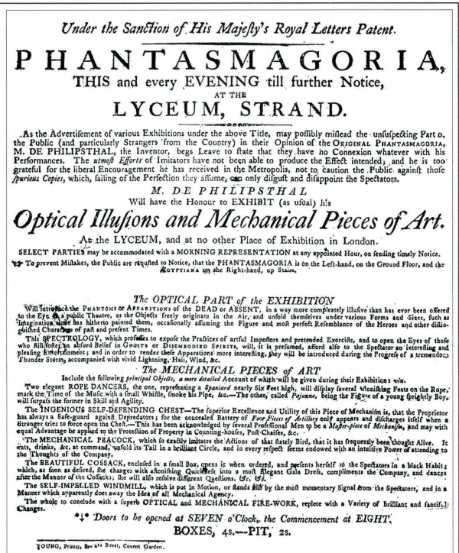
The Optical Part of the Exhibition
Will introduce the Phantoms or Apparitions of the Dead, or Absent, in away more completely illusive than has ever been offered to the Eye in the Public Theatre, as the Objects freely originate in the Air, and unfold themselves under various Forms and Sizes, such as Imagination alone has hitherto painted them, occasionally assuming the Figure and most perfect Resemblance of the Heroes and other Distinguished Characters of the past and present times.
This Spectrology, which professes to expose the practices of artful Impostors and pretended Exorcists and to open the Eyes of those who still foster an absurd Belief in Ghosts or Disembodied Spirits, will, it is presumed, afford also to the spectator an interesting and pleasing Entertainment, and in order to render these apparitions more interesting, they will be introduced during the progress of a tremendous Thunder Storm accompanied with vivid lightning, Hail, Wind, etc.
~ Paul Philidor’s announcement in 1801

Slide 2
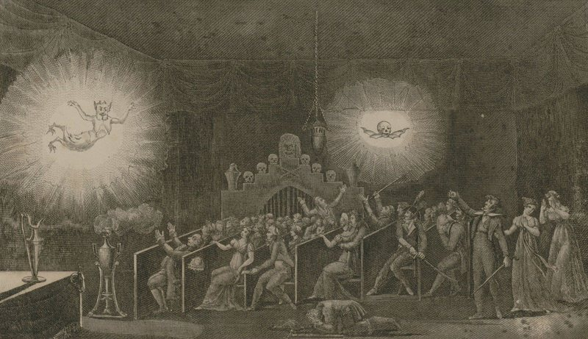
Étienne-Gaspard Robertson’s phantasmagoria show c.1793

Slide 3
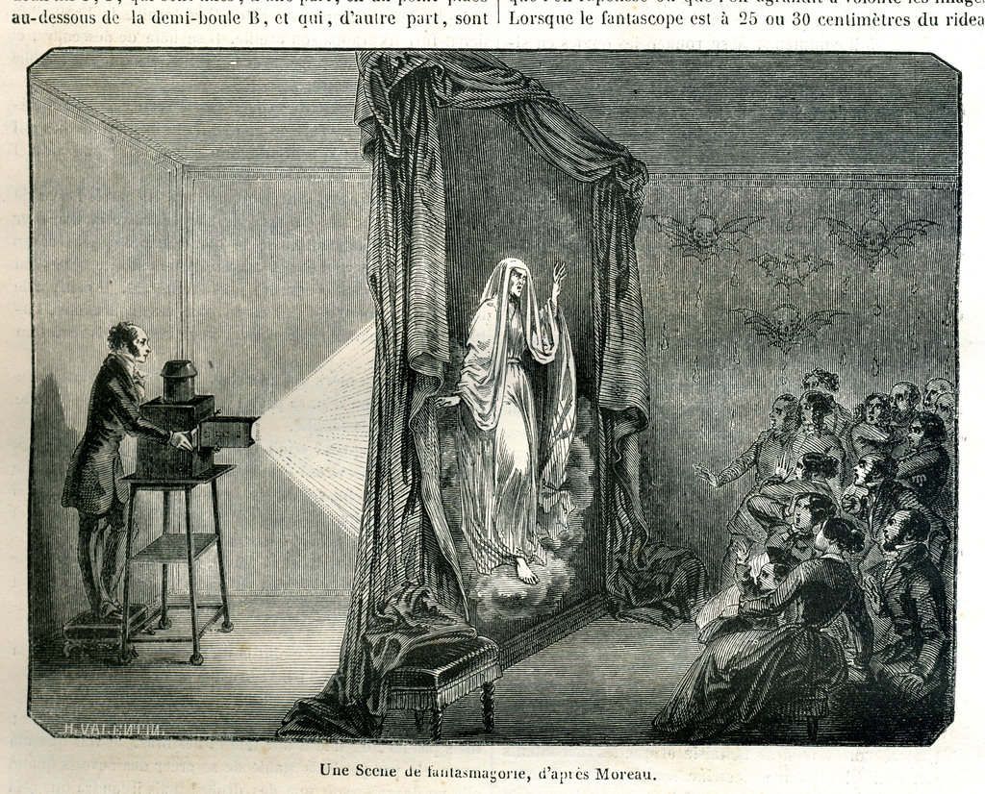
"Ghost on a Stage" engraving, Harper's Weekly (1864)

Slide 4
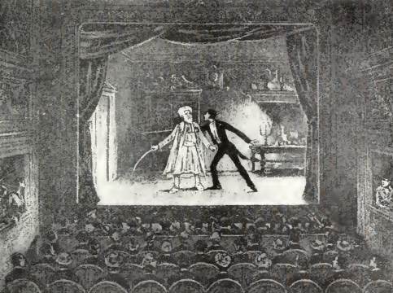
“I am only satisfied if my spectators, shivering and shuddering, raise their hands or cover their eyes out of fear of ghosts and devils dashing towards them; if even the most indiscreet among them run into the arms of a skeleton.”
(Étienne-Gaspard Robert, aka “Robertson”)

Slide 5
Literary scholar Terry Castle argues that the quelling of mystical belief that accompanied the rise of scientific reason had the curious affect of turning the phantasmagoria inwards – it was now the diseased or defective mind that “played tricks,” the psyche its own theater hosting the spectral phantoms of the past. Psychology became the new arena of unexplainable events.
Terry Castle, “Spectral Technology and the Metaphorics of Modern Reverie.” Critical Inquiry (Autumn, 1988)

Slide 6
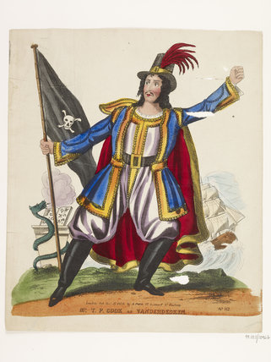
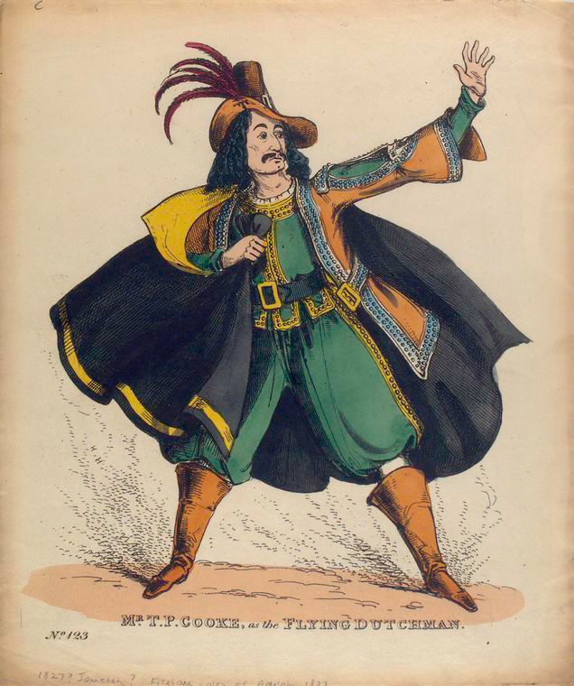
Theatrical souvenir print engraved with a portrait of the actor Mr T.P.Cooke in the role of Vanderdecken. First image from 1827, second published December 17th 1838 by A. Park. Such portraits would have been sold plain for colouring and tinselling at home. This portrait has been hand coloured. Cooke was famous for his appearances in nautical dramas and for playing supernatural villains, so the role Vanderdecken, the captain of the Flying Dutchman, was a good fit. Edward Fitzball's The Flying Dutchman, was first produced in 1826 and Cooke was praised by The Weekly Dramatic Register for "his signs, his attitudes, his fine form, and the varied, but powerful, expression of his countenance"

Slide 7
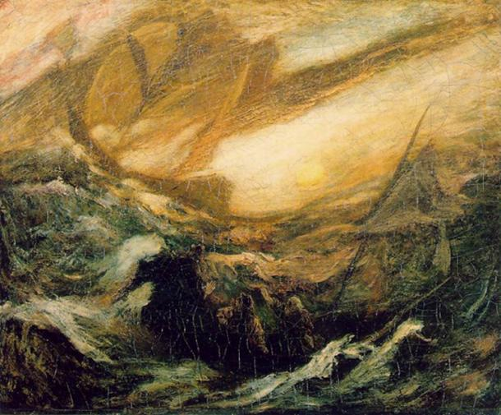
The Flying Dutchman by Albert Pinkham Ryder (1887)

Slide 8
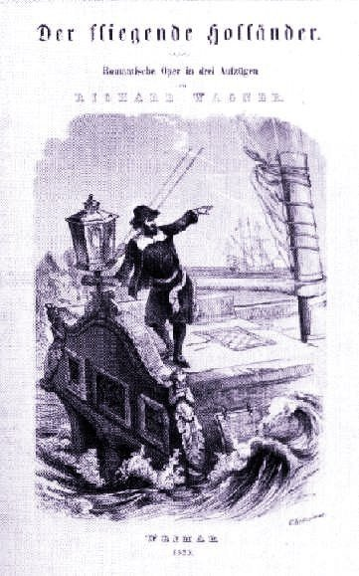
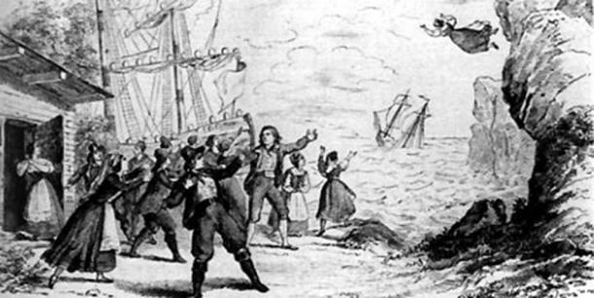
The last scene of Wagner's The Flying Dutchman (1843)

Slide 9
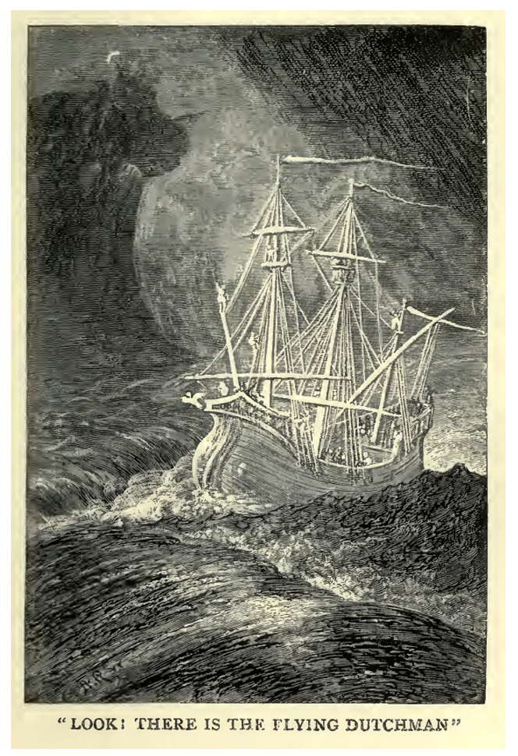
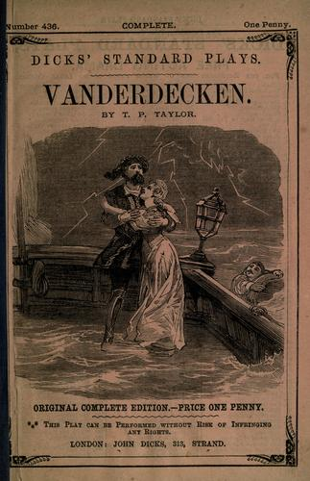
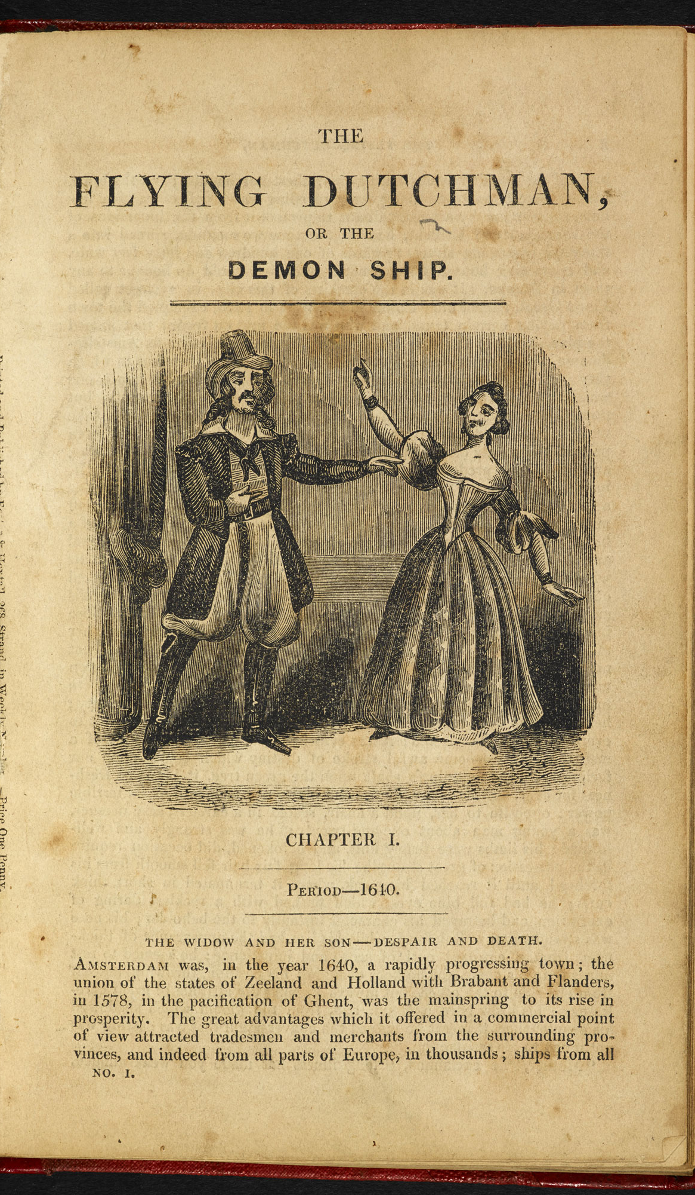

Slide 10
