Slide 1
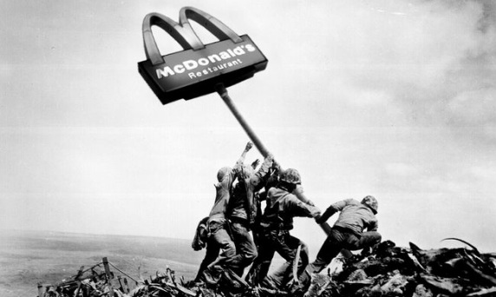
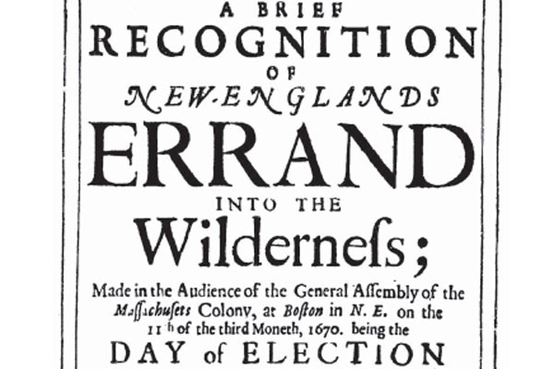
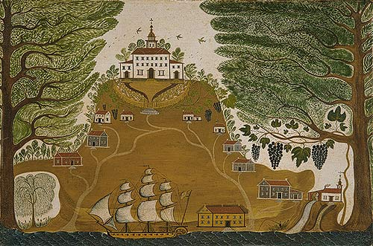
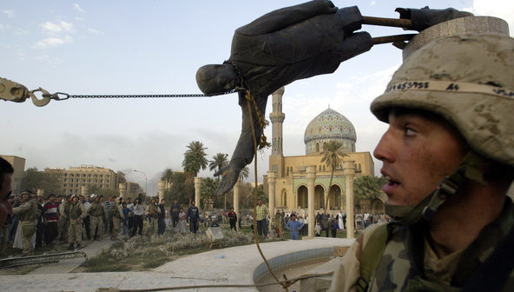
EN9B1
Narratives of American Empire

Slide 2
Module details:
Week 2: Indian Country
Mary Rowlandson, A Narrative of the Captivity and Restoration (1682)
Zitkala-Sa, 'School Days of an Indian Girl' from American Indian Stories (1921)
Vine Deloria, Jr. 'Indians Today, the Real and the Unreal' from Custer Died For Your Sins (1969)
Week 3: White Man's Burden
Edgar Allan Poe, The Narrative of Arthur Gordon Pym (1838)
White Zombie (Dir. Victor Halperin, 1932)
Week 4: African/American
Toni Morrison, Playing in the Dark (1992) [Extracts; to be supplied]
Pauline Hopkins, 'Talma Gordon' (1900)
Week 5: At the Frontier
Cormac McCarthy, Blood Meridian (1985)
American Sniper (Dir. Clint Eastwood, 2014)

Slide 3
Week 6: Making the World Safe for Democracy
Graham Greene, The Quiet American (1955)
Charlie Wilson's War (Mike Nichols, 2007)
Week 7: The New Monroe Doctrine
Joan Didion, Salvador (1983)
Salvador (Dir. Oliver Stone, 1986)
Week 8: History is a Nightmare
Tim O'Brien, In the Lake of the Woods (1994)
Phan Huy Duong, 'The Billion Dollar Skeleton' [to be supplied]
Apocalypse Now (Dir. Francis Ford Coppolla, 1979)
Week 9: Heart of Darkness
Barbara Kingsolver, The Poisonwood Bible (1998)
Week 10: After Iraq
Hassan Blasim, The Corpse Exhibition (2014) [selected stories to be supplied]
Syriana (Dir. Stephen Gaghan, 2005)
More TBC

Slide 4
Is the United States an empire?

Slide 5
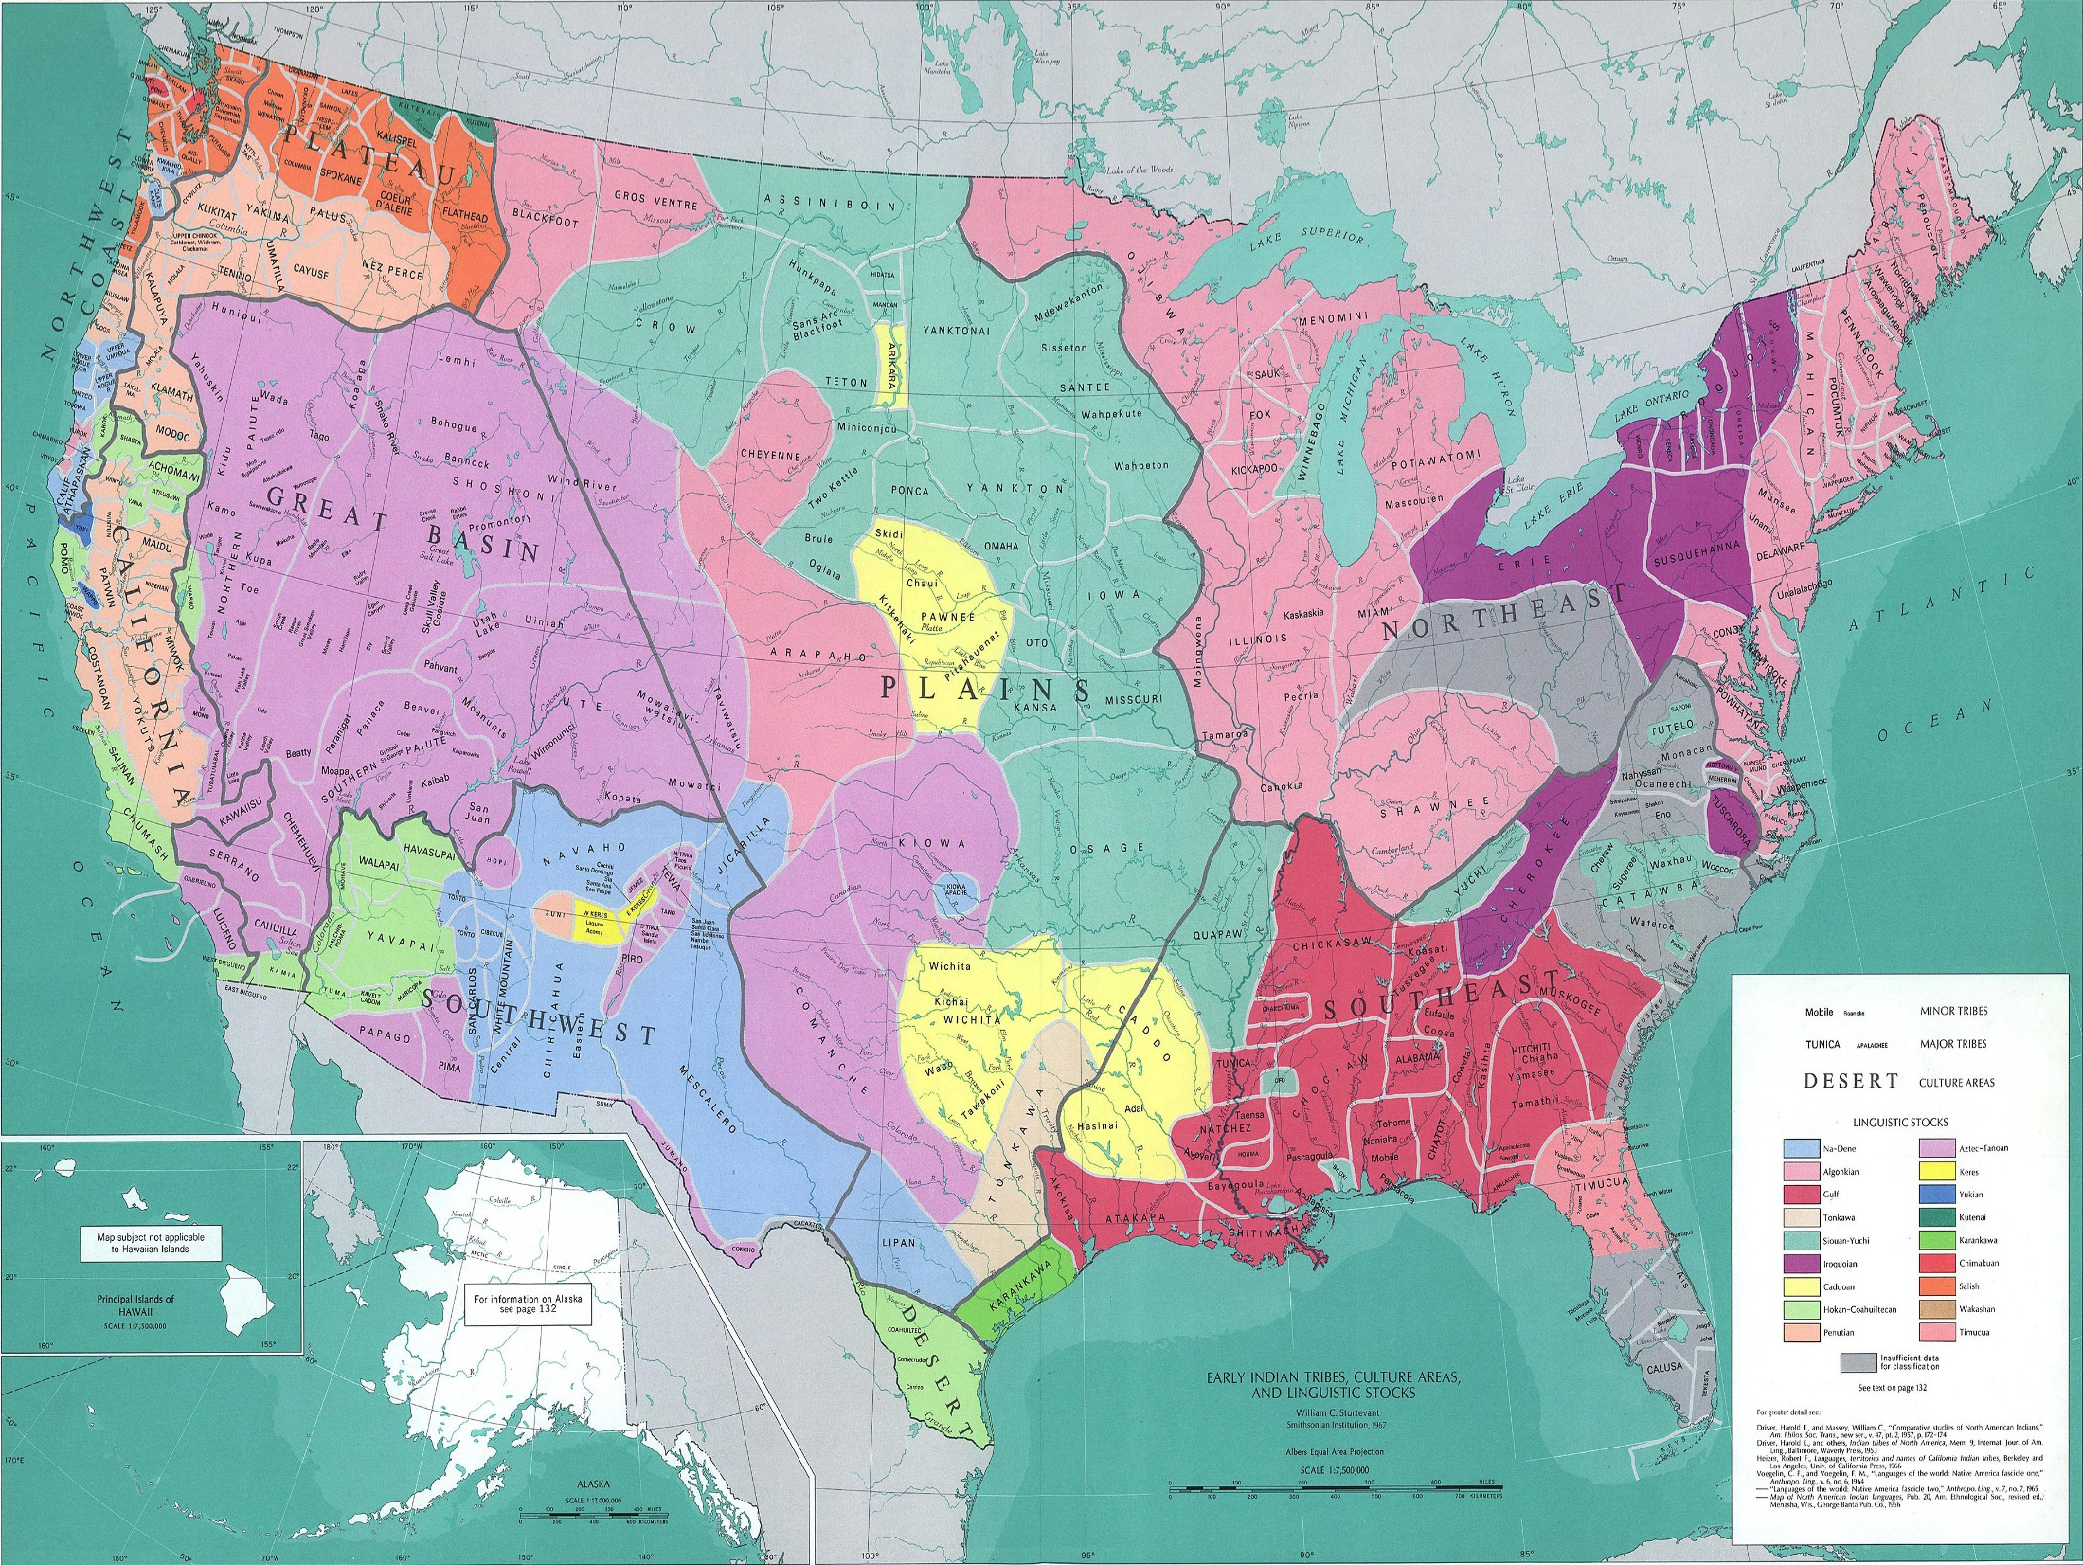

Slide 6
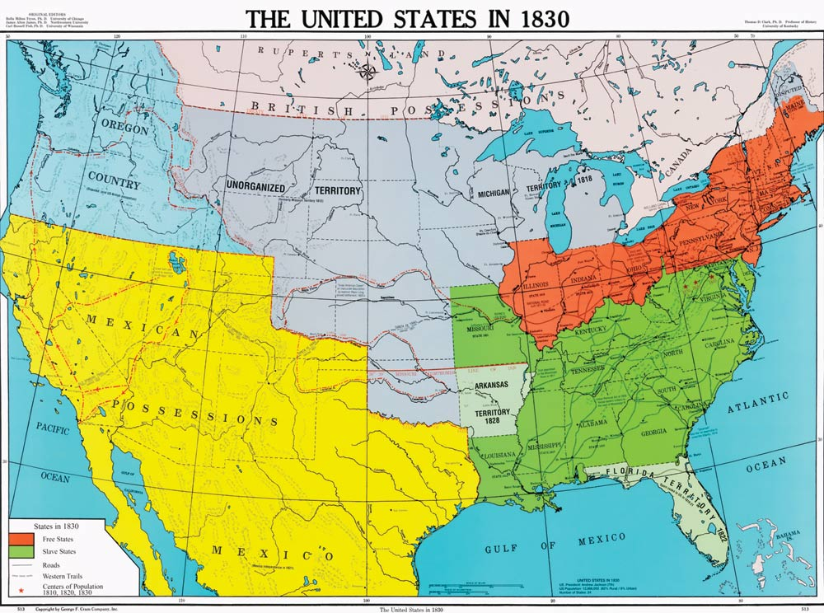

Slide 7
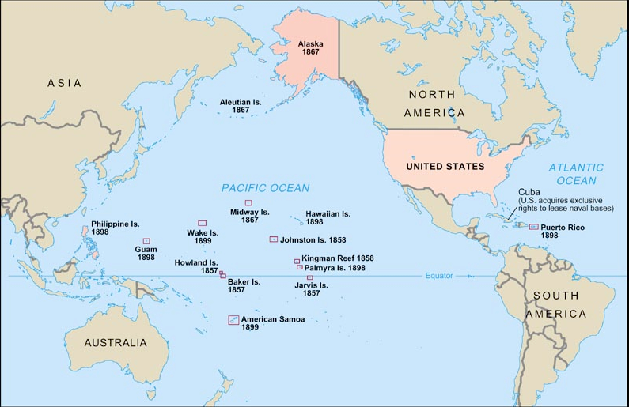

Slide 8
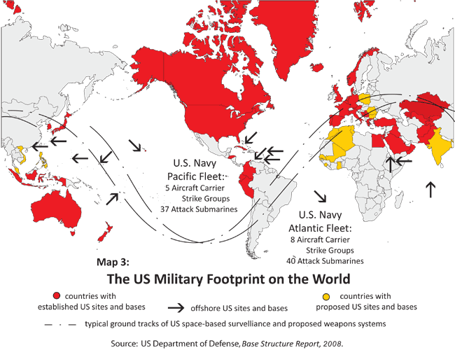

Slide 9
[F]or wee must Consider that wee shall be as a Citty upon a Hill, the eies of all people are uppon us; soe that if wee shall deale falsely with our god in this worke wee have undertaken and soe cause him to withdrawe his present help from us, wee shall be made a story and a by-word through the world, we shall open the mouthes of enemies to speake evill of the wayes of god and all professours for Gods sake…
John Winthrop, ‘A Modell of Christian Charity’ (1630)

Slide 10
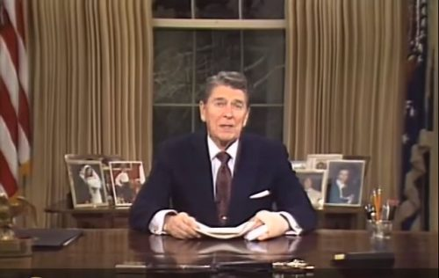
Ronald Reagan farewell address, 11th January 1989

Slide 11
[O]ur national birth was the beginning of a new history…
…The expansive future is our arena, and for our history. We are entering on its untrodden space, with the truths of God in our minds, beneficent objects in our hearts, and with a clear conscience unsullied by the past. We are the nation of human progress, and who will, what can, set limits to our onward march?
John O’Sullivan. ‘The Great Nation of Futurity’ (1839)

Slide 12
History begins today.
Richard Armitage, Deputy Secretary of State, 12th September 2001

Slide 13
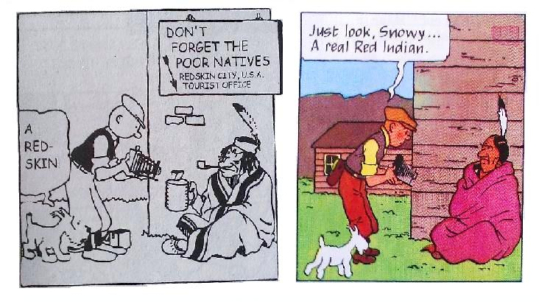
1932
1945

Slide 14
Euphemism and U.S. Imperialism
Empire of Liberty
Errand into the wilderness
Virgin Land
Manifest Destiny
American Exceptionalism
Pax Americana

