Slide 1
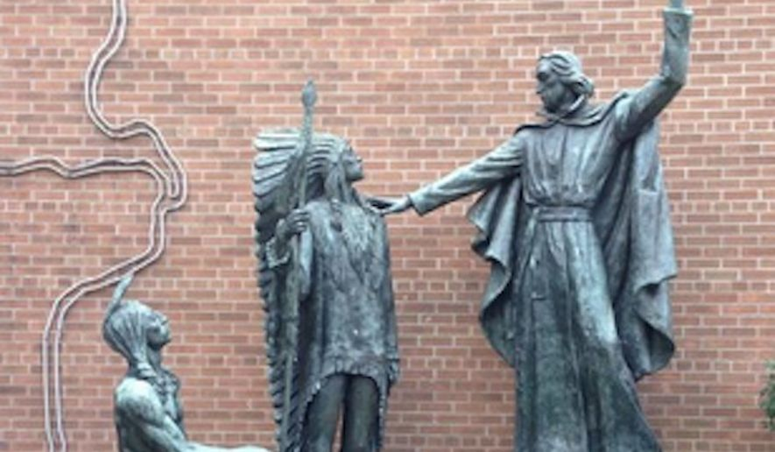
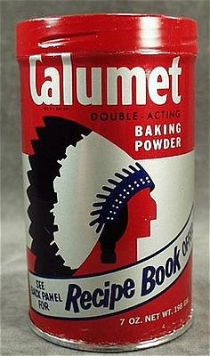
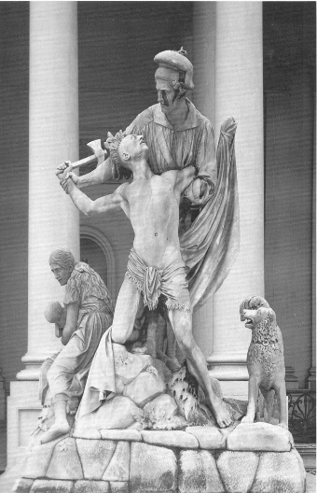
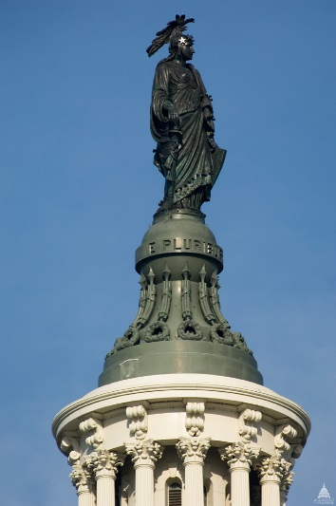
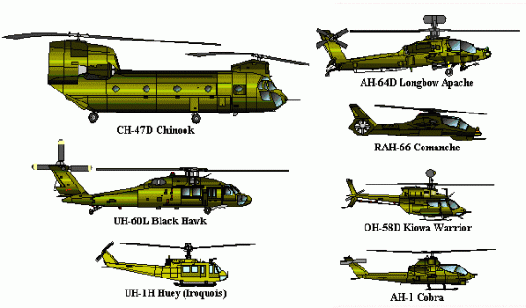

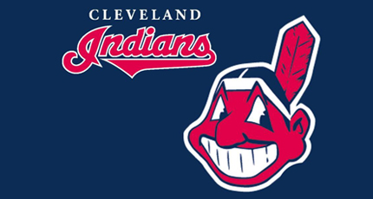
EN9B1 Narratives of American Empire
Week 2:
Indian Country

Slide 2
Euphemism and American Empire
Errand into the wilderness
The Frontier
Virgin Land
Manifest Destiny
American Exceptionalism
Pax Americana
“Nominal and adjectival exceptionalisms”:
“The former exempts the United States’ global history from empire through alternative nouns, classic examples being ‘frontier’ and ‘superpower.’ The latter names the United States as empire but sets it apart through modifiers, especially ‘democratic,’ ‘benevolent,’ and ‘ambivalent.’”
Paul Kramer, ‘Power and Connection: Imperial Histories of the United States in the World’ (2011)

Slide 3
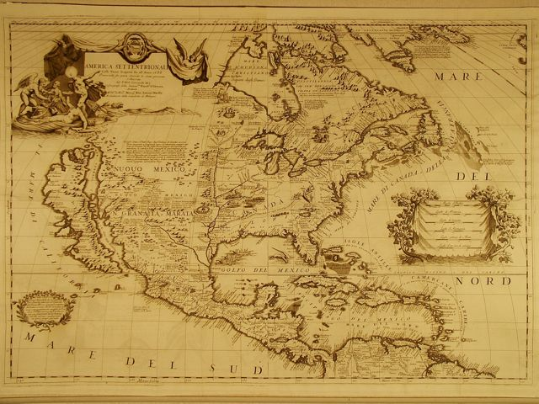

Slide 4
Besids, what could they see but a hidious & desolate wildernes, full of wild beasts & willd men? and what multituds ther might be of them they knew not. Nether could they, as it were, goe up to ye tope of Pisgah, to vew from this willdernes a more goodly cuntrie to feed their hops; for which way soever they turnd their eys (save upward to ye heavens) they could have litle solace or content in respecte of any outward objects. For sum̅er being done, all things stand upon them with a wetherbeaten face; and ye whole countrie, full of woods & thickets, represented a wild & savage heiw.
William Bradford, ‘Of Plimouth Plantation’ (1630-51)
Beyond the great Atlantick flood
There is a region vast,
A country where no English foot
In former ages past:
A waste and howling wilderness,
Where none inhabited
But hellish fiends, and brutish men
That Devils worshiped.
Michael Wigglesworth, ‘God’s Controversy with New England’ (1662)

Slide 5
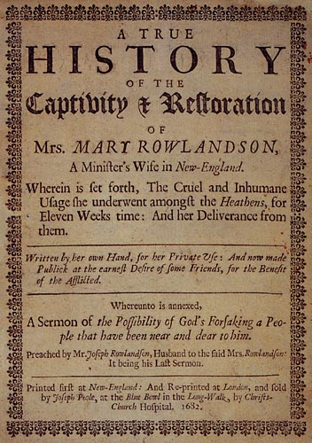
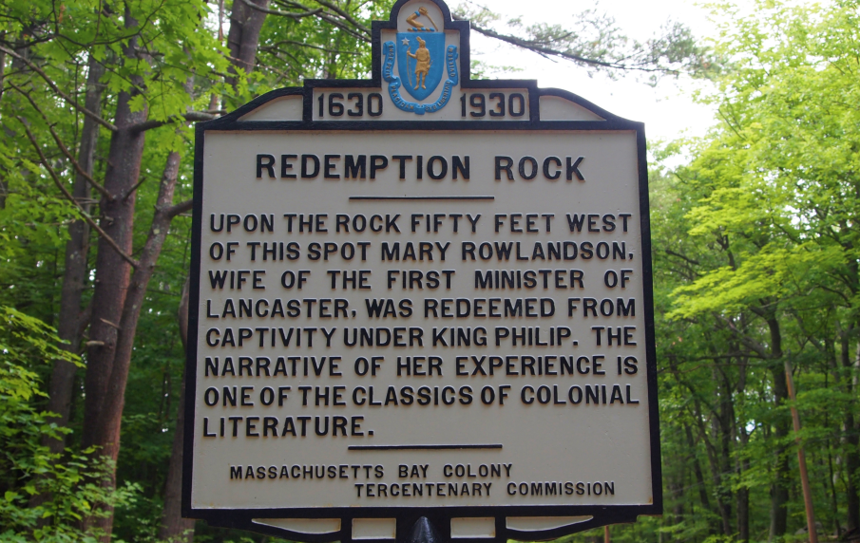
Mary Rowlandson: born in Somerset, 1637
Account of King Philip’s War (1675-78)

Slide 6
