Slide 1
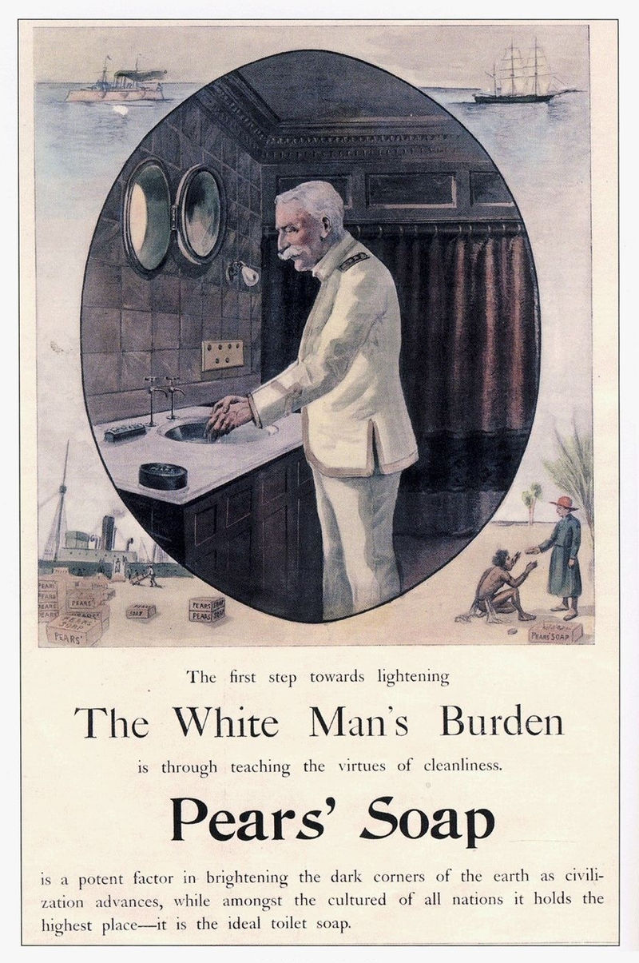
Week 3
White Man’s Burden

Slide 2
Euphemism and American Empire
Errand into the wilderness
The Frontier
Virgin Land
Manifest Destiny
American Exceptionalism

Slide 3
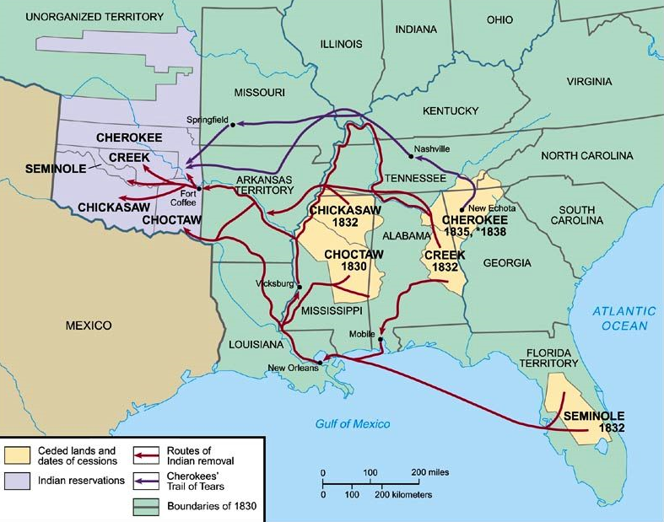
Indian Removal Act, 1830

Slide 4
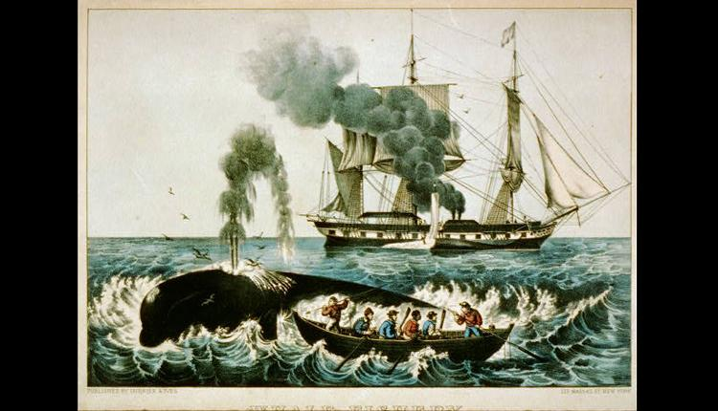

Slide 5
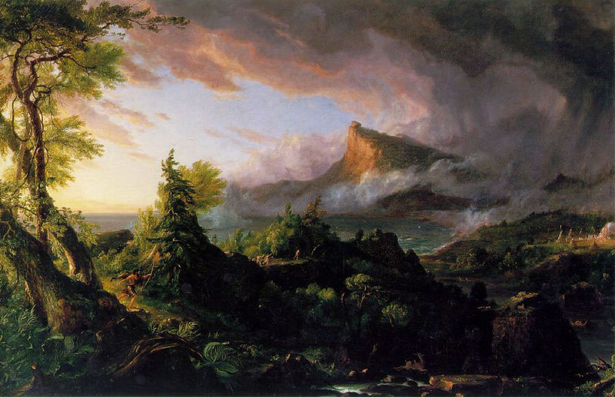
Thomas Cole, The Course of Empire series (1833-36)
The Savage State

Slide 6
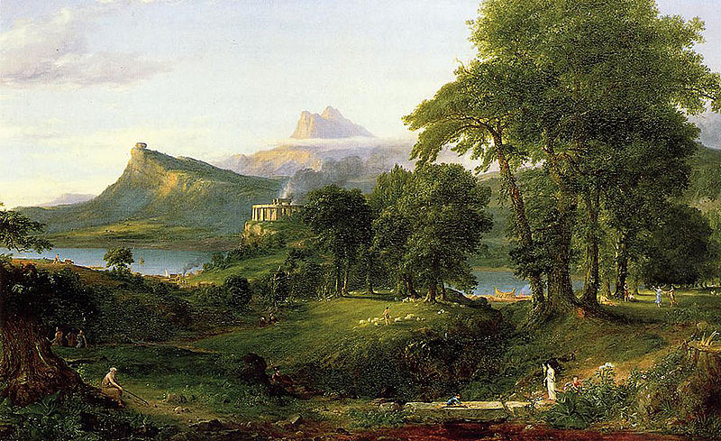
The Pastoral State

Slide 7
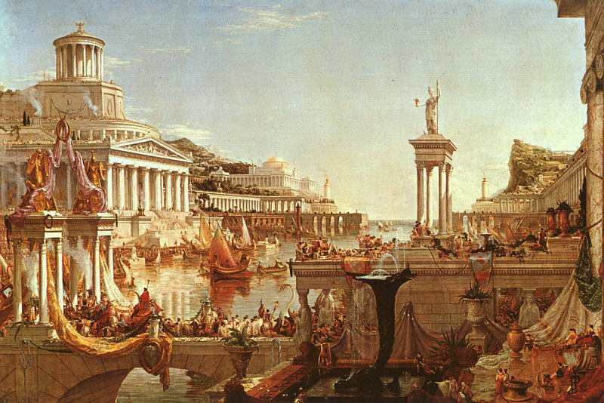
Consummation

Slide 8
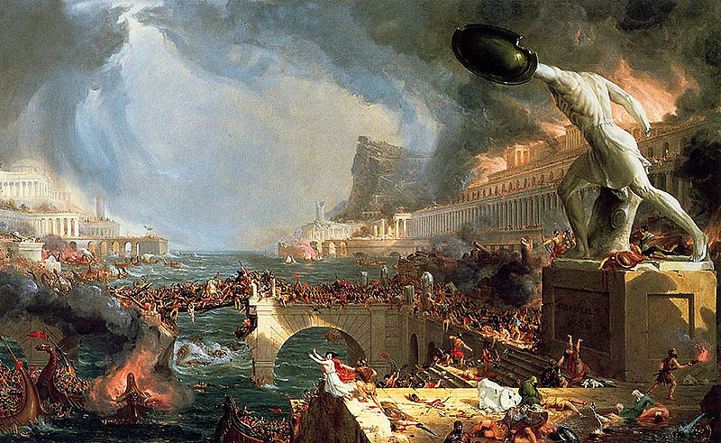
Destruction

Slide 9
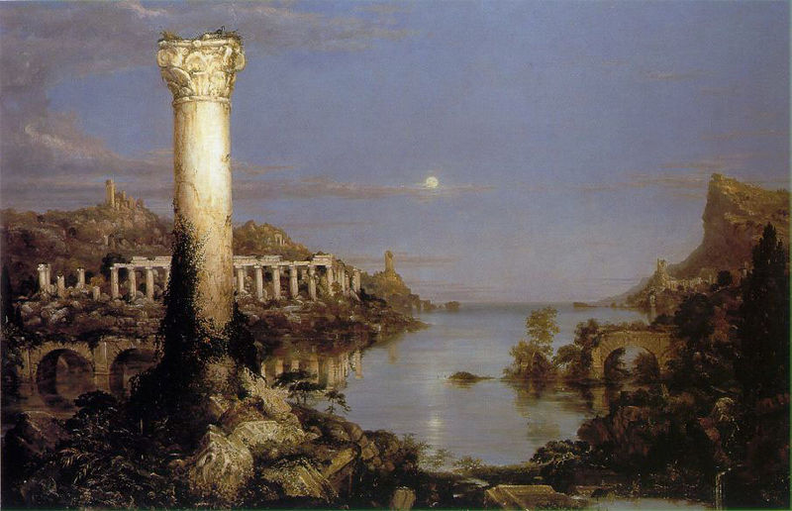
Desolation

Slide 10
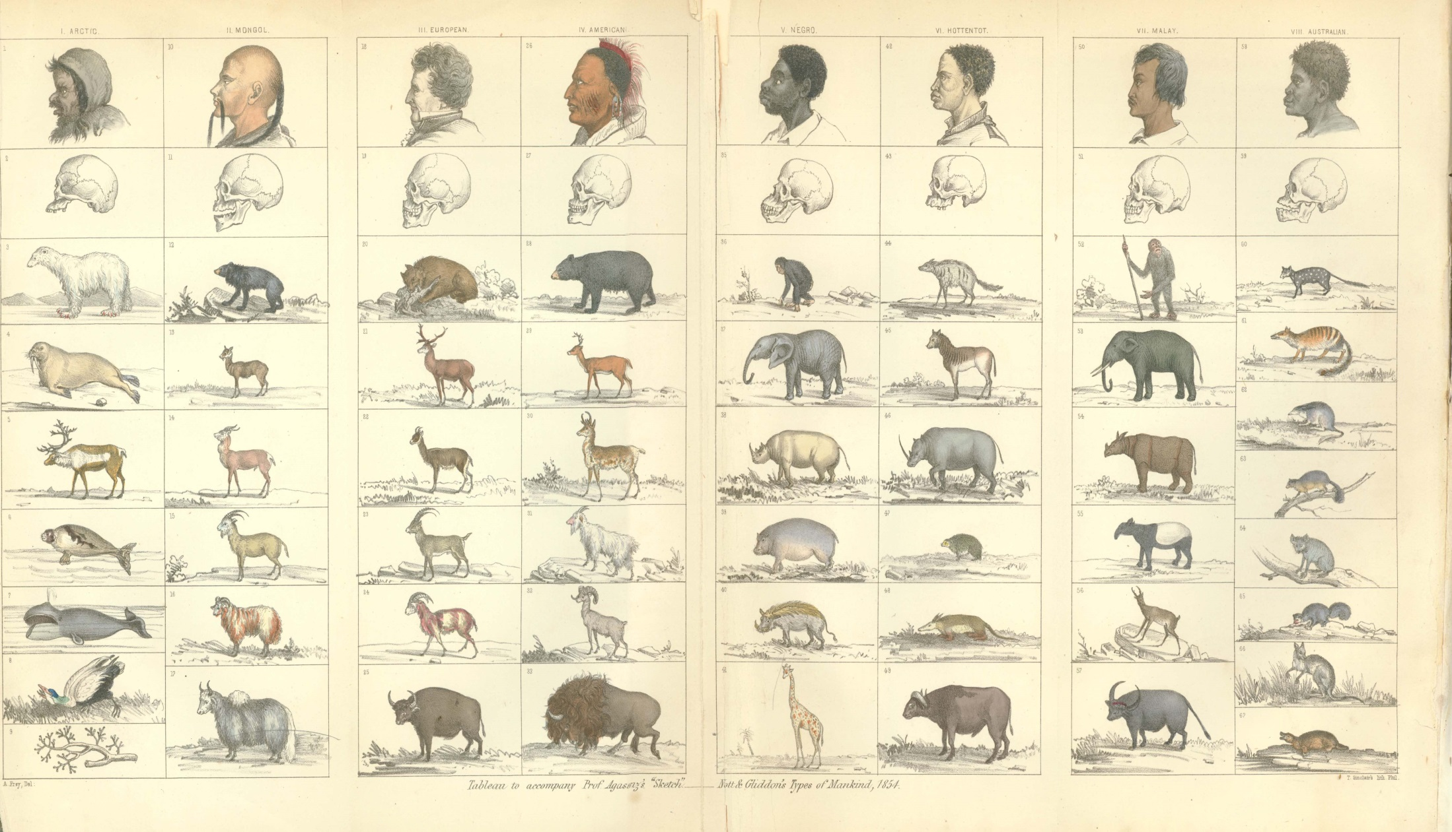
‘Types of Mankind’ (1854)

Slide 11
[I]t is clear the Athenian democracy would not suit a negro nation, nor will the government of mere law suffice for the individual negro. He is but a grown up child, and must be governed as a child, not as a lunatic or criminal. The master occupies towards him the place of parent or guardian.
…. The negro is improvident; will not lay up in summer for the wants of winter; will not accumulate in youth for the exigencies of age. He would become an insufferable burden to society. Society has the right to prevent this, and can only do so by subjecting him to domestic slavery.
In the last place, the negro race is inferior to the white race, and living in their midst, they would be far outstripped or outwitted in the chase of free competition. Gradual but certain extermination would be their fate….. In Africa or the West Indies, he would become idolatrous, savage and cannibal, or be devoured by savages and cannibals. At the North he would freeze or starve.
George Fitzhugh, Sociology for the South (1854)

Slide 12
Take up the White Man's burden, Send forth the best ye breed
Go bind your sons to exile, to serve your captives' need;
To wait in heavy harness, On fluttered folk and wild—
Your new-caught, sullen peoples, Half-devil and half-child.
Take up the White Man's burden And reap his old reward:
The blame of those ye better, The hate of those ye guard—
The cry of hosts ye humour (Ah, slowly!) toward the light:—
"Why brought he us from bondage, Our loved Egyptian night?“
Rudyard Kipling, ‘The White Man's Burden: The United States and The Philippine Islands’ (1899)

Slide 13
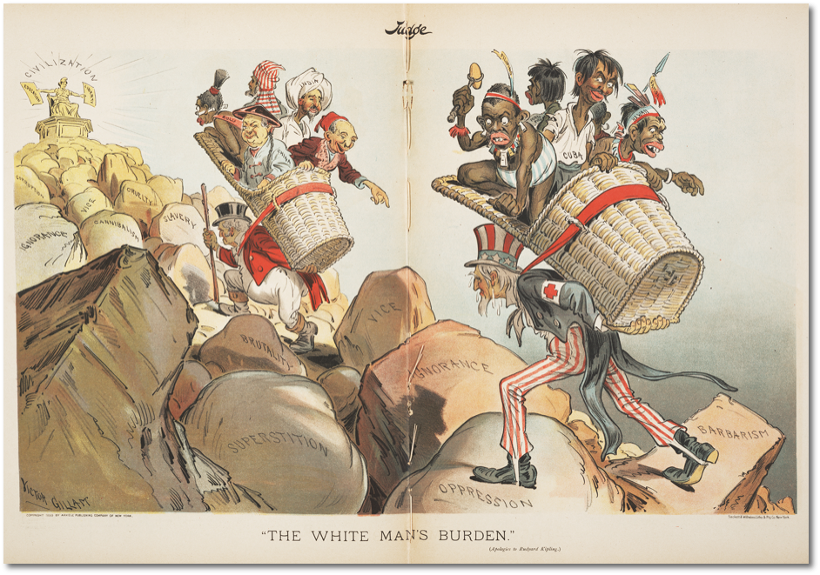
Judge magazine, April 1st 1899

Slide 14
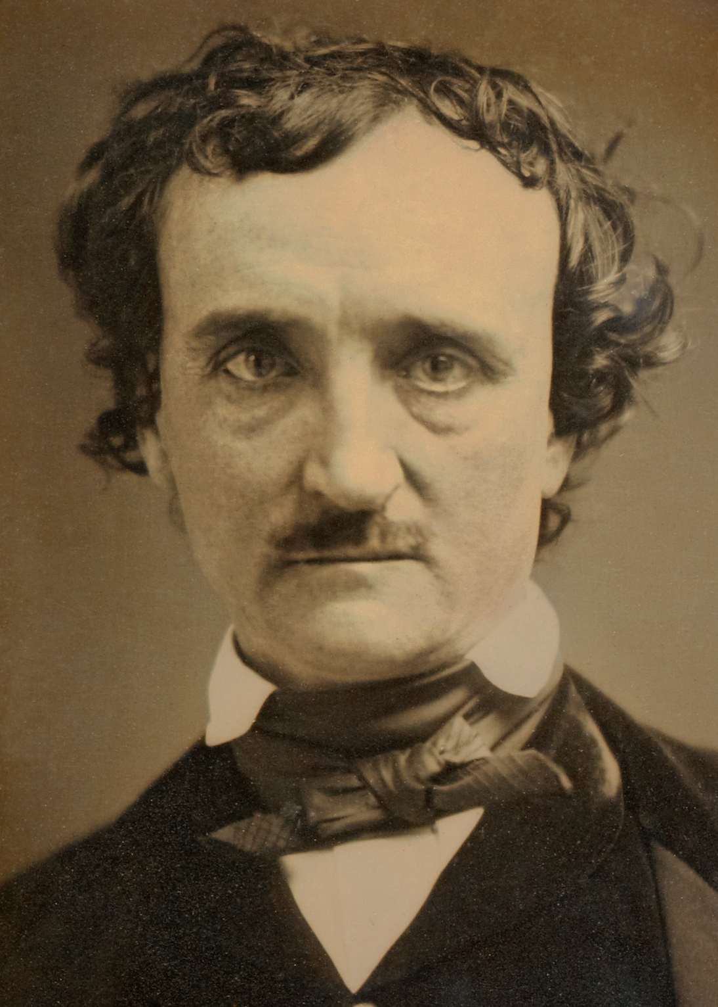
Edgar Allan Poe (1809-49)

Slide 15


