Slide 1
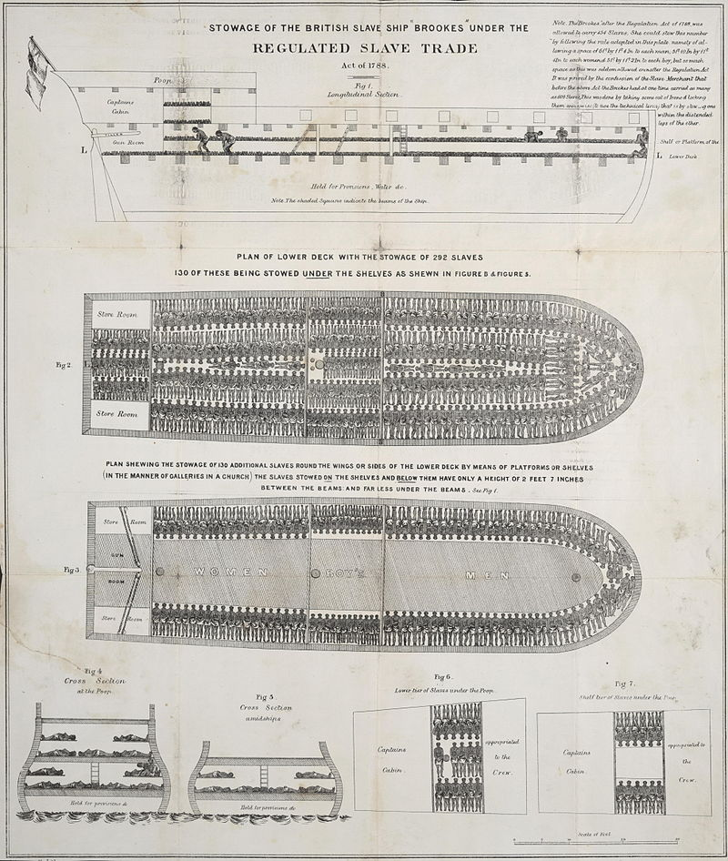
EN9B1 Narratives of
American Empire
Week 4
African/American

Slide 2
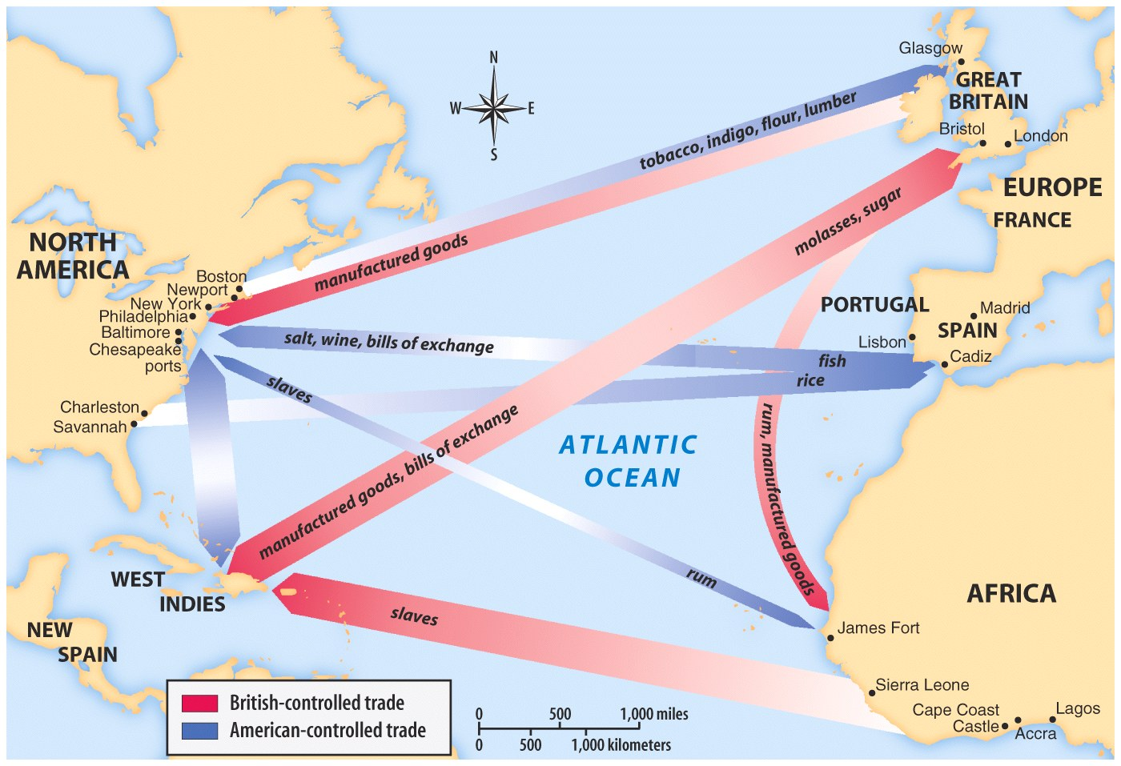

Slide 3
At this point we leave Africa, not to mention it again. For it is no historical part of the World; it has no movement or development to exhibit. Historical movements in it – that is in its northern part – belong to the Asiatic or European World…. Egypt will be considered in reference to the passage of the human mind from its Eastern to its Western phase, but it does not belong to the African Spirit. What we properly understand by Africa, is the Unhistorical, Undeveloped Spirit, still involved in the conditions of mere nature, and which had to be presented here only as on the threshold of the World's History.
G.W.F. Hegel, Lectures on the Philosophy of History (1822-30)

Slide 4


Slide 5
The specificity of the modern political and cultural formation I want to call the Black Atlantic can be defined, on one level, through a desire to transcend both the structures of the nation state and the constraints of ethnicity and national particularity…. They have always sat uneasily alongside the strategic choices forced on black movements and individuals embedded in national and political cultures and nation-states in America, the Caribbean, and Europe. (19)
The desire to pit Euro-American modernity against “bestial” slaves…is formed by the need to indict those forms of rationality which have been rendered implausible by their racially exclusive character….It is being suggested that the concentrated intensity of the slave experience is something that marks out blacks as the first truly modern people, handling the nineteenth century dilemmas and difficulties which would become the substance of everyday life in Europe a century later. (220-221)

Slide 6
