Slide 1
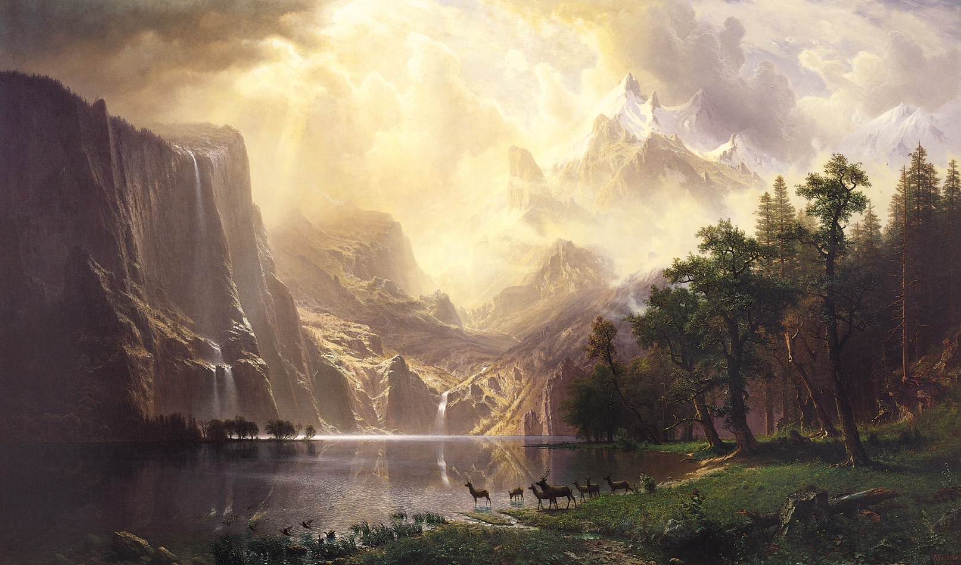
Week 5
At the Frontier

Slide 2
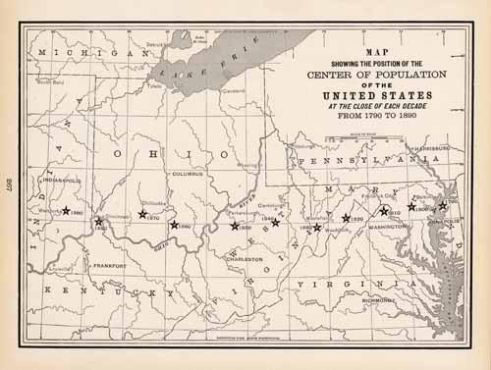

Slide 3
American development has exhibited not merely advancement…but a return to primitive conditions on a continually advancing frontier line, and a new development for that area. American social development has been continually beginning over again on the frontier. This perennial rebirth, this fluidity of American life, this expansion westward with its new opportunities, its continuous touch with the simplicity of primitive society, furnish the forces dominating American character. The true point of view in the history of this nation is not the Atlantic coast, it is the Great West…. In this advance, the frontier is the outer edge of the wave – the meeting point between savagery and civilization.
Frederick Jackson Turner, ‘The Significance of the Frontier in American History’ (1893)

Slide 4
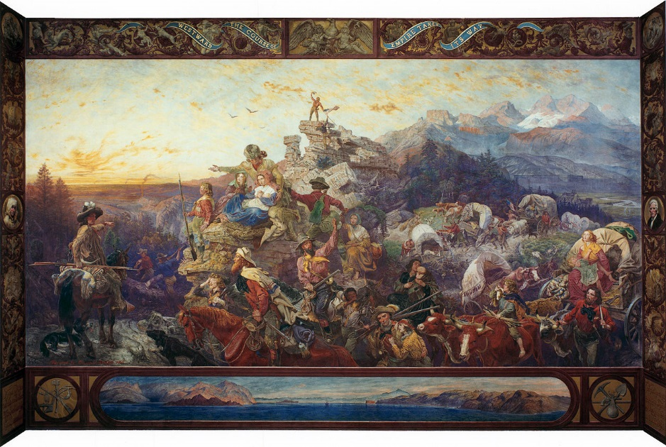

Slide 5
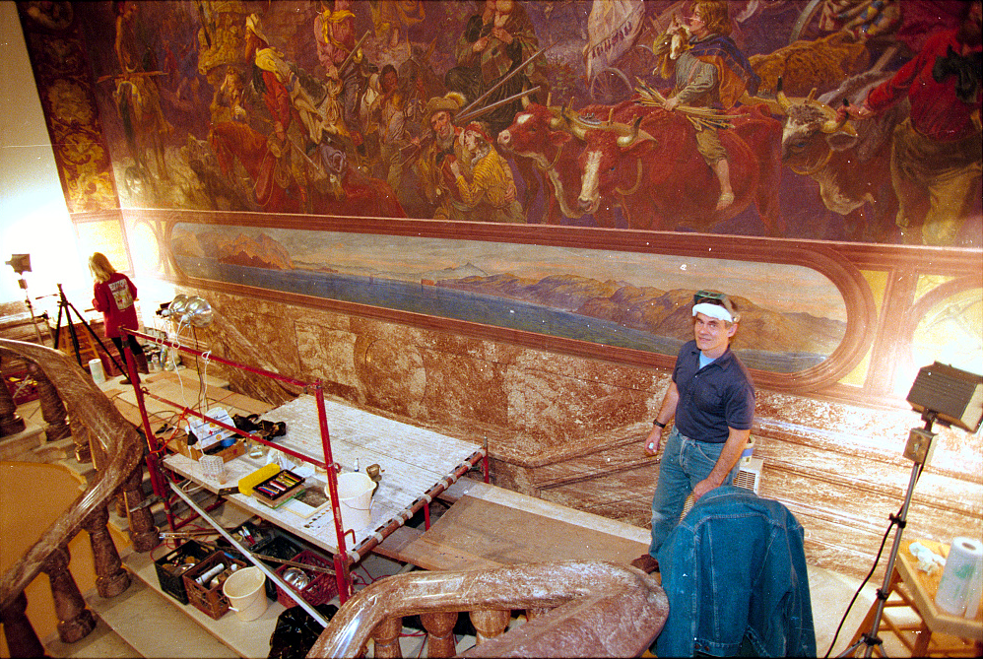

Slide 6
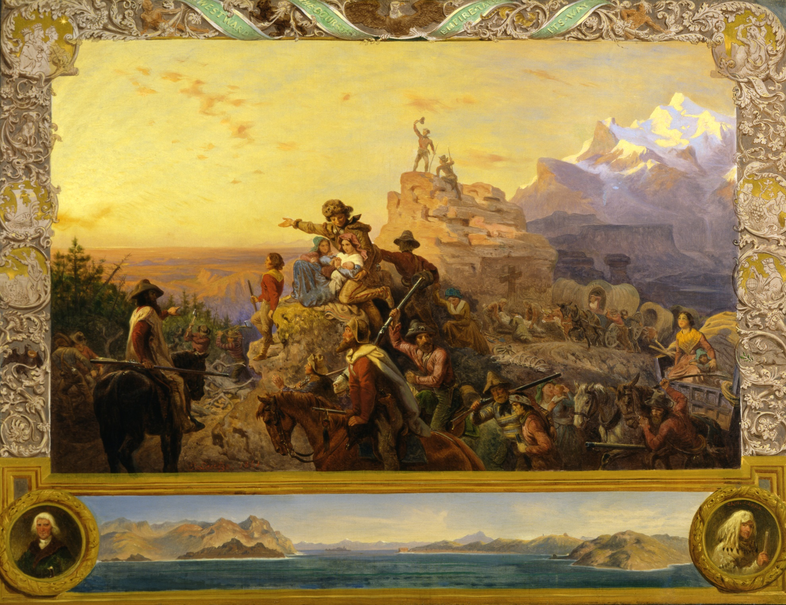
Emanuel Leutze, Westward the Course of Empire Takes Its Way (1861)

Slide 7


Slide 8
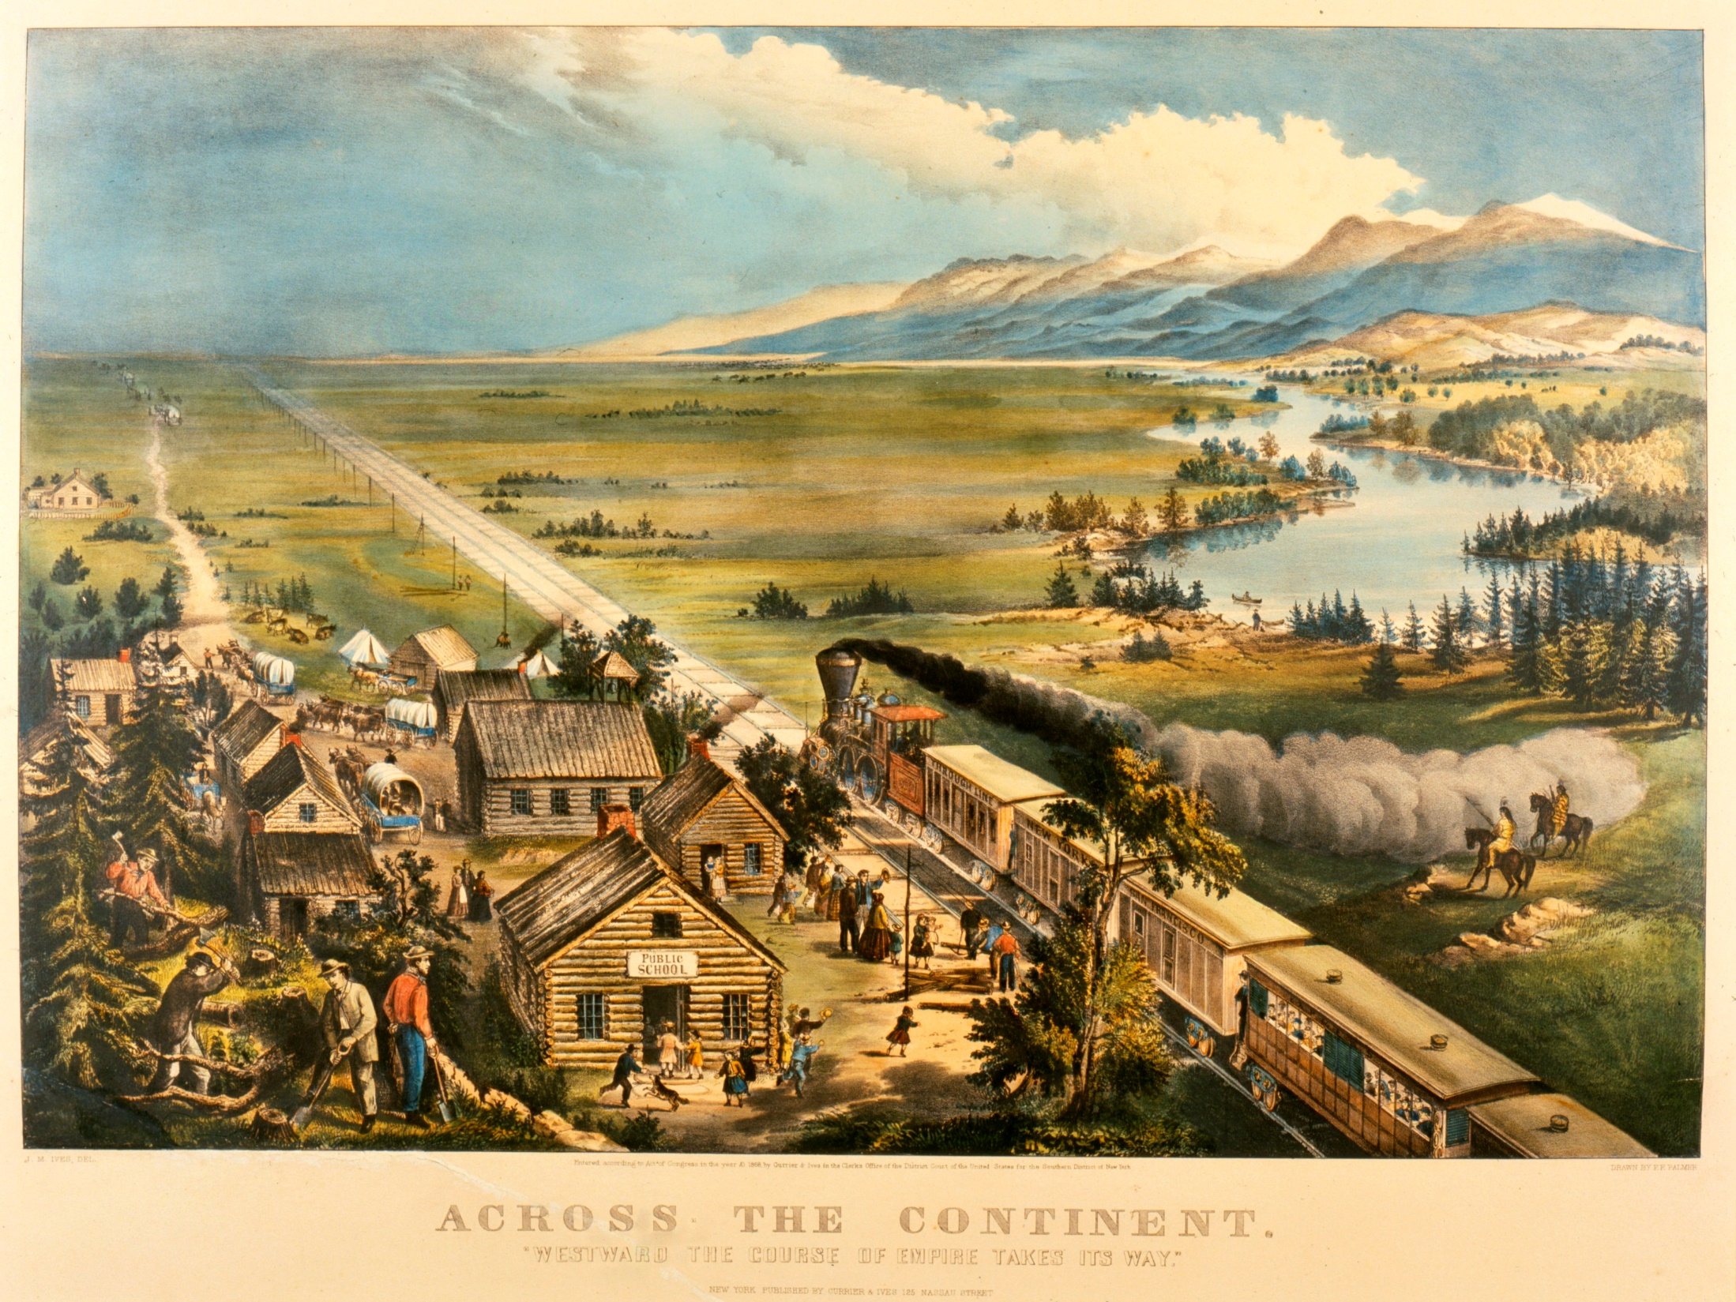

Slide 9
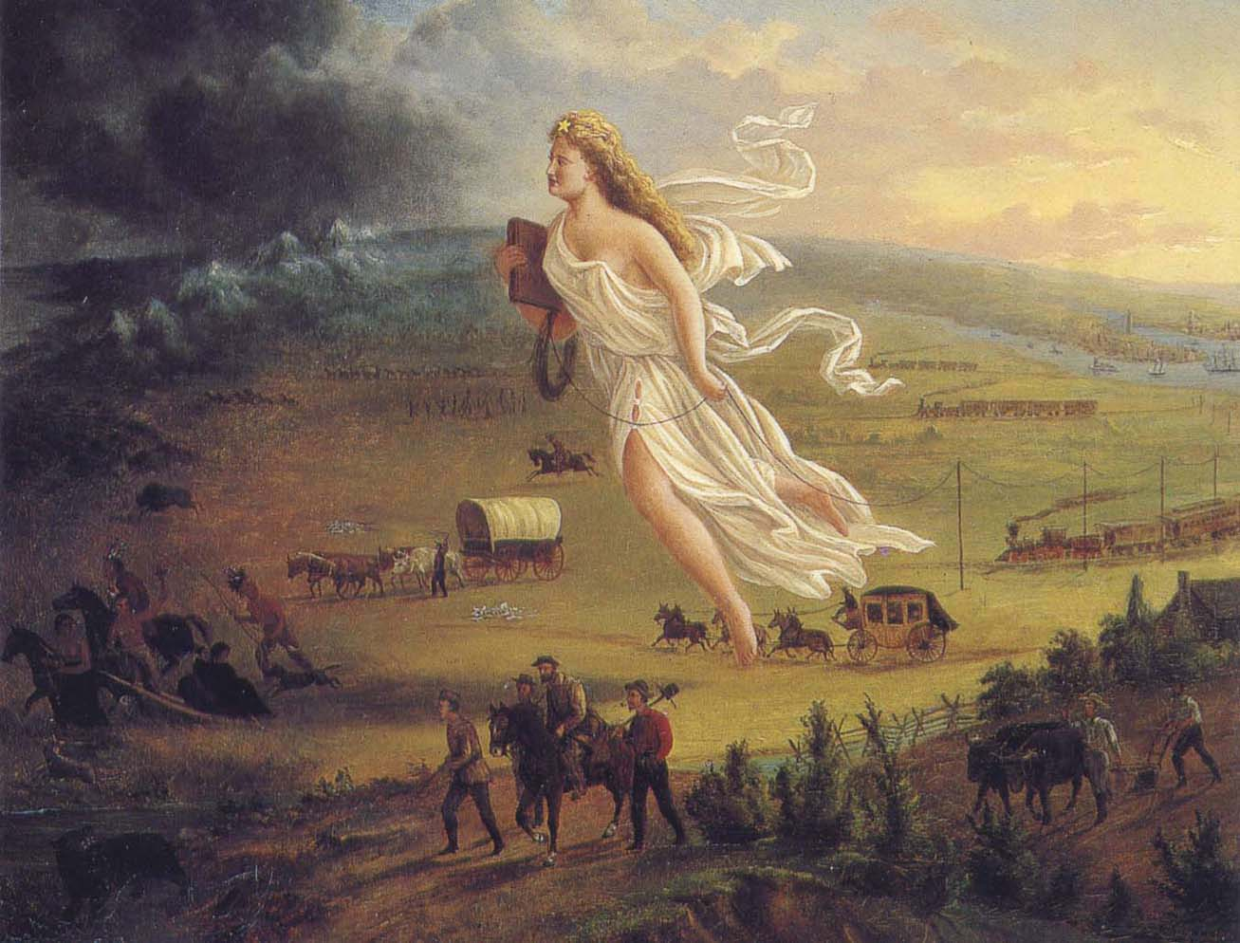
John Gast, American Progress (1872)

Slide 10
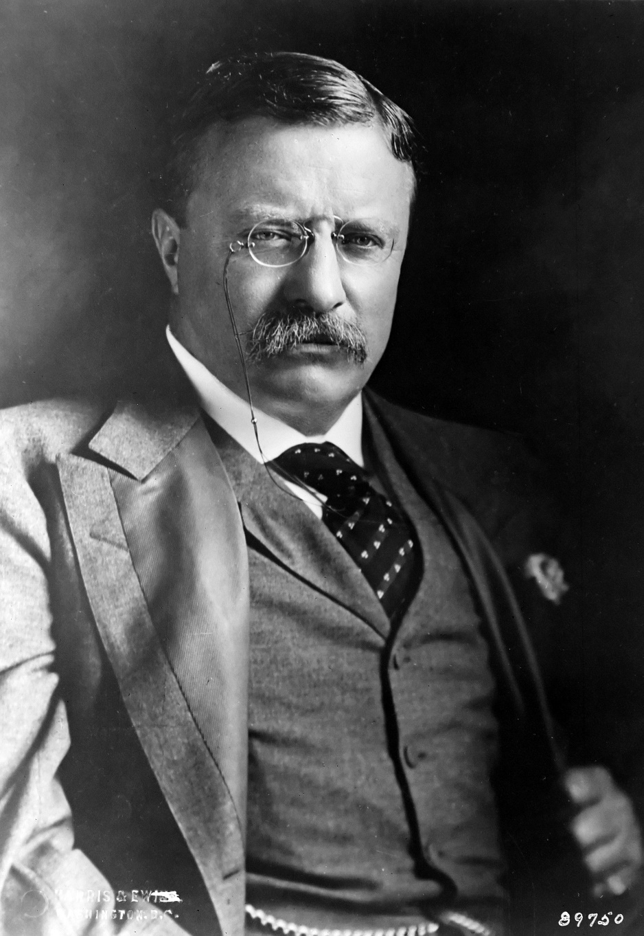
The Winning of the West (1889)
The Strenuous Life (1901):
Of course our whole national history has been one of expansion… That the barbarians receded or are conquered, with the attendant fact that peace follows their retrogression or conquest, is due solely to the power of the mighty civilized races which have not lost the fighting instinct, and which by their expansion are gradually bringing peace into the red wastes where the barbarian peoples of the world hold sway.

Slide 11
Never mind the fact that all the viable nation-states in the world today have long since been ‘modern’ in every conceivable sense, from the technological onwards; what is encouraged is the illusion that the West has something no one else possesses – but which they ought to desire for themselves. That mysterious something can then be baptized ‘modernity’ and described at great length by those called upon to sell the product in question.
Fredric Jameson, A Singular Modernity (2002)

Slide 12
Iraq is no diversion. It is a place where civilization is taking a decisive stand against chaos and terror.
George W. Bush, October 2004

Slide 13


Slide 14



