Slide 1
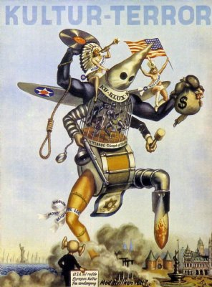
Week 6
Making the World
Safe for Democracy

Slide 2
The world must be made safe for democracy. Its peace must be planted upon the tested foundations of political liberty. We have no selfish ends to serve. We desire no conquest, no dominion. We seek no indemnities for ourselves, no material compensation for the sacrifices we shall freely make. We are but one of the champions of the rights of mankind. We shall be satisfied when those rights have been made as secure as the faith and the freedom of nations can make them.
Woodrow Wilson, April 2nd 1917

Slide 3
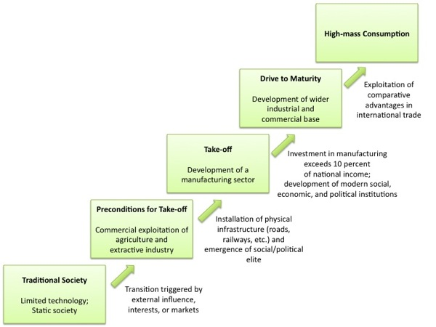
Walt Rostow, The Stages of Economic Growth: A Non-Communist Manifesto (1960)

Slide 4
The capitalist mode of economic imperialism is the first imperialism in history that does not depend simply on capturing this or that bit of territory, or dominating this or that subject people. It needs to oversee the whole global system…and ensure that imperial capital can safely and profitably navigate throughout that global system.
Ellen Meiksins Wood, Empire of Capital (2005)

Slide 5
Three governing themes of Western imperialism: the transmission of white, male power through control of colonized women; the emergence of a new global order of cultural knowledge; and the imperial command of commodity capital.
Anne McClintock, Imperial Leather: Race, Gender and Sexuality in the Colonial Contest (1995)

Slide 6
White men are saving brown women from brown men.
Gayatri Chakravorty Spivak,
‘Can the Subaltern Speak?’ (1988)

Slide 7
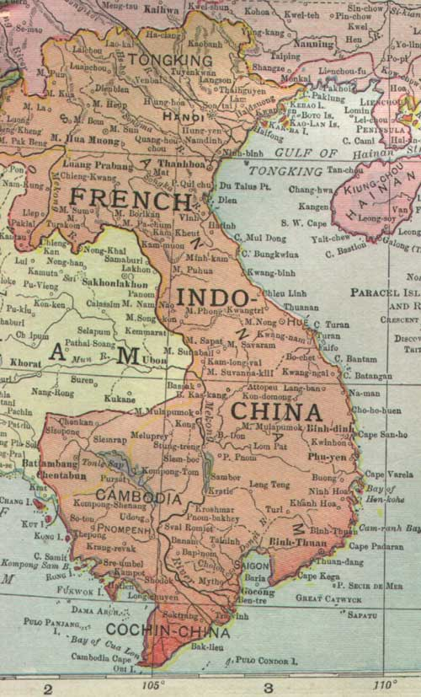
First Indochina War, 1946-1954

Slide 8
