Slide 1
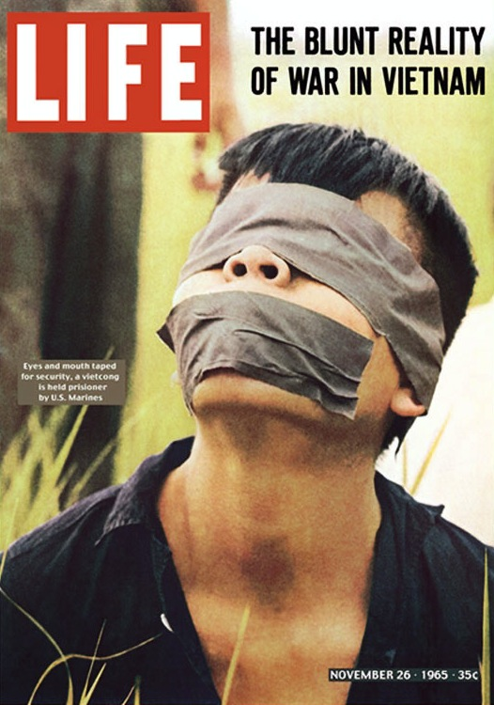
Week 8
History is a Nightmare

Slide 2
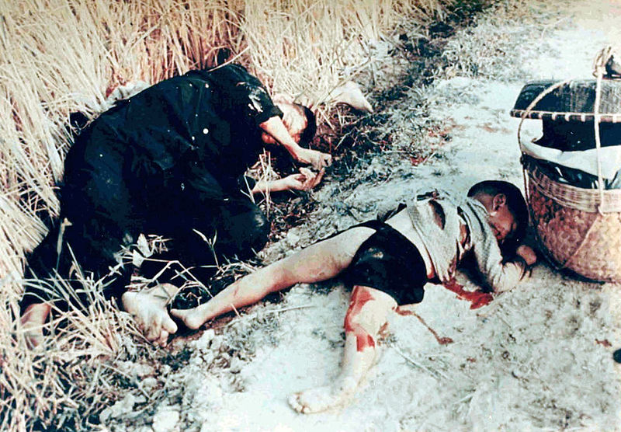
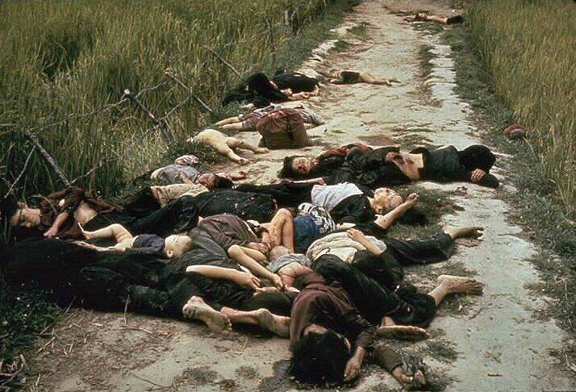
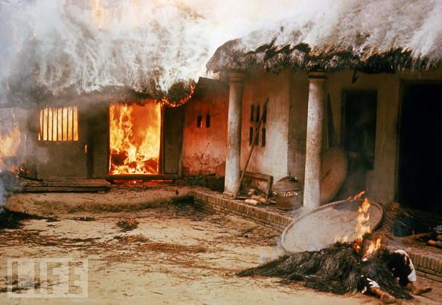

My Lai Massacre, March 16 1968

Slide 3

William Calley Jr.

Slide 4
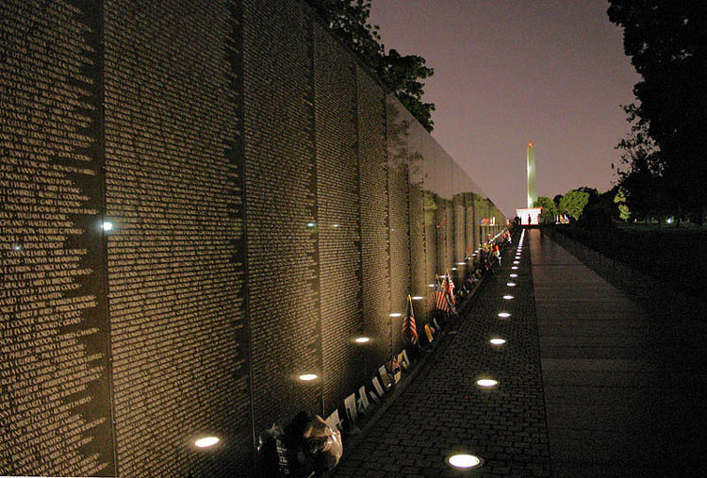

Slide 5
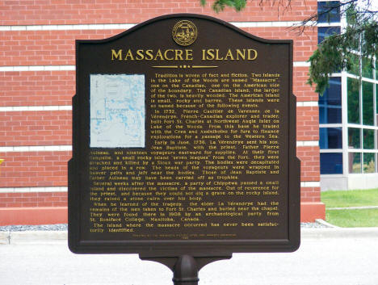

Slide 6
Historiographic Metafiction
The theoretical implications of this kind of historiographic metafiction coincide with recent historiographic theory about the nature of history writing as narrativization (rather than representation) of the past and about the nature of the archive as the textualized remains of history…
…The past really did exist, but we can only ‘know’ that past today through its texts, and therein lies its connection to the literary. If the discipline of history has lost its privileged status as the purveyor of truth, then so much the better, according to this kind of historiographic theory.
Linda Hutcheon, ‘Historiographic Metafiction: Parody and the Intertexuality of History’ (1989)

Slide 7

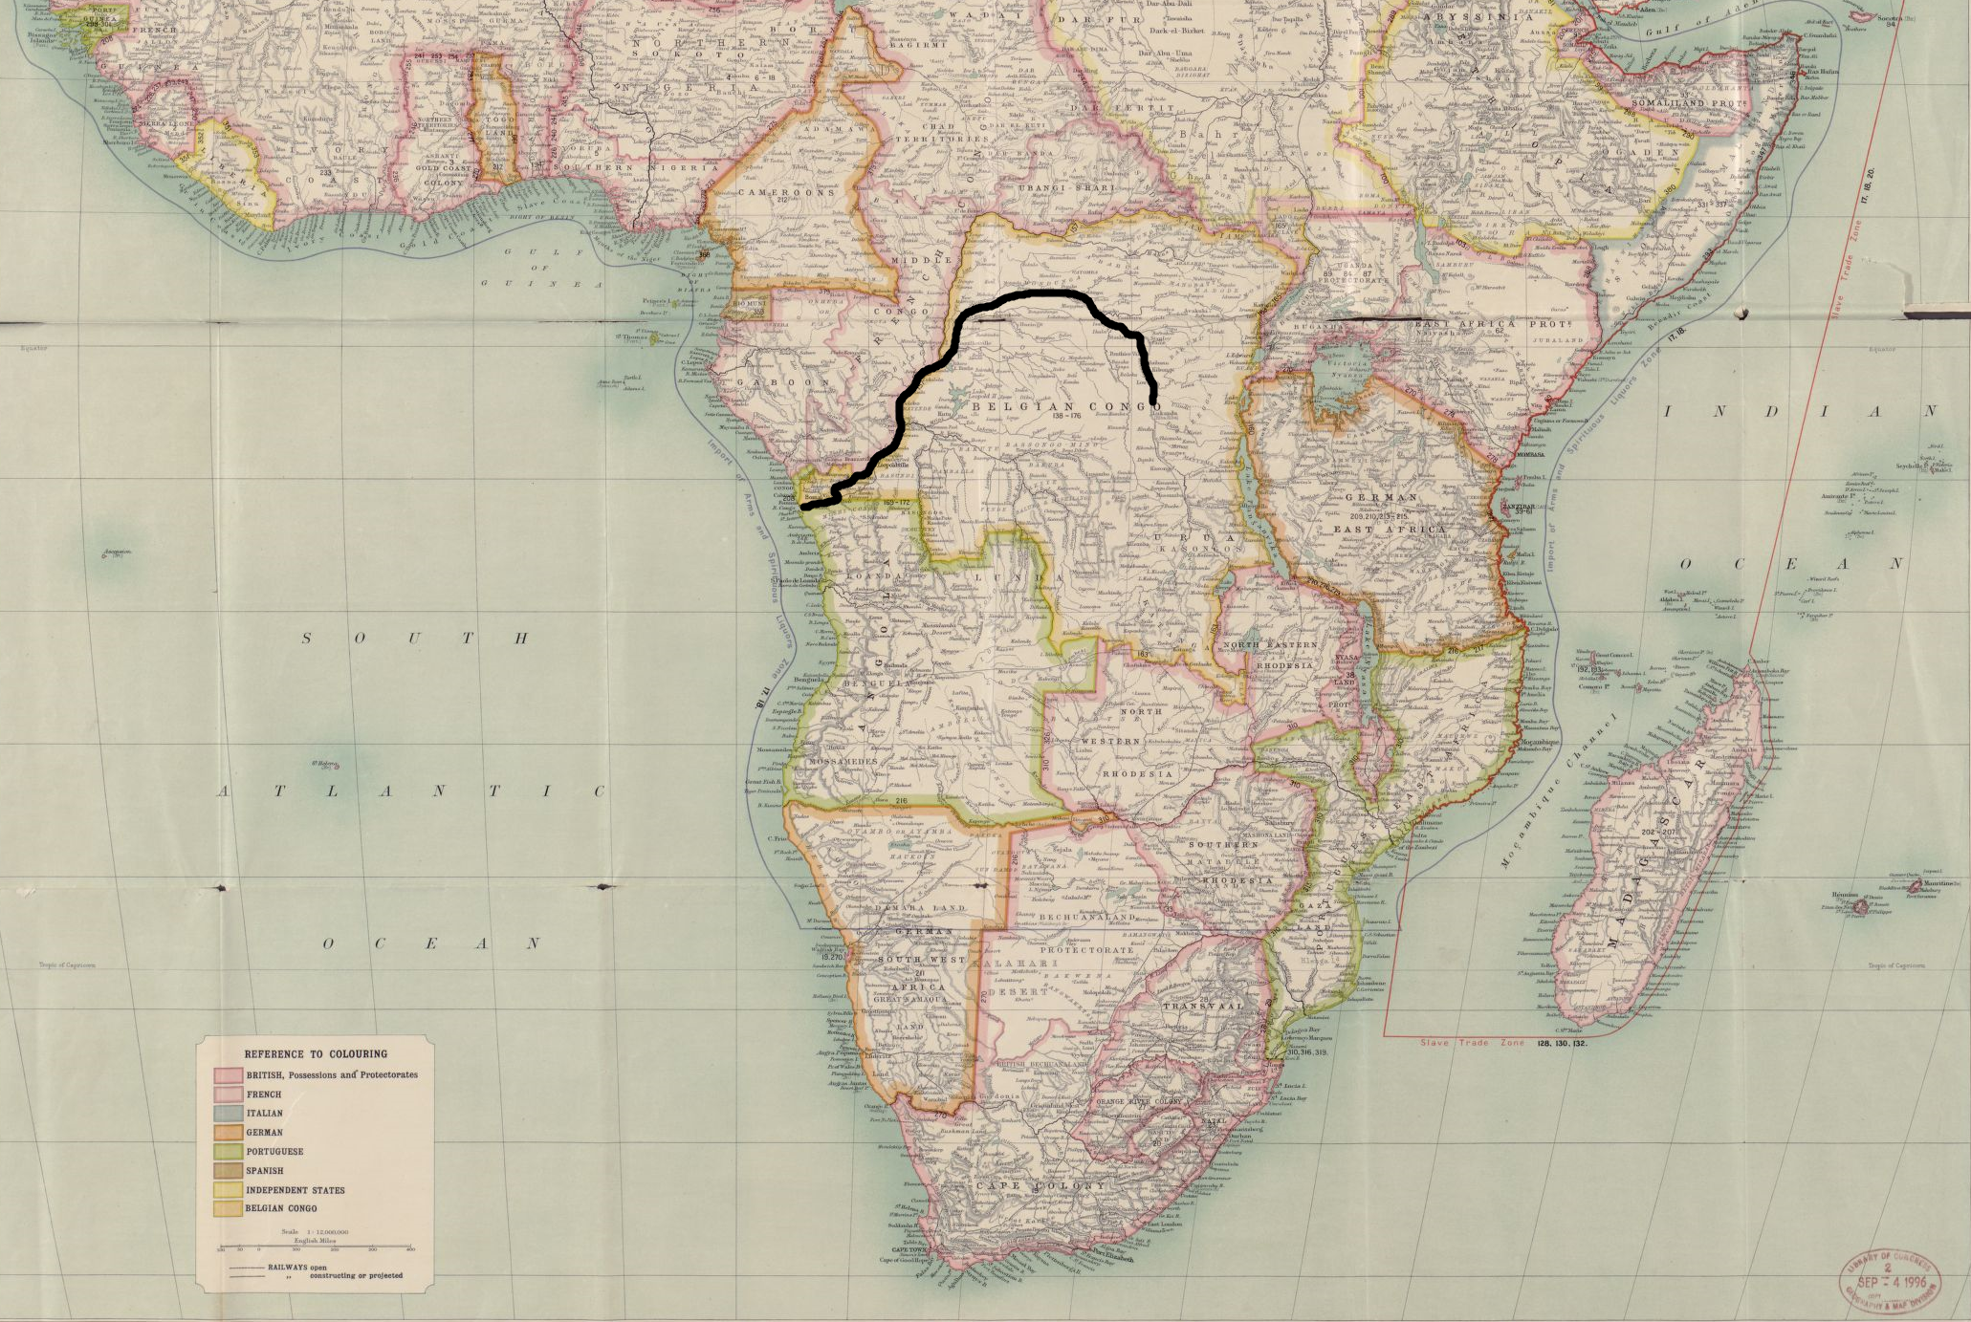
Chinua Achebe, ‘An Image of Africa: Racism in Conrad’s Heart of Darkness’ (1975) (included in Hopes and Impediments, 1988)

