Slide 1
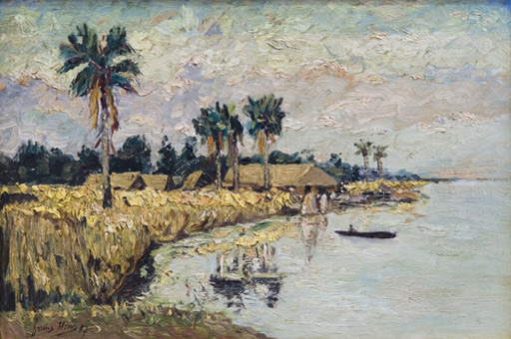
Week 9
Heart of Darkness

Slide 2
Africa…is no historical part of the World; it has no movement or development to exhibit…. What we properly understand by Africa, is the Unhistorical, Undeveloped Spirit, still involved in the conditions of mere nature, and which had to be presented here only as on the threshold of the World's History.
G.W.F. Hegel, The Philosophy of History (1837)

Slide 3
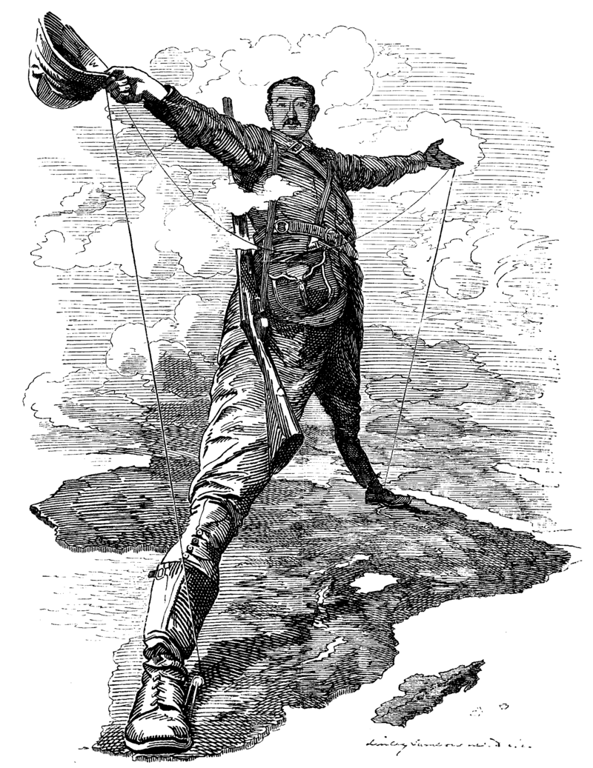
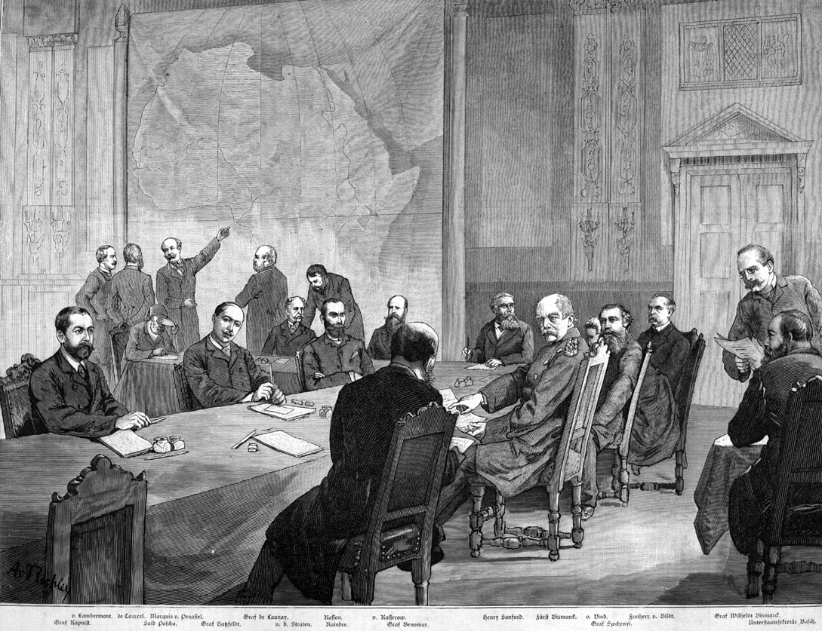
Berlin Conference (1884) and the Scramble for Africa

Slide 4
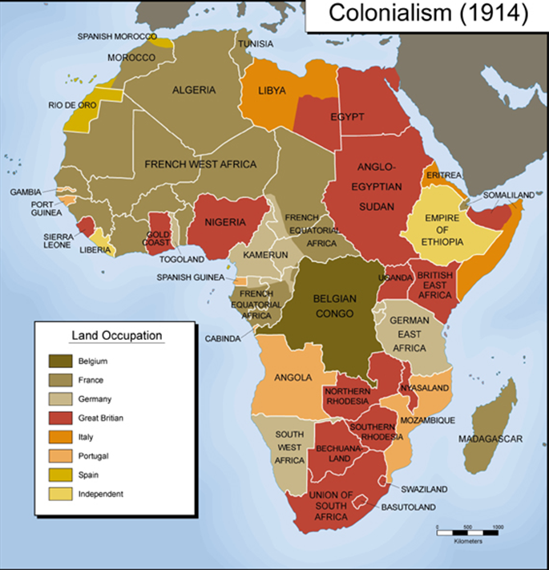

Slide 5
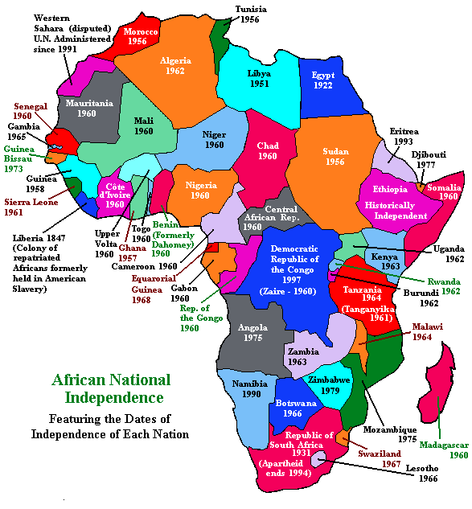

Slide 6
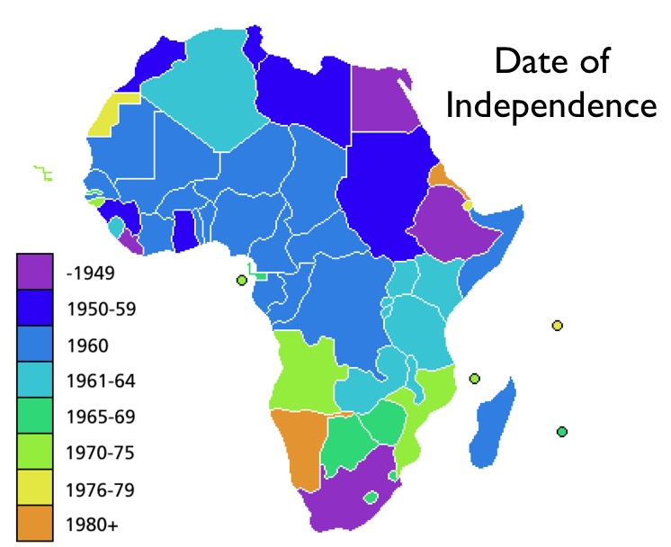

Slide 7
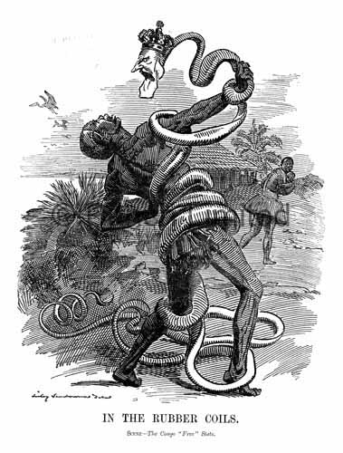
Congo Free State, 1877-1908
I implored them to place the vast and rich and populous Congo Free State in trust in my hands, so that I might…lift up those twenty-five millions of gentle and harmless blacks out of darkness into light, the light of our blessed Redeemer, the light that streams from his holy Word, the light that makes glorious our noble civilization…lift them up and make them comprehend that they were no longer outcasts and forsaken, but our very brothers in Christ.
Mark Twain, ‘King Leopold’s Soliloquy’ (1905)

Slide 8
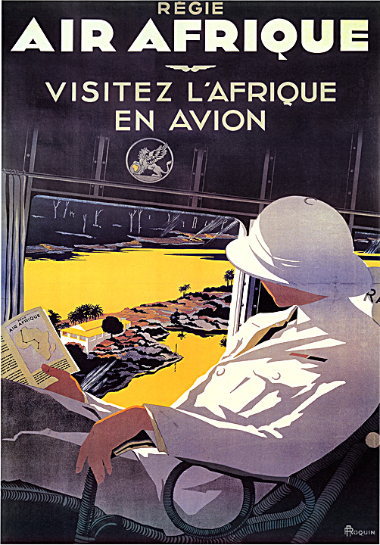
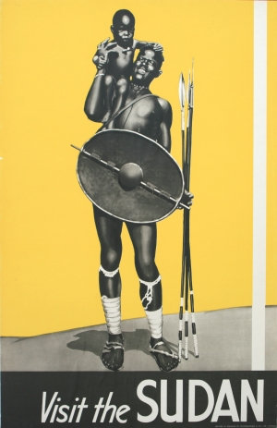

Slide 9
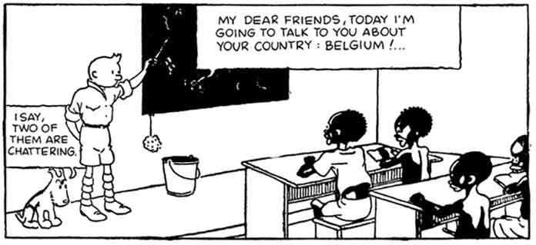

Slide 10
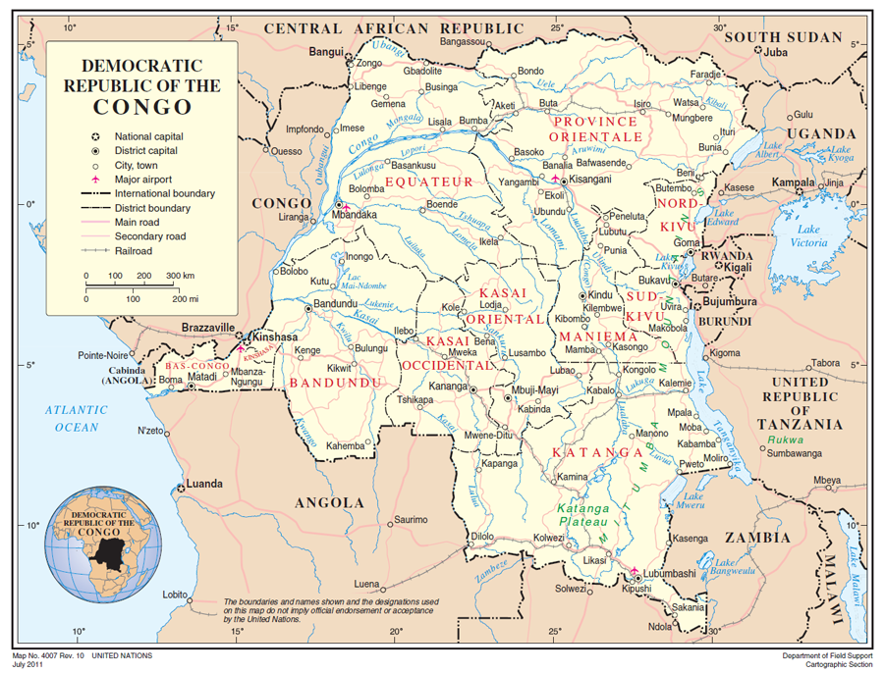
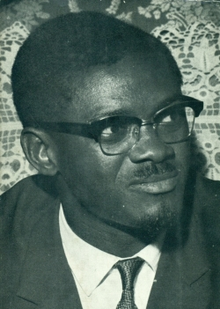
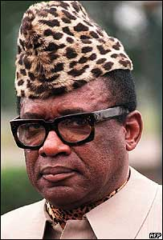
Belgian Congo, 1908-1960
1960: Independence and Patrice Lumumba
1965: General Mobutu Sese seizes power
1971: Renamed Zaire

Slide 11
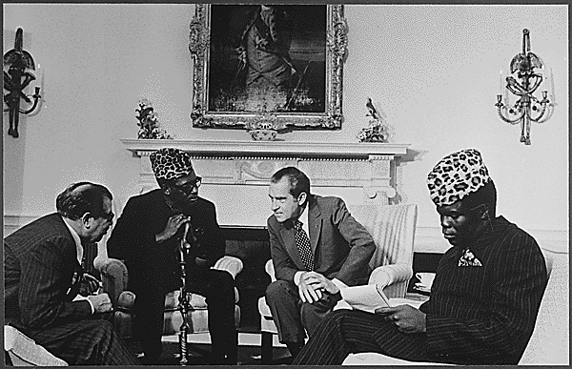
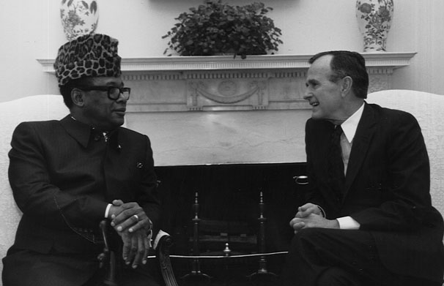

Slide 12
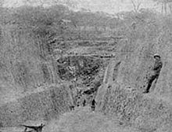

Slide 13
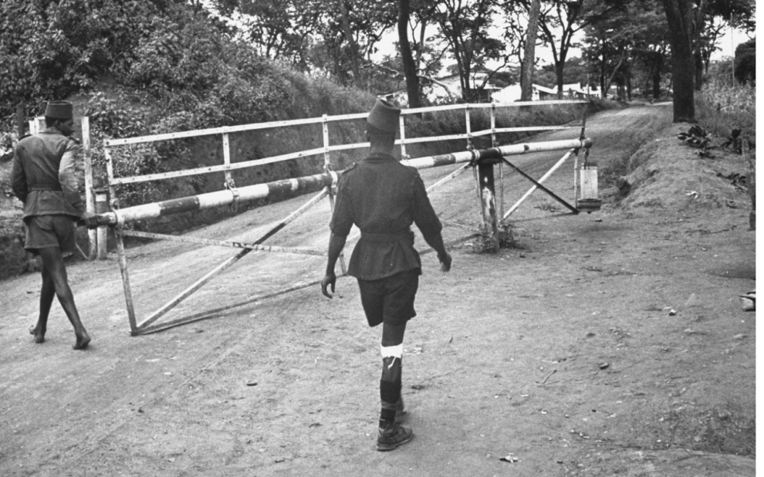
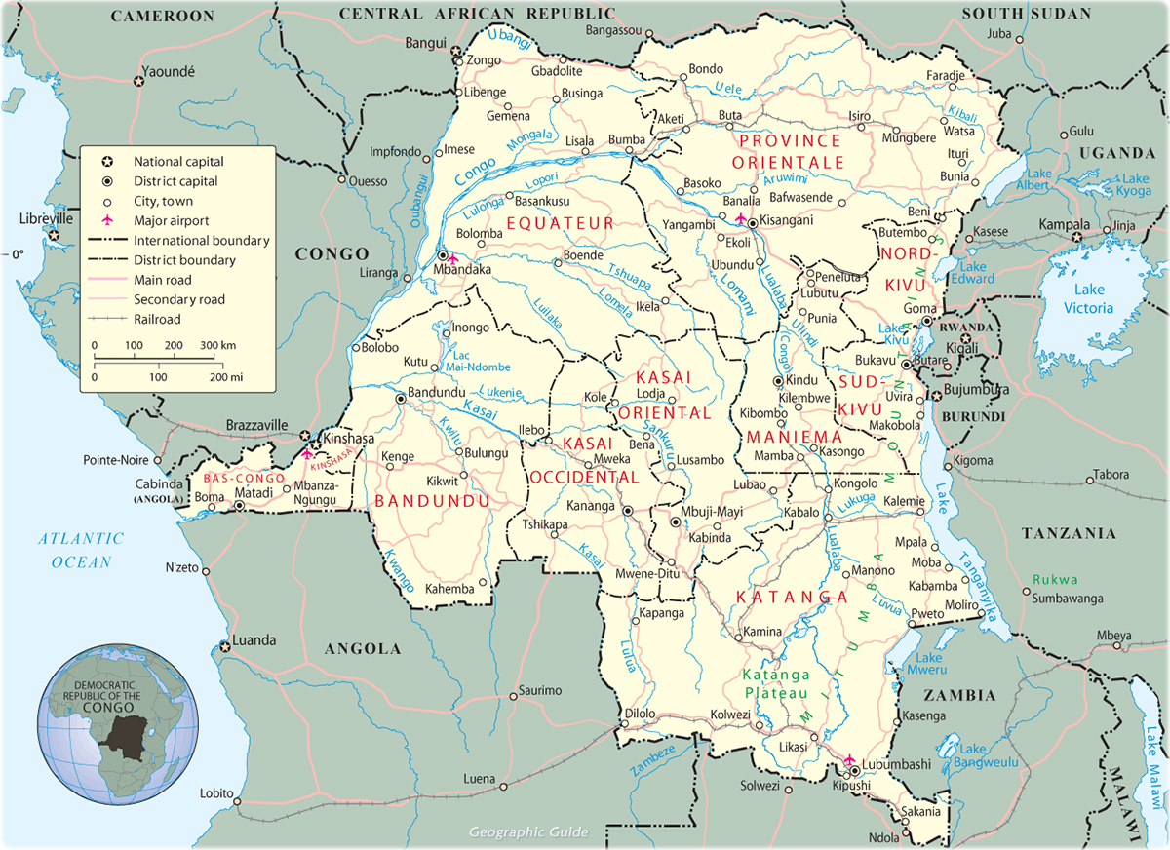
Shinkolobwe Uranium Mine

Slide 14
Paratext: “a zone between text and off-text, a zone not only of transition but also of transaction: a privileged place...of influence on the public....”
Gérard Genette

Slide 15
Joseph Conrad, Heart of Darkness (1899)
↓ ↓
Chinua Achebe, Things Fall Apart (1958)
↓
W.B. Yeats,
‘The Second Coming’ (1919))
↓
Apocalypse Now (Dir. Francis Ford Coppola, 1979)
↓
Tim O’Brien, The Things They Carried (1990)
Turning and turning in the widening gyre
The falcon cannot hear the falconer;
Things fall apart; the centre cannot hold;
Mere anarchy is loosed upon the world,
The blood-dimmed tide is loosed, and everywhere
The ceremony of innocence is drowned;
The best lack all conviction, while the worst
Are full of passionate intensity.

Slide 16
Questions:
What are significant about the novel’s paratexts? What claims do they make about its literary status and authority?
How does Kingsolver use intertexts? How does intertextuality relate to a novel’s relationship to history?
What is the effect of the novel’s polyvocality?

