Slide 1


Slide 2
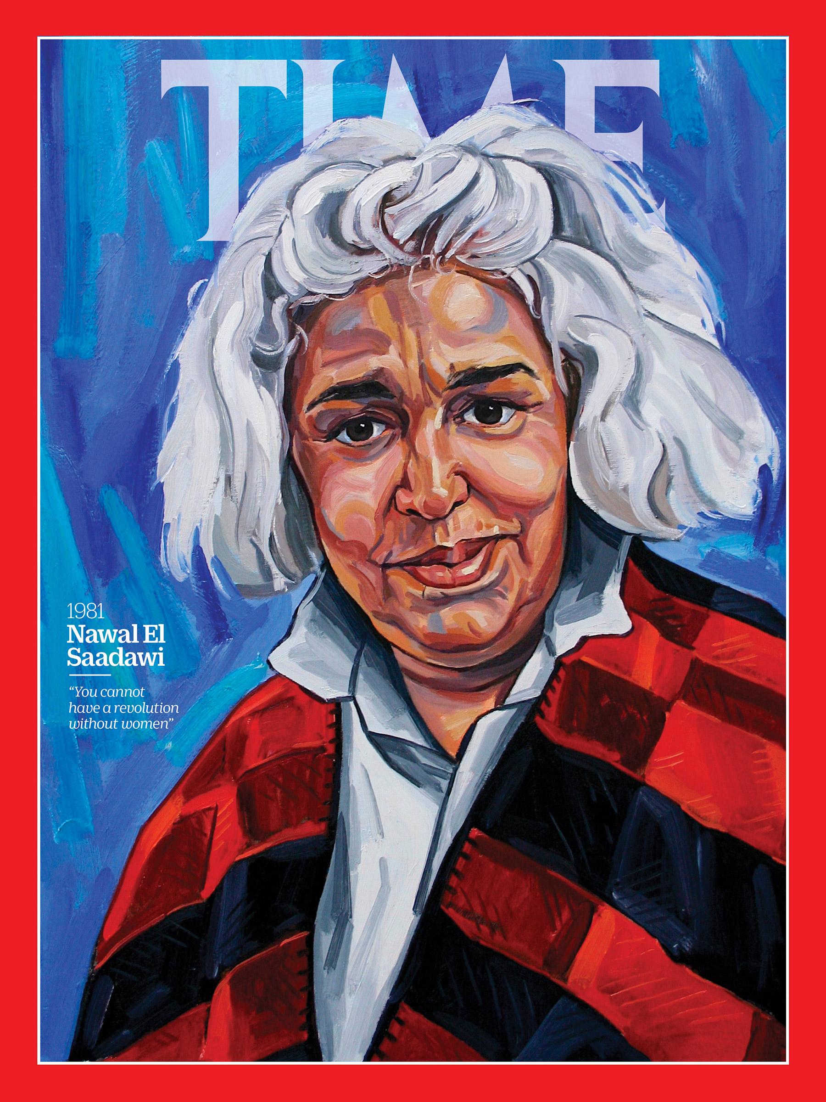


Slide 3
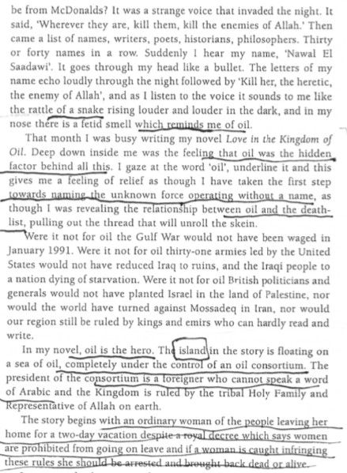


Slide 4
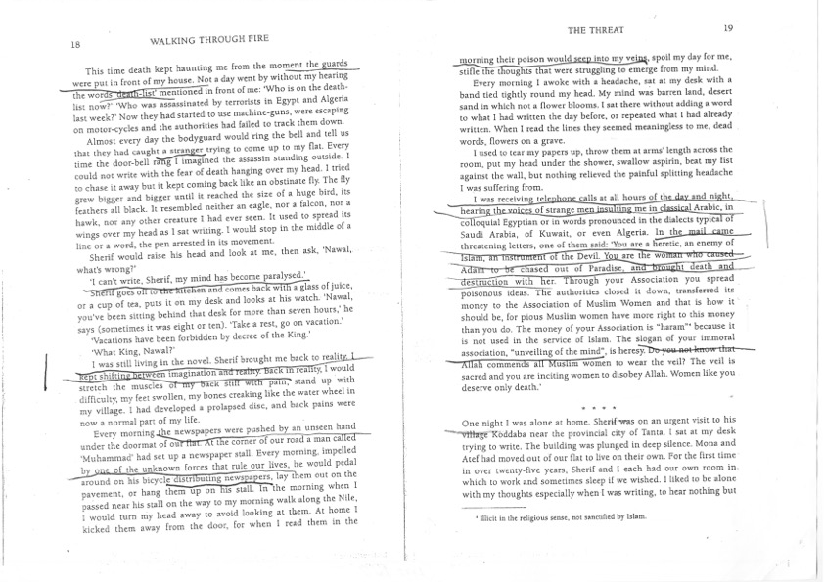

Slide 5


Slide 6

2008

Slide 7

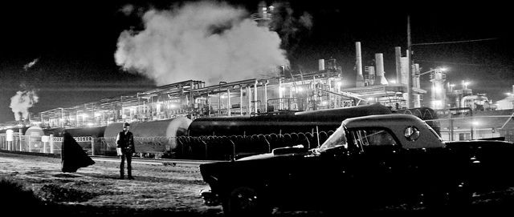

Slide 8



Slide 9



Dir. Jonathan Glazer, 2013

Slide 10


(dir. Ridley Scott, 1991)

Slide 11



Slide 12
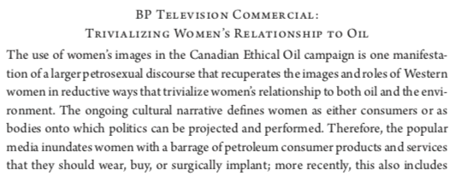
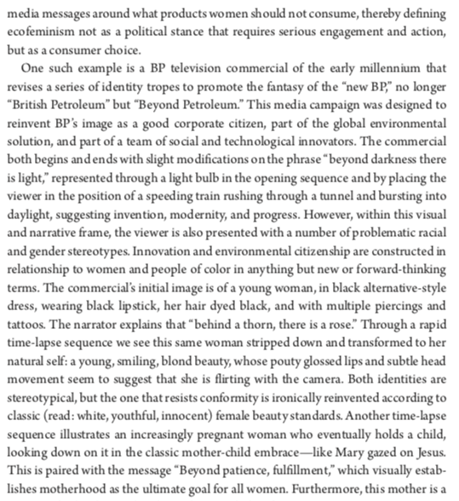
Sheena Wilson, Gendering Oil
Chevron

Slide 13


